Slide 1

Three-Phase DAB Converter
Bidirectional Power Transfer
Team Electro

Slide 2
Problem Understanding
Need efficient bidirectional DC-DC conversion for modern energy systems
Essential in electric vehicles (EVs) and battery storage systems
Requires galvanic isolation for safety and voltage matching
Must provide controlled and reversible power flow between sources
Conventional converters face high losses and limited bidirectional capability
Hence, Dual Active Bridge (DAB) is preferred for high efficiency and flexibility

Slide 3
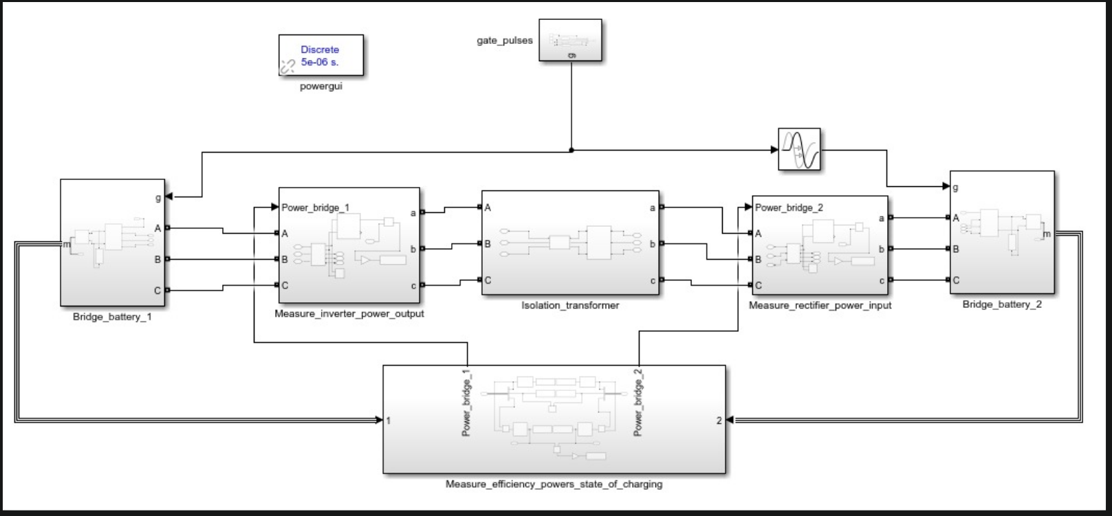
Modeling Approach
• Two 3-phase bridges • Isolation transformer • Phase shift control

Slide 4
Results & Analysis
Forward Charging (δ = 5 µs)
Input Power: 123.7 W
Output Power: 100.8 W
Efficiency: 81.47%
Current: +2.36 A / −2.09 A
Bridge Losse:1.07(B1),0.89(B2)
Reverse Charging (δ = 7 µs)
Input Power: 168.8 W
Output Power: 146.6 W
Efficiency: 86.88%
Current: +3.492 A / −2.731 A
Bridge Losses: 1.082 W (B1), 0.886 W (B2)

Slide 5
References
Dubey, G.K. – Fundamentals of Electrical Drives
Rashid, M.H. – Power Electronics: Circuits, Devices and Applications
Bimbhra, P.S. – Power Electronics
De Doncker, R.W.A.A., Divan, D.M., Kheraluwala, M.H. – “A Three-Phase Soft-Switched High-Power-Density DC/DC Converter for High-
Power Applications”, IEEE
Krismer, F., Kolar, J.W. – “Accurate Power Loss Model Derivation of a High-Current Dual Active Bridge Converter”, IEEE
MATLAB/Simulink Documentation

