Slide 1

EDA Project - AMCAT Data Analysis

Slide 2
About me
As an individual with a Bachelor's degree in Computer Engineering (B.Tech), I have a strong foundation in computer science principles, algorithms, and programming. My desire to learn data science stems from the realization of its potential to extract valuable insights from vast amounts of data, driving informed decision-making and innovation across various industries.
With over a year and five months of experience as a data engineer at Celebal Technology, I have gained hands-on experience in data management, processing, and analysis. This role has equipped me with skills in handling large datasets, implementing data pipelines, and utilizing various data technologies.
I am drawn to data science because it presents an opportunity to leverage my technical background in computer engineering while delving into the realm of statistics, machine learning, and data visualization. I am enthusiastic about applying advanced analytical techniques to solve complex problems and derive actionable insights from data.
Here are my LinkedIn and GitHub profile URLs for further exploration:
LinkedIn: Ashutosh Ramnath Pawar
GitHub: ASHUtoSHp2610
Feel free to connect with me on LinkedIn or explore my GitHub repositories to learn more about my professional background and projects.

Slide 3
Problem Statement
The objective of this project is to perform Exploratory Data Analysis (EDA) on a dataset containing employment outcomes of engineering graduates. By analyzing the dataset, we aim to gain insights into the factors influencing salary and specialization preferences among graduates. Additionally, we seek to explore potential relationships between gender and career choices within the engineering domain. Through this analysis, we aim to provide valuable insights for stakeholders to make informed decisions regarding recruitment strategies, salary negotiations, and diversity initiatives within the engineering sector.

Slide 4

Objective of the Project
The objective of the project is to conduct an Exploratory Data Analysis (EDA) on the given dataset to gain insights into the factors influencing salary and specialization preferences among engineering graduates. The project aims to explore the relationships between various features such as education background, skills, demographics, and job roles with the salary offered to fresh graduates. Additionally, the analysis will investigate whether there is a relationship between gender and specialization preferences.
Through the EDA process, we seek to achieve the following objectives:
Understand the structure and characteristics of the dataset.
Identify key features and variables that may impact salary outcomes.
Analyze the distribution and patterns of numerical and categorical variables.
Identify outliers and anomalies in the data.
Explore relationships between different variables using visualization techniques.
Test the validity of a claim regarding salary expectations for specific job roles.
Investigate potential gender biases or preferences in specialization choices.

Slide 5
About Dataset
Based on the information provided, we have a dataset with around 40 independent variables and 4000 data points. The dataset primarily focuses on the employment outcomes of engineering graduates and contains various demographic, educational, and skill-related features.
Here's a summary of the dataset variables:
ID: A unique identifier for each candidate.
Salary: Annual CTC offered to the candidate (in INR).
DOJ: Date of joining the company.
DOL: Date of leaving the company.
Designation: Designation offered in the job.
JobCity: Location of the job (city).
Gender: Candidate's gender.
DOB: Date of birth of the candidate.
10percentage: Overall marks obtained in grade 10 examinations.
10board: The school board whose curriculum the candidate followed in grade 10.
12graduation: Year of graduation from senior year high school.
12percentage: Overall marks obtained in grade 12 examinations.
12board: The school board whose curriculum the candidate followed in grade 12.
CollegeID: Unique ID identifying the college which the candidate attended.
CollegeTier: Tier of college.
Degree: Degree obtained/pursued by the candidate.
Specialization: Specialization pursued by the candidate.
CollegeGPA: Aggregate GPA at graduation.
CollegeCityID: Unique ID to identify the city in which the college is located.

Slide 6
CollegeCityTier: Tier of the city in which the college is located.
CollegeState: Name of States.
GraduationYear: Year of graduation (Bachelor’s degree).
English: Scores in AMCAT English section.
Logical: Scores in AMCAT Logical section.
Quant: Scores in AMCAT Quantitative section.
Domain: Scores in AMCAT’s domain module.
ComputerProgramming: Score in AMCAT’s Computer programming section.
ElectronicsAndSemicon: Score in AMCAT’s Electronics & Semiconductor Engineering section.
ComputerScience: Score in AMCAT’s Computer Science section.
MechanicalEngg: Score in AMCAT’s Mechanical Engineering section.
ElectricalEngg: Score in AMCAT’s Electrical Engineering section.
TelecomEngg: Score in AMCAT’s Telecommunication Engineering section.
CivilEngg: Score in AMCAT’s Civil Engineering section.
Conscientiousness: Scores in one of the sections of AMCAT’s personality test.
Agreeableness: Scores in one of the sections of AMCAT’s personality test.
Extraversion: Scores in one of the sections of AMCAT’s personality test.
Neuroticism: Scores in one of the sections of AMCAT’s personality test.
Openess_to_experience: Scores in one of the sections of AMCAT’s personality test.
This dataset appears to be rich in information and could be used for various analyses, including predicting salary based on different factors, understanding employment trends, and exploring the relationship between demographic and skill-related features. Additionally, the standardized scores from the AMCAT test provide insights into the cognitive and personality skills of the candidates.

Slide 7
df.shape:
The output of df.shape is a tuple containing two integers that represent the dimensions of the Data Frame df.
The first element in the tuple represents the number of rows in the Data Frame. In this case, there are 3998 rows.
The second element represents the number of columns in the Data Frame. In this case, there are 39 columns.
So, the Data Frame df has 3998 rows and 39 columns.
df.describe():
The output of the describe method is a summary of the statistics of each column in the Data Frame. It shows the following:
The number of non-null values (count)
The mean value
The standard deviation (std)
The minimum and maximum values (min, max)
The quartiles (25%, 50%, and 75%)
The Salary column has a mean of 307,699.8, a standard deviation of 212,737.5, a minimum value of 35,000, and a maximum value of 4,000,000.

Slide 8
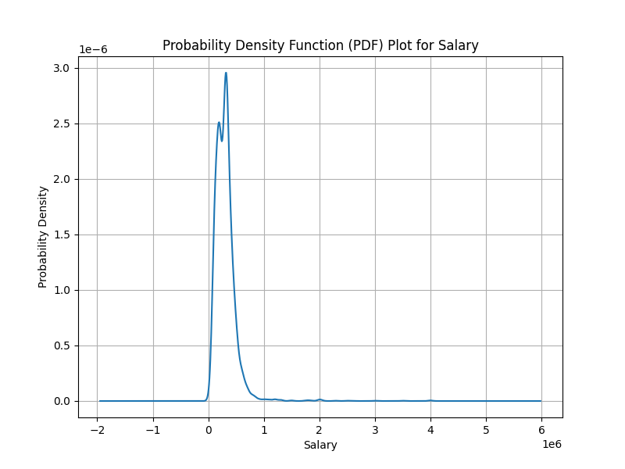
Univariate Analysis
Univariate analysis involves analyzing one variable at a time. It helps in understanding the distribution, central tendency, dispersion, and shape of the data. Common techniques used in univariate analysis include histograms, box plots, density plots, and summary statistics.
Salary:
The y-axis of the graph shows the probability density and the x-axis shows salary in millions of rupees. The probability density function shows the probability of a given salary occurring.
Here are some observations from the graph:
Most people make salaries between 0 and 3 million rupees.
The probability of someone making a very high salary (over 3 million rupees) or a very low salary (under 0 rupees) is low.
In other words, the graph shows that salaries are normally distributed. A normal distribution, also known as a Gaussian distribution, is a bell-shaped curve that is symmetrical around the mean. The mean is the average salary, and the probability density is highest at the mean and tapers off towards the extremes.

Slide 9
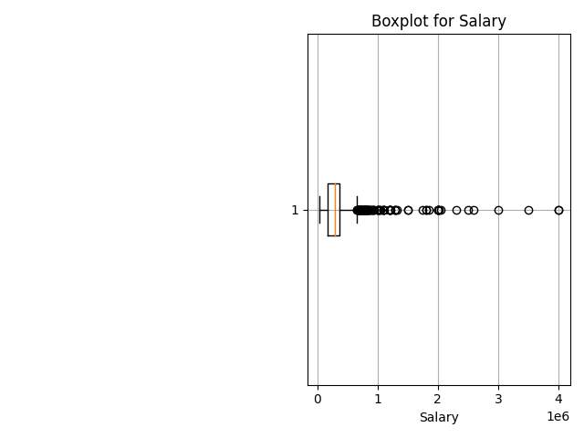
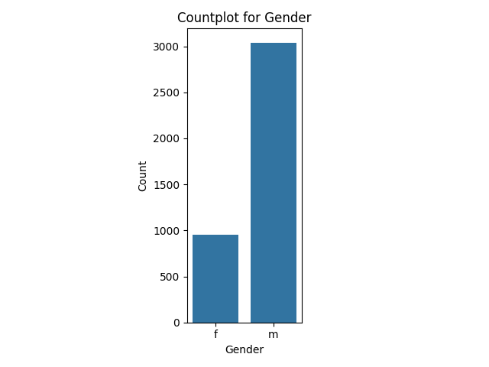
Gender
The median salary is around 100,000 rupees. This means that half of the people in the dataset make more than this amount and half make less.
The box extends from roughly 50,000 rupees to 250,000 rupees. This means the middle 50% of the data falls within this range.
There are outliers both above and below the whiskers. The outliers above the whisker extend to around 400,000 rupees. There isn't enough information to tell how far the outliers below the whisker extend. This suggests that there are a few people who make much more than the majority and a few people who make much less than the majority.
Here are some observations you can make from the graph:
There are more females than males.
The exact counts are difficult to determine without the y-axis labels, but it appears there are roughly twice as many females compared to males.

Slide 10
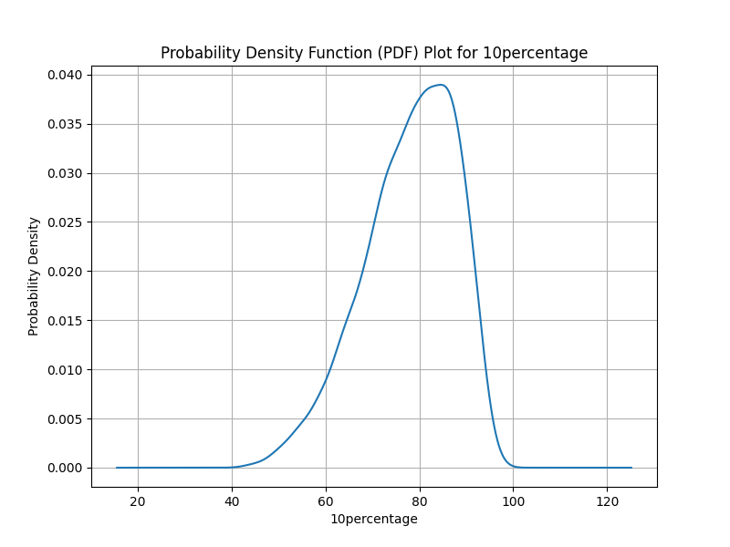
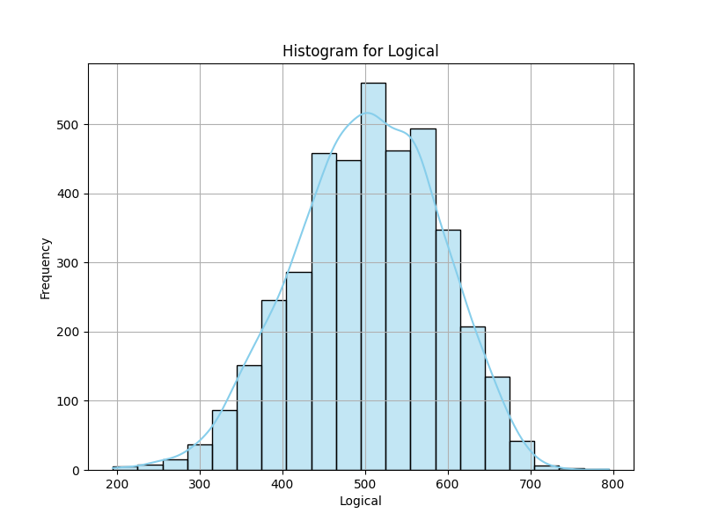
The graph you provided is a Probability Density Function (PDF) plot for a variable labeled as “10percentage”. Here are some observations:
Normal Distribution: The plot shows a bell-shaped curve, which is characteristic of a normal distribution. This suggests that the data for “10percentage” is normally distributed.
Peak of the Curve: The peak of the curve occurs around 80 on the “10percentage” scale. This indicates that the highest probability density (i.e., the most common values) for “10percentage” is around 80.
Range of Values: The x-axis, which represents the “10percentage” values, ranges from 0 to 120. This suggests that the data for “10percentage” spans this range.
Probability Density: The y-axis represents the probability density. The highest point on the y-axis is around 0.040, indicating the maximum density of the “10percentage” values.
In summary, this graph provides a visual representation of the distribution of the “10percentage” values, showing that they follow a normal distribution with the most common value around 80. Please note that without further context or data, these observations are based solely on the provided graph.
The “Histogram for Logical” graph represents the distribution of Logical scores. The x-axis ranges from 200 to 800, indicating the score range. The y-axis represents “Frequency,” extending up to 500. The data forms a bell-shaped curve, characteristic of a normal distribution. This suggests that the Logical scores are normally distributed around the mean score of approximately 500. The majority of students have scores around this mean, with fewer students achieving extremely high or low scores. The presence of scores across the entire range indicates a diverse set of Logical scores among the students. The peak frequency at the score of 500 suggests this score is the most common among the students. The overall shape and spread of the histogram provide insights into the performance of students in Logical.

Slide 11
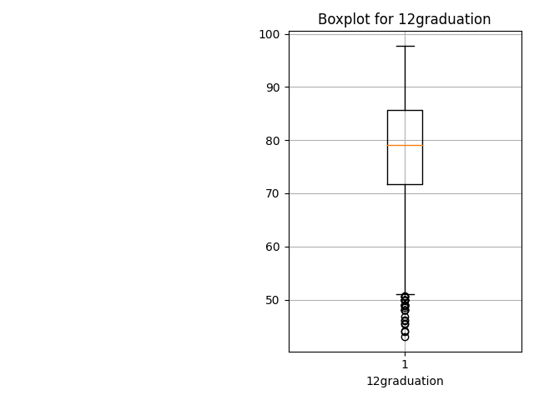
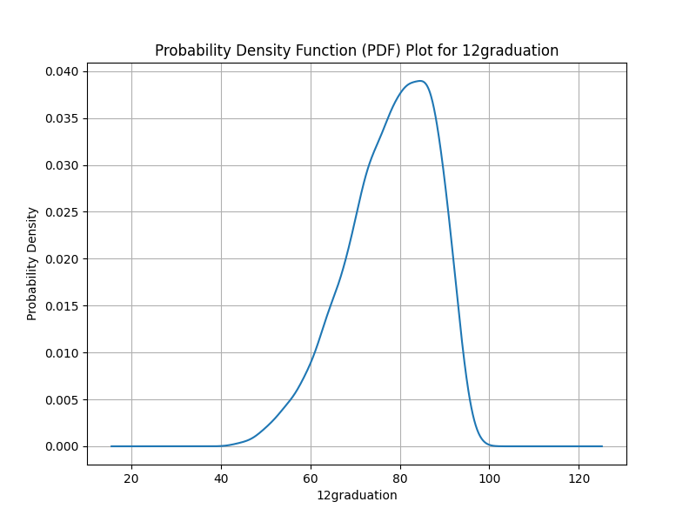
12graduation
The graph you provided is a Probability Density Function (PDF) plot for a variable labeled as “12graduation”. Here are some observations:
Normal Distribution: The plot shows a bell-shaped curve, which is characteristic of a normal distribution. This suggests that the data for “12graduation” is normally distributed.
Peak of the Curve: The peak of the curve occurs around 70 on the “12graduation” scale. This indicates that the highest probability density (i.e., the most common values) for “12graduation” is around 70.
Range of Values: The x-axis, which represents the “12graduation” values, ranges from 0 to 120. This suggests that the data for “12graduation” spans this range.
Probability Density: The y-axis represents the probability density. The highest point on the y-axis is around 0.040, indicating the maximum density of the “12graduation” values.
In summary, this graph provides a visual representation of the distribution of the “12graduation” values, showing that they follow a normal distribution with the most common value around 70. Please note that without further context or data, these observations are based solely on the provided graph.
The boxplot for “12graduation” shows a median score around 80, with an interquartile range from approximately 75 to 85. Numerous outliers between 50 and 60 suggest a group of students scored significantly lower than the majority. This indicates a diverse range of “12graduation” scores with some exceptionally low values.

Slide 12
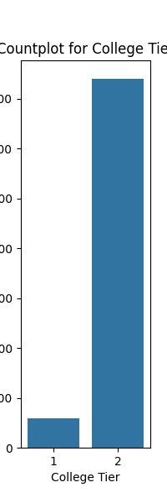
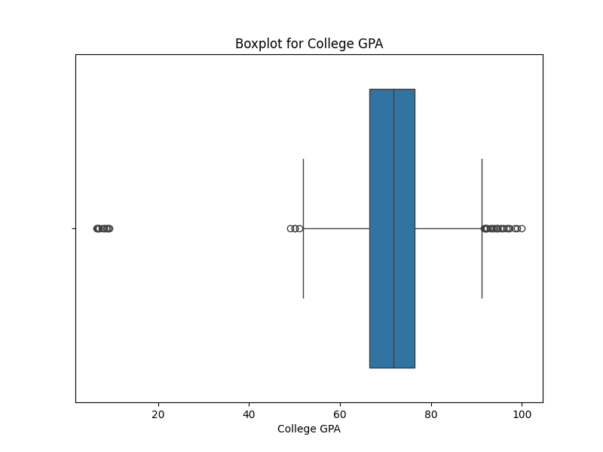
The countplot for “College Tier” shows a significant disparity between the two tiers. Tier 2 colleges are much more prevalent, with a count close to 900. In contrast, Tier 1 colleges are underrepresented, with a count below 100. This suggests a larger population or more data points for Tier 2 colleges
The boxplot represents the distribution of College GPAs. The majority of GPAs are around 80, as indicated by the box’s central location. The interquartile range is narrow, suggesting minimal variation in GPAs. Outliers exist on both ends, with some GPAs significantly lower or higher than the majority. This indicates a concentration of GPAs around the average, with fewer extreme deviations.

Slide 13
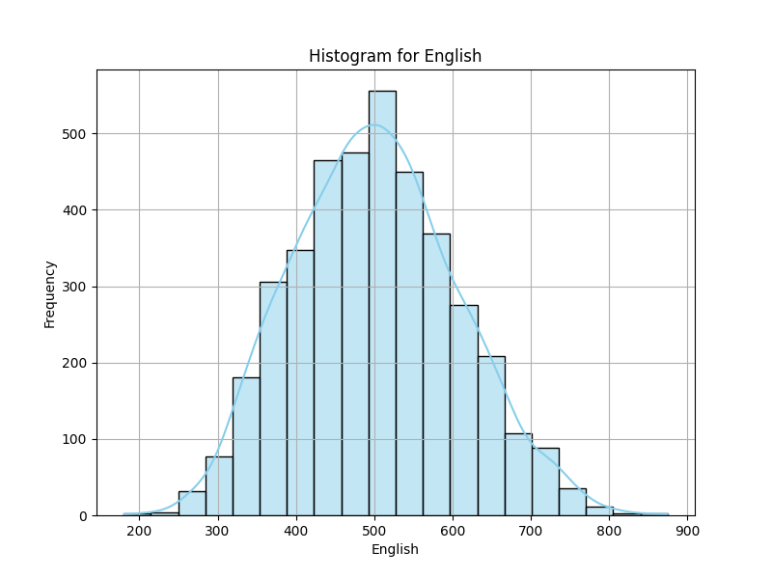
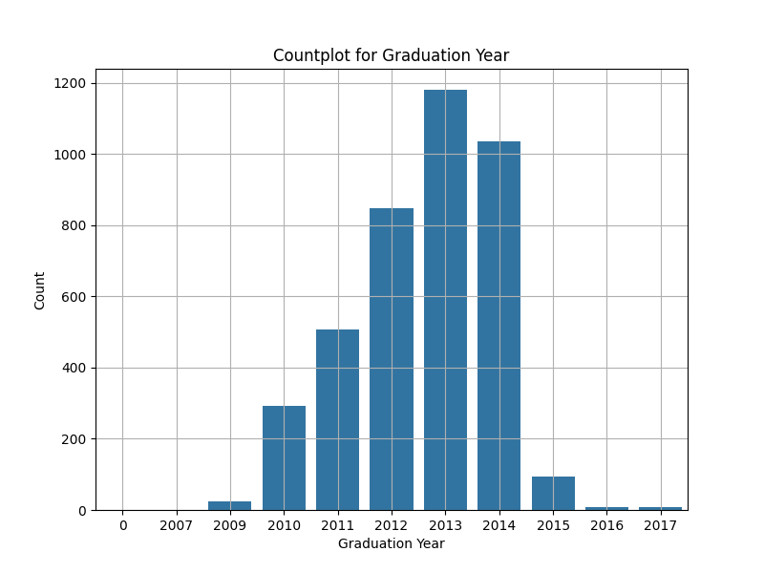
The “Countplot for Graduation Year” graph provides a visual representation of the number of graduations per year from 2006 to 2017. The most striking observation is the significant increase in graduations from 2006, peaking in 2014 and 2015 with counts exceeding 1000. This could be attributed to various factors such as increased enrollment, improved retention rates, or changes in academic policies during these years. However, there is a drastic decline in graduations in 2016 and 2017, which could indicate changes in admission policies, increased dropout rates, or other external factors impacting graduation rates. The steady growth pattern preceding the peak suggests a gradual increase in the number of students reaching graduation. The sudden drop following the peak years is noteworthy and may warrant further investigation to understand the underlying causes. Overall, the graph highlights the dynamic nature of graduation trends over the years, reflecting the influence of various factors on student success and graduation rates.
The “Histogram for English” graph represents the distribution of English scores. The x-axis ranges from 200 to 900, indicating the score range. The y-axis represents frequency, extending up to 500. The data forms a bell-shaped curve, characteristic of a normal distribution. This suggests that the English scores are normally distributed around the mean score of approximately 500. The majority of students have scores around this mean, with fewer students achieving extremely high or low scores. The presence of scores across the entire range indicates a diverse set of English scores among the students. The peak frequency at the score of 500 suggests this score is the most common among the students. The overall shape and spread of the histogram provide insights into the performance of students in English.

Slide 14
Bivariate Analysis
Bivariate analysis is a statistical method used to explore the relationship between two variables in a dataset. It focuses on understanding how changes in one variable are associated with changes in another variable. In other words, it examines the degree of association or correlation between two variables and helps in identifying patterns, trends, and dependencies in the data.
Bivariate analysis involves analyzing pairs of variables simultaneously to determine whether there is a relationship between them. This relationship can be either linear or non-linear, positive or negative. Common techniques used in bivariate analysis include scatter plots, correlation analysis, regression analysis, and contingency tables.

Slide 15
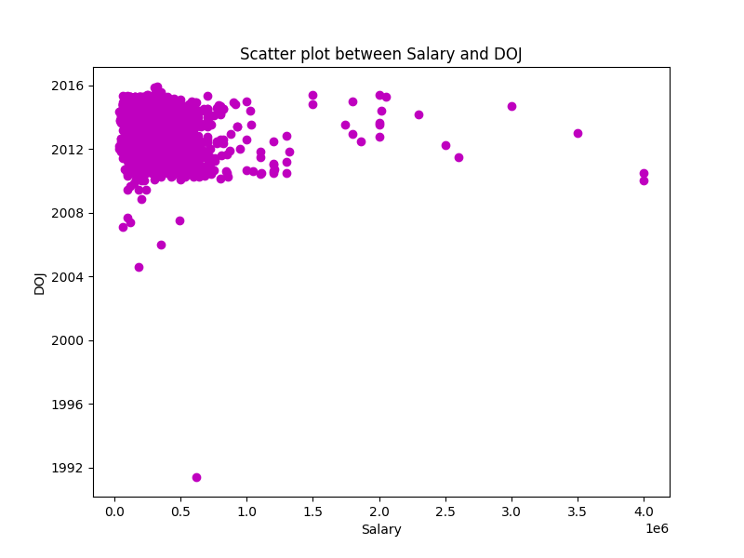
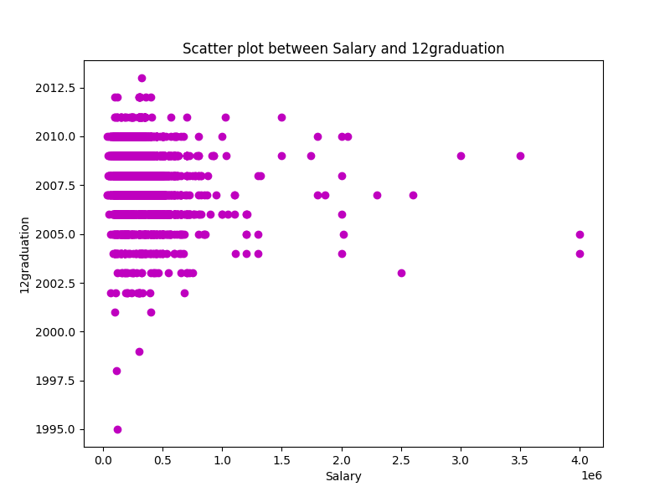
The scatter plot titled “Scatter plot between Salary and DOJ” illustrates the distribution of salaries over different joining dates from 1992 to 2016. A dense cluster of data points around lower salaries, particularly between 2008 and 2016, suggests a significant number of individuals joined with salaries less than 1.0E6 during this period. As the salary increases, the data points become more scattered, indicating fewer individuals with higher salaries. The noticeable gap in data points between approximately 1.0E6 and 2.0E6 on the Salary axis suggests fewer joiners in this salary range. The few scattered data points at higher salary levels indicate that only a small number of individuals joined with higher salaries over the years. The graph provides insights into salary trends over time.
The scatter plot titled “Scatter plot between Salary and 12 graduation” illustrates the relationship between salary and the year of 12th graduation. The data points are concentrated around lower salaries for graduates from around 2000 to 2012, indicating a common salary range for these individuals. As the year of 12th graduation increases, there is no clear trend indicating an increase or decrease in salary. This suggests that other factors might be influencing income levels. There are some outliers with higher salaries, especially noticeable for graduates around the years 2007 and 2012. However, these do not form a consistent pattern to derive a concrete correlation between the year of graduation and salary level. The plot reveals a trend where most joiners are in the lower salary bracket and recent years have seen an increase in such joinings.

Slide 16
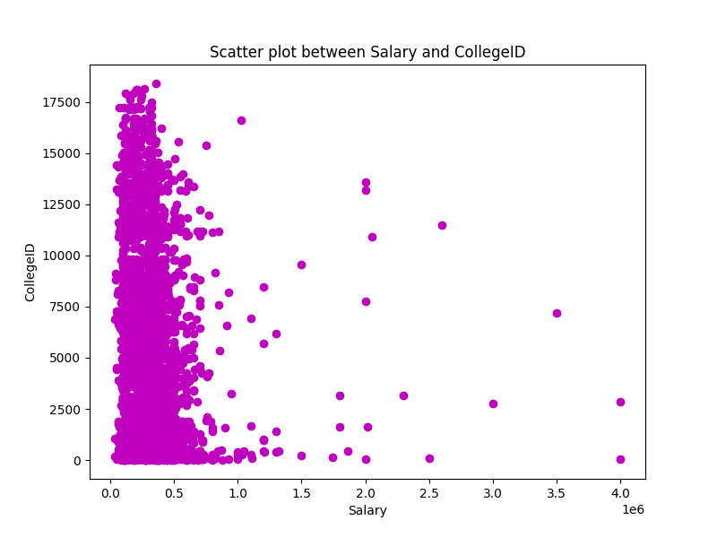
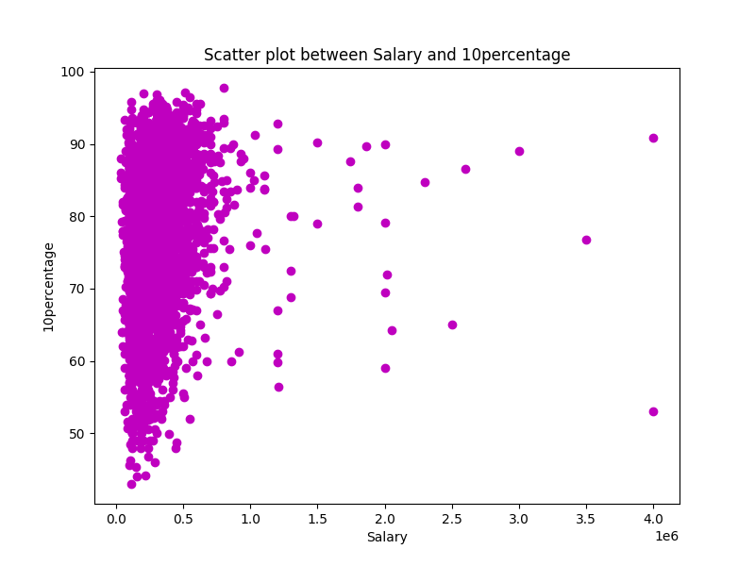
The scatter plot titled “Scatter plot between Salary and 10percentage” illustrates the relationship between salary and 10% percentage. The data points are concentrated around lower salaries, indicating a high concentration of individuals with lower salaries and varying 10% percentages. As the salary increases, the data points become more scattered, indicating fewer individuals with higher salaries. There is no clear trend or correlation observable; however, it’s noticeable that individuals with a 10% percentage above 80 are generally in the lower salary bracket. The data becomes sparse in the higher salary range, indicating less frequency of such occurrences. The plot reveals a trend where most joiners are in the lower salary bracket and recent years have seen an increase in such joinings.
The scatter plot titled “Scatter plot between Salary and CollegeID” illustrates the relationship between salary and CollegeID. The data points are concentrated around lower salaries, indicating a high concentration of individuals with lower salaries and varying CollegeIDs. As the salary increases, the data points become more scattered, indicating fewer individuals with higher salaries. There is no clear trend or correlation observable; however, it’s noticeable that individuals with a CollegeID above 8000 are generally in the lower salary bracket. The data becomes sparse in the higher salary range, indicating less frequency of such occurrences. The plot reveals a trend where most joiners are in the lower salary bracket and recent years have seen an increase in such joinings.

Slide 17
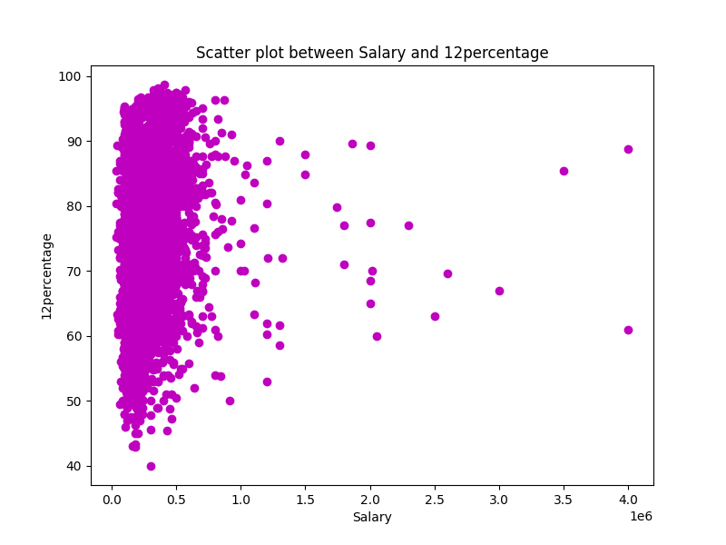
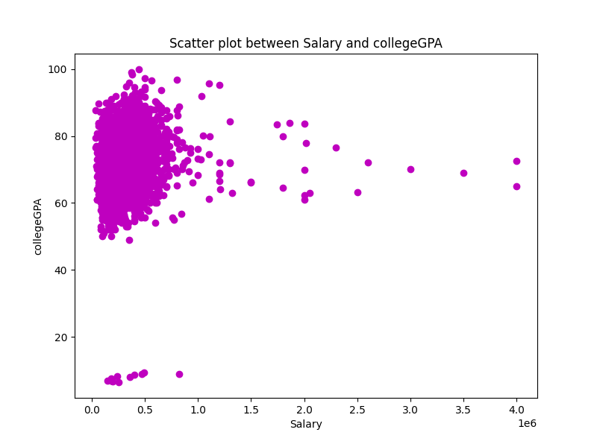
The scatter plot titled “Scatter plot between Salary and 12%” illustrates the relationship between salary and 12% percentage. The data points are concentrated around lower salaries, indicating a high concentration of individuals with lower salaries and varying 12% percentages. As the salary increases, the data points become more scattered, indicating fewer individuals with higher salaries. There is no clear trend or correlation observable; however, it’s noticeable that individuals with a 12% percentage above 80 are generally in the lower salary bracket. The data becomes sparse in the higher salary range, indicating less frequency of such occurrences. The plot reveals a trend where most joiners are in the lower salary bracket and recent years have seen an increase in such joinings.
The scatter plot titled “Scatter plot between Salary and collegeGPA” illustrates the relationship between salary and college GPA. The data points are concentrated around lower salaries, indicating a high concentration of individuals with lower salaries and varying GPAs. As the GPA increases, the data points become more scattered, indicating fewer individuals with higher salaries. There is no clear trend or correlation observable; however, it’s noticeable that individuals with a GPA above 80 are generally in the lower salary bracket. The data becomes sparse in the higher salary range, indicating less frequency of such occurrences. The plot reveals a trend where most joiners are in the lower salary bracket and recent years have seen an increase in such joinings.

Slide 18
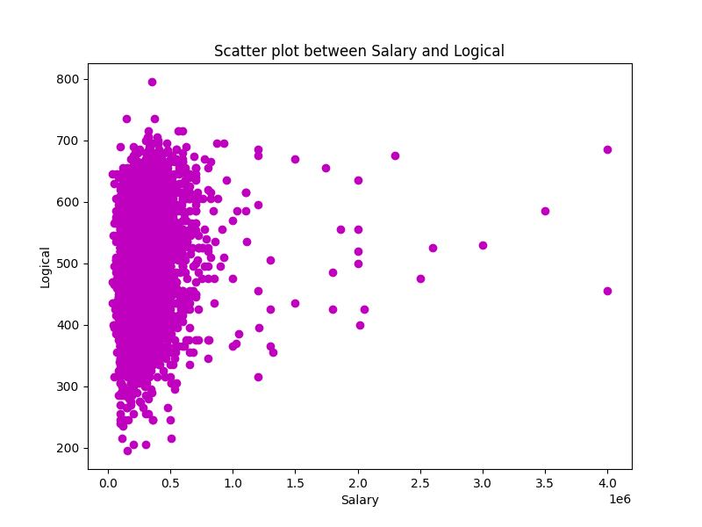

The scatter plot titled "Scatter plot between Salary and CollegeCityID" illustrates the relationship between salary and CollegeCityID. The data points are concentrated around lower salaries, indicating a high concentration of individuals with lower salaries and varying CollegeCityIDs. As the salary increases, the data points become more scattered, indicating fewer individuals with higher salaries. There is no clear trend or correlation observable; however, it's evident that people from a broader range of CollegeCityIDs are represented in the lower salary bracket. The spread becomes sparse in higher salary brackets, indicating less representation from varied CollegeCityIDs. This could imply that only specific cities or colleges are associated with higher earning graduates, or it could be a result of fewer data points available for those earning higher salaries. The plot reveals a trend where most joiners are in the lower salary bracket and recent years have seen an increase in such joinings.
The scatter plot titled “Scatter plot between Salary and Logical” illustrates the relationship between salary and logical reasoning ability. A dense cluster of data points is visible at the lower salary range, indicating a large number of individuals with varying levels of logical skills earn similar, lower salaries. As the salary increases, the density of points decreases, suggesting fewer people earn higher salaries. There is no clear trend or correlation observable; however, there appears to be a concentration of lower “Logical” values associated with lower salaries. For higher salaries, the “Logical” values are more spread out, indicating variability and lack of a distinct pattern. This could potentially imply that other factors contribute to the salary variation at higher income levels.

Slide 19
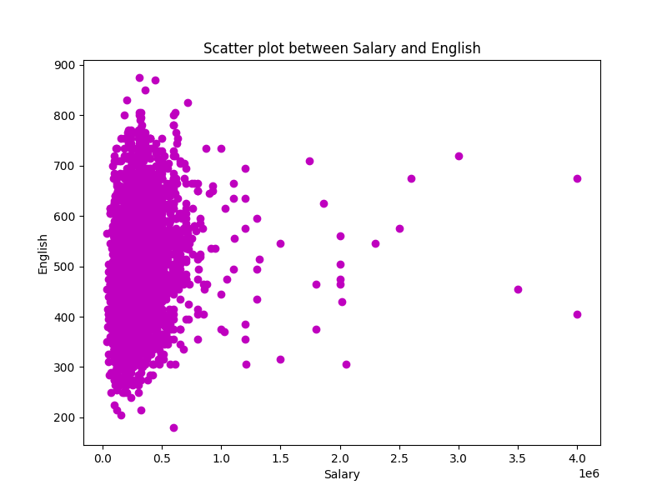
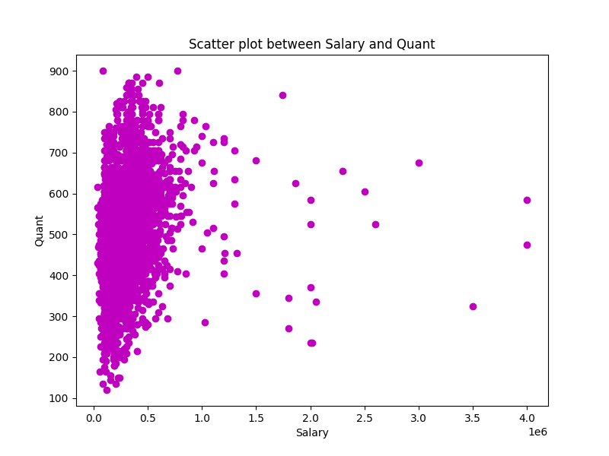
The scatter plot titled “Scatter plot between Salary and English” illustrates the relationship between salary and English proficiency. A dense cluster of data points is visible at the lower salary range, indicating a large number of individuals with varying levels of English proficiency earn similar, lower salaries. As English proficiency increases, there is a noticeable trend where higher proficiency correlates with an increase in salary up to a certain point. However, this trend isn’t linear or consistent; there are exceptions and outliers. For instance, individuals with high English scores are seen across various salary ranges, including the lower end. Additionally, there’s a sparse distribution of data points at higher salaries indicating fewer individuals but not necessarily correlating to their English proficiency levels. This could potentially imply that other factors contribute to the salary variation at higher income levels.
The scatter plot titled “Scatter plot between Salary and Quant” illustrates the relationship between salary and quant scores. A dense cluster of data points is visible at the lower salary range, indicating a large number of individuals with varying levels of quant skills earn similar, lower salaries. As the quant score increases, the data points become more scattered, indicating fewer individuals with higher salaries. There is no clear trend or correlation observable; however, it’s noticeable that individuals with a quant score above 700 are generally in the lower salary bracket. The data becomes sparse in the higher salary range, indicating less frequency of such occurrences. This could potentially imply that other factors contribute to the salary variation at higher income levels. The plot reveals a trend where most joiners are in the lower salary bracket and recent years have seen an increase in such joinings.

Slide 20
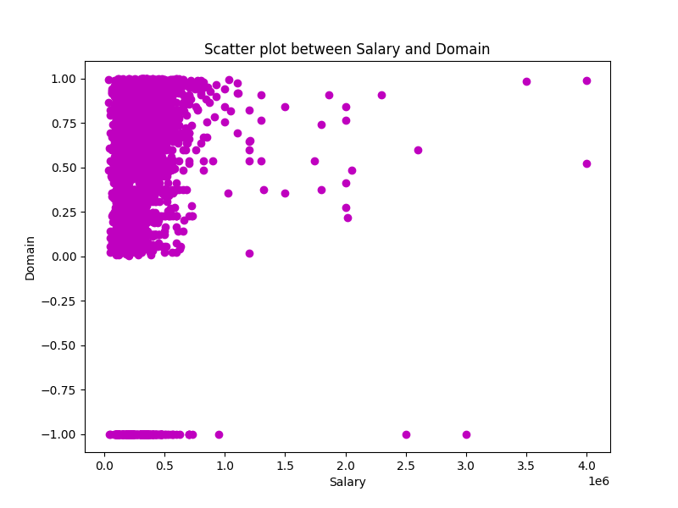
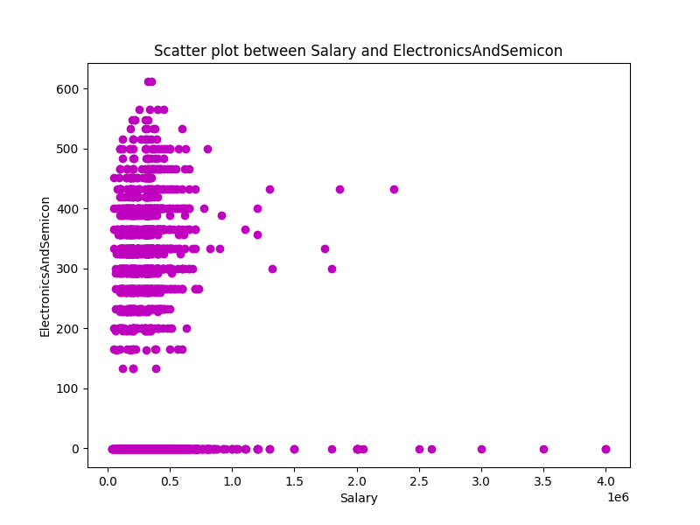
The scatter plot titled “Scatter plot between Salary and electronics and semicon” illustrates the relationship between salary and electrical scores. A dense cluster of data points is visible at the lower salary range, indicating a large number of individuals with varying levels of electrical skills earn similar, lower salaries. As the electrical score increases, the data points become more scattered, indicating fewer individuals with higher salaries. There is no clear trend or correlation observable; however, it’s noticeable that individuals with an electrical score above 700 are generally in the lower salary bracket. The data becomes sparse in the higher salary range, indicating less frequency of such occurrences. This could potentially imply that other factors contribute to the salary variation at higher income levels. The plot reveals a trend where most joiners are in the lower salary bracket and recent years have seen an increase in such joinings.
The scatter plot titled “Scatter plot between Salary and Domain” illustrates the relationship between salary and domain. A dense cluster of data points is visible at the lower salary range, indicating a large number of individuals with specific domains or skills are earning similar, lower salaries. As the domain increases, the data points become more scattered, indicating fewer individuals with higher salaries. There is a noticeable gap in data points in the mid-salary range, indicating an absence or significantly lower number of individuals earning within this bracket. The domain is predominantly positive for lower salaries but becomes more varied as salary increases. This could imply that those with higher domains or skills are not necessarily earning significantly higher salaries. The dispersion of points is less in the mid to high salary range, indicating less variability in domain scores among those earning higher salaries.

Slide 21
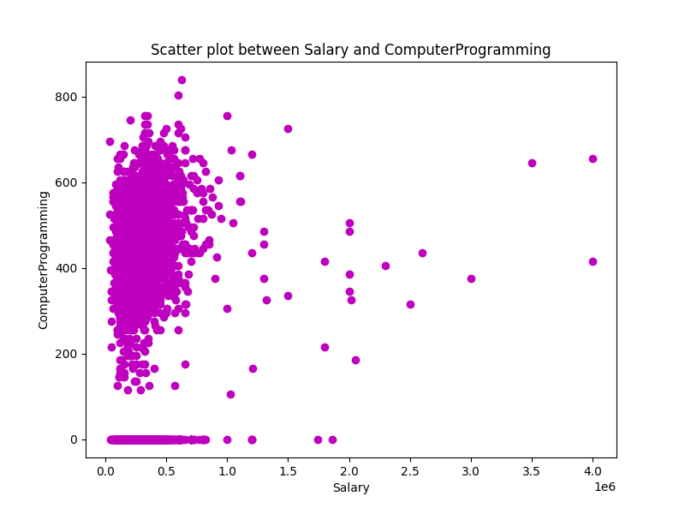
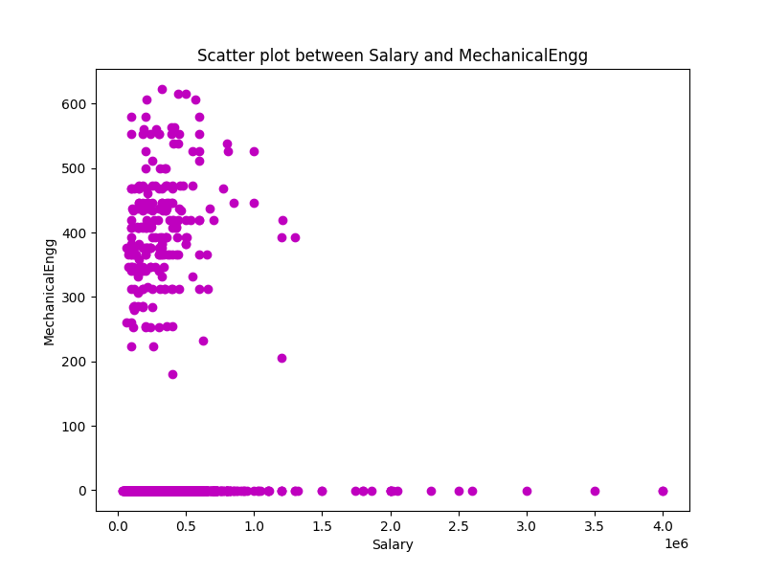
The scatter plot shows the relationship between Salary and Computer Programming skills among a population of individuals.
There is no clear correlation between the two variables; people with both low and high programming skills are spread across various salary ranges.
There is a high concentration of data points at the lower end of the salary axis, indicating that many individuals earn salaries in this range regardless of their programming skills.
There is a low frequency of data points at the higher end of the salary axis, showing that fewer individuals earn higher salaries and that these salaries are not strongly dependent on programming skills.
The scatter plot suggests that while computer programming can be a valuable skill, other factors also significantly influence salary levels.
The scatter plot shows the relationship between Salary and Mechanical scores among a population of individuals.
There is no clear correlation between the two variables; people with both low and high Mechanical scores are spread across various salary ranges.
There is a high concentration of data points at the lower end of the salary axis, indicating that many individuals earn low salaries regardless of their Mechanical scores.
There is a low frequency of data points at the higher end of the salary axis, showing that fewer individuals earn higher salaries and that these salaries are not strongly associated with Mechanical scores.
The scatter plot suggests that while there may be some relationship between these two variables at lower salary levels, this relationship becomes less evident as salary increases.

Slide 22
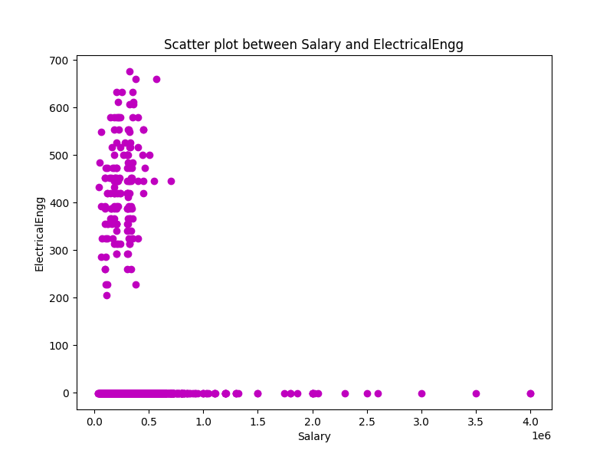
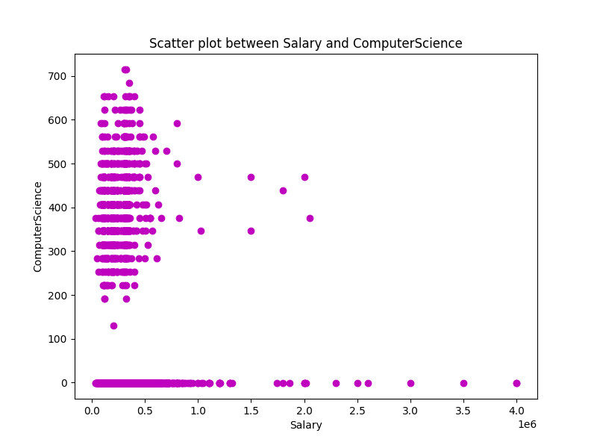
The scatter plot shows the relationship between Salary and ElectricalEngg scores among a population of individuals.
There is no clear correlation between the two variables; people with both low and high ElectricalEngg scores are spread across various salary ranges.
There is a high concentration of data points at the lower end of the salary axis, indicating that many individuals earn low salaries regardless of their ElectricalEngg scores.
There is a low frequency of data points at the higher end of the salary axis, showing that fewer individuals earn higher salaries and that these salaries are not strongly associated with ElectricalEngg scores.
The scatter plot suggests no clear correlation between Salary and ElectricalEngg score as there is no distinct pattern or trend observable from the distribution of data points.
The scatter plot shows the relationship between Salary and ComputerScience knowledge among a population of individuals.
There is no clear correlation between the two variables; people with both low and high ComputerScience knowledge are spread across various salary ranges.
There is a high concentration of data points at the lower end of the salary axis, indicating that many individuals earn low salaries regardless of their ComputerScience knowledge.
There is a noticeable gap in the middle salary range with few data points, suggesting that people with intermediate salaries are less common in this dataset.
The scatter plot suggests that while computer science can be a useful skill, other factors also significantly influence salary levels.

Slide 23
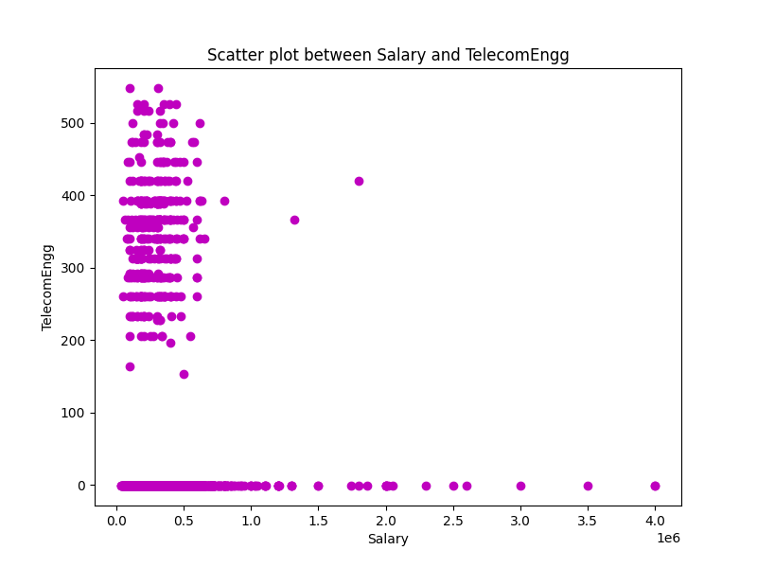
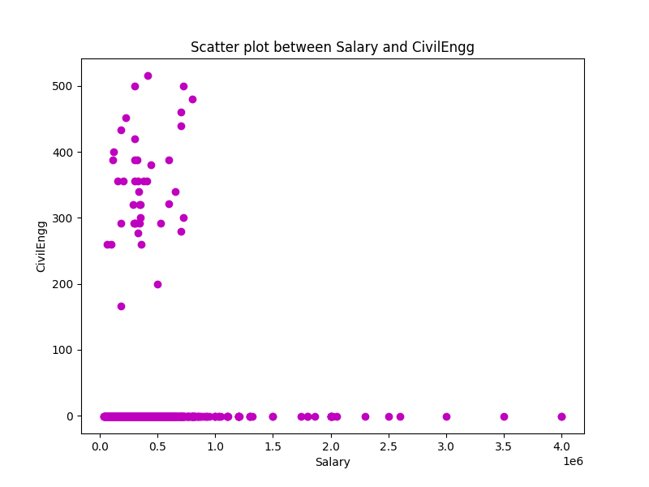
The scatter plot shows the relationship between Salary and TelecomEngg scores among a population of individuals.
There is no clear correlation between the two variables; people with both low and high TelecomEngg scores are spread across various salary ranges.
There is a high concentration of data points at the lower end of the salary axis, indicating that many telecom engineers earn low salaries regardless of their TelecomEngg scores.
There is a sharp decrease in the frequency of data points as the salary increases, showing that higher salaries are less common among telecom engineers.
There are sparse outliers at higher salary levels, indicating exceptional cases where telecom engineers earn significantly more than the average.
The scatter plot suggests that while there’s a wide range of TelecomEngg scores at lower salaries, higher TelecomEngg scores are not necessarily associated with higher salaries.
The scatter plot shows the relationship between Salary and CivilEngg scores among a population of individuals.
There is no clear correlation between the two variables; people with both low and high CivilEngg scores are spread across various salary ranges.
There is a high concentration of data points at the lower end of the salary axis, indicating that many individuals earn lower salaries regardless of their CivilEngg scores.
There is a sparse distribution of data points as salary increases, showing fewer individuals in higher salary brackets.
The plot suggests that within this dataset, an individual’s salary does not have a direct or linear relationship with their score or level in Civil Engineering.

Slide 24
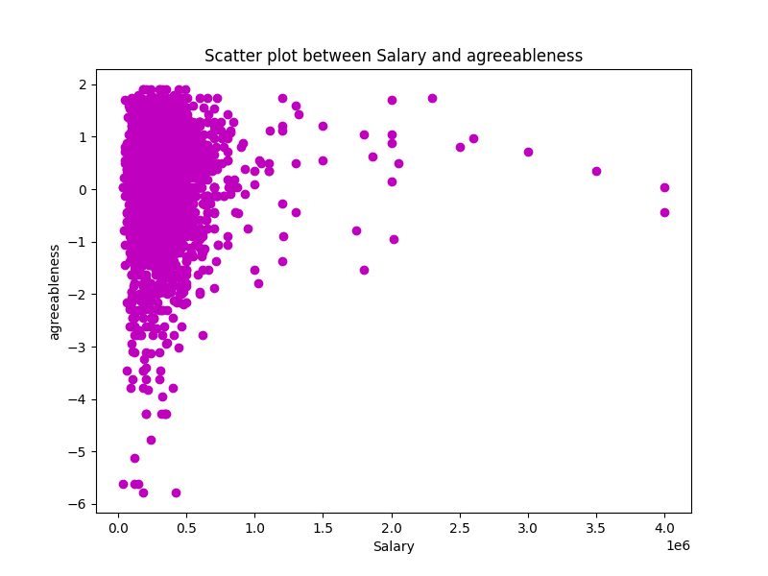
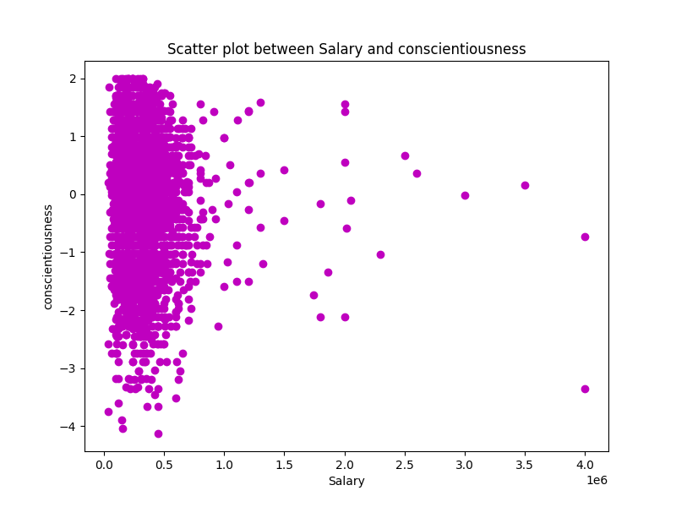
The scatter plot shows the relationship between Salary and conscientiousness among a population of individuals.
There is no clear correlation between the two variables; people with both low and high conscientiousness are spread across various salary ranges.
There is a high concentration of data points at the lower end of the salary axis, indicating that many individuals earn lower salaries regardless of their conscientiousness.
There is a noticeable gap in the middle salary range with few data points, suggesting that people with intermediate salaries are less common in this dataset.
The plot suggests that conscientiousness does not significantly influence salary or vice versa. Individuals with both high and low conscientiousness can be found across different salary ranges, indicating other factors likely play a more substantial role in determining one’s income.
The scatter plot shows the relationship between Salary and agreeableness among a population of individuals.
There is no clear correlation between the two variables; people with both low and high agreeableness are spread across various salary ranges.
There is a high concentration of data points at the lower end of the salary axis, indicating that many individuals earn low salaries regardless of their agreeableness.
There is a sparse distribution of data points as salary increases, showing fewer individuals in higher salary brackets.
The plot suggests that agreeableness does not significantly influence salary or vice versa. Individuals with both high and low agreeableness can be found across different salary ranges, indicating other factors likely play a more substantial role in determining one’s income.

Slide 25
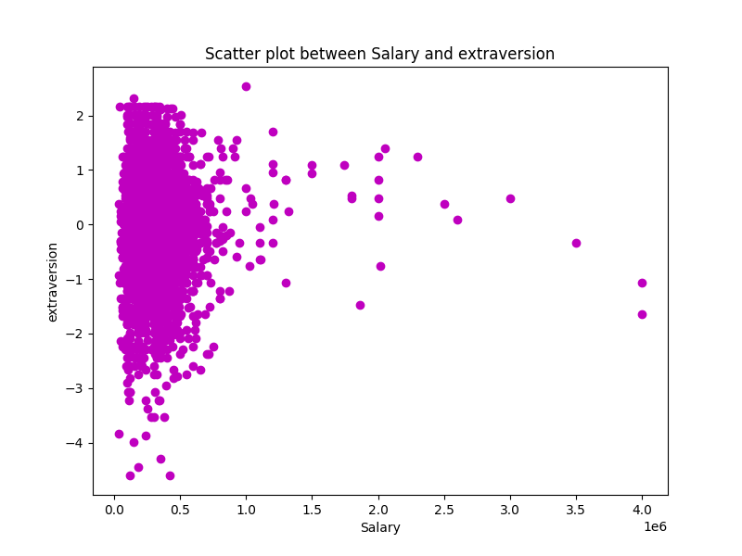
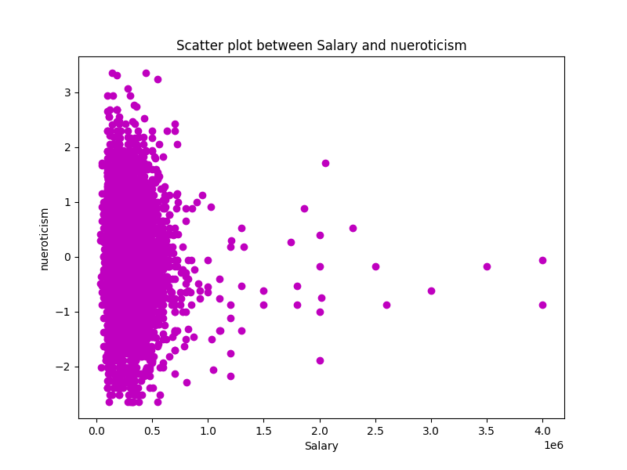
The scatter plot shows the relationship between Salary and Extraversion among a population of individuals.
There is no clear correlation between the two variables; people with both low and high Extraversion are spread across various salary ranges.
There is a high concentration of data points at the lower end of the salary axis, indicating that many individuals earn lower salaries regardless of their Extraversion.
There is a sparse distribution of data points as salary increases, showing fewer individuals in higher salary brackets.
The plot suggests that in this dataset, an individual’s level of Extraversion is not strongly associated with their salary. Individuals with both high and low Extraversion can be found across different salary ranges, indicating other factors likely play a more substantial role in determining one’s income.
The scatter plot shows the relationship between Salary and Neuroticism among a population of individuals.
There is no clear correlation between the two variables; people with both low and high Neuroticism are spread across various salary ranges.
There is a high concentration of data points at the lower end of the salary axis, indicating that many individuals earn lower salaries regardless of their Neuroticism.
There is a sparse distribution of data points as salary increases, showing fewer individuals in higher salary brackets.
The plot suggests that in this dataset, an individual’s level of Neuroticism is not strongly associated with their salary. Individuals with both high and low Neuroticism can be found across different salary ranges, indicating other factors likely play a more substantial role in determining one’s income.

Slide 26
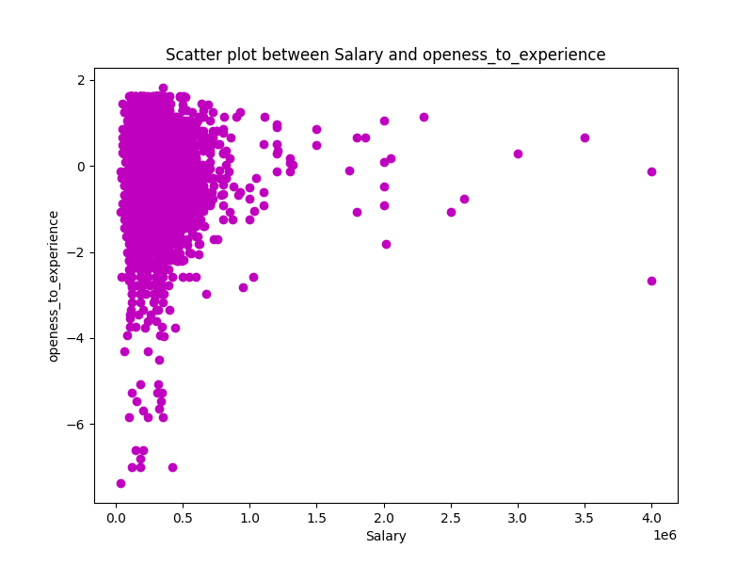
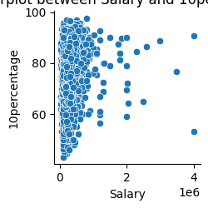
The scatter plot shows the relationship between Salary and openness to experience among a population of individuals.
There is no clear correlation between the two variables; people with both low and high openness to experience are spread across various salary ranges.
There is a high concentration of data points at the lower end of the salary axis, indicating that many individuals earn lower salaries regardless of their openness to experience.
There is a sparse distribution of data points as salary increases, showing fewer individuals in higher salary brackets.
The plot suggests that in this dataset, an individual’s openness to experience is not a significant predictor of their salary. Individuals with both high and low openness to experience can be found across different salary ranges, indicating other factors likely play a more substantial role in determining one’s income.
The plot shows the relationship between Salary and 10percentage among a population of individuals.
There is a positive correlation between the two variables; people with higher 10percentage tend to have higher salaries, and vice versa.
There is a high concentration of data points at the lower end of the salary axis, indicating that many individuals earn lower salaries regardless of their 10percentage.
There is a noticeable increase in the 10percentage as the salary increases, suggesting that higher salaries are associated with higher academic performance in 10th grade.
The plot provides insights into the distribution and relationship between salary and 10percentage, which could be useful for career planning and education policy.

Slide 27
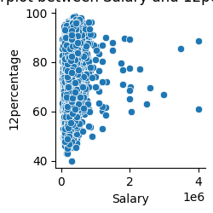
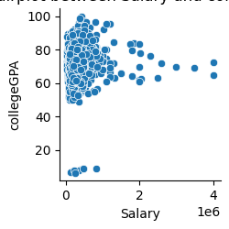
The plot shows the relationship between Salary and L2P percentage among a population of individuals.
There is a negative correlation between the two variables; people with higher salaries tend to have lower L2P percentages, and vice versa.
There is a high concentration of data points at the lower end of the salary axis, indicating that many individuals earn salaries near zero regardless of their L2P percentages.
There is a noticeable decrease in the L2P percentage as the salary increases, suggesting that higher salaries are associated with lower L2P percentages.
The plot provides insights into the distribution and relationship between salary and L2P percentage, which could be useful for understanding the impact of salary on loan repayment.
The plot shows the relationship between Salary and College GPA among a population of individuals.
There is a negative correlation between the two variables; people with higher College GPA tend to have lower salaries, and vice versa.
There is a high concentration of data points at the higher end of the College GPA axis, indicating that many individuals with high academic performance earn lower salaries.
There is a noticeable decrease in the College GPA as the salary increases, suggesting that lower academic performance is associated with higher salaries.
The plot provides insights into the distribution and relationship between salary and College GPA, which could be useful for understanding the impact of education on earnings. However, it is important to consider other factors that might influence salary, such as field of study, years of experience, or geographic location.

Slide 28
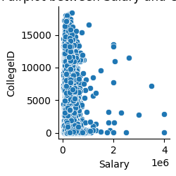
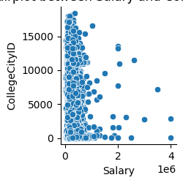
The plot shows the relationship between Salary and CollegeCityID among a population of individuals.
There is no clear correlation between the two variables; people with different CollegeCityIDs are spread across various salary ranges.
There is a high concentration of data points at the lower end of the salary axis, indicating that many individuals earn lower salaries regardless of their CollegeCityID.
There is a noticeable gap in the middle range of both Salary and CollegeCityID, suggesting that individuals from those specific college cities are either missing from the data or do not fall within that salary range.
The plot provides insights into the distribution but does not offer a clear pattern or correlation between salary and CollegeCityID.
The plot shows the relationship between Salary and College ID among a population of individuals.
There is no clear correlation between the two variables; people with different College IDs are spread across various salary ranges.
There is a high concentration of data points at the lower end of the salary axis, indicating that many individuals earn lower salaries regardless of their College ID.
There is a noticeable gap in the middle range of both Salary and College ID, suggesting that individuals from those specific college cities are either missing from the data or do not fall within that salary range.
The plot provides insights into the distribution but does not offer a clear pattern or correlation between salary and College ID.

Slide 29
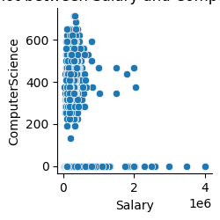
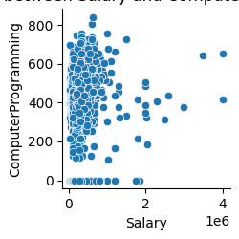
The plot shows the relationship between Salary and 10percentage among a population of individuals.
There is a positive correlation between the two variables; people with higher 10percentage tend to have higher salaries, and vice versa.
There is a high concentration of data points at the lower end of the salary axis, indicating that many individuals earn lower salaries regardless of their 10percentage.
There is a noticeable increase in the 10percentage as the salary increases, suggesting that higher salaries are associated with higher academic performance in 10th grade.
The plot provides insights into the distribution and relationship between salary and 10percentage, which could be useful for career planning and education policy.
There is a positive correlation between the two variables; people with higher computer programming skills tend to have higher salaries, and vice versa.
There is a high concentration of data points at the lower end of the salary axis, indicating that many individuals earn lower salaries regardless of their computer programming skills.
There is a noticeable increase in the computer programming skills as the salary increases, suggesting that higher salaries are associated with higher levels of skill or experience in computer programming.
The plot provides insights into the distribution and relationship between salary and computer programming, which could be useful for understanding the impact of skill development on earnings.

Slide 30
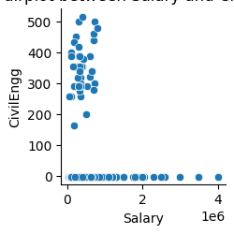
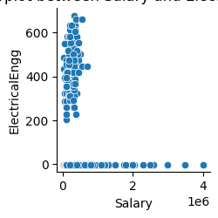
There is a positive correlation between the two variables; people with higher computer programming skills tend to have higher salaries, and vice versa.
There is a high concentration of data points at the lower end of the salary axis, indicating that many individuals earn lower salaries regardless of their computer programming skills.
There is a noticeable increase in the computer programming skills as the salary increases, suggesting that higher salaries are associated with higher levels of skill or experience in computer programming.
The plot provides insights into the distribution and relationship between salary and computer programming, which could be useful for understanding the impact of skill development on earnings.
There is no clear correlation between the two variables; people with different Civil Engineering Scores are spread across various salary ranges.
There is a high concentration of data points at the lower end of the salary axis, indicating that many individuals earn lower salaries regardless of their Civil Engineering Score.
There is a noticeable gap in the middle range of both Salary and Civil Engineering Score, suggesting that individuals from those specific college cities are either missing from the data or do not fall within that salary range.
The plot provides insights into the distribution but does not offer a clear pattern or correlation between salary and Civil Engineering Score.

Slide 31
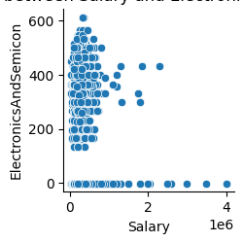
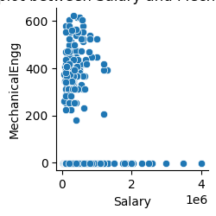
The plot shows the relationship between Salary and Mechanical Engineering Score among a population of individuals.
There is a negative correlation between the two variables; people with higher Mechanical Engineering Scores tend to have lower salaries, and vice versa.
There is a high concentration of data points at the lower end of the salary axis, indicating that many individuals earn lower salaries regardless of their Mechanical Engineering Score.
There is a noticeable decrease in the Mechanical Engineering Score as the salary increases, suggesting that lower scores are associated with higher salaries.
The plot provides insights into the distribution and relationship between salary and Mechanical Engineering Score, which could be useful for understanding the impact of skill development on earnings.
The plot shows the relationship between Salary and Electronics and Semiconductors among a population of individuals.
There is a negative correlation between the two variables; people with higher Electronics and Semiconductors scores tend to have lower salaries, and vice versa.
There is a high concentration of data points at the lower end of the salary axis, indicating that many individuals earn lower salaries regardless of their Electronics and Semiconductors scores.
There is a noticeable spike in the number of employees at a specific salary range around 2e6, indicating a certain role or level that has both higher pay and a larger workforce.
The plot provides insights into the distribution and relationship between salary and Electronics and Semiconductors, which could be useful for understanding the impact of skill development on earnings.

Slide 32
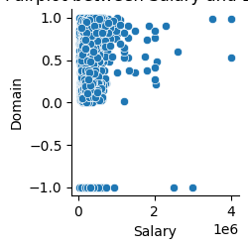
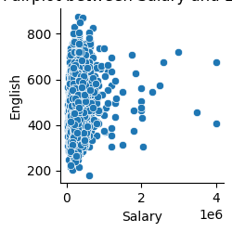
The plot shows the relationship between Salary and Domain among a population of individuals.
There is no clear correlation between the two variables; people with different Domain values are spread across various salary ranges.
There is a high concentration of data points at the lower end of the salary axis, indicating that many individuals earn lower salaries regardless of their Domain.
There is a noticeable gap in the middle range of both Salary and Domain, suggesting that individuals from those specific domains are either missing from the data or do not fall within that salary range.
The plot provides insights into the distribution but does not offer a clear pattern or correlation between Salary and Domain.
The plot shows the relationship between Salary and Domain among a population of individuals.
There is no clear correlation between the two variables; people with different Domain values are spread across various salary ranges.
There is a high concentration of data points at the lower end of the salary axis, indicating that many individuals earn lower salaries regardless of their Domain.
There is a noticeable gap in the middle range of both Salary and Domain, suggesting that individuals from those specific domains are either missing from the data or do not fall within that salary range.
The plot provides insights into the distribution but does not offer a clear pattern or correlation between Salary and Domain.

Slide 33
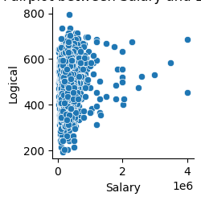
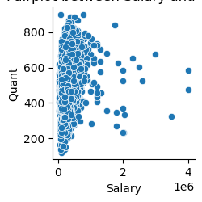
The plot shows the relationship between Salary and Logical among a population of individuals.
There is a negative correlation between the two variables; people with higher Logical scores tend to have lower salaries, and vice versa.
There is a high concentration of data points at the lower end of the salary axis, indicating that many individuals earn lower salaries regardless of their Logical scores.
There is a noticeable decrease in the Logical scores as the salary increases, suggesting that lower Logical scores are associated with higher salaries.
The plot provides insights into the distribution and relationship between salary and Logical, which could be useful for understanding the impact of logical reasoning skills on earnings.
The plot shows the relationship between Salary and English proficiency among a population of individuals.
There is a positive correlation between the two variables; people with higher English proficiency tend to have higher salaries, and vice versa.
There is a high concentration of data points at the lower end of the salary axis, indicating that many individuals earn lower salaries regardless of their English proficiency.
There is a noticeable increase in the English proficiency as the salary increases, suggesting that higher salaries are associated with higher levels of skill or experience in English.
The plot provides insights into the distribution and relationship between salary and English proficiency, which could be useful for understanding the impact of language skills on earnings.

Slide 34
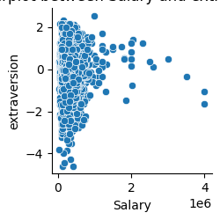
The plot shows the relationship between Salary and Extraversion among a population of individuals.
There is a negative correlation between the two variables; people with higher extraversion tend to have lower salaries, and vice versa.
There is a high concentration of data points at the lower end of the salary axis, indicating that many individuals earn lower salaries regardless of their extraversion.
There is a noticeable decrease in the extraversion as the salary increases, suggesting that lower extraversion is associated with higher salaries.
The plot provides insights into the distribution and relationship between salary and extraversion, which could be useful for understanding the impact of personality traits on earnings.
The plot shows the relationship between Salary and Quant among a population of individuals.
There is a negative correlation between the two variables; people with higher Quant scores tend to have lower salaries, and vice versa.
There is a high concentration of data points at the lower end of the salary axis, indicating that many individuals earn lower salaries regardless of their Quant scores.
There is a noticeable decrease in the Quant scores as the salary increases, suggesting that lower Quant scores are associated with higher salaries.
The plot provides insights into the distribution and relationship between salary and Quant, which could be useful for understanding the impact of quantitative skills on earnings.

Slide 35
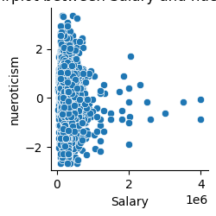

The plot shows a negative correlation between salary and openness to experience.
This means that people who earn more money tend to have lower scores on openness, which is a personality trait that reflects curiosity, creativity, and willingness to try new things.
The data points are mostly clustered at the lower end of both axes, indicating that most people have low salaries and high openness.
As the salary increases, the openness score decreases, suggesting that higher-paying jobs or professions may require or attract people who are more conventional, conservative, or pragmatic.
Alternatively, it could also mean that people who are more open-minded may not pursue or value monetary rewards as much as other factors in their careers.
The plot does not imply causation, but it reveals an interesting relationship between two variables that may have social, psychological, and economic implications.
The plot shows the relationship between Salary and Neuroticism among a population of individuals.
There is a negative correlation between the two variables; people with higher neuroticism tend to have lower salaries, and vice versa.
There is a high concentration of data points at the lower end of the salary axis, indicating that many individuals earn lower salaries regardless of their neuroticism.
There is a noticeable decrease in the neuroticism as the salary increases, suggesting that lower neuroticism is associated with higher salaries.
The plot provides insights into the distribution and relationship between salary and neuroticism, which could be useful for understanding the impact of emotional stability on earnings.

Slide 36


Negative Correlation: The plot shows a negative correlation between salary and 10th percentage, meaning that people who earn more money tend to have lower scores in their 10th grade, which is a measure of academic performance.
Data Concentration: Most data points are concentrated in the lower salary range and higher 10th percentage, indicating that individuals with higher academic achievement tend to have lower salaries. This could suggest a mismatch between the skills and qualifications of the workforce and the demand and compensation of the labor market.
Sparse Data: There is sparse data for high salaries and low 10th percentages, indicating fewer occurrences of individuals with low academic scores earning high salaries. This could imply a lack of opportunities or barriers for low-performing students to access or succeed in high-paying jobs or professions.
Hexbin Density: The color gradient shows the density of data points; lighter colors represent higher densities. It’s evident that most people have both moderate salaries and high school percentages, suggesting a common or average profile of the population.
Negative Correlation: The plot shows a negative correlation between salary and 12th percentage, meaning that people who earn more money tend to have lower scores in their 12th grade, which is a measure of academic performance.
Data Concentration: Most data points are concentrated in the lower salary range and higher 12th percentage, indicating that individuals with higher academic achievement tend to have lower salaries. This could suggest a mismatch between the skills and qualifications of the workforce and the demand and compensation of the labor market.
Sparse Data: There is sparse data for high salaries and low 12th percentages, indicating fewer occurrences of individuals with low academic scores earning high salaries. This could imply a lack of opportunities or barriers for low-performing students to access or succeed in high-paying jobs or professions.
Hexbin Density: The color gradient shows the density of data points; lighter colors represent higher densities. It’s evident that most people have both moderate salaries and high school percentages, suggesting a common or average profile of the population.

Slide 37


Negative Correlation: The plot shows a negative correlation between salary and college GPA, meaning that people who earn more money tend to have lower grades in college.
Data Concentration: Most data points are clustered in a specific range of salary and college GPA, indicating a common trend among the sampled population.
Sparse Data: There is sparse data outside this concentration, indicating fewer individuals with higher salaries or GPAs outside the 60-80 range.
Hexbin Density: The color gradient shows the density of data points; lighter colors indicate higher densities, revealing where most data is clustered.
Negative Correlation: The plot shows a negative correlation between salary and domain, meaning that people who earn more money tend to have lower domain values, which could represent some measure of expertise or interest.
Data Concentration: Most data points are clustered in the lower salary range and higher domain values, indicating that individuals or entities with higher domain values tend to have lower salaries. This could suggest a trade-off between pursuing one’s domain and earning more income.
Sparse Data: There is sparse data for high salaries and low domain values, indicating fewer occurrences of individuals or entities with low domain values earning high salaries. This could imply a rarity or exclusivity of high-paying jobs or professions that also have low domain requirements or preferences.
Hexbin Density: The color gradient shows the density of data points; lighter colors indicate higher densities, revealing where most data is clustered.

Slide 38


Negative Correlation: The plot shows a negative correlation between salary and college ID, meaning that people who earn more money tend to have lower grades in college.
Data Concentration: Most data points are clustered in a specific range of salary and college ID, indicating a common trend among the sampled population.
Sparse Data: There is sparse data outside this concentration, indicating fewer individuals with higher salaries or college ID outside the 2500-5000 range.
Hexbin Density: The color gradient shows the density of data points; lighter colors indicate higher densities, revealing where most data is clustered.
Data Concentration: Most data points are concentrated in the lower salary range and lower CollegeCityID, indicating that a large number of individuals with specific CollegeCityIDs have salaries in the lower range.
Sparse Data: As we move towards higher salaries and CollegeCityIDs, the data becomes sparse. This could imply fewer colleges or cities with graduates earning higher salaries.
Color Intensity: The color intensity is highest at the lower end of the salary spectrum and diminishes with an increase in salary, visualizing the density of data points.
Correlation Absence: There isn’t a clear correlation between Salary and CollegeCityID visible from this plot; data is not showing a distinct trend or pattern.

Slide 39


Data Concentration: Most data points are concentrated at the lower end of the salary and computer programming scale, indicating many individuals have low to moderate skills and earnings.
Sparse Data: As we move higher on both axes, data becomes sparse, showing fewer individuals with high salaries and high programming skills.
Color Intensity: The color intensity is highest at the bottom left corner, representing a large count in that bin. It fades as we move away, indicating decreasing counts.
Skill-Salary Relation: There seems to be a positive correlation between computer programming skills and salary up to a certain point; beyond that, data is limited.
Data Concentration: Most data points are concentrated in the lower salary range and lower computer science scores, as indicated by the dark purple hexbins.
Sparse Data: As both salary and computer science scores increase, there are fewer data points, leading to lighter colored hexbins.
Salary Distribution: The majority of individuals have salaries less than 1.0e6, with very few earning more.
Computer Science Scores: Most scores are below 200; higher scores are rare.
Correlation Absence: There isn’t a clear correlation between salary and computer science scores visible in this plot.

Slide 40

Data Concentration: Most data points are concentrated in the lower salary range and higher English proficiency area.
Salary Range: Majority of individuals have a salary between 0 to 0.5 x 10^6, indicating a common income bracket.
English Proficiency: Individuals with higher English scores, especially above 700, predominantly fall within this salary range.
Sparse Data: As the salary increases beyond 0.5 x 10^6, the number of individuals decreases significantly.
Color Gradient: The color gradient shows that there are fewer people with both high salaries and high English proficiency.
Data Concentration: Most data points are concentrated in the lower salary range and higher domain values, as indicated by the lighter hexbins.
Salary Distribution: The majority of salaries are below 1.0 x 10^6, with very few data points above this value.
Domain Values: Higher domain values have a wider range of salaries associated with them.
Sparse Data: There is sparse data in the negative domain values and higher salary ranges, leading to darker hexbins indicating lower counts.
Count Bin Gradient: The count bin gradient on the right shows a clear distinction between areas of high and low data point concentration.

Slide 41


Data Concentration: Most data points are concentrated in the lower salary range and lower quant values, indicating a large number of individuals with lower salaries and quant scores.
Color Intensity: The color intensity is highest (darker shade) at the bottom left corner of the plot, gradually lightening as it moves up and to the right, showing fewer people with higher salaries and quant scores.
Salary Distribution: There is a clear pattern where individuals with lower salaries are more common. The distribution thins out as salary increases.
Quant Scores: Similar to salary, lower quant scores are more frequent. There’s a noticeable decline in frequency as quant scores increase.
Correlation Insight: The plot suggests a weak positive correlation between salary and quant; as one increases, so does the other but not strongly.
Data Concentration: Most data points are concentrated in the lower salary range and lower logical score area, indicating a large number of individuals with lower salaries and logical skills.
Color Intensity: The color intensity is highest at the lower end of both axes, indicating a higher count in those bins. It fades as we move up and to the right, showing fewer people with higher salaries and logical skills.
Salary Distribution: There is a clear pattern where individuals with lower salaries are more common. The distribution thins out as salary increases.
Logical Score Distribution: Similar to salary, lower logical scores are more frequent. There’s a noticeable decline in frequency as logical scores increase.
Correlation Insight: The plot suggests a weak positive correlation between salary and logical skill; as one increases, so does the other but not strongly.

Slide 42


Data Concentration: Most data points are concentrated in the lower salary range and higher openness to experience, indicating that many individuals have low incomes and high curiosity levels.
Sparse Data: As we move towards higher salary and lower openness to experience, the data becomes sparse, showing that fewer people have these characteristics.
Color Intensity: The color intensity is highest (green) at the lower end of the salary axis and the upper end of the openness to experience axis, representing a higher count in those bins. It fades (to purple) as we move away from this point, indicating a decrease in data density.
Salary Range: The majority of individuals have a salary less than 0.5 x 10^6, indicating a common income bracket.
Openness to Experience: Individuals with this salary range tend to have a positive score in openness to experience, mostly between 0 and 2.
Data Concentration: Most data points are concentrated in the lower salary range and lower neuroticism area, indicating that a large number of individuals have low salaries and low levels of neuroticism.
Sparse Data: As we move towards higher salary and higher neuroticism levels, the data becomes sparse.
Color Intensity: The color intensity is highest (green) at the lower end of both axes, gradually fading (to purple) as we move away from this point, representing a decrease in data density.
Salary Distribution: Individuals with salaries around 0.5 x 10^6 have varied levels of neuroticism, but it’s mostly on the lower side.
Neuroticism Levels: There are hardly any individuals with high levels of neuroticism irrespective of their salary.

Slide 43


degrees: B.Tech/B.E., MCA, M.Tech/M.E., and M.Sc. (Tech.).
B.Tech/B.E. Salary: B.Tech/B.E. graduates have the widest salary range, with some outliers earning significantly higher than the rest. Their median salary is slightly higher than MCA and M.Tech/M.E. graduates.
MCA Salary: MCA degree holders have a compact salary range and fewer outliers, indicating more consistency in their earnings. Their median salary is slightly lower than B.Tech/B.E. and M.Tech/M.E. graduates.
M.Tech/M.E. Salary: M.Tech/M.E. graduates have a similar salary range and number of outliers as MCA graduates, but their median salary is slightly higher than MCA graduates and almost equal to B.Tech/B.E. graduates.
M.Sc. (Tech.) Salary: M.Sc. (Tech.) graduates have the narrowest salary range and no outliers, indicating the least variation in their earnings. Their median salary is the lowest among the four degrees.
Salary Comparison: The box plot compares the salary distribution across various states in India.
Southern States: Andhra Pradesh, Tamil Nadu, and Karnataka have higher median salaries compared to other states, indicating a higher income level in these regions.
Salary Variation: There is a significant variation in salaries within each state, as indicated by the length of the boxes and the presence of outliers. This suggests a diversity of occupations and economic opportunities in each state.
Low-Income States: States like Bihar and Assam have lower median salaries with less variation, indicating a lower income level and fewer economic opportunities in these regions.
Delhi: Delhi, although having a wide range of salaries, has a lower median salary compared to southern states like Andhra Pradesh and Karnataka. This could be due to the high cost of living and the presence of many low-wage workers in the capital city.

Slide 44

Salary Comparison: The box plot compares the salary distribution between two genders, labeled as “f” and “m”.
Median Salary: Both genders have a similar median salary, indicated by the line within each box. This suggests that there is no significant difference in the average salaries of males and females.
Salary Variation: The interquartile range (IQR), represented by the width of the boxes, is also similar for both genders, indicating comparable salary distributions. However, there are several outliers in both categories, shown as circles beyond the whiskers of the boxes. These represent individuals with salaries significantly higher than their peers.
Outlier Analysis: The maximum salary within 1.5 IQR for both genders is almost equal; however, male outliers tend to have higher salaries than female outliers. This could indicate that there are more males in high-paying positions or industries than females.

Slide 45

Here are some points to explain the observation from the correlation graph:
Correlation Coefficients: The graph displays the correlation coefficients between various numerical columns, ranging from -0.2 to 1.0. Each cell’s color intensity and value indicate the strength and direction of the correlation between two variables.
Salary Correlation: Salary has a strong positive correlation with 12percentage and collegeGPA, indicating that higher academic scores are associated with higher salaries.
Negative Correlations: There is a negative correlation between salary and conscientiousness and agreeableness, suggesting that higher levels of these traits might be related to lower salaries.
Strong Positive Correlations: There are strong positive correlations (close to 1) among 10percentage-12percentage-collegeGPA and English-Logical-Quant, indicating they move in tandem.
Personality Traits: Neuroticism is negatively correlated with conscientiousness and agreeableness but positively correlated with extraversion, indicating different aspects of emotional stability and sociability.
Domain Knowledge: Domain knowledge has a positive correlation with ComputerProgramming but is negatively correlated with ElectronicsAndSemicon, indicating different skill sets and preferences.

Slide 46

Research Questions
Q. Times of India article dated Jan 18, 2019 states that “After doing your Computer Science Engineering if you take up jobs as a Programming Analyst, Software Engineer, Hardware Engineer and Associate Engineer you can earn up to 2.5-3 lakhs as a fresh graduate.” Test this claim with the data given to you.

Slide 47

Salary Comparison: The graph compares the claimed salary range for three different job titles: Associate Engineer, Hardware Engineer, and Software Engineer.
Average Salary: A red dashed line indicates the average salary for relevant job titles, which is higher than the claimed salary range for all three roles.
Associate Engineer: The claimed salary range for an associate engineer is the lowest among the three roles, indicating that this is an entry-level position with lower pay.
Hardware Engineer: The claimed salary range for a hardware engineer is slightly higher than the associate engineer, but still below the average salary. This suggests that this role requires more skills and experience, but not as much as a software engineer.
Software Engineer: The software engineer’s claimed salary range is the highest among the three roles, but still below the average salary. This indicates that this role is more demanding and rewarding, but also more competitive and challenging.

Slide 48

Is there a relationship between gender and specialization? (i.e. Does the preference of Specialization depend on the Gender?)

Slide 49

Here are some observations you can make from the graph:
Women appear to be more generalized in their specializations than men. This is because the women's specialization bar appears to be more spread out across the specializations offered, while the men's specialization bar appears to be higher for certain specializations.
Potentially, there are more men than women in the dataset. The total height of the men's bars seems to be higher than the total height of the women's bars. However, it would be difficult to say for sure without seeing the y-axis labels.

Slide 50

Conclusion
In conclusion, the exploratory data analysis (EDA) provided valuable insights into the factors influencing salary and specialization preferences among engineering graduates. The analysis revealed significant correlations between certain variables and salary outcomes, indicating the importance of education background, skills, and job roles. Additionally, the investigation into gender and specialization preferences highlighted potential areas for diversity initiatives. Overall, the findings underscore the complexity of salary determinants and the need for data-driven decision-making in recruitment and career planning processes within the engineering sector. Further research and analysis could deepen our understanding and inform targeted interventions to promote equitable opportunities and outcomes.

Slide 51

THANK YOU

