Slide 1




Next Gen Employability Program
Full Stack Web Development with AI Tools
Team Details – NG_CP_Team_547
Name: Ashvini Patil
Name: Bhumika Patil
Name: Isha Pawar
College: MVPS’s Karmaveer Adv Baburao Ganpatrao Thakre College of Enineering, Nashik.

Slide 2

The content is curated from online/offline resources and used for educational purpose only.
Notes:
Speaker would be briefing the students that this content has been prepared for the educational purpose only and is referred from multiple sites which are cited in the last.​​
---------------------------------------------------​​
A disclaimer is a statement or notice that is intended to clarify, limit, or provide information about the scope, limitations, or potential risks associated with certain actions, information, products, services, or content. ​​
​​
​

Slide 3

Project Title
Study Buddy – AI Powered Study Companion
Notes:
In this slide speaker will be introducing the program and its outcomes. The speaker will introduce himself in brief

Slide 4

Table of Contents
Problem Statement
Introduction / Proposed Solution
Features and Functionality
System Architecture
Result
Technology
References
Notes:
This slide, The speaker will talk about the content that we will be covering in this session as follows:
Introduction
Importance of UI/UX in industry
History and Definitions of UI and UX
Key Differences between UI/UX
Use Cases
Significance in Web Development
Use Cases
Visual Design Principles
Design process
Color theory and psychology
Typography and readability
Layout and Spacing
Responsive design basics
Usability and Accessibility
Usability Aspects
Web Content Accessibility Guidelines (WCAG)
Inclusive design practices
Consistency
User Experience
User-Centered Design
User research methods
Interactive Elements and Feedback
Mini Case Study
Discussing a popular UI/UX design
Hands-On
Introduction to Figma for UI/UX design

Slide 5
How students study today — and why it fails: Traditional Methods Students refer to books or browse the internet Time-consuming, unorganized, no personalization Using General AI (GPT) AI responses depend on entire chat history, not your specific material File upload limits — can't upload multiple papers at once No structured quiz platform — just raw text responses Have to copy-paste questions manually into separate tools Finding MCQs & Flashcards Hard to find subject-specific MCQs online Flashcard tools require manual entry No tool connects your PDF → Quiz → Progress in one place
Problem Statement
Notes:
This slide, The speaker will talk about the content that we will be covering in this session as follows:
Introduction
Importance of UI/UX in industry
History and Definitions of UI and UX
Key Differences between UI/UX
Use Cases
Significance in Web Development
Use Cases
Visual Design Principles
Design process
Color theory and psychology
Typography and readability
Layout and Spacing
Responsive design basics
Usability and Accessibility
Usability Aspects
Web Content Accessibility Guidelines (WCAG)
Inclusive design practices
Consistency
User Experience
User-Centered Design
User research methods
Interactive Elements and Feedback
Mini Case Study
Discussing a popular UI/UX design
Hands-On
Introduction to Figma for UI/UX design

Slide 6
Proposed Solution
Study Buddy solves this by
Smart PDF Upload
Upload multiple PDFs under one subject
Add more files anytime after uploading
Difficulty-Based Quiz
Easy / Medium / Hard filter
Retry only wrong questions
Progress Tracking
Score history, streak, avg score
AI Content Generation
Custom MCQ & Flashcard count
Generate from selected files only
Chat With Material
Answers based on YOUR PDFs only
Cross-file question support
Notes:
This slide, The speaker will talk about the content that we will be covering in this session as follows:
Introduction
Importance of UI/UX in industry
History and Definitions of UI and UX
Key Differences between UI/UX
Use Cases
Significance in Web Development
Use Cases
Visual Design Principles
Design process
Color theory and psychology
Typography and readability
Layout and Spacing
Responsive design basics
Usability and Accessibility
Usability Aspects
Web Content Accessibility Guidelines (WCAG)
Inclusive design practices
Consistency
User Experience
User-Centered Design
User research methods
Interactive Elements and Feedback
Mini Case Study
Discussing a popular UI/UX design
Hands-On
Introduction to Figma for UI/UX design

Slide 7
Features and Functionality
Core Features
Multi-PDF upload under one subject
Custom no. of MCQ & Flashcard generation
Difficulty-based quiz (Easy / Medium / Hard)
Retry wrong questions only
Correct answers + explanations revealed after quiz
AI Integration
Groq API — Llama 3.3 70B (free, fast)
Generates MCQs, Flashcards from YOUR material
Chat answers strictly based on uploaded PDFs
Cross-file question answering
Full chat history saved per material
Security
@login_required on every page
Users can only access their own data
Password — min 8 chars, letter, number, special character
API keys stored in .env file
Database Design
User
StudyMaterial (title, subject)
MaterialFile (PDF files)
Question (MCQ, options, difficulty)
Flashcard (front, back)
ChatMessage (role, content, timestamp)
QuizAttempt (score, total, date)
AttemptAnswer (question, answer, is_correct)

Slide 8
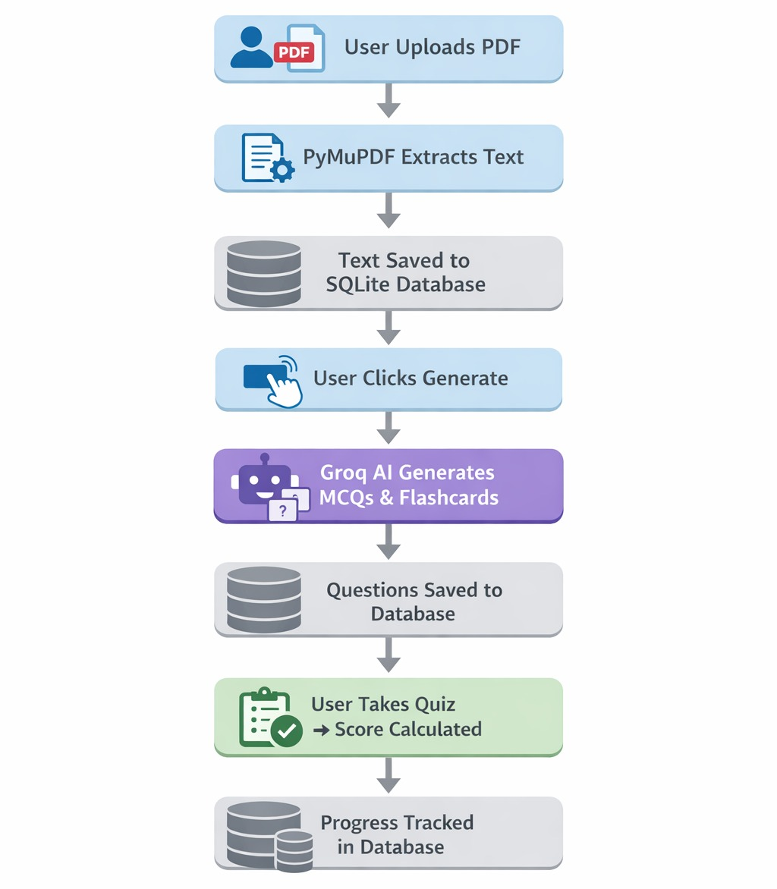
System Architecture

Slide 9
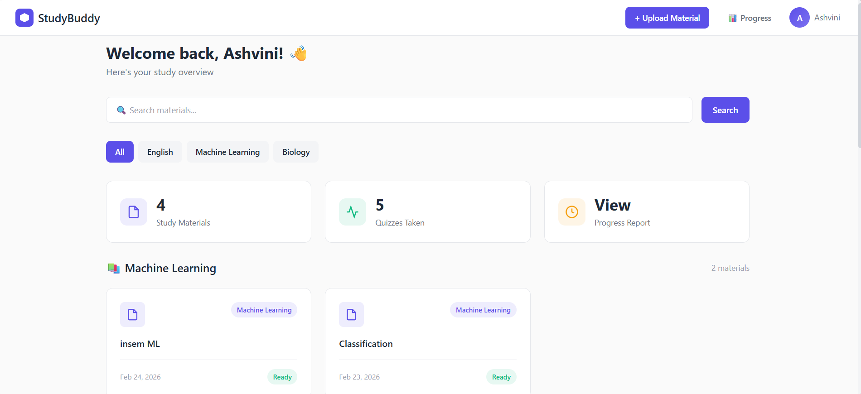
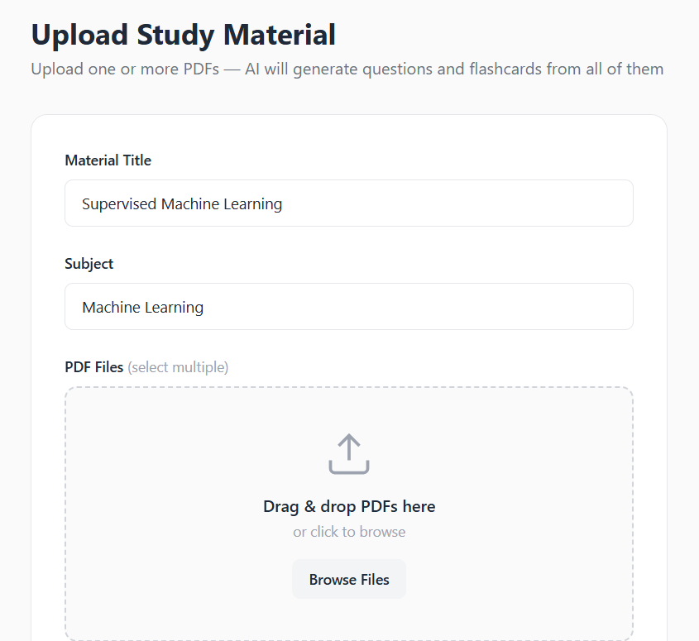
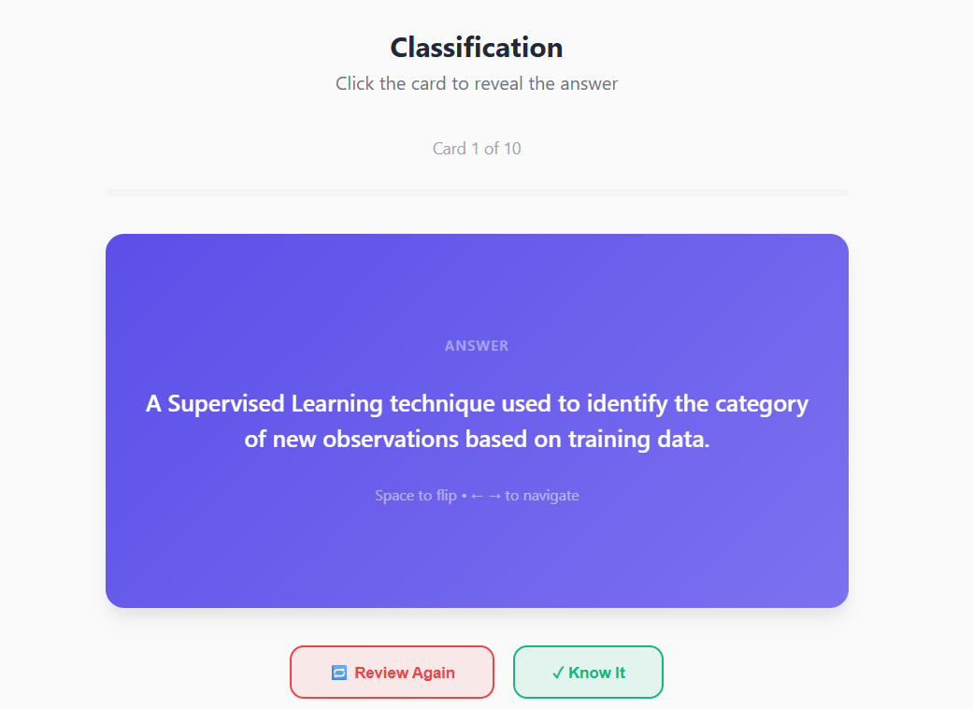
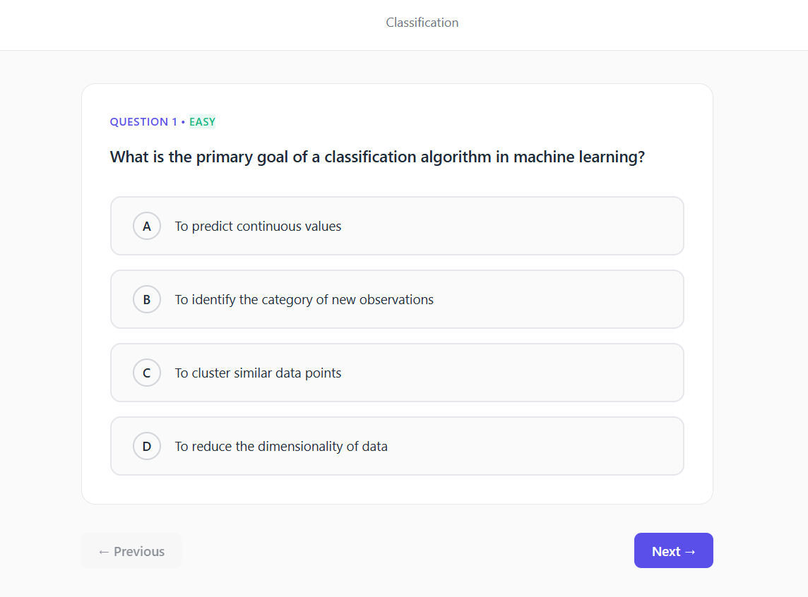
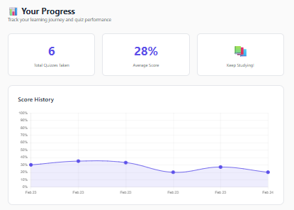
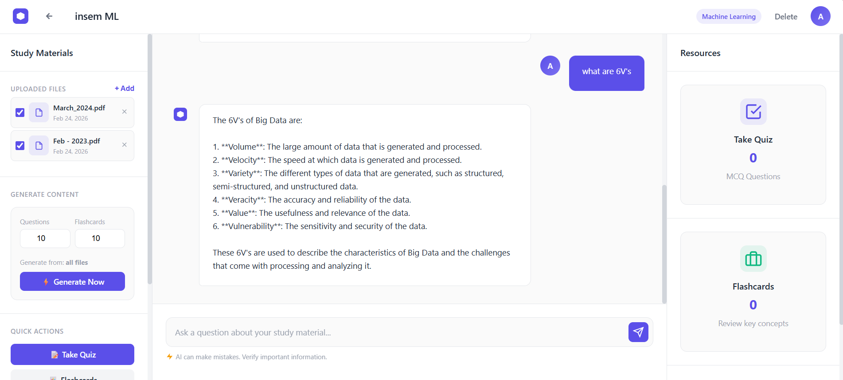
Results

Slide 10
Technology Stack
Backend:
Python + Django → Web server, URL routing, business logic, authentication
Database:
SQLite → Stores users, study materials, questions, scores, chat history
Artificial Intelligence:
Groq API — Llama 3.3 70B → Generates MCQs, Flashcards, answers chat questions
PDF Processing:
PyMuPDF (fitz) → Extracts and combines text from uploaded PDF files
Frontend:
HTML, CSS, Bootstrap, JavaScript → Responsive UI, flashcard animations, quiz navigation, chat interface
Notes:
This slide, The speaker will talk about the content that we will be covering in this session as follows:
Introduction
Importance of UI/UX in industry
History and Definitions of UI and UX
Key Differences between UI/UX
Use Cases
Significance in Web Development
Use Cases
Visual Design Principles
Design process
Color theory and psychology
Typography and readability
Layout and Spacing
Responsive design basics
Usability and Accessibility
Usability Aspects
Web Content Accessibility Guidelines (WCAG)
Inclusive design practices
Consistency
User Experience
User-Centered Design
User research methods
Interactive Elements and Feedback
Mini Case Study
Discussing a popular UI/UX design
Hands-On
Introduction to Figma for UI/UX design

Slide 11
References
Django Documentation — The Web Framework for Perfectionists with Deadlines https://docs.djangoproject.com
Groq API Documentation — Llama 3.3 70B Fast AI Inference https://console.groq.com/docs
PyMuPDF Documentation — PDF Text Extraction Library https://pymupdf.readthedocs.io
Python Software Foundation — Python 3.11 Documentation https://docs.python.org
SQLite Documentation — Lightweight Database Engine https://www.sqlite.org
Notes:
This slide, The speaker will talk about the content that we will be covering in this session as follows:
Introduction
Importance of UI/UX in industry
History and Definitions of UI and UX
Key Differences between UI/UX
Use Cases
Significance in Web Development
Use Cases
Visual Design Principles
Design process
Color theory and psychology
Typography and readability
Layout and Spacing
Responsive design basics
Usability and Accessibility
Usability Aspects
Web Content Accessibility Guidelines (WCAG)
Inclusive design practices
Consistency
User Experience
User-Centered Design
User research methods
Interactive Elements and Feedback
Mini Case Study
Discussing a popular UI/UX design
Hands-On
Introduction to Figma for UI/UX design

