Slide 1

RMK College of Engineering and Technology
SCIENCE DAY PROJECT
TEAM LEADER:
GANESSH M M (111622201019)
TEAM MEMBER:
ASHWANDH RAJ P (111622201005)

Slide 2


Agenda
A
Introduction
Primary goals
Language used
Working
How it looks
Login page

Slide 3
Outing Odyssey

Slide 4
Revolutionize Your School's Leave Process with Our Streamlined Web Solution."
AIM:

Slide 5
Introduction
"Introducing a streamlined and efficient web-based solution for student outing forms. Enter your details with ease and have them converted into a PDF file for immediate distribution to your respected counsellor."

Slide 6


Language used
FRONT END:
BACK END:

Slide 7
Everybody should learn to program a computer ,because it teaches you how to think
“
”
-Steve Jobs

Slide 8
Working
Our web-based platform provides an easy and efficient solution for students and parents to request for leave of absence from school.
Upon opening the webpage, the user will be directed to a form where they can input the necessary information.
Upon submission, a success message will be displayed and the information will be stored in a PDF file.
The PDF file will then be sent to the respective counsellor for verification.
After the counsellor has given their digital signature, the file will be sent to the coordinator and H.O.D for further approval.
Once all signatures have been obtained, the file will be sent to the student and parent with a printable option.

Slide 9
Features of the System
User-friendly form for easy input of information
Automated PDF file creation and distribution
Secure and efficient digital signature process
Real-time status tracking and updates
Easy printing options for student and parent
Streamlined communication between school departments

Slide 10
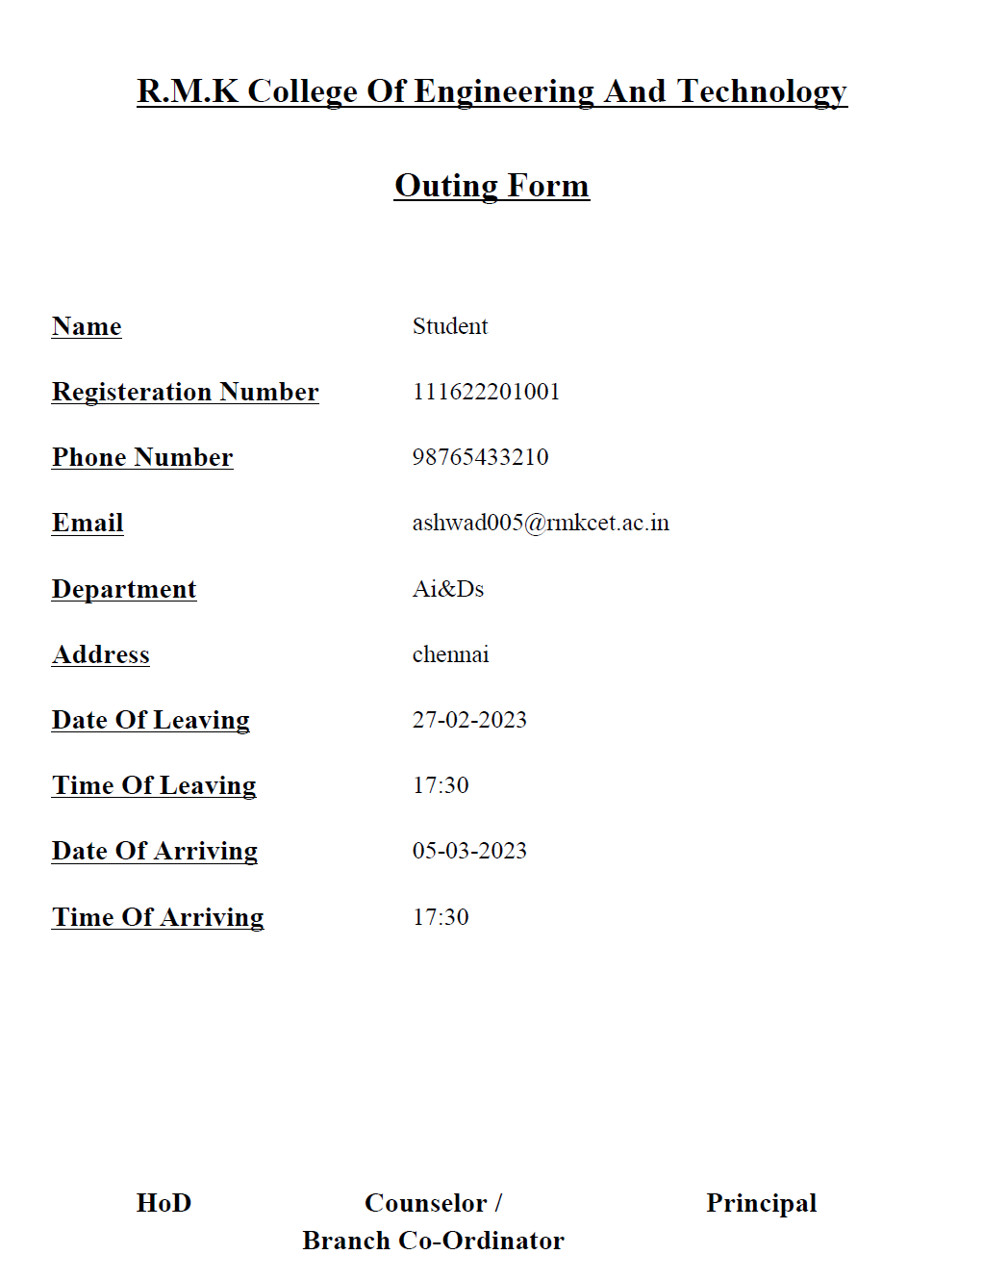
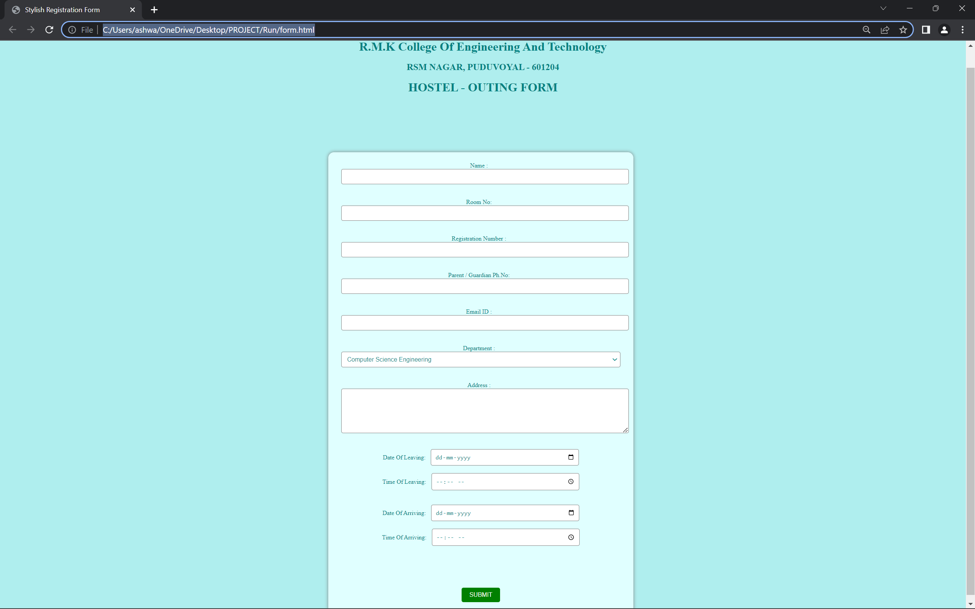
How it looks
PDF Look:
Web Page Look:
Image 1
Image 2

Slide 11
Thank you
"Leading the way in modernizing education processes."

