Slide 1
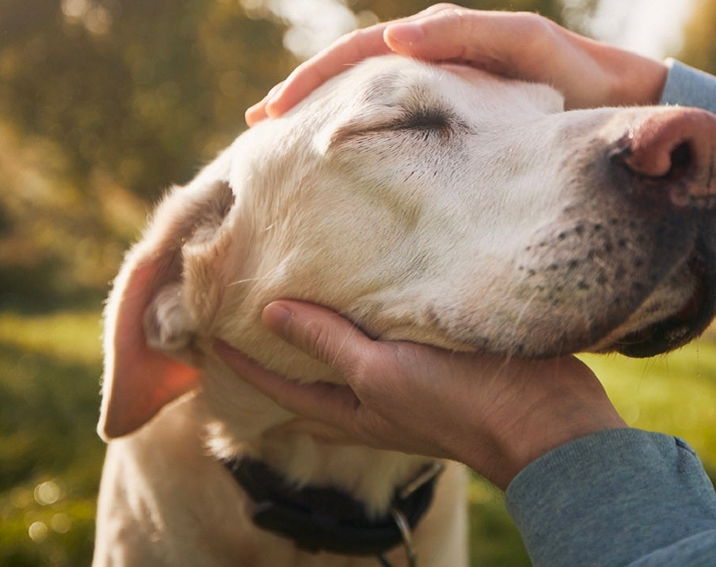
PET CARE AND RELOCATION SERVICES
TEAM MEMBERS:
ASHWANDH RAJ P-111622201005
KARTHICK G -111622201047
KARTHIKEYAN T-111622201051
MANOJKUMAR C-111622201060

Slide 2
Introduction
India’s pet industry is rapidly expanding, with more people adopting pets and treating them as family members.
The pet industry in India is booming, driven by increased pet ownership and the growing trend of treating pets as family members.
Pet owners seek reliable care and stress-free relocation solutions for their pets, creating a dual opportunity for a startup.

Slide 3

Lucrative Market Opportunity
Rising Pet Ownership: Over 32 million pets in India, with numbers growing annually.
Holistic Solution: Pet owners prefer a single service provider that can care for their pets and handle their relocation needs.
Increasing Mobility: With more people moving for work, education, and lifestyle changes, there is a growing demand for safe and reliable pet relocation.

Slide 4
.
Growing Pet Ownership: The rise in pet ownership, especially in urban areas, increases the demand for both care and relocation services.
Urban Mobility: As people move for work, education, or lifestyle changes, they need reliable services to relocate their pets.
International Travel: Globalization and expatriate communities contribute to the need for international pet relocation.

Slide 5
Target Audience
Urban Professionals: Require daily pet care, boarding, and relocation services when moving.
01
Expats and International Travelers: Need assistance with relocating pets across borders.
02
Military Families: Often relocate and need both care and transportation services.
03
Busy Families: Seek reliable care and relocation for their pets during travel or moves.
04

Slide 6
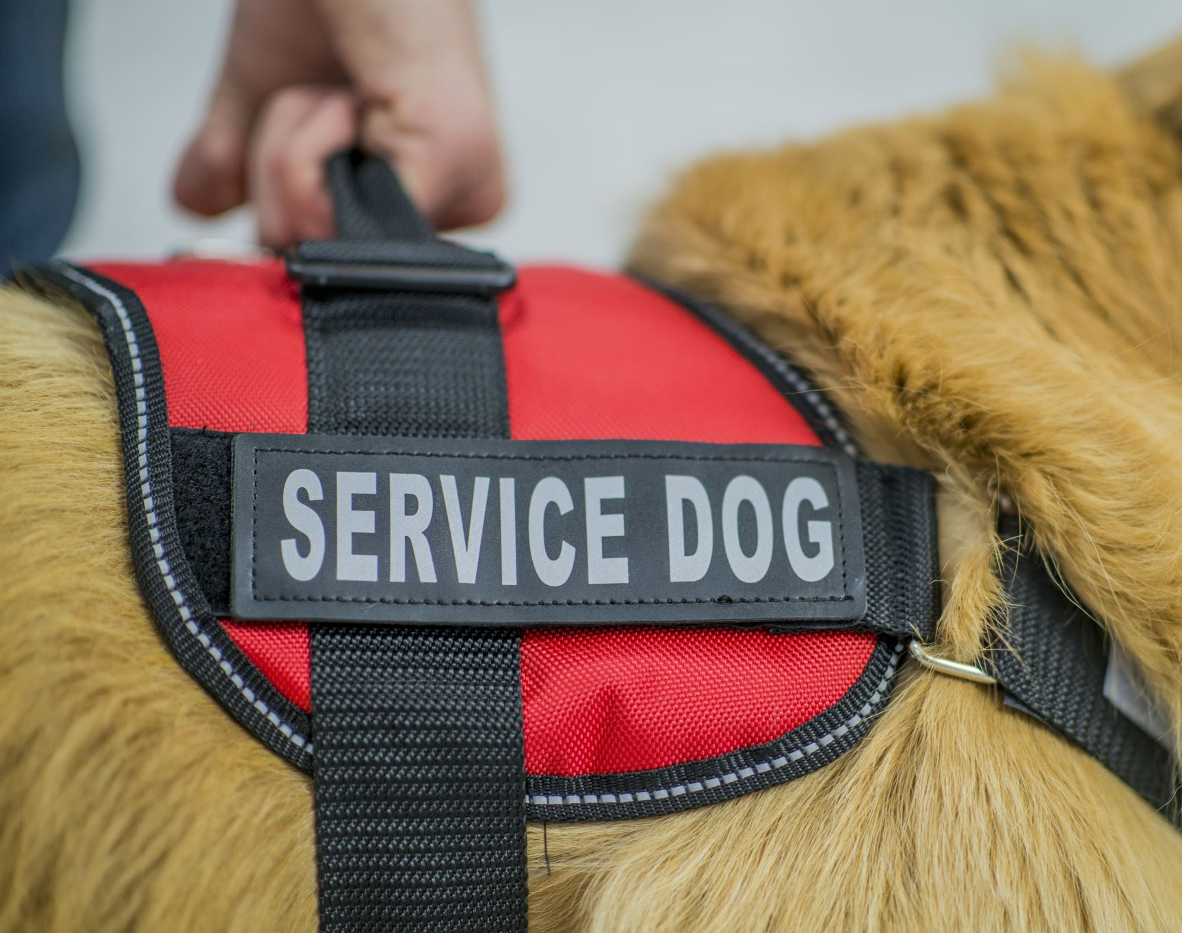
Services Offered
Pet Care Services:
Daily pet sitting and walking
Boarding and daycare
Grooming and health check-ups
Specialized care for senior pets

Slide 7
Relocation Services:
Consultation and travel planning
Documentation and compliance (pet passports, vaccinations)
Safe transportation (domestic and international)
Quarantine arrangements and home delivery

Slide 8
Key Differentiators
Comprehensive Care: A one-stop solution for all pet needs, from daily care to relocation.
Expertise and Safety: Trained professionals ensure pets are well-cared for and relocated safely.
Personalized Service: Tailored solutions to meet the specific needs of each pet and owner.
End-to-End Support: From planning to final delivery, we handle every aspect of care and relocation. ``

Slide 9
Business Model
Revenue Streams:
Pet care services: Regular income from sitting, boarding, grooming, and daycare.
Relocation services: One-time fees for domestic and international pet transport.
Additional services: Pet food sales, accessories, and premium care options.

Slide 10
.
Customer Segments:
Pet owners requiring daily care
Pet owners moving homes (domestic and international)
Corporate clients for employee relocation packages

Slide 11
Marketing Strategy
Digital Marketing: Leverage a website, social media, and online ads to reach pet owners.
Partnerships: Collaborate with veterinarians, pet stores, and relocation agencies.
Referral Programs: Encourage customers to refer friends with discounts or rewards.
Educational Content: Share tips and guides on pet care and relocation through blogs, videos, and newsletters.

Slide 12
Financial Projections
Revenue Projections: Estimate based on services provided, market demand, and pricing.
Cost Structure: Breakdown of startup costs, operational expenses, and pricing strategy.
Scalability: Opportunities to expand services, enter new markets, and increase profitability.

Slide 13
Challenges and Solutions
Regulatory Compliance: Stay updated on legal requirements for pet relocation.
Logistics Coordination: Ensure smooth coordination between care and transportation services.
Pet Anxiety: Provide solutions to minimize stress during care and relocation.
Customer Trust: Build trust through transparency, consistent updates, and excellent service.

