Slide 1
Supervised Learning Models to Predict the Yield Curve
Forecasting US Treasury yields one week ahead with XGBoost, Keras, fastai, TabNet and Lightning Flash
Ashwin Anand (PES1UG24AM057) · Abhishek Mundanat (PES1UG24AM012)
MLBD · Department of AIML, PES University
Notes:
Introduce yourselves (Ashwin and Abhishek) and the project. One sentence: we tried to predict the 1-month, 5-year and 30-year US Treasury yields one week ahead with five machine learning frameworks, and compared them on simplicity, transparency and efficacy.

Slide 2
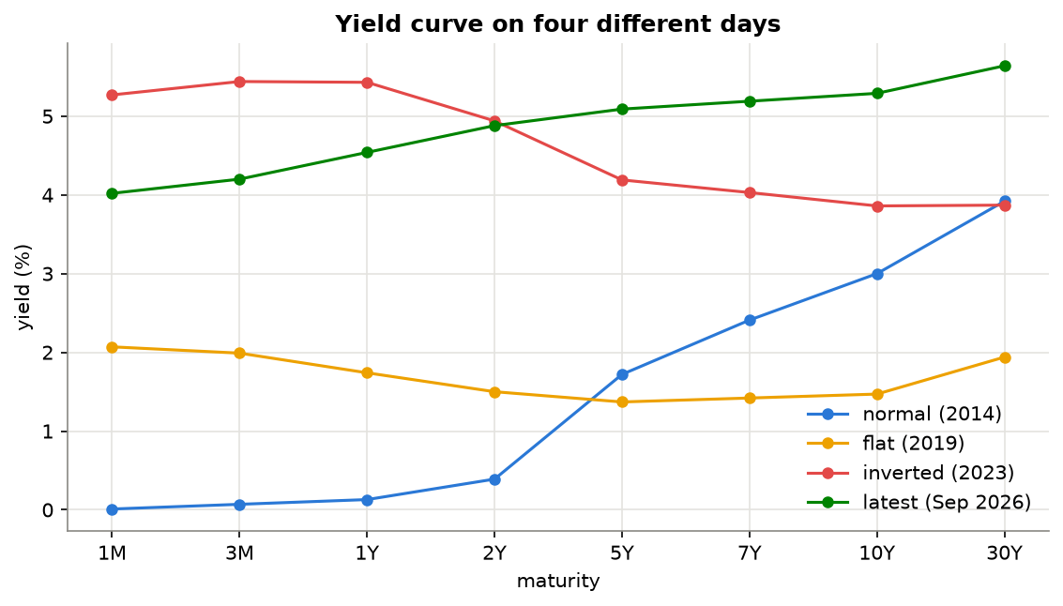
What is the yield curve and why predict it?
Yields of US Treasury bonds from 1 month to 30 years
Benchmark for mortgages, bank loans and corporate bonds
Normally slopes upward; an inverted curve has often come before a recession
Used by pension funds, insurers, banks and central banks
Task: predict the 1M, 5Y and 30Y yields 5 trading days ahead
Notes:
A yield curve plots the interest rates of bonds with the same credit quality but different maturities. The US Treasury curve is the benchmark for mortgages, loans and corporate bonds. Normally it slopes up. When it inverts (short rates above long rates) it has often signalled a recession. The plot shows four real days: a steep curve in 2014, flat in 2019, inverted in 2023 and the latest curve in September 2026.

Slide 3
Objectives
1
2
3
4
5
XGBoost
Keras
fastai
TabNet
Lightning Flash
gradient boosted trees
TensorFlow MLP
PyTorch, one-cycle training
PyTorch, attention masks
PyTorch, task library
Collect daily data from 2010 to 2026 (Yahoo Finance and FRED)
Explore the data (EDA) and choose a sensible target
Train the 5 frameworks plus 2 baselines: naive "no change" and linear regression
Compare on Simplicity, Transparency, Efficacy and on RMSE, MAE, R²
Check whether any model is really better than the naive forecast
Notes:
The assignment has five parts: get the data from Yahoo Finance, do EDA, build regression models with five frameworks, compare them on simplicity, transparency and efficacy plus RMSE, MAE and R2, and write the report and presentation. On top of that we added baselines, three experiments and a significance test.

Slide 4
Data: Yahoo Finance and FRED
FRED (Federal Reserve)
Yahoo Finance (yfinance)
8 Treasury yields: 1M, 3M, 1Y, 2Y, 5Y, 7Y, 10Y, 30Y
Baa corporate spread over the 10Y
Debt held by the Fed, the public and foreign investors (weekly and quarterly)
Yield indices ^IRX, ^FVX, ^TNX, ^TYX, used as a cross-check
VIX, S&P 500, Brent oil, gold, US dollar index
No 1M yield and no debt data, so FRED is needed
4,189
< 1 bp
23
trading days, Jan 2010 to Sep 2026
average gap between Yahoo and FRED (5Y, 10Y, 30Y)
features after feature engineering
Notes:
Yahoo Finance only has four Treasury yields and not the 1-month yield, which is one of our targets, nor the debt data. So the yield curve and debt data come from FRED, the Federal Reserve database, like in the original case study. Yahoo gives the market indicators. Where both sources have the same yield, they agree almost perfectly, so the data is reliable. Quarterly debt numbers are only used from the date they would have been published, to avoid look-ahead bias.

Slide 5
Project pipeline
1
2
3
4
5
6
Collect
Prepare
Explore
Features & split
Train
Evaluate
FRED + Yahoo, raw CSVs
one calendar, publication lag, debt shares
EDA, PCA, stationarity
23 features, split by date
7 models × 3 experiments
same metrics from saved predictions
Train 2010-2021 · Validation 2022 · Test Jan 2023 - Sep 2026 (never shuffled)
Neural networks are trained with 3 random seeds and averaged. Hyperparameters are chosen on 2022 only.
Notes:
Every notebook uses the same shared code for the data, the split and the metrics, so the comparison is fair. Each framework has its own notebook and saves its test predictions to CSV; the last notebook only reads those files and computes everything the same way.

Slide 6
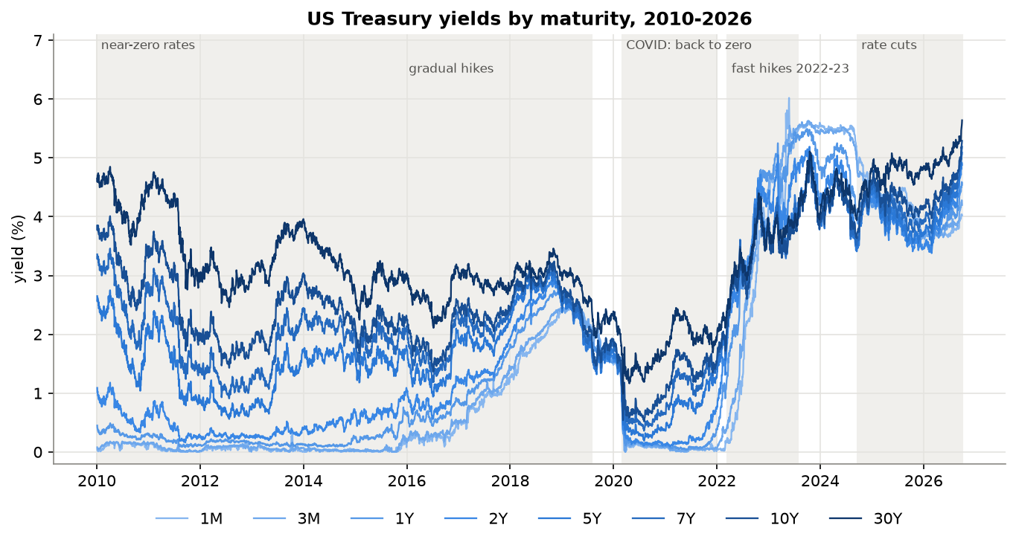
16 years of very different rate regimes
6.02%
1M yield peak, May 2023 debt-ceiling standoff
5.64%
30Y yield in Sep 2026, highest in the data
0.52%
10Y low in Aug 2020 (COVID)
Notes:
Zero rates until 2015, gradual hikes until 2019, COVID in 2020, then the fastest hikes in decades in 2022 and 2023. The 1-month yield jumped to 6.02% in May 2023 during the debt-ceiling standoff. Since late 2024 rates were cut, but long yields kept rising and the 30-year reached 5.64% in September 2026, the highest in the data.

Slide 7
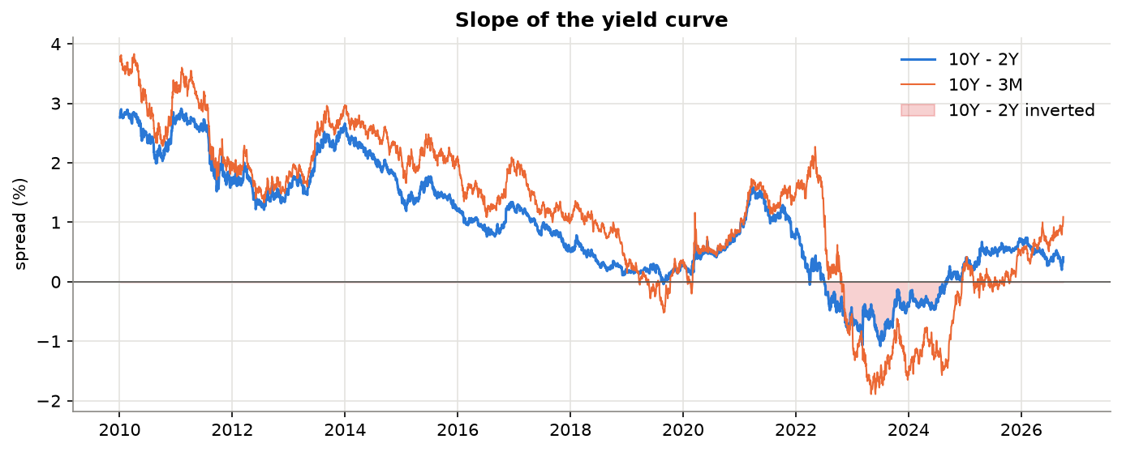
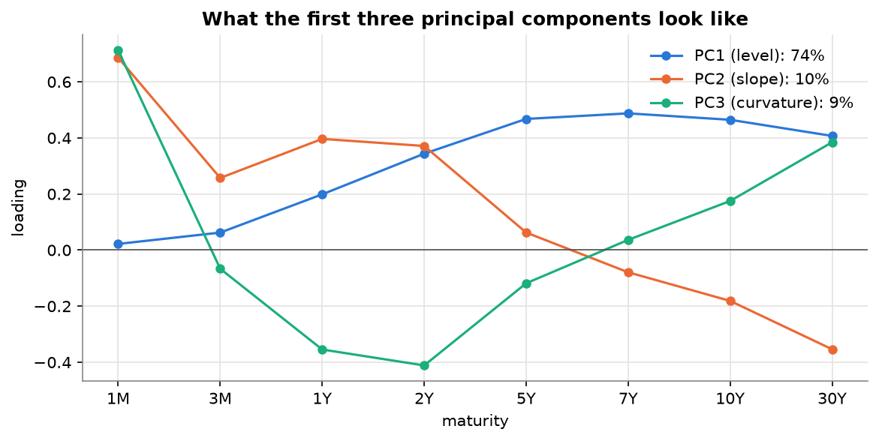
Inversion and the three factors of the curve
537 days
93%
10Y-2Y inverted, Jul 2022 to Aug 2024
of daily movement explained by level, slope and curvature
Notes:
Left: the 10Y-2Y spread was negative for 537 trading days, from July 2022 to August 2024, the longest inversion in the data. Right: PCA on daily changes shows that three factors, level, slope and curvature, explain 93 percent of all movement of the 8 yields, which matches Litterman and Scheinkman 1991. So the 8 yield features are largely redundant.

Slide 8
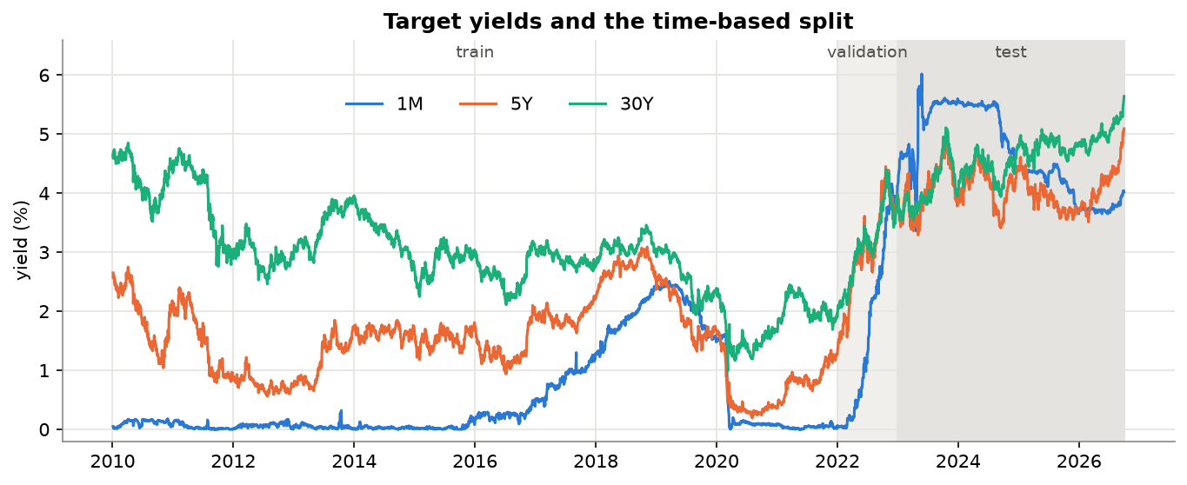
Key insight: predict the change, not the level
100%
of test days with the 1M yield above its training maximum
26%
for the 30Y yield
Levels are non-stationary (ADF p ≈ 0.8-0.9); weekly changes are stationary (p ≈ 0)
Copying today's yield already gives R² ≈ 0.84-0.96, so R² on levels is misleading
Benchmark every model against the naive "no change" forecast
Notes:
This is the most important slide. Yield levels are not stationary: ADF p-values around 0.8 to 0.9, and next week's yield is almost today's yield. Worse, every test day for the 1M and 5Y yields is above the highest value seen in training. Decision trees cannot predict above the training maximum. Weekly changes are stationary and stay in the same range in every period, so we also predict the change.

Slide 9
Three experiments for every model
A
Level
B
Change
C
Change, no levels
Target
Predict the yield 5 days ahead
Inputs
All 23 features (as in the case study)
Target
Predict the 5-day change, add it to today's yield
Inputs
All 23 features
Target
Predict the 5-day change
Inputs
15 features: spreads, changes, debt ratios, market data (no raw yields)
Every experiment is scored on the rebuilt yield level, so A, B and C can be compared directly.
Notes:
Experiment A copies the original case study. B changes only the target. C also removes the 8 raw yield levels from the inputs, because the inputs are just as non-stationary as the target. We checked on the validation year, not the test set, that this choice of inputs makes sense.

Slide 10
Seven models
Model | How it works | Tuning
Naive | today's yield = next week's yield | -
Linear regression | least squares on standardised features | -
XGBoost | boosted trees, one model per target, early stopping | 12 combinations
Keras | MLP, Adam, MSE loss, dropout, early stopping | 6 architectures
PyTorch + fastai | tabular_learner, Normalize, lr_find, fit_one_cycle | 8 settings
PyTorch + TabNet | sequential attention with sparse feature masks | 4 settings
PyTorch + Lightning Flash | TabularRegressor, MLP backbone, one model per target | 4 settings
Neural networks: 3 random seeds each, results averaged
Notes:
Two baselines and the five frameworks. XGBoost and Flash train one model per target; Keras, fastai and TabNet predict all three targets with one network. Each framework got a similar small tuning budget, chosen on the 2022 validation set, and early stopping where the framework supports it.

Slide 11
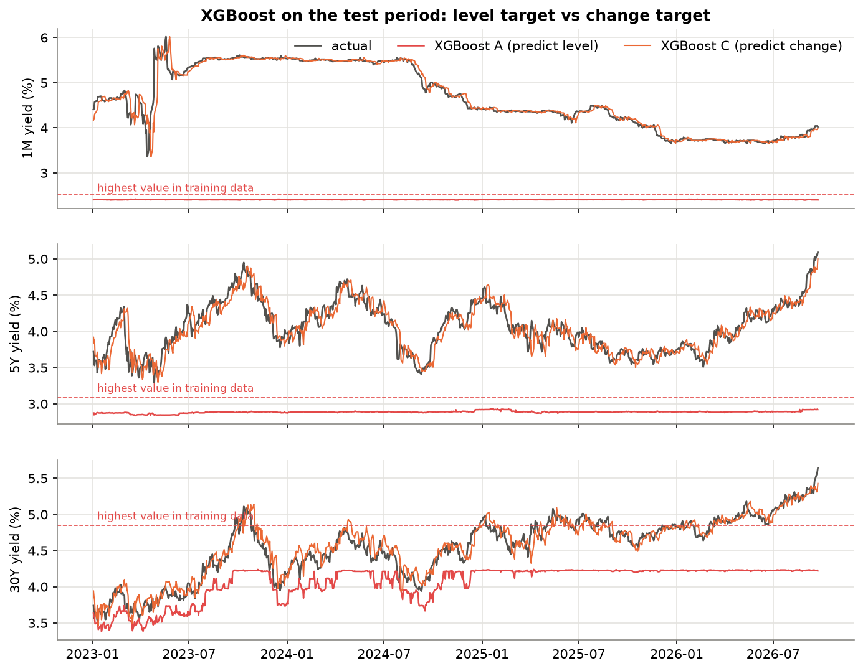
Experiment A: trees cannot extrapolate
137 bp
XGBoost average error when predicting the level (A)
13.8 bp
XGBoost average error when predicting the change (C)
Lesson: the target choice matters more than the framework
Notes:
When XGBoost predicts the level, its forecasts can never go above the highest value it saw in training, the dashed line. It predicted about 2.4 percent for the 1-month yield while the real yield was 3.4 to 6 percent. Average error 137 basis points. The neural networks can go above the line, but they also failed. Experiment C follows the real yield because it predicts only the small weekly change.

Slide 12
Main result: no model beats the naive forecast
13.2 bp
average error of the naive "no change" forecast
13.5 - 14.9 bp
average error of all models (experiment C)
Simpler models come closest to naive
Direction accuracy only 47-57%
R² on levels 0.82-0.96 for every model, even naive
Notes:
This chart shows skill against the naive forecast in experiment C, averaged over the three targets. Zero means as good as naive, negative means worse. Every model is slightly worse. Linear regression and XGBoost come closest, the four neural networks are a bit worse. Average errors are between 13.2 and 14.9 basis points, within about 1.7 basis points of naive.

Slide 13
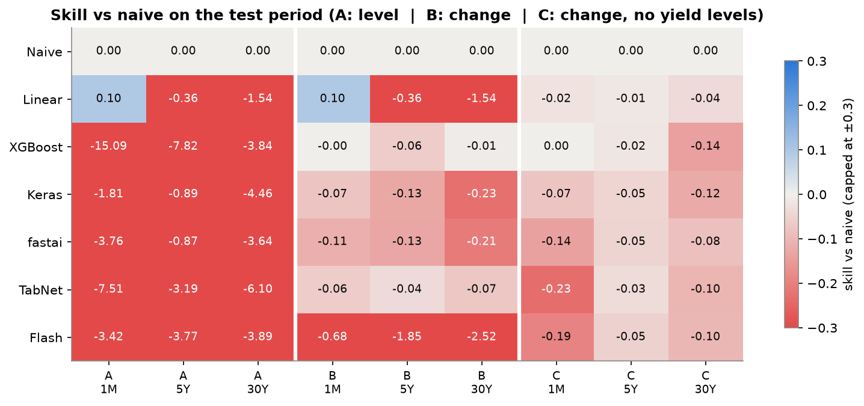
All experiments at a glance
Going from A to C cuts the error of every learned model by 1.5 to 10 times
Notes:
Red means worse than naive, blue better. Experiment A on the left is red for every learned model. In B, XGBoost and TabNet get close to naive but Flash fails. C is the most consistent experiment, all models between minus 0.23 and 0. For linear regression A and B are identical because today's yields are inputs, so the two targets are the same least-squares problem.

Slide 14
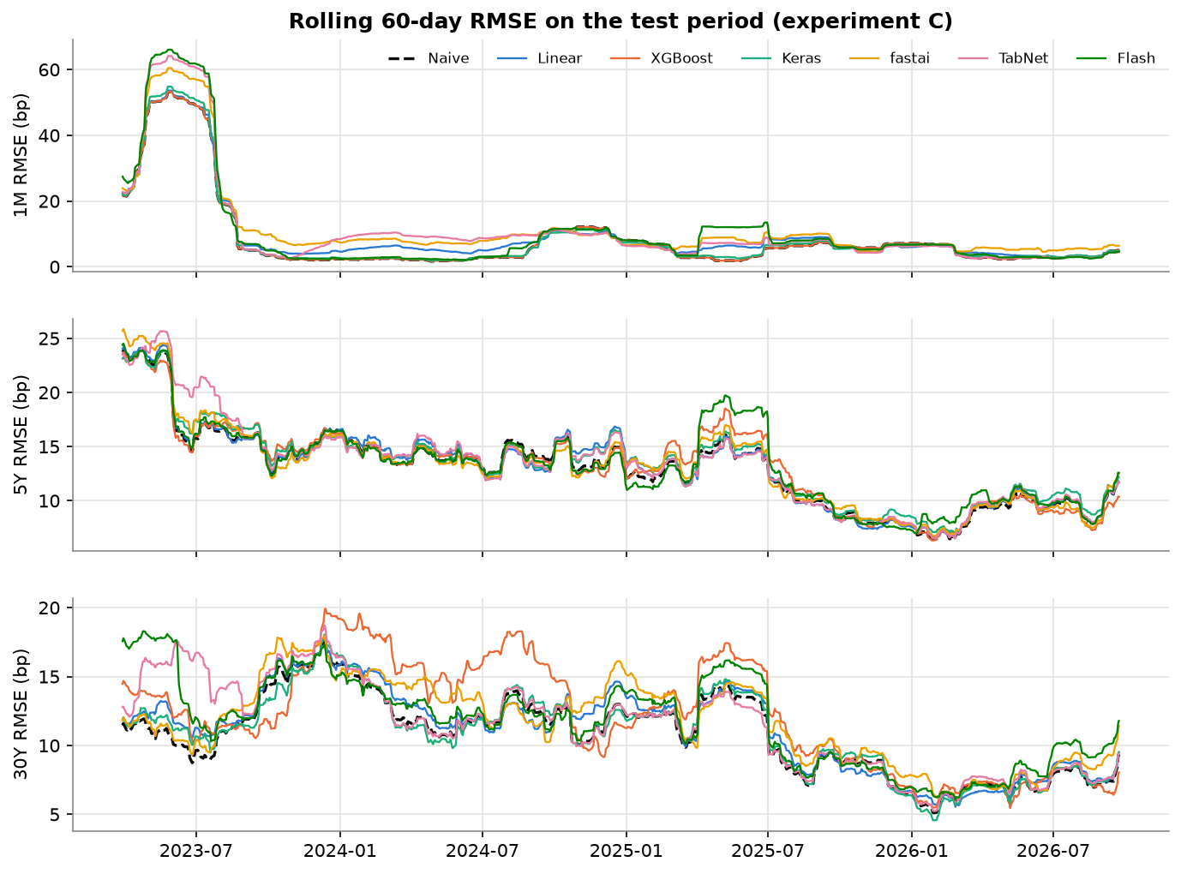
Are the differences real?
0 / 18
model-target pairs significantly better than naive (Diebold-Mariano, 5%)
8 / 18
significantly worse, mostly the 30Y
Matches research: a random walk is very hard to beat at short horizons (Diebold & Li, 2006)
Notes:
The Diebold-Mariano test compares the errors of each model with the naive forecast, corrected for the overlapping 5-day forecasts. None of the 18 model and target pairs is significantly better than naive, and 8 are significantly worse, mostly the 30-year yield. The rolling error shows that spring 2023 was hardest for every model: the Silicon Valley Bank collapse in March and the debt-ceiling standoff in May.

Slide 15
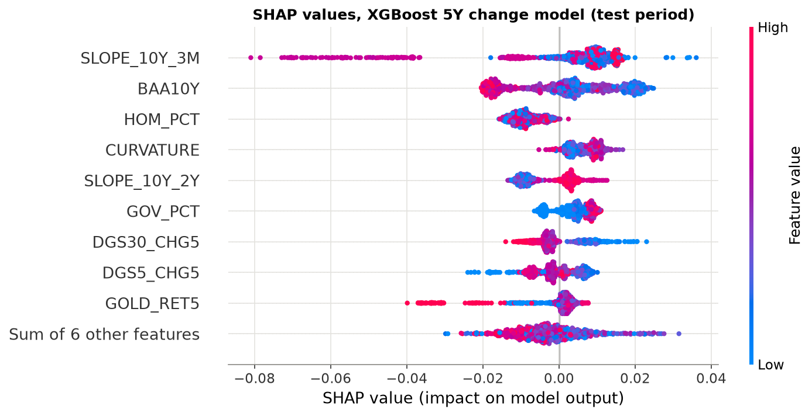
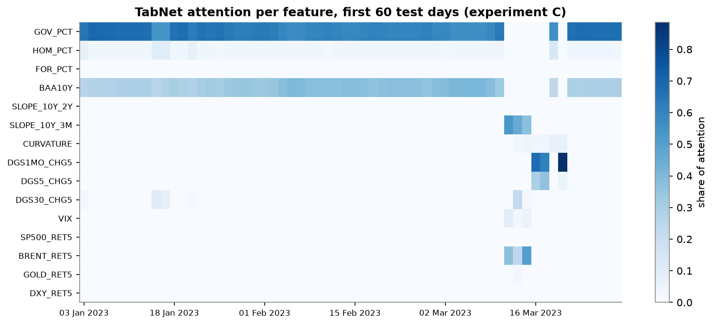
Explaining the models
TabNet masks: attention shifts during the March 2023 bank stress
XGBoost + SHAP: wide credit spread → lower forecast
Most used input: 10Y-3M slope (top 5 in 5 of 6 models)
Notes:
Left: SHAP values for the XGBoost 5-year model. A wide credit spread pushes the forecast down, which makes economic sense: in stress, investors buy government bonds. Right: TabNet's attention masks. For most days it looks at slow features, but in mid-March 2023, when Silicon Valley Bank collapsed, it switched to the curve slope and recent momentum. The 10Y-3M slope is a top-5 feature for 5 of the 6 models.

Slide 16
Simplicity, transparency and efficacy
Framework | Simplicity | Transparency | Efficacy | Overall
XGBoost | 4.0 | 5.0 | 5.0 | 4.67
TabNet | 2.4 | 3.5 | 2.5 | 2.79
Keras | 3.0 | 1.0 | 3.5 | 2.50
fastai | 3.4 | 1.0 | 2.0 | 2.13
Flash | 2.3 | 1.0 | 2.0 | 1.75
Why XGBoost wins
5 lines of code, under 1 s to train
Gain importance and exact SHAP values
Same result on every run
Best results of the five frameworks
Why Flash is last
Scores from 1 (worst) to 5 (best), based on measured values (lines of code, hyperparameters, training time, setup effort, explanation features, skill and direction accuracy)
Archived in 2023: separate Python 3.10 environment
In-place data bug gave wrong forecasts
Notes:
Simplicity uses lines of code, number of hyperparameters, training time and setup effort. Transparency is a checklist: built-in importance, explanation of a single prediction, inspectable model, same result every run. Efficacy uses skill and direction accuracy in experiment C. XGBoost wins all three. Flash is last because it is archived and needed a separate environment and fixes.

Slide 17
Problems we solved
1
Lightning Flash bug
Flash normalises the DataFrame you pass it in place; reused data was normalised repeatedly and forecasts exploded. Fixed by passing .copy().
2
Archived library
Flash needs pytorch-lightning < 2.0: separate Python 3.10 environment, setuptools < 81, and the missing 'requests' dependency added.
3
PyTorch freezing
XGBoost and PyTorch both ship OpenMP on macOS and PyTorch hung at 0% CPU. Fixed by running each framework in its own notebook.
4
Missing data on Yahoo
No 1M yield or debt data on Yahoo Finance, so FRED was used and the two sources were cross-checked.
Notes:
These are real problems from the project. The Flash one is the most interesting. The first Flash results had errors of hundreds of percentage points, and only for some seeds. Comparing seeds showed that Flash's normalisation statistics changed between runs on the same data. Reading Flash's source code showed it normalises the DataFrame passed to it in place, so reused data was normalised again and again. Passing a copy fixed it. Because Flash is archived, this bug will never be fixed upstream.

Slide 18
Conclusion
1. The target matters more than the framework: predicting levels fails, predicting changes works.
2. No model beats the naive "no change" forecast; one-week yield moves are close to unpredictable.
3. Simpler is better here: linear regression and XGBoost come closest to naive.
4. XGBoost ranks first on simplicity, transparency and efficacy; Lightning Flash last.
Notes:
Four takeaways. First, the choice of target matters more than the framework. Second, nothing beats the naive forecast, which is what efficient-market theory and earlier research suggest. Third, simpler models are closer to naive and more stable. Fourth, XGBoost is the best framework overall for this problem.

Slide 19
Limitations and future work
Limitations
Future work
One horizon (1 week) and one train / test split
Models trained once on 2010-2021, never updated
Publication lag of debt data approximated
Small tuning budget, CPU only
No inflation or Fed funds futures data
Longer horizons (1-3 months)
Forecast Nelson-Siegel level, slope and curvature factors
Walk-forward retraining as new data arrives
Add Fed funds futures and inflation data
Notes:
The main limitations: only one horizon and one split, models never retrained after 2021, publication lag approximated, small tuning budget, and no inflation or Fed funds futures data. Future work: longer horizons, Nelson-Siegel factors, walk-forward retraining and market expectations of the policy rate.

Slide 20
Thank you. Questions?
Code, notebooks, data and report: github.com/ASHWINANAND19/yield-curve-prediction
Notes:
Open the GitHub repository if asked. Be ready to run a notebook, change one hyperparameter and explain the result.

