Slide 1
MA336 -07-SP:Artificial intelligence and machine learning with applications Final project -Determining the factors affecting the flight delay
Registered ID : 2310158

Slide 2
Problem
To find the factors influencing the flight delay with given dataset.

Slide 3
Dataset
Source: https://www.kaggle.com/datasets/sriharshaeedala/airline-delay/data
Moderate dataset
171666 rows and 21 columns
Contains numerical and non numeric values

Slide 4
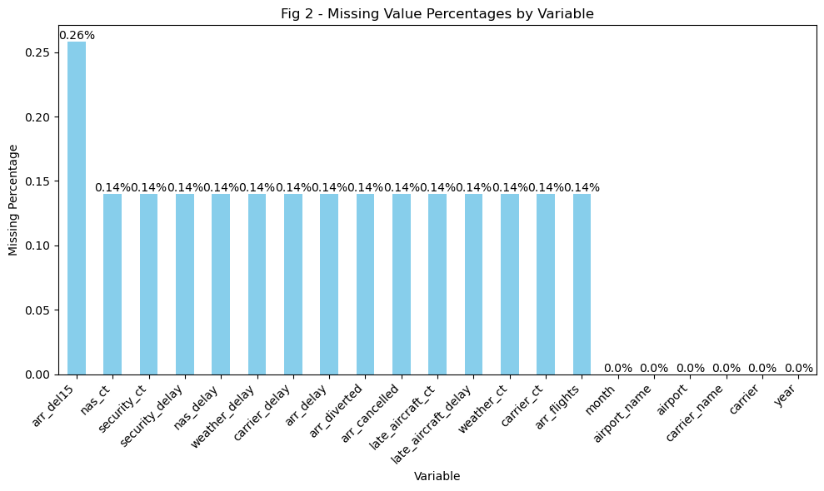
Data preprocessing –Missing values- KNN imputation

Slide 5
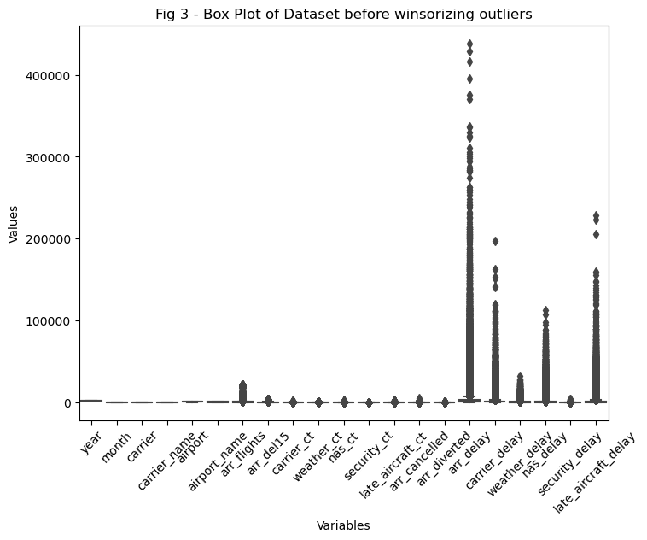
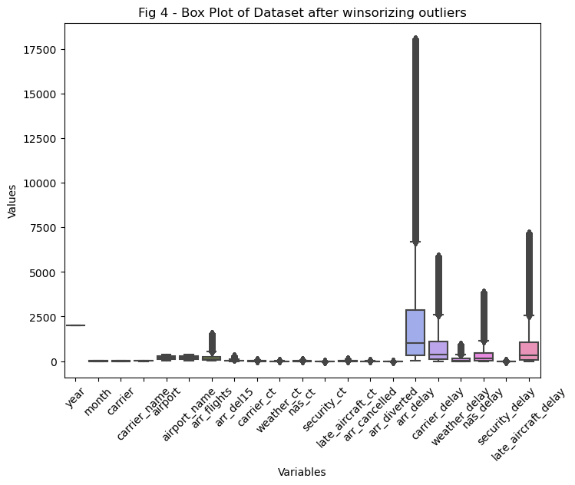
Handling outliers – Winsorizer technique

Slide 6
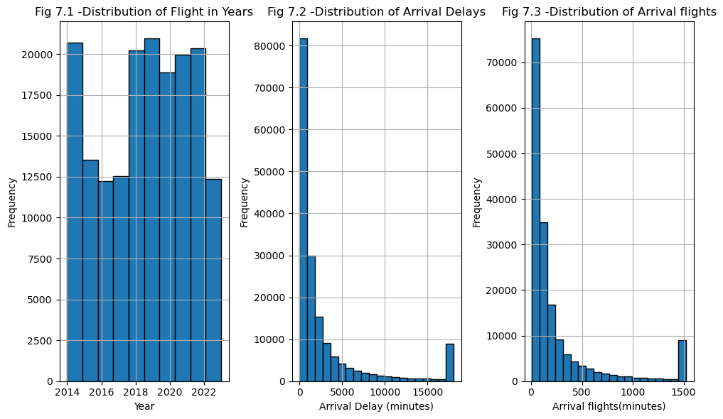
EDA

Slide 7
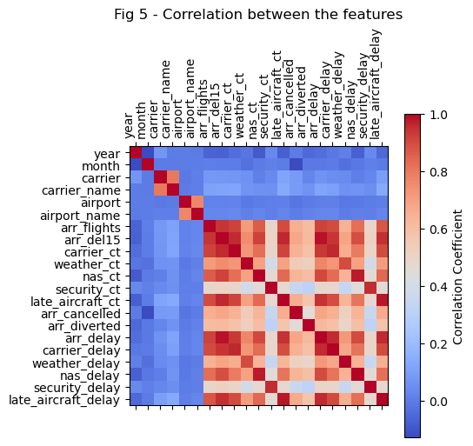
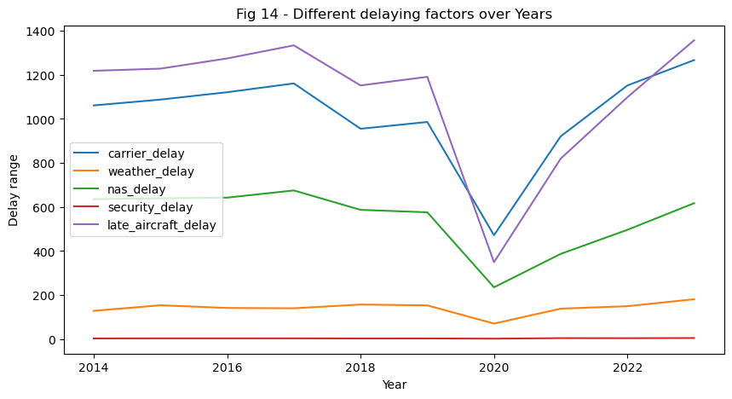
EDA

Slide 8
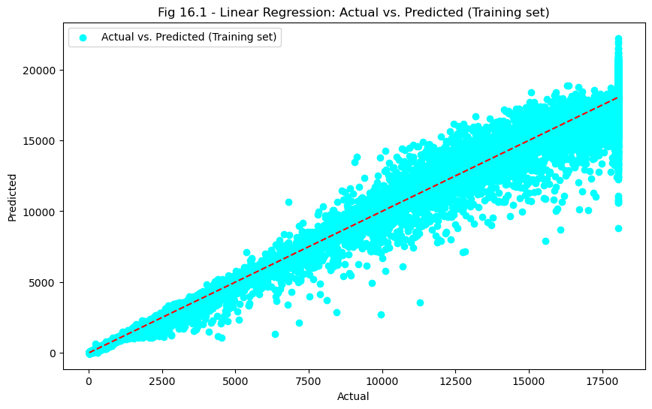
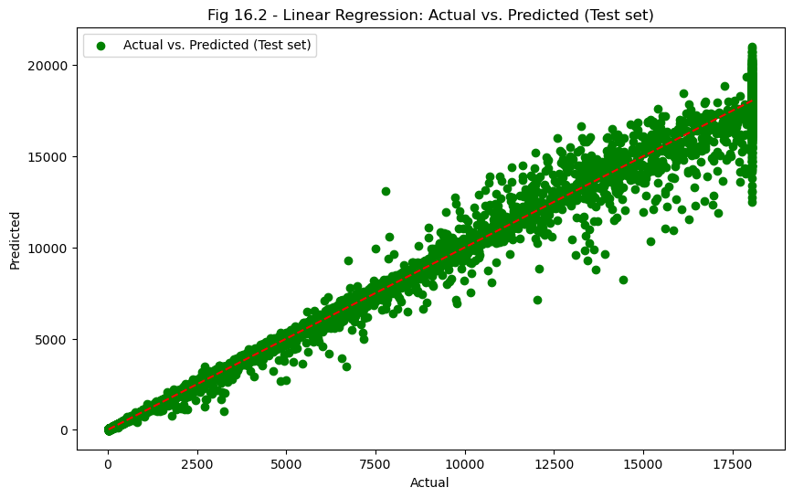
Regression model

Slide 9
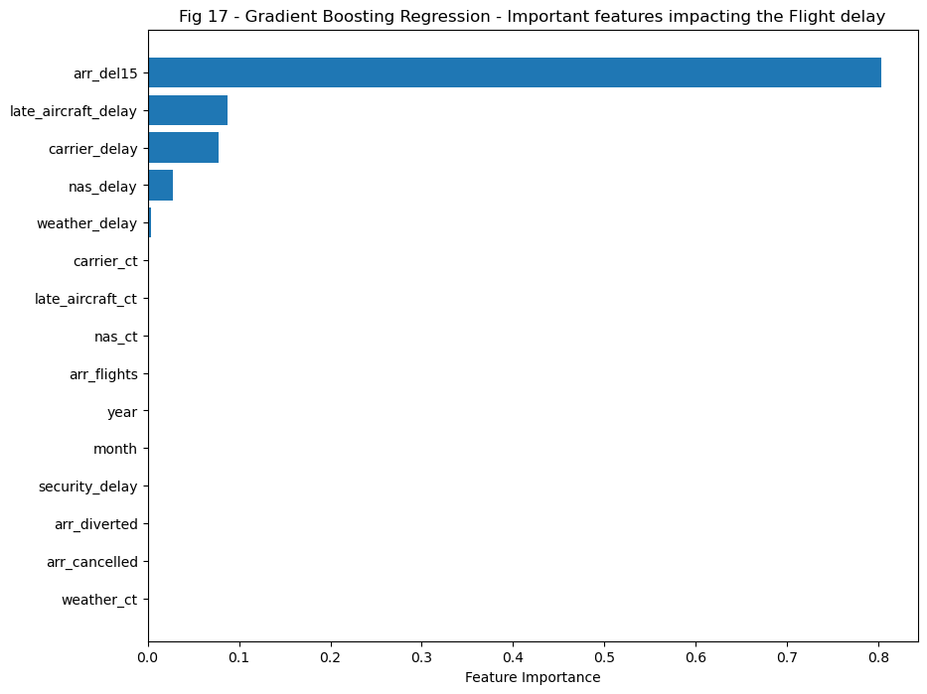
GBR(Gradient Boosting Regression)

Slide 10
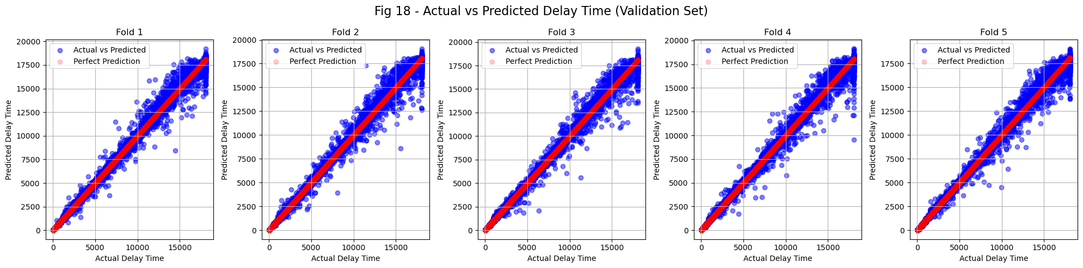
Light GBM(Light Gradient Boosting Machine)

Slide 11
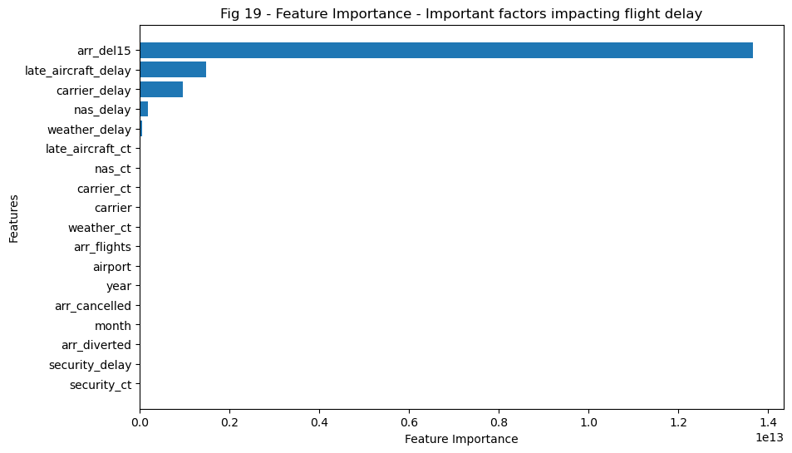
Conclusion

