Slide 1
Institute analysis Using pandas
Comprehensive Data Analytics project examining institute feedback and performance metrics across multiple dimension
Team members:-1)E.Ashwith 2)B.sai teja
3)Anudeep
guided by:-Devendra kumaran (data analysis trainer)

Slide 2
Project Overview
•This project focuses on analyzing student data from our institute.
• Collected feedback using Google Forms
• Total 227 student records analyzed
• Used Pandas and Power BI for analysis and visualization
• This analysis helps identify strengths and areas that need improvement
• The project supports data-driven decision making for the institute

Slide 3





Tools and Technologies Used
• Google Forms – Data collection
• Excel – Data storage
• Pandas – Data cleaning and processing
• Power BI – Data visualization
• Google Colab – Running Python code

Slide 4
Data Collection
• Created Google Form and shared with students
• Collected feedback on courses, trainers, fees, placements
• Data automatically stored in Excel
• The dataset contains both categorical and numerical data
• Used this data for further analysis

Slide 5
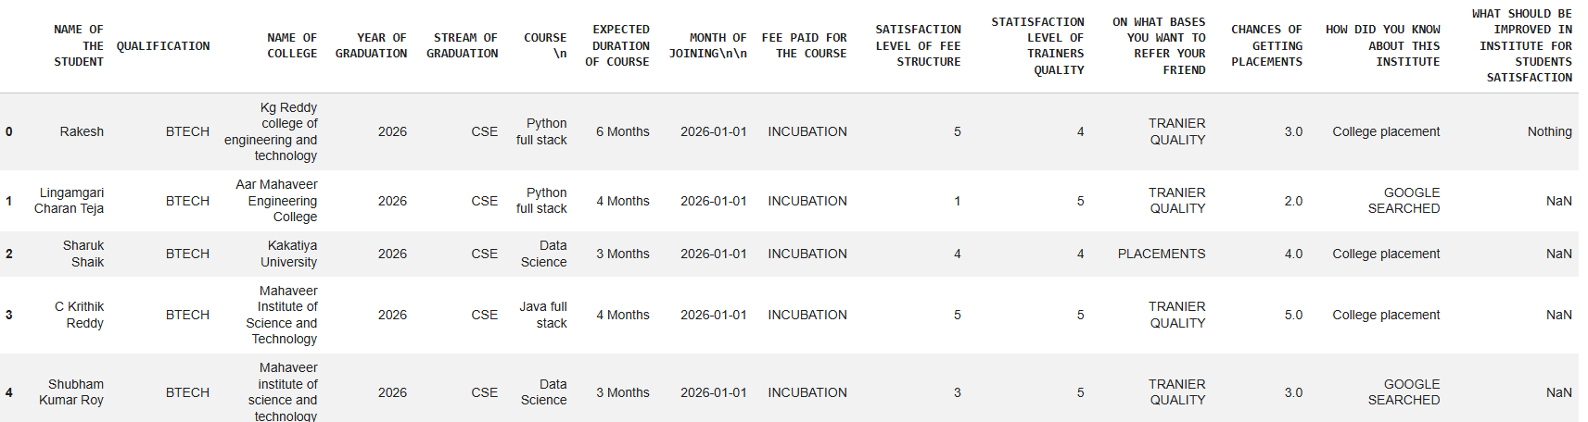
Data cleaning
• Cleaned the dataset using Pandas library
• Converted course names to lowercase for consistency
Fixed spelling differences in course names
• Handled missing values using mode (most frequent value)
• Removed incorrect and duplicate data
Ensured all columns have proper data types

Slide 6
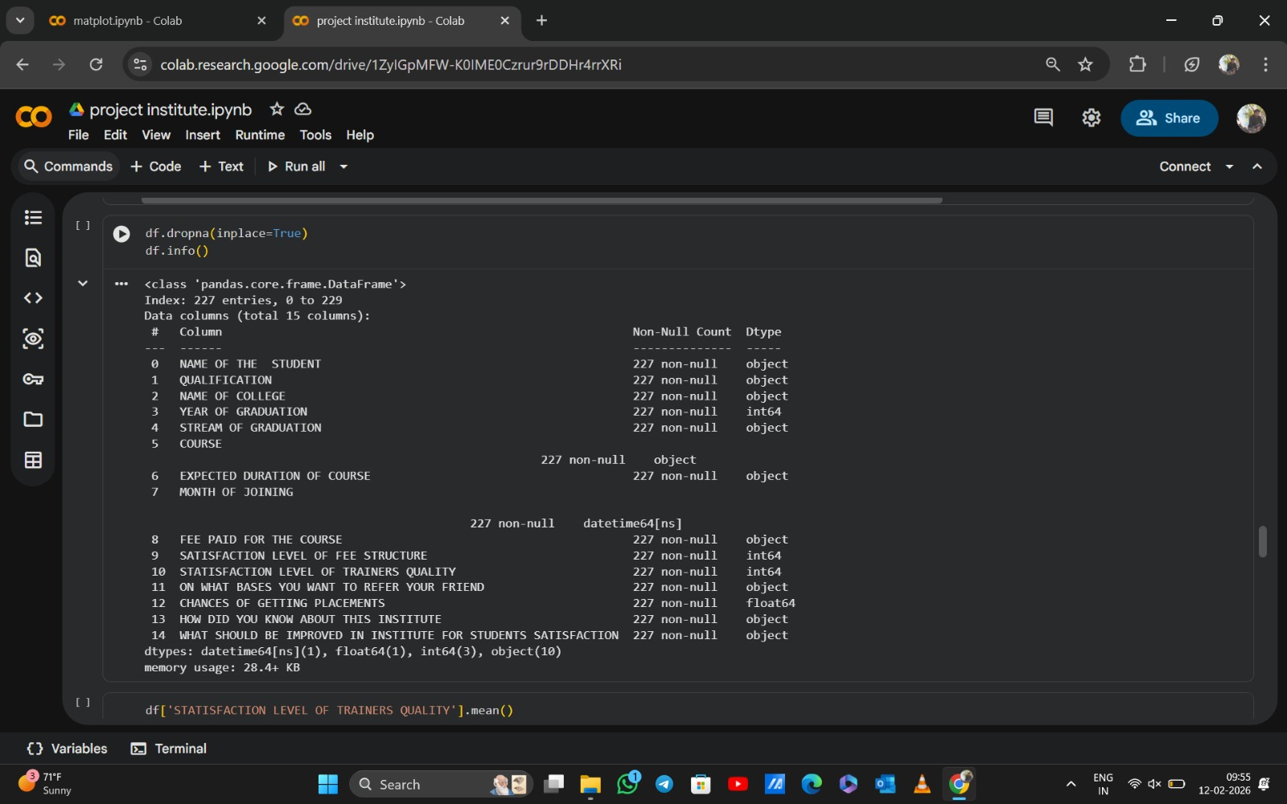

Slide 7
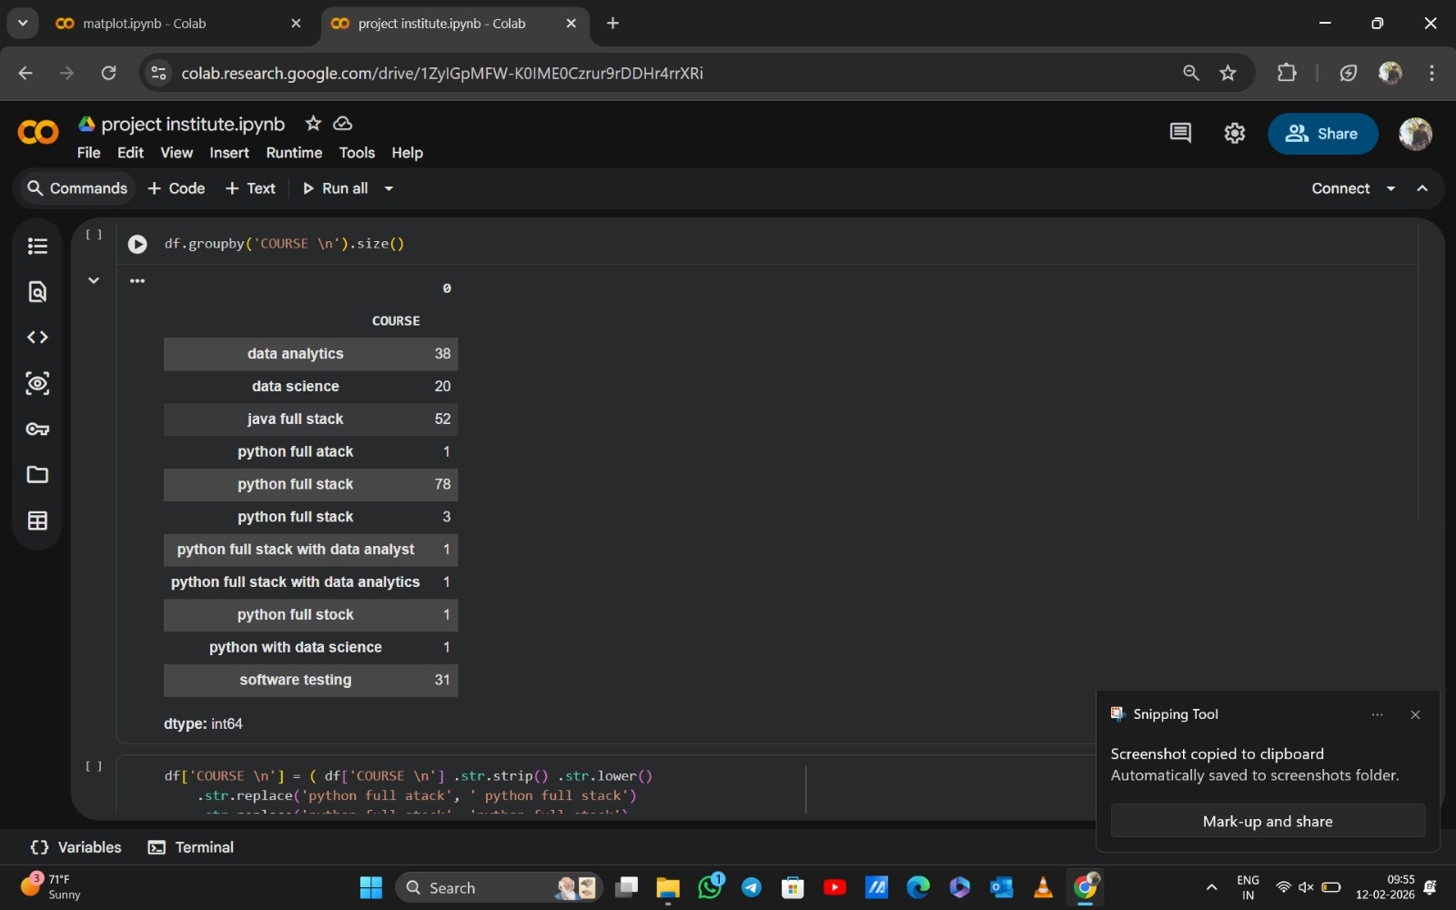

Slide 8
Statistical Analysis
• Trainer satisfaction average is 4.39, which is the highest among all metrics
• Fee structure satisfaction average is 4.07, showing students are satisfied with fees
• Placement confidence average is 3.65, which indicates placement support needs improvement
• Most students enrolled in Python Full Stack course (83 students)
• Majority of students joined through college placements (117 students) and friend referrals (76 students)
• Most students prefer course duration of 3 to 6 months
• Majority of students belong to BTECH and CSE background
• Most students are part of the incubation program
• Trainer quality is the main reason students refer the institute

Slide 9
Power BI Dashboard
• Imported cleaned data into Power BI for visualization
• Created interactive dashboard to analyze student data
• Used bar charts to show course enrollment and student count
• Used pie charts to show fee distribution and student categories
• Used KPI cards to display average satisfaction levels and placement confidence
• Used slicers to filter data based on course and fee structure
• Slicer helps users view specific data based on selection
• Dashboard makes data easy to understand through visual representation
• Helps identify trends, patterns, and key insights
• Supports better decision making for institute improvement

Slide 10
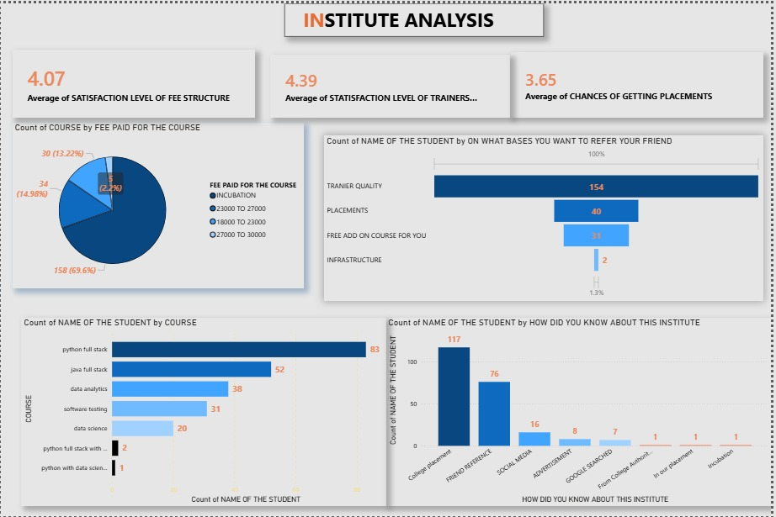

Slide 11
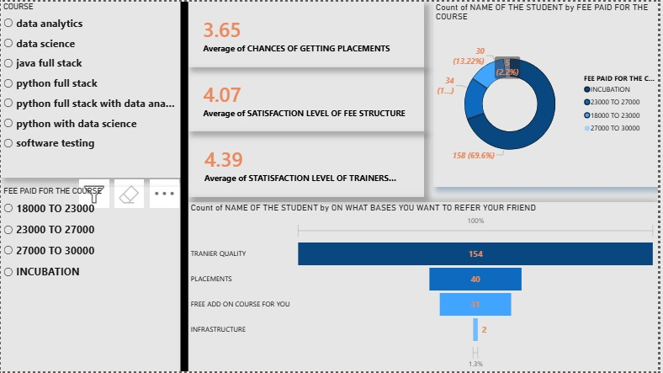

Slide 12
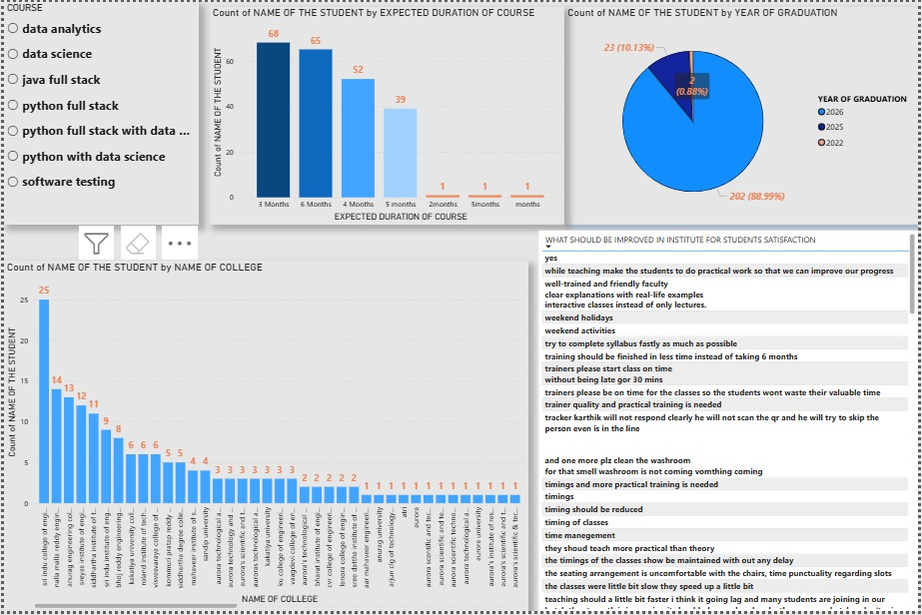

Slide 13
Key Insights
• Trainer quality is the biggest strength of the institute • Python Full Stack is the most popular course • College placements and referrals drive most enrollments • Fee satisfaction is good • Placement confidence needs improvement

Slide 14
Improvements Needed
• Improve placement support and provide more job opportunities
• Conduct placement preparation sessions like mock interviews and resume building
• Increase social media marketing to reach more students
• Provide more practical training and real-time project experience
• Improve class timing and maintain proper schedule
• Complete courses within the expected duration
• Provide more interactive and hands-on learning sessions

Slide 15
conclusion
From our analysis, we found that trainer quality is the biggest strength of the institute, and most students are satisfied with trainers. Python Full Stack is the most popular course among students.
However, placement confidence is slightly lower, so the institute can improve placement support.
Overall, this project helps the institute understand student feedback and make better decisions to improve student satisfaction and institute performance.

Slide 16
THANKYOU

