Slide 1
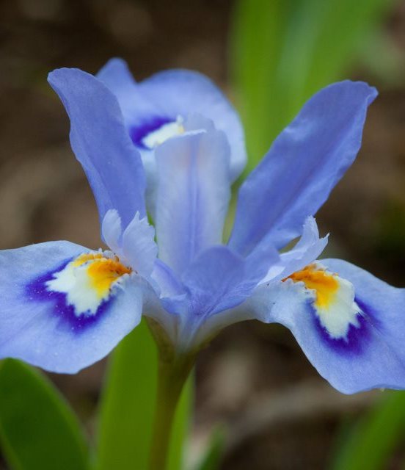

Author ASIF IQBAL KHAN
The Sparks Foundation
GRIP – GRIPJAN2022
Notes:
Line spacing + Page numbers

Slide 2
Agenda
01 Introduction
02 Data Science Process
03 Project Explanation
04 What’s Next
05 Conclusion

Slide 3

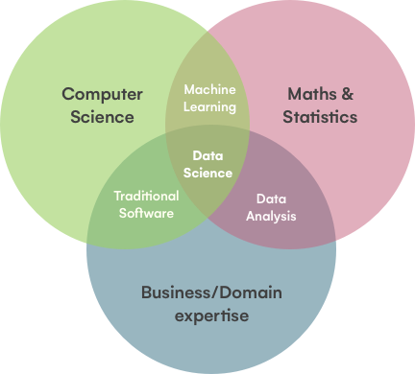
Introduction
01
Data science in simple words can be defined as an interdisciplinary field of study that uses data for various research and reporting purposes to derive insights and meaning out of that data. Data science requires a mix of different skills including statistics, business acumen, computer science, and more

Slide 4
Steps involved in any Data Science Project.
02

Slide 5
Data Science Process
1
Frame the problem
Collect the raw data needed for your problem
3
Process the data for analysis
Explore the data
5
Perform in-depth analysis
Communicate the results of the analysis

Slide 6
Project Explanation
03

Slide 7
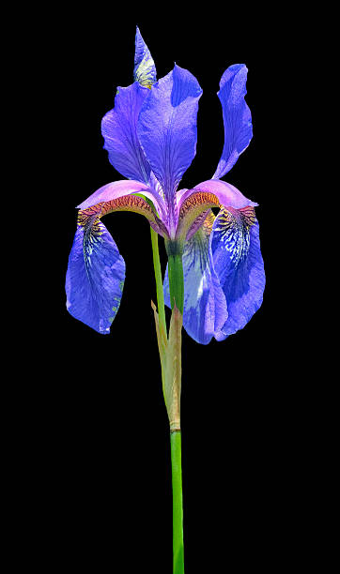
PROBLEM STATEMENT This data set consists of the physical parameters of three species of flower — Versicolor, Setosa and Virginica. The numeric parameters which the dataset contains are Sepal width, Sepal length, Petal width and Petal length. In this data we will be predicting the classes of the flowers based on these parameters. The data consists of continuous numeric values which describe the dimensions of the respective features. We will be training the model based on these features.
About this project -

Slide 8
Viewing the Data
 | Id | SepalLengthCm | SepalWidthCm | PetalLengthCm | PetalWidthCm | Species
0 | 1 | 5.1 | 3.5 | 1.4 | 0.2 | Iris-setosa
1 | 2 | 4.9 | 3.0 | 1.4 | 0.2 | Iris-setosa
2 | 3 | 4.7 | 3.2 | 1.3 | 0.2 | Iris-setosa
3 | 4 | 4.6 | 3.1 | 1.5 | 0.2 | Iris-setosa
4 | 5 | 5.0 | 3.6 | 1.4 | 0.2 | Iris-setosa

Slide 9
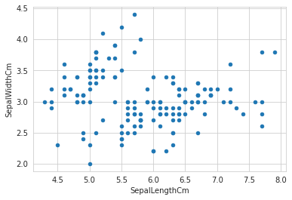
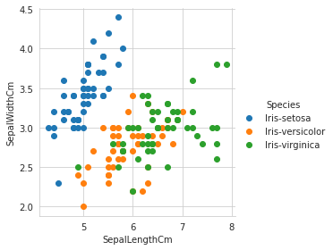
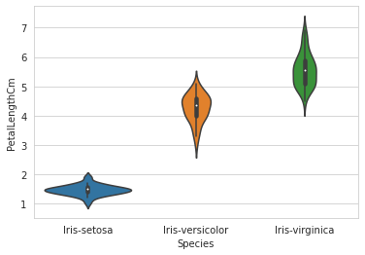
Analyzing the data Visually
Jun
2-D Scatter Plot
Scatter Plot Colored by Species
Violine plot

Slide 10
What’s next
04

Slide 11

Building ML model
Dividing the data for training and testing
Once we have understood what the dataset is about, we can start training a model based on the algorithms. Here, we will be implementing some of the commonly used algorithms in machine learning. Let us start by training our model with some of the samples. We will be using an inbuilt library called ‘train_test_split’ which divides our data set into a ratio of 80:20.

Slide 12
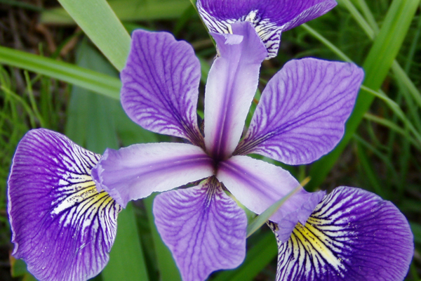
Goal:
Predicting accuracy of every algorithm used
Building a model
Finding the model that gives best result.

Slide 13
Training the model
1. Logical Regression
2. K-Nearest Neighbour (KNN)
3.Decision Trees

Slide 14
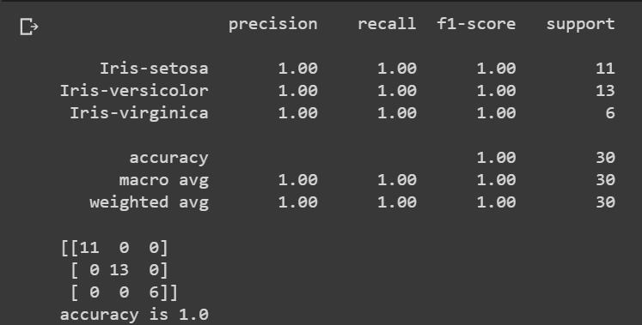
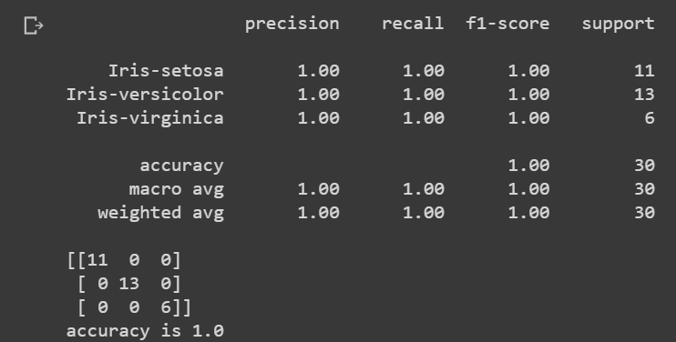
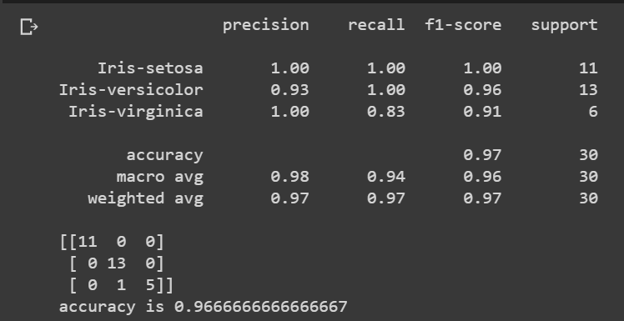
Logical Regression
K-Mean Neighbour
Decision Tree

Slide 15
Conclusion
We can use the logical regression and KNN algorithm to better predict the class of the flower based on the parameters.
Decision Tree algorithm would not be the right fit for this dataset.
Visual analysis helps to understand the data and helps in choosing the right model for our use.

