Slide 1

AEROPREDICT
TEAM EXPLANATION AND VIVA
AeroPredict: team explanation
The explanation every teammate should know
An offline Random Forest study uses the existing dataset.
The 3D website explains scenario conditions and flight journeys.
Speaking notes contain file references, worked answers and implementation details.
01 / 12
Notes:
60-second answer to learn: AeroPredict contains an educational 3D flight website and an offline machine-learning experiment. We kept all 6000 synthetic rows and the ten original features. Python fits a Random Forest classifier for delays of at least 15 minutes and a regressor for minutes. We selected parameters on validation and evaluated on 900 unseen synthetic records. The current Node website still uses separate rules in Simulation and Aviationstack schedules in Live. Blender creates 3D assets and Three.js renders them. Route camera controls change only the viewpoint. We should explain this boundary whenever asked how ML is used.
SOURCES
C:/Users/24u11/Documents/Codex/2026-10-18/th/outputs/AeroPredict_RandomForest_Study/train_evaluate.py
C:/Users/24u11/Documents/Codex/2026-10-18/th/outputs/AeroPredict_RandomForest_Study/metrics.json
C:/Users/24u11/Documents/Codex/2026-10-18/th/outputs/AeroPredict_Local_Presentation/training-data/metadata.json
C:/Users/24u11/Documents/Codex/2026-10-18/th/outputs/AeroPredict_Local_Presentation/README.md
DESIGN ASSET
Illustrative aviation cover background generated with the built-in image tool. It is not a website screenshot or a real flight photo.

Slide 2
AEROPREDICT
TEAM EXPLANATION AND VIVA
Project components and code map
File or location
Explain this role
RF study / train_evaluate.py
Read exact features, train models, evaluate and save outputs
random_forest_*.joblib
Fitted preprocessing and classifier/regressor pipelines
server.mjs and server/
Local website, private key, cache and provider records
engine.mjs and journey.mjs
Current website rules and user interaction
globe.mjs and airport-scene.mjs
Route cameras, playback and Blender model display
02 / 12
Notes:
Explain how we built it: Python and scikit-learn implement the approved separate study, pandas reads CSVs, ColumnTransformer encodes inputs and joblib saves models. Node.js implements the web server and protects private settings. Browser ES modules connect forms and rendering. Blender Python scripts construct assets, and GLB exports run in Three.js. The current website does not call the saved RF model. Do not open .env on the projector. The training file contains the complete search and evaluation procedure and no provider calls.
SOURCES
C:/Users/24u11/Documents/Codex/2026-10-18/th/outputs/AeroPredict_RandomForest_Study/train_evaluate.py
C:/Users/24u11/Documents/Codex/2026-10-18/th/outputs/AeroPredict_Local_Presentation/CODE_INDEX.md
C:/Users/24u11/Documents/Codex/2026-10-18/th/outputs/AeroPredict_Local_Presentation/server.mjs
C:/Users/24u11/Documents/Codex/2026-10-18/th/outputs/AeroPredict_Local_Presentation/public/simulation/journey.mjs

Slide 3
AEROPREDICT
TEAM EXPLANATION AND VIVA
The exact dataset and features
Categorical features
Numeric features
origin
departure_hour_ist
day_of_week
destination
month
weather
congestion_pct
incoming_delay_minutes
Origin is always HYD.
Its column remains unchanged.
distance_km
scheduled_duration_minutes
6,000 synthetic rows. Original chronological split: 4,200 / 900 / 900.
Labels are delayed_15_plus and departure_delay_minutes. Never put either label into X.
03 / 12
Notes:
The input columns are exactly metadata.features in the current project. They are separate from the old app with its different dataset. We preserve origin even though every row is HYD. The ten raw features are unchanged in all experiments and copies. Categorical encoding changes representation rather than adding a new external feature. Both label columns, IDs, data_source, split and raw date/time strings stay out of X. The outcomes are fictional, so performance reflects synthetic data patterns. Hash checks verify that the original training, validation and test files remain byte-identical.
SOURCES
C:/Users/24u11/Documents/Codex/2026-10-18/th/outputs/AeroPredict_RandomForest_Study/train_evaluate.py
C:/Users/24u11/Documents/Codex/2026-10-18/th/outputs/AeroPredict_RandomForest_Study/metrics.json
C:/Users/24u11/Documents/Codex/2026-10-18/th/outputs/AeroPredict_Local_Presentation/training-data/metadata.json

Slide 4
AEROPREDICT
TEAM EXPLANATION AND VIVA
Preprocessing, training and testing
Step
What to say
4200 training rows
Fit the encoder and each estimator on training data
10 raw input columns
Three categorical and seven numeric features
18 encoded columns
One-hot representation inside the saved pipeline
900 validation rows
Choose tree parameters using F1 or MAE
900 test rows
Final evaluation after choices are fixed
04 / 12
Notes:
Code walkthrough: FEATURES = META[features], then X = df[FEATURES]. ColumnTransformer applies OneHotEncoder to origin, destination and weather and passes through the other seven numeric columns. Fit the preprocessing inside each Pipeline using training rows only. Ten raw columns become 18 encoded numeric columns. Trees do not need StandardScaler here. Validation chooses max_depth and min_samples_leaf. Classification maximizes validation F1, while regression minimizes validation MAE. The script freezes choices before producing test predictions. It does not train on test rows or fit the encoder on all rows. Reloaded saved pipelines reproduce all 900 test predictions.
SOURCES
C:/Users/24u11/Documents/Codex/2026-10-18/th/outputs/AeroPredict_RandomForest_Study/train_evaluate.py
C:/Users/24u11/Documents/Codex/2026-10-18/th/outputs/AeroPredict_RandomForest_Study/metrics.json
C:/Users/24u11/Documents/Codex/2026-10-18/th/outputs/AeroPredict_Local_Presentation/training-data/metadata.json

Slide 5
AEROPREDICT
TEAM EXPLANATION AND VIVA
How our Random Forest combines trees
Clear-scenario regressor
Delay estimate
Tree 1 of 200
5.41 min
Tree 2 of 200
7.87 min
Tree 3 of 200
6.98 min
Mean of all 200 trees
8.12 min
Classifier: average tree probabilities. Regressor: average tree minute estimates.
05 / 12
Notes:
Viva answer: RF is an ensemble of 200 decision trees. Each trains on bootstrap-resampled training rows. Classifier splits consider sqrt(18) candidate features, rounded down to 4 in this setup. The regressor uses all 18 encoded features at splits because max_features=1.0. Both use depth 8 and minimum leaf size 5. The first three actual regression tree estimates for the Clear example are 5.41, 7.87, 6.98 minutes. Those are only 3 of 200 trees. Averaging all 200 returns 8.12 minutes. The first three classifier probabilities are 32.3%, 33.3%, 92.3%. The mean across all 200 is 28.9%, so the chosen class is below 15 minutes. Raw forest probabilities are not guaranteed to be calibrated. A fixed random seed makes the experiment reproducible.
SOURCES
C:/Users/24u11/Documents/Codex/2026-10-18/th/outputs/AeroPredict_RandomForest_Study/train_evaluate.py
C:/Users/24u11/Documents/Codex/2026-10-18/th/outputs/AeroPredict_RandomForest_Study/metrics.json
C:/Users/24u11/Documents/Codex/2026-10-18/th/outputs/AeroPredict_Local_Presentation/training-data/metadata.json
https://scikit-learn.org/stable/modules/generated/sklearn.ensemble.RandomForestClassifier.html
https://scikit-learn.org/stable/modules/generated/sklearn.ensemble.RandomForestRegressor.html

Slide 6
AEROPREDICT
TEAM EXPLANATION AND VIVA
Measured results and example answers
RF test accuracy 81.1% F1 85.5% MAE 9.15 min
Same HYD–BLR inputs | RF experiment | Current website
Clear, traffic 35%, incoming 10 min | 8.1 min | 21 min
Storm, traffic 85%, incoming 45 min | 53.2 min | 66 min
Answer: the trained experiment and website rule formula are separate implementations.
06 / 12
Notes:
Learn the distinction as well as the percentage. Measured RF test accuracy is 81.1%, precision 87.0%, recall 84.1%, F1 85.5% and AUC 0.900. Regression MAE is 9.15 minutes and RMSE is 12.92 minutes. These figures use 900 held-out synthetic records. Confusion matrix rows are actual and columns predicted, ordered below 15 / delayed: [[228,75],[95,502]]. Thus 730 of 900 classifications are correct. The Clear example yields RF 8.1 minutes versus website 21. Storm yields RF 53.2 versus website 66. RF learns relationships in the generated dataset, while the website uses its own chosen formula. The hypothetical examples have no observed outcome and do not provide extra accuracy evidence. Agreement between trees does not guarantee real-world confidence.
SOURCES
C:/Users/24u11/Documents/Codex/2026-10-18/th/outputs/AeroPredict_RandomForest_Study/train_evaluate.py
C:/Users/24u11/Documents/Codex/2026-10-18/th/outputs/AeroPredict_RandomForest_Study/metrics.json
C:/Users/24u11/Documents/Codex/2026-10-18/th/outputs/AeroPredict_Local_Presentation/training-data/metadata.json
C:/Users/24u11/Documents/Codex/2026-10-18/th/outputs/AeroPredict_RandomForest_Study/worked_examples.csv
C:/Users/24u11/Documents/Codex/2026-10-18/th/outputs/AeroPredict_Local_Presentation/public/simulation/engine.mjs

Slide 7
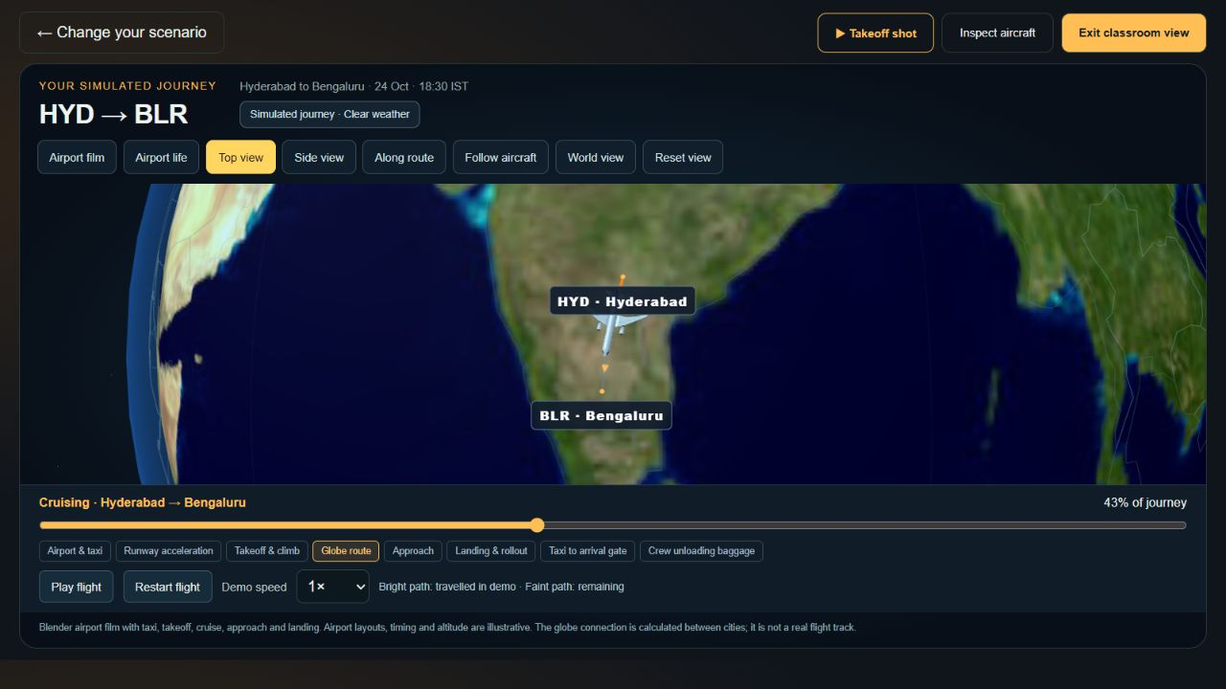
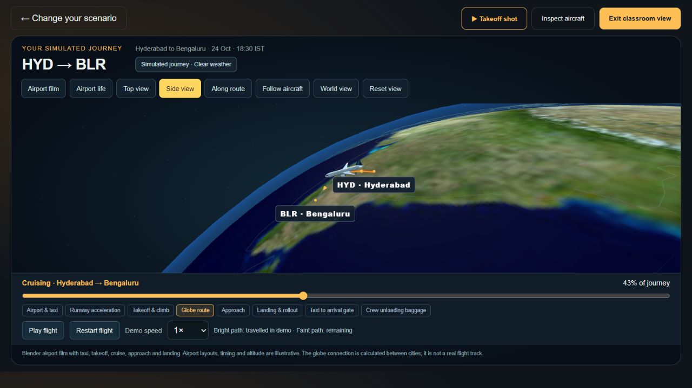
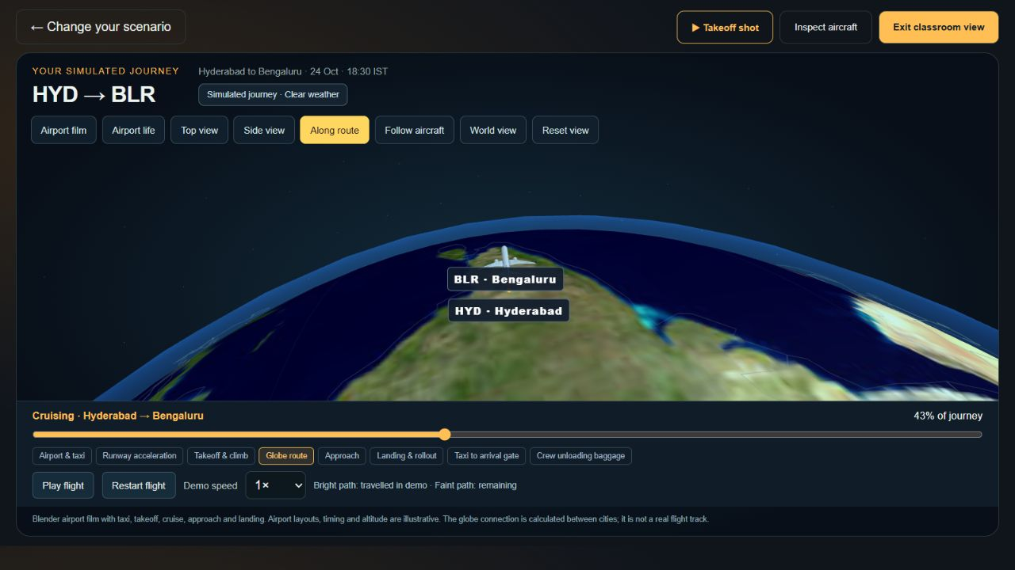
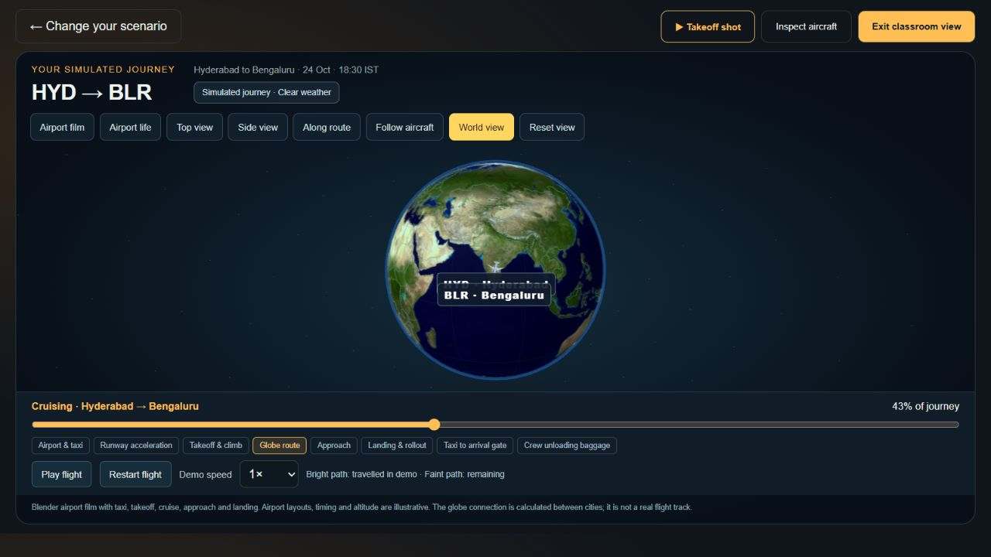
AEROPREDICT
TEAM EXPLANATION AND VIVA
Route, Side View and camera controls
Control
Simple explanation
Top view
Looks down on the route area
Side view
Shows the curve from an oblique side angle
Along route
Turns the camera to look along the airport connection
World view
Fits the entire globe
Follow aircraft
Keeps the camera near the aircraft
Airport coordinates define the route. Camera controls change only how we look at it.
07 / 12
Notes:
Geometry explanation: airport latitude and longitude become unit vectors on the Earth sphere. Spherical linear interpolation finds intermediate points between origin and destination. The displayed curve has 161 samples. A small sinusoidal radial lift improves visibility and does not represent actual altitude. The aircraft follows the curve tangent. Top is near overhead, Side is oblique, and Along route changes azimuth to face along the connection. World fits the Earth. Follow anchors near the aircraft. Drag orbits the camera. Scroll, pinch or the slider changes viewing distance within bounds. Camera easing avoids abrupt jumps. Screen-size caps are 24 pixels in World, 76 in route views and 160 in the aircraft camera. No camera control changes RF predictions or the website estimate.
SOURCES
C:/Users/24u11/Documents/Codex/2026-10-18/th/outputs/AeroPredict_Local_Presentation/public/simulation/route-math.mjs
C:/Users/24u11/Documents/Codex/2026-10-18/th/outputs/AeroPredict_Local_Presentation/public/simulation/globe.mjs

Slide 8
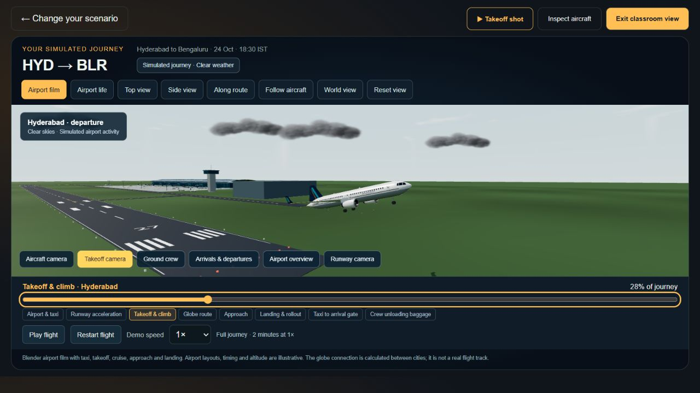
AEROPREDICT
TEAM EXPLANATION AND VIVA
Airport film and Blender models
Blender to browser
Editable .blend scenes export as GLB assets for Three.js.
Shared timeline
120 seconds at 1×. Pause, speed and stage controls use the same clock.
The aircraft animation illustrates the journey. It does not run the ML model.
08 / 12
Notes:
Blender Python scripts construct the plane and airport. Editable .blend files preserve the scenes. GLB exports contain meshes, materials and named nodes. Three.js loads them through GLTFLoader. JavaScript animates transforms and visibility. The shared clock advances progress by elapsedSeconds * speed / 120. Timing in seconds: taxi 0–18, runway 18–30, takeoff 30–40, globe 40–70, approach 70–82, landing 82–92, gate taxi 92–100 and unloading 100–120. Stage buttons jump to a time and pause. Scrubbing recomputes actors deterministically. Four-second blends join airport and globe backgrounds using one foreground plane. Blender does not run on each visitor computer. The layouts and timing are illustrative.
SOURCES
C:/Users/24u11/Documents/Codex/2026-10-18/th/outputs/AeroPredict_Local_Presentation/aircraft/create-aircraft-v2.py
C:/Users/24u11/Documents/Codex/2026-10-18/th/outputs/AeroPredict_Local_Presentation/airport/aeropredict-airport-living.blend
C:/Users/24u11/Documents/Codex/2026-10-18/th/outputs/AeroPredict_Local_Presentation/public/simulation/flight-sequence.mjs
C:/Users/24u11/Documents/Codex/2026-10-18/th/outputs/AeroPredict_Local_Presentation/public/simulation/globe.mjs

Slide 9
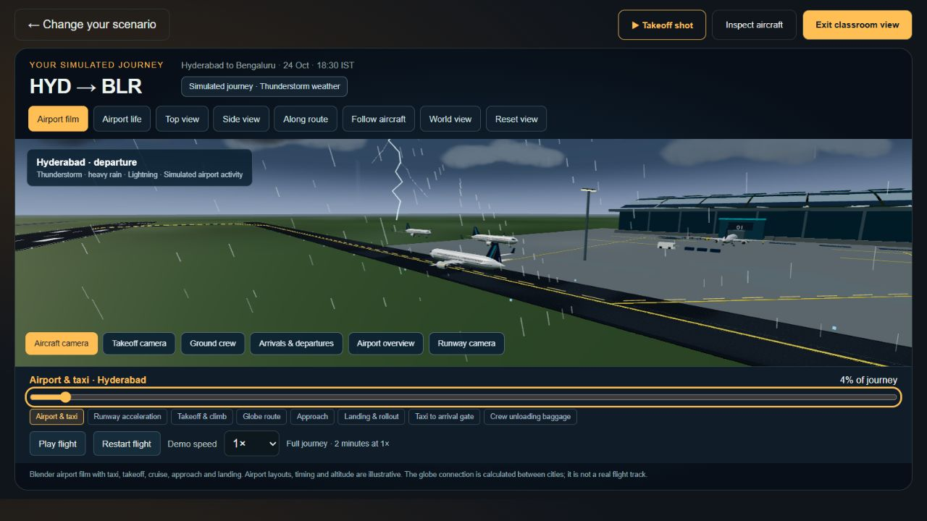
AEROPREDICT
TEAM EXPLANATION AND VIVA
Weather, crew and surface flicker
Scenario weather
Clear, rain, storm and fog alter the display and current rule weight.
Crew and ground surfaces
Arrival workers unload bags. Separating overlapping surfaces reduces flicker.
09 / 12
Notes:
Weather is student-selected rather than a live weather feed. The website rule weights are Clear 0, Rain 1.1, Thunderstorm 2.2 and Fog 1.7. Visual profiles change rain, mist, clouds, lightning and wet surfaces. Blender supplies cloud and branched lightning assets, while JavaScript controls their timing. Storm strikes start around 4 seconds and repeat at 7.5-second intervals. Reduced-motion mode avoids the bright flash. Four arrival crew unload eight bags at the gate during the final 20 seconds. Other ground actors follow choreographed routes. Surface flicker, or z-fighting, came from nearly overlapping asphalt and grass. Mesh unions removed overlaps and depth offsets separated markings. This improves graphics, not forecast accuracy.
SOURCES
C:/Users/24u11/Documents/Codex/2026-10-18/th/outputs/AeroPredict_Local_Presentation/public/simulation/weather-profile.mjs
C:/Users/24u11/Documents/Codex/2026-10-18/th/outputs/AeroPredict_Local_Presentation/public/simulation/weather-effects.mjs
C:/Users/24u11/Documents/Codex/2026-10-18/th/outputs/AeroPredict_Local_Presentation/public/simulation/arrival-unloading.mjs
C:/Users/24u11/Documents/Codex/2026-10-18/th/outputs/AeroPredict_Local_Presentation/airport/fix-depth-surfaces.py
C:/Users/24u11/Documents/Codex/2026-10-18/th/outputs/AeroPredict_Local_Presentation/presentation/blender-storm-final.png

Slide 10
AEROPREDICT
TEAM EXPLANATION AND VIVA
Live data, the API key and QR sharing
Topic
Answer
API key
A private account credential kept by the backend
Caching and quota
Five-minute policy and persistent local 100-attempt ceiling
Live path
Provider snapshot if valid, plus a calculated reference curve
START_HERE.cmd
Starts the local website and public-sharing setup
Public QR
Current temporary HTTPS link, while laptop and tunnel stay online
GitHub
Source-code sharing, with separate hosting needed for the backend
10 / 12
Notes:
The Aviationstack key identifies our provider account and usage. It stays in private .env, outside browser JavaScript. GET /api/flights reaches the Node backend, which normalizes HYD departures and contacts the provider only when permitted. SQLite preserves snapshots and atomic budget reservations. A five-minute cache/cooldown and a local 100-attempt ceiling reduce usage. Failed attempts count. Other account activity is outside the local counter. Startup can read a saved snapshot without a provider call. A live plane needs valid timestamped coordinates. The dashed curve joins airports and is not a flown track. START_HERE opens the local classroom page and attempts a verified Cloudflare tunnel. The laptop must stay awake and online for its public QR, while classmates may use another network. A new tunnel may change the URL. GitHub shares source code. GitHub Pages cannot run the Node/SQLite backend.
SOURCES
C:/Users/24u11/Documents/Codex/2026-10-18/th/outputs/AeroPredict_Local_Presentation/server/flights.mjs
C:/Users/24u11/Documents/Codex/2026-10-18/th/outputs/AeroPredict_Local_Presentation/server/budget.mjs
C:/Users/24u11/Documents/Codex/2026-10-18/th/outputs/AeroPredict_Local_Presentation/server/classroom-page.mjs
C:/Users/24u11/Documents/Codex/2026-10-18/th/outputs/AeroPredict_Local_Presentation/START_HERE.cmd
https://aviationstack.com/documentation

Slide 11
AEROPREDICT
TEAM EXPLANATION AND VIVA
Viva questions: machine learning
Mam may ask | Short answer
Where is Random Forest used? | In our separate Python training and evaluation study.
Did you change the dataset? | No. The 6000 rows and ten original raw features are unchanged.
Why use many trees? | Averaging diverse trees reduces dependence on one tree.
How did you avoid data leakage? | Train-only encoding, date-separated splits and no target inputs.
Is 81.1% real flight accuracy? | It is accuracy on 900 held-out synthetic records only.
11 / 12
Notes:
Full answers: 1. We use an RF classifier for delay >=15 minutes and an RF regressor for minutes in a separate offline experiment. 2. We use the original 6000 synthetic rows, ten features and 4200/900/900 splits. 3. We one-hot encode categorical columns and retain numeric features, excluding both targets. 4. The forest contains 200 bootstrap-trained trees. Classification averages tree probabilities, while regression averages minutes. 5. Accuracy of 81.1% refers to 900 synthetic test rows. It does not establish airline performance. F1 combines precision and recall. The majority baseline already has 79.8% F1 because positive labels dominate. MAE of 9.15 minutes means mean absolute error over these synthetic outcomes. It does not guarantee that every prediction falls within 9.15 minutes.
SOURCES
C:/Users/24u11/Documents/Codex/2026-10-18/th/outputs/AeroPredict_RandomForest_Study/train_evaluate.py
C:/Users/24u11/Documents/Codex/2026-10-18/th/outputs/AeroPredict_RandomForest_Study/metrics.json
C:/Users/24u11/Documents/Codex/2026-10-18/th/outputs/AeroPredict_Local_Presentation/training-data/metadata.json

Slide 12
AEROPREDICT
TEAM EXPLANATION AND VIVA
Viva questions: website and demonstration
Mam may ask | Short answer
Is the globe line the real flight path? | It is a calculated airport connection, not a recorded track.
Why does Side View keep the same result? | It changes camera state, not prediction inputs.
How did you build the airport film? | Blender exports GLB models. Three.js and a shared clock animate them.
Why are website and RF minutes different? | The current rules and the trained experiment are separate.
How can the class open it? | Run START_HERE and use the current verified public QR.
12 / 12
Notes:
Suggested rehearsal roles: one person explains the problem and dataset, another explains RF methodology and results, another operates the camera/film, and another explains the API and QR. Every teammate should learn these answers. The route is a great-circle connection rather than an actual airway. Side View changes camera state without changing the score. The airport film uses a clock, Blender assets and Three.js. ML does not generate the animation. When live coordinates are missing, the app hides the plane rather than inventing a position. Website example results 21/66 use rules, while RF 8.1/53.2 comes from the offline study. Before class, start the server, check the public QR on mobile data, inspect the cached snapshot age and prepare fixed weather inputs. The RF experiment and mocked tests consume no Aviationstack calls. Use the current QR because temporary links may expire.
SOURCES
C:/Users/24u11/Documents/Codex/2026-10-18/th/outputs/AeroPredict_Local_Presentation/PRESENTATION_NOTES.md
C:/Users/24u11/Documents/Codex/2026-10-18/th/outputs/AeroPredict_Local_Presentation/public/simulation/route-math.mjs
C:/Users/24u11/Documents/Codex/2026-10-18/th/outputs/AeroPredict_Local_Presentation/public/simulation/globe.mjs
C:/Users/24u11/Documents/Codex/2026-10-18/th/outputs/AeroPredict_Local_Presentation/README.md
C:/Users/24u11/Documents/Codex/2026-10-18/th/outputs/AeroPredict_RandomForest_Study/worked_examples.csv

