Slide 1

Risk Management

Slide 2
VALUE ADDED COURSE WORK
TOPIC-RISK MANGMENT
CREATED BY: ASISH KUMAR SAHOO
202218022
MSC. DATA SCIENCE

Slide 3
DATASET
Age: Age of customers
Sex: Gender of customers
Job: 0 - unskilled and non-resident, 1 - unskilled and resident, 2 - skilled, 3 - highly skilled
Housing: The condition of the customers home(free, own and rent)
Saving accounts:(little, moderate, quite rich, rich)
Checking account: (in DM - Deutsch Mark)
Credit amount: (in DM)
Duration: (in month)
Purpose: Customers purpose of credit(car, furniture/equipment, radio/TV, domestic appliances, repairs, education, business, vacation/others)
Risk: Target variable (good,bad)

Slide 4
EXPLORATORY DATA
ANALYSIS

Slide 5
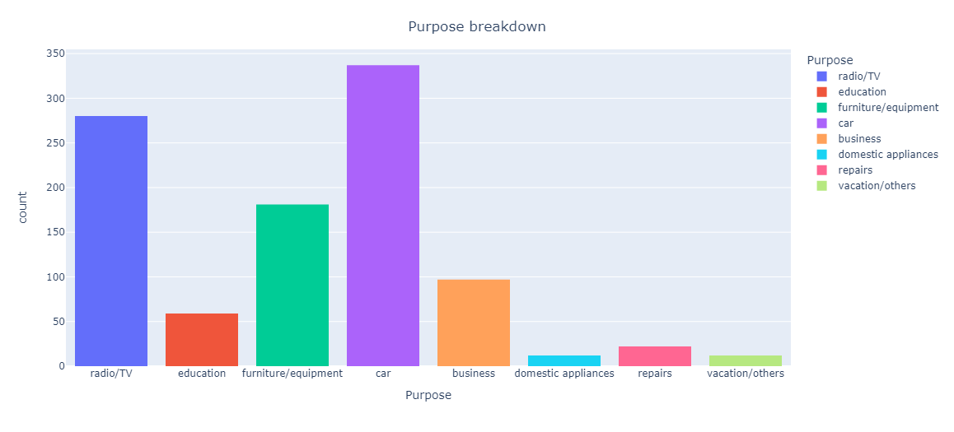

Slide 6
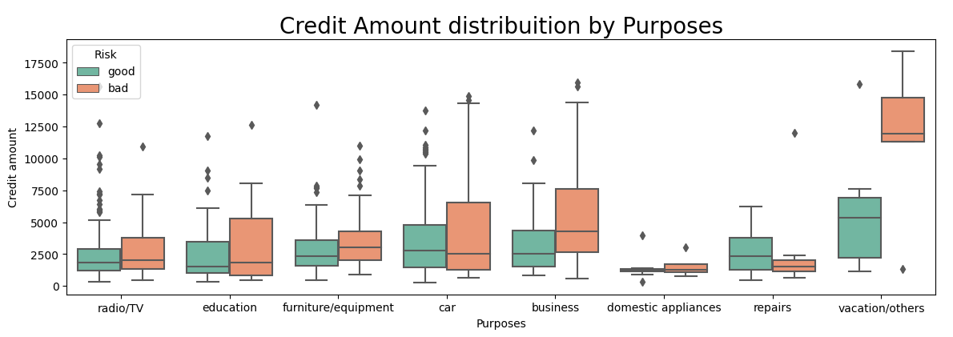
Observation:
When the credit amount is higher, the density of bad risk appears to be greater compared to good risk. This suggests a correlation between higher credit amounts and an increased likelihood of encountering bad risk.
Education and Car Loans: Notably, the range of bad risk is more prominent than that of good risk for education and car loans. This indicates a higher level of risk associated with these specific loan categories.
Vacation Loans and Higher Credit Amounts: An interesting observation is that higher credit amounts in the context of vacation loans consistently lead to bad risk. This implies that larger credit amounts for vacation loans often result in unfavorable outcomes, such as defaults or repayment issues.

Slide 7
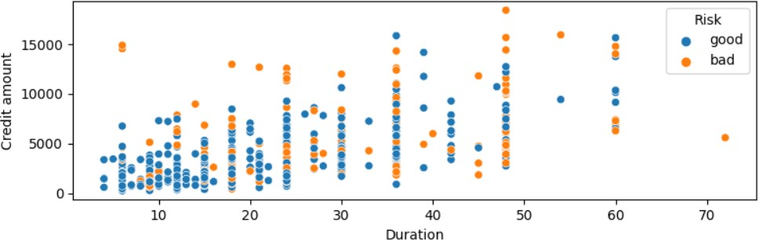
Here, most of the good loans are for credit amount and also for less months of duration and as the credit amount and the duration increases, the underlying risk also increases.

Slide 8
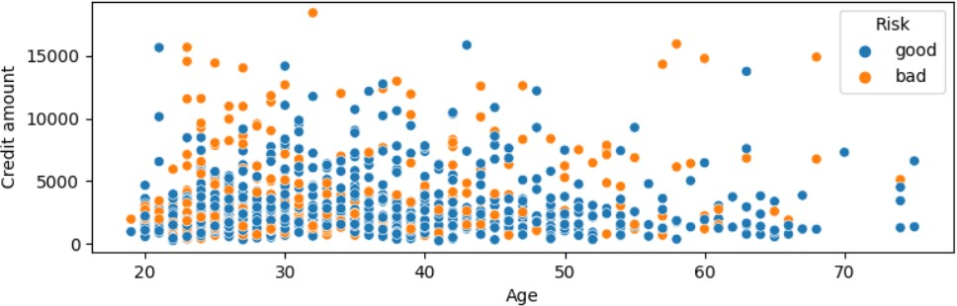
Here, most of the people in their 30’s the loan compared to people in their 20’s. Also, if the person is old and the credit amount is high, then the underlying risk is also high.

Slide 9
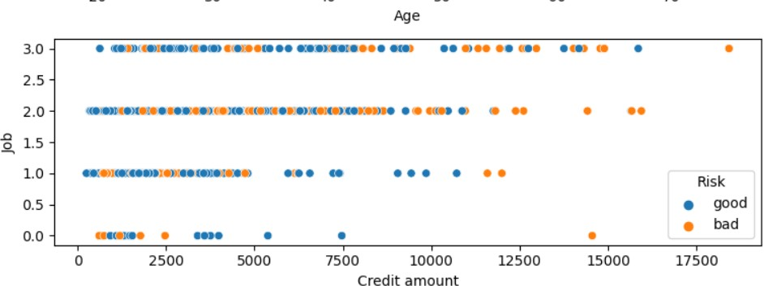
Here, there’s a less risk in giving loan to people who are highly skilled as in with job 3. Also, there’s a high risk in giving the loan for credit amount above 100000.

Slide 10
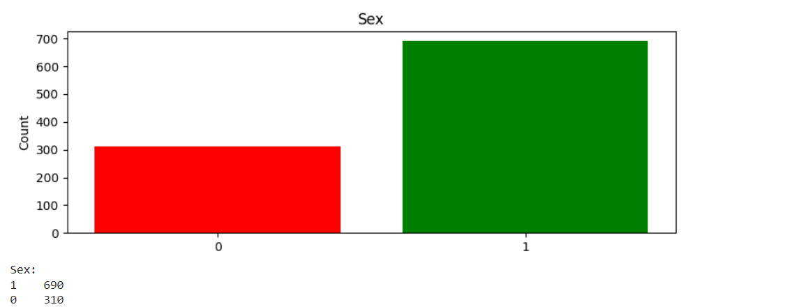
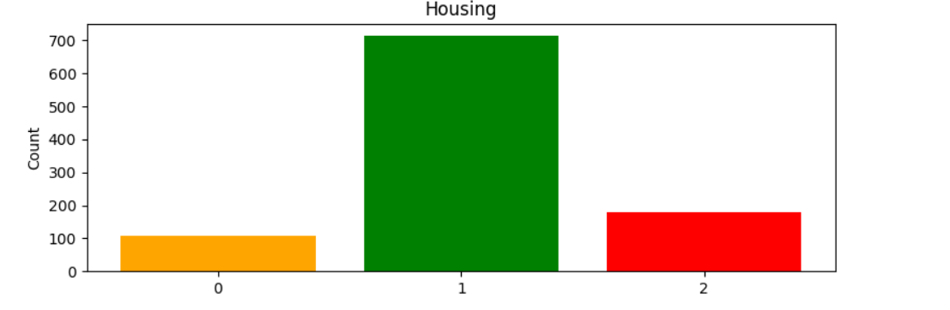
Female Male
Free Own Rent

Slide 11
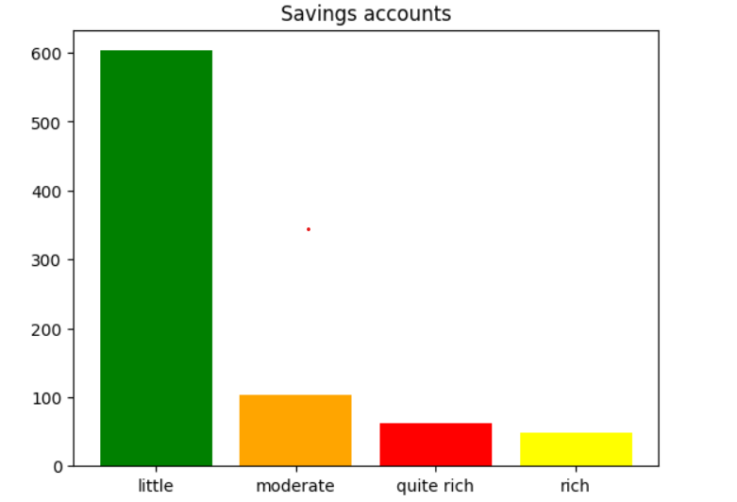
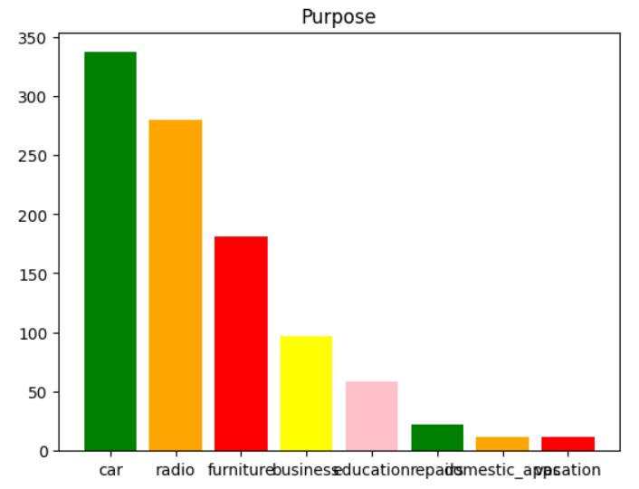

Slide 12
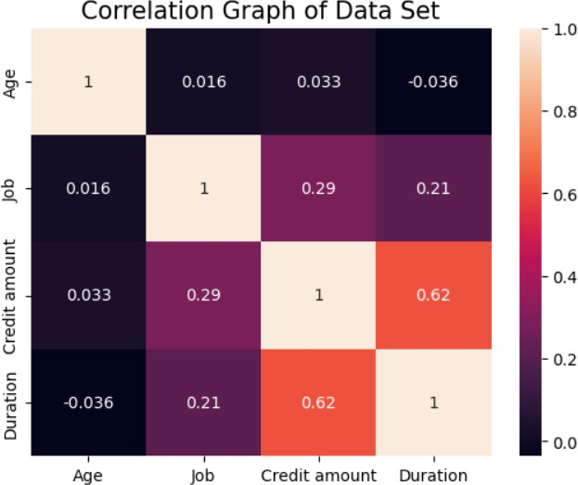
-Here we have plotted a heatmap which gives idea about correlation between the variables. .
-A correlation equal to one means they are perfectly correlated while correlation greater than 0 means they are positively correlated, correlation less than zero will show the variables are negatively correlated and correlation equal to zero will show that the variables are independent of each other.
-All the variables are perfectly correlated with each other have correlation one. Similarly using the heat map we can find the correlation with other variables

Slide 13
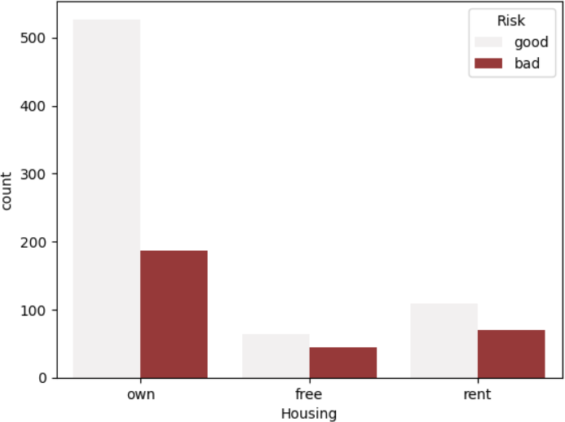
Analyzing risk on the basis of housing(own, free, rent)
-From the bar plot we can see that the frequency of owning the housing is maximum followed by free and renting the house.
In all the cases the risk is more favourable than unfavourable.
In owning the house deals with most good and bad risk. However the total proportion of good to bad risk is found to be lowest in owning a house class and is found to be highest in having free house group.

Slide 14
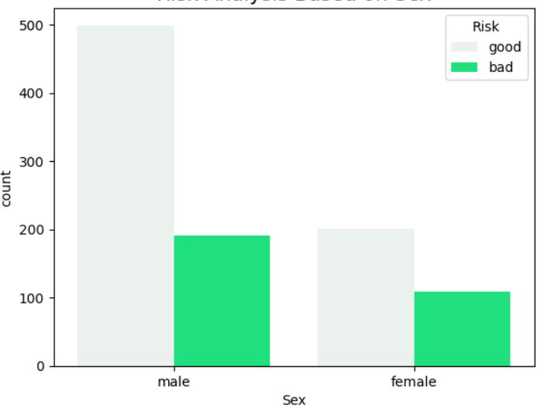
Analyzing risk on the basis of gender
-From the bar plot we can see that the frequency of male section is higher that that of female section
-In this bar plot male group has both higher good and bad risk than the female group
-The ratio of having good to bad risk is higher in male group than in female group.
-Male section has higher count of bad risk but also has higher count of good risk than female group.

Slide 15
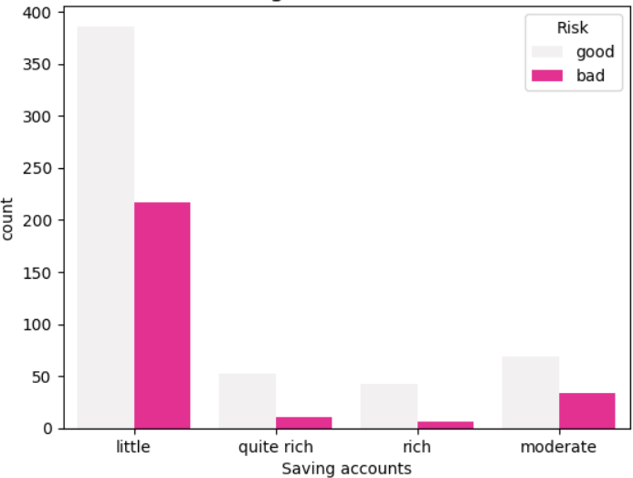
Analyzing risk on the basis of savings account
-From the barplot we can see that the data consist of maximum amount of saving account which is categorized as little followed by moderate, quite rich then rich.
-The little group has the highest bad risk count but also has the highest good risk count folllwed by moderate, quire rich and rich.
-The proportion of good risk to bad risk is found to be highest in rich group followed by quitw rich, moderate and then little.

Slide 16
MACHINE
LEARNING
MODELS
APPLICATION

Slide 17
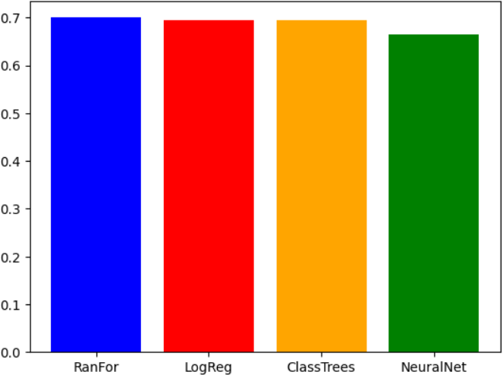
ACCURACY OF DIFFERENT MACHINE LEARNING MODELS
-From the bar plot we can see that after applying different machine learning models we are having nearly same level of accuracy but not same.
-The highest accuracy is found to be in
Random forest followed by logistic regression,classification trees and neural network.
-The accuracy of random forest is found to be around 0.7 .
-The accuracy of logistic regression and
classification trees is found to be .69
-The accuracy of neural network is found to be 0.66

Slide 18
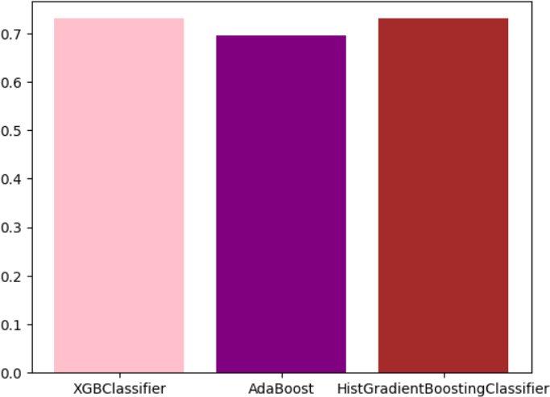
ACCURACY OF DIFFERENT MACHINE LEARNING MODELS
-From the bar plot we can see that after applying different machine learning models we are having nearly same level of accuracy but not same.
-The highest accuracy is found to be in
Hist Gradient Boosting Classifier and XGB Classifier
-The accuracy of Hist Gradient
Boosting Classifier and XGB Classifier are found to be around 0.7 .
-The accuracy ofAdaBoost is found to
be 0.69

Slide 19
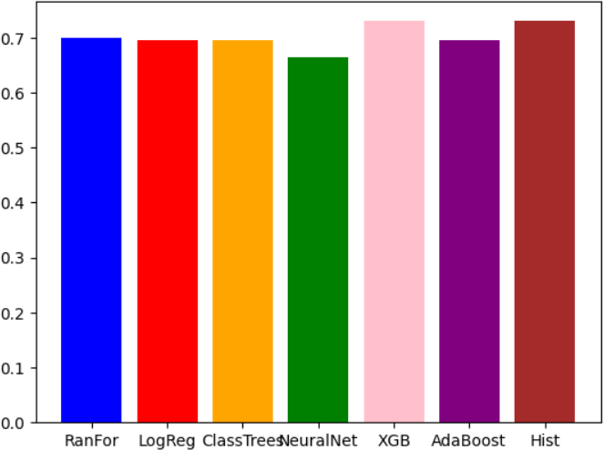

Slide 20
FINDINGS
 | ACCURACY | F-1 SCORE | Recall value
Logistic Regression | .73 | .83 | .733
Decision tree | .6 | .71 | .71
Neural Network | .68 | .81 | .72
XGBOOST | .73 | .82 | .93
AdaBoost | .695 | .8051 | .89
Hist Gradient Boosting | .73 | .82 | .87
Random Forest | .75 | .37 | .56

Slide 21
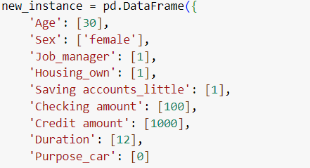

Problem: To whom we will give the loan?
Solution: Here we have applied random forest machine learning algorithm to get the idea about to whom we will give the loan and to whom we will not give the loan.
We have considered all the parameters given in the dataset to conclude the result.
For example: Below are details of a loan applicant for the loan.
We have considers the above mentioned parameters and information to conclude our results.
Results:
So for the above loan applicant we will accept the loan request and approve the loan.

Slide 22
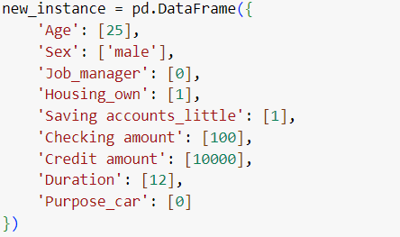

Problem-2 : Considering another example
Solution: Here we have applied random forest machine learning algorithm to get the idea about to whom we will give the loan and to whom we will not give the loan.
We have considered all the parameters given in the dataset to conclude the result.
Below are details of a loan applicant for the loan:
We have considers the above mentioned parameters and information to conclude our results.
Results:
So for the above loan applicant we will accept the loan request and approve the loan.

Slide 23


