Slide 1
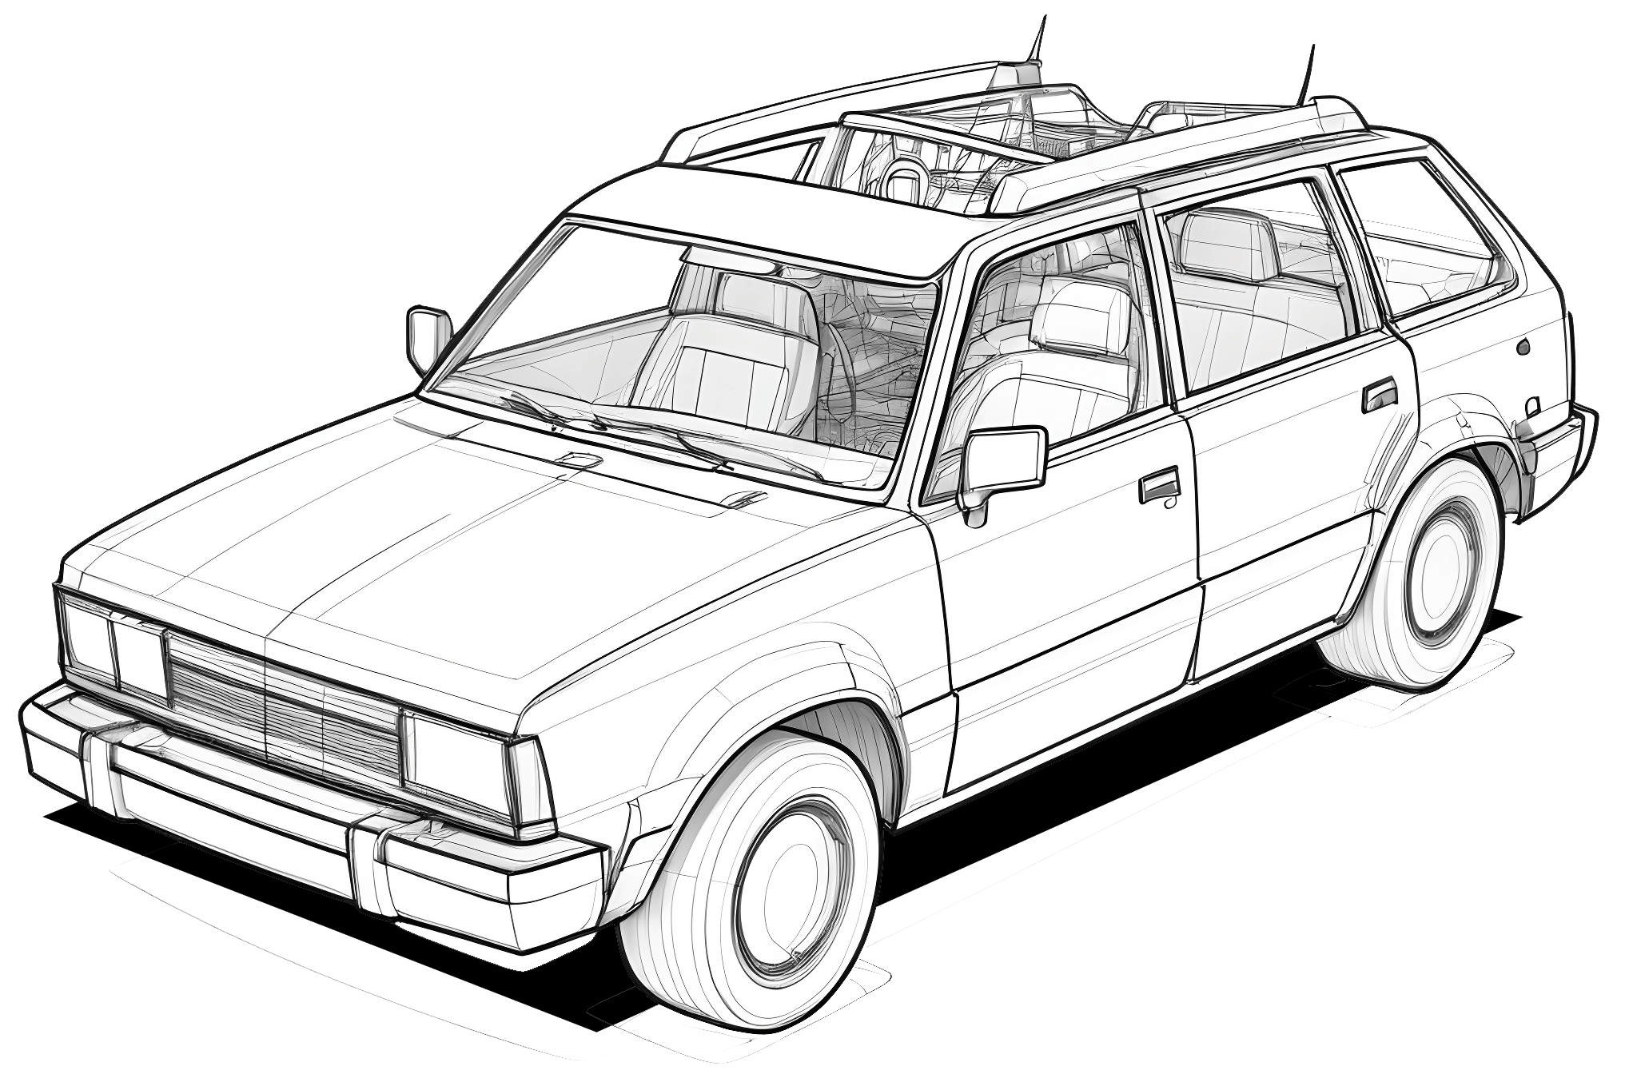

Bri4ka

Slide 2
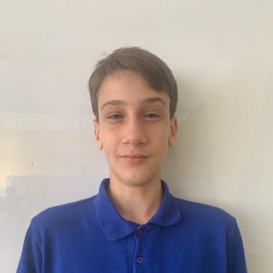

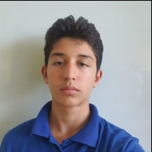
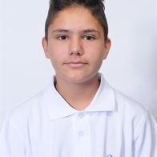
Our Team
Aleksandur Stoyanov Ivanov
Mitko Milenov Doychev
Daniel Plamenov Hristov
Stiliqn Kaloqnov Dimitrov

Slide 3
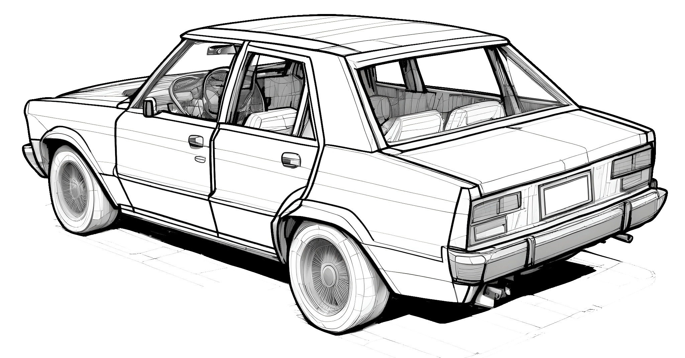
About the project
Our project is about an online site called Bri4ka which helps car owners and enthusiasts looking for quick, reliable answers to their vehicle problems. Our platform is designed to guide you step by step through diagnosing and fixing common car issues - saving you time, money, and frustration. Whether you're dealing with a strange noise, a dashboard warning light, or a performance issue, Bri4ka is here to help.

Slide 4






Used Technologies

Slide 5
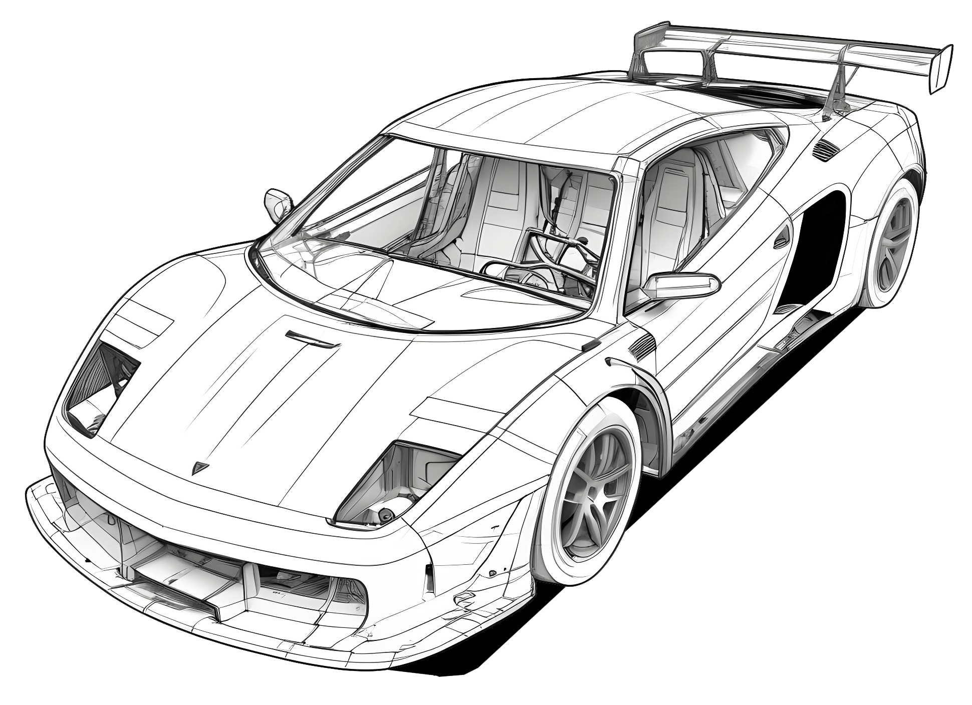
Let’s continue to the project

