Slide 1
Chocoholics Anonymous
Alberto Kato
Jorge Ribeiro
Rafael Oliveira
CSC440 – Software Engineering

Slide 2
Summary
Technologies applied
Project Overview
Testing Strategies
Project Demonstration

Slide 3

1. Technologies applied
The language used in the project is Java.

Slide 4
1. Technologies applied
The project’s version control is GitHub.

Slide 5


1. Technologies applied
For data persistence, we used MySQL and Java Database Connectivity (JDBC).

Slide 6

2. Project Overview
The project runs from the console. Eclipse IDE is used for this task.

Slide 7
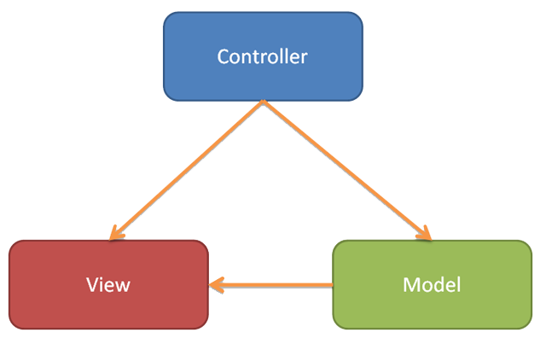
2. Project Overview
MVC is used as a development pattern.

Slide 8
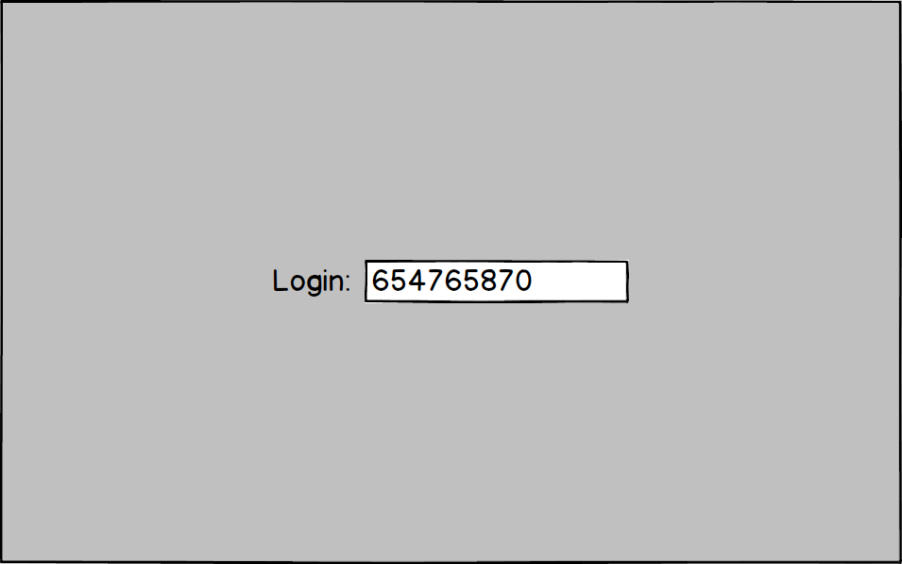
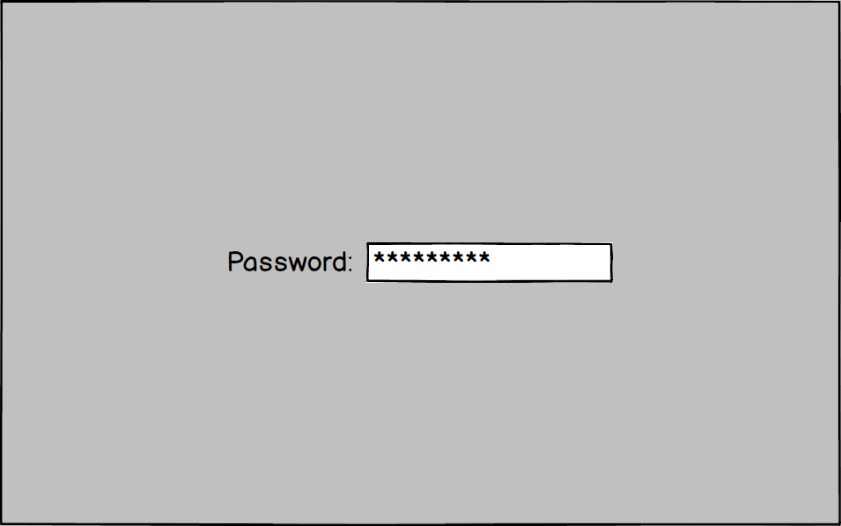
2. Project Overview
Using the Mockup, some screens were designed.

Slide 9
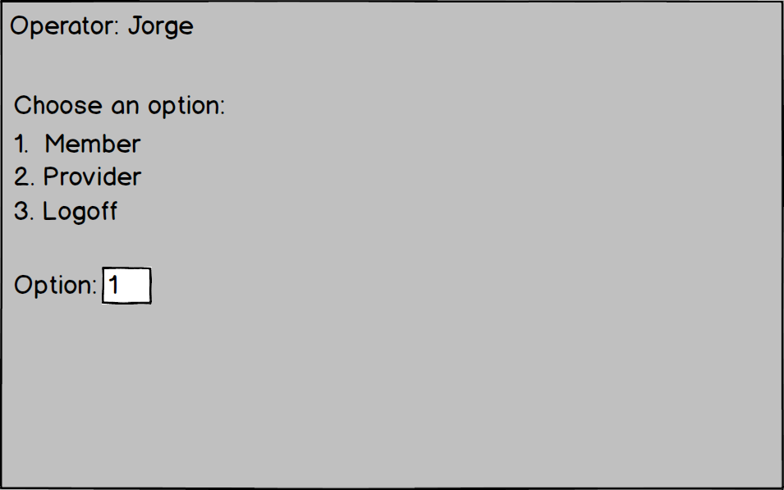
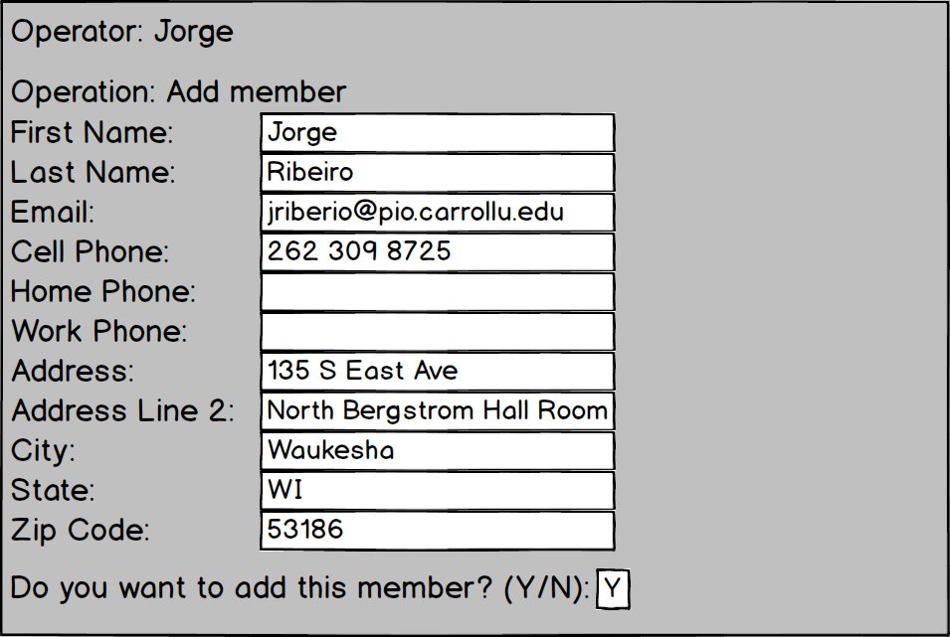
2. Project Overview
Using the Mockup, some screens were designed.

Slide 10
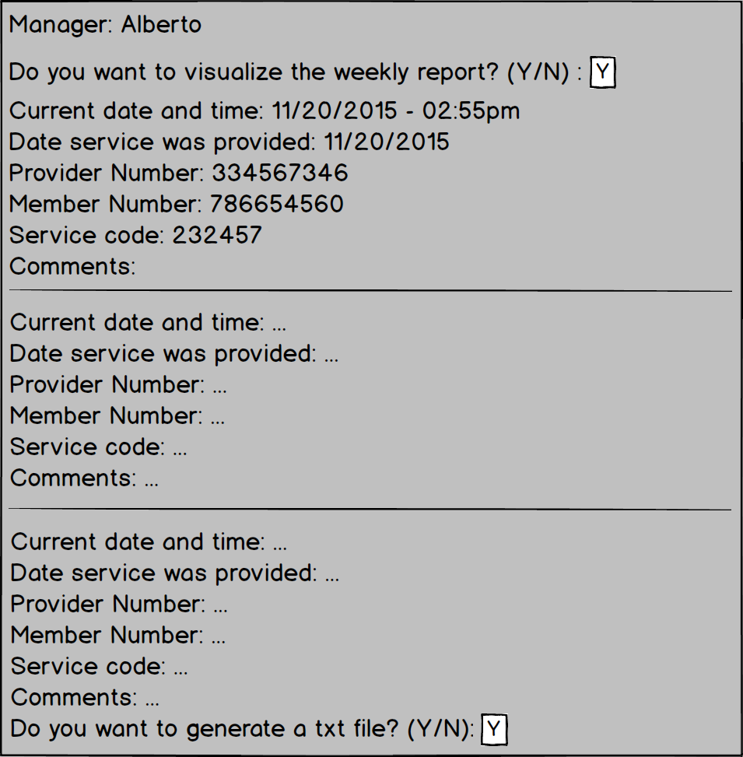
2. Project Overview
Using the Mockup, some screens were designed.

Slide 11
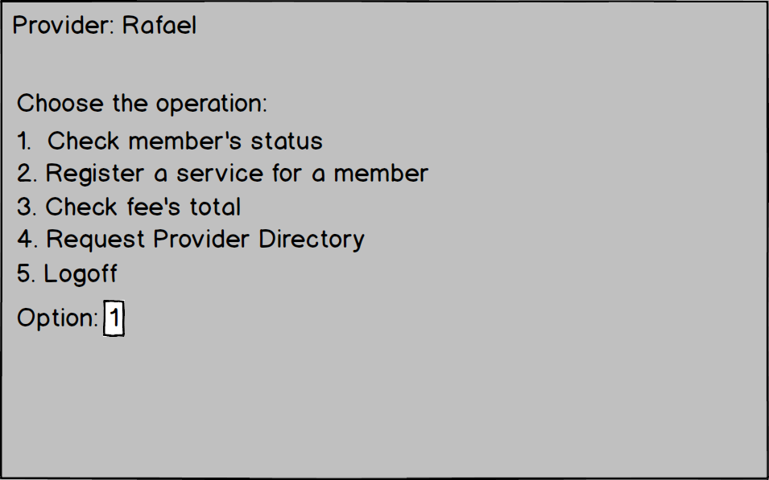
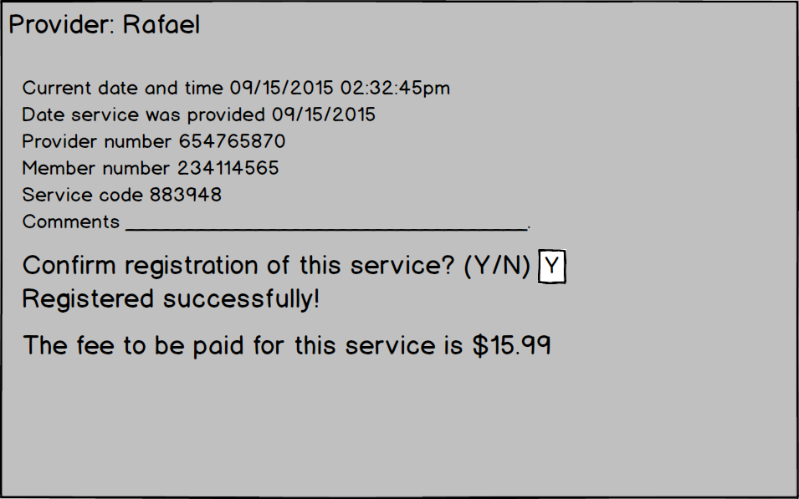
2. Project Overview
Using the Mockup, some screens were designed.

Slide 12
3. Testing Strategies
We used the Unit Testing strategy.
Test Description | Input Data | Expected Results | Passed: Y || N?

Slide 13
4. Project Demonstration
Now, the project working.

