Slide 1


Dataset-JSON: SAS© implementation
Lex Jansen
Senior Director, Data Science Development, CDISC (contractor)

Slide 2

About your presenter
16 years in an IT/Standards role in Biostatistics at Organon
4 years as a consultant to help companies implement CDISC
11 years at SAS.
8 years as a Principal Software Developer working on SAS Clinical Standards Toolkit (implementing mostly XML based standards (Define-XML, ODM, Dataset-XML)) and SAS Life Science Analytics Framework (Java)
3 years as Principal Solution Consultant at SAS implementing Life Science Analytics Framework
Since Nov 2021 Senior Director, Data Science Development at CDISC (contractor)
Core member of the CDISC Data Exchange Standards team since 2008. (co-lead since Nov 2021)
Core member of the CDISC Define-XML development team.
One of the main Define-XML v2 developers.
Developer of CDISC/PhUSE Define-XML v2 stylesheet.
One of the main developers of the Analysis Results Metadata v1.0 for Define-XML v2.0 extension

Slide 3
Agenda
Dataset-JSON Document Structure
SAS and JSON
Writing Dataset-JSON with SAS
Reading Dataset-JSON with SAS
Comparing SAS datasets and JSON files
Demo
Conclusion

Slide 4
Dataset-JSON Document Structure

Slide 5
Dataset-JSON Document Structure
Dataset-JSON was adapted from the Dataset-XML specification, but uses JSON format instead of XML
Each Dataset-JSON file is connected with a Define-XML file, containing detailed metadata
Each Dataset-JSON files contains basic information about dataset variables, so that it is possible to have a simple view of the contents of a dataset without the need of a Define-XML document
Dataset-JSON Specification:
https://www.cdisc.org/dataset-json
https://wiki.cdisc.org/display/PUB/Dataset-JSON
GitHub repository with JSON Schema and examples: https://github.com/cdisc-org/DataExchange-DatasetJson

Slide 6
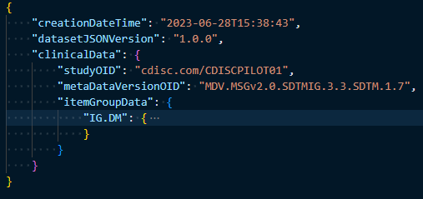
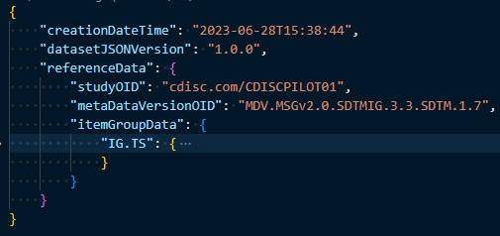
Dataset-JSON Document Structure
At the top level of the Dataset-JSON object, there are some required attributes (creationDateTime and datasetJSONVersion)*, and one of two optional attributes: clinicalData or referenceData.
Subject data is stored in clinicalData and non-subject data is stored in referenceData.
studyOID and metaDataVersionOID must match corresponding values in Define-XML
*See the specification for other optional attributes

Slide 7
Dataset-JSON Document Structure - top level attributes
Attribute | Usage | Description
creationDateTime | Required | Time of creation of the file containing the document.
datasetJSONVersion | Required | Version of Dataset-JSON standard
fileOID | Optional | A unique identifier for this file.
asOfDateTime | Optional | The date/time at which the source database was queried in order to create this document.
originator | Optional | The organization that generated the Dataset-JSON file.
sourceSystem | Optional | The computer system or database management system that is the source of the information in this file.
sourceSystemVersion | Optional | The version of the "SourceSystem" above.
clinicalData | Optional | Contains datasets for clinical data across multiple subjects.
referenceData | Optional | Contains datasets for non-subject data domains.

Slide 8
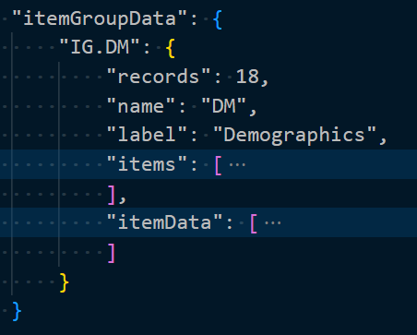
Dataset-JSON Document Structure
itemGroupData is an object with attributes corresponding to individual datasets.
The attribute name (IG.DM) is the OID of a described dataset, which must be the same as the OID of the corresponding itemGroup in the Define-XML file
records, name, label: basic dataset information (all required)
items - basic information about variables
itemData - dataset data

Slide 9
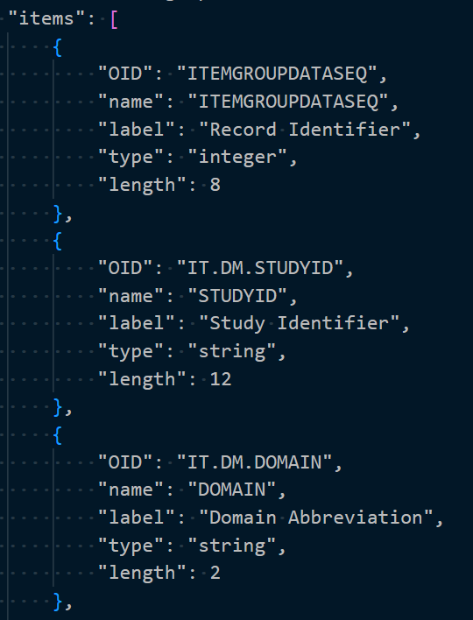
Dataset-JSON Document Structure
items - array of basic information about dataset variables.
The order of elements in the array must be the same as the order of variables in the described dataset.
The first element always describes the Record Identifier (ITEMGROUPDATASEQ)

Slide 10
Dataset-JSON Document Structure
OID - OID of a variable (must correspond to the variable OID in the Define-XML file)
name - variable name
label - variable description
type - type of the variable. 'string', 'integer', 'decimal', 'float', 'double', 'boolean'
length - variable length - most useful for the string type
displayFormat - supports data visualization of numeric float and date values
keySequence - indicates that this item is a key variable in the dataset structure
The last 3 attributes are optional

Slide 11
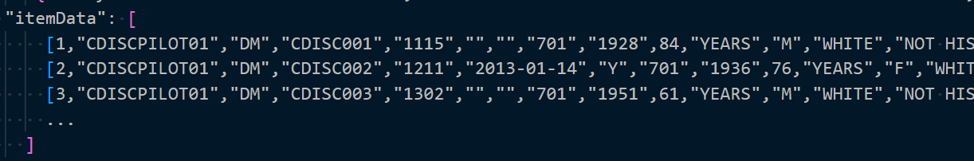
Dataset-JSON Document Structure
itemData is an array of records with variables values
Each record itself is represented as an array of variables values
The first value is a unique sequence number for each record in the dataset
Missing values are represented by null in the case of numeric variables, and an empty string in case of character variables: [1, "MyStudy", "", "DM", null]

Slide 12
SAS and JSON

Slide 13
SAS and JSON
Starting in SAS© 9.4, you can use PROC JSON to write SAS data sets to JSON files
Starting in SAS© 9.4TS1M4, you can use the JSON engine to read JSON files into SAS data sets

Slide 14
Writing Dataset-JSON with SAS

Slide 15
Writing Dataset-JSON with SAS
PROC JSON in SAS© gives the user control over the JSON output:
through the utilization of options
through the ability to control containers (objects or arrays)
by writing directly to the output file
by choosing exactly what to include or not include in the resulting JSON file
PROC JSON OUT=fileref | "external-file" <options>;
EXPORT <libref.>SAS-data-set <(data-set-options)> </options>;
WRITE VALUES value(s) </options>;
WRITE OPEN type;
WRITE CLOSE;
RUN;

Slide 16
Writing Dataset-JSON with SAS
PROC JSON options (I used the underlined)
PRETTY | NOPRETTY - how to format the JSON output
FMTxxx | NOFMTxxx - whether to apply a character, numeric or date/time SAS format to the resulting output if a such a SAS format is associated with a SAS data set variable
KEYS | NOKEYS - whether exported observations are written as JSON objects or as JSON arrays
SASTAGS | NOSASTAGS - include or suppress SAS metadata
SCAN | NOSCAN - scans and encodes input strings to ensure that only characters that are acceptable are exported to the JSON output file
TRIMBLANKS | NOTRIMBLANKS - remove or retain trailing blanks from the end of character data in the JSON OUTPUT

Slide 17
Writing Dataset-JSON with SAS
The EXPORT statement
identifies the SAS data set to be exported
allows to control the resulting output by using options that are specific to PROC JSON
Allows to control SAS data set options that are applied to the input SAS data set.
Same options as on the previous slide (except PRETTY / NOPRETTY)
If the EXPORT statement is the first statement after the PROC JSON statement, the top-level container is a JSON object
if the NOSASTAGS option is specified in either the PROC JSON or the EXPORT statement, the top-level container is a JSON array

Slide 18
Writing Dataset-JSON with SAS
The WRITE statement allows the user to write one or more literal values to the JSON output file
The value can be either a string, a number, a Boolean value (TRUE or FALSE), or NULL
SCAN | NOSCAN and TRIMBLANKS | NOTRIMBLANKS can be specified
The WRITE OPEN <type> and WRITE CLOSE statements allow the user to open, close, and nest containers
<type> in the WRITE OPEN statement can be either ARRAY or OBJECT

Slide 19
Writing Dataset-JSON with SAS
PROC JSON OUT=jsonfout PRETTY; WRITE OPEN OBJECT; WRITE VALUES "creationDateTime" "&CurrentDateTime"; WRITE VALUES "datasetJSONVersion" "1.0.0"; WRITE VALUES "clinicalData"; WRITE OPEN OBJECT; WRITE VALUES "studyOID" "<study OID>"; WRITE VALUES "metaDataVersionOID" "<MDV OID>"; WRITE VALUES "itemGroupData"; WRITE OPEN OBJECT; WRITE VALUES "IG.DM"; WRITE OPEN OBJECT; WRITE VALUES "records" 18; WRITE VALUES "name" "DM"; WRITE VALUES "label" "Demographics"; WRITE VALUES "items"; WRITE OPEN ARRAY; EXPORT work.column_metadata / KEYS; WRITE CLOSE; WRITE VALUES "itemData"; WRITE OPEN ARRAY; EXPORT work.column_data / NOKEYS; WRITE CLOSE; WRITE CLOSE; WRITE CLOSE; WRITE CLOSE; WRITE CLOSE; RUN;
{ "creationDateTime": "2023-06-28T15:38:43", "datasetJSONVersion": "1.0.0", "clinicalData": { "studyOID": "<study OID>", "metaDataVersionOID": "<MDV OID>", "itemGroupData": { "IG.DM": { "records": 18, "name": "DM", "label": "Demographics", "items": [
],
"itemData": [
] } } } }
column metadata
Column data

Slide 20
Writing Dataset-JSON with SAS
PROC JSON OUT=jsonfout PRETTY; WRITE OPEN OBJECT; WRITE VALUES "creationDateTime" "&CurrentDateTime"; WRITE VALUES "datasetJSONVersion" "1.0.0"; WRITE VALUES "clinicalData"; WRITE OPEN OBJECT; WRITE VALUES "studyOID" "<study OID>"; WRITE VALUES "metaDataVersionOID" "<MDV OID>"; WRITE VALUES "itemGroupData"; WRITE OPEN OBJECT; WRITE VALUES "IG.DM"; WRITE OPEN OBJECT; WRITE VALUES "records" 18; WRITE VALUES "name" "DM"; WRITE VALUES "label" "Demographics"; WRITE VALUES "items"; WRITE OPEN ARRAY; %write_json_metadata_array(work.column_metadata); WRITE CLOSE; WRITE VALUES "itemData"; WRITE OPEN ARRAY; EXPORT work.column_data / NOKEYS; WRITE CLOSE; WRITE CLOSE; WRITE CLOSE; WRITE CLOSE; WRITE CLOSE; RUN;
{ "creationDateTime": "2023-06-28T15:38:43", "datasetJSONVersion": "1.0.0", "clinicalData": { "studyOID": "<study OID>", "metaDataVersionOID": "<MDV OID>", "itemGroupData": { "IG.DM": { "records": 18, "name": "DM", "label": "Demographics", "items": [
],
"itemData": [
] } } } }
column metadata
Column data
The %write_json_metadata_array macro does not write key-value pairs when the value is null.

Slide 21
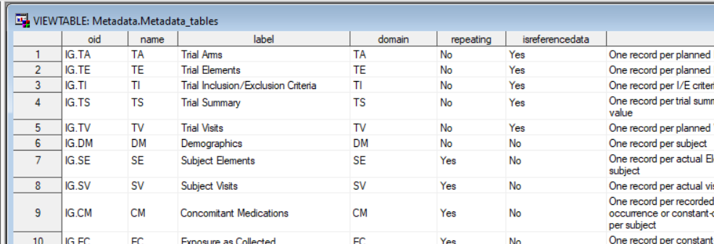
Writing Dataset-JSON with SAS - metadata

Slide 22
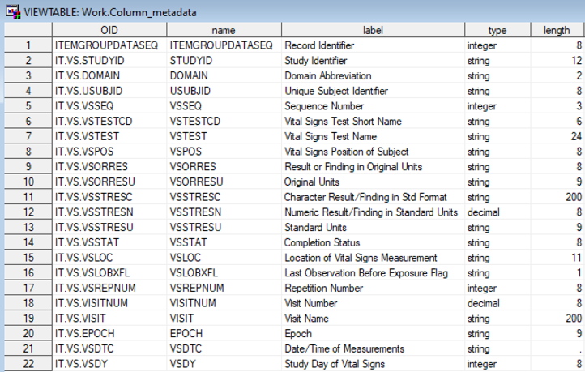
Writing Dataset-JSON with SAS - column metadata

Slide 23
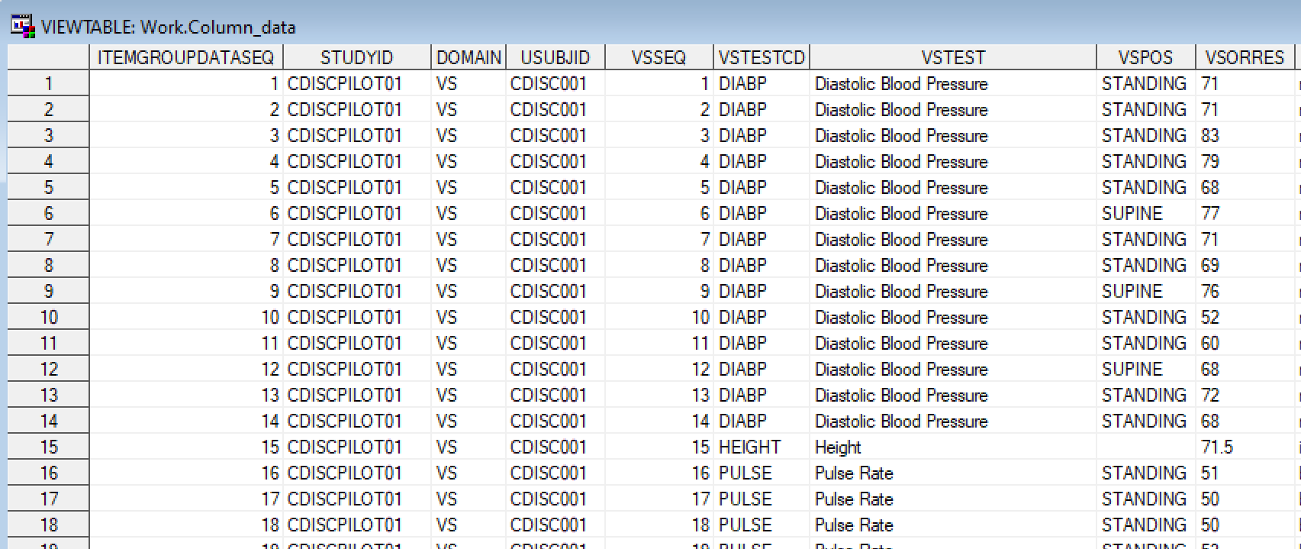
Writing Dataset-JSON with SAS - column data

Slide 24
Using Define-XML metadata when creating Dataset-JSON
Get variable formats from Define-XML when creating SAS datasets from Dataset-JSON (especially for numeric date/time variables)
Get OIDs from Define-XML when creating Dataset-JSON
Use pre-specified metadata from Define-XML (length, label, datatype) for creating Dataset-JSON
Important to check that Define-XML is consistent with the data!
/* Create metadata from Define-XML for ADaM */ %CreateMetadataFromDefineXML( definexml=&root/json/adam/define.xml, metadatalib=metaadam ); /* Some manual data type updates */ data metaadam.metadata_columns; set metaadam.metadata_columns; if xml_datatype='float' then do; if index(name, 'VISIT') then json_datatype='decimal'; end; run;
/* Create metadata from Define-XML for SDTM */ %CreateMetadataFromDefineXML( definexml=&root/json/sdtm/define.xml, metadatalib=metasdtm ); /* Some manual data type updates */ data metasdtm.metadata_columns; set metasdtm.metadata_columns; if xml_datatype='float' then do; if name ne 'LBSTRESN' then json_datatype='decimal'; end; run;

Slide 25
Writing Dataset-JSON - %write_datasetjson()
%write_datasetjson(
dataset= /* (libname.)memname of the data set */
xptpath=, /* Path to XPT file */
jsonpath=, /* Path to Dataset-JSON file */
usemetadata=N, /* Use Define-XML metadata? (Y/N */
metadatalib=, /* Define-XML metadata library */
datasetJSONVersion=1.0.0,
fileOID=,
asOfDateTime=,
originator=,
sourceSystem=,
sourceSystemVersion=,
studyOID=,
metaDataVersionOID=,
metaDataRef=,
pretty=NOPRETTY
);

Slide 26
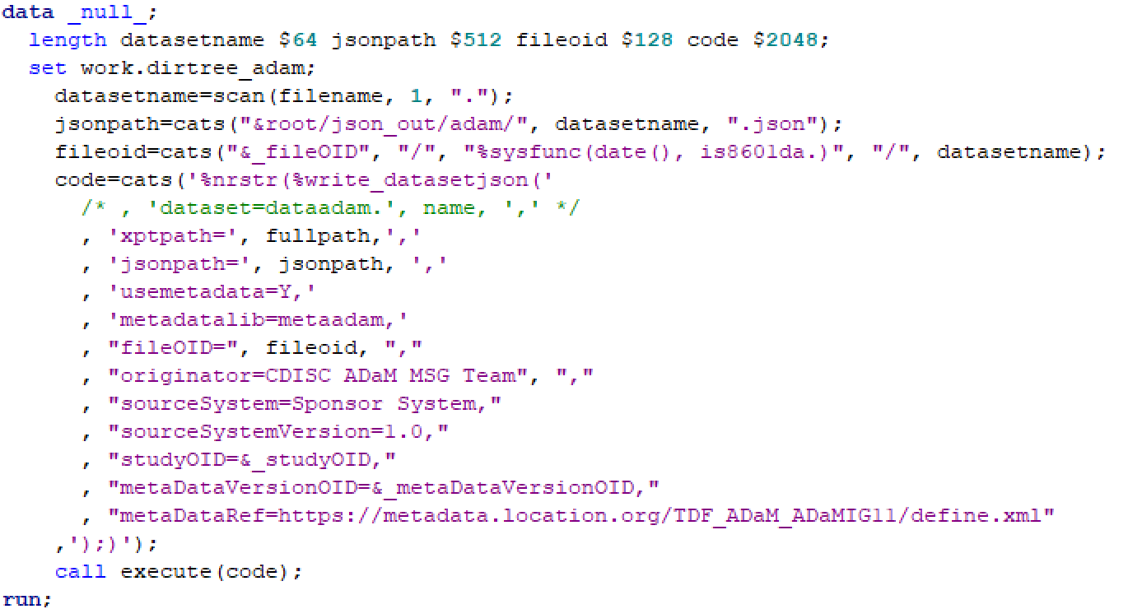
Writing Dataset-JSON - %write_datasetjson() - loop

Slide 27
Reading Dataset-JSON with SAS

Slide 28
Reading Dataset-JSON with SAS
Starting in SAS© 9.4TS1M4, you can use the JSON engine to read JSON files into SAS data sets
A JSON map is a file that the JSON engine uses to define the data set structures that are created when reading JSON

Slide 29
Reading Dataset-JSON with SAS
FILENAME jsonfile "<path to the JSON file>";
FILENAME mapfile "<path to the MAP file to be created>";
LIBNAME data_out "<path to the output folder>";
LIBNAME jsonfile JSON FILEREF=jsonfile MAP=mapfile AUTOMAP=CREATE NOALLDATA ORDINALCOUNT=NONE;
PROC COPY IN=jsonfile OUT=data_out;
RUN;

Slide 30
Reading Dataset-JSON with SAS
Creates 6 data sets:
ALLDATA
CLINICALDATA
studyOID, metaDataVersionOID
ITEMGROUPDATA_IG_DM
records, name, label
IG_DM_ITEMS
contains column metadata (OID, name, label, type, length, displayFormat, keySequence)
IG_DM_ITEMDATA
contains column data (element1, element2, element3, …)
ROOT
contains creationDateTime, datasetJSONVersion
{ "creationDateTime": "<yyyy-mm-ddThh:mm:ss>", "datasetJSONVersion": "1.0.0", "clinicalData": { "studyOID": "<study OID>", "metaDataVersionOID": "<MDV OID>", "itemGroupData": { "IG.DM": { "records": 18, "name": "DM", "label": "Demographics", "items": [
]
"itemData": [
] } } } }
column metadata
column data

Slide 31

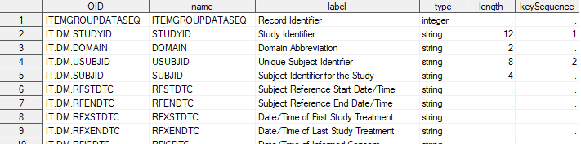
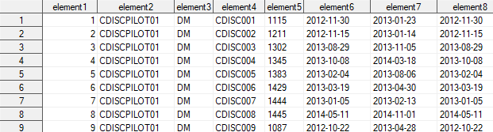
Reading Dataset-JSON with SAS
ITEMGROUPDATA_IG_DM
IG_DM_ITEMS
IG_DM_ITEMDATA

Slide 32
Reading Dataset-JSON - %read_datasetjson()
%read_datasetjson(
jsonpath=, /* Path to Dataset-JSON file */
datalib= /* Library to save SAS dataset */
dropseqvar=N, /* Drop ITEMGROUPDATASEQ variable? (Y/N) */
savemetadata=N, /* Save Dataset-JSON metadata? (Y/N) */
metadatalib= /* Library to save Dataset-JSON metadata */
);

Slide 33
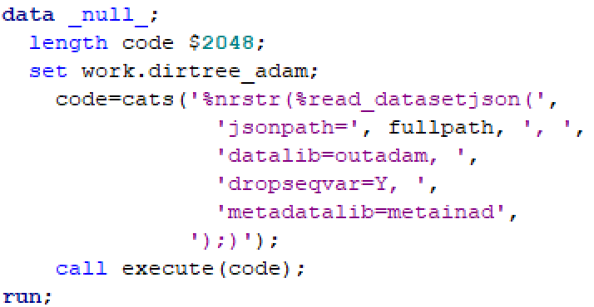

Reading Dataset-JSON - %read_datasetjson() - loop

Slide 34
Comparing SAS datasets and JSON files

Slide 35
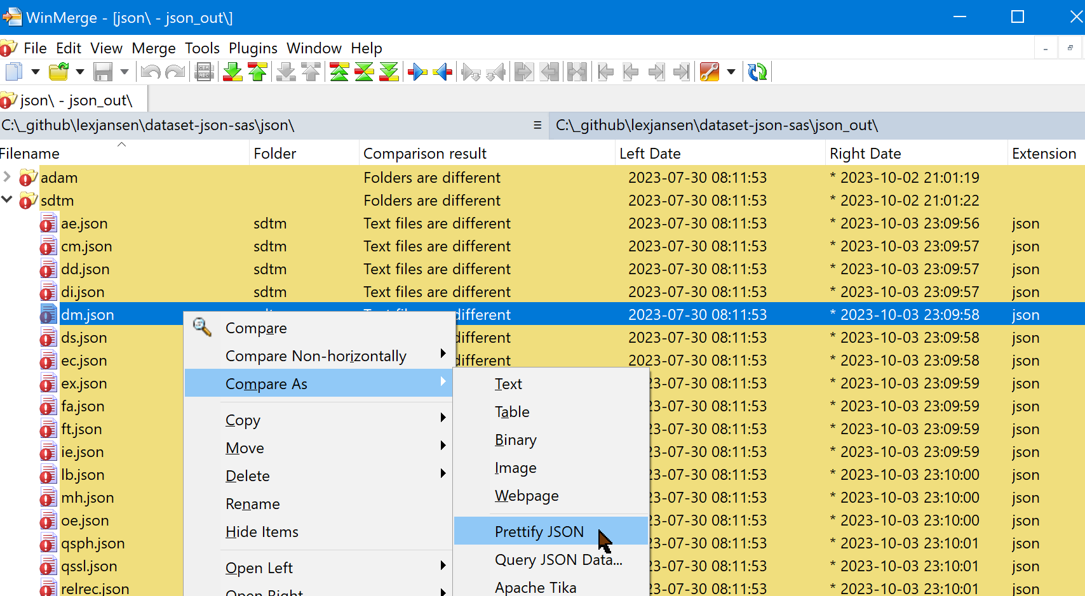
Comparing JSON files
WinMerge (https://winmerge.org/) can compare JSON files in 'pretty' mode

Slide 36
Comparing SAS datasets
PROC COMPARE
%macro utl_comparedata(
baselib=,
complib=,
dsname=,
compareoptions=%str(listall criterion=0.00000001 method=absolute),
resultds=,
detailall=N
);

Slide 37
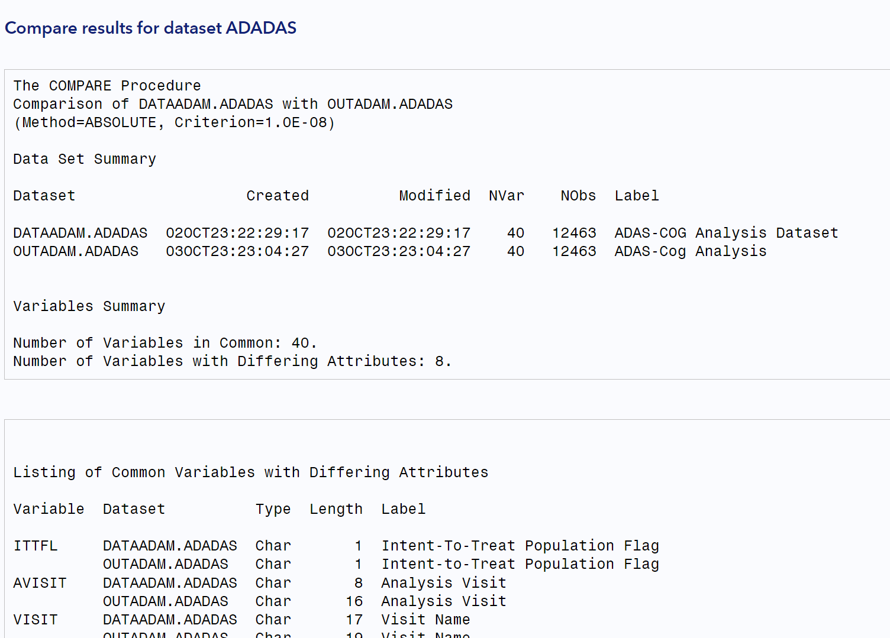
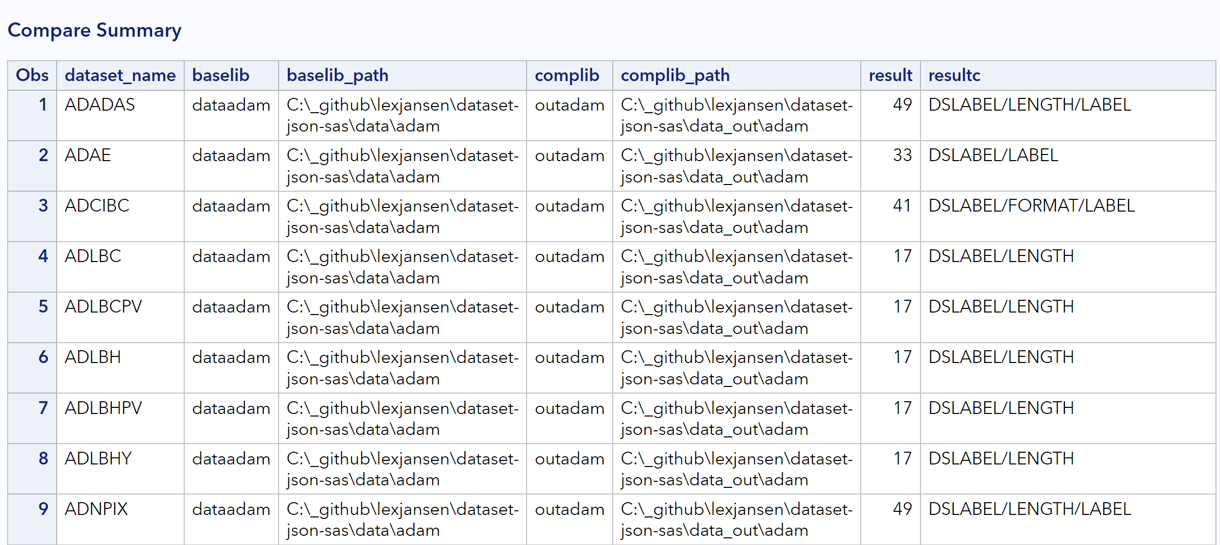
Comparing SAS datasets

Slide 38
Demo

Slide 39
Conclusion

Slide 40
Conclusion
Dataset-JSON provides an efficient alternative to SAS Version 5 Transport files with full support for UTF-8
Dataset-JSON is good step towards a modern API-based communication protocol
SAS fully supports reading and writing Dataset-JSON files

Slide 41

GitHub Repository: https://github.com/lexjansen/dataset-json-sas
Email: lexjansen@gmail.com ljansen@cdisc.org
Web: https:\\www.lexjansen.com
LinkedIn: https://www.linkedin.com/in/lexjansen/

