Slide 1
Dataset-JSON SAS© implementation
Lex Jansen

Slide 2

About Lex Jansen
16 years in an IT/Standards role in Biostatistics at Organon
4 years as a consultant to help companies implement CDISC
10 years at SAS
7 years as Principal Software Developer working on SAS Clinical Standards Toolkit (implementing mostly XML based standards (Define-XML, ODM, Dataset-XML)) and SAS Life Science Analytics Framework (Java).
3 years as Principal Solution Consultant implementing SAS Life Science Analytics Framework
Since November 2021: Senior Director, Data Science Development at CDISC (contract through Lex Jansen Consulting LLC)
Core member of the CDISC Data Exchange Standards team since 2008. Co-lead since November 2021
Core member of the CDISC Define-XML development team.
One of the main Define-XML v2 developers.
Developer of CDISC/PhUSE Define-XML v2.x XSL stylesheets.
One of the main developers of the Analysis Results Metadata v1.0 for Define-XML v2.0 extension
Core member of the CDISC Dataset-XML development team.

Slide 3
Agenda
Introduction
What is JSON
Dataset-JSON Document Structure
SAS and JSON
Writing Dataset-JSON with SAS
Reading Dataset-JSON with SAS
Conclusion

Slide 4
Introduction

Slide 5
Introduction
In 1999, the FDA standardized the submission of clinical and non-clinical data using the SAS Version 5 XPT Transport Format
The SAS Version 5 XPT Transport format dates from 1989 and was first available as part of SAS version 5
Since 1989 there have been many changes to the industry with respect to the process for submissions and the approaches to data curation and manipulation - but we still submit in SAS Version 5 XPT Transport format
For many years it has been recognized that the ASCII-based SAS Version 5 XPT Transport format has some limitations and issues

Slide 6
Introduction - SAS Version 5 XPT Transport files
Technical limitations:
Current data formats supported are limited to US ASCII (for Character formats) and IBM INTEGER and DOUBLE (for Numeric formats).
Only supports US ASCII Character encoding. No multibyte characters are supported; this requires translation and/or transcription from the source data
Recently SAS changed the specification from: "All character data are stored in ASCII, regardless of the operating system" to "All character data is stored in the Windows encoding that is compatible with the SAS session encoding that is used to create the file”.
Although technically character data can be stored in encodings other than ASCII, there is no method of conveying encoding information other than documenting it with the delivery of the transport file.
Variable names must be alphanumeric, Variable names are limited to a maximum length of 8 characters, Variable labels are restricted to a maximum length of 40 characters
Character variable data widths are limited to 200 characters

Slide 7
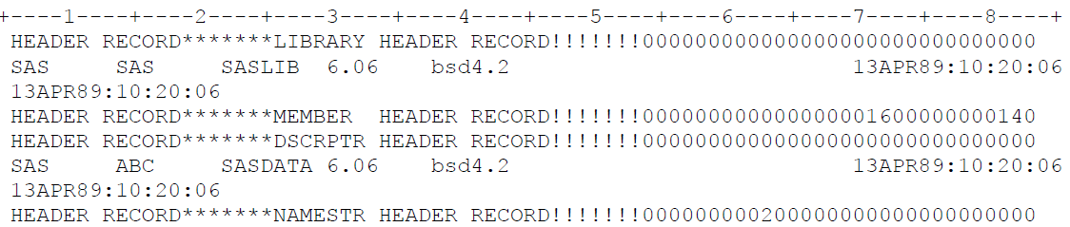
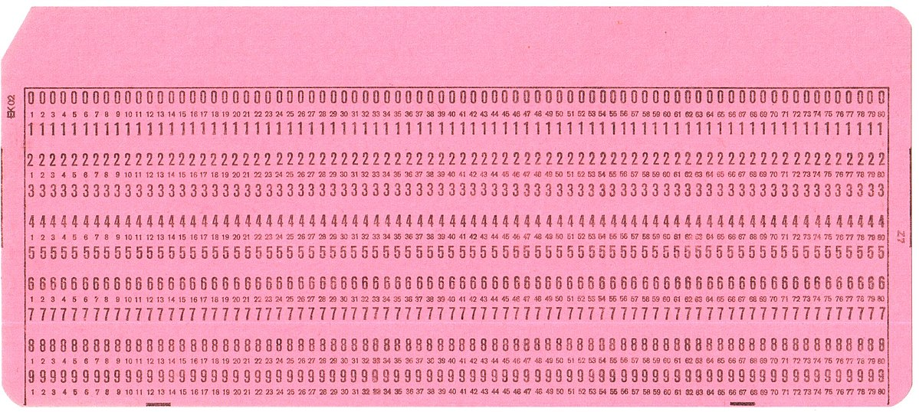
Introduction - SAS Version 5 XPT Transport files
Storage limitations:
The SAS Version 5 XPT Transport format has a highly inefficient use of storage space. There is often empty space for columns allocated, but not used by data and this can lead to significant wasted space
Fixed fields and records that are often padded with blanks
This inefficiency forces sponsors to re-size character variables to be compliant with regulatory requirements
The inability to compress datasets leads to significant file logistical issues, due to the requirement that the maximum size of the files is 5 Gigabytes or smaller
image: Wikimedia Commons

Slide 8
Introduction - SAS Version 5 XPT Transport files
Other limitations:
The format is only suited for transporting and storing two-dimensional "flat" data structures. This restricts the structure of the content that can be transported.
The two-dimensional nature of the transport format has led to sub-optimal designs in the structures of the content models (SDTM, ADaM, SEND), that are used to store and transport clinical and nonclinical data
Even more challenges for other types of data (RWD, …)
SAS Version 5 Transport format is not an extensible modern technology
Owned by SAS - not supported and maintained by an open, consensus-based standards development organization

Slide 9
Introduction
In 2012 FDA organized a Public Meeting on Study Data Exchange
SAS created the SAS Version 8 XPT Transport format to address some of the issues raised.
Some of the SAS Version 5 Transport format limitations have been addressed in the SAS Version 8 Transport format, e.g. longer character fields, longer names and labels. However, the updated format does not address the other issues and concerns.
CDISC presented Dataset-XML at the public meeting

Slide 10
Introduction - Dataset-XML
In April 2014 CDISC published version 1.0 of the Dataset-XML standard
Dataset-XML is an ODM-based standard format for transporting tabular dataset data in XML between any two entities
Dataset-XML can be easily extended beyond the tabular two-dimensional format
FDA and sponsors did a successful pilot with Dataset-XML, although the observation about the Dataset-XML file size seemed an obstacle for the acceptance of this new format.
Another concern raised about Dataset-XML has been that the metadata - Define-XML - is completely separated from the data. To be able to process a Dataset-XML file one always needs the associated Define-XML document.

Slide 11
Introduction - Dataset-JSON
Dataset-JSON was adapted from the Dataset-XML specification but uses JSON format
Like Dataset-XML, each Dataset-JSON file is connected to the Define-XML document, containing detailed metadata information
Dataset-JSON files contain basic information about dataset variables, so that it is possible to have a simple view of the contents of a dataset without the need of a Define-XML document
Dataset-JSON files are also much smaller in size compared to SAS Version 5 XPT Transport files and Dataset-XML files
JSON is very well positioned to play a role in the digital transition from a file based format (XPT) to an API-based communication protocol
Most modern web services use JSON as a data exchange format due to the speed and agility it offers

Slide 12
Dataset-JSON vs Dataset-XML vs SAS v5 XPT Size (Kb)
 |  | SAS v5 XPT | Dataset-XML | Dataset-JSON
SDTM | FT | 5,917 | 4,287 | 858
 | LB | 2,699 | 4,104 | 640
 | VS | 784 | 1,372 | 229
ADaM | ADLBC | 33,441 | 145,575 | 24,942
 | ADQSNPIX | 12,840 | 61,561 | 8,404
 | ADVS | 13,313 | 51,646 | 8,257
These are numbers about uncompressed files
These are exchange formats, not operational formats

Slide 13
What is JSON

Slide 14
What is JSON
JavaScript Object Notation (JSON) is lightweight, text-based, language-independent syntax for defining data interchange formats
Derived from the JavaScript programming language but is programming language independent
JSON defines a small set of structuring rules for the portable representation of structured data
A JSON text is a sequence of tokens formed from Unicode code points that conforms to the JSON value grammar
JSON is a syntax of braces, brackets, colons and commas
Insignificant whitespace (character tabulation, line feed, carriage return, space) is allowed before or after any token, or within strings, but not within any token
{ } [ ] : ,

Slide 15
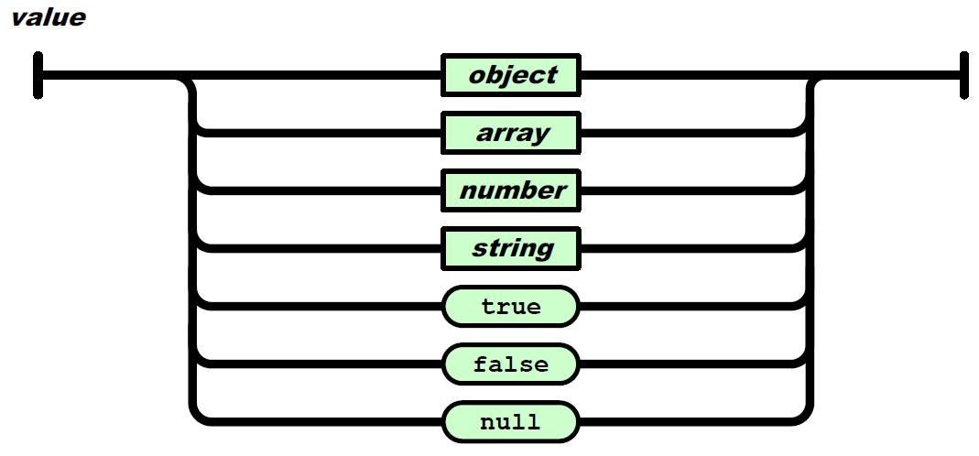
What is JSON
A JSON value must be an object, array, number, or string or one of following literals: false, null, true
A string must be wrapped in double quotation marks.

Slide 16
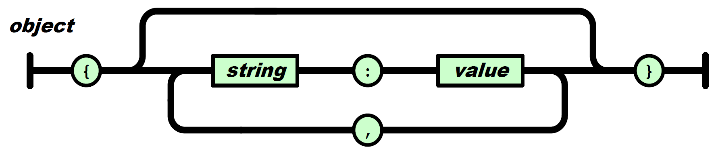
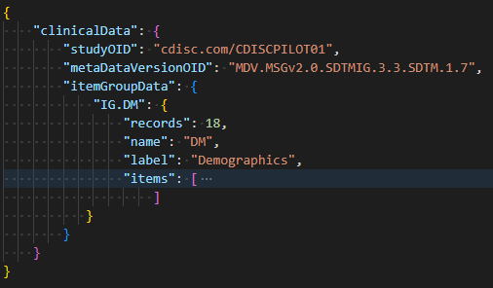
What is JSON - JSON Object

Slide 17
What is JSON - JSON Object
JSON objects: simple notation for expressing collections of name/value pairs
No restrictions on the strings used as names
No requirement that name strings be unique
No significance to the ordering of name/value pairs
Invalid "JSON" object – no quotes around "name" and "label"
Invalid "JSON" object – single quotes instead of double quotes
Valid JSON object

Slide 18
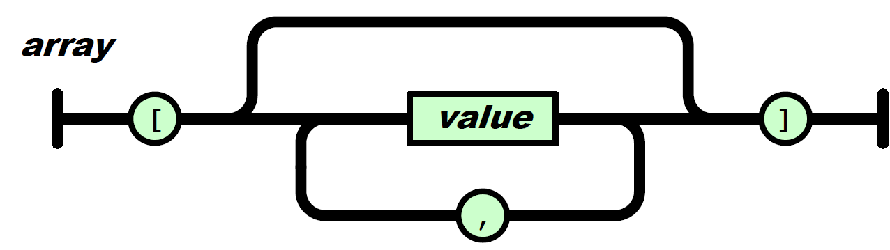
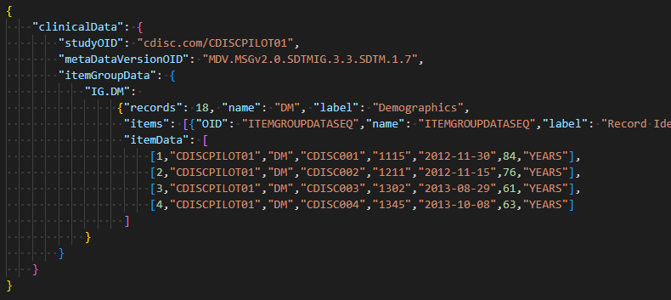
What is JSON - JSON Array

Slide 19
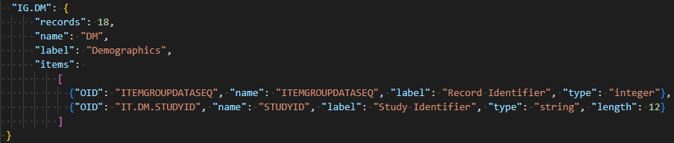
What is JSON - JSON Array

Slide 20


What is JSON - JSON Array
Array structures often used where there is some semantics to the ordering
JSON arrays provide support for ordered lists of values
There is no requirement that the values in an array be of the same type.
Invalid "JSON" array – missing values incorrectly represented
Valid JSON array - for missing values use null or an empty string (string value)

Slide 21
What is JSON - JSON Objects and Arrays
JSON objects and arrays can be nested
This means that pretty much any simple or complex data structure can be presented
ordinary arrays
associative arrays
lists
symbol tables
sets
records
graphs
trees
…

Slide 22
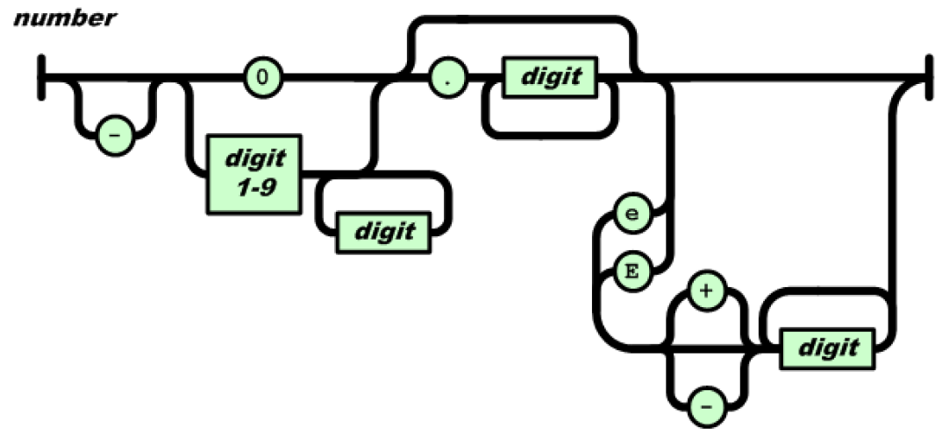
What is JSON - Numbers
JSON is agnostic about the semantics of numbers.
A number is a sequence of digits (no double, float, or decimal data types)
It may have a preceding minus sign, fractional part or exponent

Slide 23
What is JSON - Strings
A string in JSON is a sequence of Unicode code points wrapped with quotation marks
Some code points must be escaped by a backslash (\)
\" quotation mark
\\ backslash
\b backspace
\f form feed
\n line feed
\r carriage return
\t character tabulation
Any code point may be represented as a hexadecimal escape sequence
The following four cases all produce the same result: "\u002F" "\u002f" "\/" "/"

Slide 24
Dataset-JSON Document Structure

Slide 25
Dataset-JSON Document Structure
Dataset-JSON was adapted from the Dataset-XML specification, but uses JSON format instead of XML
Specification: https://wiki.cdisc.org/display/ODM2/Dataset-JSON
GitHub repository with JSON Schema and examples: https://github.com/cdisc-org/DataExchange-DatasetJson
Each Dataset-JSON file is connected with a Define-XML file, containing detailed information about the metadata
Each Dataset-JSON files contains basic information about dataset variables, so that it is possible to have a simple view of the contents of a dataset without the need of a Define-XML document

Slide 26
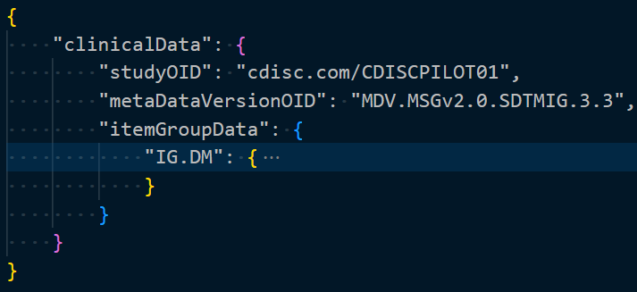
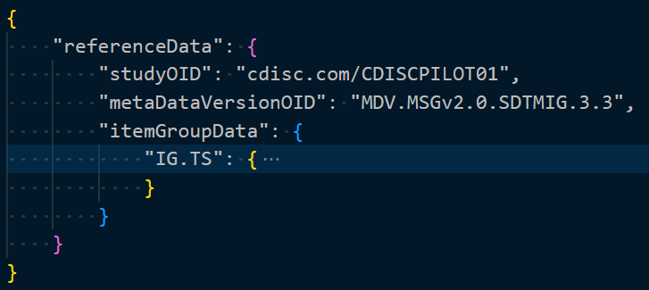
Dataset-JSON Document Structure
At the top level of the Dataset-JSON object, there are one of two optional attributes: clinicalData, referenceData.
Subject data is stored in clinicalData and non-subject data is stored in referenceData.
studyOID and metaDataVersionOID must match corresponding values in Define-XML

Slide 27
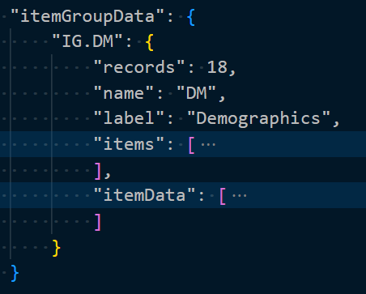
Dataset-JSON Document Structure
itemGroupData is an object with attributes corresponding to individual datasets.
The attribute name (IG.DM) is the OID of a described dataset, which must be the same as OID of the corresponding itemGroup in the Define-XML file
records, name, label: basic dataset information
items - basic information about variables
itemData - dataset data

Slide 28
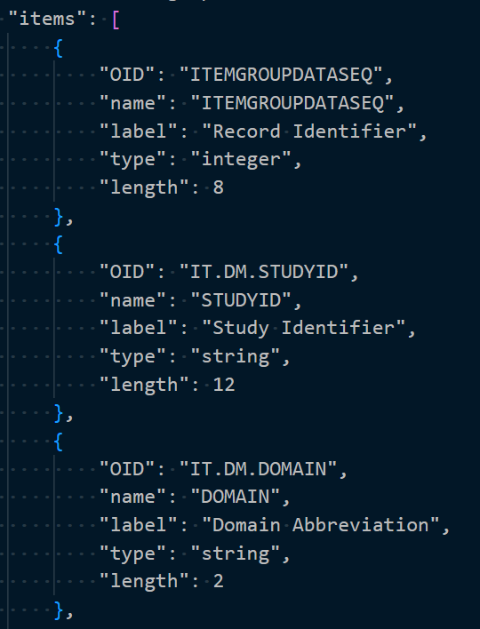
Dataset-JSON Document Structure
items - array of basic information about dataset variables.
The order of elements in the array must be the same as the order of variables in the described dataset.
The first element always describes the Record Identifier (ITEMGROUPDATASEQ)

Slide 29
Dataset-JSON Document Structure
OID - OID of a variable (must correspond to the variable OID in the Define-XML file)
name - variable name
label - variable description
type - type of the variable. 'string', 'integer', 'decimal', 'float', 'double', 'boolean'
length - variable length - most useful for the string type
The length attribute is optional

Slide 30
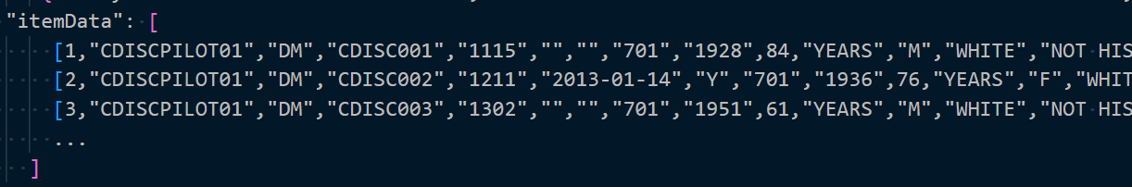
Dataset-JSON Document Structure
itemData is an array of records with variables values
Each record itself is represented as an array of variables values
The first value is a unique sequence number for each record in the dataset
Missing values are represented by null in the case of numeric variables, and an empty string in case of character variables: [1, "MyStudy", "", "DM", null]

Slide 31
SAS and JSON

Slide 32
SAS and JSON
In previous papers I showed how to use PROC LUA and a JSON Lua library in SAS to process JSON files:
Parsing JSON Files in SAS© Using PROC LUA (PHUSE 2021)
Extracting Data Standards Metadata and Controlled Terminology from the CDISC Library using SAS with PROC LUA (PharmaSUG 2021)
The Lua JSON libraries are an efficient way to manage complex JSON files in SAS that are not too big
Using SAS can cumbersome when dealing with complex JSON files as it requires the merging of many datasets and dealing with the management of JSON MAP files to correct decisions that the SAS JSON automapper makes in terms of variable types and variable lengths
PROC LUA reads the entire JSON file into a Lua table that is kept in memory
This works well with REST APIs and metadata tables but can lead to issues when working with very large datasets

Slide 33
SAS and JSON
Since the Dataset-JSON format is simple and files might get very large I used native SAS© technology for reading and writing Dataset-JSON files
It was always possible to create output compliant with the JSON structure using SAS put statements or to parse JSON files in a data step --- a very tedious process!
Starting in SAS© 9.4, you can use PROC JSON to write SAS data sets to JSON files
Starting in SAS© 9.4TS1M4, you can use the JSON engine to read JSON files into SAS data sets

Slide 34
Writing Dataset-JSON with SAS

Slide 35
Writing Dataset-JSON with SAS
PROC JSON in SAS© gives the user control over the JSON output:
through the utilization of options
through the ability to control containers (objects or arrays)
by writing directly to the output file
by choosing exactly what to include or not include in the resulting JSON file
PROC JSON OUT=fileref | "external-file" <options>;
EXPORT <libref.>SAS-data-set <(data-set-options)> </options>;
WRITE VALUES value(s) </options>;
WRITE OPEN type;
WRITE CLOSE;
RUN;

Slide 36
Writing Dataset-JSON with SAS
PROC JSON options (I used the underlined)
PRETTY | NOPRETTY - how to format the JSON output
FMTxxx | NOFMTxxx - whether to apply a character, numeric or date/time SAS format to the resulting output if a such a SAS format is associated with a SAS data set variable
KEYS | NOKEYS - whether exported observations are written as JSON objects or as JSON arrays
SASTAGS | NOSASTAGS - include or suppress SAS metadata
SCAN | NOSCAN - scans and encodes input strings to ensure that only characters that are acceptable are exported to the JSON output file
TRIMBLANKS | NOTRIMBLANKS - remove or retain trailing blanks from the end of character data in the JSON OUTPUT

Slide 37
Writing Dataset-JSON with SAS
The EXPORT statement
identifies the SAS data set to be exported
allows to control the resulting output by using options that are specific to PROC JSON
Allows to control SAS data set options that are applied to the input SAS data set.
Same options as on the previous slide (except PRETTY / NOPRETTY)
If the EXPORT statement is the first statement after the PROC JSON statement, the top-level container is a JSON object
if the NOSASTAGS option is specified in either the PROC JSON or the EXPORT statement, the top-level container is a JSON array

Slide 38
Writing Dataset-JSON with SAS
The WRITE statement allows the user to write one or more literal values to the JSON output file
The value can be either a string, a number, a Boolean value (TRUE or FALSE), or NULL
SCAN | NOSCAN and TRIMBLANKS | NOTRIMBLANKS can be specified
The WRITE OPEN <type> and WRITE CLOSE statements allow the user to open, close, and nest containers
<type> in the WRITE OPEN statement can be either ARRAY or OBJECT

Slide 39
Writing Dataset-JSON with SAS
PROC JSON OUT=jsonfout PRETTY; WRITE OPEN OBJECT; WRITE VALUES "clinicalData"; WRITE OPEN OBJECT; WRITE VALUES "studyOID" "<study OID>"; WRITE VALUES "metaDataVersionOID" "<MDV OID>"; WRITE VALUES "itemGroupData"; WRITE OPEN OBJECT; WRITE VALUES "IG.DM"; WRITE OPEN OBJECT; WRITE VALUES "records" 18; WRITE VALUES "name" "DM"; WRITE VALUES "label" "Demographics"; WRITE VALUES "items"; WRITE OPEN ARRAY; EXPORT work.column_metadata / KEYS; WRITE CLOSE; WRITE VALUES "itemData"; WRITE OPEN ARRAY; EXPORT work.column_data / NOKEYS; WRITE CLOSE; WRITE CLOSE; WRITE CLOSE; WRITE CLOSE; WRITE CLOSE; RUN;
{ "clinicalData": { "studyOID": "<study OID>", "metaDataVersionOID": "<MDV OID>", "itemGroupData": { "IG.DM": { "records": 18, "name": "DM", "label": "Demographics", "items": [
],
"itemData": [
] } } } }
column metadata
Column data

Slide 40
Writing Dataset-JSON with SAS
PROC JSON OUT=jsonfout PRETTY; WRITE OPEN OBJECT; WRITE VALUES "clinicalData"; WRITE OPEN OBJECT; WRITE VALUES "studyOID" "<study OID>"; WRITE VALUES "metaDataVersionOID" "<MDV OID>"; WRITE VALUES "itemGroupData"; WRITE OPEN OBJECT; WRITE VALUES "IG.DM"; WRITE OPEN OBJECT; WRITE VALUES "records" 18; WRITE VALUES "name" "DM"; WRITE VALUES "label" "Demographics"; WRITE VALUES "items"; %* Use macro to avoid creating null values for missing attributes; %write_json_metadata_array(work.column_metadata); WRITE CLOSE; WRITE VALUES "itemData"; WRITE OPEN ARRAY; EXPORT work.column_data / NOKEYS; WRITE CLOSE; WRITE CLOSE; WRITE CLOSE; WRITE CLOSE; WRITE CLOSE; RUN;
{ "clinicalData": { "studyOID": "<study OID>", "metaDataVersionOID": "<MDV OID>", "itemGroupData": { "IG.DM": { "records": 18, "name": "DM", "label": "Demographics", "items": [
],
"itemData": [
] } } } }
column metadata
Column data

Slide 41

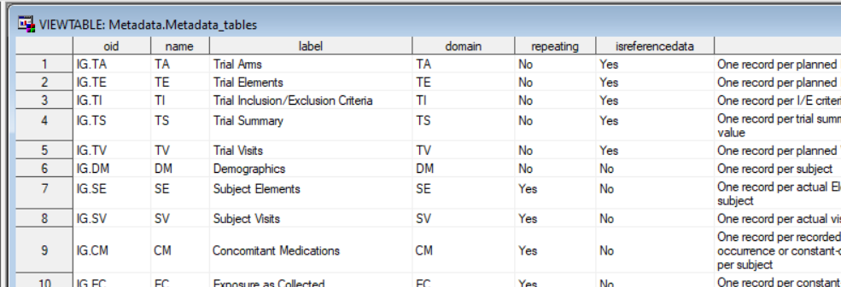
Writing Dataset-JSON with SAS - metadata

Slide 42
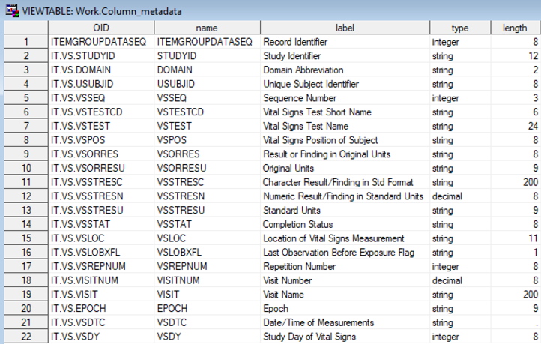
Writing Dataset-JSON with SAS - column metadata

Slide 43
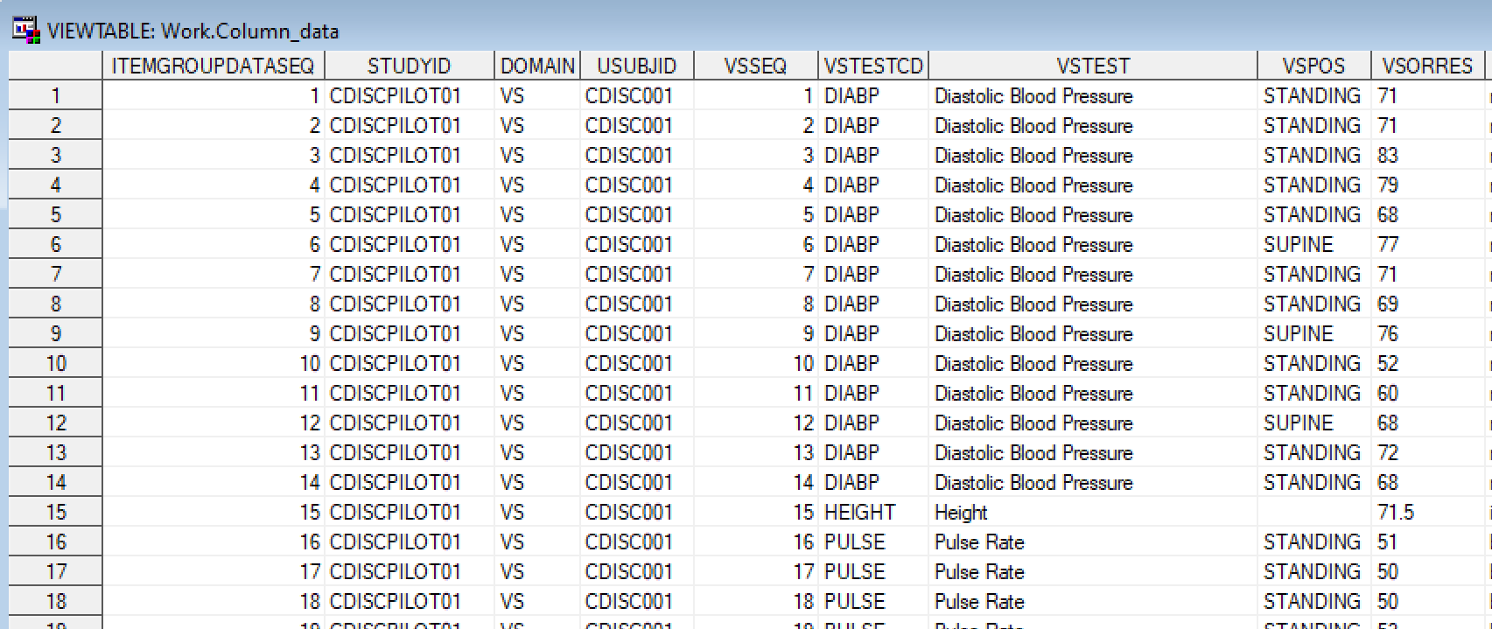
Writing Dataset-JSON with SAS - column data

Slide 44
Reading Dataset-JSON with SAS

Slide 45
Reading Dataset-JSON with SAS
Starting in SAS© 9.4TS1M4, you can use the JSON engine to read JSON files into SAS data sets
A JSON map is a file that the JSON engine uses to define the data set structures that are created when reading JSON
Without a specified map, the JSON engine will automatically create a map
AUTOMAP = REUSE uses the MAP fileref if the file exists. Otherwise, generates a map
AUTOMAP = CREATE generates a JSON map and writes it to the MAP fileref
A data set named ALLDATA is created by default when the JSON engine runs. The ALLDATA data set contains all of the information in the JSON file. This can be turned off with the NOALLDATA option
The generated data sets contain ordinal variables, which are key variables that provide a relationship between the data sets to help with merging. Ordinal variables will not be created when ORDINALCOUNT= NONE

Slide 46
Reading Dataset-JSON with SAS
FILENAME jsonfile <path to the JSON file>";
FILENAME mapfile "<path to the MAP file to be created>";
LIBNAME data_out "<path to the output folder>";
LIBNAME jsonfile JSON FILEREF=jsonfile MAP=mapfile AUTOMAP=CREATE NOALLDATA ORDINALCOUNT=NONE;
PROC COPY IN=jsonfile OUT=data_out;
RUN;

Slide 47
Reading Dataset-JSON with SAS
{ "clinicalData": { "studyOID": "<study OID>", "metaDataVersionOID": "<MDV OID>", "itemGroupData": { "IG.DM": { "records": 18, "name": "DM", "label": "Demographics", "items": [
]
"itemData": [
] } } } }
Creates 4 data sets:
CLINICALDATA
studyOID, metaDataVersionOID
ITEMGROUPDATA_IG_DM
records, name, label
IG_DM_ITEMS
contains column metadata
IG_DM_ITEMDATA
contains column data
column metadata
column data

Slide 48

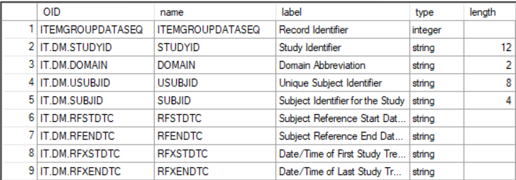
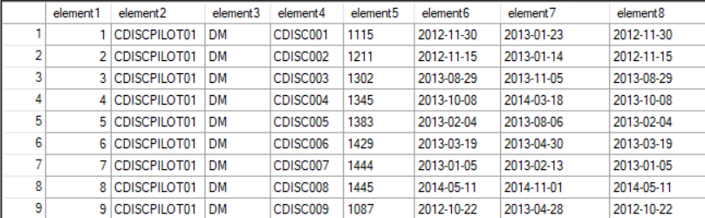
Reading Dataset-JSON with SAS
ITEMGROUPDATA_IG_DM
IG_DM_ITEMS
IG_DM_ITEMDATA

Slide 49
Conclusion

Slide 50
Conclusion
Dataset-JSON provides an efficient alternative to SAS Version 5 Transport files with full support for UTF-8
Dataset-JSON is good step towards a modern API-based communication protocol
SAS fully supports reading and writing Dataset-JSON files

Slide 51

GitHub Repository: https://github.com/lexjansen/dataset-json-sas
Email: lexjansen@gmail.com ljansen@cdisc.org
Web: https:\\www.lexjansen.com
LinkedIn: https://www.linkedin.com/in/lexjansen/

