Slide 1


Dataset-JSON: SAS© implementation
Lex Jansen
Senior Director, Data Science Development, CDISC (contractor)
CDISC Q3 COSA Quarterly Spotlight Webinar - 2023-10-05

Slide 2

About your presenter
16 years in an IT/Standards role in Biostatistics at Organon
4 years as a consultant to help companies implement CDISC
11 years at SAS.
8 years as a Principal Software Developer working on SAS Clinical Standards Toolkit (implementing mostly XML based standards (Define-XML, ODM, Dataset-XML)) and SAS Life Science Analytics Framework (Java)
3 years as Principal Solution Consultant at SAS implementing Life Science Analytics Framework
Since Nov 2021 Senior Director, Data Science Development at CDISC (contractor)
Core member of the CDISC Data Exchange Standards team since 2008. (co-lead since Nov 2021)
Core member of the CDISC Define-XML development team.
One of the main Define-XML v2 developers.
Developer of CDISC/PhUSE Define-XML v2 stylesheet.
One of the main developers of the Analysis Results Metadata v1.0 for Define-XML v2.0 extension

Slide 3
Agenda
Dataset-JSON Document Structure
SAS and JSON
Writing Dataset-JSON with SAS
Reading Dataset-JSON with SAS
Comparing SAS datasets / Dataset-JSON files
Validating Dataset-JSON files
Demo

Slide 4
Dataset-JSON Document Structure

Slide 5
Dataset-JSON Document Structure
Dataset-JSON was adapted from the Dataset-XML specification, but uses JSON format instead of XML
Each Dataset-JSON file is connected with a Define-XML file, containing detailed metadata
Each Dataset-JSON files contains basic information about dataset variables, so that it is possible to have a simple view of the contents of a dataset without the need of a Define-XML document
Dataset-JSON Specification:
https://www.cdisc.org/dataset-json
https://wiki.cdisc.org/display/PUB/Dataset-JSON
GitHub repository with JSON Schema and examples: https://github.com/cdisc-org/DataExchange-DatasetJson

Slide 6
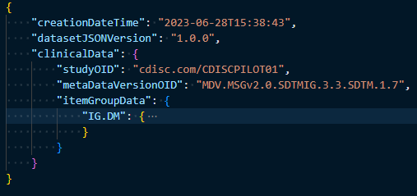
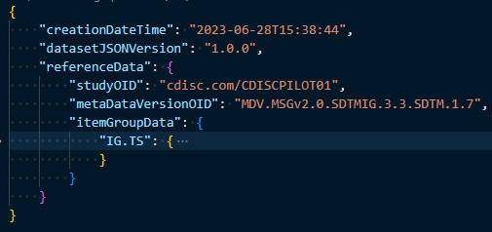
Dataset-JSON Document Structure
At the top level of the Dataset-JSON object, there are some required attributes (creationDateTime and datasetJSONVersion)*, and one of two optional attributes: clinicalData or referenceData.
Subject data is stored in clinicalData and non-subject data is stored in referenceData.
studyOID and metaDataVersionOID must match corresponding values in Define-XML
*See the specification for other optional attributes

Slide 7
Dataset-JSON Document Structure - top level attributes
Attribute | Usage | Description
creationDateTime | Required | Time of creation of the file containing the document.
datasetJSONVersion | Required | Version of Dataset-JSON standard
fileOID | Optional | A unique identifier for this file.
asOfDateTime | Optional | The date/time at which the source database was queried in order to create this document.
originator | Optional | The organization that generated the Dataset-JSON file.
sourceSystem | Optional | The computer system or database management system that is the source of the information in this file.
sourceSystemVersion | Optional | The version of the "SourceSystem" above.
clinicalData | Optional | Contains datasets for clinical data across multiple subjects.
referenceData | Optional | Contains datasets for non-subject data domains.

Slide 8
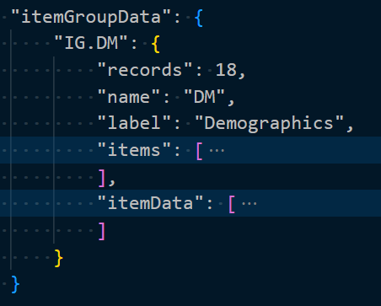
Dataset-JSON Document Structure
itemGroupData is an object with attributes corresponding to individual datasets.
The attribute name (IG.DM) is the OID of a described dataset, which must be the same as the OID of the corresponding itemGroup in the Define-XML file
records, name, label: basic dataset information (all required)
items - basic information about variables
itemData - dataset data

Slide 9
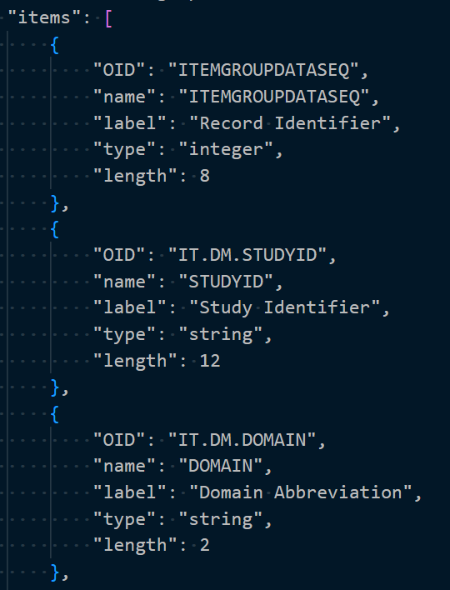
Dataset-JSON Document Structure
items - array of basic information about dataset variables.
The order of elements in the array must be the same as the order of variables in the described dataset.
The first element always describes the Record Identifier (ITEMGROUPDATASEQ)

Slide 10
Dataset-JSON Document Structure
OID - OID of a variable (must correspond to the variable OID in the Define-XML file)
name - variable name
label - variable description
type - type of the variable. 'string', 'integer', 'decimal', 'float', 'double', 'boolean'
length - variable length - most useful for the string type
displayFormat - supports data visualization of numeric float and date values
keySequence - indicates that this item is a key variable in the dataset structure
The last 3 attributes are optional

Slide 11
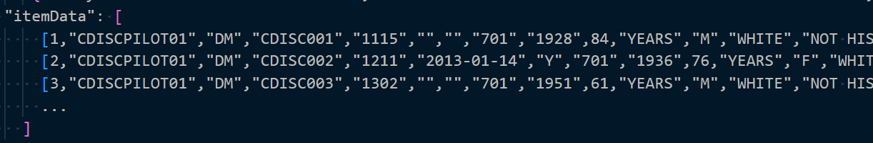
Dataset-JSON Document Structure
itemData is an array of records with variables values
Each record itself is represented as an array of variables values
The first value is a unique sequence number for each record in the dataset
Missing values are represented by null in the case of numeric variables, and an empty string in case of character variables: [1, "MyStudy", "", "DM", null]

Slide 12
SAS and JSON

Slide 13
SAS and JSON
Starting in SAS© 9.4, you can use PROC JSON to write SAS data sets to JSON files
Starting in SAS© 9.4TS1M4, you can use the JSON engine to read JSON files into SAS data sets

Slide 14
Writing Dataset-JSON with SAS

Slide 15
Writing Dataset-JSON with SAS
PROC JSON in SAS© gives the user control over the JSON output:
through the utilization of options
through the ability to control containers (objects or arrays)
by writing directly to the output file
by choosing exactly what to include or not include in the resulting JSON file
PROC JSON OUT=fileref | "external-file" <options>;
EXPORT <libref.>SAS-data-set <(data-set-options)> </options>;
WRITE VALUES value(s) </options>;
WRITE OPEN type;
WRITE CLOSE;
RUN;

Slide 16
Writing Dataset-JSON with SAS
PROC JSON OUT=jsonfout PRETTY; WRITE OPEN OBJECT; WRITE VALUES "creationDateTime" "&CurrentDateTime"; WRITE VALUES "datasetJSONVersion" "1.0.0"; WRITE VALUES "clinicalData"; WRITE OPEN OBJECT; WRITE VALUES "studyOID" "<study OID>"; WRITE VALUES "metaDataVersionOID" "<MDV OID>"; WRITE VALUES "itemGroupData"; WRITE OPEN OBJECT; WRITE VALUES "IG.DM"; WRITE OPEN OBJECT; WRITE VALUES "records" 18; WRITE VALUES "name" "DM"; WRITE VALUES "label" "Demographics"; WRITE VALUES "items"; WRITE OPEN ARRAY; EXPORT work.column_metadata / KEYS; WRITE CLOSE; WRITE VALUES "itemData"; WRITE OPEN ARRAY; EXPORT work.column_data / NOKEYS; WRITE CLOSE; WRITE CLOSE; WRITE CLOSE; WRITE CLOSE; WRITE CLOSE; RUN;
{ "creationDateTime": "2023-06-28T15:38:43", "datasetJSONVersion": "1.0.0", "clinicalData": { "studyOID": "<study OID>", "metaDataVersionOID": "<MDV OID>", "itemGroupData": { "IG.DM": { "records": 18, "name": "DM", "label": "Demographics", "items": [
],
"itemData": [
] } } } }
column metadata
Column data
EXPORT creates empty strings or null with missing data..

Slide 17
Writing Dataset-JSON with SAS
PROC JSON OUT=jsonfout PRETTY; WRITE OPEN OBJECT; WRITE VALUES "creationDateTime" "&CurrentDateTime"; WRITE VALUES "datasetJSONVersion" "1.0.0"; WRITE VALUES "clinicalData"; WRITE OPEN OBJECT; WRITE VALUES "studyOID" "<study OID>"; WRITE VALUES "metaDataVersionOID" "<MDV OID>"; WRITE VALUES "itemGroupData"; WRITE OPEN OBJECT; WRITE VALUES "IG.DM"; WRITE OPEN OBJECT; WRITE VALUES "records" 18; WRITE VALUES "name" "DM"; WRITE VALUES "label" "Demographics"; WRITE VALUES "items"; WRITE OPEN ARRAY; %write_json_metadata_array(work.column_metadata); WRITE CLOSE; WRITE VALUES "itemData"; WRITE OPEN ARRAY; EXPORT work.column_data / NOKEYS; WRITE CLOSE; WRITE CLOSE; WRITE CLOSE; WRITE CLOSE; WRITE CLOSE; RUN;
{ "creationDateTime": "2023-06-28T15:38:43", "datasetJSONVersion": "1.0.0", "clinicalData": { "studyOID": "<study OID>", "metaDataVersionOID": "<MDV OID>", "itemGroupData": { "IG.DM": { "records": 18, "name": "DM", "label": "Demographics", "items": [
],
"itemData": [
] } } } }
column metadata
Column data
The %write_json_metadata_array macro does not write key-value pairs when the value is null.

Slide 18
Using Define-XML metadata when creating Dataset-JSON
/* Create metadata from Define-XML for ADaM */ %CreateMetadataFromDefineXML( definexml=&root/json/adam/define.xml, metadatalib=metaadam ); /* Some manual data type updates */ data metaadam.metadata_columns; set metaadam.metadata_columns; if xml_datatype='float' and index(name, 'VISIT') then json_datatype='decimal'; run;
/* Create metadata from Define-XML for SDTM */ %CreateMetadataFromDefineXML( definexml=&root/json/sdtm/define.xml, metadatalib=metasdtm ); /* Some manual data type updates */ data metasdtm.metadata_columns; set metasdtm.metadata_columns; if xml_datatype='float' and name ne 'LBSTRESN' then json_datatype='decimal'; run;
Get OIDs from Define-XML when creating Dataset-JSON
Use pre-specified metadata from Define-XML (label, datatype, length, and KeySequence) for creating Dataset-JSON
Get variable display formats from Define-XML when creating SAS datasets from Dataset-JSON (especially for numeric date/time variables)
Important to check that Define-XML is consistent with the data!

Slide 19
Writing Dataset-JSON - %write_datasetjson()
%write_datasetjson(
dataset= /* (libname.)memname of the data set */
xptpath=, /* Path to XPT file */
jsonpath=, /* Path to Dataset-JSON file */
usemetadata=N, /* Use Define-XML metadata? (Y/N */
metadatalib=, /* Define-XML metadata library */
datasetJSONVersion=1.0.0,
fileOID=,
asOfDateTime=,
originator=,
sourceSystem=,
sourceSystemVersion=,
studyOID=,
metaDataVersionOID=,
metaDataRef=,
pretty=NOPRETTY);

Slide 20
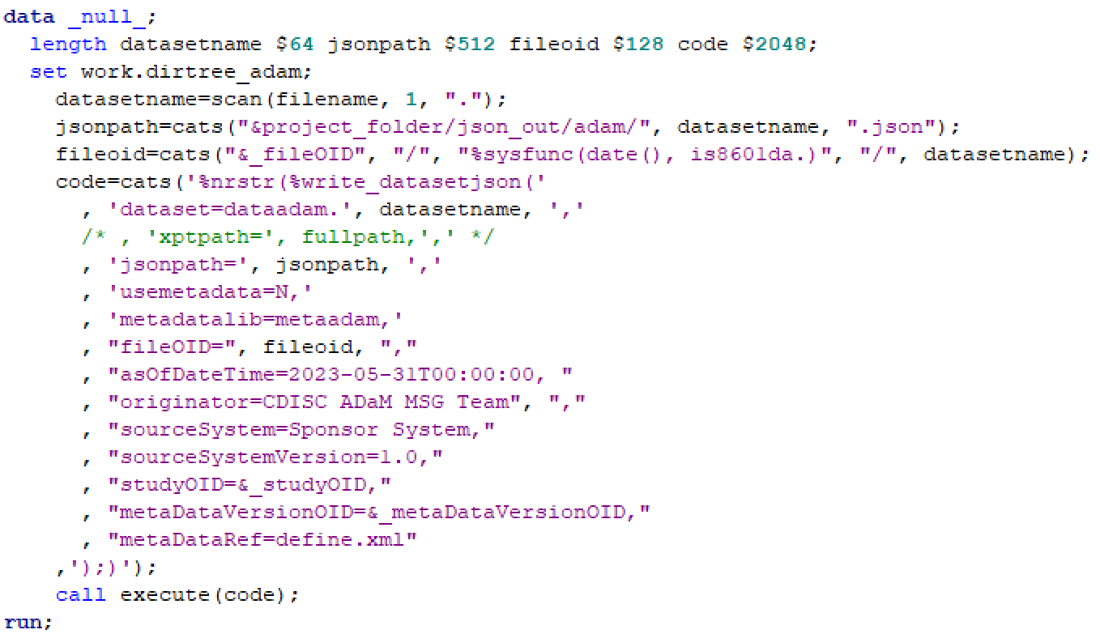
Writing Dataset-JSON - %write_datasetjson() - loop

Slide 21
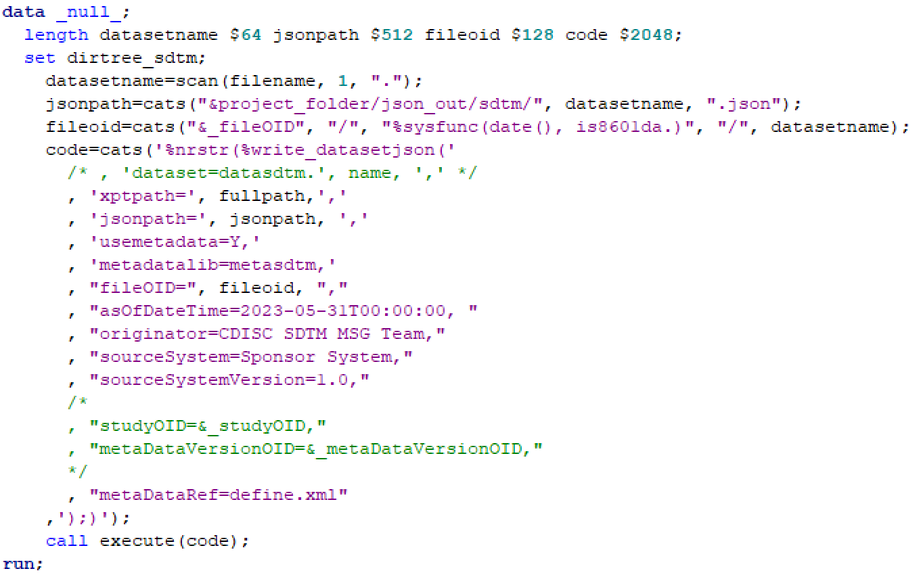
Writing Dataset-JSON - %write_datasetjson() - loop

Slide 22
Reading Dataset-JSON with SAS

Slide 23
Reading Dataset-JSON with SAS
Starting in SAS© 9.4TS1M4, you can use the JSON engine to read JSON files into SAS data sets
A JSON map is a file that the JSON engine uses to define the data set structures that are created when reading JSON

Slide 24
Reading Dataset-JSON with SAS
FILENAME jsonfile "<path to the JSON file>";
FILENAME mapfile "<path to the MAP file to be created>";
LIBNAME data_out "<path to the output folder>";
LIBNAME jsonfile JSON FILEREF=jsonfile MAP=mapfile AUTOMAP=CREATE NOALLDATA ORDINALCOUNT=NONE;
PROC COPY IN=jsonfile OUT=data_out;
RUN;

Slide 25
Reading Dataset-JSON with SAS
Creates 6 data sets:
ALLDATA
CLINICALDATA
studyOID, metaDataVersionOID
ITEMGROUPDATA_IG_DM
records, name, label
IG_DM_ITEMS
contains column metadata (OID, name, label, type, length, displayFormat, keySequence)
IG_DM_ITEMDATA
contains column data (element1, element2, element3, …)
ROOT
contains creationDateTime, datasetJSONVersion
{ "creationDateTime": "<yyyy-mm-ddThh:mm:ss>", "datasetJSONVersion": "1.0.0", "clinicalData": { "studyOID": "<study OID>", "metaDataVersionOID": "<MDV OID>", "itemGroupData": { "IG.DM": { "records": 18, "name": "DM", "label": "Demographics", "items": [
]
"itemData": [
] } } } }
column metadata
column data

Slide 26

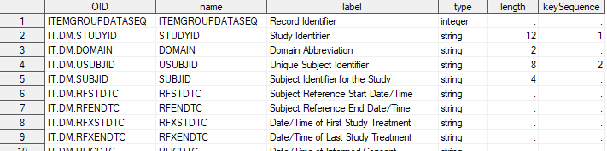
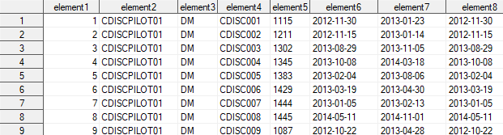
Reading Dataset-JSON with SAS
ITEMGROUPDATA_IG_DM
IG_DM_ITEMS
IG_DM_ITEMDATA

Slide 27
Reading Dataset-JSON - %read_datasetjson()
%read_datasetjson(
jsonpath=, /* Path to Dataset-JSON file */
datalib= /* Library to save SAS dataset */
dropseqvar=N, /* Drop ITEMGROUPDATASEQ variable? (Y/N) */
savemetadata=N, /* Save Dataset-JSON metadata? (Y/N) */
metadatalib= /* Library to save Dataset-JSON metadata */
);

Slide 28
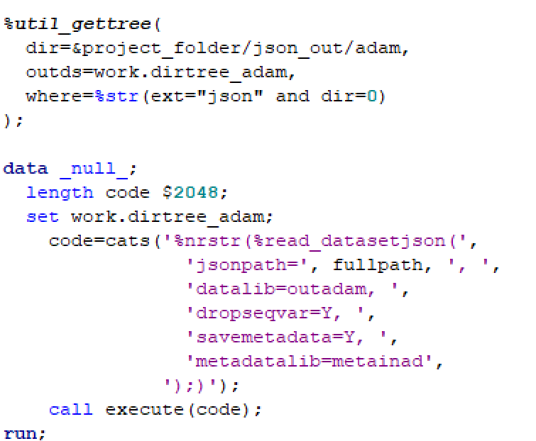
Reading Dataset-JSON - %read_datasetjson() - loop

Slide 29
Comparing SAS datasets / Dataset-JSON files

Slide 30
Comparing SAS datasets
Compare results in a summary
Details for datasets that had differences
%macro util_comparedata(
baselib=,
complib=,
dsname=,
compareoptions=%str(listall criterion=0.00000001 method=absolute),
resultds=,
detailall=N
);

Slide 31
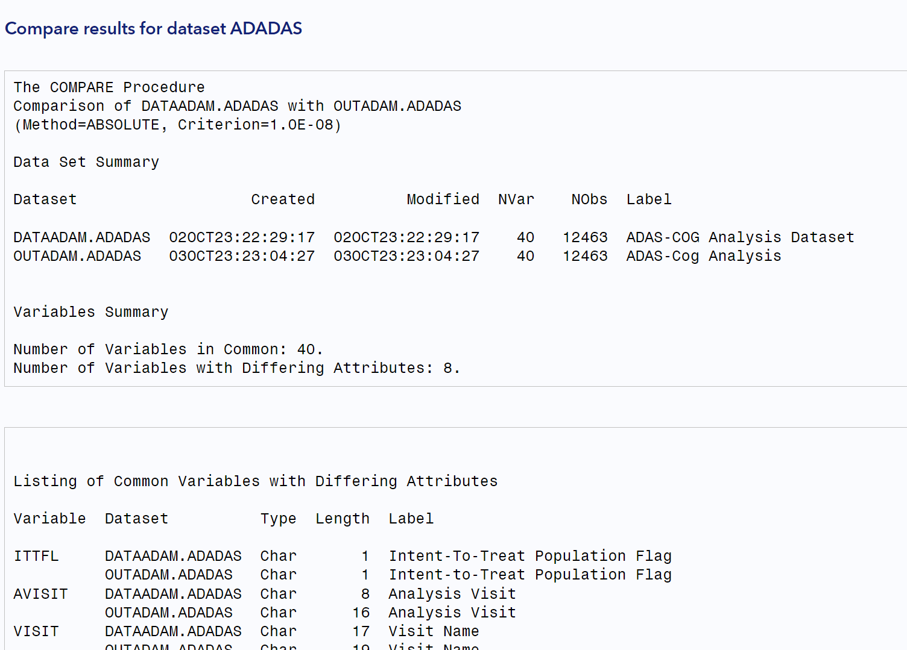
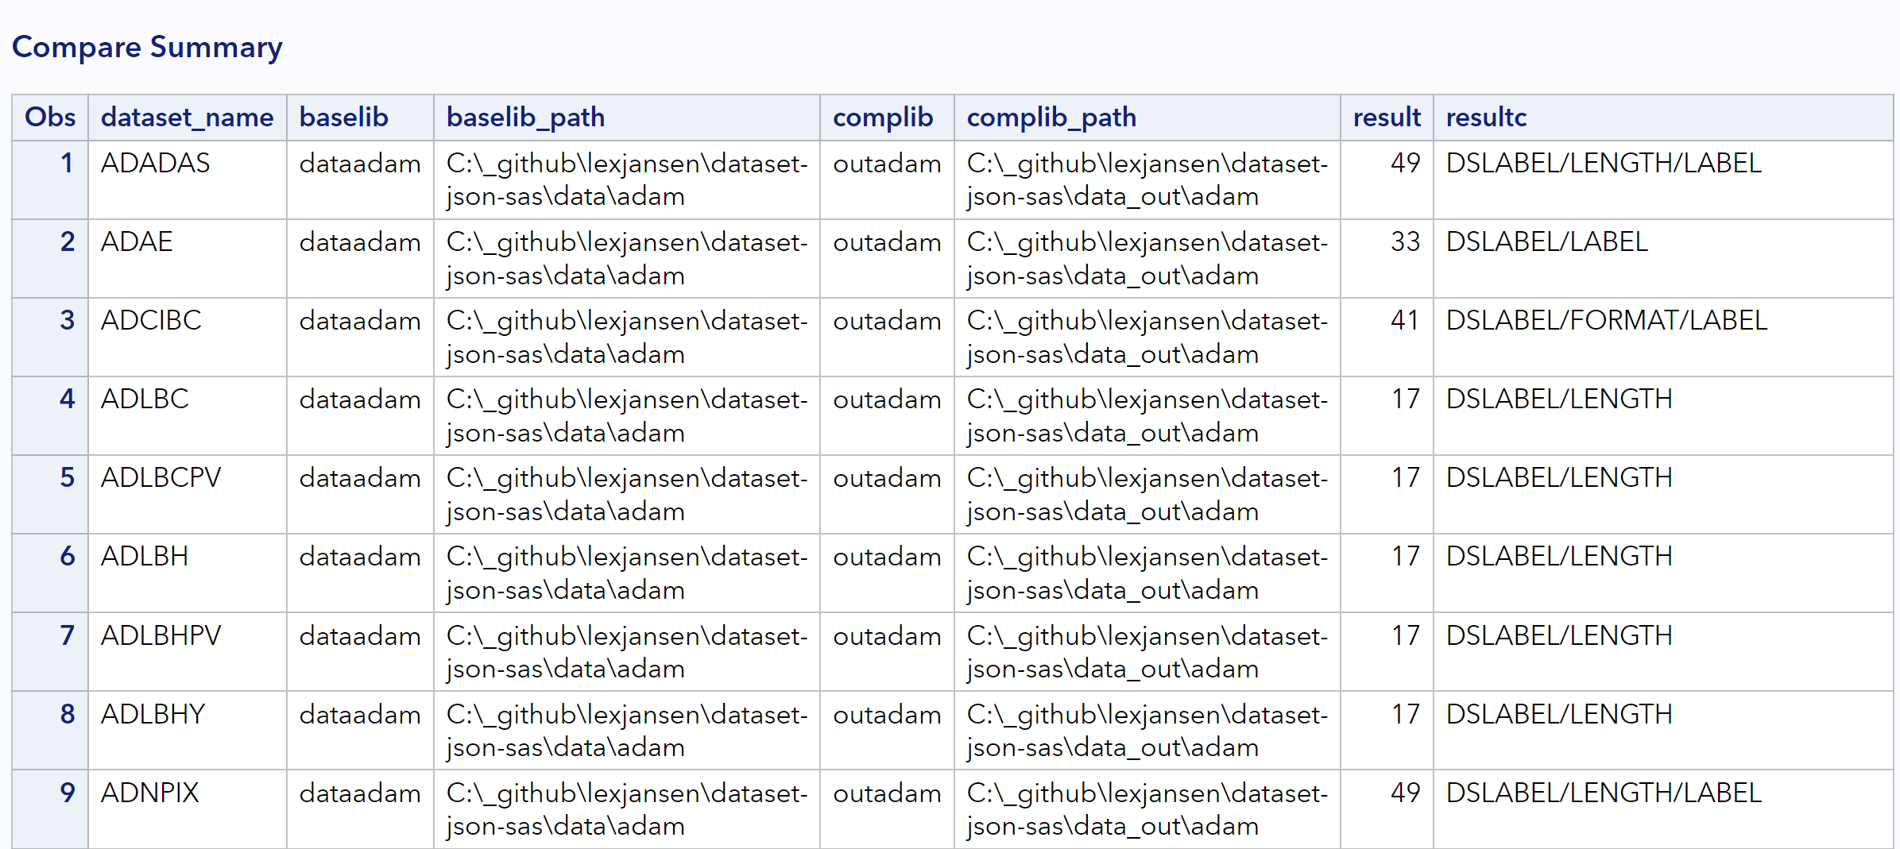
Comparing SAS datasets

Slide 32
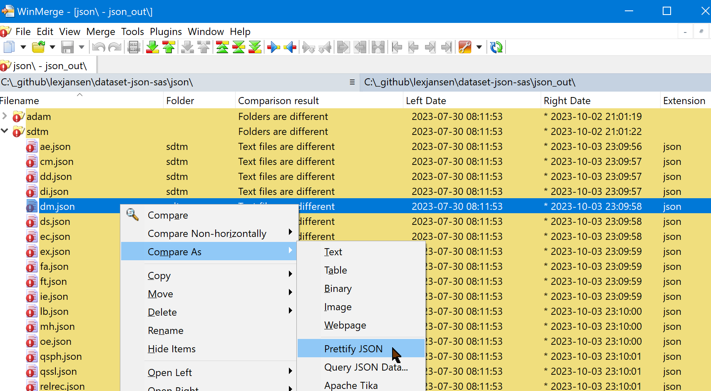
Comparing JSON files
WinMerge (https://winmerge.org) can compare JSON files in 'pretty' mode

Slide 33
Validating Dataset-JSON files

Slide 34
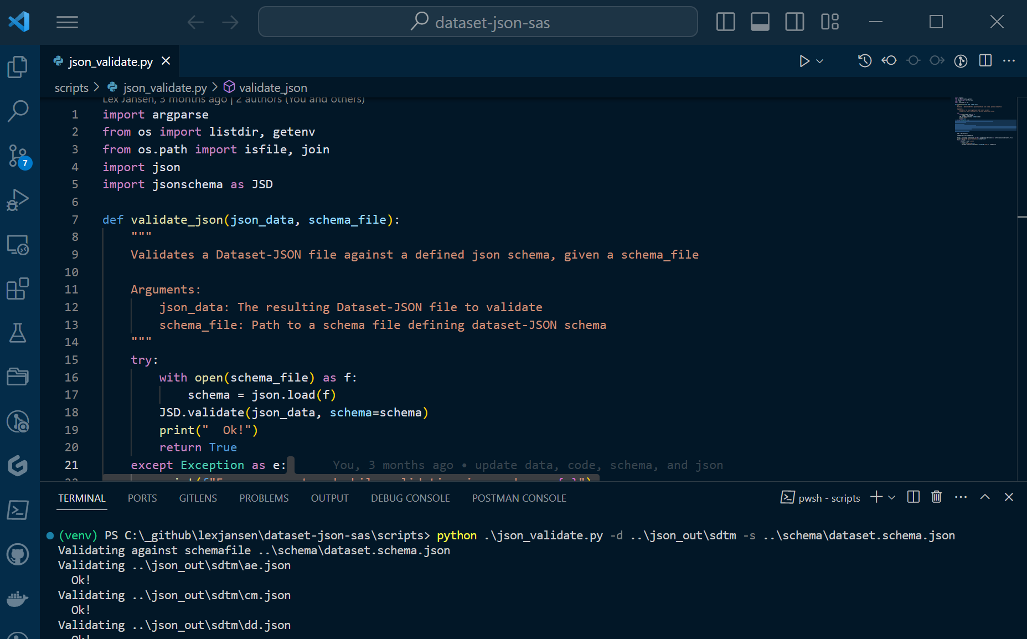
Validating Dataset-JSON files
python .\json_validate.py -d <folder> -s ..\schema\dataset.schema.json

Slide 35
Demo

Slide 36


GitHub: https://github.com/lexjansen/dataset-json-sas open issues at: https://github.com/lexjansen/dataset-json-sas/issues
Email: ljansen@cdisc.org lexjansen@gmail.com
Web: https:\\www.lexjansen.com
LinkedIn: https://www.linkedin.com/in/lexjansen/

