Slide 1
Dataset-JSON - SAS Implementation
Author: Lex Jansen
Repository: https://github.com/lexjansen/dataset-json-sas
Description: SAS macros and example programs used to create SAS datasets from Dataset-JSON as well as creating Dataset-JSON from SAS datasets. Metadata from Define-XML is read with Lua and used to for validation purposes and as pre-specified metadata.
Purpose: Demonstrate Dataset-JSON’s utility as a data exchange format.
License: MIT

Slide 2
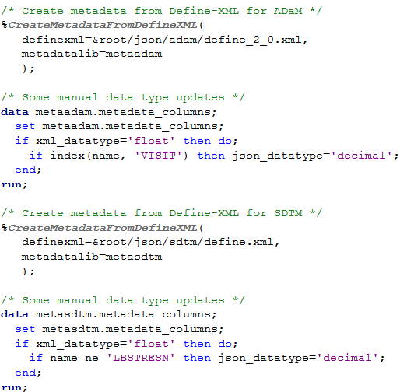
Using metadata from Define-XML
Get variable formats from Define-XML when creating SAS datasets from Dataset-JSON (especially for numeric date/time variables)
Get OIDs from Define-XML when creating Dataset-JSON
Use pre-specified metadata from Define-XML (length, label, datatype) for creating Dataset-JSON

Slide 3
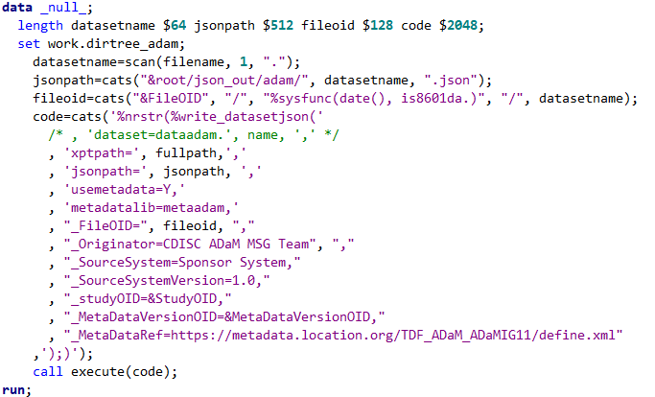
Writing Dataset-JSON - %write_datasetjson()

Slide 4
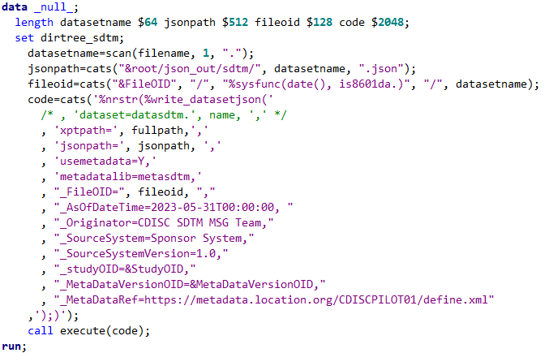
Writing Dataset-JSON - %write_datasetjson()

Slide 5
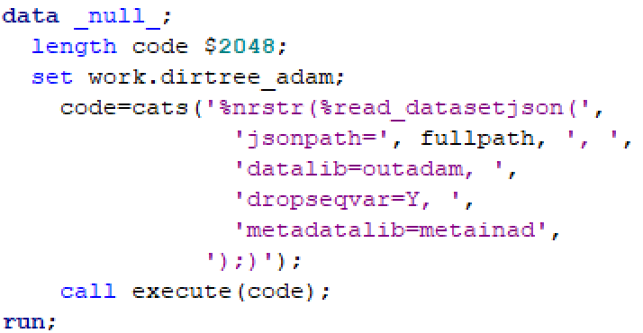

Reading Dataset-JSON - %read_datasetjson()

