Slide 1
MACHINE LEARNING AND ITS APPLICATIONS

Slide 2

MACHINE LEARNING?

Slide 3
The term Machine Learning was coined by Arthur Samuel in 1959, an American pioneer in the field of computer gaming and artificial intelligence.

Slide 4
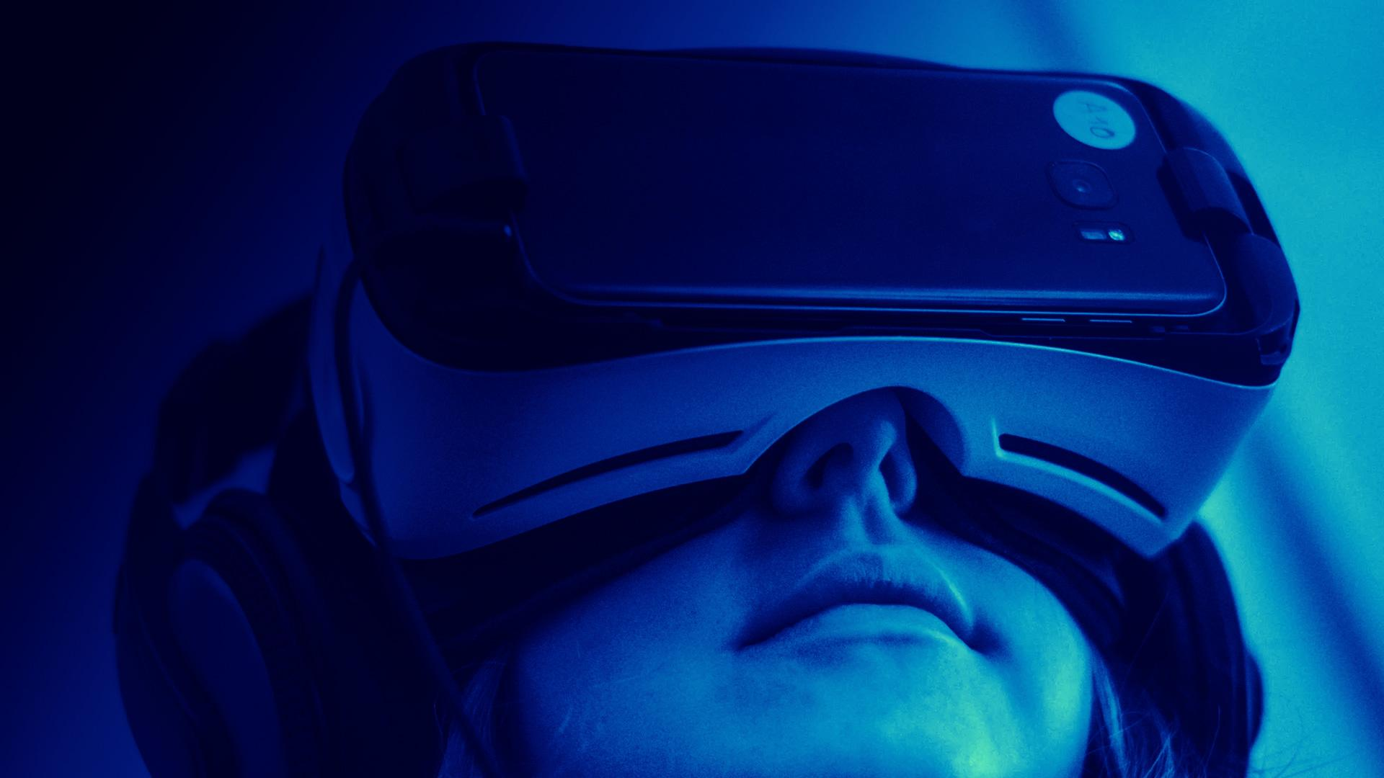
Machine Learning is the field of study that gives computers the capability to learn without being explicitly programmed.

Slide 5
A machine is said to learn from experience E with respect to some class of tasks T and performance measure P if its performance at tasks in T, as measured by P, improves with experience E.
-TOM MITCHELL

Slide 6
Example: playing checkers.
E = the experience of playing many games of checkers
T = the task of playing checkers.
P = the probability that the program will win the next game.

Slide 7
WHY?
Machine Learning provides smart alternatives to analyzing vast volumes of data.
By developing fast and efficient algorithms and data-driven models for real-time processing of data, Machine Learning can produce accurate results and analysis.

Slide 8
APPLICATIONS

Slide 9
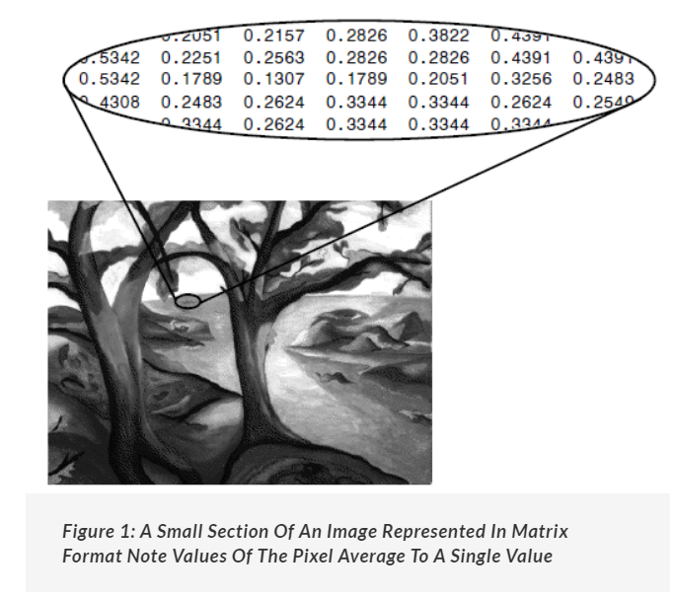
Image recognition
based on the intensity of the pixels in black and white images or colour images.
LDA (Linear Discriminant Analysis).

Slide 10
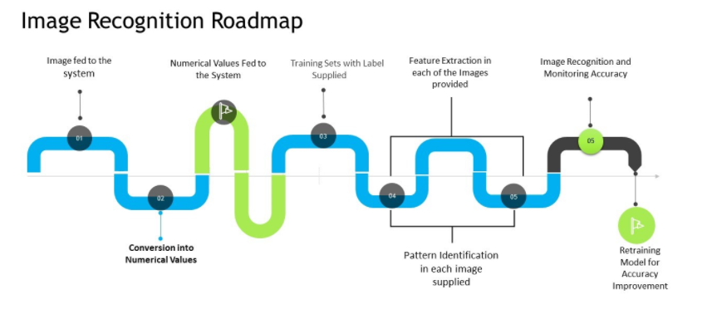

Slide 11
Medical diagnosis
Assisting in formulating a diagnosis or recommends a treatment option
Oncology and pathology use machine learning to recognise cancerous tissue
Analyse bodily fluids

Slide 12
AMA Journal of Ethics article, AI applications in healthcare “can now diagnose skin cancer more accurately than a board-certified dermatologist.” The article points to machine learning’s additional benefits, including diagnostics speed and efficiency and a shorter time frame for training an algorithm versus a human.

Slide 13
https://journalofethics.ama-assn.org/article/ethical-dimensions-using-artificial-intelligence-health-care/2019-02
https://healthinformatics.uic.edu/blog/machine-learning-in-healthcare/#:~:text=Machine%20learning%20algorithms%20can%20detect,innovate%20cancer%20diagnosis%20and%20treatment.

Slide 14

SOCIAL MEDIA!!

Slide 15
Suggesting Friends
Face Recognition

Slide 16
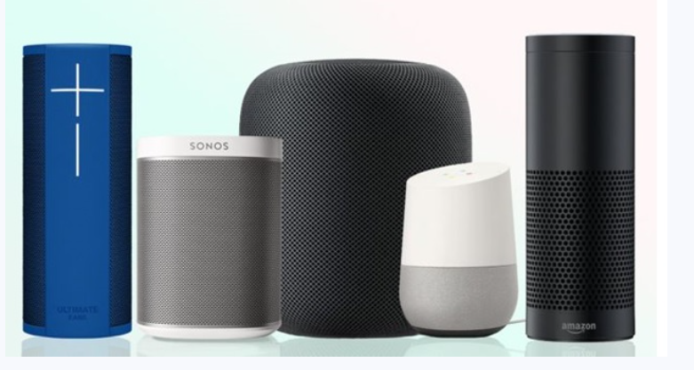
VIRTUAL ASSITANT

Slide 17
LINKS:
https://hackr.io/blog/real-world-machine-learning-applications
https://www.salesforce.com/eu/blog/2020/06/real-world-examples-of-machine-learning.html
https://www.nature.com/subjects/machine-learning
https://theconversation.com/global/topics/machine-learning-8332
https://www.youtube.com/watch?v=J6tgYBMXR6s&list=PLobzMSC-raKifQd9vHHPkMam_jrQEyzCX

Slide 18


