Slide 1
Human-Computer Interaction
Dr. Neha Rani
CEN 4721 Fall 2024

Slide 2
Announcements
Reminder:
You need to be working on implementation of Design A now
A working system is needed for Oct. 24th class session
Test 1 on Oct 10th
HomeWork 1 grades will be released later today

Slide 3
Usability Testing
Dr. Neha Rani
CEN 4721

Slide 4
Usability
What is usability:
Optimization of user’s interactions with the product
Usability is not a unidimensional construct
This is partly why simply saying a system is ‘usable’ or ‘not usable’ is not very helpful

Slide 5
Usability
Typical usability dimensions:
Effective to use (Effectiveness)
Efficient to use (Efficiency)
Safe to use (Safety)
Have good utility (Utility)
Easy to learn (Learnability)
Easy to remember (Memorability)
This is not a comprehensive list
Not all of these dimensions will apply to every interface/system
The designer has to make a judgment on what usability dimensions would make the most sense for a specific interface or depending on given goals

Slide 6
Goals of Usability Testing
Establish a baseline of user performance and user-satisfaction levels of the user interface for future usability evaluations
Establish and validate user performance measures
Identify potential design concerns to be addressed in order to improve the efficiency, productivity, and end-user satisfaction
Example errors:
Navigation errors – failure to locate functions, excessive keystrokes to complete a function, failure to follow recommended screen flow, …
Presentation errors – failure to locate and properly act upon desired information in screens, selection errors due to labeling ambiguities, …
Control usage problems – improper toolbar or entry field usage, …

Slide 7
Usability Testing: What
Carefully measure performance on prepared tasks typical for system’s intended uses
Emphasizes collection of quantitative data
Though qualitative data may also be collected (e.g., videotapes of user while using system)
Performed in laboratory-like conditions
Highly controlled environment

Slide 8
Usability Testing: What
User is given very specific, pre-determined tasks
Often includes detailed logging
Videotaping of user
Keystroke, mouse, command use, other software logging

Slide 9
Usability Testing: How
Very formal process
Usability test planned, piloted
Script prepared to ensure consistency for each test
Subjects recruited
Consent gained
Subjects informed about usability test (using script)
Subjects perform usability test (using script)
Subjects debriefed on process (using script)
Data analyzed

Slide 10
Usability Metrics

Slide 11
Usability Metrics
’Quantifying’ usability
Metric:
A “system or standard of measurement” represented in units that can be utilized to describe more than one attribute
https://usabilitygeek.com/usability-metrics-a-guide-to-quantify-system-usability/

Slide 12
Usability Metrics
Why?
The need to effectively communicate with the stakeholders of the system you’re evaluating.
Compare the usability of two or more products and to quantify the severity of a usability product.
https://usabilitygeek.com/usability-metrics-a-guide-to-quantify-system-usability/

Slide 13
Usability Testing: Typical Metrics
Effectiveness:
How good an interface is at doing what it is supposed to do
Efficiency:
The way an interface supports users to carry out their tasks
Memorability:
How easy an interface is to remember how to use, once learned
Satisfaction
Cognitive load
Learning time

Slide 14
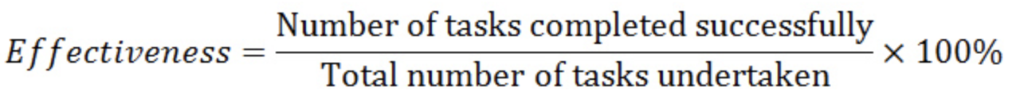
Usability Testing: Typical Metrics
Completion rate:
No. of errors:
Unintended actions, slips, mistakes or omissions that a user makes while attempting a task
Create error log:
Short description, severity rating, error category
Task time-to-completion:
Task Time = End Time – Start Time

Slide 15
Usability Metrics
Effectiveness usability metric:
Completion rate:

Slide 16
Usability Metrics
Effectiveness usability metric:
Completion rate:
E.g.:
5 users perform a task using the same system.
3 users manage to achieve the goal of the task while the other 2 do not.
Overall user effectiveness of the system:
- Number of tasks completed successfully = 3 - Total number of tasks undertaken = 5

Slide 17
Usability Metrics
Effectiveness usability metric:
Completion rate:
E.g.:
Overall user effectiveness of the system:
Effectiveness =
3/5 X 100% = 60%
- Number of tasks completed successfully = 3 - Total number of tasks undertaken = 5

Slide 18
Usability Metrics
Effectiveness usability metric:
Completion rate:
Typically:
Average Task Completion Rate is 78%
(based on an analysis of 1,100 tasks)

Slide 19
Usability Metrics
Effectiveness usability metric:
Completion rate:

Slide 20
Usability Metrics
Effectiveness usability metric:
No. of errors:
Unintended actions, slips, mistakes or omissions that a user makes while attempting a task

Slide 21
Usability Metrics
Effectiveness usability metric:
No. of errors:
Unintended actions, slips, mistakes or omissions that a user makes while attempting a task
Create error log:
Short description, severity rating, error category
Identify usual errors and then have frequency of errors

Slide 22
Usability Metrics
Effectiveness usability metric:
No. of errors:
Unintended actions, slips, mistakes or omissions that a user makes while attempting a task
Create error log:
Short description, severity rating, error category
Typically:
Average number of errors per task is 0.7, with 2 out of every 3 users making an error.

Slide 23
Usability Metrics
Efficiency usability metric:
Task time:
Task Time = End Time – Start Time

Slide 24
Usability Metrics
Efficiency usability metric:
Task time:
Task Time = End Time – Start Time
End time:
When the user completes the task
OR When the user quits the task
Can distinguish between first-time users and ‘expert’ users

Slide 25
Usability Testing: Typical Metrics
Completion rate:
No. of errors:
Unintended actions, slips, mistakes or omissions that a user makes while attempting a task
Create error log:
Short description, severity rating, error category
Task time-to-completion:
Task Time = End Time – Start Time

Slide 26
Usability Testing: Typical Metrics
Effectiveness:
How good an interface is at doing what it is supposed to do
Efficiency:
The way an interface supports users to carry out their tasks
Memorability:
How easy an interface is to remember how to use, once learned
Satisfaction
Cognitive load
Learning time

Slide 27
Usability Testing: Typical Metrics
Self-reported usability:
Pre-designed questionnaires that you can adapt:
System Usability Scale (SUS)
IBM Computer Usability Scale (CSUQ)
After scenario questionnaire (ASQ)
Covers the various usability dimensions

Slide 28
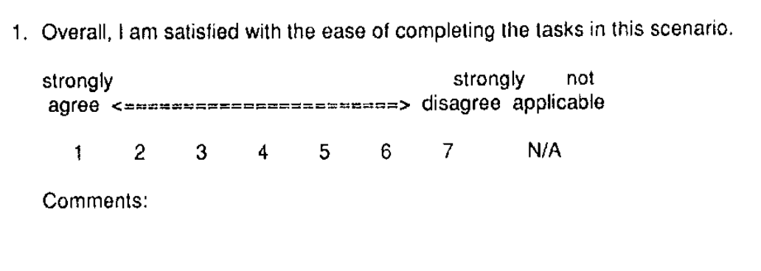
Usability Metrics
Self-reported usability:
Task-level satisfaction:
Given after each task/scenario, whether participant succeeded or failed
ASQ (After-Scenario Questionnaire)
http://drjim.0catch.com/PsychometricEvaluationOfAnAfter-ScenarioQuestionnaire.pdf

Slide 29
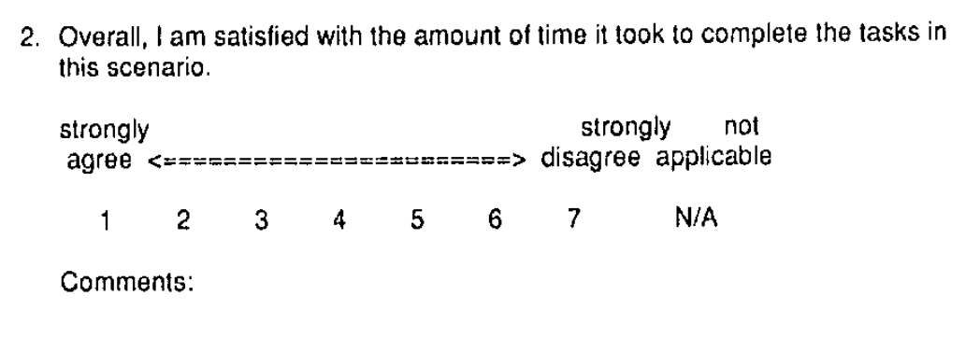
Usability Metrics
Self-reported usability:
ASQ (After-Scenario Questionnaire):
http://drjim.0catch.com/PsychometricEvaluationOfAnAfter-ScenarioQuestionnaire.pdf

Slide 30
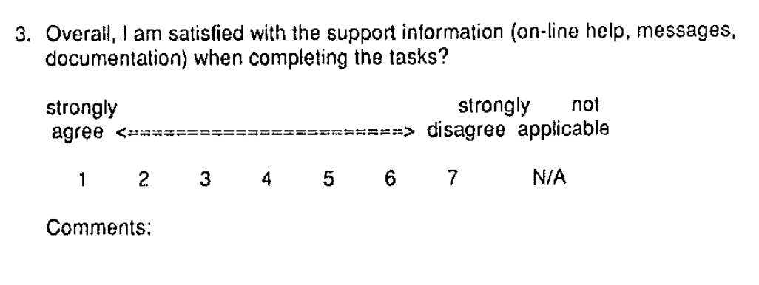
Usability Metrics
Self-reported usability:
ASQ (After-Scenario Questionnaire):
http://drjim.0catch.com/PsychometricEvaluationOfAnAfter-ScenarioQuestionnaire.pdf

Slide 31
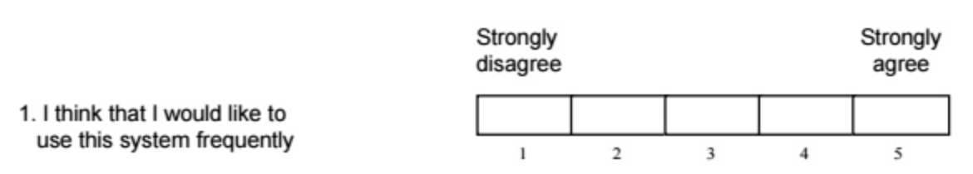
Usability Metrics
Self-reported usability:
Test-level satisfaction:
Given at the end of the test
System Usability Scale (SUS)

Slide 32
Usability Metrics
System Usability Scale (SUS)
I think that I would like to use this system frequently.
I found the system unnecessarily complex.
I thought the system was easy to use.
I think that I would need the support of a technical person to be able to use this system.
I found the various functions in this system were well integrated.
I thought there was too much inconsistency in this system.
I would imagine that most people would learn to use this system very quickly.
I found the system very cumbersome to use.
I felt very confident using the system.
I needed to learn a lot of things before I could get going with this system.

Slide 33
Usability Metrics
System Usability Scale (SUS)
Calculate the average of all the user ratings across the 10 items.
Usability scores for 1 user
Average the usability scores for all your users
Overall usability score for your interface

Slide 34
Usability Tasks

Slide 35
Designing Usability tasks
Different types of tasks:
Scenario tasks
Direct tasks
Closed tasks
Open-ended tasks
https://blog.ubuntu.com/2013/08/16/usability-testing-how-do-we-design-effective-tasks

Slide 36
Designing Usability tasks
Scenario tasks:
Persona + Scenario + Context details
“You are holding a dinner party this Saturday. You want to find a chicken curry recipe from the BBC food site.”
https://blog.ubuntu.com/2013/08/16/usability-testing-how-do-we-design-effective-tasks
Notes:
A scenario task is presented as a mini user story: often it has the character, the context and the necessary details for achieving the goal. For example, to test the browser and bottom menu on the phone:

Slide 37
Designing usability tasks
Scenario tasks:
Mini-user story + Context details
“You are holding a dinner party this Saturday. You want to find a chicken curry recipe from the BBC food site.”
Direct tasks:
Instructional
“Find a chicken curry recipe from the BBC food site.”
https://blog.ubuntu.com/2013/08/16/usability-testing-how-do-we-design-effective-tasks
Notes:
Scenario Vs Direct tasks: Direct tasks can be somewhat artificial.

Slide 38
Designing usability tasks
Closed task:
Specific to what the participants need to do
Has one correct answer
Can measure if participants solved or failed a task (calculate success rates)
“You want to text your landlord to say you will give her the rent tomorrow. Her number is: 7921233290.”
https://blog.ubuntu.com/2013/08/16/usability-testing-how-do-we-design-effective-tasks

Slide 39
Designing usability tasks
Closed task:
Specific to what the participants need to do
Has one correct answer
Can measure if participants solved or failed a task (calculate success rates)
“You want to text your landlord to say you will give her the rent tomorrow. Her number is: 7921233290.”
Open-ended task:
Less specific direction as to what you want a participant to do
Gives users more freedom to explore the interface
“You heard your friends mention something called ‘Ubuntu’. You are interested in it and want to find out more about what Ubuntu is and what it can offer you?”
https://blog.ubuntu.com/2013/08/16/usability-testing-how-do-we-design-effective-tasks
Notes:
This is particularly useful if you want to find out about what areas users would spontaneously interact with, or which ones matter most to them.
Drawbacks:
- Since participants have control over the task, features that require user feedback might be missed; or vise versa, they may spend too much time on something that is not the focus of the testing.
- Some participants may experience uncertainty as to where to look and when they have accomplished the task. Others may be more interested in getting the test done, and therefore do not put in as much effort as what they would in reality.
- You cannot assign task success rates to open-ended tasks, as there is no correct answer, so it is not suitable if a performance comparison is needed.

Slide 40
Designing usability tasks
Some things to pay attention to:
Level of details:
Enough information so participants understand what they are supposed to do
Not too much that natural interaction is impeded
Consider:
“You want to show your friends a picture’”
VS “You want to show your friends a picture of a cow’”
https://blog.ubuntu.com/2013/08/16/usability-testing-how-do-we-design-effective-tasks
Notes:
For the former, the goal is more vague and participants would be likely to click on the first image or a random picture, and assume the task is done. As a result, we might miss usability problems. For the latter, the task communicates the requirements more effectively: it would be accomplished once they found the picture of a cow. Furthermore, it also provides us with more opportunities to assess the navigation and interaction further, as participants need to navigate among the pictures to find the relevant one.

Slide 41
Designing usability tasks
Some things to pay attention to:
Level of details:
Enough information so participants understand what they are supposed to do
Not too much that natural interaction is impeded
Consider:
“You want to show your friends a picture’”
VS “You want to show your friends a picture of a cow’”
Dependencies:
Proceeding to next task depends on whether or not participants solved previous task successfully
https://blog.ubuntu.com/2013/08/16/usability-testing-how-do-we-design-effective-tasks

Slide 42
Think-Aloud Protocol

Slide 43
Usability Testing
Metrics result in quantitative data (what).
Ways to collect qualitative data (why):
Think-Aloud protocol
Interviews
You will not need to do interviews for usability testing in this class, but you will have to do them for User study 2 for your project

Slide 44
Usability Testing: Think Aloud
User thinks aloud as they use an application or prototype to accomplish a particular task
Results in qualitative data
Provides insights into how user perceives and interprets the application
Data provided/collected immediately
Not a retrospective account
Increases chance that timely, “accurate” data is given

Slide 45
Usability Testing: Think Aloud
Ask participant to say whatever comes to mind as they use the application
Indicate that anything that may be confusing is not their fault, but the fault of the application’s design
You want them to feel comfortable criticizing the application
Shift blame from internal to external attribution (participant to designer)
Be prepared to prompt subject to remind them to continue thinking aloud
“What are you thinking about now?”

Slide 46
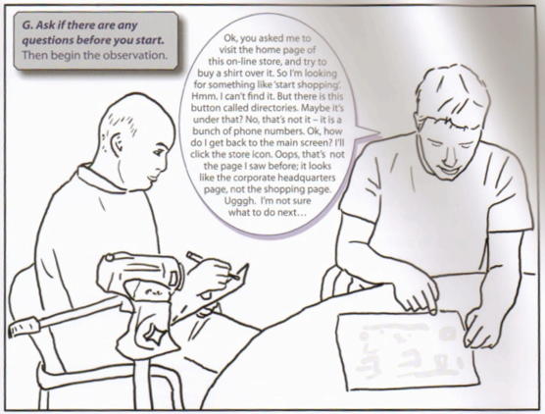
Why Think Aloud?
Ok, you asked me to visit the homepage of this online store, and try to buy a shirt. So I’m looking for something like “start shopping”. Hmm, I can’t find it. But there is this button called “directories”, maybe it’s under that? No….
While users are doing the activity, ask them to talk aloud their thought process.
Why talk aloud? Why not just observe?
You will see what they do but not why they do it.
from Greenberg et al, Sketching User Experiences: The Workbook, p.239

Slide 47
Why Think Aloud?
Users will ask questions or make guesses:
These are clues as to their internal mental model and possibly places where the design and their understanding don’t match.

Slide 48
Why Think Aloud?
Users will ask questions or make guesses:
These are clues as to their internal mental model and possibly places where the design and their understanding don’t match.
We will get feedback on:
The task flow, organization, and interactions
The look-and-feel and graphic design

Slide 49
The Usability Test

Slide 50
You need:
Controlled environment
System/Prototype
Test plan
Script
Data collection instruments
Questionnaires
Interview guides

Slide 51
Preparing the test plan
Download template for test plan from Canvas
Will be posted later today

Slide 52
Preparing the script
Download template for script from Canvas
Introduction
Scenario description
Tasks
Prompts
Concrete end goals

Slide 53
You need:
Controlled environment
System/Prototype
Test plan
Script
Data collection instruments
Questionnaires
Interview guides

Slide 54
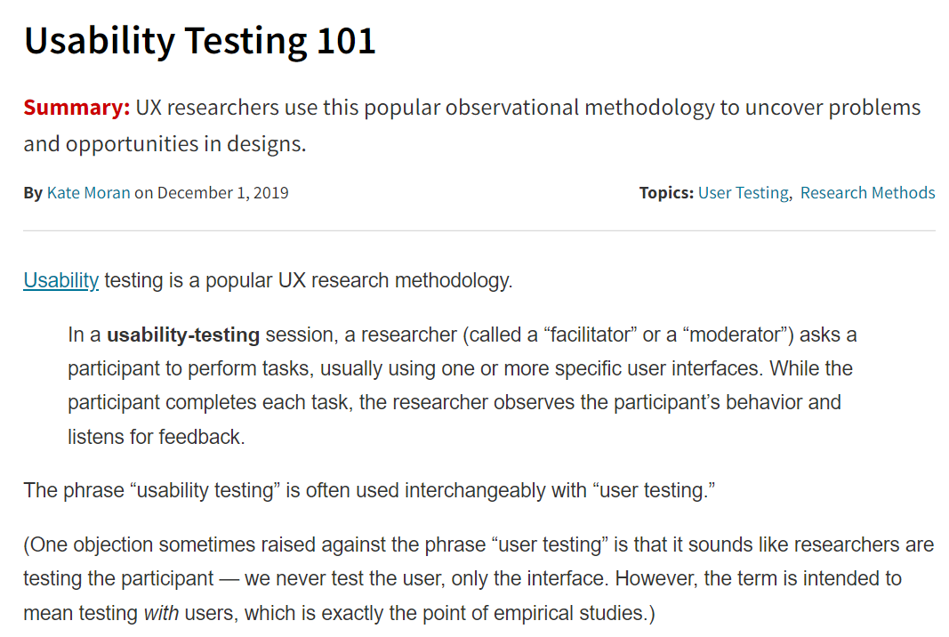
Supplemental Reading
Moran, K. Usability Testing 101. Nielsen Norman Group
https://www.nngroup.com/articles/usability-testing-101/

