Slide 1

IEGGR: Improved Energy_aware and Delivery Guarantee Geographic Routing
Kenza Redjimi, Mehdi Boulaiche, and Mohammed Redjimi

Slide 2
Presentation includes
Introductions. Pn-3
Related Works. Pn-4
Network Model. Pn-5
Approach. Pn-6
Proposed Algorithms. Pn-7 to 11
Example. Pn-12
Results. Pn-13 to 14

Slide 3
Introduction
Improved Energy-aware and delivery Guarantee Geographic Routing protocol (IEGGR)
The protocol utilizes local knowledge to conserve node energy and introduces a mechanism to compute the shortest path in terms of energy consumption
Utilizes the positions of neighboring nodes closest to the base station to forward packets through the shortest path in terms of energy consumption
Includes a recovery mechanism to forward packets around voids, extending network lifetime and increasing packet delivery rate

Slide 4
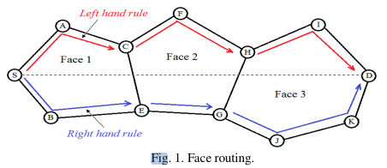
Related Works
Category | Key idea
Flat Routing Protocols | Minimize communication overhead and energy consumption.
Hierarchical Routing Protocols | Divides nodes into clusters with a cluster head assigned to each cluster.
Geographic Routing Protocols | Utilizes node position information to forward packets toward the destination. Reduces routing control overhead and is suitable for the Internet of Things (IoT)
Void Problem and Planar Graph Routing | Addresses the void problem in geographic routing by using planar graph routing strategy, which combines greedy algorithm and face routing.
Optimizing End-to-End Energy Consumption | Discusses the use of Dijkstra's shortest path algorithm to calculate the optimal path for minimizing end-to-end energy consumption in geographic routing protocols.

Slide 5
Network model
The wireless sensor network consists of static, energy-limited nodes equipped with GPS for location awareness and bidirectional radios for communication.
Each node periodically exchanges beacon messages to obtain neighbor location and remaining energy information.
The network is represented as a connected unit disk graph.
The model accounts for the power required for signal transmission and reception based on the distance between nodes and a media attenuation factor.

Slide 6
Approach
The IEGGR algorithm addresses the void problem in geographic routing by initiating a Minimal Spanning Tree (MST) calculation process.
Each node constructs a local sub-graph, including neighbors closest to the base station, and calculates a minimal spanning tree using Prim's algorithm.
When encountering a void, the node widens its sub-graph area and applies source routing to forward packets around the void. The algorithm involves constructing the local sub-graph, determining the recovery area size, and using greedy and recovery modes to forward packets efficiently.
The routing area and recovery area are defined based on the proximity of nodes to the base station, and the routing technique differs between the two areas.

Slide 7
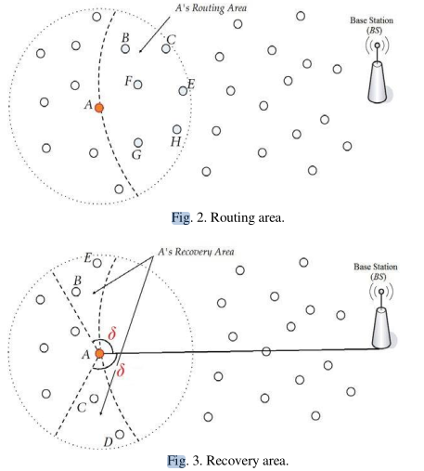
Sub-graph Formation Algorithm
Routing Area sub-graph:
Nodes in the sub-graph V' are selected based on their distance to the base station and the source node, within the communication range.
Edges in the sub-graph E' are determined based on the distance criteria and the connection to the source node.
Recovery Area sub-graph:
Nodes in the sub-graph V' are selected based on a distance calculation involving angles and distances to the base station and the source node, within a specified width angle.
Edges in the sub-graph E' are determined based on the distance criteria and the connection to the source node.
The algorithm ensures that nodes maintain sub-graphs for routing and recovery areas, with nodes and edges selected based on specific distance and angle criteria.

Slide 8
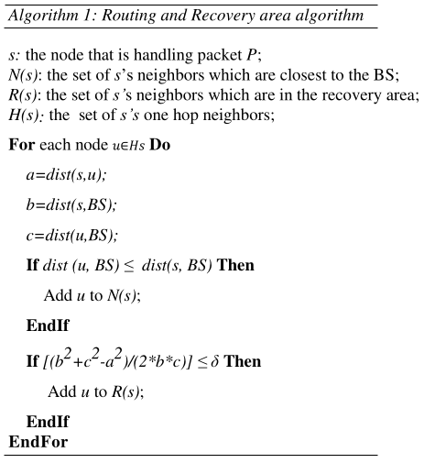
Algorithm 1: Routing and Recovery area algorithm
This algorithm is used to determine the nodes that belong to the routing area (N(s)) and the recovery area (R(s)) for a given node s.
It iterates through the set of one-hop neighbors of node s and calculates the distances between these neighbors, the base station, and node s.
Based on these distances and a specified angle threshold (δ), the algorithm adds the neighbors to either the routing area or the recovery area.
The routing area includes neighbors closer to the base station than node s, while the recovery area includes neighbors within a certain angle range from node s.

Slide 9
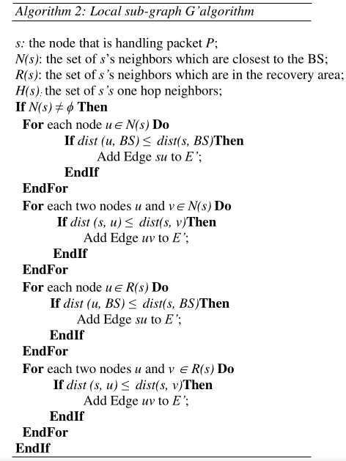
Algorithm 2: Local sub-graph G’algorithm
This algorithm constructs the local sub-graph G' for a given node s based on its set of neighbors closest to the base station (N(s)) and the set of neighbors in the recovery area (R(s)).
It adds edges to the sub-graph based on distance criteria, ensuring that edges are formed between node s and its neighbors in N(s) and R(s) according to specific distance conditions.
If the set N(s) is not empty, the algorithm adds edges between node s and its neighbors in N(s) and R(s) to form the local sub-graph G'.

Slide 10
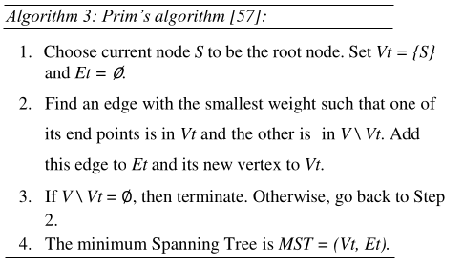
Algorithm 3: Prim’s algorithm
This algorithm is Prim's algorithm, used to find the minimum spanning tree in a graph.
It starts with a root node, and at each step, it adds the edge with the smallest weight that connects a node in the current set to a node outside the current set.
This process continues until all nodes are included in the set. The resulting set of edges forms the minimum spanning tree (MST) for the given graph

Slide 11
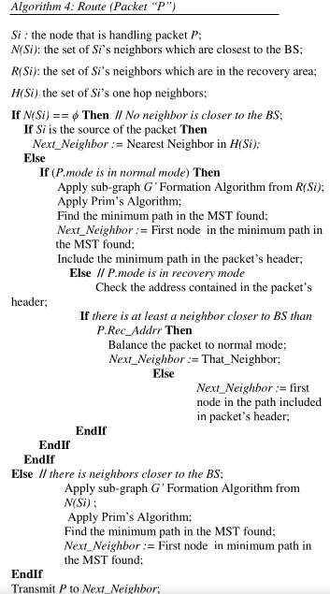
Algorithm 4: Route (Packet “P”)
This algorithm determines the next neighbor to which a packet should be forwarded based on the node's current state and the available neighbors.
It first checks if there are any neighbors closer to the base station. If there are no such neighbors, it selects the next neighbor based on the mode of operation (normal or recovery mode) and the packet's content.
If there are neighbors closer to the base station, it applies Prim's algorithm to find the minimum path in the minimum spanning tree (MST) and selects the first node in the minimum path as the next neighbor.
Finally, it transmits the packet to the selected next neighbor.

Slide 12
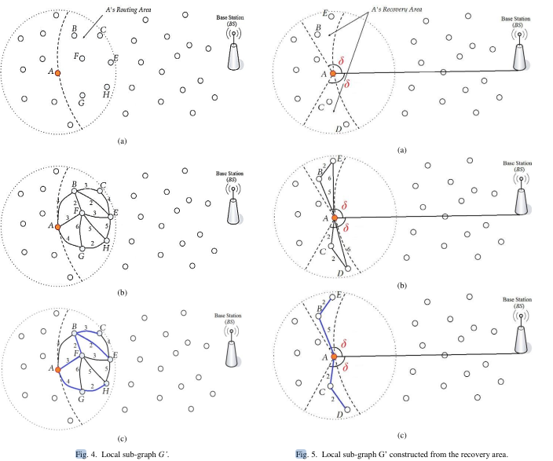
Example

Slide 13
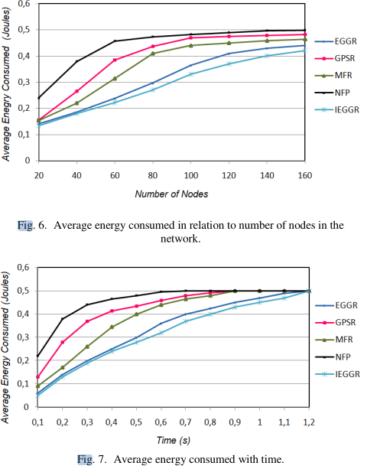
Results

Slide 14
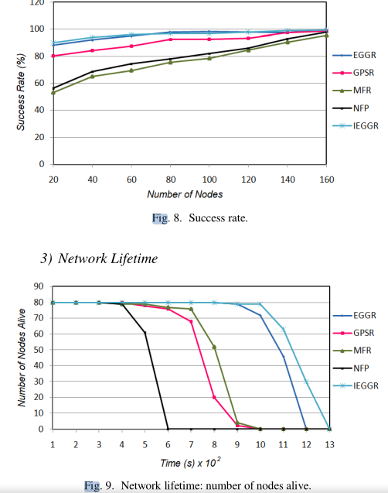
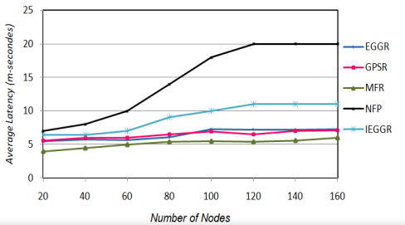
Results

Slide 15
?

Slide 16
Thanks for your Attentions!

