Slide 1

Transformers
(Computational Intelligence)

Slide 2
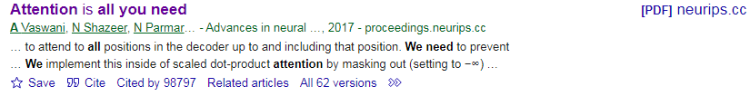
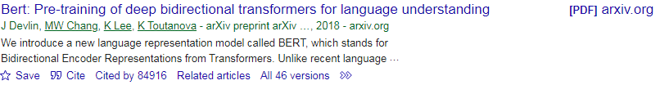
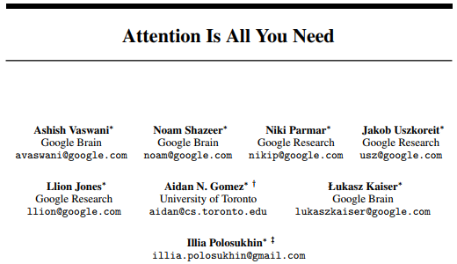
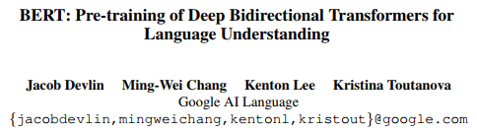
Original paper

Slide 3
Presentation Include
Language model history
Why transformer?
Advantage vs previous models
Problem of text presentation
Intro. Of Transformer
Transformer-self attention
Practical model
BERT

Slide 4
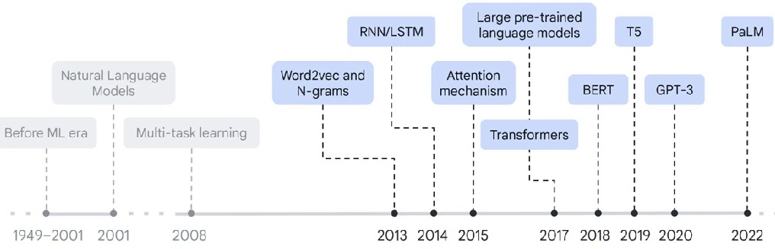
language model history

Slide 5
why transformer?
Capturing Contextual Information
Handling Long-Range Dependencies
Language Generation
Multilingual Support
State-of-the-Art Performance
Pre-training and Fine-tuning
….

Slide 6
Advantage to previous models
Ability to handle long-range dependencies
Parallel processing
Reduced vanishing gradient problem
Attention mechanism
Multilingual support
Memory efficiency
Superior performance on NLP benchmarks
…

Slide 7
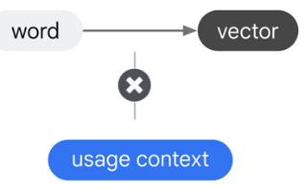
Problem of text presentation
Example:
bank in river bank or bank in bank rubber

Slide 8
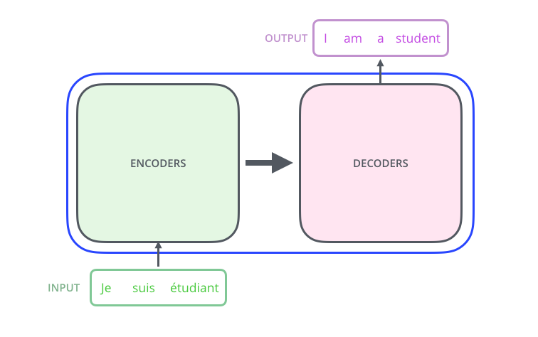
Intro. Of Transformer
Encoder/Decoder mechanism
Use attention model
Advantage :
Parallelism
Use large amount of data
All that because of Model Architecture

Slide 9
Intro. Of Transformer
Attention mechanism help improve machine translation applications performance
Transformer model use attention mechanism at the core
Consist of encoder/decoder
Encoder: Encode the input sequence passed to the decoder.
Decoder: decode the representation for a relevant task.

Slide 10
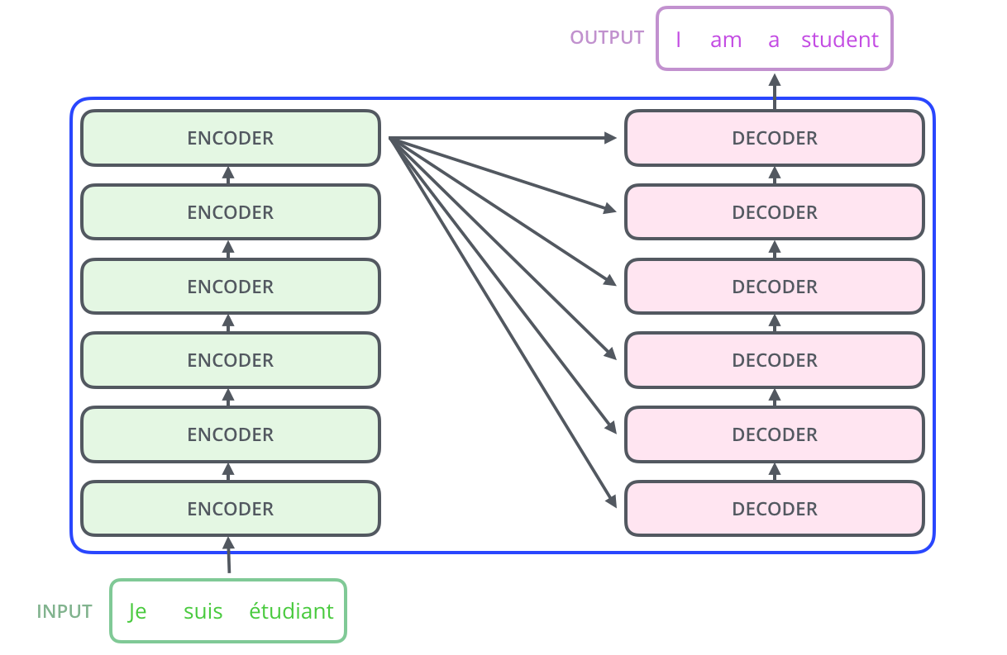
Intro. Of Transformer

Slide 11
Transformer
Encoder all identical structures but with different weights
Self attention : Looks at a relevant part of the words
Feed forward: Apply independently to each position.
Decoder: contain self attention layer, feed forward layer and Encoder/Decoder attention layer helps Decoder focus on relevant part of input sentences

Slide 12
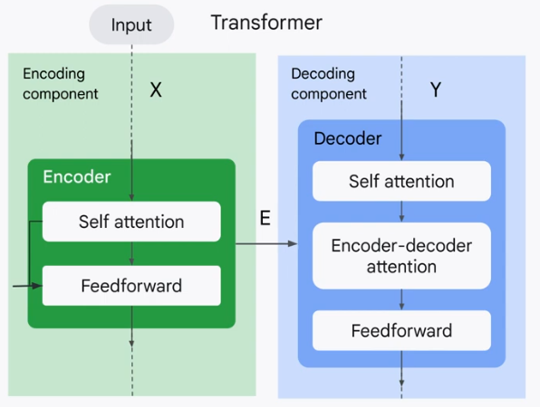
Transformer

Slide 13
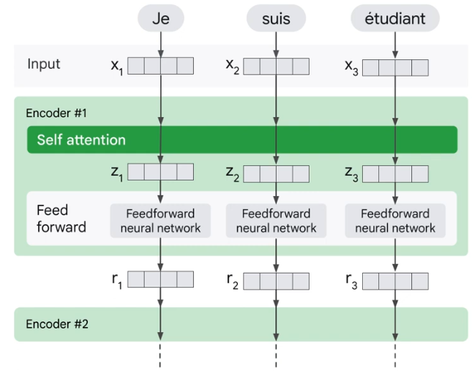
Transformer-self attention

Slide 14
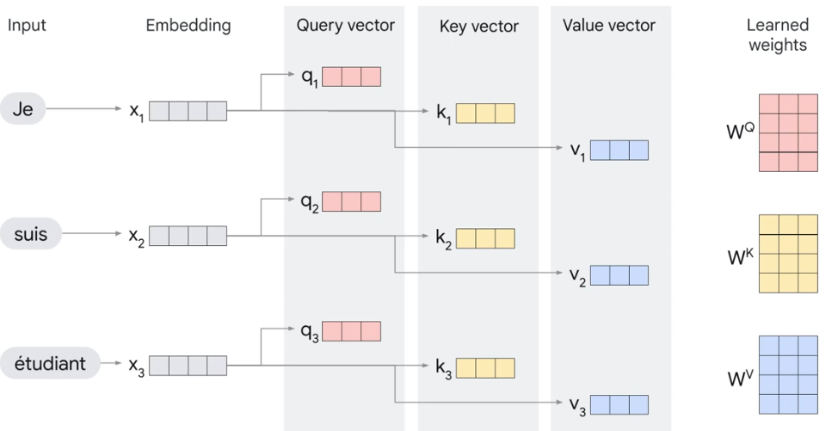
Transformer-self attention

Slide 15
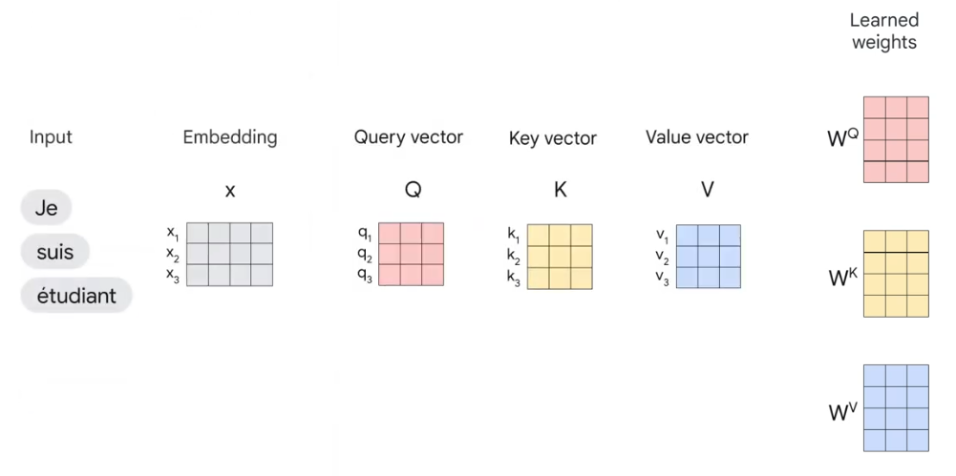
Transformer-self attention

Slide 16
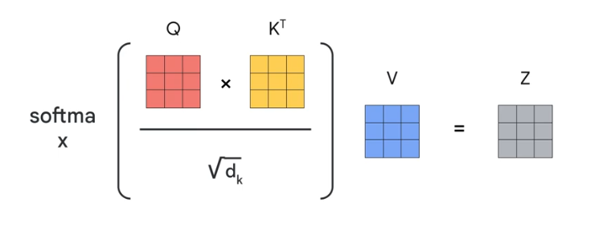
Transformer-self attention

Slide 17
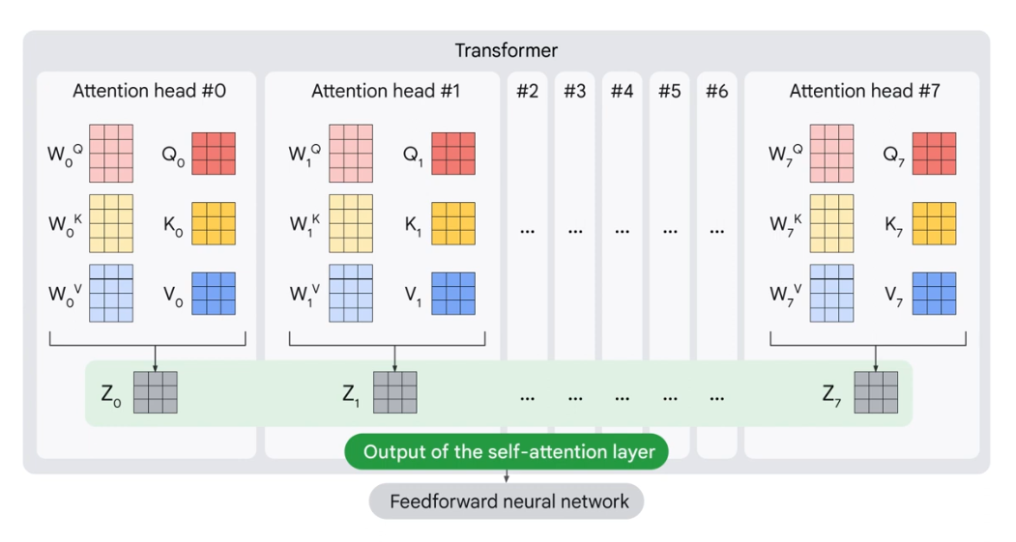
Transformer-self attention

Slide 18
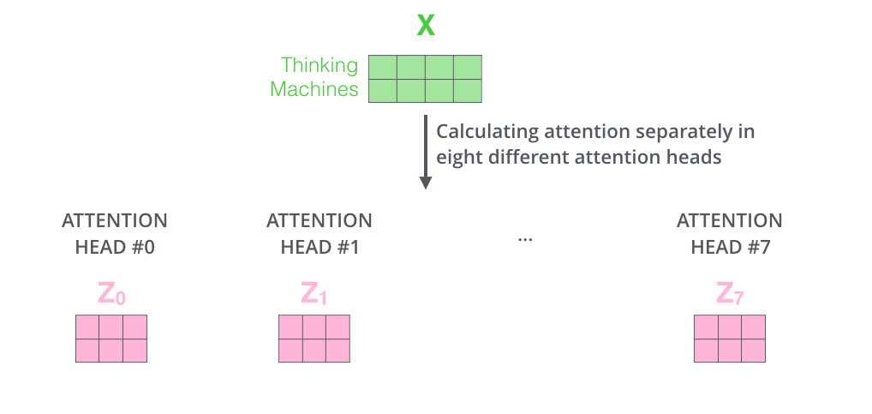
Transformer-self attention

Slide 19
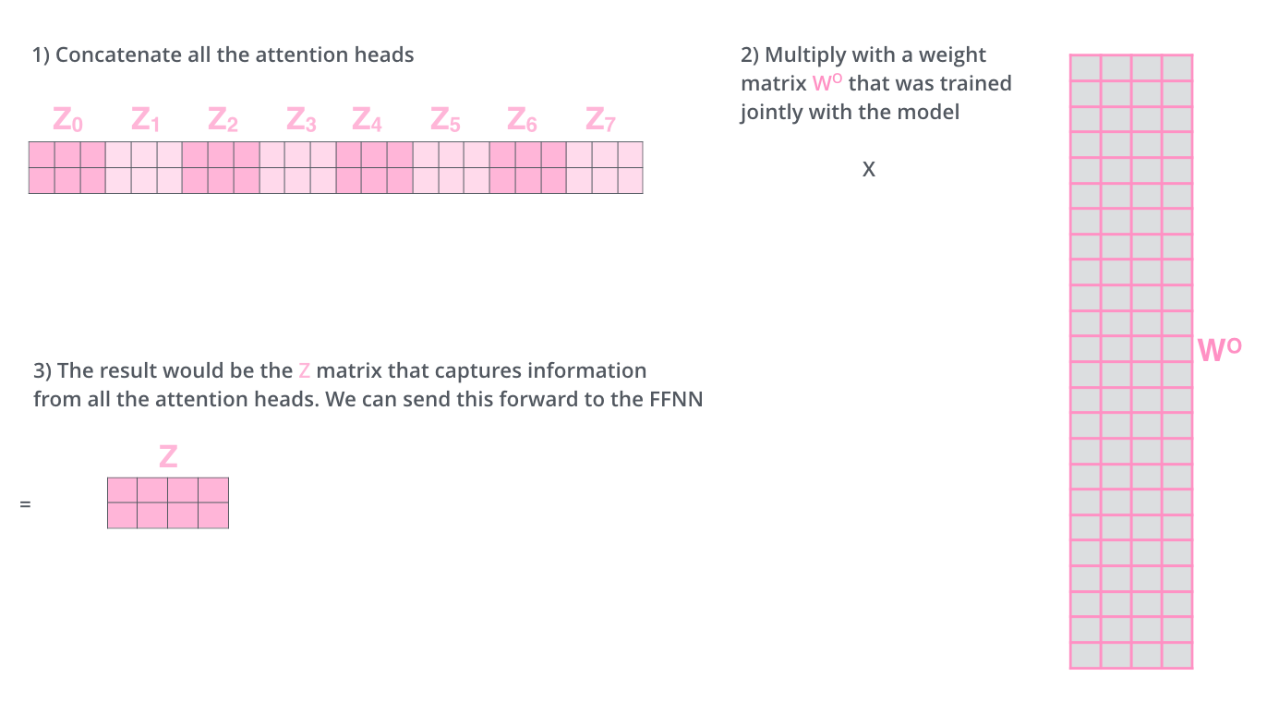
Transformer-self attention

Slide 20
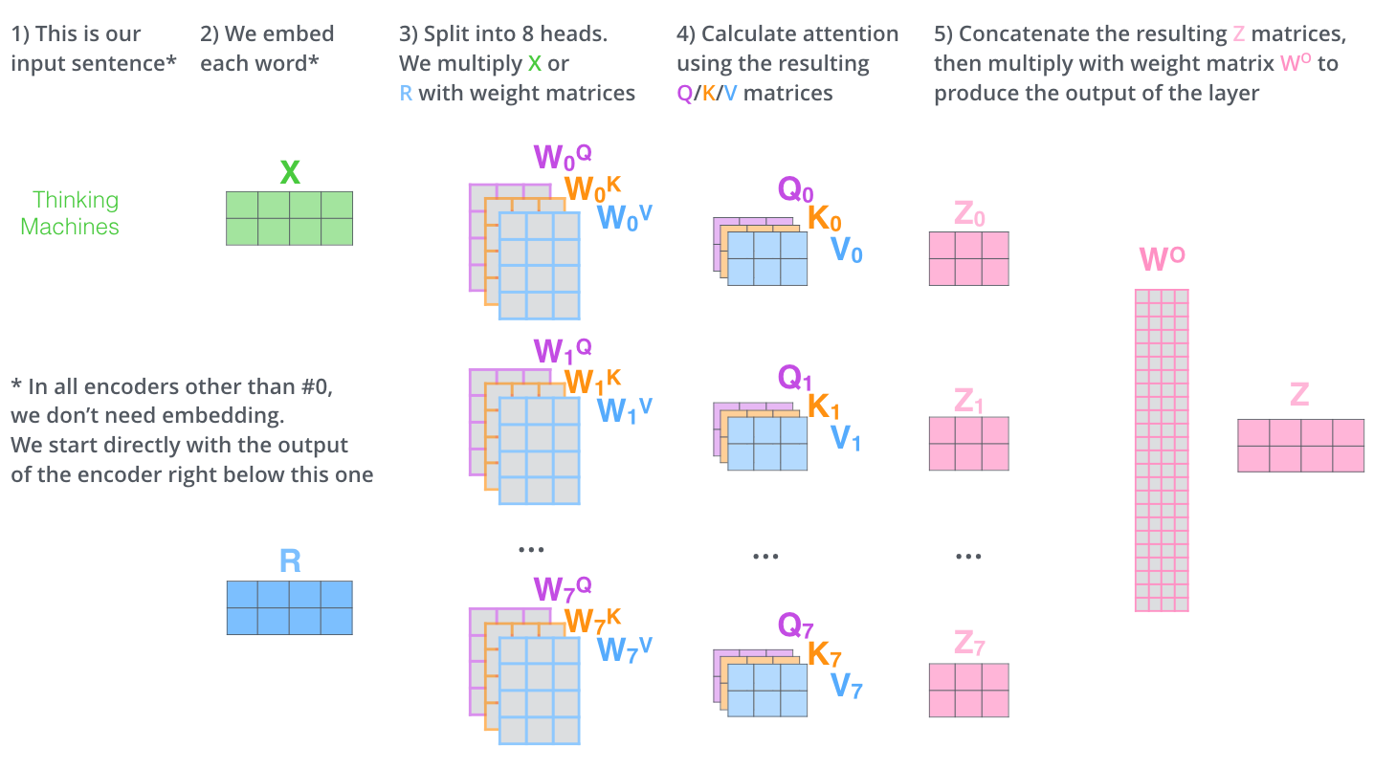
Transformer

Slide 21
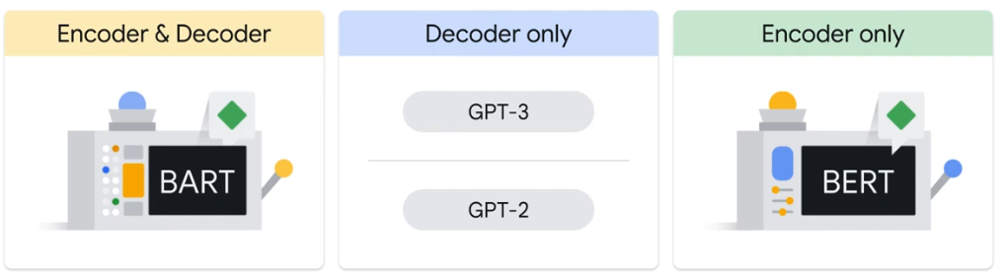
Practical model
BERT Model (Bidirectional Encoder Representation from Transformer)

Slide 22
Bert Model Overview
Trained in two variations
Able to handle long input context
Trained on entire Wikipedia and book corpus
Targeted at multi-task objective
Trained on TPU
Works at both sentence-level and token-level task
Be fine-tuned for many different tasks
…

Slide 23
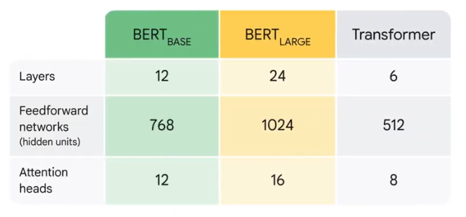
Bert versions

Slide 24
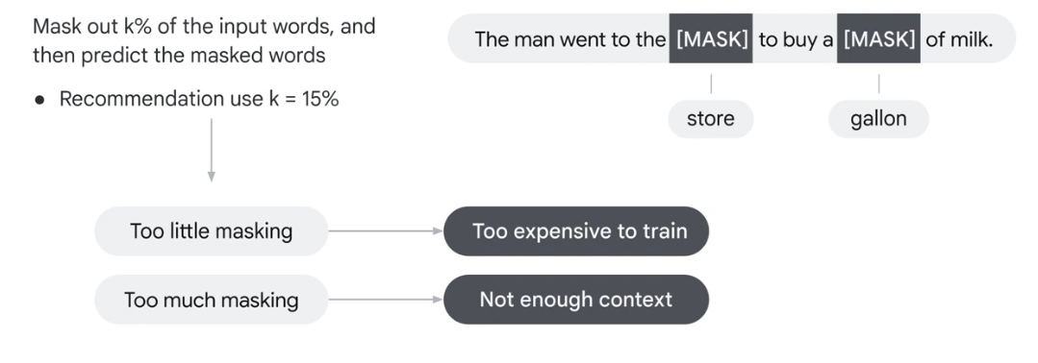
The way that Bert works
Masked Language Modeling(MLM)

Slide 25
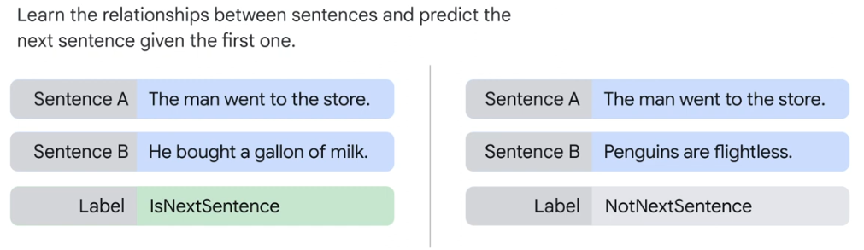
Bert Model
Next Sequence Predictions(NSP)

Slide 26
source
[1] : Ashish Vaswani, Noam Shazeer, Niki Parmar, Jakob Uszkoreit, Llion Jones, Aidan N. Gomez, Łukasz Kaiser, Illia Polosukhin, “Attention is All you Need”, 31st Conference on Neural Information Processing Systems, 2017.
[2] : J Devlin, MW Chang, K Lee, K Toutanova, “BERT: Pre-training of Deep Bidirectional Transformers for Language Understanding” , arXiv, 2018.

Slide 27
?

Slide 28
Thank you for your
Attention!

