Slide 1
Vedit – простой векторный редактор
Максим Акулин
Алексей Захаров
Станислав Яркеев

Slide 2
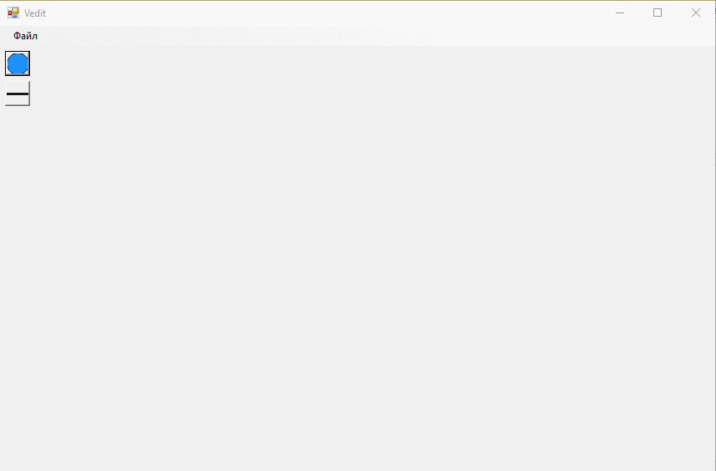

Slide 3
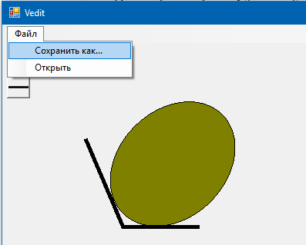
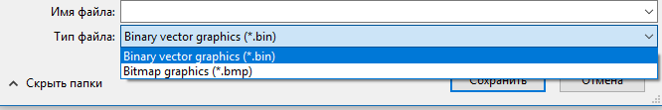

Slide 4
Точки расширения
Добавление новых:
фигур (IShape)
форматов ввода / вывода (ISerializer<T>, IDeserializer<T>)
действий в меню (IMenuAction)
кнопок панели инструментов (IToolButton).

Slide 5
Добавление фигуры
public interface IShape : IDrawable {}
public interface IDrawable
{
Vector Position { get; set; }
SizeF BoundingRectSize { get; set; }
float Angle { get; set; }
void Paint(Bitmap bitmap);
}

Slide 6
public abstract class DrawableObject : IDrawable
{
public void Paint(Graphics graphics)
{
var centerOffset = new Vector(Size.Width, Size.Height) * 0.5;
graphics.TranslateTransform(Position + centerOffset);
graphics.RotateTransform(Angle);
graphics.TranslateTransform(-1 * centerOffset);
PaintStraight(graphics);
}
protected abstract void PaintStraight(Graphics graphics);
}

Slide 7
public class ShapeButton<TShape> : IToolButton
where TShape : IShape, new()
{
public Bitmap GetImage(Size size)
{
var result = new Bitmap(size.Width, size.Height);
var shape = new TShape();
shape.BoundingRectSize = size;
shape.Paint(result);
return result;
}
public void HandleClick(Editor editor)
{
editor.Document.CreateShape<TShape>();
}
}

Slide 8
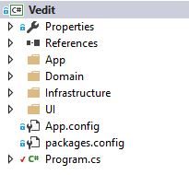
Архитектура приложения

Slide 9
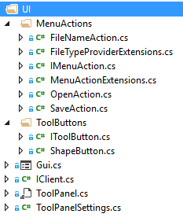
GUI
void OnCanvasMouseDown(object sender, MouseEventArgs e)
{
clickContext =
editor.GetClickContext(e.Location.ToVector());
var shape = clickContext.Shape;
if (shape != null)
editor.SelectShape(shape);
…
}

Slide 10
Логика GUI
public class Editor
{
Document Document { get; set; }
Bitmap Draw();
ClickContext GetClickContext(Vector point);
void TransformShape(ClickContext context, Vector offset);
void SelectShape(IShape shape);
void ClearSelection();
}

Slide 11
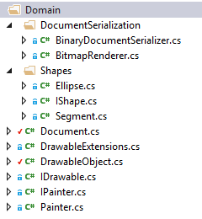
public class Document
{
public List<IShape> Shapes { get; }
public ImageSettings ImageSettings { get; }
public Document(ImageSettings imageSettings)
{
ImageSettings = imageSettings;
Shapes = new List<IShape>();
}
public IShape CreateShape<TShape>()
where TShape : IShape, new()
{
var shape = new TShape {Position = new Vector(0, 0)};
Shapes.Add(shape);
return shape;
}
public IShape FindShape(Vector point) => Shapes.LastOrDefault(s => s.ContainsPoint(point));
}

Slide 12
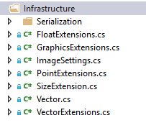
public class BinarySerializer<T> : ISerializer<T>, IDeserializer<T>
{
private readonly BinaryFormatter formatter;
public BinarySerializer(BinaryFormatter formatter)
{
this.formatter = formatter;
}
public void Serialize(Stream stream, T obj)
{
formatter.Serialize(stream, obj);
}
public T Deserialize(Stream stream)
{
return (T) formatter.Deserialize(stream);
}
}

Slide 13
Сборка зависимостей
var kernel = new StandardKernel();
kernel.Bind<IClient>().To<Gui>().InSingletonScope();
kernel.Bind<Editor>().ToSelf().InSingletonScope();
…
kernel.Bind(c => c.FromThisAssembly()
.SelectAllClasses()
.InheritedFromAny(
typeof(IMenuAction),
typeof(ISerializer<Document>),
typeof(IDeserializer<Document>))
.BindAllInterfaces());

Slide 14
Сборка зависимостей
static Type[] GenerateShapeButtonTypes()
{
return Assembly.GetAssembly(typeof(Program))
.GetTypes()
.Where(t => typeof(IShape).IsAssignableFrom(t) && t.IsClass && !t.IsAbstract)
.Select(t => typeof(ShapeButton<>).MakeGenericType(t))
.ToArray();
}
foreach (var buttonType in GenerateShapeButtonTypes())
kernel.Bind<IToolButton>().To(buttonType);

Slide 15
Тесты
[TestFixture]
internal class Vector_Should
{
[TestCase(2, 1, 0, 0, Math.PI / 2, new double[] {-1, 2},
Description = "when base is zero")]
[TestCase(2, 0, 1, 3, Math.PI / 2, new double[] { 4, 4 },
Description = "when base is non-zero")]
[TestCase(1, 3, 1, 3, Math.PI / 2, new double[] { 1, 3 },
Description = "when equal to base")]
public void RotatesCorrectly(double x, double y, double baseX, double baseY, double angle,
double[] expected)
{
var eps = 10e-7;
UnpackVector(new Vector(x, y).Rotate(new Vector(baseX, baseY), angle))
.Should()
.Equal(expected, (a, e) => Math.Abs(a - e) < eps);
}
}

Slide 16
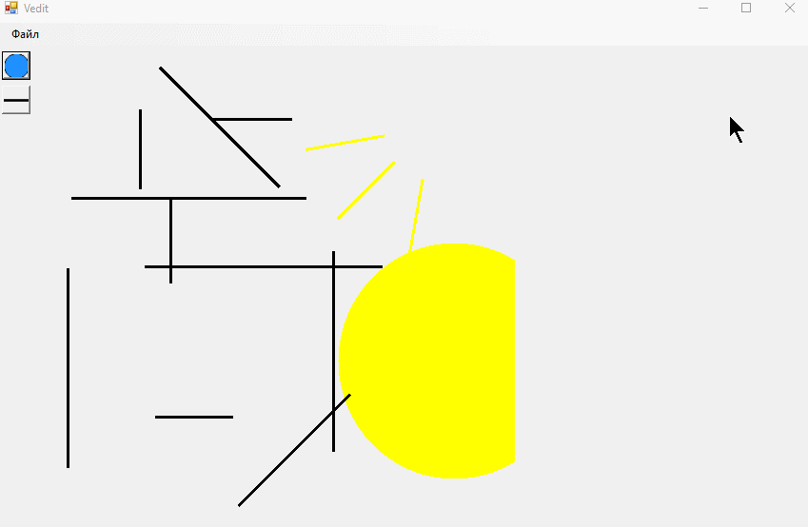
Вопросы?

