Slide 1



LEAVE
APPLICATION
PROJECT NAME :
Leave Wizard.
PRESENTED BY :
Asma Shaheen
PRESENTED TO :
Wavemaker team

Slide 2



AGENDA
1
Problems
4
Tech stack
Objectives and Goals
5
Enhancements
2
6
Snapshots
3
Overview

Slide 3



PROBLEMS
Inconvenience Delayed processing Limited access:

Slide 4

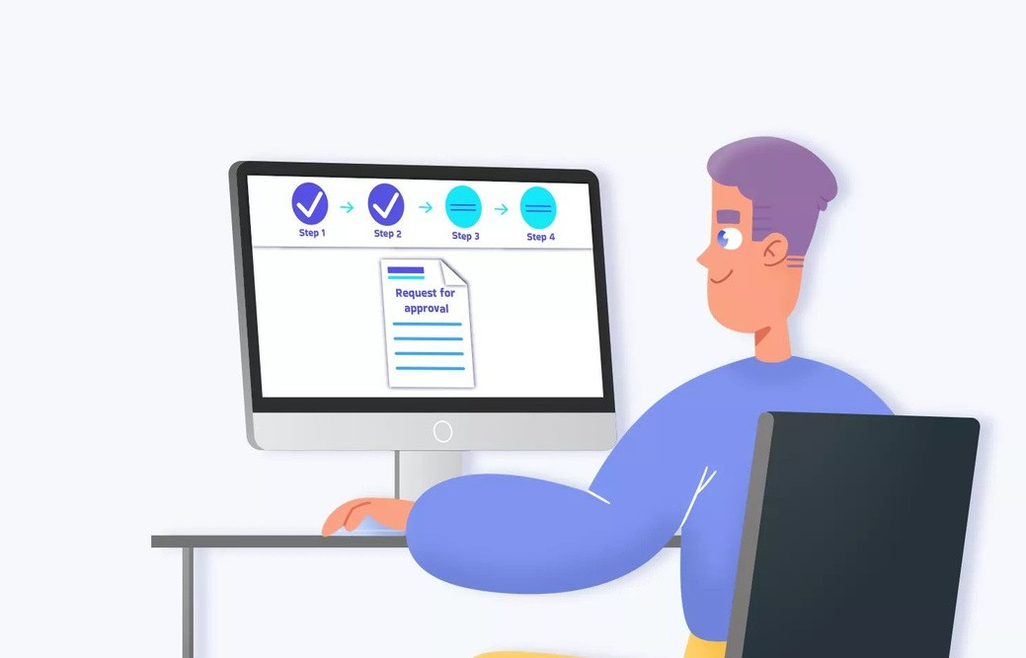

OVERVIEW
Easy Leave approvals
Helps in office resource management Transparency and Fairness

Slide 5



TECH STACK
Spring
mysql
HTML, CSS, JS
Bootstrap

Slide 6




ENHANCEMENTS
Integrate with payroll Request leave on one click.

Slide 7
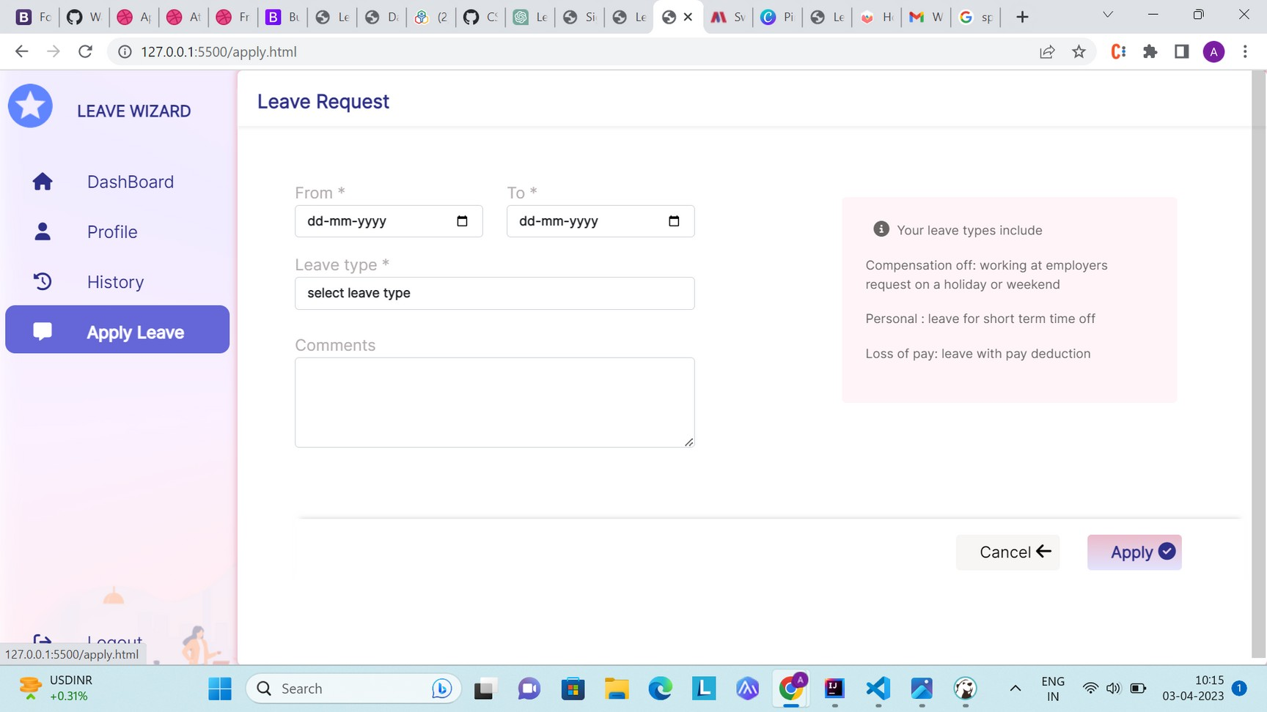


Slide 8
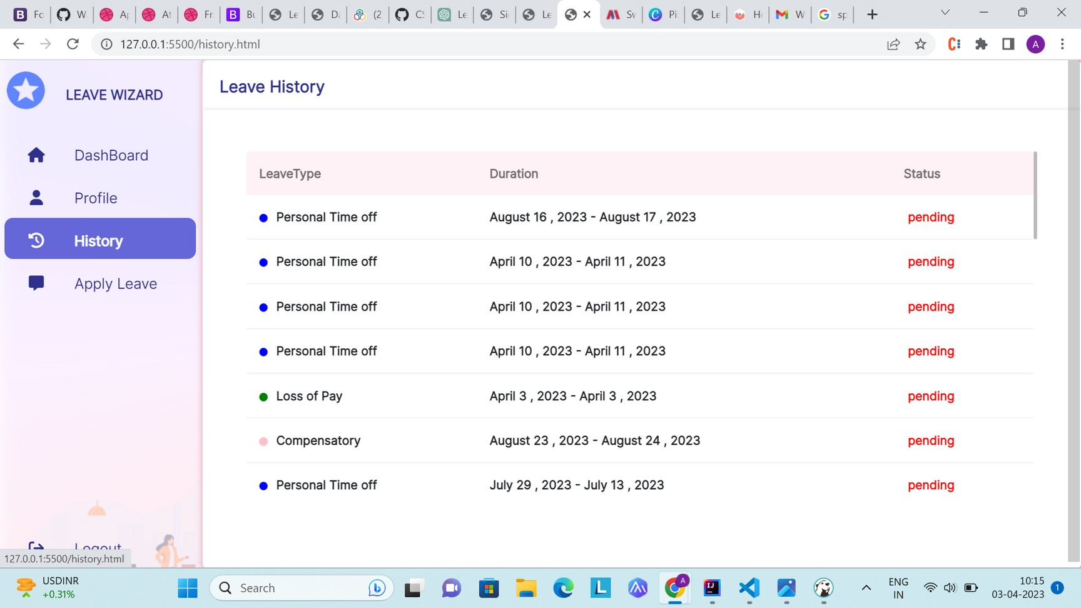

Slide 9
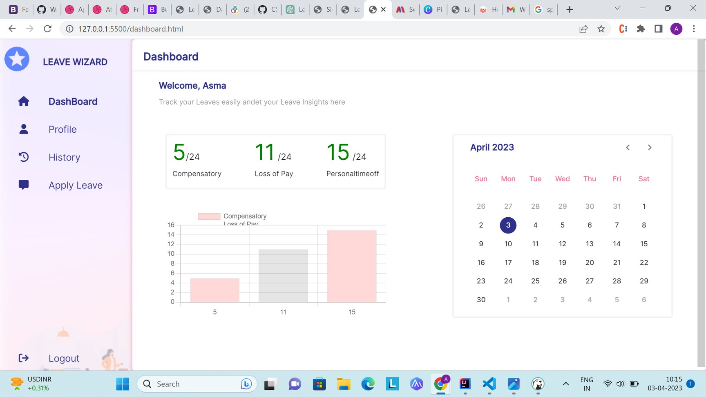


Slide 10
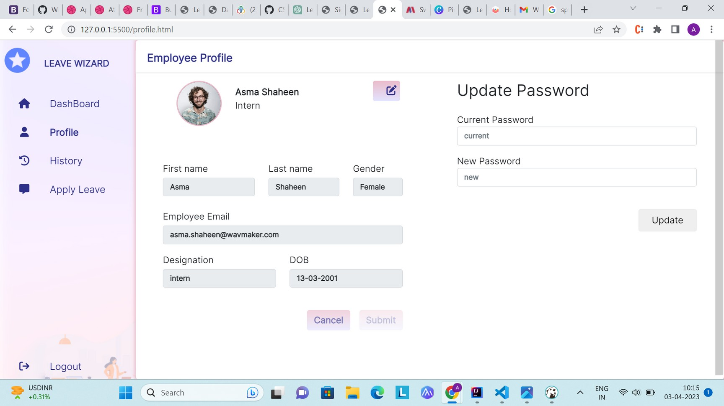


Slide 11
Thank You

