Slide 1
Data-Driven Modeling for Machine Damage Accumulation Prediction
Problem 1
Team CodeJackets
Muyang Guo; Su Yu;
Changxuan Zhao
Georgia Institute of Technology

Slide 2
Introduction
Traditional inspections require extensive human resources
Empirical life-cycle models cannot accommodate abrupt machine usages
Sensors are available for in-process machine monitoring
Machine-specific models can improve
Machine condition monitoring
Maintenance scheduling
Machine lifespan

Slide 3
Problem Formulation
Objective: Predict the accumulated machine damage from monitored in-process machine parameters.
Hypothesis: Data-driven models can learn relationships between machine damage and process parameters from historical data, and such relationships can predict future damage
Challenge: Non-linear and discontinuous relationship
Data: 2 dependent variables, 11 independent variables

Slide 4
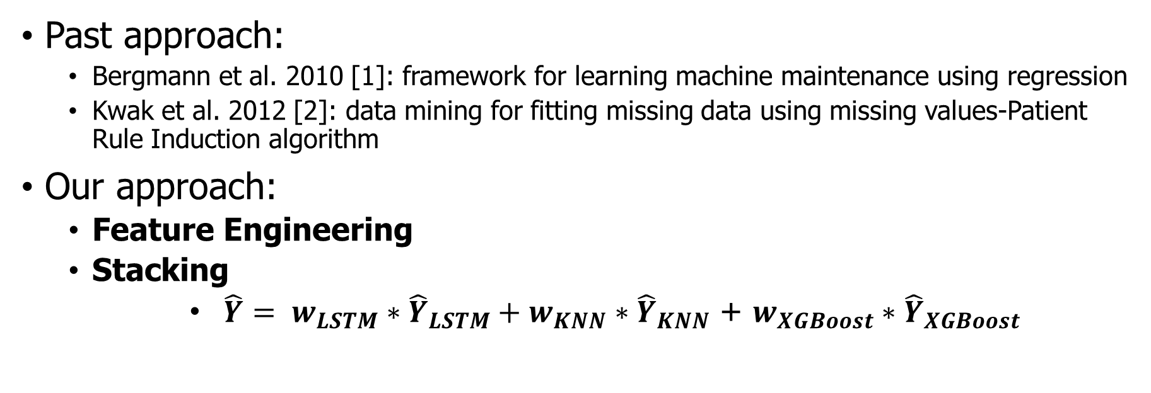
Approach
Past approach:
Bergmann et al. 2010 [1]: framework for learning machine maintenance using regression
Kwak et al. 2012 [2]: data mining for fitting missing data using missing values-Patient Rule Induction algorithm
Our approach:
Feature Engineering
Stacking
$\hat{Y}= w_{LSTM}∗{\hat{Y}}_{LSTM}+w_{KNN}∗{\hat{Y}}_{KNN}$ + $w_{XGBoost}∗{\hat{Y}}_{XGBoost}$
[1] https://www.ndt.net/article/ndtnet/2010/bergmann.pdf
[2] https://www.sciencedirect.com/science/article/pii/S0957417411012450?via%3Dihub

Slide 5
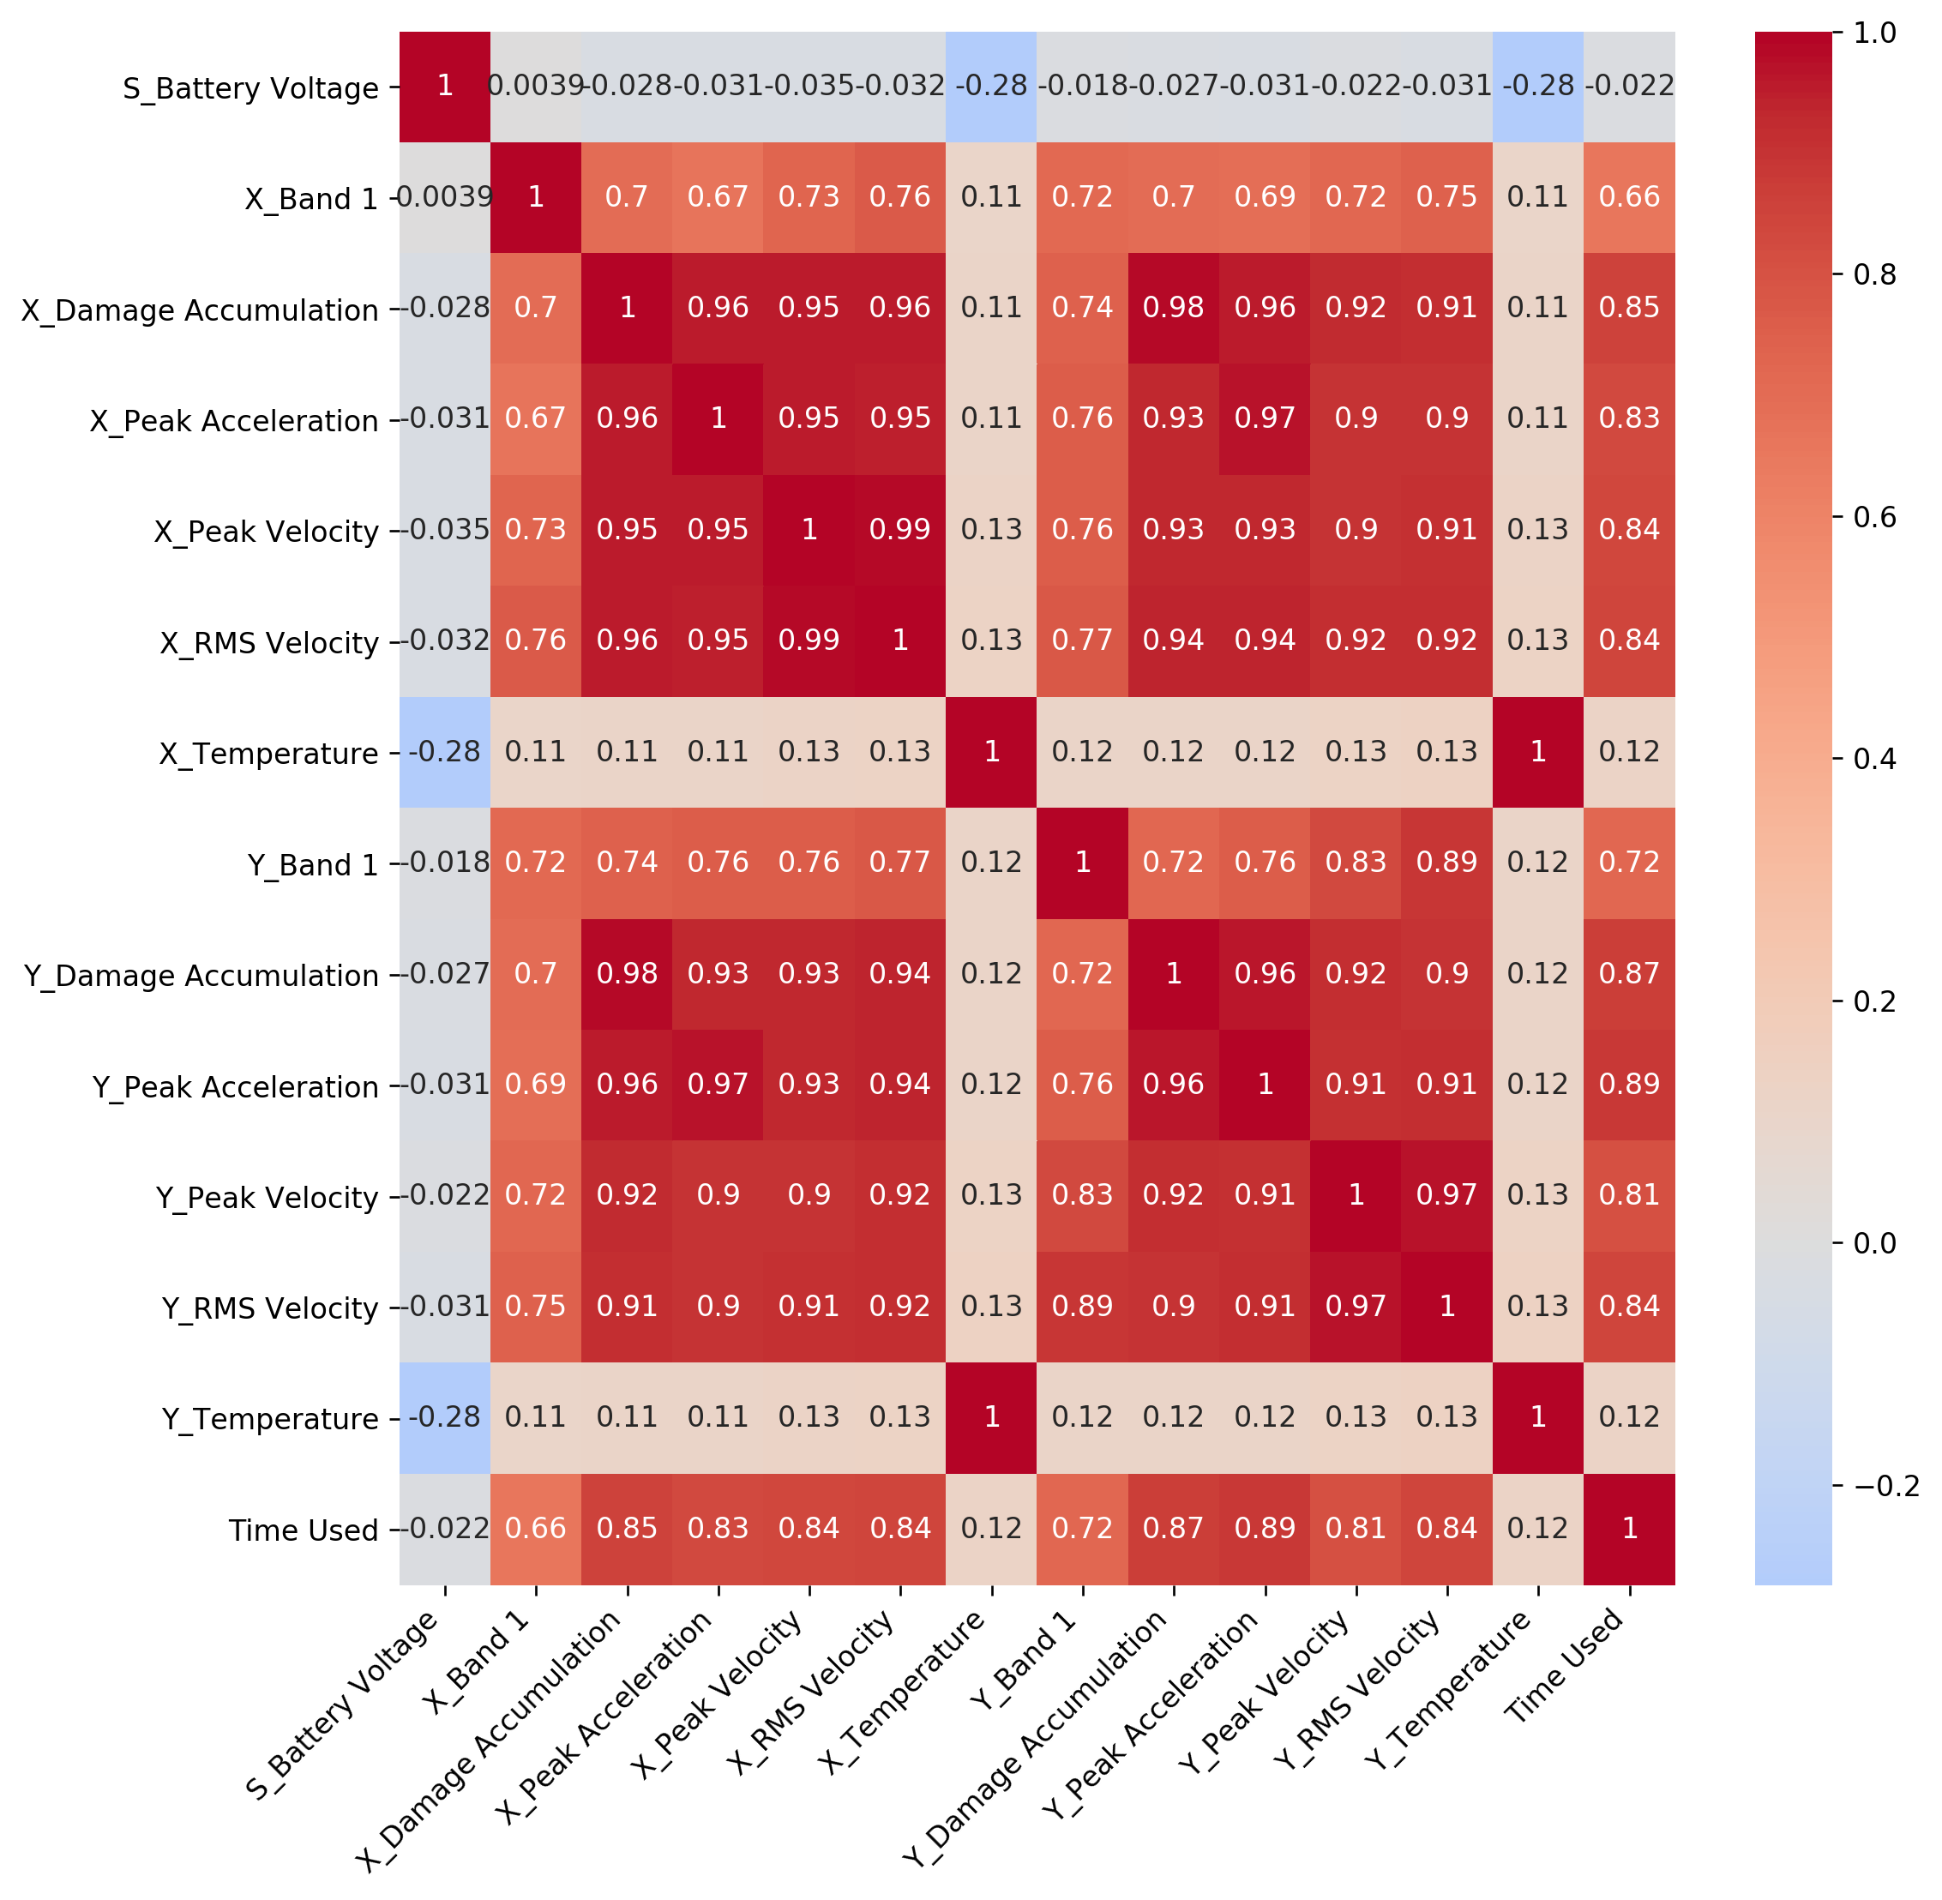
Data Cleaning and Analytics
All data mapped within a universal time scale
Missing data is linearly interpolated using the 2 closest data point
Correlation Matrix applied
Battery Voltage is irrelevant

Slide 6
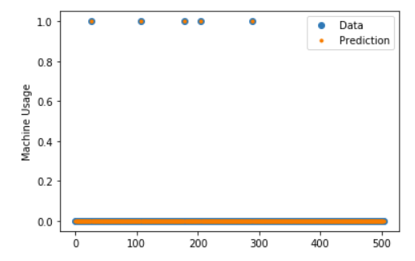
Feature Engineering
Binary Classification on Machine Usage
Adding time-related attribute to XGBoost and KNN
Achieved using Random Forest
Random Forest outperforms Logistics Regression with RMS=0.16%

Slide 7
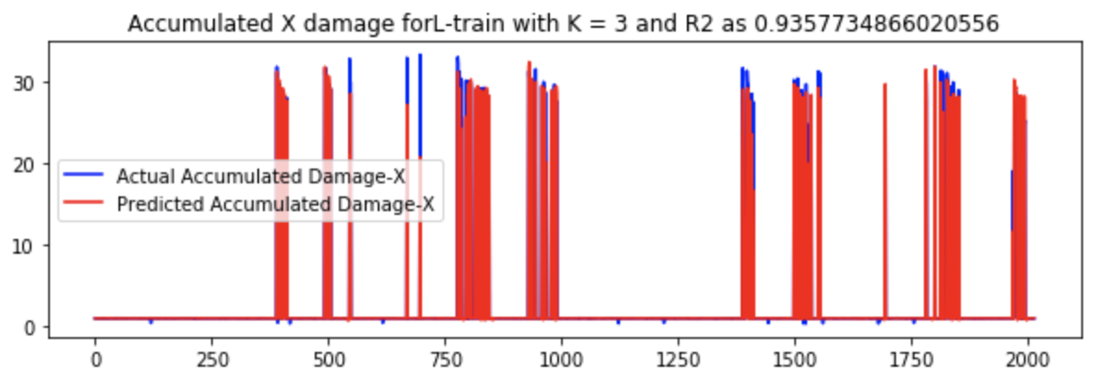
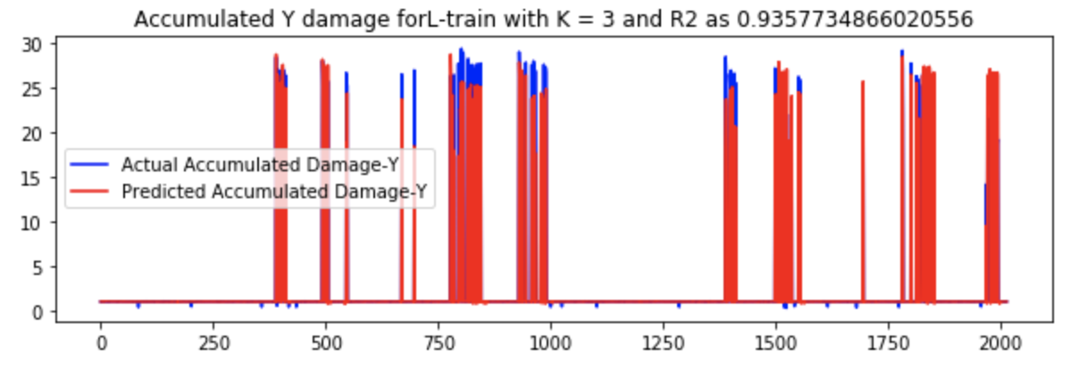
KNN Regression
KNN Regression
Model accuracy increases with increasing data size
Accuracy will increase with continuous recording of historical data
Not good with drilling process

Slide 8
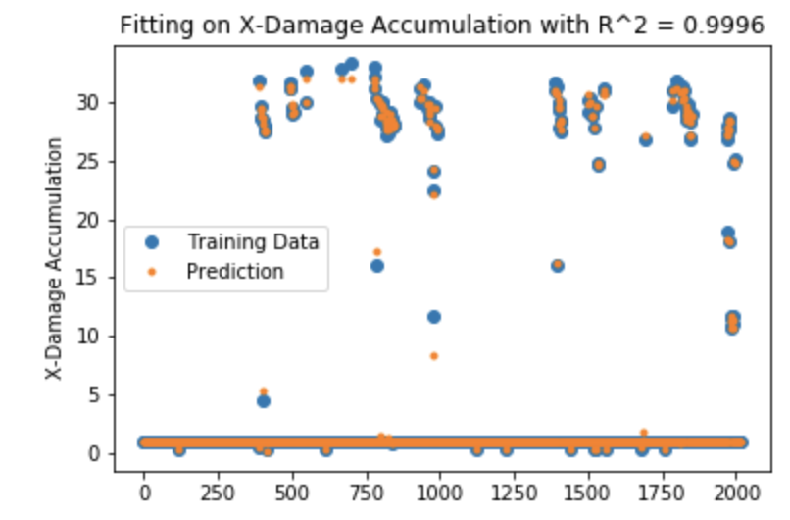
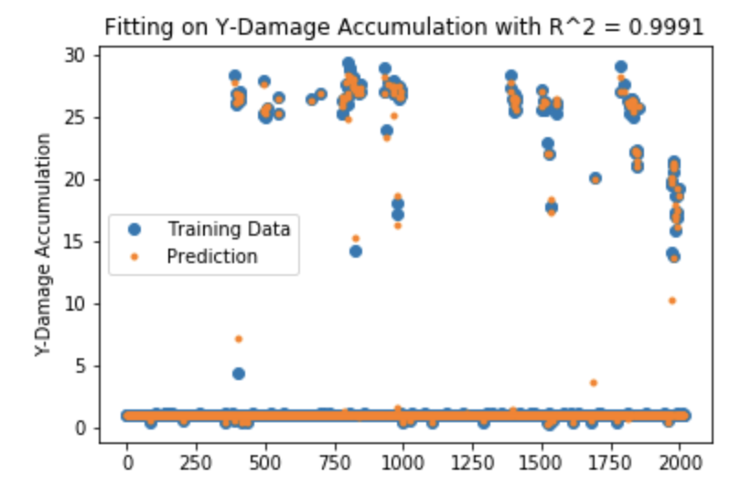
XGBoost
XGBoost
Efficient
Adaptable to different data distributions

Slide 9
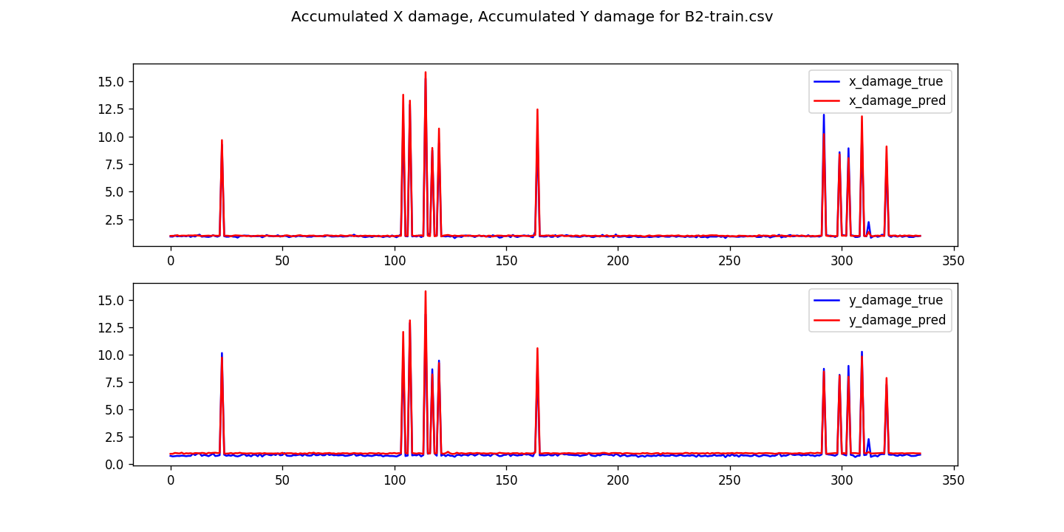
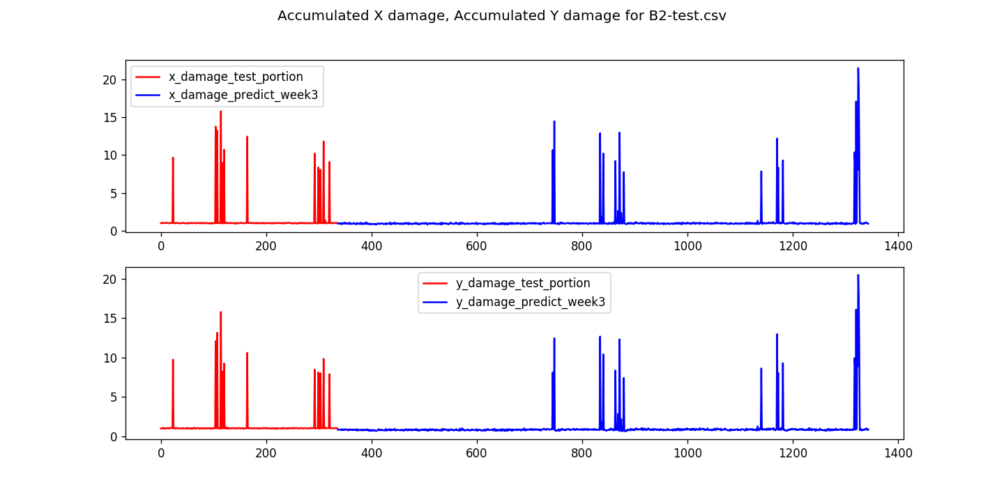
LSTM
Recurrent neural network: learn order dependence among data in a sequential feed
Capable for making prediction for a relatively long period
3rd_week prediction

Slide 10
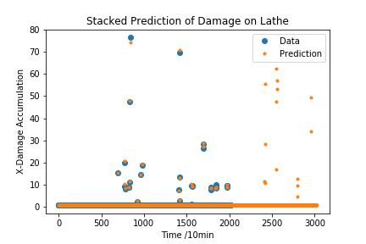
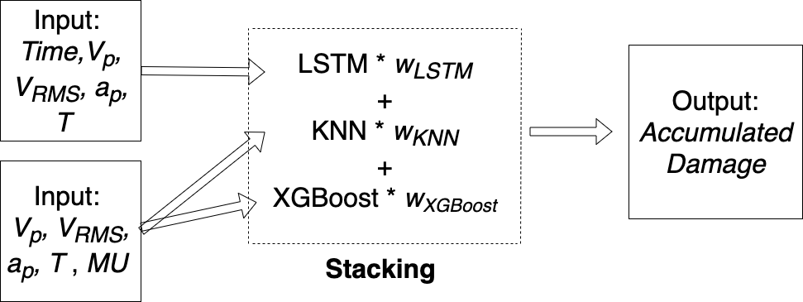
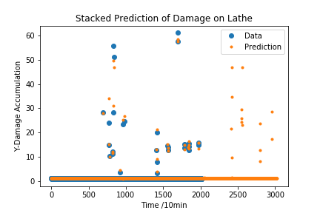
Stacking
Weight:
X Damage: KNN = -0.01, LSTM = 0.07, XGBoost = 0.94
Y Damage: KNN = 0.08, LSTM = -0.01, XGBoost = 0.93

Slide 11
Results
Computational Time:
~0.48 sec per test dataset
~4.9 sec for all test dataset
The R² of predicted damages using stacked algorithm is higher than those using single algorithms
Method | KNN | LSTM | XGBoost | Stacked Result
Average R2 of damage accumulation in X direction of all training datasets | 0.772 | 0.940 | 0.993 | 0.994
Average R2 of damage accumulation in Y direction of all training datasets | 0.785 | 0.897 | 0.989 | 0.990

Slide 12
Findings and Discussion
LSTM as a recurrent neural network address the time-series data
KNN and XGBoost address the dense and clustered characteristics of data
Feature engineering can be used to address the sequential effects for non-sequential algorithms
XGBoost performs the best among all 3 algorithms when using alone

Slide 13
Closure & Insights
Accumulated machine damages are predicted with high accuracy
Sensor battery voltage dropped after data analytics
Timestamp is not important, but time sequence is
Stacking combines the advantage of all algorithms

