Slide 1
Additive Manufacturing Product Single Layer Shape Accuracy Analysis by Using Multi-type Dataset
Problem 2
HACKATHON_DDX
Yinshuang Xiao, Anlan Dong, Kaiyue Deng

Slide 2
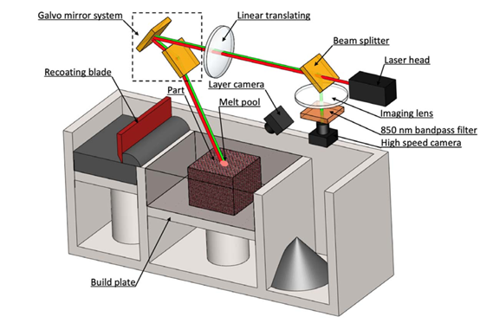
PROBLEM DESCRIPTION
Background
Additive manufacturing (AM) quality is greatly influence by melting process, layer powder spreading, and system calibration, etc.
Secondary systems are applied to record product forming process to help understand AM characters and identify stochastic influential factors.
Challenges
Data recorded by different secondary systems may have different forms. To fully apply the available data source, cross-comparing methodology is needed for datasets with different forms.
Yang, Z., Lu, Y., Yeung, H., & Krishnamurty, S. (2020). From Scan Strategy to Melt Pool Prediction: A Neighboring-Effect Modeling Method. Journal of Computing and Information Science in Engineering, 20(5).

Slide 3
PROBLEM DESCRIPTION
Goal
Establish a data cross-comparing methodology to bridge data with different formats and analyze single layer shape accuracy.
Data
Command scan path data (mm) and laser power data (W) (Benchmark data)
Image files recorded by layer camera (Measured data 1)
Measurement scan path data (mm) and laser power data (W) (Measured data 2)
MPM camera image (Measured data 3)
Yang, Z., Lu, Y., Yeung, H., & Krishnamurty, S. (2020). From Scan Strategy to Melt Pool Prediction: A Neighboring-Effect Modeling Method. Journal of Computing and Information Science in Engineering, 20(5).

Slide 4
Approach
Command & measured laser power data
Matlab
Command scan path raw data
Product shape (command)
Pixel wise comparison
Measured scan path raw data
Product shape (measured 1)
Variation analysis
Trained computer vision algorithm
Layer image
Product shape (measured 2)
FFT Signal Processing
Amplitude comparison
Melt Pool Image
Measured Optical Amplitude
Python + OpenCV

Slide 5
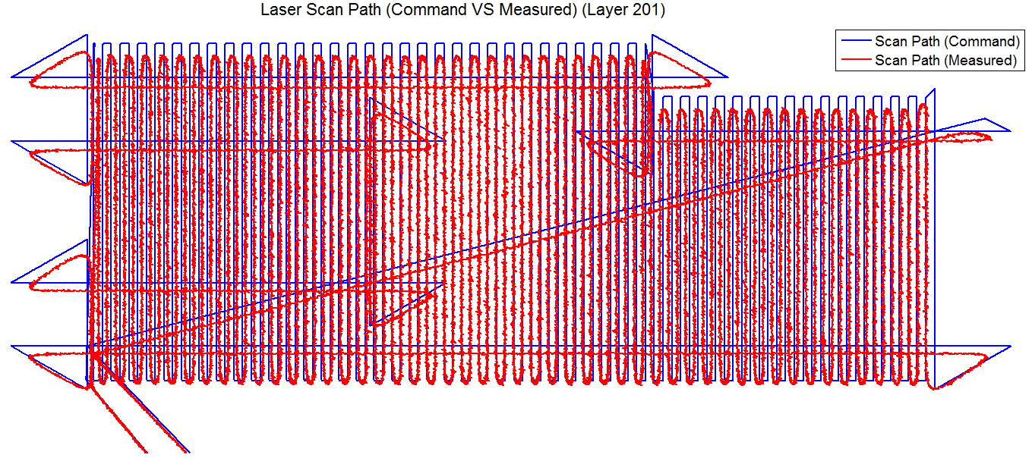


Approach
Trigger Signal Times in 3 layers used in the topic:
In 185: 4670/103380

Slide 6
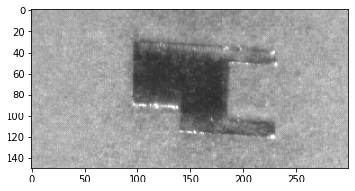
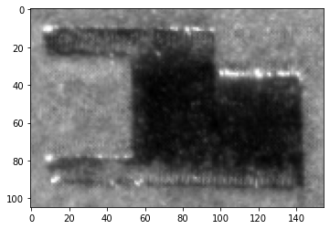
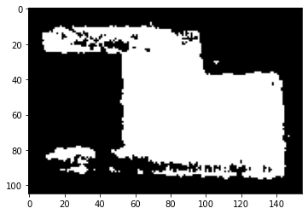
LWI Image Processing:
Raw:
Cropped:
Processed:

Slide 7
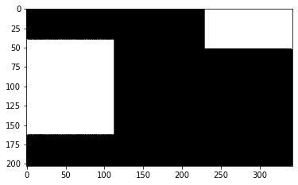
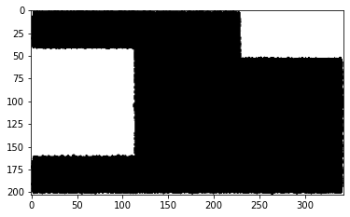
Command Pattern Vs. DAQ Pattern

Slide 8
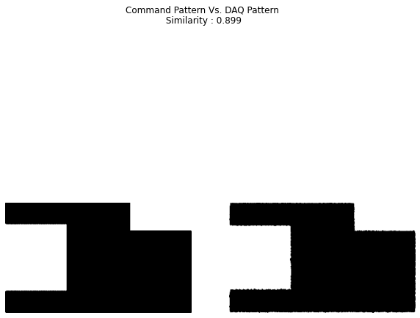

Slide 9
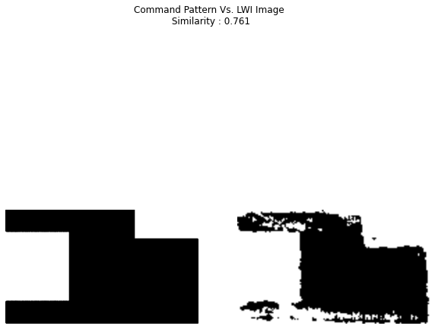

Slide 10
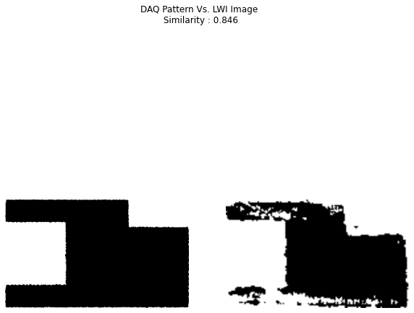

Slide 11
Findings and Discussion
How your approach/model/simulation helps address the challenges and solve the problem?
It helps visualize the comparisons between the supposed layers and the actual layers. And proposes a protocol for directing recoater blade to a more proper position.

Slide 12
Future Work
Continue FFT signal processing of melt pool images, and analyze how the variations in laser power affect the fidelity of dimensions. [3]
Higher Resolution LWI Camera will yield better and more meaningful result.
Study control system of PBF and direct recoater blade.

Slide 13
References
[1] Kolb, T., Elahb, R., Scheitler, C., Hentschel, O., Tremel, J. and Schmidt., M., 2020, “Camera signal dependencies within coaxial melt pool monitoring in laser powder bed fusion,” Rapid Prototyping Journal, 26(1), pp. 100-106. DOI: 10.1108/RPJ-01-2019-0022
[2] Scime, L. and Beuth, J., 2018. “Anomaly detection and classification in a laser powder bed additive manufacturing process using a trained computer vision algorithm.” Additive Manufacturing, 19, pp.114-126.
[3] Guo, Q. et al., 2019, “In-situ characterization and quantification of melt pool variation under constant input energy density in laser powder bed fusion additive manufacturing process.” Additive Manufacturing, 28, pp. 600-609.

