Slide 1
Regression Model for Machine Damage Accumulation
Problem 1
SAX Hacks
Xingang Li & Sai Elagandula, Amaninder Singh Gill
Florida Tech, University of Arkansas

Slide 2
PROBLEM DESCRIPTION
Introduction
Background
We need to build a surrogate model to predict the machine damage accumulation using history data.
Data
Data are from sensors from 5 machines in time series.
Challenges
Data are needed to be cleaned
A predict model with generality and good accuracy

Slide 3
Approach overview and background information
Data cleaning
Data plotting
Variables selection
Multivariate regression

Slide 4
Data cleaning
The missing data are identified first
We filled the data using forward fill method (if the missing data has no former data available, we used backward fill method)
Data plotting for single independent and dependent variables (examples)

Slide 5
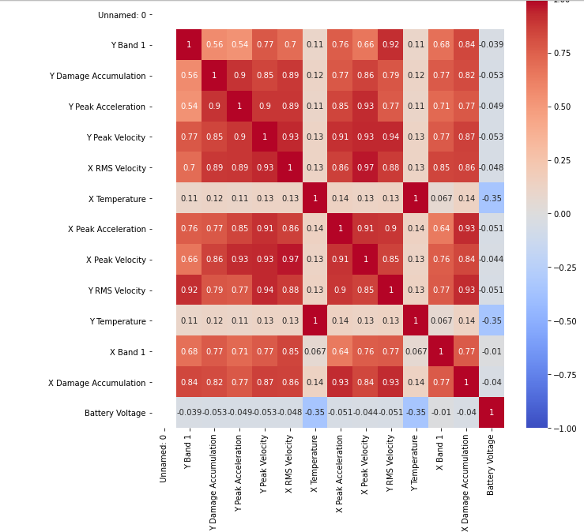
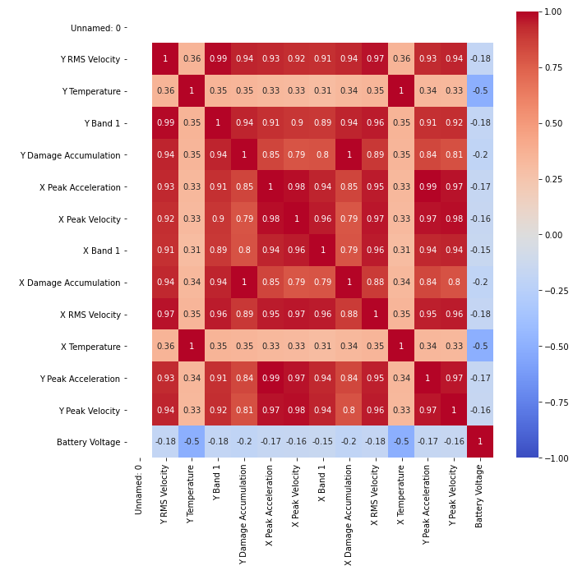
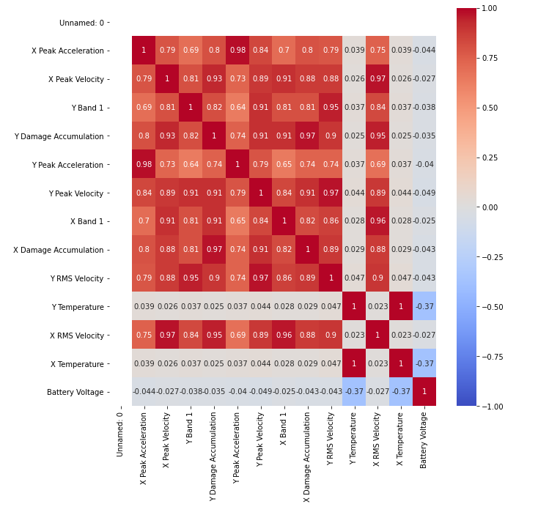
Variables selection using heat maps (examples)
Bridgeport 1
Lathe
Drill

Slide 6
Results
Results for regression expressions (examples)
Bridgeport 1
Lathe
Drill

Slide 7
Findings and Discussion
Not all independent variables are highly related to the damage accumulation. Variables were selected to improve the accuracy of the model.
The surrogate models can be built using multivariate linear regression models and we got a good accuracy in terms of the R^2 scores.
High polynomial regression is easier to overfit the dataset, and a linear regression has more generality
More work can be done for feature selection in the future to improve the accuracy of the prediction

