Slide 1
Generating a Data-Driven Surrogate Model for Machine Damage Accumulation
Problem 1
UB Manufacturing & Artificial Intelligence Team (UBMAIT)
Dustin Bielecki & Darshil Patel, Raj Khawale
University at Buffalo, NY (UB)

Slide 2
Agenda
Problem Description
Approach
Results & Discussion
Summary

Slide 3
PROBLEM DESCRIPTION

Slide 4
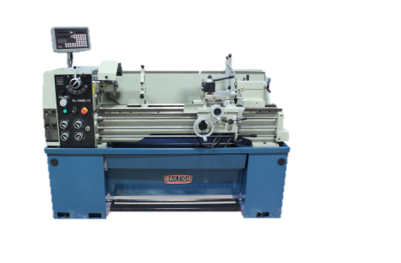
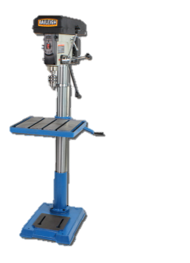
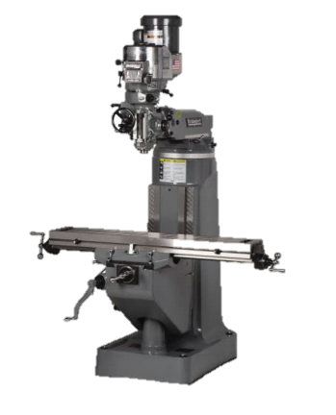
Introduction
Objective : To create a data driven model that rapidly outputs damage accumulation values based on other parameter measurements for manufacturing facilities of Bernard M. Gordon Learning Factory
Implicit Challenges
Can we construct data driven digital twin for forecasting?
Can we identify signals in data which have most impact?
Can we reduce machine damage by focusing on specific parameters?
Deep learning-based feature engineering for stock price movement prediction” Wen Long, Zhichen Lu, Lingxiao Cui.
Integrating the Digital Twin of the manufacturing system into a decision support system for improving the order management process”, Kunath, M., & Winkler, H.

Slide 5
Datasets
Two weeks of data for 5 machines (3 Bridgeport mills, 1 lathe, 1 drill press) is provided for training our model
Training Inputs
(11 variables)
Output
(2 variables)
Data-Driven Model
Peak acceleration
RMS velocity
Ambient Temperature
Peak velocity
Battery Voltage
……..
Damage accumulation
- X-axis
- Y-axis

Slide 6
APPROACH

Slide 7
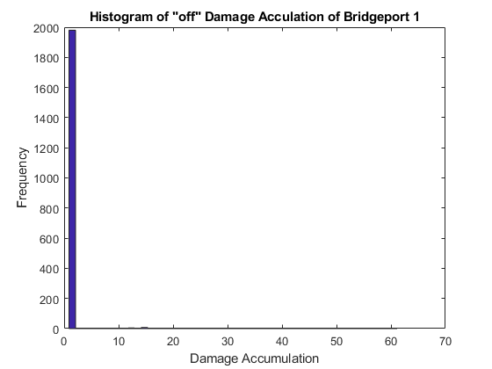
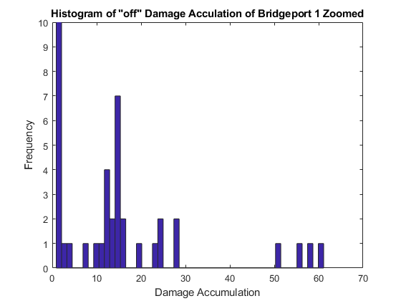
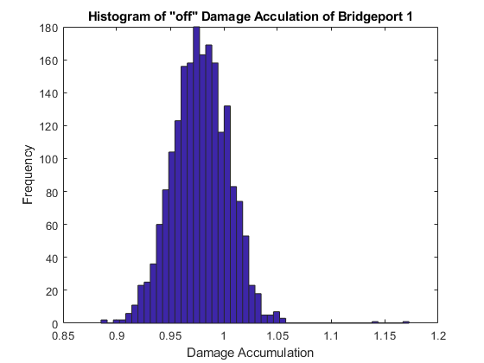
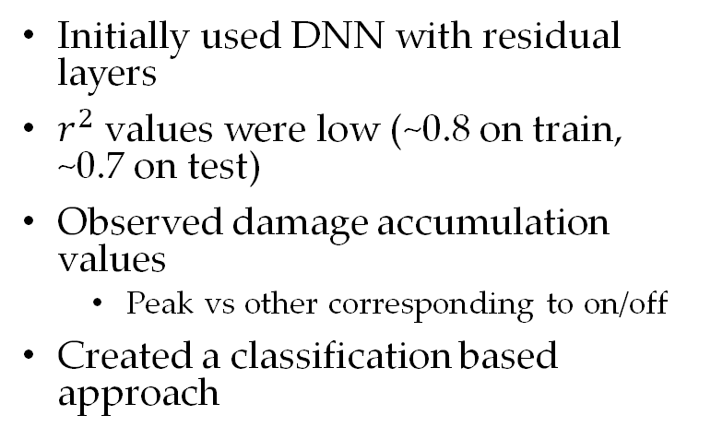
Approach – Initial
Initially used DNN with residual layers
$r^{2}$ values were low (~0.8 on train, ~0.7 on test)
Observed damage accumulation values
Peak vs other corresponding to on/off
Created a classification based approach
A. B. Geva, "ScaleNet-multiscale neural-network architecture for time series prediction," in IEEE Transactions on Neural Networks, vol. 9, no. 6, pp. 1471-1482, Nov. 1998, doi: 10.1109/72.728396.

Slide 8
Approach - Classification
SVM
ResNN
MLE
Inputs
Inputs are fed into an SVM for on/off classification
Machine status off defaults the damage accumulation values to maximum likelihood of the data
Machine status on feeds the
Machine on
Machine off
Zhang Y. (2012) Support Vector Machine Classification Algorithm and Its Application. In: Liu C., Wang L., Yang A. (eds) Information Computing and Applications. ICICA 2012. Communications in Computer and Information Science, vol308. Springer, Berlin, Heidelberg.
Dave, Vishwesh & Shah, Kaivan. (2019). COMPARATIVE ANALYSIS OF REGULARIZATION TECHNIQUES IN ARTIFICIAL NEURAL NETWORKS. 10.1729/Journal.22756.
Basu, Atreya & Watters, Carolyn & Author, Michael. (2003). Support Vector Machines for Text Categorization.. 103. 10.1109/HICSS.2003.1174243.

Slide 9
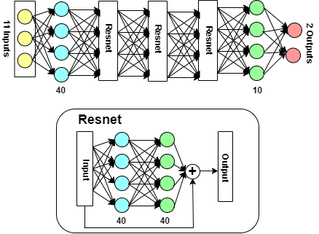
Approach - NN
Network uses the full 11 inputs
Hidden layer of 40 nodes
3 Residual blocks
Final hidden layer of 10 nodes
2 node output representing the damage accumulation
He, Kai mi ng& Zhang, Xi angyu& Ren, Shaoqi ng& Sun, Ji an. (2015). Deep Residual Learning for Image Recognition.
Ioffe, Sergey & Szegedy, Christian. (2015). Batch Normalization: Accelerating Deep Network Training by Reducing Internal Covariate Shift.5:51
Srivastava, Nitish & Hinton, Geoffrey & Krizhevsky, Alex & Sutskever, Ilya & Salakhutdinov, Ruslan. (2014). Dropout: A Simple Way to Prevent Neural Networks from Overfitting. Journal of Machine Learning Research. 15. 1929-1958.

Slide 10
RESULTS & DISCUSSION

Slide 11
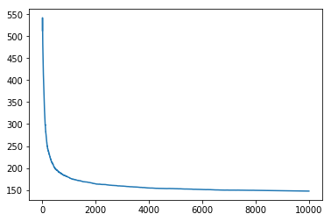
Results
Mean Squared Error vs Epoch
Training performance
Samples were run for 10,000 epochs
The mean squared error was still seemingly high due to limited number of samples
This is still much better than assuming average values
Dataset was actually sparse
Mean Squared Error
Epoch

Slide 12
Results – r²
Bridgeport 1
0.879 on reduced data, 0.932 on full dataset
Bridgeport 2
-1.493 on reduced data, 0.959 on full dataset
Bridgeport 3
-35.75 on reduced data, 0.942 on full dataset
Drill
-7.194 on reduced data, 0.906 on full dataset
Lathe
-2.647 on reduced data, 0.927 on full dataset

Slide 13
Findings and Discussion
 | Bridgeport 1 | Bridgeport 1 | Bridgeport 1 | Drill Press | Lathe
Total Samples | 2008 | 2008 | 2001 | 2006 | 1993
Correct Samples | 2010 | 2008 | 2001 | 2007 | 1998
Number "on" | 30 | 64 | 22 | 6 | 120
Misclass "on" | 2 | 0 | 0 | 1 | 3
Misclass "off" | 0 | 0 | 0 | 0 | 3

Slide 14
Results – Classification
Bridgeport 1
0.879 on reduced data, 0.932 on full dataset
Bridgeport 2
-1.493 on reduced data, 0.959 on full dataset
Bridgeport 3
-35.75 on reduced data, 0.942 on full dataset
Drill
-7.194 on reduced data, 0.906 on full dataset
Lathe
-2.647 on reduced data, 0.927 on full dataset

Slide 15
SUMMARY

Slide 16
References
1) Deep learning-based feature engineering for stock price movement prediction” Wen Long, Zhichen Lu, Lingxiao Cui.
2) Integrating the Digital Twin of the manufacturing system into a decision support system for improving the order
management process, Kunath, M., & Winkler, H.
3) A. B. Geva, "ScaleNet-multiscale neural-network architecture for time series prediction," in IEEE Transactions on Neural
Networks, vol. 9, no. 6, pp. 1471-1482, Nov. 1998, doi: 10.1109/72.728396.
4) He, Kai mi ng& Zhang, Xi angyu& Ren, Shaoqi ng& Sun, Ji an. (2015). Deep Res i dual learning for image recognition.
5) Loffe, Sergey & Szegedy, Christian. (2015). Batch Normalization: Accelerating deep network training by reducing internal
covariate
shift.5:51
6) Srivastava, Nitish & Hinton, Geoffrey & Krizhevsky, Alex & Sutskever, Ilya & Salakhutdinov, Ruslan. (2014). Dropout: A
simple way to prevent neural networks from overfitting. Journal of Machine Learning Research. 15. 1929-1958.
7) Dave, Vishwesh & Shah, Kaivan. (2019). COMPARATIVE ANALYSIS OF REGULARIZATION TECHNIQUES IN
ARTIFICIAL NEURAL NETWORKS. 10.1729/Journal.22756.
8) Basu, Atreya & Watters, Carolyn & Author, Michael. (2003). Support Vector Machines for Text Categorization.. 103.
10.1109/HICSS.2003.1174243.

