Slide 1
Predicting machine damage accumulation using a data-driven surrogate model
Problem #1
Team Name: We74
Presenter & Teammates : Manav Prabhakar, Salil Saxena, Sharveshwaran U

Slide 2





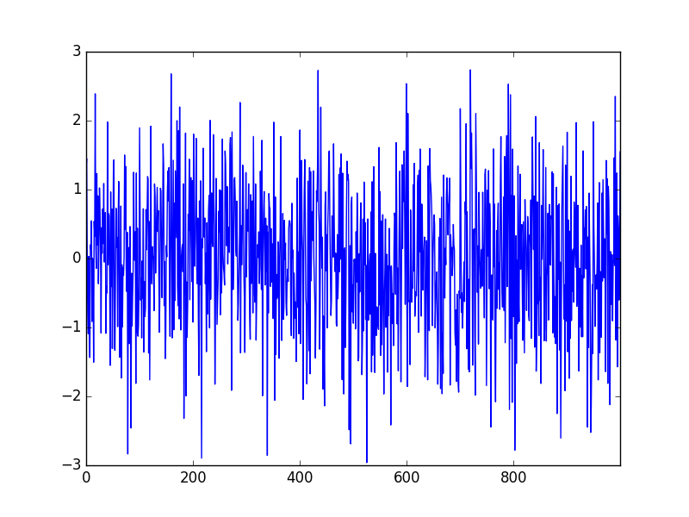
The Problem
Wear and Tear and machine breakdown
Unscheduled Maintenance Breaks
Unstructured and disorganized Sensor Data
Computational expensiveness of current models
Noise and Irregularities in Data
Exploiting the Power of Digital Twin

Slide 3

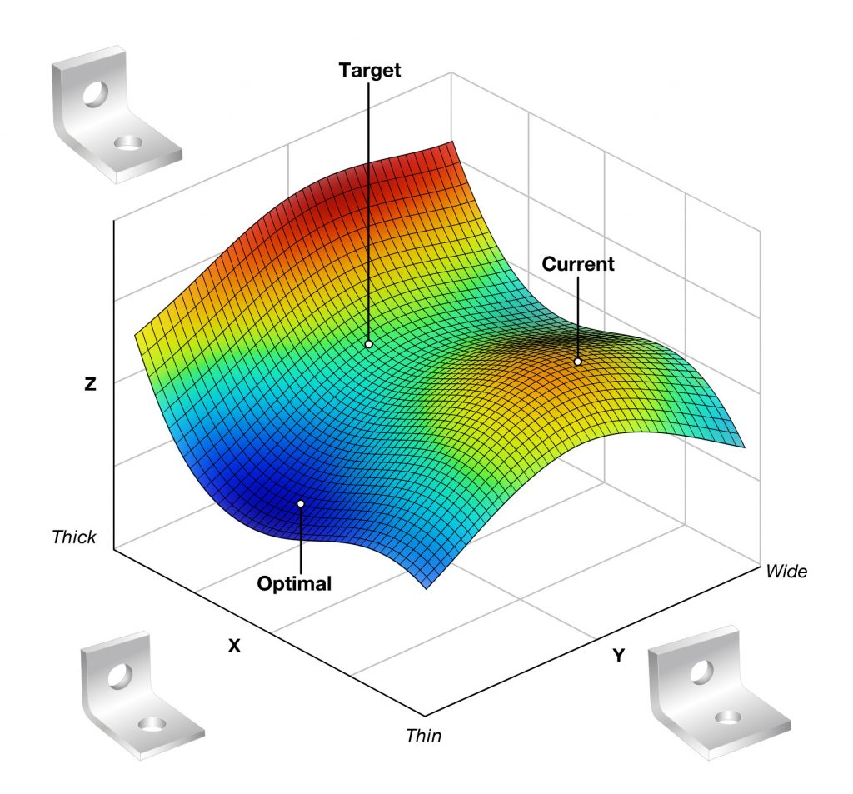


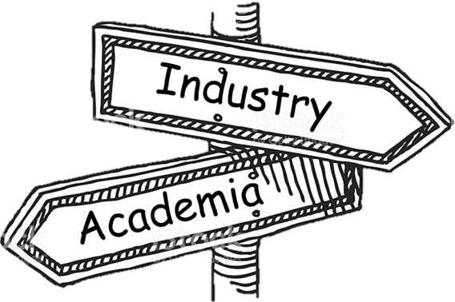
The Solution
Surrogate Regression Models
Harvesting smaller datasets

Slide 4
Approach
Organize (Data),Process (Data)
Data – Redundant Parameters <-Exploratory Data Analysis (Data)
Refined Dataset <- Data Completion <- Exponential Moving Average (Data)
Model <- Max Efficiency (LSTM, Linear Regression, Neural Networks)*
Training (Model - most efficient - entire training set)**
Damage Accumulation <- Predict_Values (the Testing Set)
*Using 85% of the training set as training samples and the rest 15 as testing samples.
**Battery Voltage of the sensor was not considered since, it has no physical connection with the wear and tear of any mechanical part.

Slide 5
Results

Slide 6
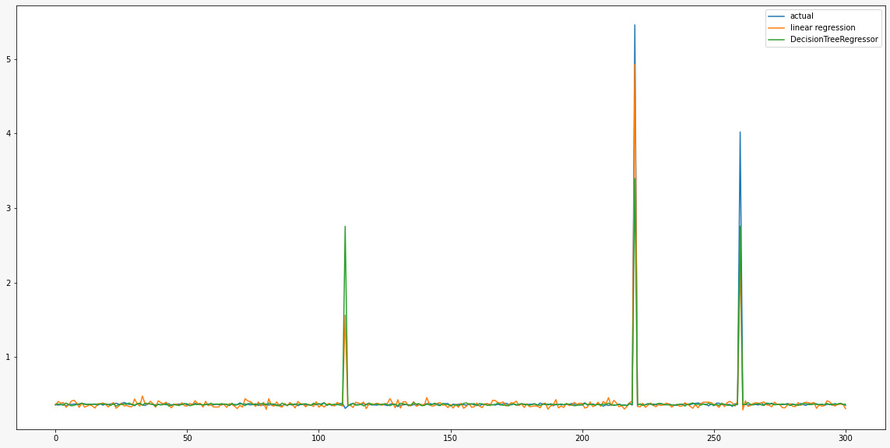
R^2 : +0.8691582383278811
DecisionTreeRegressor: 0.6962642301912688
Damage Accumulation: Drill Press X
For simple LSTM: loss (MSE) was around 38.
for NN: testing R^2 score was -1.7

Slide 7

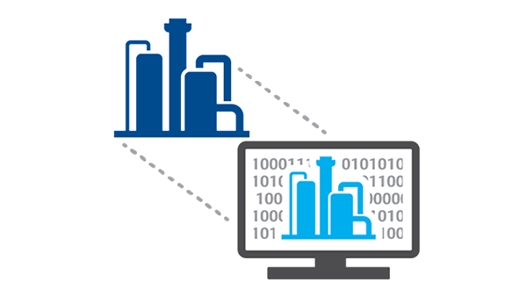




What next? – The paradigm shift!
Predictive Maintenance
Preventive Maintenance
Reactive Maintenance

Slide 8

Potential Applications of the work
Critical Analysis: Project Scheduling at the Learning Factory
04
10
14
16
No. of hrs
08
02
06
12
11
Project 1
14
Project 2
6 students -> 6 Projects
Different Deadlines
Different Durations
10
Project 3
8
Project 4
15
Project 5
12
Project 6
Projects

Slide 9
Time to breakdown
0
70
2
4
2
4
1
2
2
5
6
6
2
6
4
6
1
1
6
2
3
2
3
Buffer Time
Maintenance Break
Monday
Tuesday
Wednesday
Thursday
Friday
Saturday
Weighted Priority
Project 6
1
Completed by Tuesday
Completed by Wednesday
Completed by Wednesday
Completed by Thursday
Completed by Friday
Completed by Friday
Project 2
2
Priority Stack
Project 3
3
Project 4
4
Project 1
5
Project 5
6

Slide 10
Project 7
Deadline closer than Project 4 so gets priority higher than project 4
Pop all Projects with higher priority than Project 7 from the Priority Stack and Push Project 7 into the stack
Re-arrange the priorities as shown and push the remaining elements back in stack.
Reschedule the week at the end of the day
Project 3
3
New Priority
Project 2
2
Project 6
1
Project 6
1
Project 2
2
Project 3
3
Project 7
4
Project 7
4
Project 4
5
Project 4
5
Project 1
6
Project 1
6
Project 5
7
Project 5
7

Slide 11
Closure & Insights
The processing of the dataset was a cumbersome task. The sensors not giving values at certain intervals can prove to be hazardous for the model.
If the model accompanied by other specifications is able to calculate the number of hours of constant use before which the machine may break down, project scheduling can prove out to be a powerful application.
It could be used in all Universities world-wide and can prove to be a huge market for the developers.
All approaches discussed for problem solving are specific to the particular dataset and may not be generalized.
Gaussian Processing Regression also offers a good option for noise reduction as it is completely different than conventional regression in terms how it maps its data points.

Slide 12
References
Literature
[1] Kunath, M., & Winkler, H. (2018). Integrating the Digital Twin of the manufacturing system into a decision support system for improving the order management process. Procedia CIRP, 72, 225-231.
[2] Long, Wen, Zhichen Lu, and Lingxiao Cui. "Deep learning-based feature engineering for stock price movement prediction." Knowledge-Based Systems 164 (2019): 163-173.
[3] Souvik Chakraborty, Sondipon Adhikari, Ranjan Ganguli (2020), “The Role of surrogate models in the development of Digital Twins of Dynamic Systems.”
Images
https://www.google.com/imghp?hl=EN

