Slide 1
Generating a Data-Driven Surrogate Model for Machine Damage Accumulation
Problem 1
Team name: What the Hack?
Bi Senior Foua, Madan Dahal, Laxmi Poudel

Slide 2
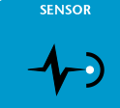
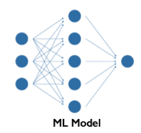

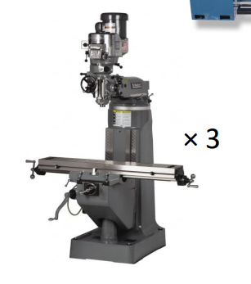

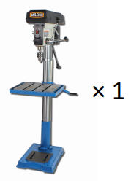
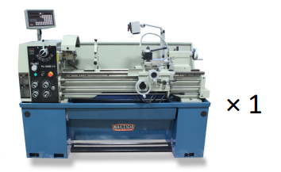
PROBLEM DESCRIPTION
Sensor Data Analysis and Machine Learning
Background
Problem origination: Bernard M. Gordon Learning Factory but general to any machining shop
Eventual Objective:
Prognostics
Remaining useful life analysis
Predictive maintenance
Forecasting
Immediate Objective: Fault accumulation prediction
Data
Two weeks of labeled data for training
5 machines: 3X Bridgeport, 1X Drill press, and 1X Lathe
Challenges:
Data cleaning
Sensor dataset
Training and Testing Data
Output

Slide 3
Approach
Problem Understanding
Why develop a surrogate model?
Problem domain: Application of sensor data in PM, Industrial IoT, Health monitoring, Stock price prediction
Most popular approach:
Deep Learning are effective for prediction and regression
CNN, RNN, LSTM, Autoencoders are some of the popular DL methods
Long et al. even combined CNN and ANN with multi-filters neural network to improve the predicting ability of the model [Long et al., 2018]
Namuduri et al. provides common us of ML methods to PM using sensor data [Namuduri et al., 2020]
Programming Language: Python
Framework : TensorFlow, Keras
Algorithm: SVM, DL, GB, Ensemble, RF, KNN, LR
To provide end user flexibility to choose model that works for their objective
Literature Review
Data Cleaning
Model Building
Model Testing

Slide 4

Results
Machine Name | Model Used X-Axial (R Square value) | Computational Time | Model Used Y-Radial (R Square value) | Computational Time
Bridgeport3 | LR = .8262 Knn = .8649 SVM = .7690 DT = .7693 RF = .8558 GB = .7929 Ensemble = .8612 NN = .8723 | 271 ms ± 54.2 ms per loop | LR = .9507 Knn = .9512 SVM = .9018 DT = .9055 RF = .96.27 GB = .9481 NN = .8912 Ensemble = .9710 | 1.82 s ± 207 ms per loop
Lathe | LR = .5030 SVM = .9155 DT = .9223 RF = .9718 GB = .9619 NN = . 9122 Ensemble = .8923 Knn = 0.9622 | 4.17 ms ± 656 µs per loop | LR = .7249 SVM = .8418 DT = .9323 RF = .9313 GB = .9453 NN = .8513 Ensemble = .9444 Knn = .9494 | 2.95 ms ± 123 µs per loop
$$R^{2 }−value$$

Slide 5
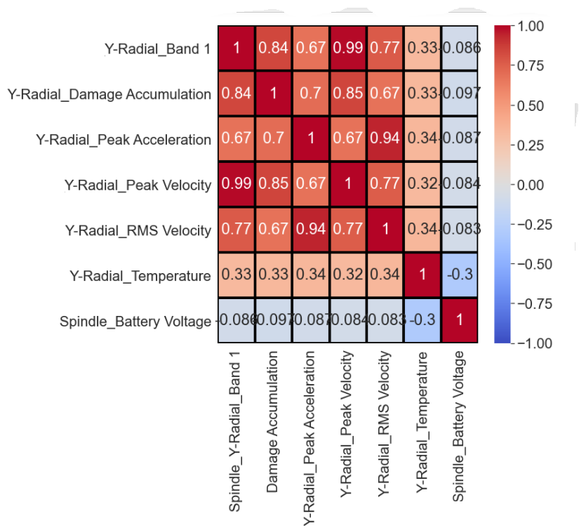
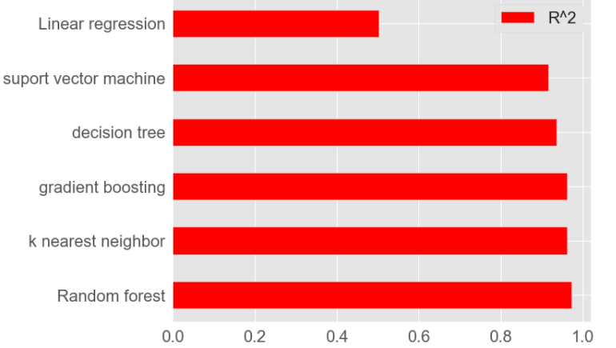

Results
$$R^{2 }$$
Comparison of R-value for Bridgeport 3 (Y-radial axis)
Correlation table for Bridgeport 3

Slide 6
Findings and Discussion
Rather than using a single approach to solve the problem, we wanted to see how do different machine learning methods result in different R-value
Use of different ML methods allow user to choose the model that works best for their eventual outcome whether it be prognosis, forecasting, etc.
Each model performed differently on each machine as demonstrated by different R-value for different machines
The deep learning and ensemble models performed better in general compared to the other ML models

Slide 7
Closure & Insights
Real life data are messy and require lot of pre-processing
Any ML used is only as effective as the training data it is fed
Feature engineering and Data Processing could help improve precision

Slide 8
Thank you! Questions?

