Slide 1
Introduction to Convolution Neural Network (CNN)
Xingang Li
Mechanical Engineering
University of Arkansas

Slide 2
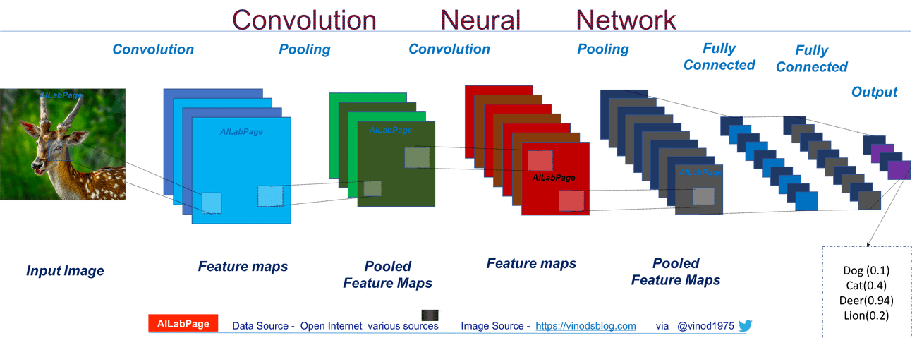
Convolution Neural Network (CNN)
CNNs are neural networks with convolutional layers (Conv layers)
CNNs are widely used for image classification and others

Slide 3
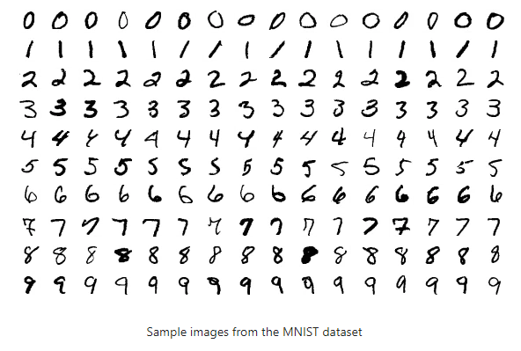
MNIST Dataset
“Hello World” problem
70,000 images
Handwritten digits 0~9 (10 classes)

Slide 4
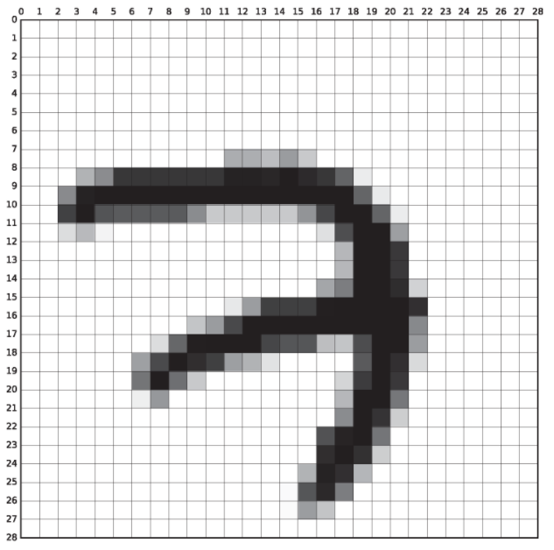
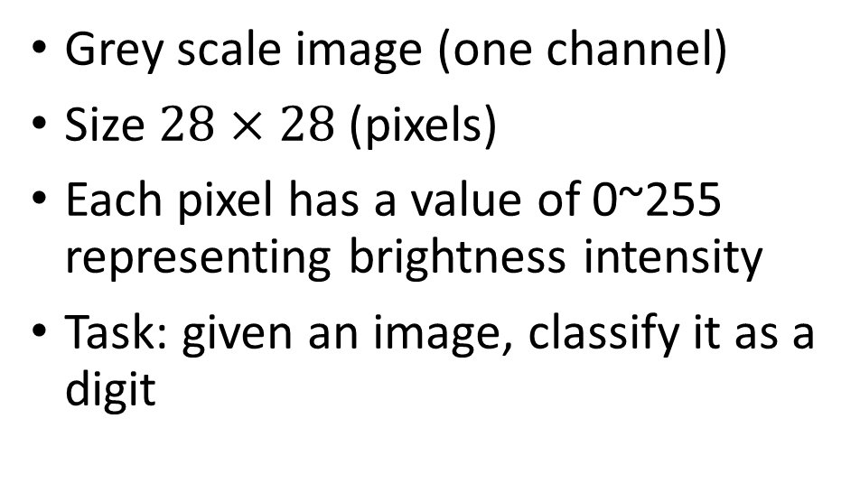
MNIST Dataset
Grey scale image (one channel)
Size $28×28$ (pixels)
Each pixel has a value of 0~255 representing brightness intensity
Task: given an image, classify it as a digit

Slide 5
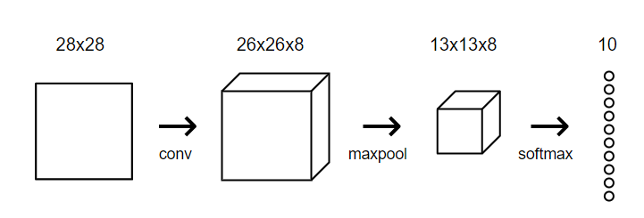

A Simple CNN Structure
Prediction
$$×1$$
Loss
Div(prediction, label)

Slide 6

A Simple CNN Structure
Prediction
$$×1$$
Loss
Div(prediction, label)

Slide 7
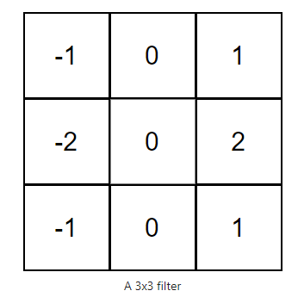
Convolution
Conv layers: filters (kernels), 2D matrices of numbers
We can convolve a filter with an input image
Overlay the filter on top of the image at a location, usually top left
Performing element-wise multiplication between the values in the filter and their corresponding values in the image
Summing up all the element-wise products. This sum is the output value for the destination pixel in the output image.
Repeat 1-3 for all locations.

Slide 8
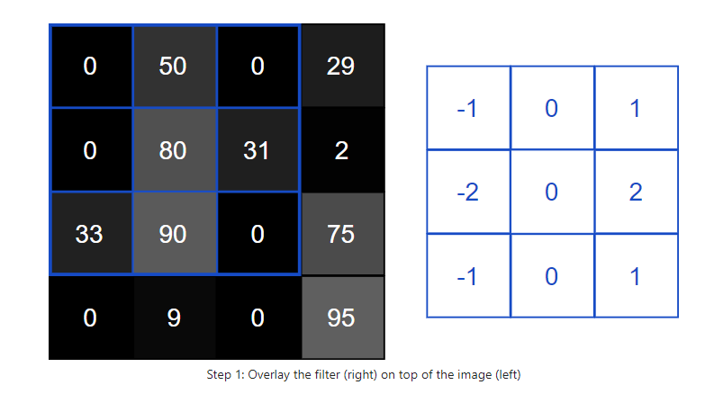
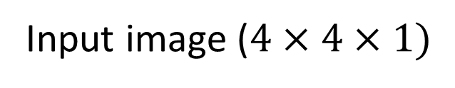
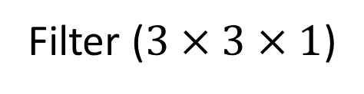
Convolution Step 1 : Overlay
Input image ($4×4×1)$
The filter values are needed to be initialized at first and will be updated through the training process
Usually starts from top left of an image
Filter ($3×3×1$)

Slide 9
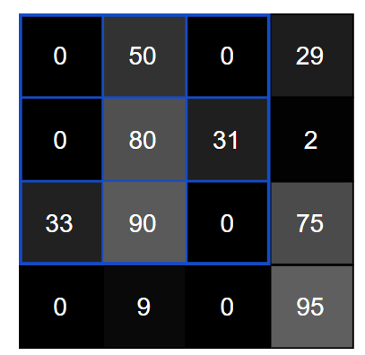
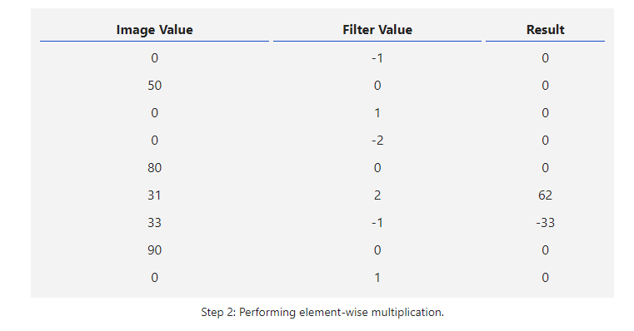
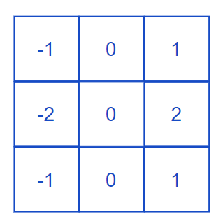


Convolution Step 2 : Element-wise Multiplication
Multiply the image value with the filter value in the corresponding position
$$⊙$$
$$=$$

Slide 10
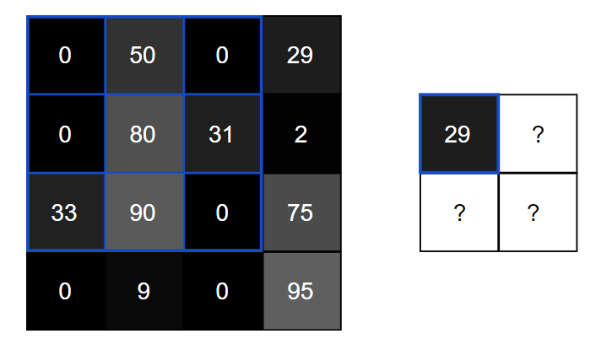
Convolution Step 3 : Sum Up to Destination Pixel
Feature map
Sum up

Slide 11
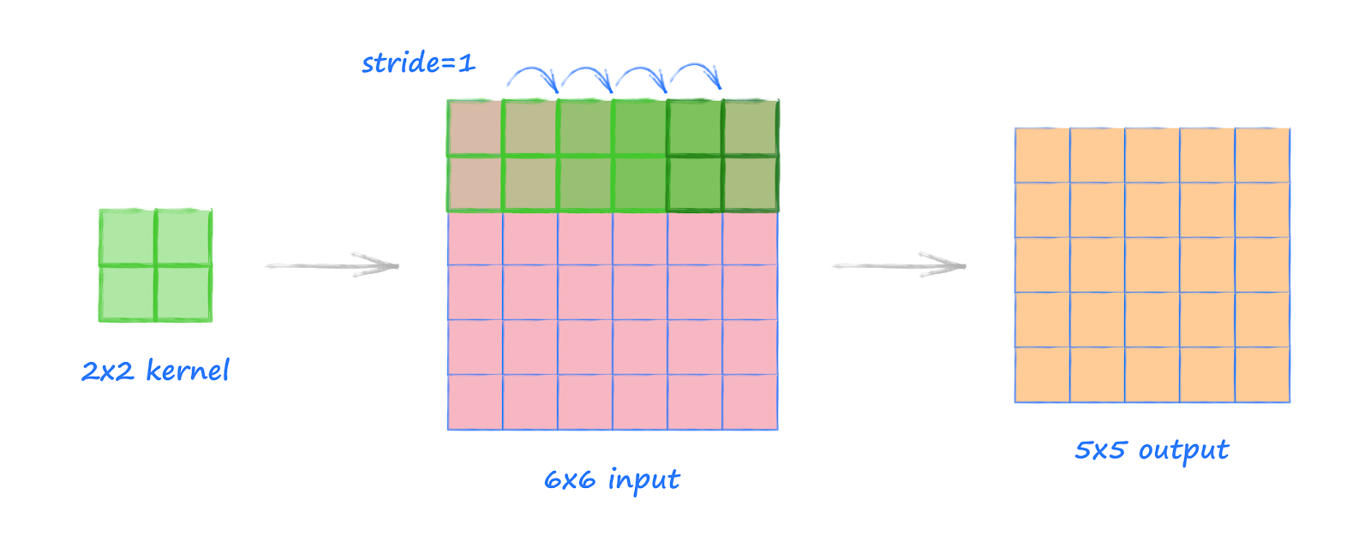
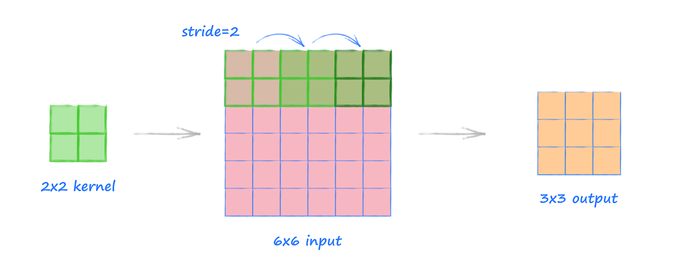
Stride
How many pixels a filter moves along the image for one step
Length and width directions
Output size = (L – K)/S + 1
Example:
(6 - 2)/1 + 1 = 5
(6 - 2)/2 + 1 = 3

Slide 12
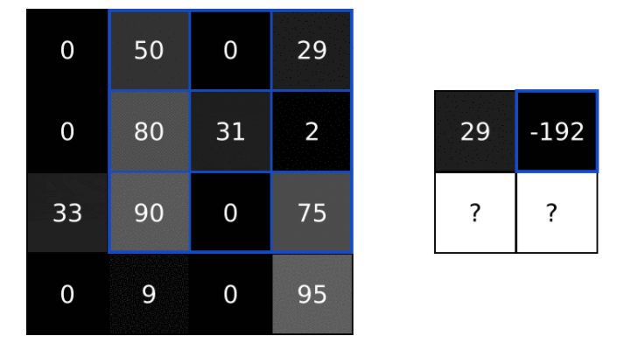
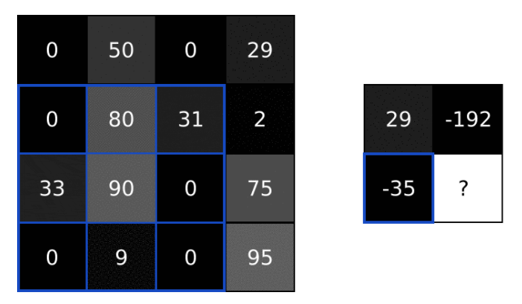
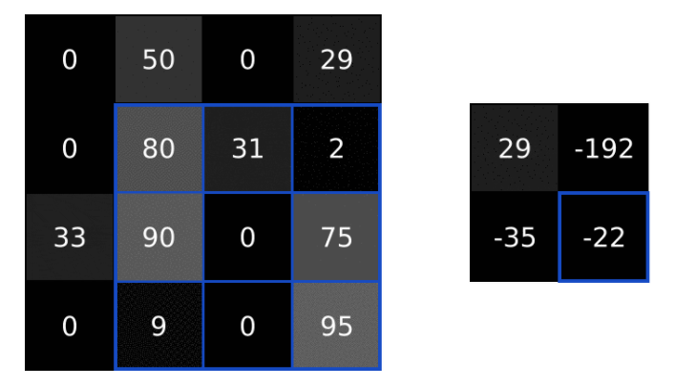
Convolution Step 4: Repeat
Stride: 1
Several filters in one Conv layer
Multiple Conv layers in CNN

Slide 13
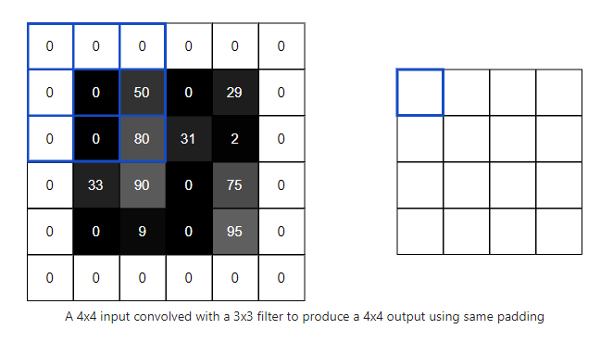
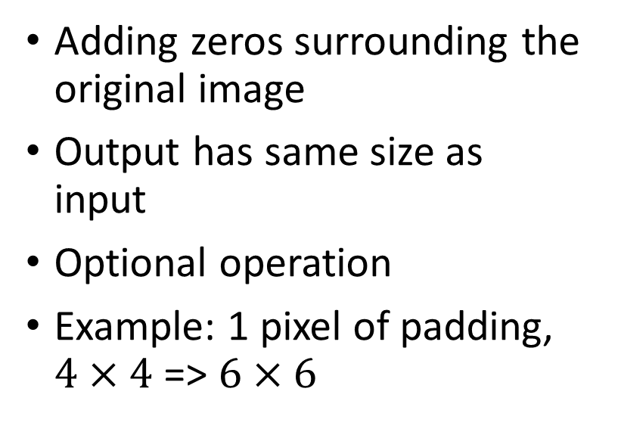
Padding
input
output
Adding zeros surrounding the original image
Output has same size as input
Optional operation
Example: 1 pixel of padding, $4×4$ => $6×6$
Output size = (L – K)/S + 1
(6 – 3) + 1 = 4

Slide 14
A Simple CNN Structure
Prediction
$$×1$$
Loss
Div(prediction, label)

Slide 15
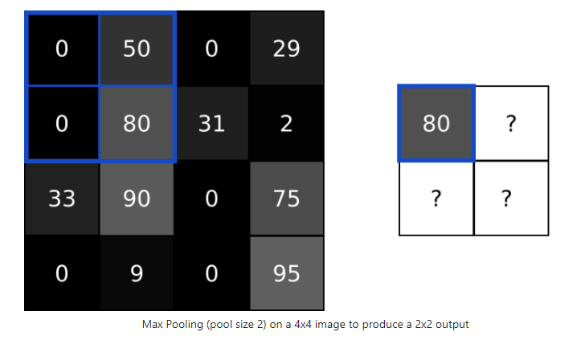
Pooling
Feature map (output of a Conv layer)
Reduce the size of feature maps
Down-sampling
Max, Average pooling

Slide 16
Pooling
Feature map (output of a Conv layer)
Example: Max pooling with a pooling size of 2 and a stride of 2 (almost always the case)

Slide 17
A Simple CNN Structure
Prediction
$$×1$$
Loss
Div(prediction, label)

Slide 18
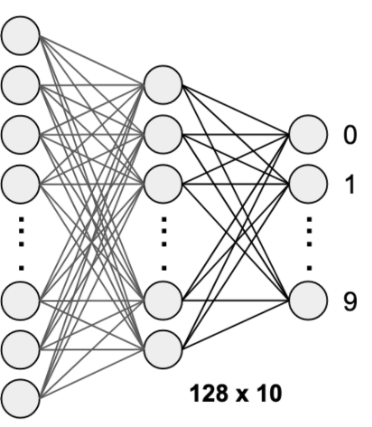
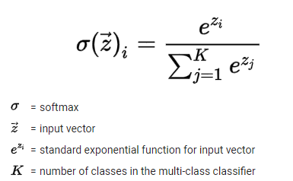
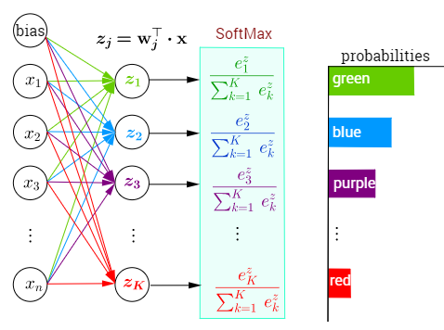
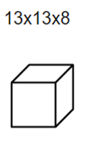










Softmax
Fully connected layers
Sum=1
$$z$$
$$0$$
$$0.3$$
Flatten
$$1$$
$$0.2$$
$$2$$
$$0.15$$
…
Output 0~1 (probability), quantifying how sure we are of the prediction
Add up to 1
Standard final layer of a multiclass classification problem
Enable the use of Cross-entropy loss
$$9$$
$$0.05$$
10
Prediction: 0
0.3
1352 ($13×13×8$)

Slide 19
A Simple CNN Structure
Prediction
$$×1$$
Loss
Div (prediction, label)

Slide 20
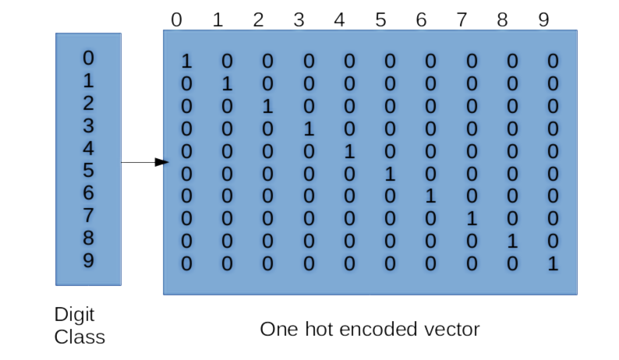
One Hot Vector
A vector that contains all “zeros” except for a single “one”, and the “one” locates corresponding index
Improve efficiency
10-class problem using 10-dim vectors
As labels of training data
Another example
3 classes: Dog, cat, horse
Dog [1, 0, 0]
Cat [0, 1, 0]
Horse [0, 0, 1]

Slide 21

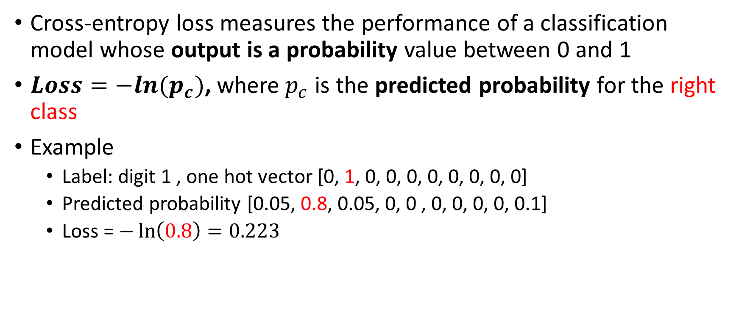



Cross-entropy Loss
Cross-entropy loss measures the performance of a classification model whose output is a probability value between 0 and 1
$Loss=−ln⁡(p_{c})$, where${ p}_{c}$ is the predicted probability for the right class
Example
Label: digit 1 , one hot vector [0, 1, 0, 0, 0, 0, 0, 0, 0, 0]
Predicted probability [0.05, 0.8, 0.05, 0, 0 , 0, 0, 0, 0, 0.1]
Loss = $−\ln\left(0.8\right)=0.223$
$$0$$
$$1$$
0.8
$$2$$
$$9$$

Slide 22
A Simple CNN Structure
Forward Pass
Prediction
$$×1$$
Loss
Div(prediction, label)
Adding nonlinearity using activation function, e.g., ReLU, sigmoid
Back propagation

Slide 23
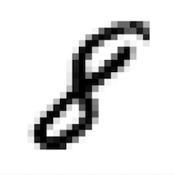

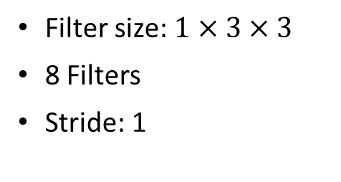
Trained CNN
$$×1$$
Prediction: 8
Filter size: $1×3×3$
8 Filters
Stride: 1
Pooling size: 2
Stride: 2

Slide 24
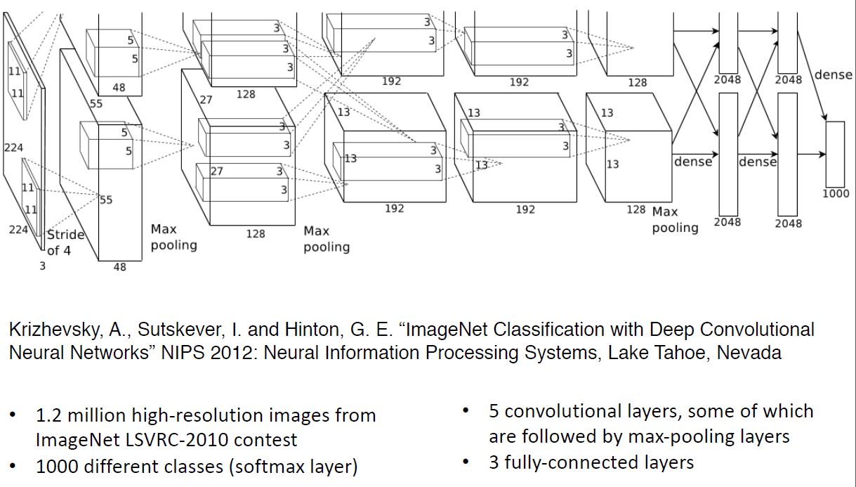
AlexNet

Slide 25
Conclusion
Forward pass of CNN
Leave backward propagation for your own explorations
Learning materials
https://victorzhou.com/blog/intro-to-cnns-part-1/
https://victorzhou.com/blog/intro-to-cnns-part-2/
https://towardsdatascience.com/a-comprehensive-guide-to-convolutional-neural-networks-the-eli5-way-3bd2b1164a53

Slide 26
Thank you! Questions? xl038@uark.edu Xingang Li

