Slide 1
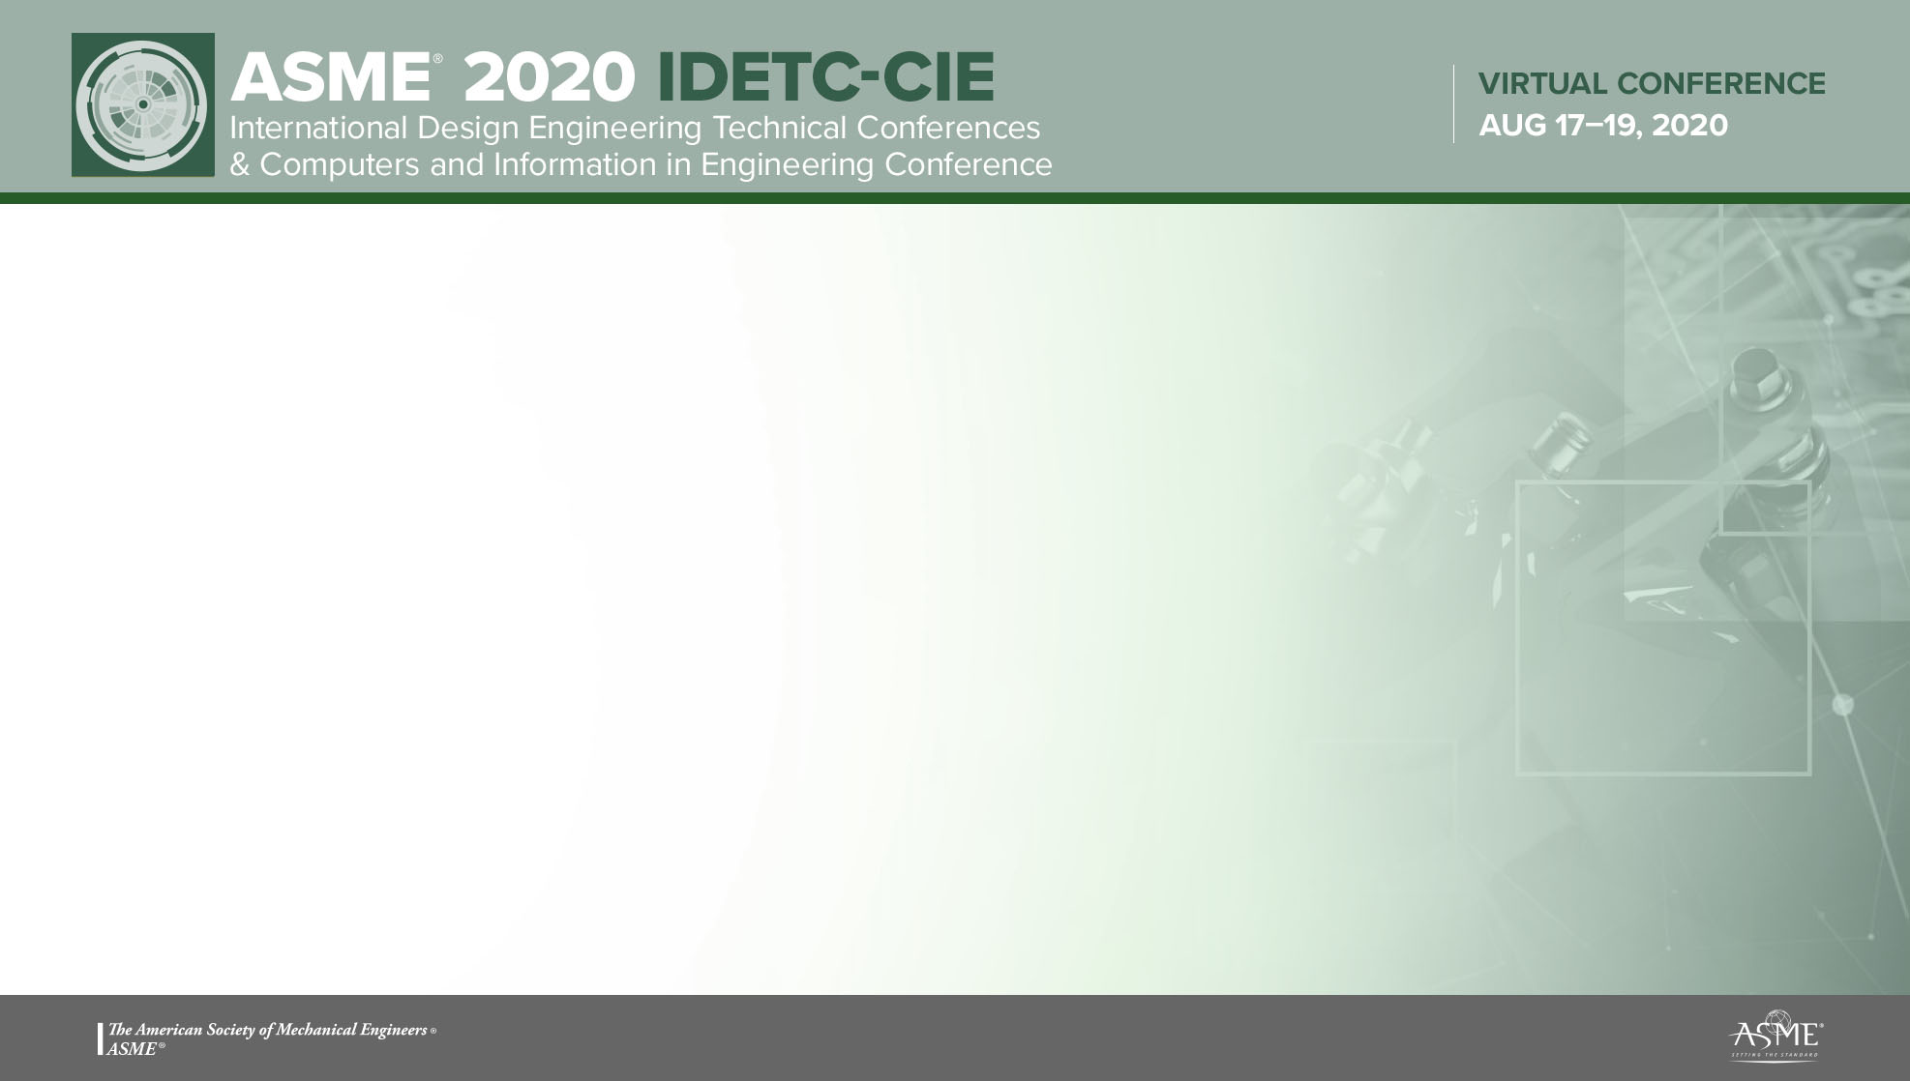
Python Tutorial
Dehao Liu

Slide 2
Outline
Introduction
Installation of Python and PyCharm
PyCharm Lessons
Usage of Libraries

Slide 3
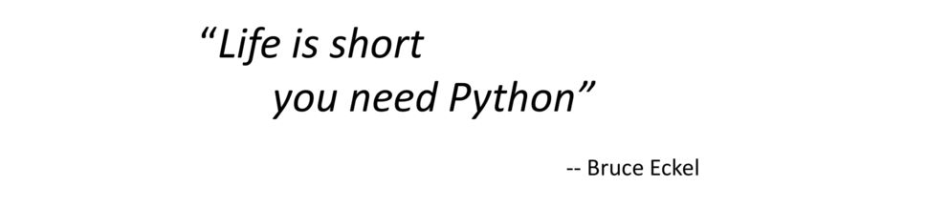
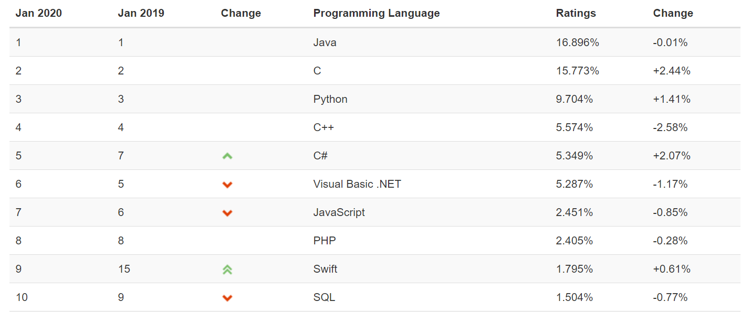
Introduction
Why python?
Short answer
Long answer
Easy to use
Rich set of libraries and frameworks
Large community and corporate Support
Popular in machine learning community
https://www.tiobe.com/tiobe-index/

Slide 4
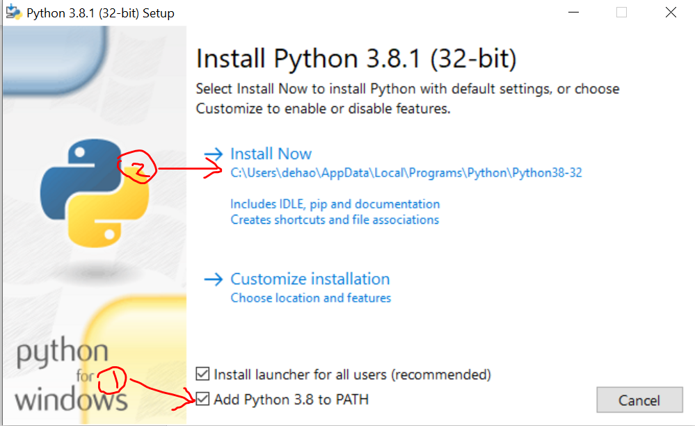
Installation of Python
Download Python from https://www.python.org/downloads/ (Use Python 3.8.1 as an example, and the OS is windows 10; In Mac/Linux system, python has been installed.)
Python 2.7 is also fine, but it will not have official support in the future
Run downloaded package as administrator and install Python as follows
Disable path length limit

Slide 5
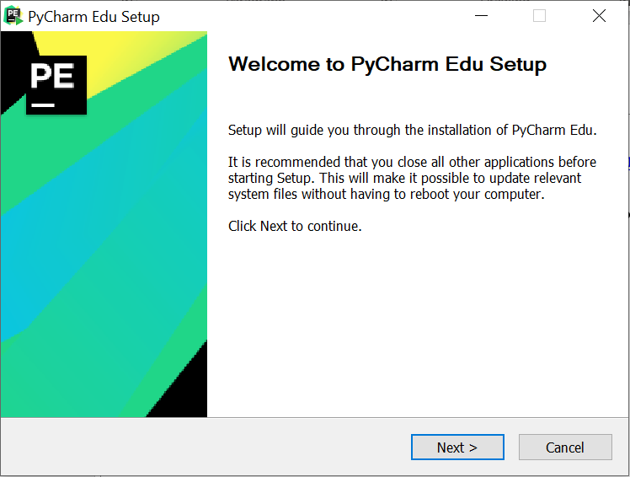
Installation of PyCharm
Download PyCharm Educational Edition from https://www.jetbrains.com/education/download/#section=pycharm-edu
Run downloaded package as administrator and install PyCharm as follows https://www.jetbrains.com/help/pycharm/quick-start-guide.html

Slide 6
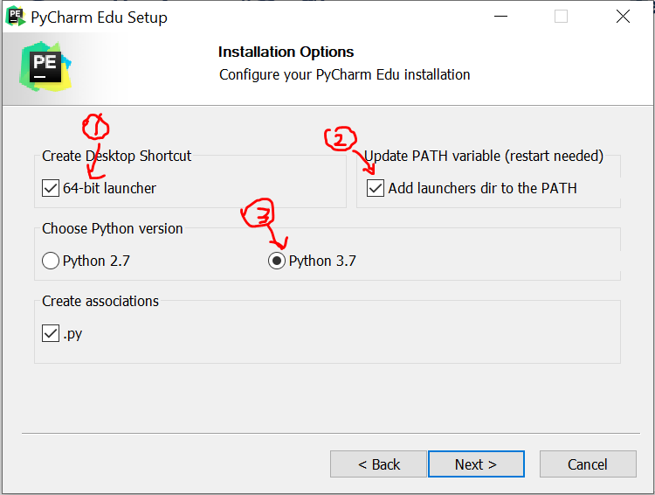
Installation of PyCharm
(Optional) Add launchers dir to the PATH so that you can run PyCharm command in the terminal
Reboot the system after installation
Do not import settings

Slide 7
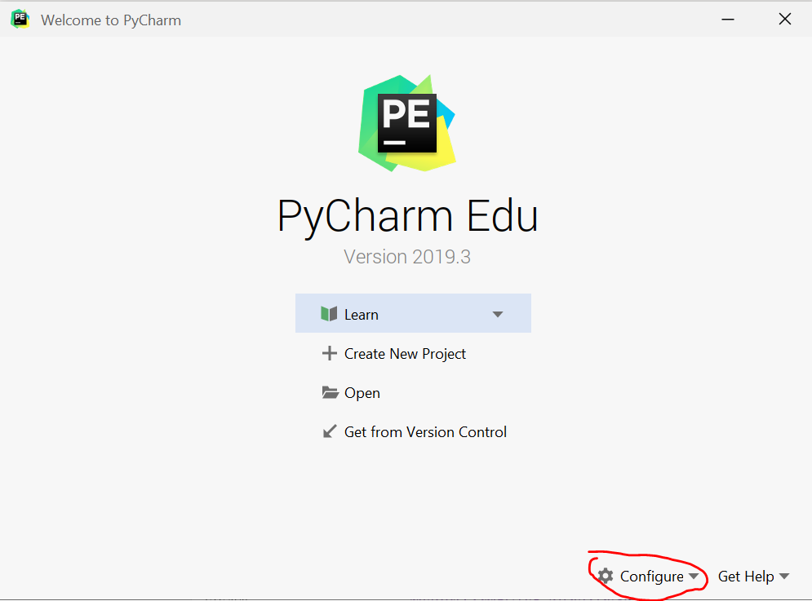
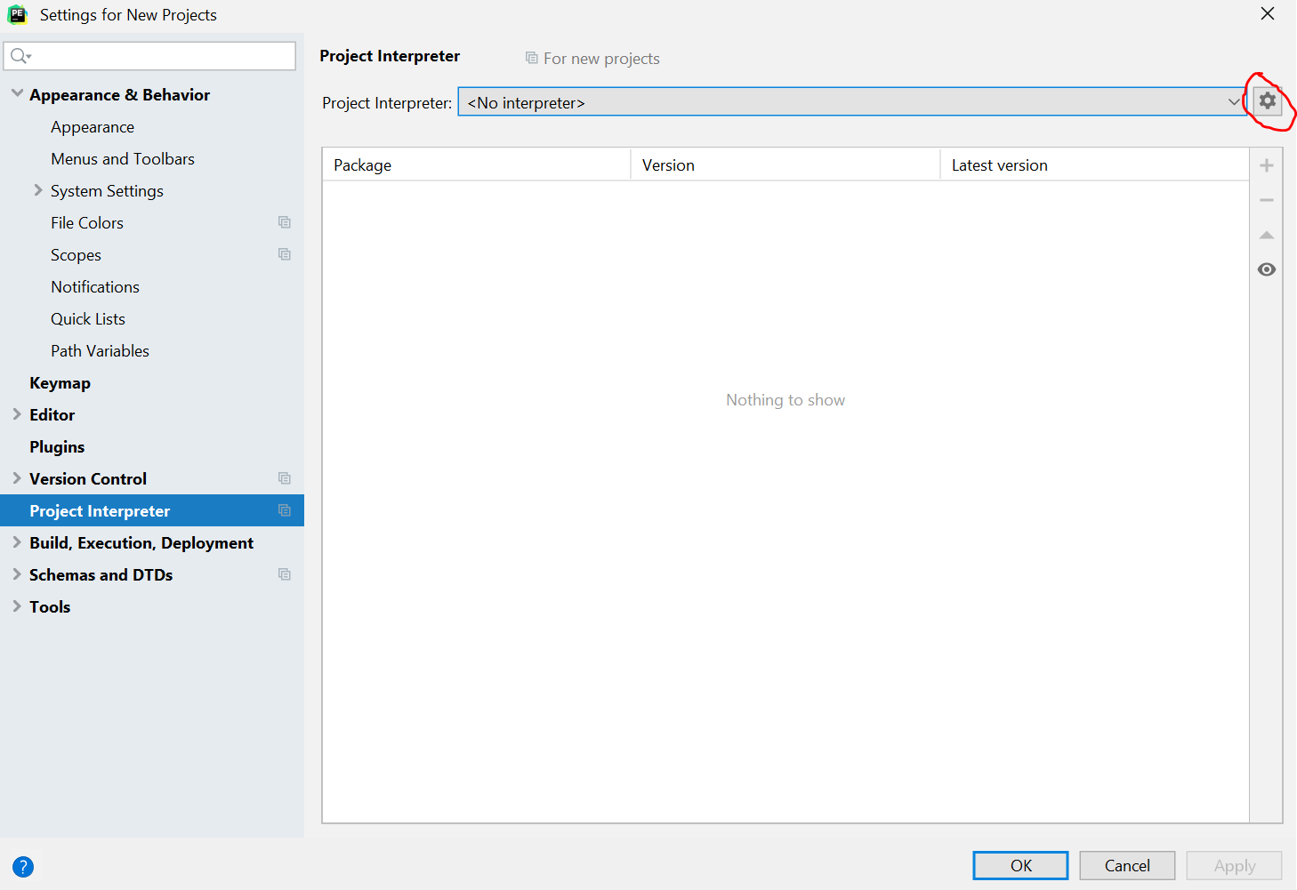
Configuration of PyCharm
Click the button “Configure” and choose “settings”
Under the “Project Interpreter”, click the highlighted button and “add” interpreter

Slide 8
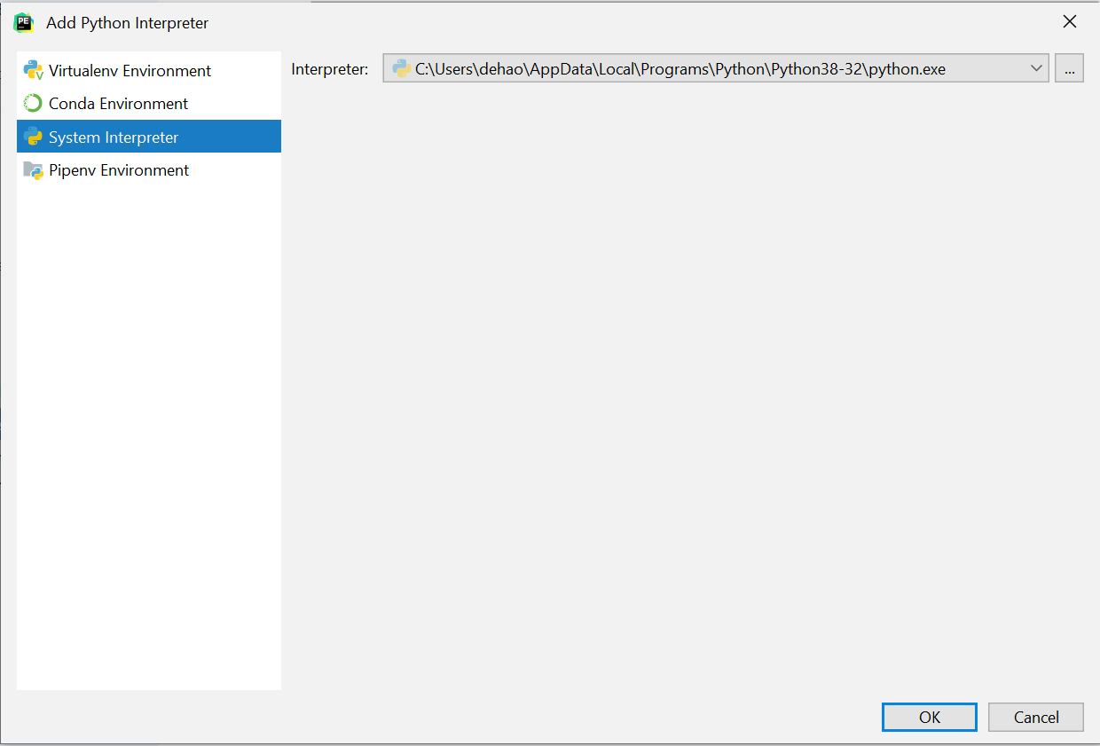
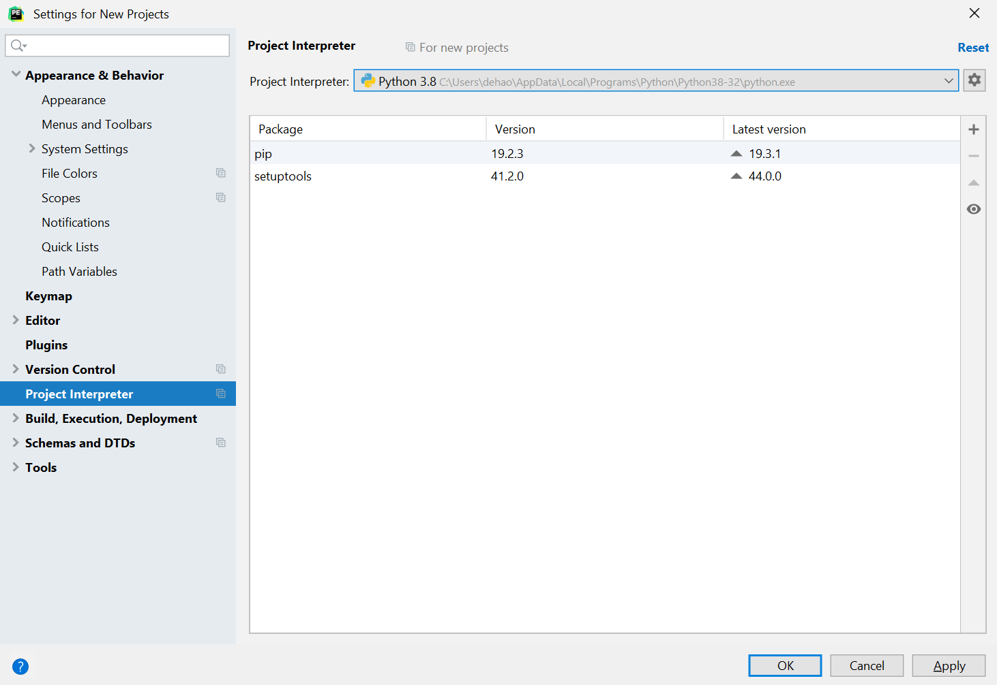
Configuration of PyCharm
Add system interpreter or you can add the interpreter from anaconda
You can see installed packages in project interpreter

Slide 9
Installation of Python libraries
Basically, the python libraries are installed by “pip” package manager https://en.wikipedia.org/wiki/Pip_(package_manager)
(Recommended) You can either install python libraries in PyCharm https://www.jetbrains.com/help/pycharm-edu/installing-uninstalling-and-upgrading-packages.html
Or you can install python libraries by typing commands in the terminal https://scipy.org/install.html

Slide 10
PyCharm Lessons
Basically, the python libraries are installed by “pip” package manager https://en.wikipedia.org/wiki/Pip_(package_manager)
(Recommended) You can either install python libraries in PyCharm https://www.jetbrains.com/help/pycharm-edu/installing-uninstalling-and-upgrading-packages.html
Or you can install python libraries by typing commands in the terminal https://scipy.org/install.html

Slide 11
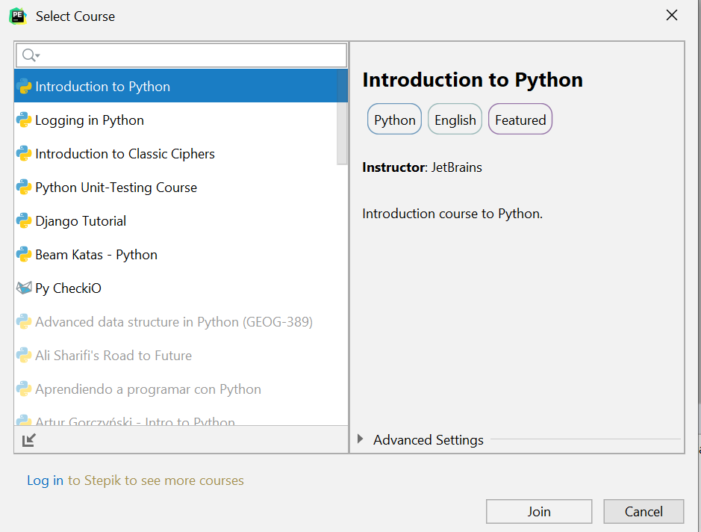
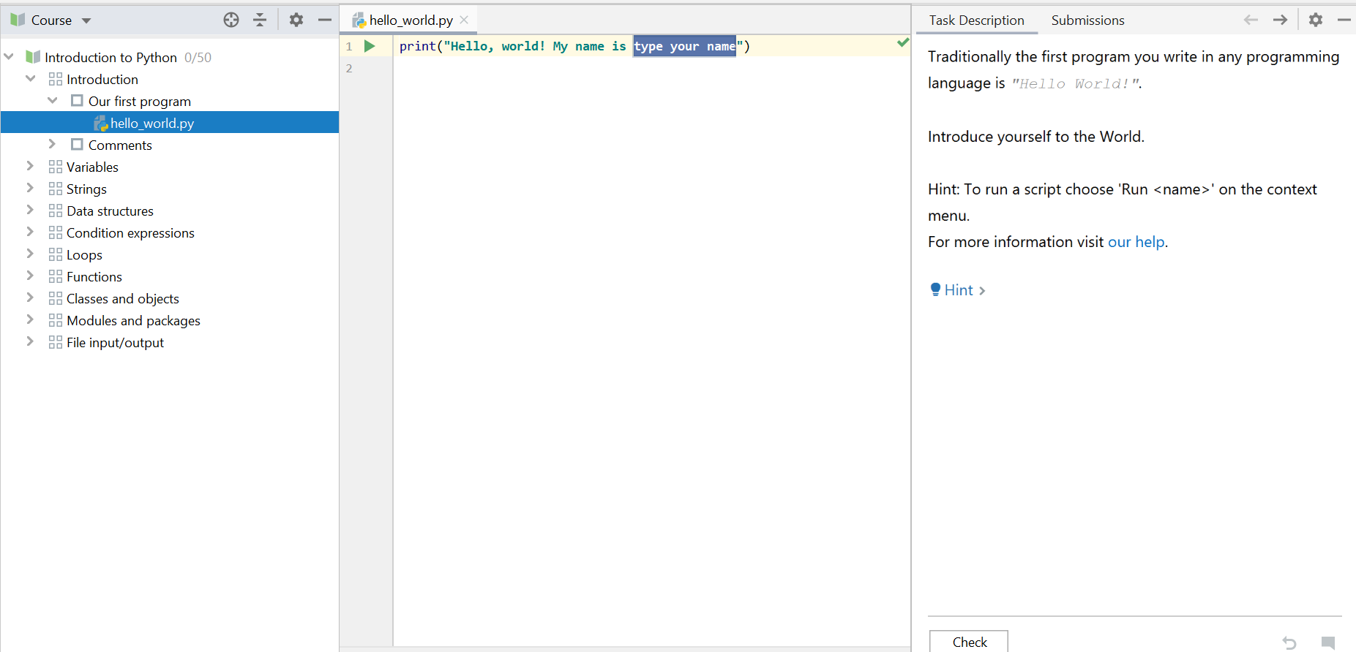
PyCharm Lessons
You can learn more about Python by joining the course “Introduction to Python” in File/Learn/Browse course.

Slide 12
Usage of Libraries
numpy
matplotlib
Python tutorial from cs231n http://cs231n.github.io/python-numpy-tutorial/#numpy
More tutorials
https://docs.scipy.org/doc/numpy/user/quickstart.html
https://matplotlib.org/tutorials/introductory/pyplot.html
https://scikit-learn.org/stable/tutorial/index.html

