Slide 1

Analyzing and Predicting Student Outcomes in Higher Education: An Insightful Exploration of Academic Performance and Socioeconomic Factors
ASNA JAMSHID
PROJECT-3
OESON TRAINING AND INTERNSHIP

Slide 2
Introduction
Overview of the dataset
Objective: Predict student outcomes based on various socioeconomic features

Slide 3

Data Preprocessing
Handling categorical and numerical features:
Converted categorical variables to numerical ones using Label Encoding.
Encoding the target variable: Converted 'Target' to numerical values.
Splitting the data: Divided the dataset into training and testing sets.
Ensuring data quality: Checked for missing values and handled them appropriately.

Slide 4
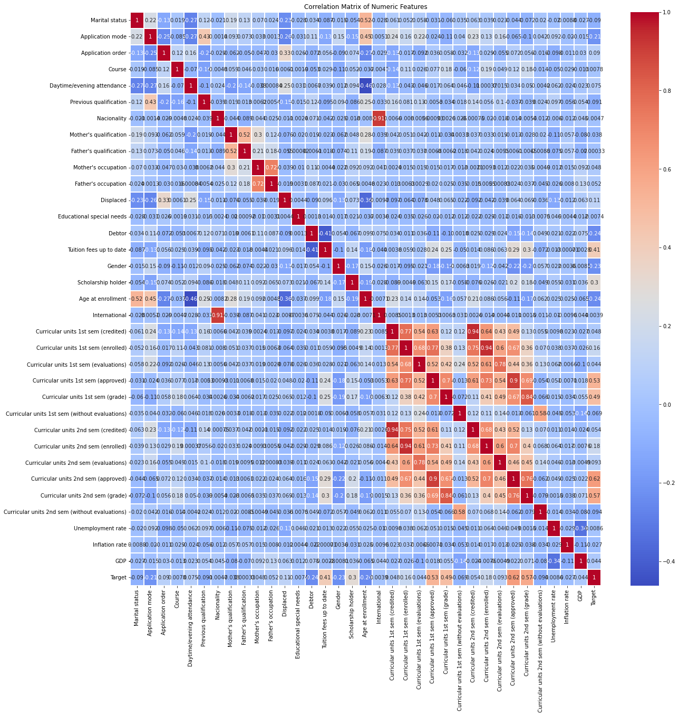

C
CORRELATION MATRIX

Slide 5

Model Training and Evaluation
Model used: RandomForestClassifier
Mean Cross-validation results: 76%
Training accuracy: 81%
Testing accuracy: 80%

Slide 6
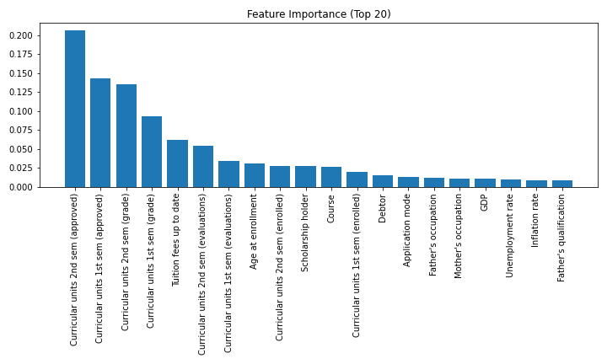
Feature Importance

Slide 7

Feature Importance Analysis
Feature importance in machine learning refers to techniques that assign a score to input features based on how useful they are at predicting a target variable. The higher the score, the more important the feature is considered.
Key Insights from Our Analysis:
Curricular Units (2nd Semester Approved): This feature has the highest importance score (0.2019). It indicates that the number of approved curricular units in the second semester is the most critical factor in predicting student outcomes.
Curricular Units (1st Semester Approved): With a score of 0.1338, this feature is the second most important. It shows the significance of students' performance in their first semester.
Curricular Units (2nd Semester Grade): This feature's importance score is 0.1302, highlighting the grades obtained in the second semester as a crucial predictor.
Curricular Units (1st Semester Grade): Scoring 0.0755, it emphasizes that grades in the first semester are also essential but less so than the second semester's performance.
Curricular Units (2nd Semester Evaluations): With an importance score of 0.0583, this feature underlines the role of evaluations in the second semester.

Slide 8

Additional Significant Features:
Tuition Fees Up to Date: This financial metric, with a score of 0.0556, shows the importance of students being current with their tuition fees.
Age at Enrollment: The age of students at the time of enrollment has a significant impact, with a score of 0.0401.
Scholarship Holder: Whether a student is a scholarship holder has an importance score of 0.0240, indicating financial aid's role in student outcomes.
Gender: Gender also plays a role in predicting student success, with an importance score of 0.0104.
Implications:
Curricular Performance: most critical factors are related to students' performance in curricular units, especially in the second semester. This suggests focusing on supporting students academically during these periods.
Financial Stability: Features like tuition fee status and scholarships highlight the importance of financial stability in student success.
Demographic Factors: Age and gender also play a role, although less significant than academic performance.

Slide 9
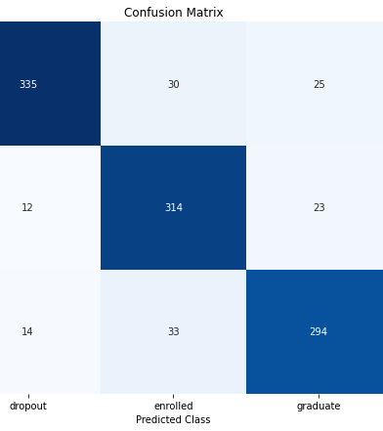
Confusion Matrix
Short Description of Confusion Matrix Insights
Class "Dropout":
Correctly classified: 335
Misclassified as "Enrolled": 30
Misclassified as "Graduate": 25
Class "Enrolled":
Correctly classified: 314
Misclassified as "Dropout": 12
Misclassified as "Graduate": 23
Class "Graduate":
Correctly classified: 294
Misclassified as "Dropout”: 14
Misclassified as "Enrolled”: 33

Slide 10

Classification Report:
Class | Precision | Recall | f1Score | Support
Drop-out | 93% | 86% | 89% | 390
Enrolled | 83% | 90% | 87% | 349
Graduated | 86% | 86% | 86% | 341

Slide 11
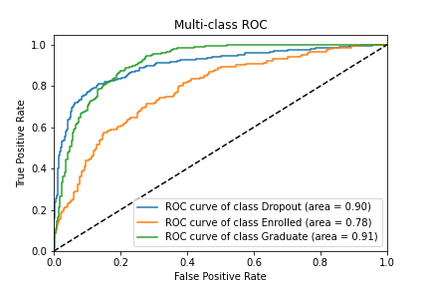
ROC-AUC Curve

Slide 12

Insights from the Curve:
Dropout Class: The AUC is 0.92, indicating that the model performs very well in distinguishing students who drop out.
Enrolled Class: The AUC is 0.90, showing that the model also performs well in identifying students who are still enrolled.
Graduate Class: The AUC is 0.93, suggesting the model is very effective in predicting students who graduate.
Implications:
The high AUC values for all classes demonstrate the model's strong discriminative power.
The model is reliable in predicting the student outcomes based on the given features

Slide 13
CONCLUSION
The analysis involved creating a predictive model to classify students into three categories - dropout, enrolled, and graduate - based on socioeconomic and academic factors. A Random Forest Classifier algorithm was employed to train and evaluate the model. The model's performance was thoroughly assessed using various metrics and visualizations. The predictive model demonstrated high accuracy and reliability in classifying student outcomes, as evidenced by its strong performance across different evaluation measures. The feature importance analysis provided insights into the crucial factors influencing student success, offering valuable guidance for policymakers and educational institutions in resource allocation and decision-making. Although the current model exhibits strong performance, future improvements, such as incorporating additional features or advanced modeling techniques, could potentially further enhance its accuracy and robustness. This model serves as a powerful tool for educators and administrators, enabling data-driven decision-making to support student retention and graduation rates, ultimately contributing to improved educational outcomes.

