Slide 1

Data Science Jobs and Salaries Analysis
OESON
DATA SCIENCE INTERNSHIP
PROJECT-2
ASNA JAMSHID

Slide 2

OBJECTIVE
Perform
Perform Data Analysis: Dive into the dataset to extract meaningful insights on salary trends worldwide across different data-related job titles.
Utilize
Visualization: Utilize bar charts, line graphs, and other visual tools to present the data analysis with clear labeling and formatting.
Interpret
Inferences and Business Relevance: Interpret the visualized data to provide in-depth insights into the business implications of these global salary trends, aiding recruiters in understanding the competitive landscape.

Slide 3
INTRODUCTION
Introduction to the Dataset: This presentation delves into a comprehensive dataset extracted from a leading job portal, showcasing the job status and salaries of various data-centric roles throughout 2023.
Significance: Understanding these global salary trends is pivotal for recruiters and organizations aiming to attract top talent in the data science industry.
Analysis Objective: Our objective is to analyze this rich dataset to extract meaningful insights that will illuminate the actual remuneration for each job title across the globe.
Outcome Expectation: By the end of this analysis, we will have a clearer picture of salary distributions, enabling recruiters to fine-tune their strategies to meet the evolving demands of the data job market.

Slide 4
DATA ANALYSIS
The problem statement at hand revolves around understanding global salary trends in data-related jobs to aid recruiters in offering competitive salaries.
Our dataset comprises comprehensive information on job titles, salary details, and geographical distribution, making it well-suited for addressing this problem.
Key variables such as 'salary_in_usd' allow for cross-country salary comparisons, while factors like 'experience_level' provide insights into how experience influences salaries worldwide.
By analyzing these variables, we anticipate uncovering valuable insights that will enable recruiters to benchmark salaries effectively and allocate resources strategically to attract top talent.
Ultimately, our analysis aims to empower recruiters with the knowledge needed to make informed decisions in a competitive job market.

Slide 5
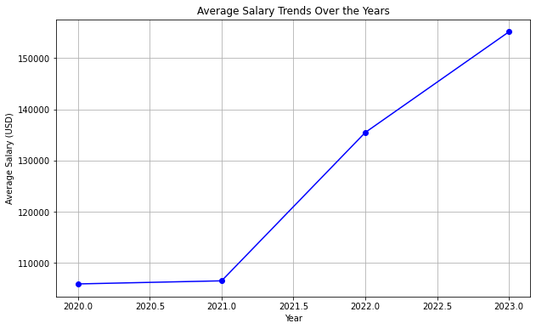
DATA ANALYSIS(CONT)
Average salaries have shown a steady increase over the years, rising from $105,878.86 in 2020 to $155,132.59 in 2023.
2020: $105,878.86
2021: $106,483.64
2022: $135,467.50
2023: $155,132.59
This upward trend reflects a growing recognition of the value of data-related expertise in the job market.
Among the most frequently occurring job titles,
Data Engineer: 2195 occurrences
Data Scientist: 1989 occurrences
Data Analyst: 1388 occurrences
The prevalence of Data Engineers and Scientists suggests a highly competitive landscape for professionals possessing these sought-after skills.

Slide 6
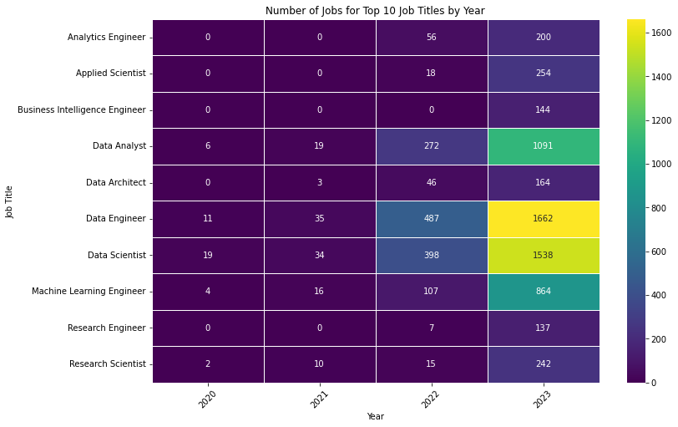
TOP 10 DATA JOBS
Data Engineer 2195
Data Scientist 1989
Data Analyst 1388
Machine Learning Engineer 991
Applied Scientist 272
Research Scientist 269
Analytics Engineer 256
Data Architect 213
Business Intelligence Engineer 144
Research Engineer 144

Slide 7
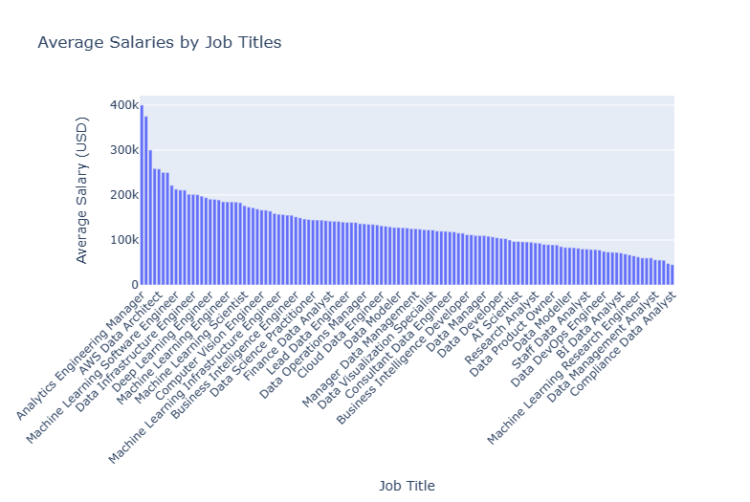
Evaluating Average Salaries Across Top Data Roles

Slide 8
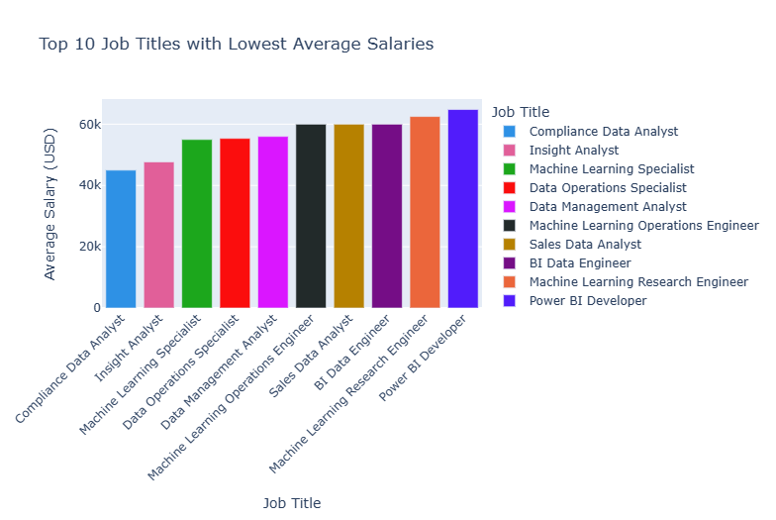
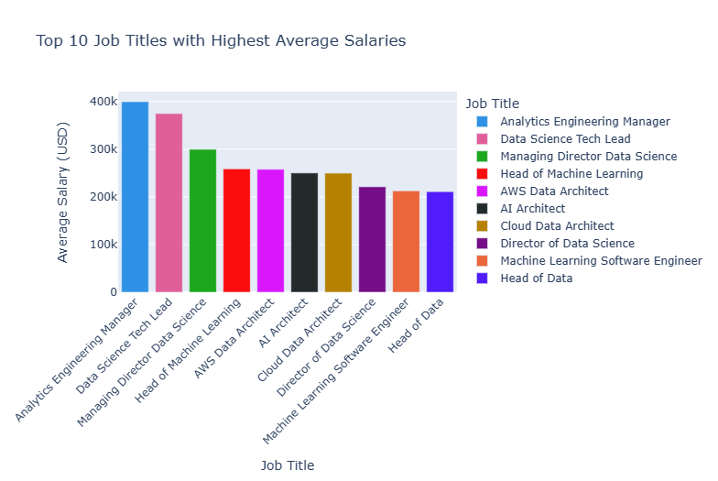
Salary Range: The Highs and Lows of Data-Related Positions
Understanding these salary trends can help predict future shifts in the job market and guide professionals in their career development and negotiation strategies.

Slide 9
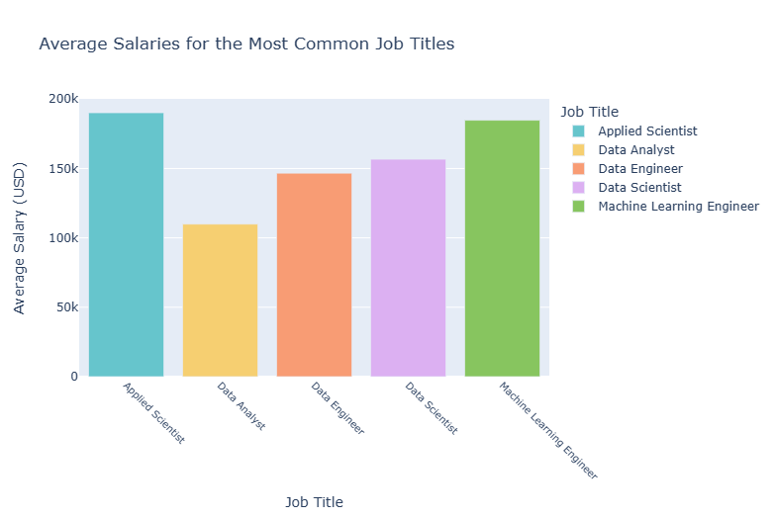
Exploring Data Roles Compensation: Insights into Salary Variations
The salary spectrum within the data field showcases a notable variation among different job titles, signifying the diverse valuation of roles. Applied Scientists and Data Scientists emerge as the top earners, indicating the high value placed on their specialized skills. In contrast, Data Engineers and Machine Learning Engineers command mid-range salaries, reflecting their significant demand in the market. Conversely, Data Analysts demonstrate comparatively lower average salaries, potentially influenced by factors like required specialization levels or market supply dynamics.

Slide 10
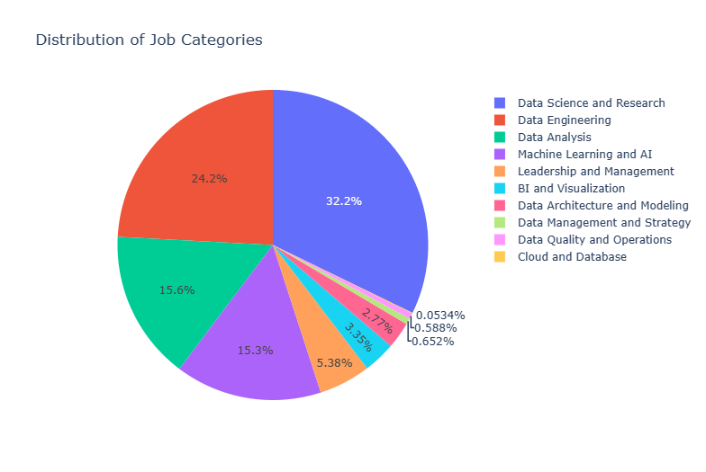
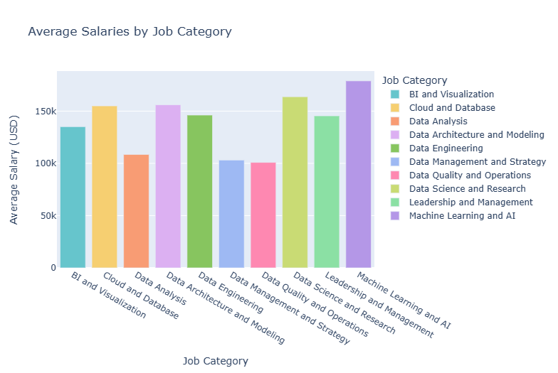
Job Category Distribution vs. Average Salaries
The pie chart shows that Data Science and Research make up the largest portion of job categories at 32.4%. However, when we look at average salaries, Leadership and Management and Machine Learning and AI roles offer the highest pay, averaging $120,000 and $130,000, respectively. On the other hand, roles like BI and Visualization and Data Analysis have lower average salaries, around $80,000 and $75,000, respectively. This comparison highlights the disparity between job distribution and salary levels in the data-related field

Slide 11
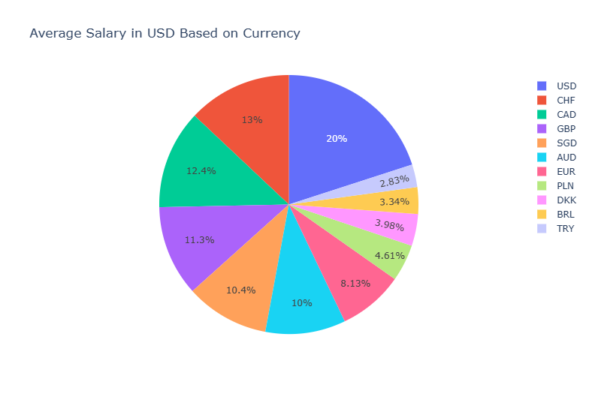
Global Salary Distribution by Currency
The visualization showcases the distribution of average salaries based on different currencies.
USD (United States Dollar) accounts for the largest portion, representing 20% of salaries.
Other notable currencies include CHF (Swiss Franc), CAD (Canadian Dollar), and GBP (British Pound Sterling).
Smaller slices represent currencies such as EUR (Euro), PLN (Polish Złoty), and DKK (Danish Krone).
These percentages offer insights into the prevalence of specific currencies in salary calculation

Slide 12
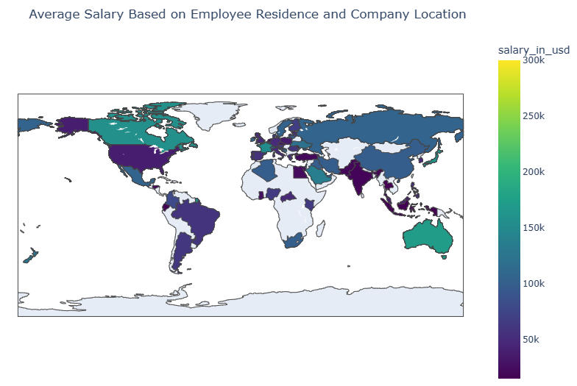
Global Salary Distribution by Location
World map visualizing average salaries based on employee residence and company location.
Darker shades in North America, Europe, and Australia indicate higher average salaries.
Lighter shades in Africa, South America, and parts of Asia suggest lower average salaries.
The graph highlights global disparities in salaries based on geographical location.

Slide 13
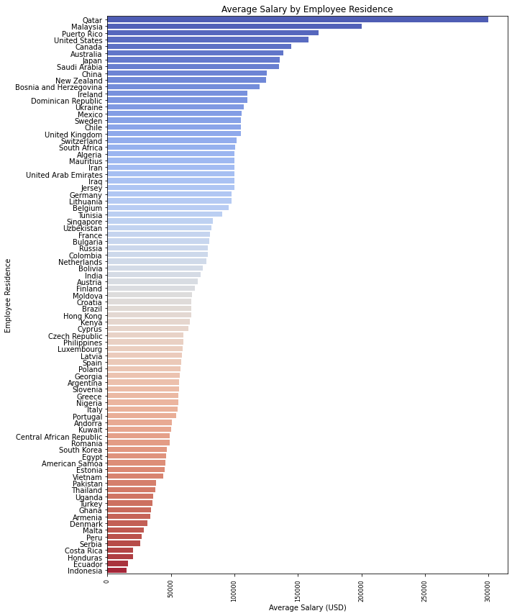
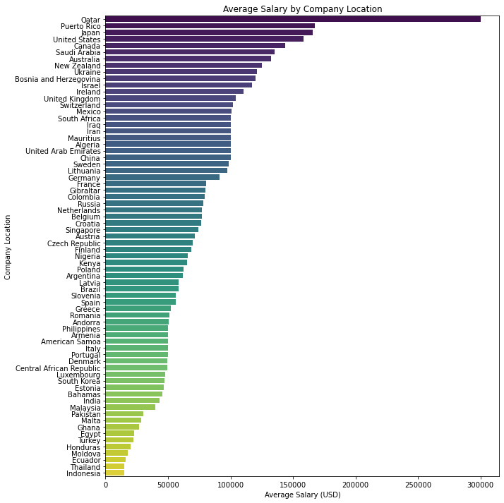
Comparative Analysis of Average Salaries Based on Employee and Company Locations
Both plots highlight Qatar as a top-paying location for both employees and companies, indicating a robust economy and competitive job market.
The United States consistently appears among the top-paying countries in both plots, reinforcing its position as a key player in the global job market.
Factors such as cost of living, industry demand, and job roles play a significant role in determining average salaries in different geographical locations.

Slide 14
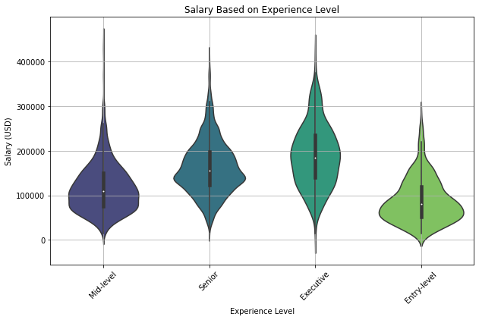
Understanding Salary Trends Across Experience Levels
The plot illustrates salary distribution across different experience levels in the data-related field.
It shows a consistent increase in compensation as the experience level progresses.
Wider sections indicate denser salary data points, offering insights into the distribution of salaries within each experience category.
Median salaries, represented by white dots, provide a snapshot of typical earnings within each experience level.
The y-axis ranges from $0 to over $400,000, providing a clear view of the salary range across different career stages.

Slide 15
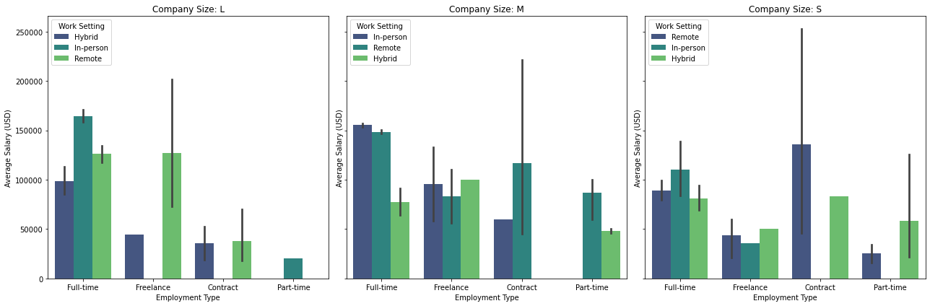
Insights from Employment and Work Setting Analysis

Slide 16
CONT’
Employment Trends: The spread of employment types (Full-Time, Freelance, Contract, Part-Time) across various company sizes reflects current trends. For instance, if Full-Time positions dominate across all sizes, it implies that they're the prevalent choice.
Work Setting Preferences: Differences in bar heights for In-person, Remote, and Hybrid setups within each employment type may reveal preferences or policies. For instance, taller Remote bars in the Freelance category may signify a preference for remote work.
Company Size Dynamics: Analyzing bars across different company sizes (L, M, S) offers insights into employment structures. Larger companies may favor Full-Time roles, while smaller ones might lean towards Contract or Freelance positions for flexibility.

Slide 17
CONCLUSION
Our analysis of global salary trends in data-related jobs has unveiled crucial insights for recruiters and stakeholders. From examining salary distributions to exploring workforce dynamics, our findings offer actionable guidance for optimizing recruitment strategies and fostering organizational growth in the data-driven landscape.

Slide 18

THANK YOU

