Slide 1

ASNA JAMSHID
STOCK PRICE ANALYSIS
OESON DATA SCIENCE INTERNSHIP PROJECT 1

Slide 2

CONTENTS
1.INTRODUCTION
2.PROJECT OBJECTIVE
3.DESCRIPTIVE ANALYSIS
4.REGRESSION ANALYSIS
5.CONCLUSION

Slide 3
INTRODUCTION
This project explores the ever-changing stock market landscape through descriptive statistical analysis of trends and performance, coupled with chart visualization. It specifically zooms in on three leading US tech giants: Microsoft, Apple, and Tesla. The dataset includes stock price details for these companies and the S&P 500 index. This data set was retrieved from Yahoo Finance and spans 2018 to 2023.

Slide 4
PROJECT OBJECTIVE
To assess the financial risk in the stock market by analyzing the stock price data of three major companies - Microsoft, Apple, and Tesla - along with the S&P 500 index. The project aims to:
Perform descriptive statistical analysis on the stock price values of each company from 2018 to 2023.
Visualize the price trends of each stock using charts such as scatter plots and histograms.
Calculate descriptive statistics including mean, median, and standard deviation.
Develop regression models to analyze the relationship between the percentage change in stock price and the market return on the stock.
Compare the calculated Beta values to evaluate each stock’s progress and risk level.

Slide 5
DESCRIPTIVE ANALYSIS
In the analysis of Apple, Microsoft, and Tesla, descriptive analysis plays a crucial role in understanding the historical trends and patterns in their stock market performance. By examining descriptive statistics such as means, medians, standard deviations, and ranges for stock prices, we can gain insights into their central tendencies, volatility, and variability over time. This information helps investors and analysts assess the risk associated with each stock, identify potential investment opportunities, and make informed decisions about portfolio management. Additionally, descriptive analysis provides a foundation for further statistical analysis and modeling to forecast future trends and performance.

Slide 6
Comparing the descriptive statistics of Microsoft, Tesla, and Apple with the S&P 500 index reveals distinct characteristics of each stock market. Microsoft's prices tend to have a narrower range and lower volatility compared to the S&P 500, as indicated by smaller standard deviations and ranges. Additionally, Microsoft's prices exhibit a relatively symmetric distribution with a slightly negative kurtosis, suggesting a moderate tail. Tesla's market, on the other hand, demonstrates significantly higher volatility and wider price ranges, with larger standard deviations and ranges compared to both Microsoft and the S&P 500. The distribution of Tesla's prices also appears to be skewed to the right, with a positive skewness value indicating a longer tail on the higher end of the price spectrum. Apple's market statistics fall somewhere between Microsoft and Tesla, with moderate volatility, slightly narrower ranges, and distribution closer to symmetry, although still exhibiting some positive skewness. Overall, these comparisons highlight the diverse nature of each stock market, with Microsoft offering stability, Tesla showing high volatility, and Apple falling somewhere in between.
Comparison of descriptive statistics

Slide 7
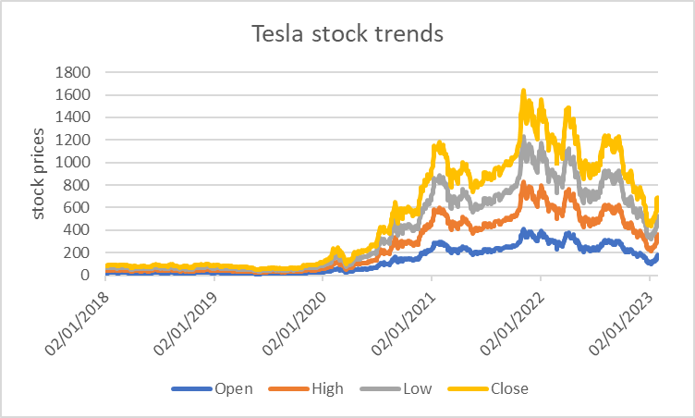
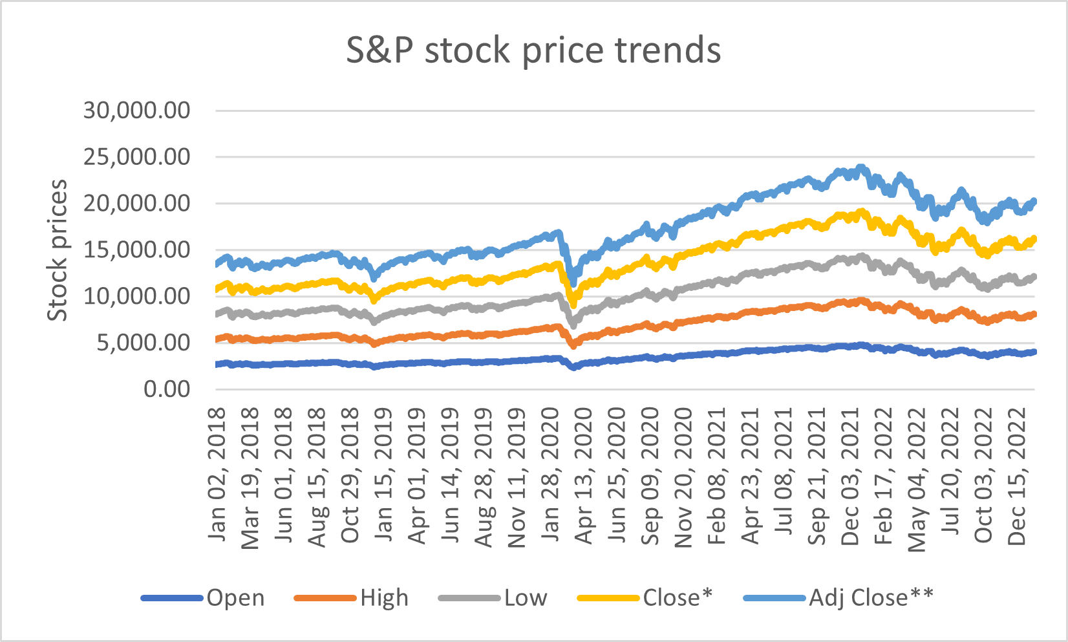
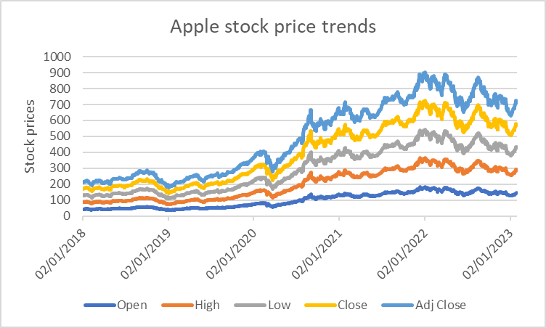
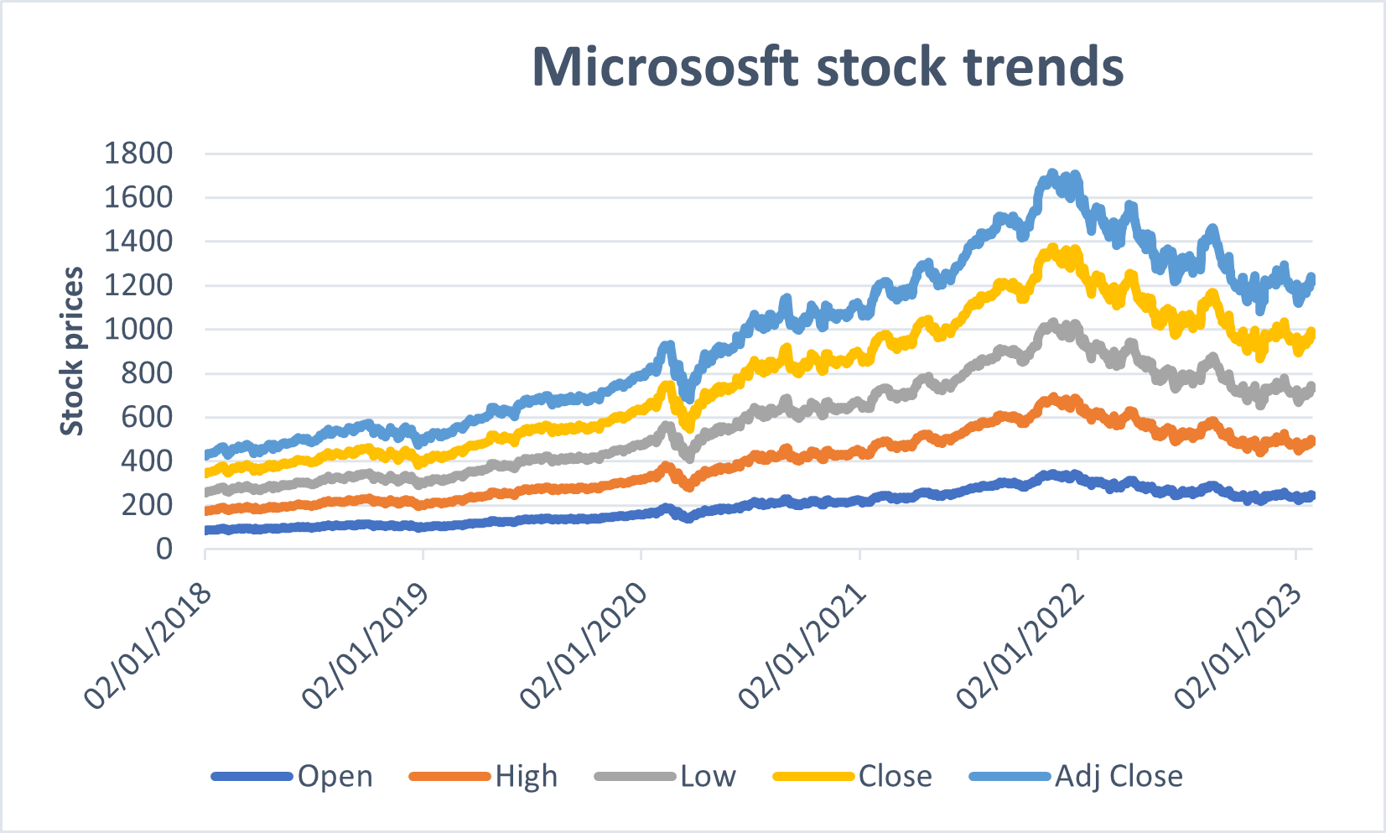
Stock Market Trend Analysis: Line Plots
The plot illustrates the fluctuations in the open, high, low, and close stock prices, allowing for a direct comparison between each other. By visually representing these variations, it provides insights into how these prices differ within the stock market. Comparing the open, high, low, and close prices allows analysts to understand the range of price movements within a given period, indicating the market's volatility, trading patterns, and potential trends. This comparison helps investors make informed decisions based on the relative movements and relationships between these price points.

Slide 8
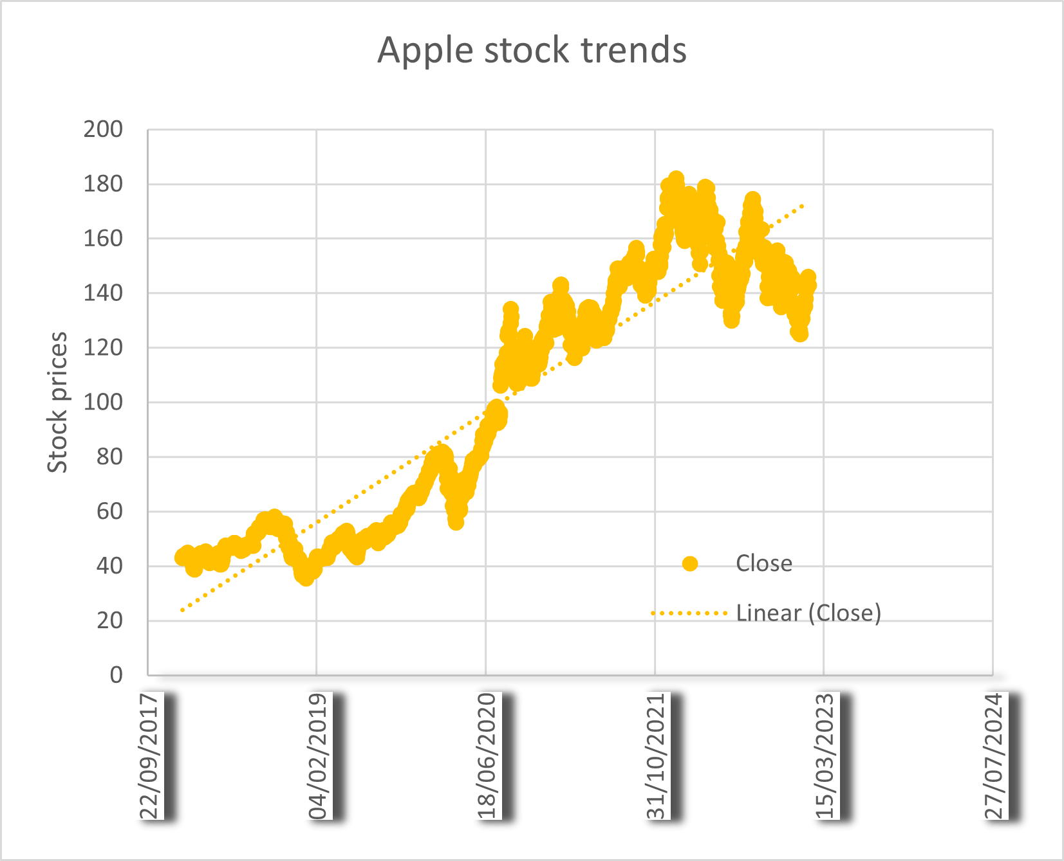
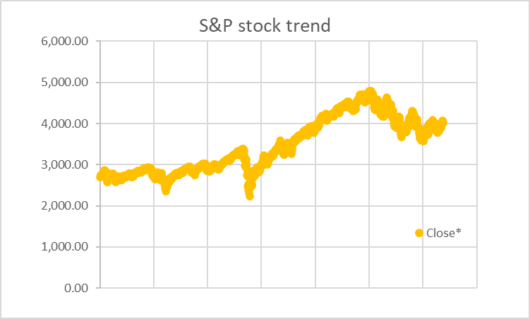
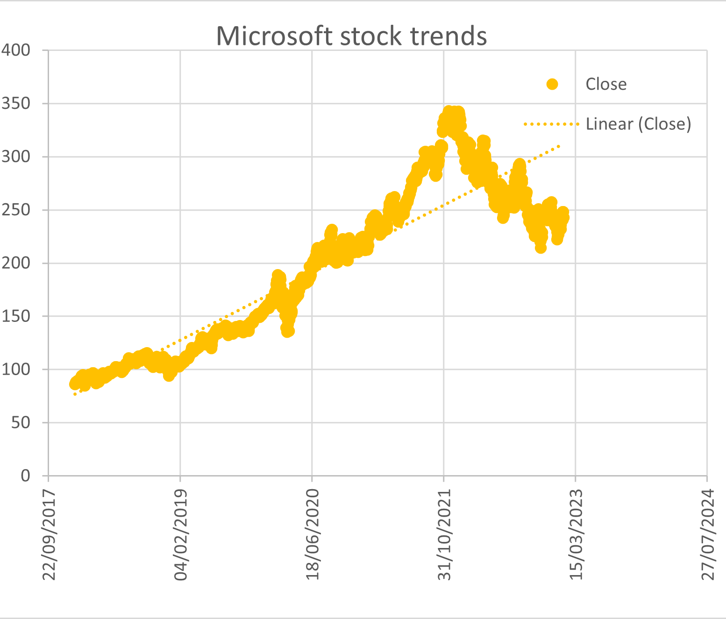
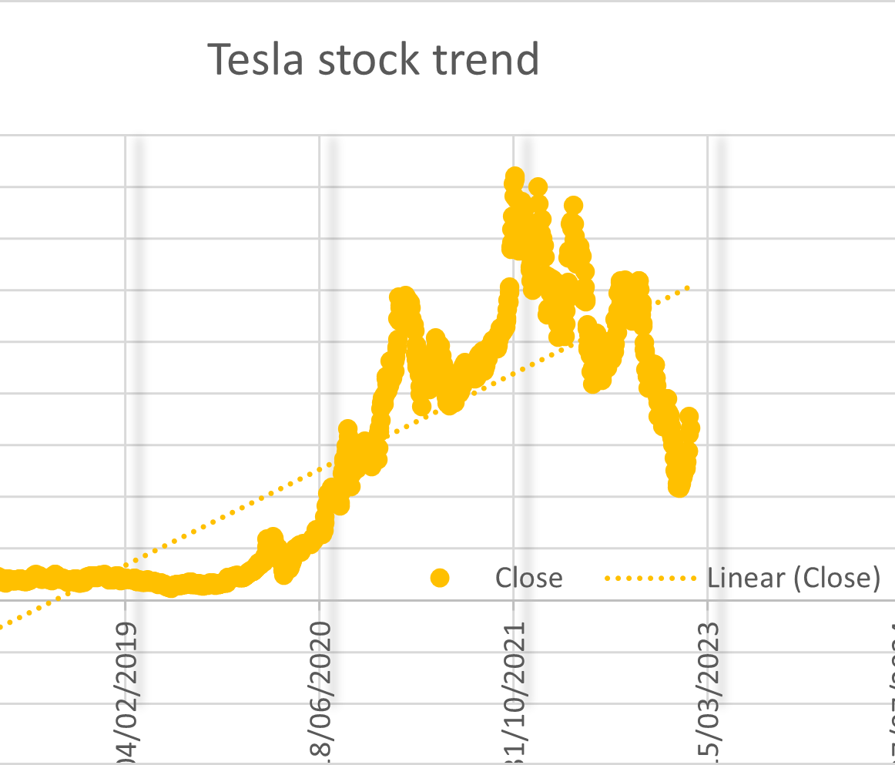
Comparative Scatter Plots Analysis
In a scatter plot comparing the close prices of Microsoft, Tesla, Apple, and the S&P 500 index, each stock's closing price would be plotted against each other. Microsoft's scatter plot would likely show a tight clustering of points around a diagonal line, indicating a strong correlation with the S&P 500 index due to its stability and representation in the index. Tesla's scatter plot, in contrast, would display points scattered more widely, reflecting its higher volatility and potential deviation from the broader market trend. Apple's scatter plot would fall between Microsoft and Tesla, showing some correlation with the S&P 500 index but also exhibiting variability due to its market dynamics. The scatter plot for the S&P 500 index would show points clustering closely together, representing the collective behavior of the market as a whole. Comparing these scatter plots would visually demonstrate the relationships and differences in price movements between individual stocks and the broader market index.

Slide 9
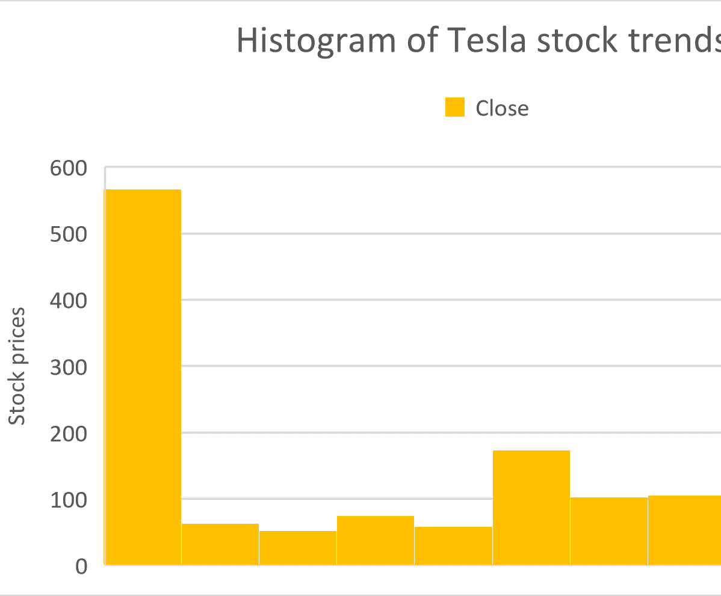
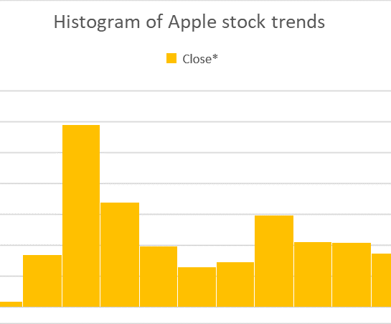
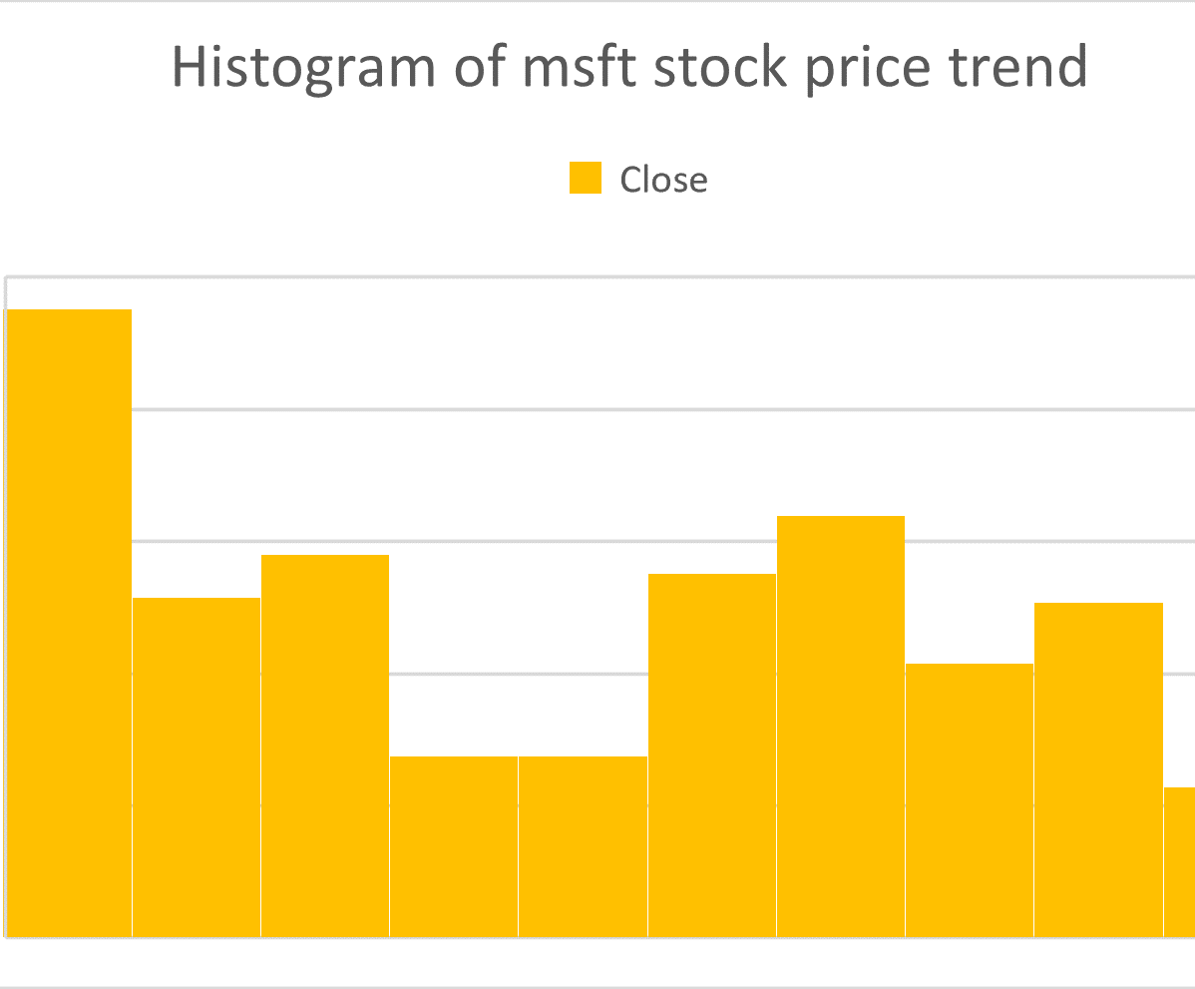
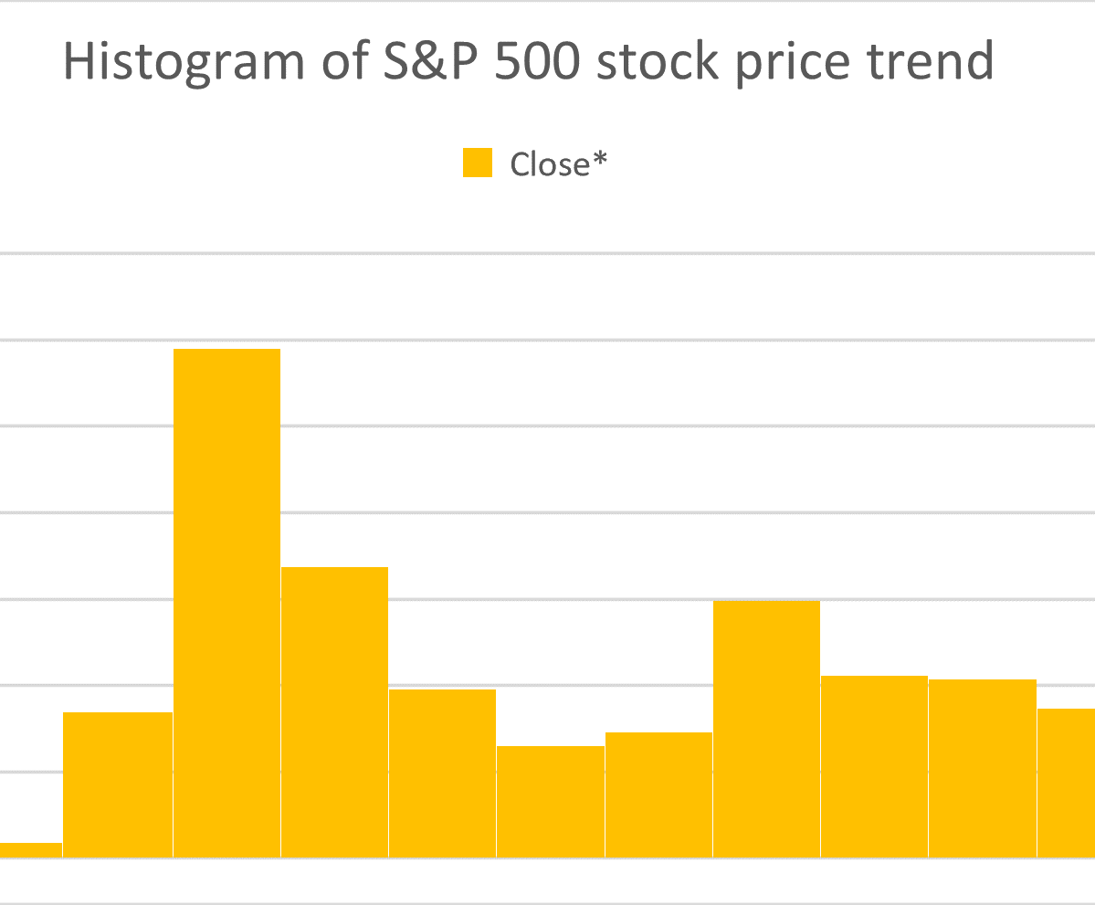
Stock Market Histogram Analysis
Histogram plots for Microsoft, Tesla, Apple, and the S&P 500 index would visually represent their price distributions. Microsoft's histogram would likely show a symmetric distribution with moderate variability, reflecting its stability. Tesla's histogram would display a wider spread and a positively skewed distribution, indicating its high volatility. Apple's histogram would fall between Microsoft and Tesla, with moderate variability and some skewness towards higher prices. The S&P 500 histogram would depict the collective market behavior, potentially resembling Microsoft's but with broader variability. Comparing these histograms would visually illustrate the differences in distribution and volatility among the stocks and the broader market index.

Slide 10
REGRESSION ANALYSIS
Regression Analysis for Tesla, Apple, and Microsoft: This statistical method helps us understand how changes in market conditions, represented by the S&P 500 index, correlate with the stock prices of Tesla, Apple, and Microsoft. By analyzing historical data, we can determine how much of each stock's movement can be explained by broader market trends. This analysis is crucial for investors as it provides insights into how these stocks may behave in the future, helping them make informed decisions about investment strategies.

Slide 11
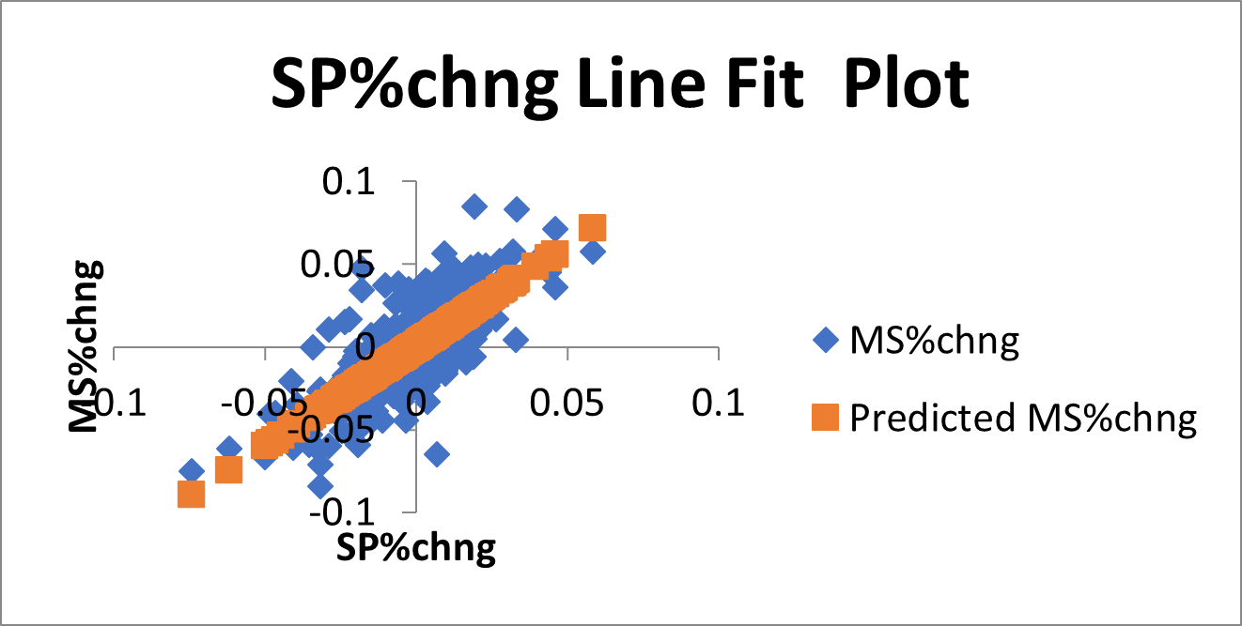
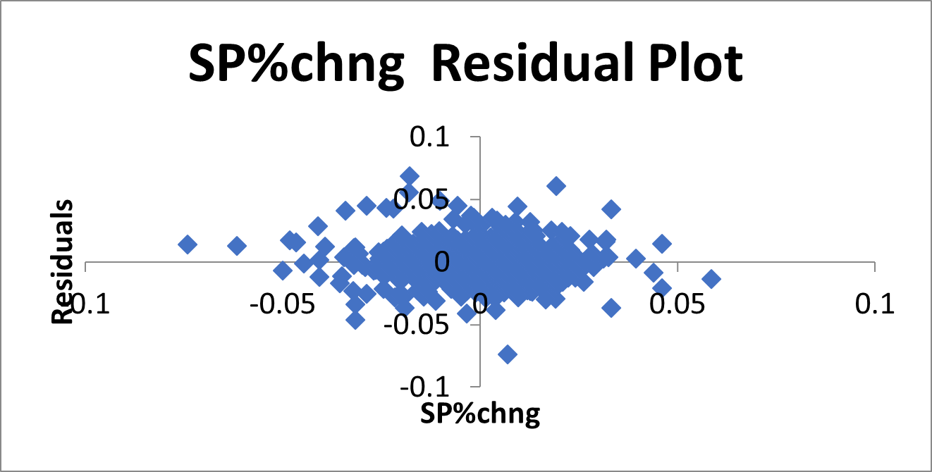
Regression Analysis of Microsoft
Microsoft's stock demonstrates relatively lower volatility compared to Tesla and Apple, with a beta value of 1.213. While still influenced by market changes, Microsoft offers a more stable investment option with a more modest level of risk. Investors seeking stability and consistent growth may find Microsoft preferable.

Slide 12
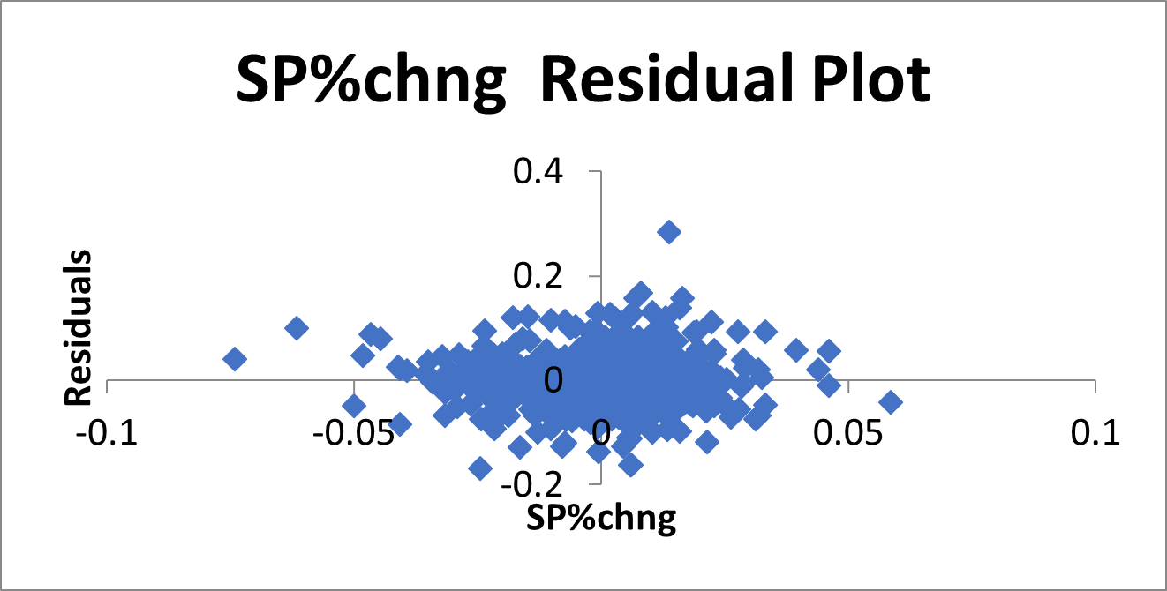
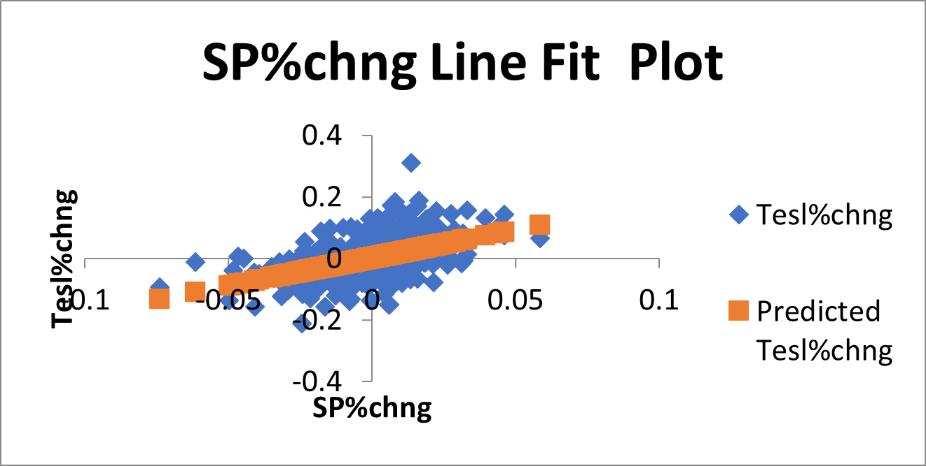
Regression analysis of Tesla
Tesla displays the most volatility among the trio, experiencing considerable price fluctuations in reaction to market movements. With a beta value of 1.8367, Tesla's stock is identified as highly responsive to market changes, indicating increased risk. Investors contemplating Tesla should brace themselves for significant fluctuations in stock prices.

Slide 13
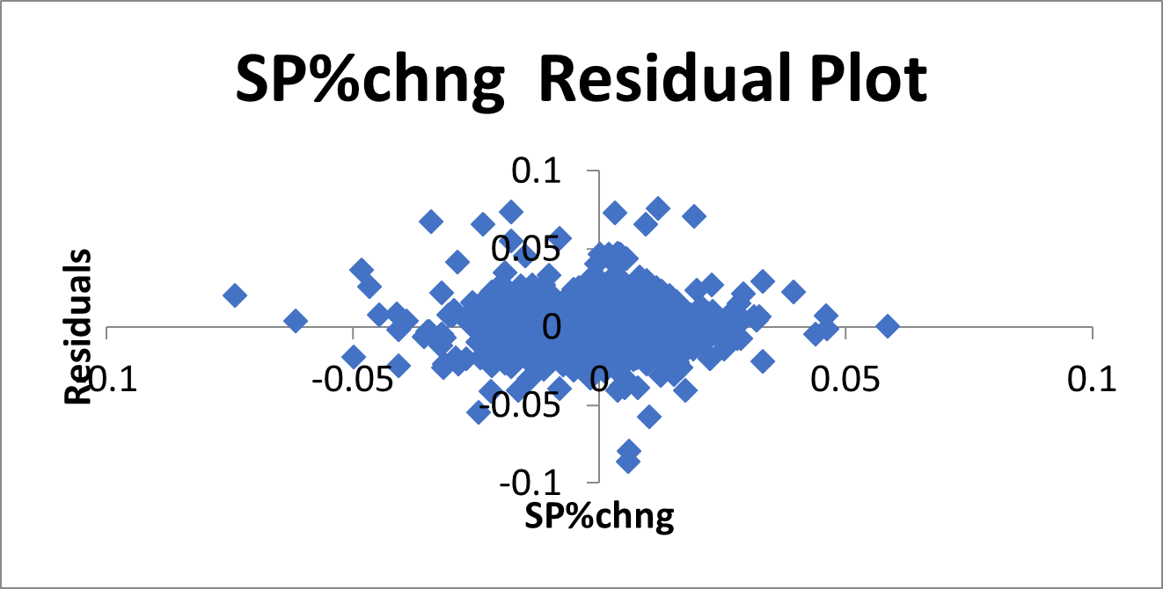
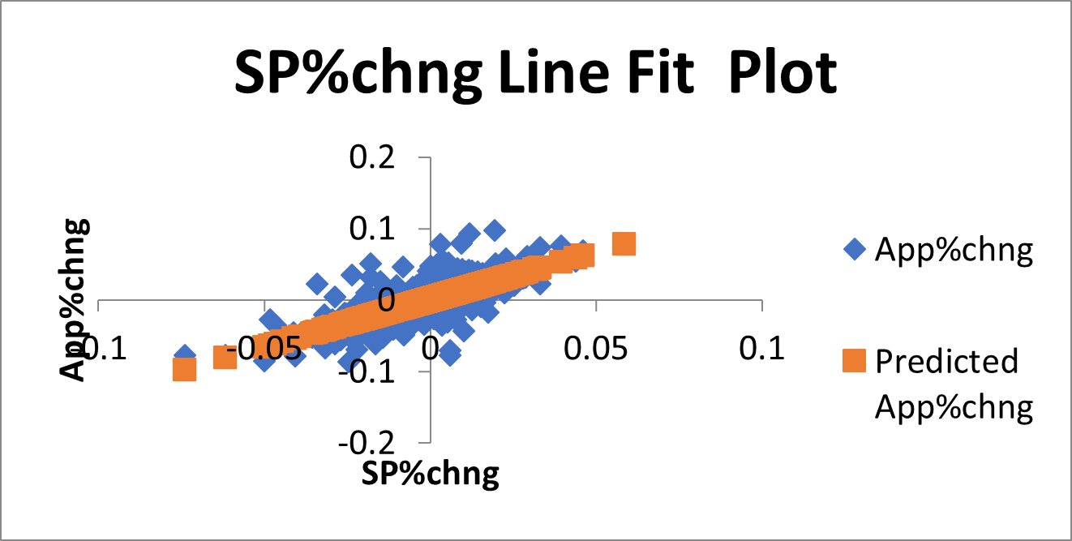
Regression Analysis of Apple Inc.
With a beta value of 1.32, Apple's stock is significantly more volatile than the overall market. This indicates a higher level of risk associated with investing in Apple, as its stock tends to amplify market movements. While there is greater growth potential, investors should be aware of the increased risk involved.

Slide 14
Risk Insights from Regression Analysis
Apple Inc. emerges as the riskiest investment among the three, with a beta value of 1.32, signifying significant volatility and heightened sensitivity to market fluctuations.
Tesla exhibits even greater volatility, with a beta value of 1.8376, positioning it as the riskiest investment among Apple, Tesla, and Microsoft.
Conversely, Microsoft presents a more stable investment option with a beta value of 1.213, indicating lower volatility compared to both Apple and Tesla.
While Apple and Tesla appeal to investors seeking higher growth potential, they come with increased risk due to their elevated volatility.
In contrast, Microsoft provides a more balanced risk-reward profile, appealing to investors prioritizing stability and consistent growth in their investments.

Slide 15
CONCLUSION
Microsoft, Tesla, and Apple stocks exhibit distinct performance and risk levels.
Tesla is the riskiest option with high volatility, followed by Apple with moderate volatility, and then Microsoft with lower volatility.
Tesla's stock is highly unpredictable, while Apple and Microsoft offer more stability.
Investors should consider their risk tolerance and investment goals when choosing among these stocks.
Overall, Tesla may offer higher potential returns but comes with greater risk, while Microsoft and Apple provide a more balanced risk-return profile.

Slide 16

THANK YOU

