Slide 1
Report on the Survey of 2018 Nephrology Fellows
George Washington University Health Workforce Institute

Slide 2
Leo Quigley, MPH George Washington University Health Workforce Institute and School of Nursing
Edward Salsberg, MPA, FAAN George Washington University Health Workforce Institute and School of Nursing
Ashté Collins, MD George Washington University School of Medicine
The views and findings in this report reflect the work of the GW Health Workforce Institute (GW-HWI) and do not necessarily reflect the views of ASN or GW University. The GW-HWI and ASN welcome comments and feedback on this report.

Slide 3
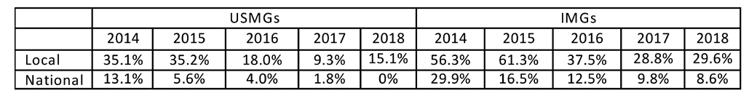
Percentage of Nephrology Fellows Responding “No Jobs” or “Very Few Jobs”

Slide 4
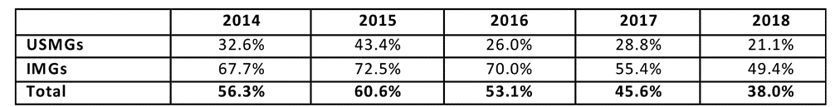
Percentage of Nephrology Fellows Having a Difficult Time Finding a Satisfactory Position

Slide 5
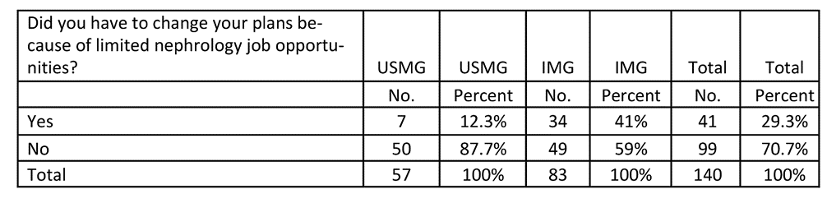
Changing Plans Due to Limited Practice Opportunities

Slide 6
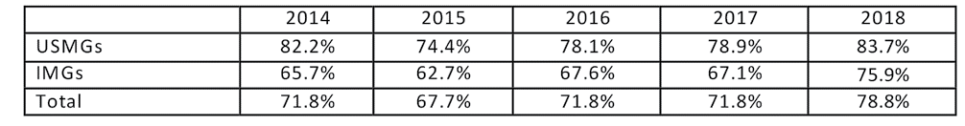
Would Recommend Nephrology to Medical Students and Residents

Slide 7
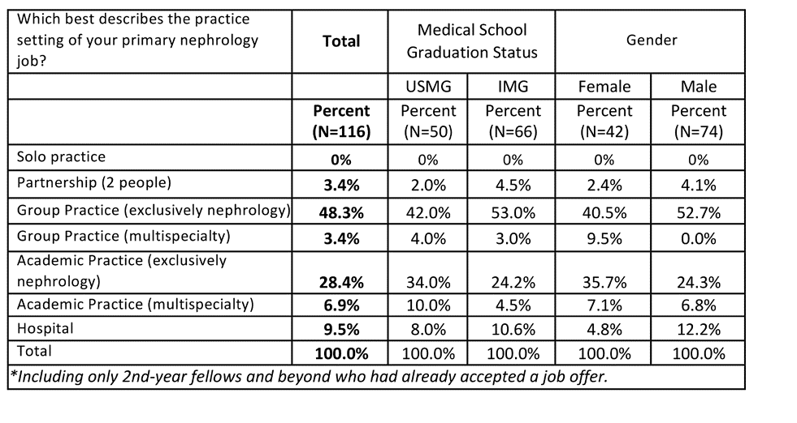
Setting of Primary Nephrology Job

Slide 8
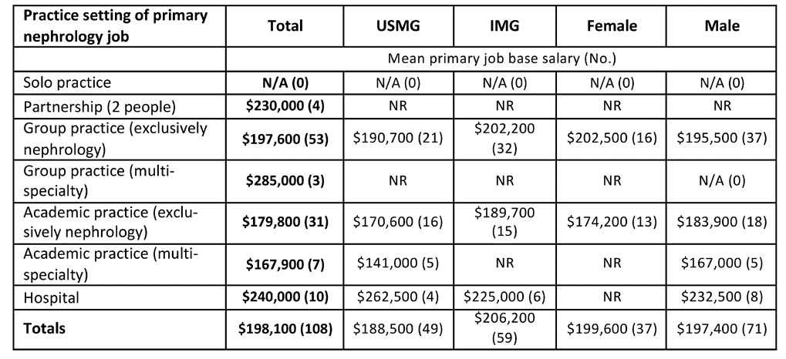
Base Salary by Practice Setting of Primary Nephrology Job

Slide 9
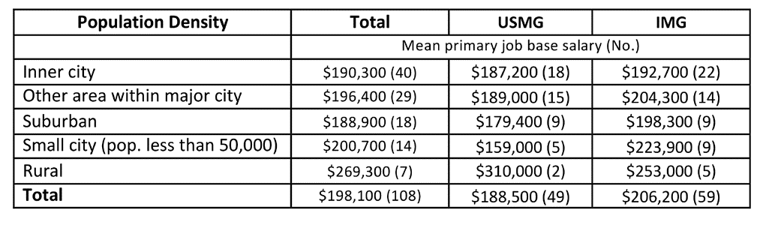
Base Salary by Population Density of Primary Nephrology Job Location

Slide 10
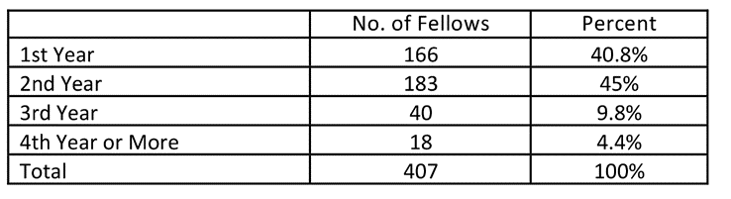
Exhibit 1: Respondents by Fellowship Year

Slide 11
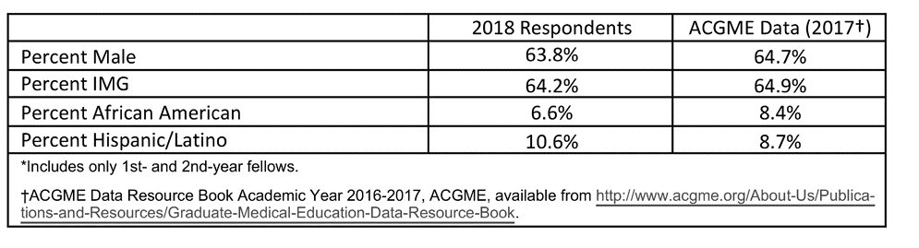
Exhibit 2: Comparison of 1st- and 2nd-Year Fellow Survey Respondents with ACGME Data

Slide 12
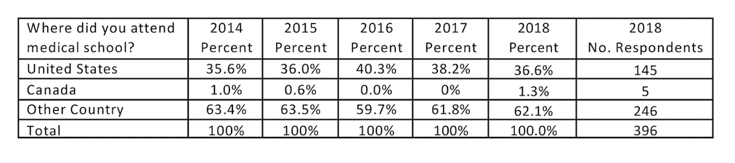
Exhibit 3: Medical School

Slide 13
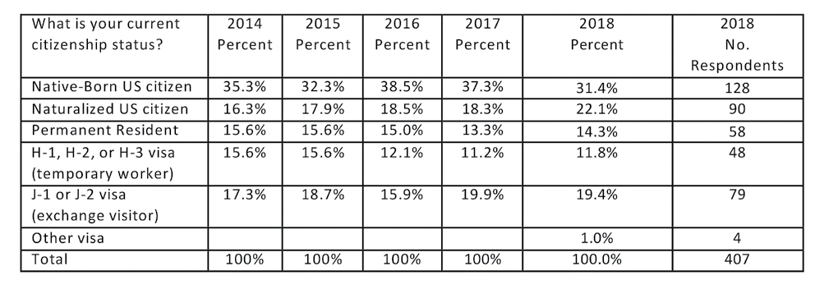
Exhibit 4: Citizenship Status

Slide 14
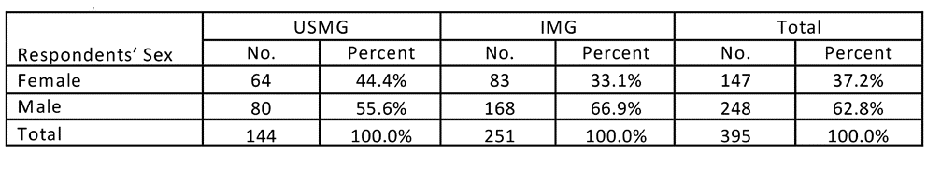
Exhibit 5: Sex of 2018 Respondents

Slide 15
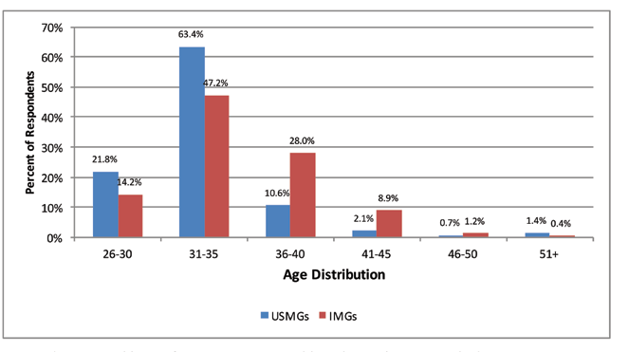
Exhibit 6: Age of 2018 Respondents

Slide 16
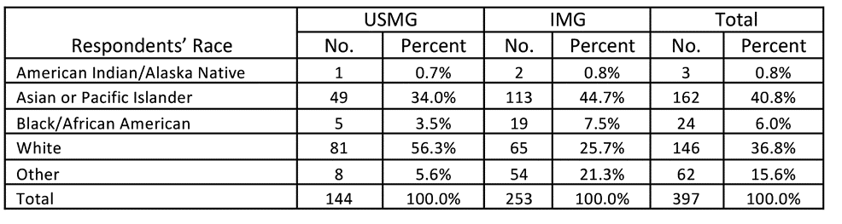
Exhibit 7: Race of 2018 Respondents

Slide 17
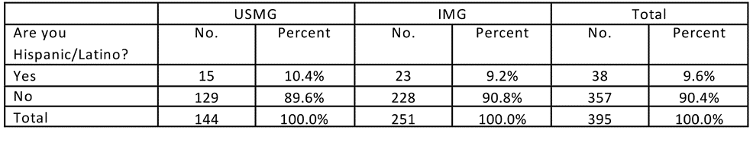
Exhibit 8: Ethnicity of 2018 Respondents

Slide 18
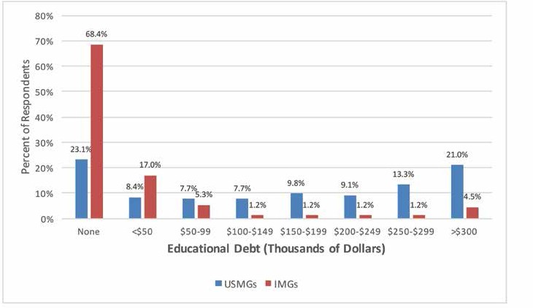
Exhibit 9: Educational Debt

Slide 19
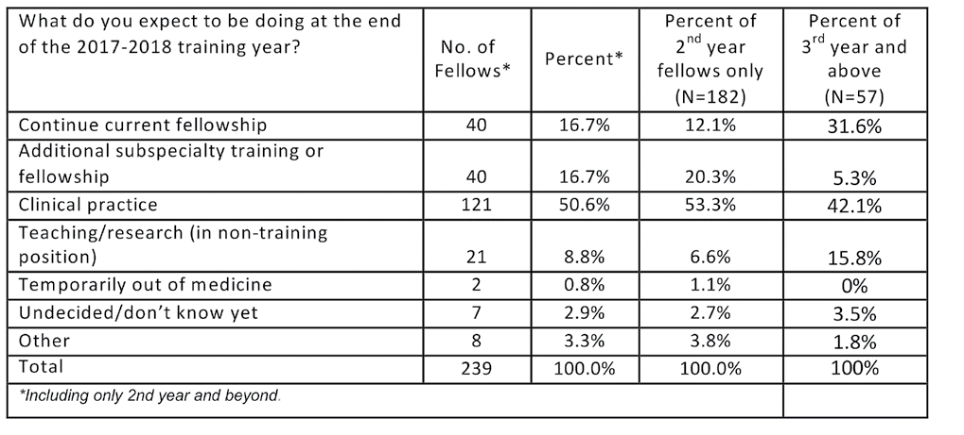
Exhibit 10: Activity After Completion of Current Training Year

Slide 20
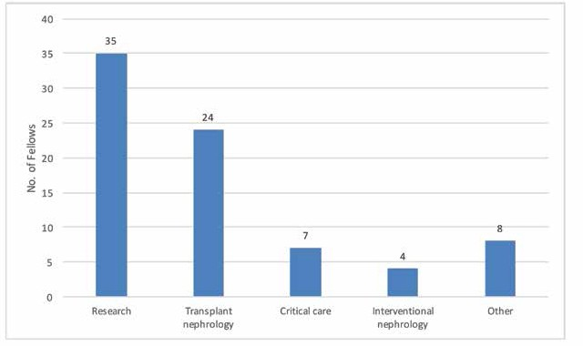
Exhibit 11: Type of Continuing Training Pursued by Fellows

Slide 21
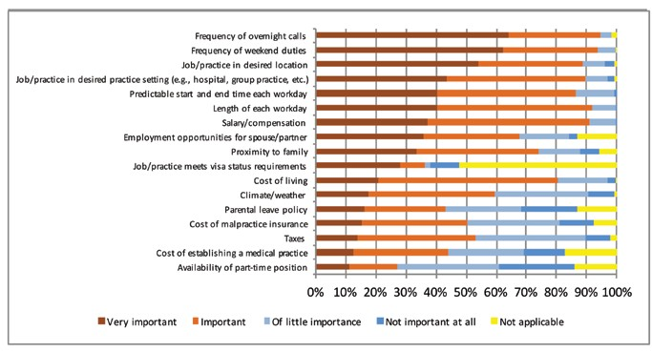
Exhibit 12: Factors Influencing Job Selection

Slide 22
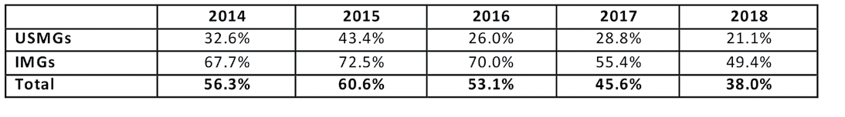
Exhibit 13: Percentage of Nephrology Fellows Having a Difficult Time Finding a Satisfactory Position

Slide 23
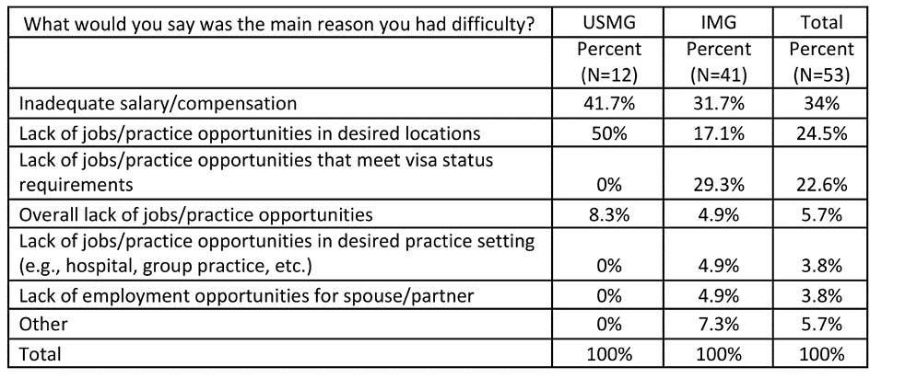
Exhibit 14: Reasons for Difficulty

Slide 24
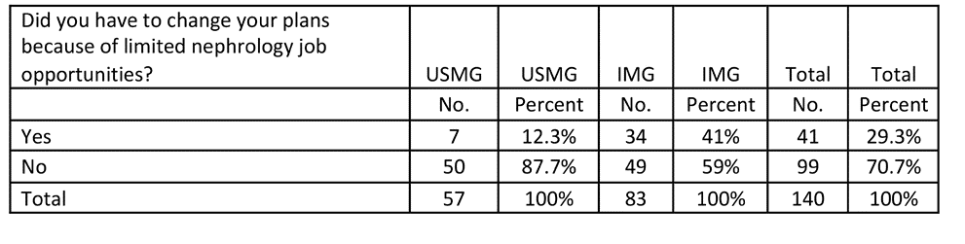
Exhibit 15: Changing Plans Due to Limited Practice Opportunities

Slide 25
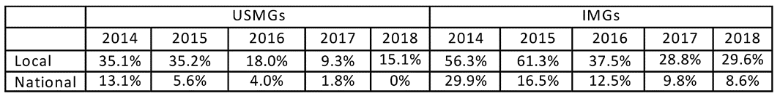
Exhibit 16: Percentage of Nephrology Fellows Responding “No Jobs” or “Very Few Jobs”

Slide 26
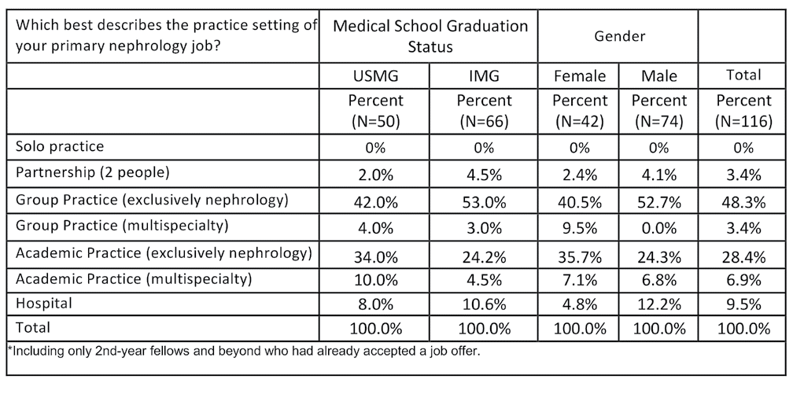
Exhibit 17: Setting of Primary Nephrology Job

Slide 27
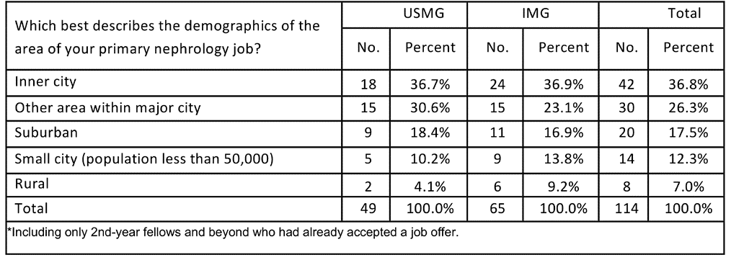
Exhibit 18: Location of Primary Nephrology Job (Demographics)

Slide 28
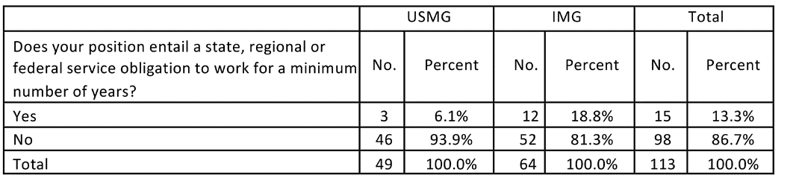
Exhibit 19: Service Obligation

Slide 29
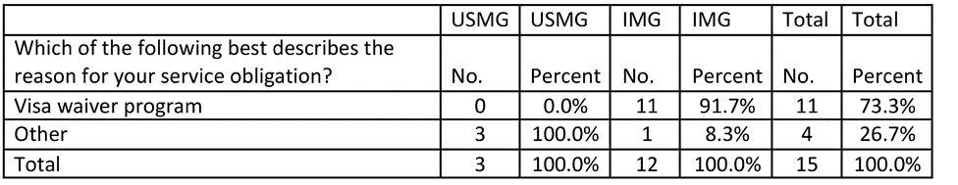
Exhibit 20: Reason for Service Obligation

Slide 30
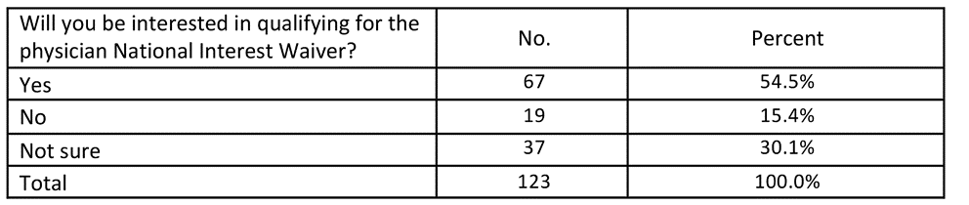
Exhibit 21: Interest in Physician National Interest Waiver

Slide 31
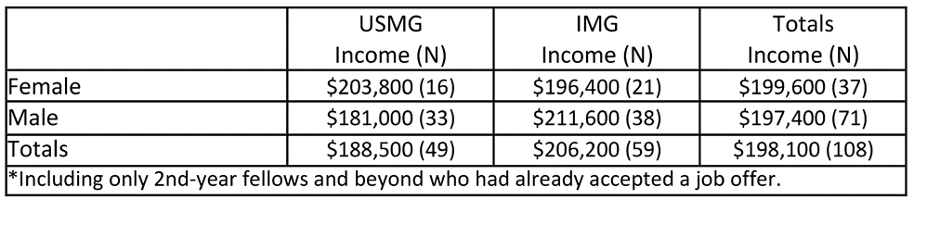
Exhibit 22: Expected Base Salary by IMG Status and Sex (Mean)

Slide 32
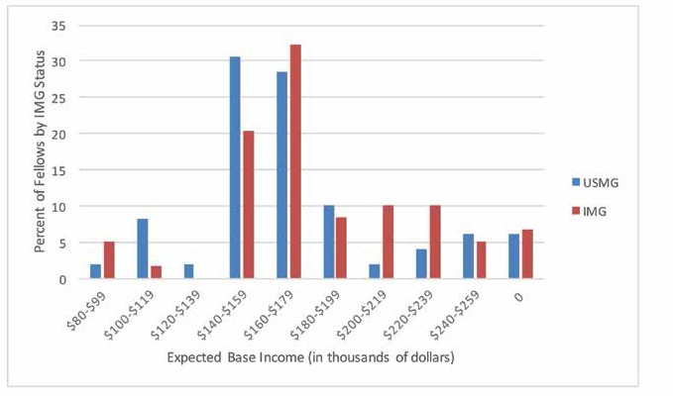
Exhibit 23: Distribution of Expected Base Salary for USMGs and IMGs

Slide 33
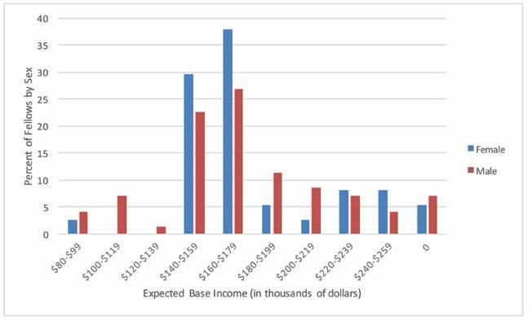
Exhibit 24: Distribution of Expected Base Salary by Sex

Slide 34
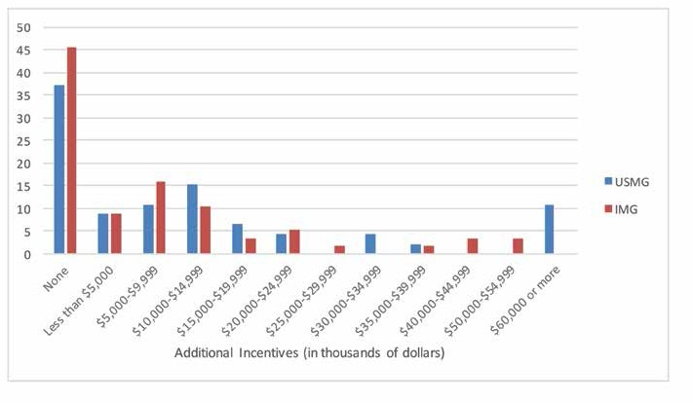
Exhibit 25: Distribution of Incentive Income for USMGs and IMGs

Slide 35
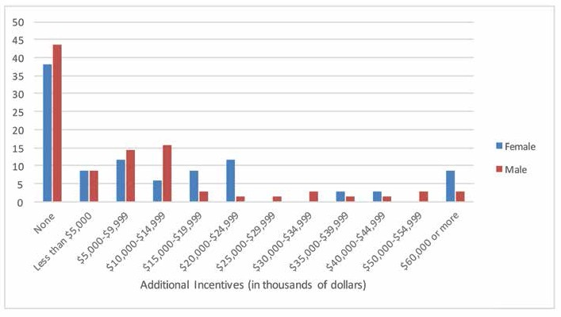
Exhibit 26: Distribution of Incentive Income by Sex

Slide 36
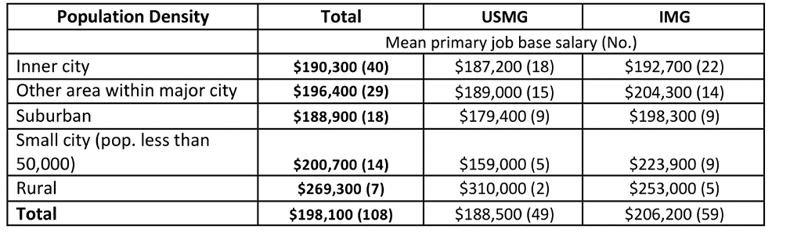
Exhibit 27: Distribution of Expected Base Salary by Demography

Slide 37
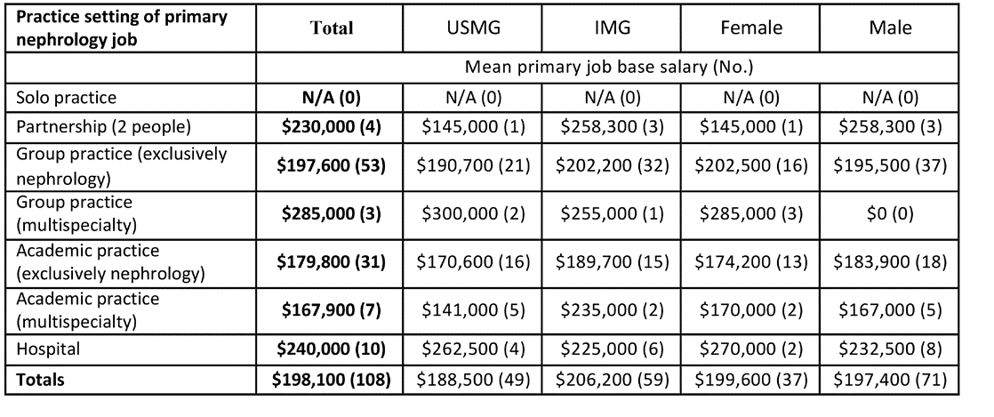
Exhibit 28: Distribution of Expected Base Salary by Setting, IMG Status and Gender

Slide 38
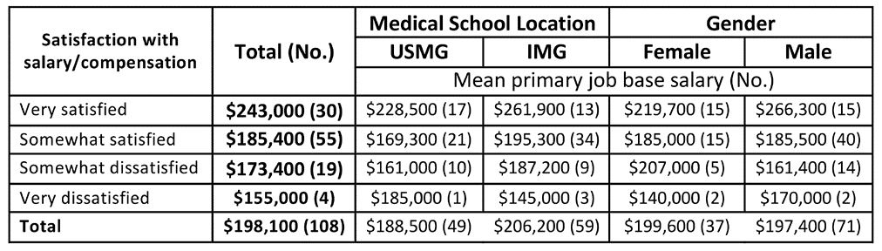
Exhibit 29: Distribution of Expected Base Salary by Satisfaction with Salary, IMG Status and Gender

Slide 39
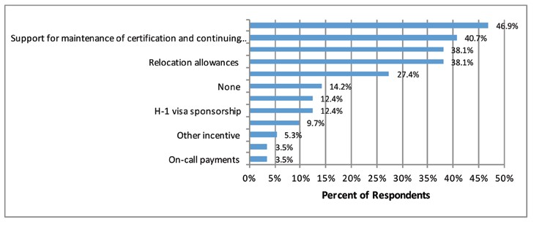
Exhibit 30: Incentives Received

Slide 40
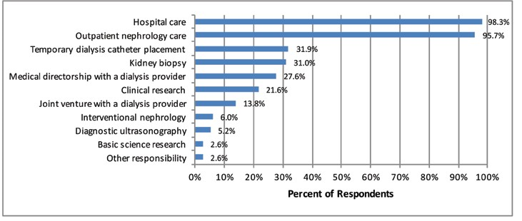
Exhibit 31: Primary Job Responsibilities

Slide 41
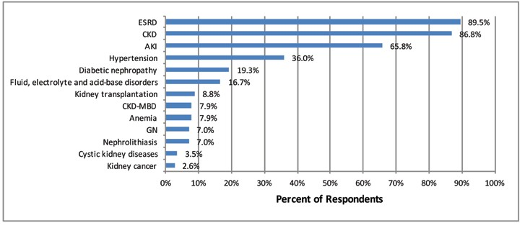
Exhibit 32: Conditions Fellows Expect to Treat

Slide 42
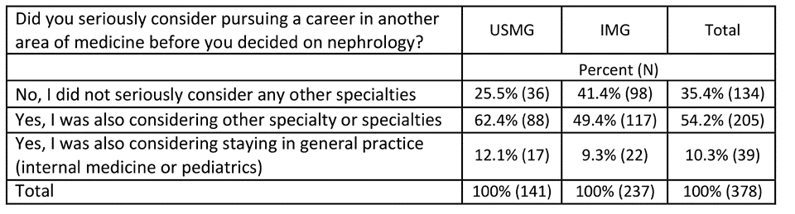
Exhibit 33: Consideration Given to a Career Outside Nephrology

Slide 43
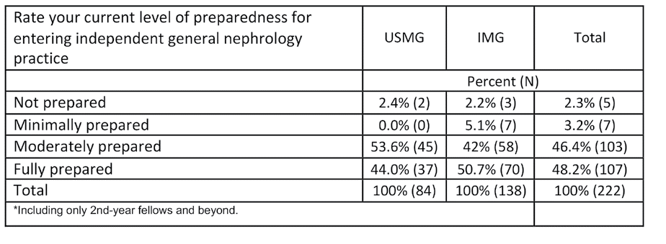
Exhibit 34: Level of Preparedness for General Nephrology Practice

Slide 44
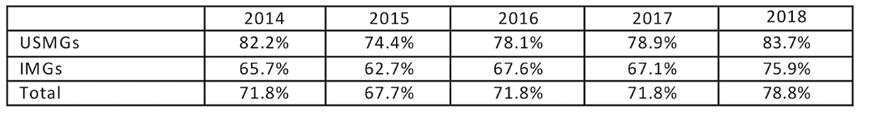
Exhibit 35: Would Recommend Nephrology to Medical Students and Residents

