Slide 1
August/September ERAS Applications
Kurtis Pivert, ASN Data Science Officer

Slide 2
AY 2019 Nephrology Match Update: August/September ERAS Applications

Slide 3
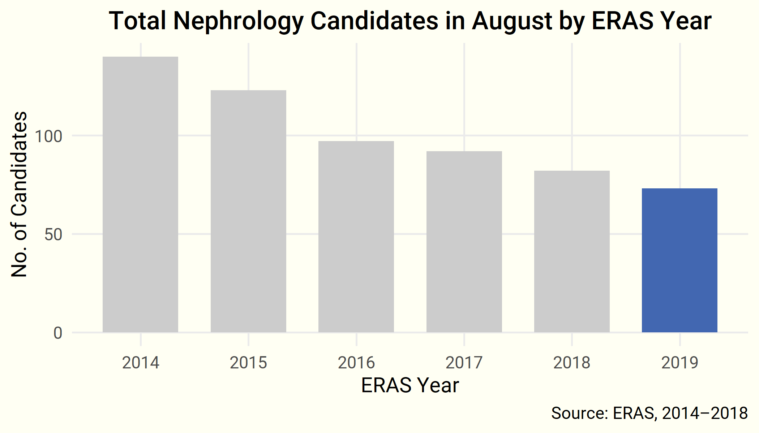
Fall Rebound in Candidates—August

Slide 4
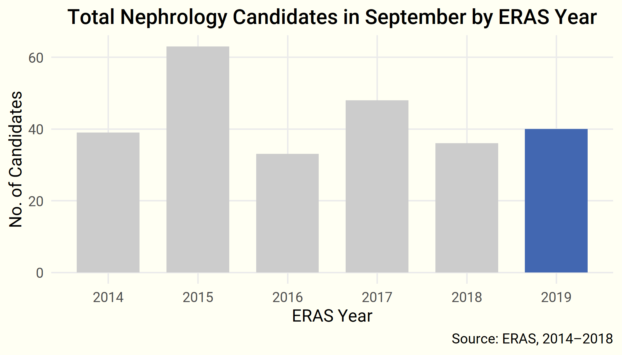
Fall Rebound in Candidates—September

Slide 5
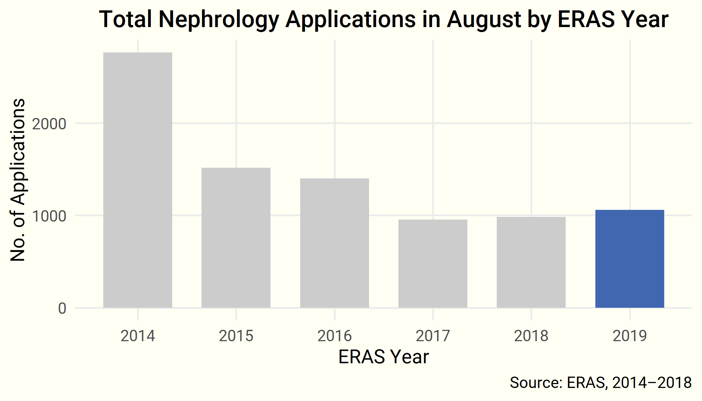
…and Applications—August

Slide 6
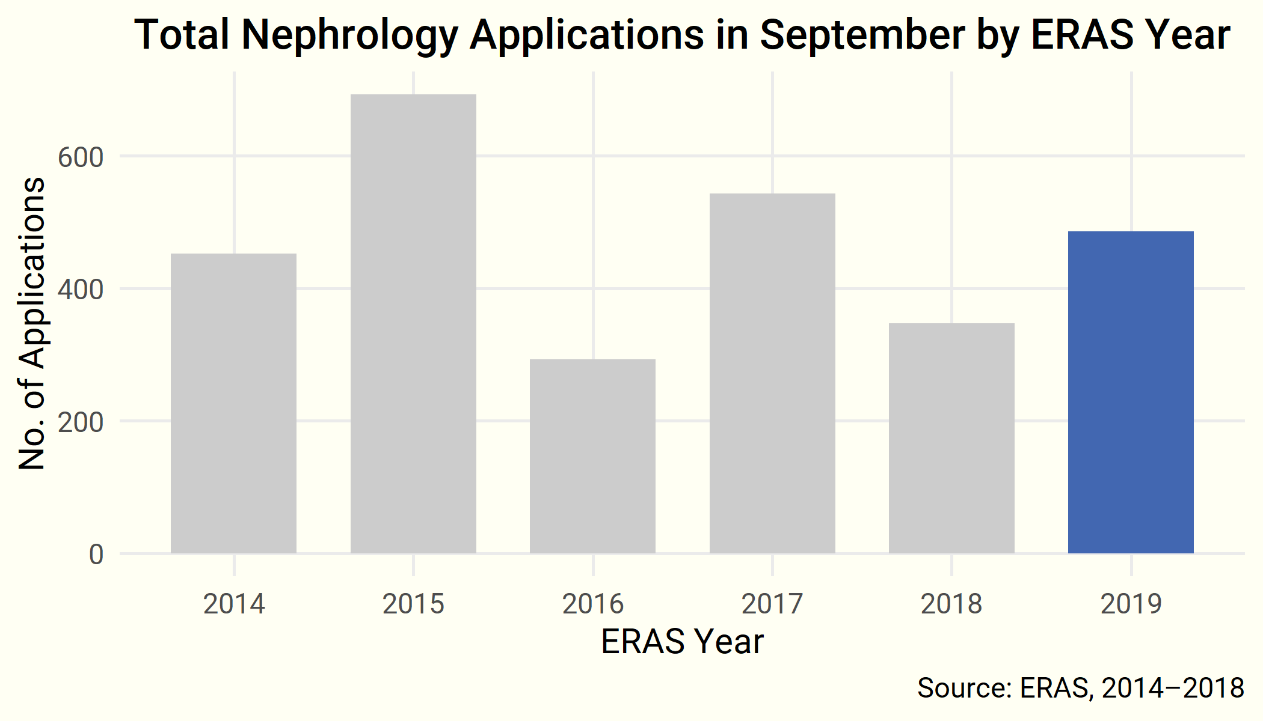
…and Applications—September

Slide 7
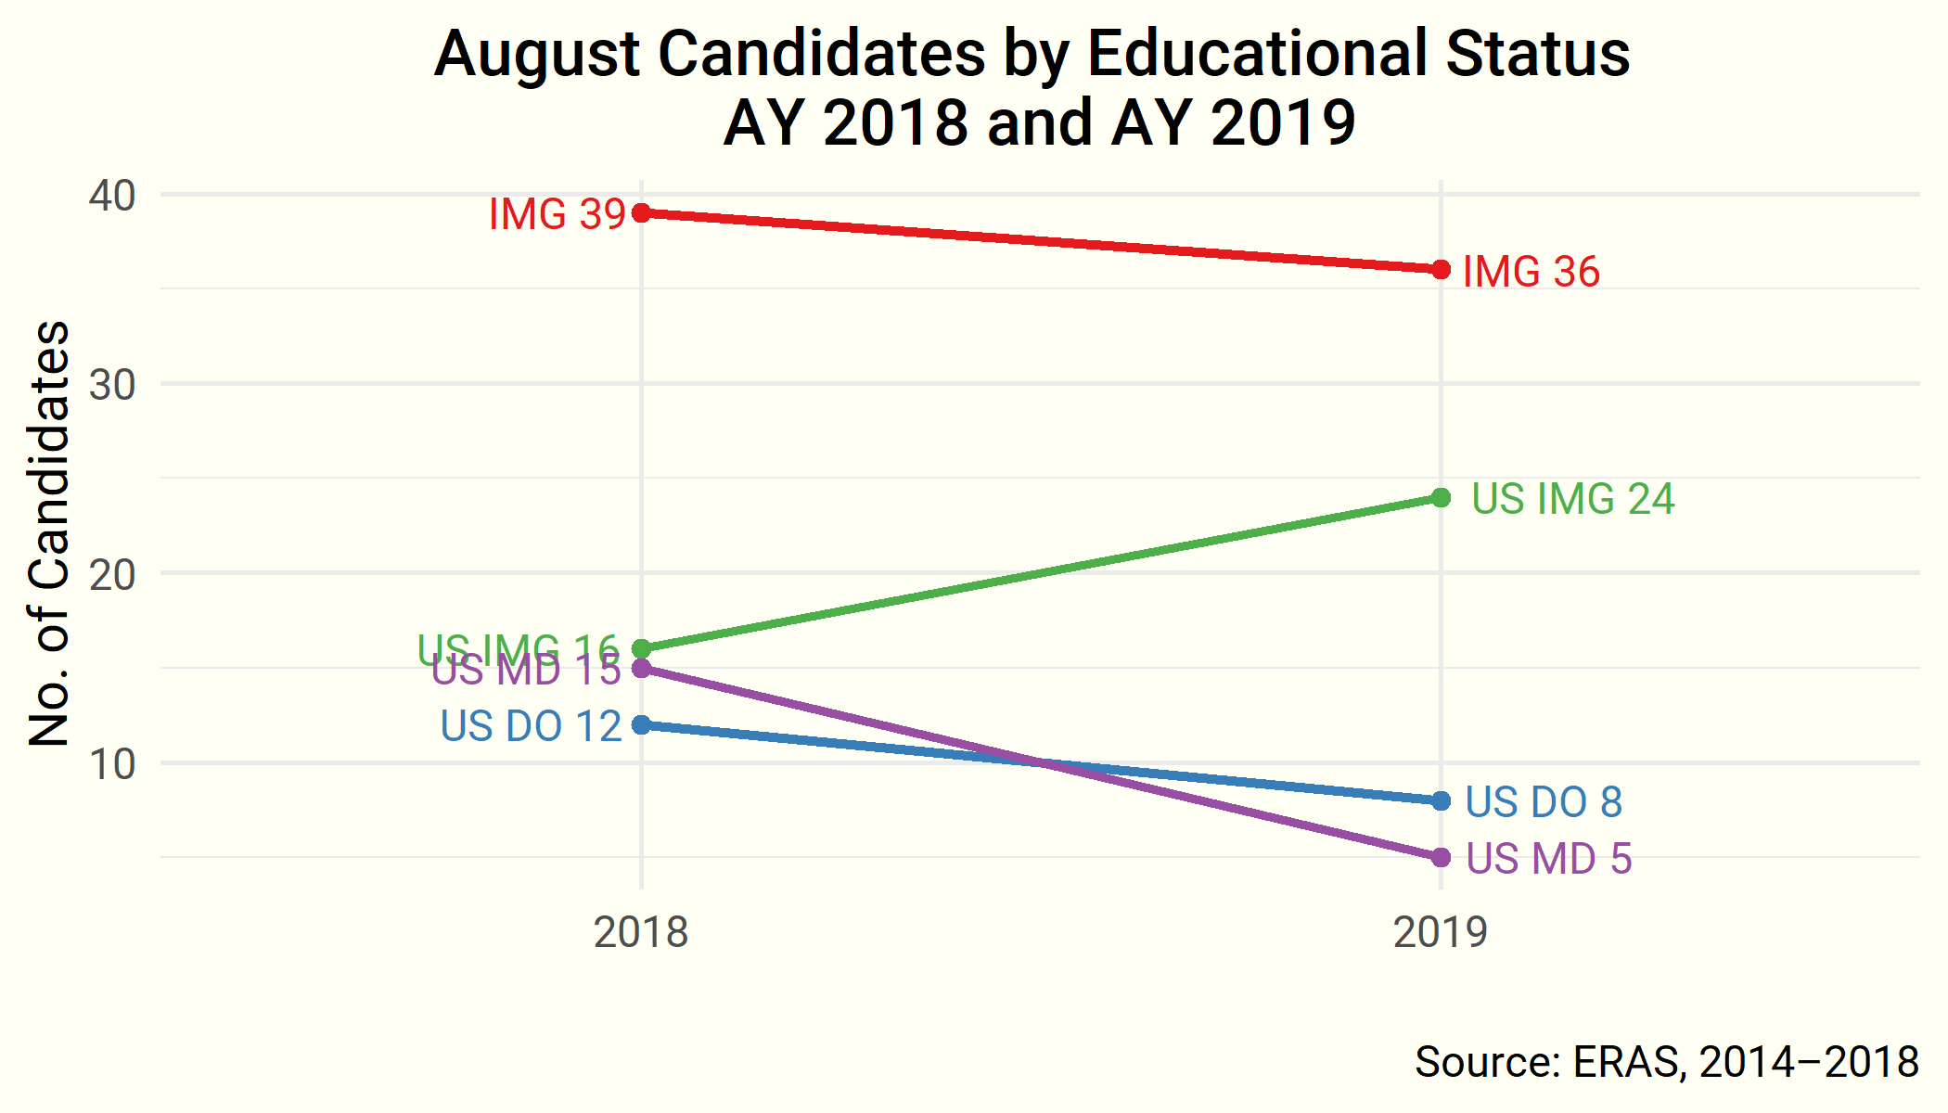
Educational Status—August

Slide 8
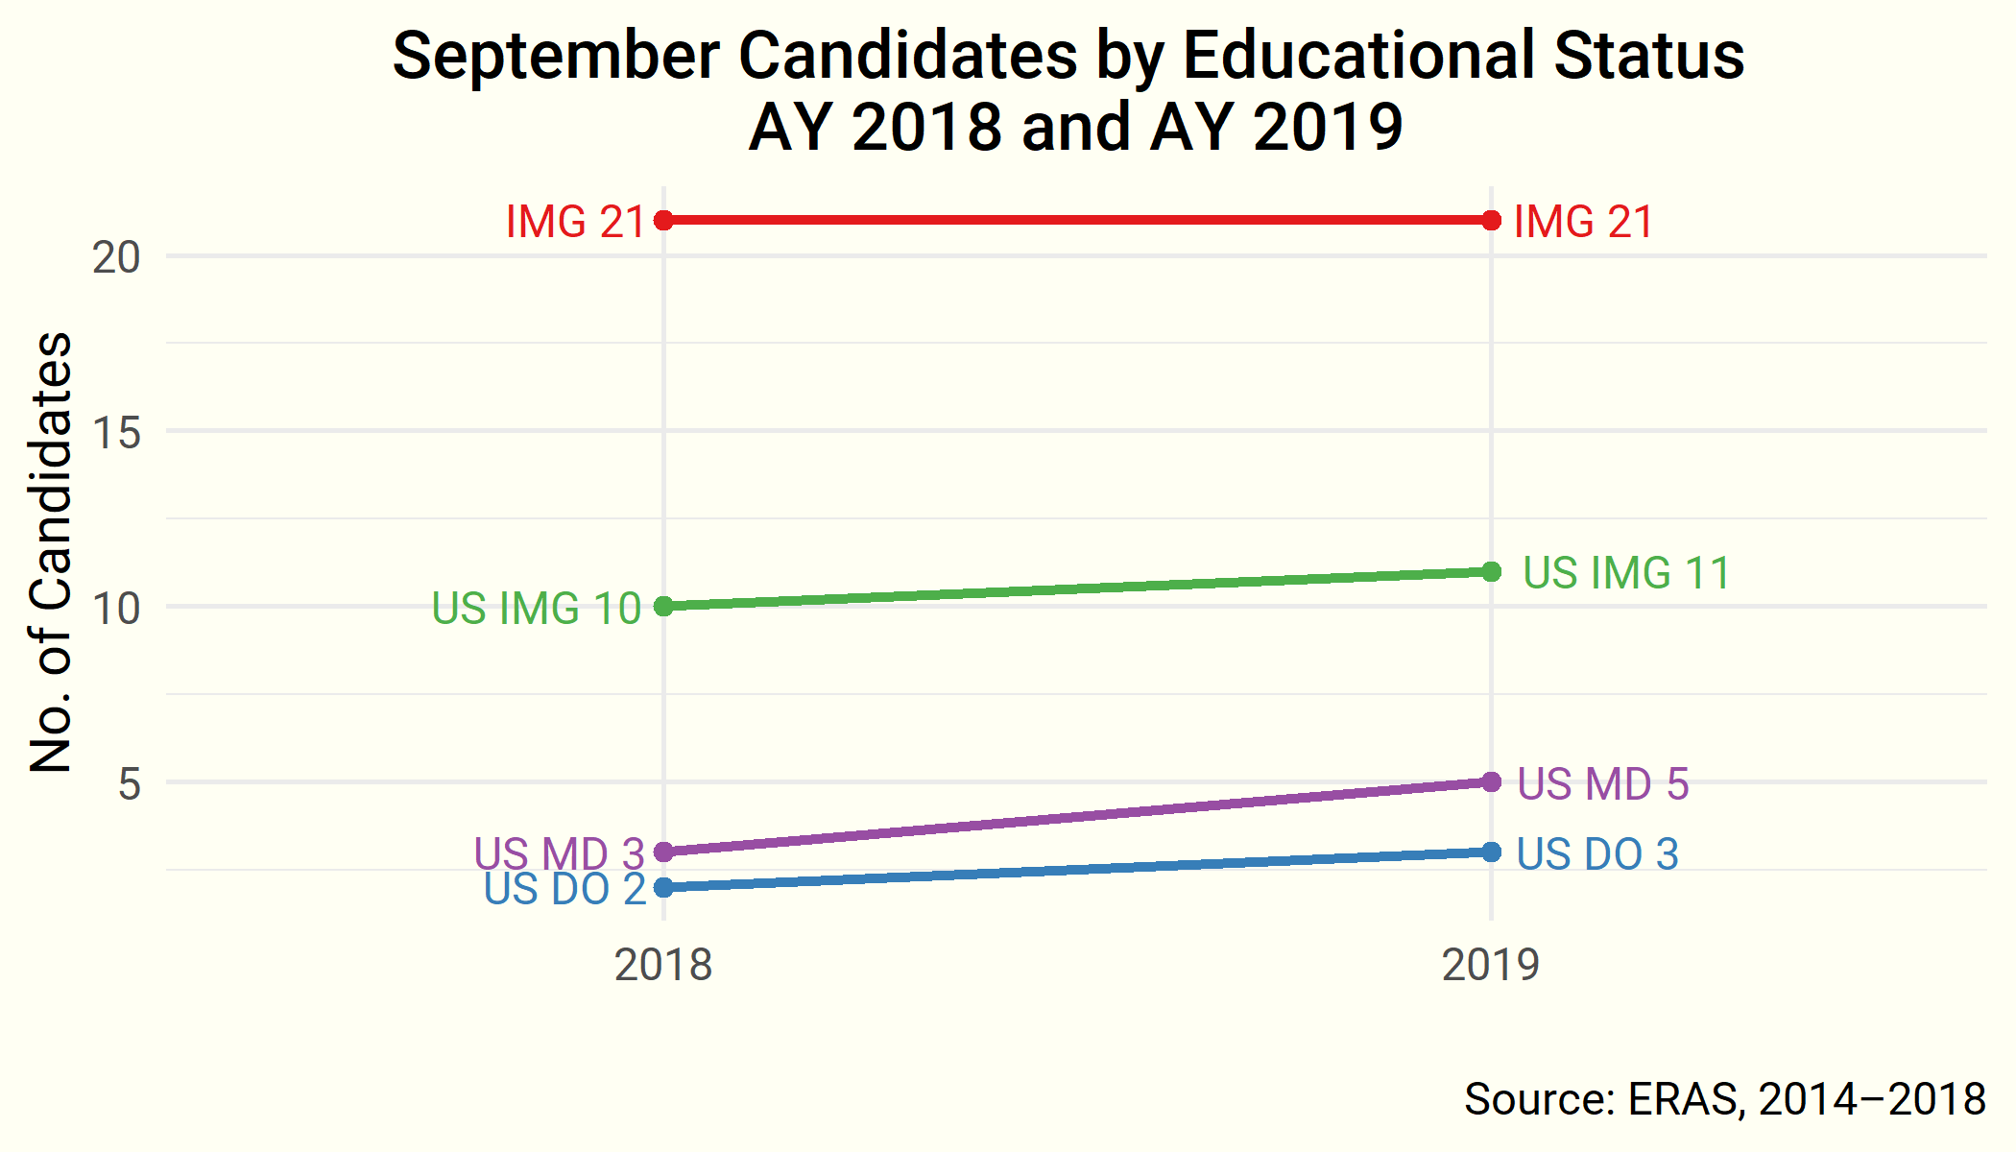
Educational Status—September

Slide 9
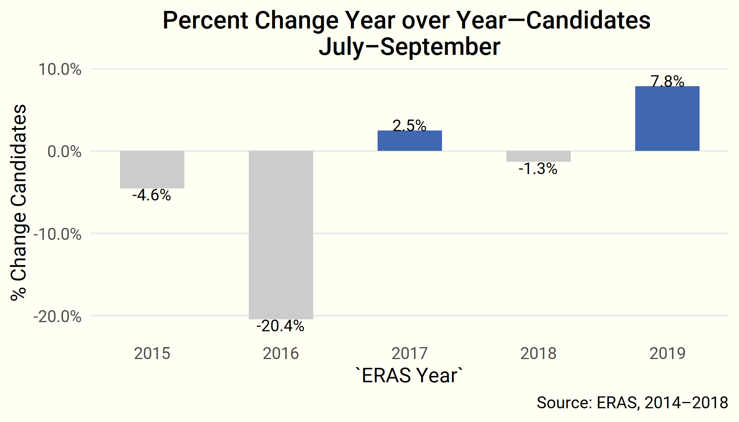
Year over Year—Candidates

Slide 10
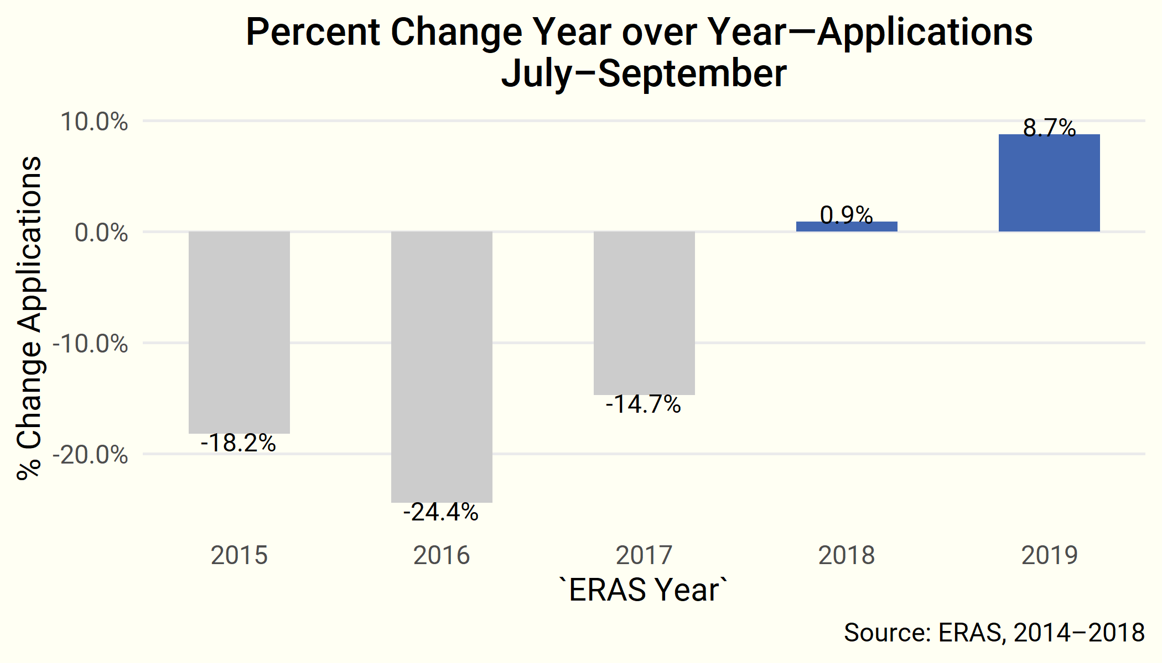
Year over Year—Applications

Slide 11
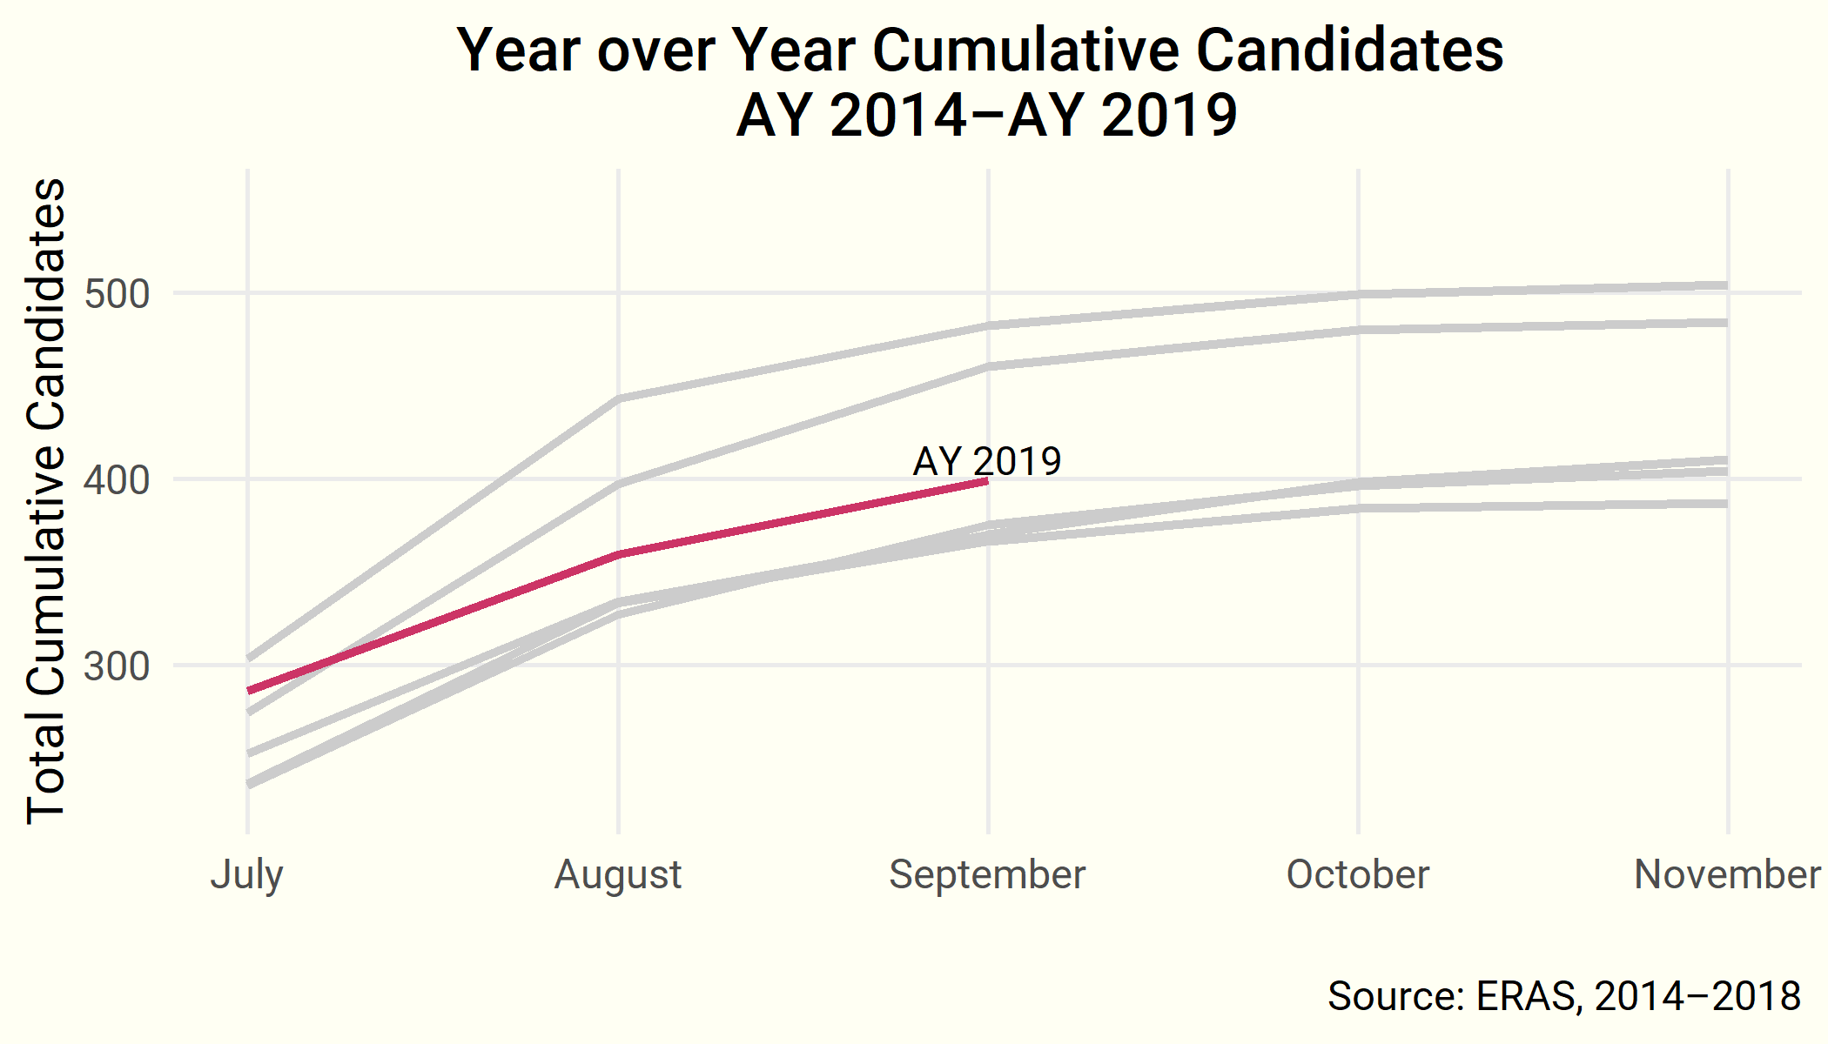
Year over Year—Cumulative Candidates

Slide 12
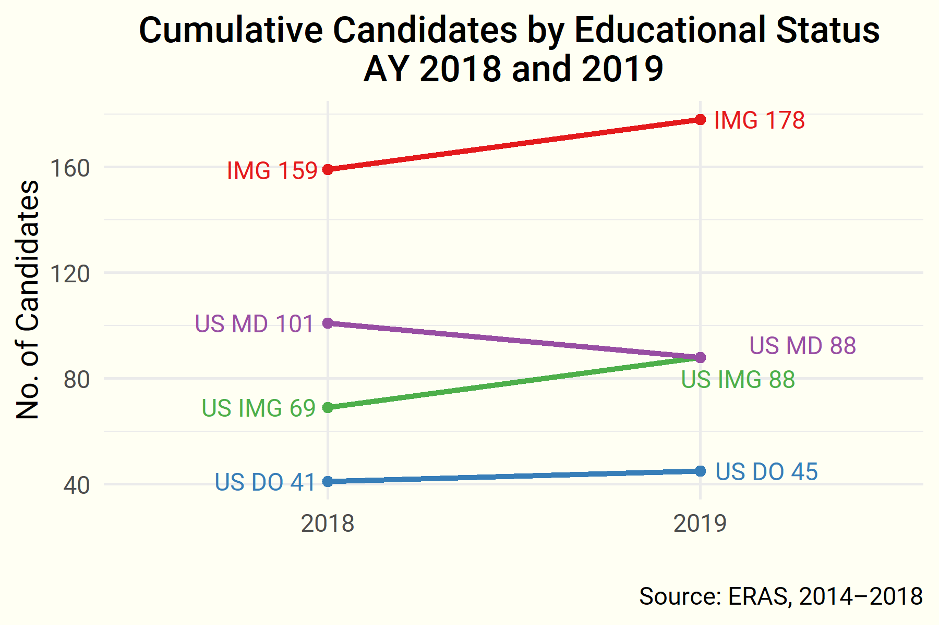
Educational Status

Slide 13
Up Next
The next Data Brief will report preliminary nephrology Match results on Match Day, Wednesday, November 28.
Questions? Comments?
Contact ASN Data Science Officer Kurtis Pivert at 202-699-0238 or kpivert@asn-online.org.

