Slide 1
AY 2019—Turning of the Tide?
Kurtis Pivert, ASN Data Science Officer

Slide 2
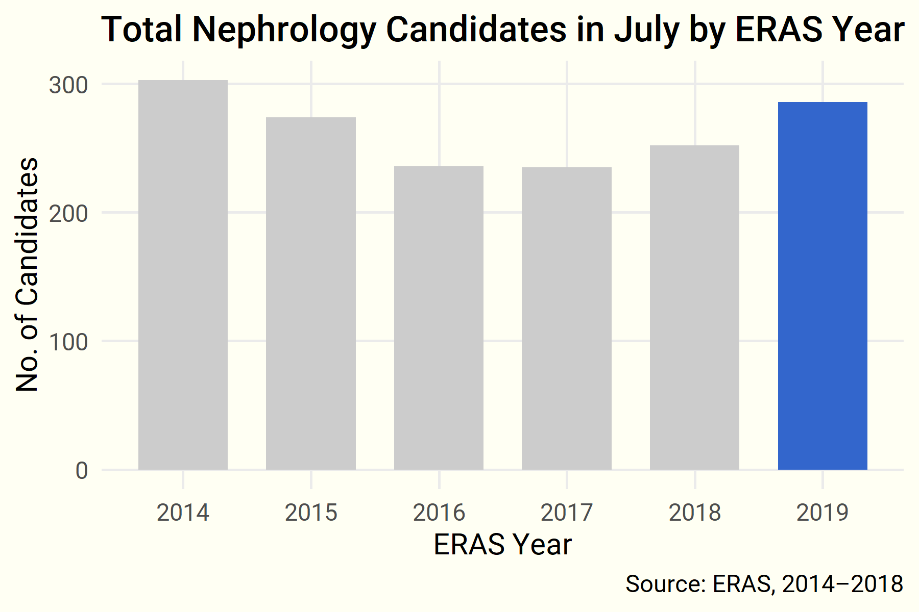
Total candidates in July are up …

Slide 3
… and candidate trends are reversing.
Starting with last year’s application cycle, the year-over-year trend of declining

Slide 4
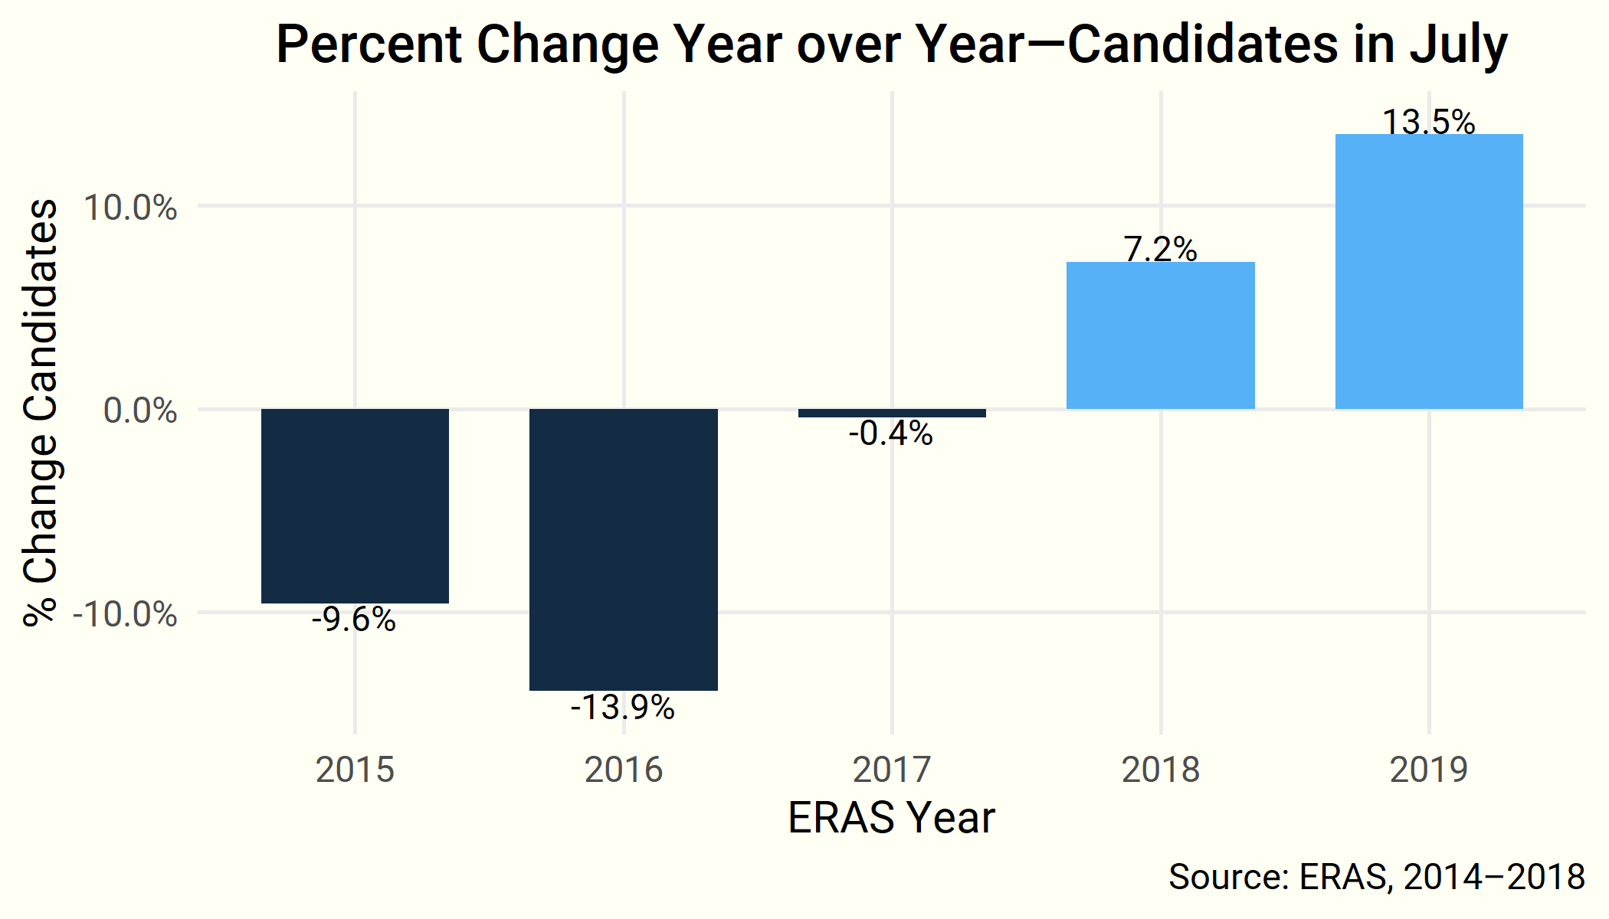

Slide 5
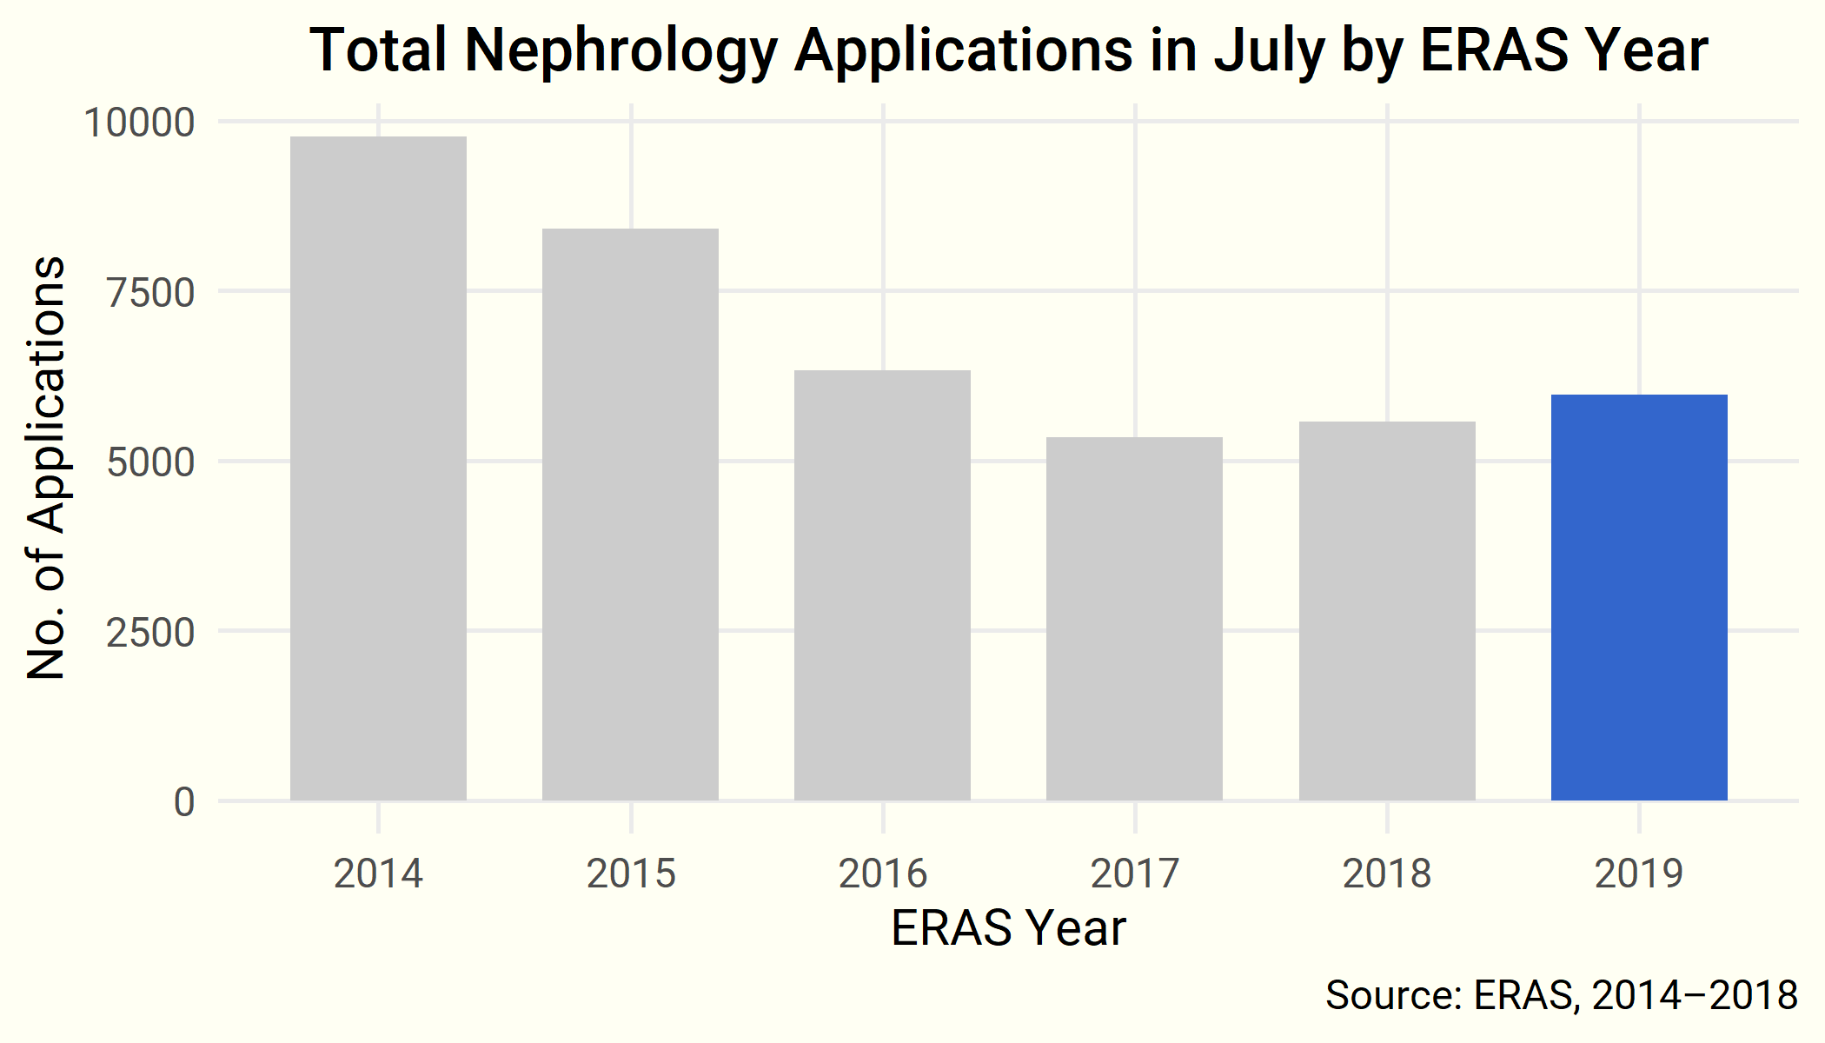
Applications to nephrology fellowships are up slightly …

Slide 6
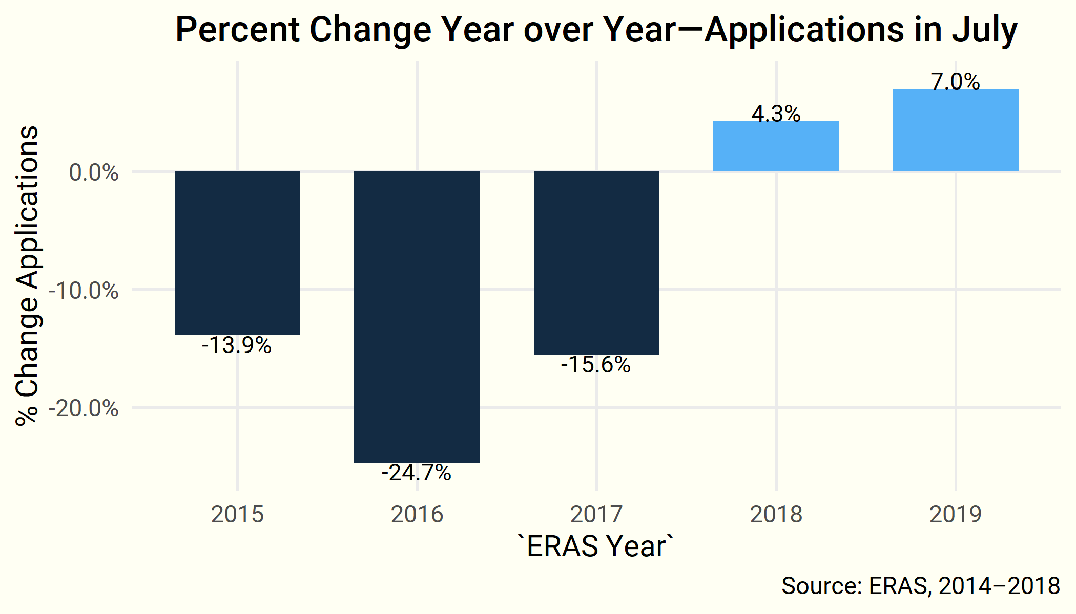
… and growing slowly year over year.

Slide 7
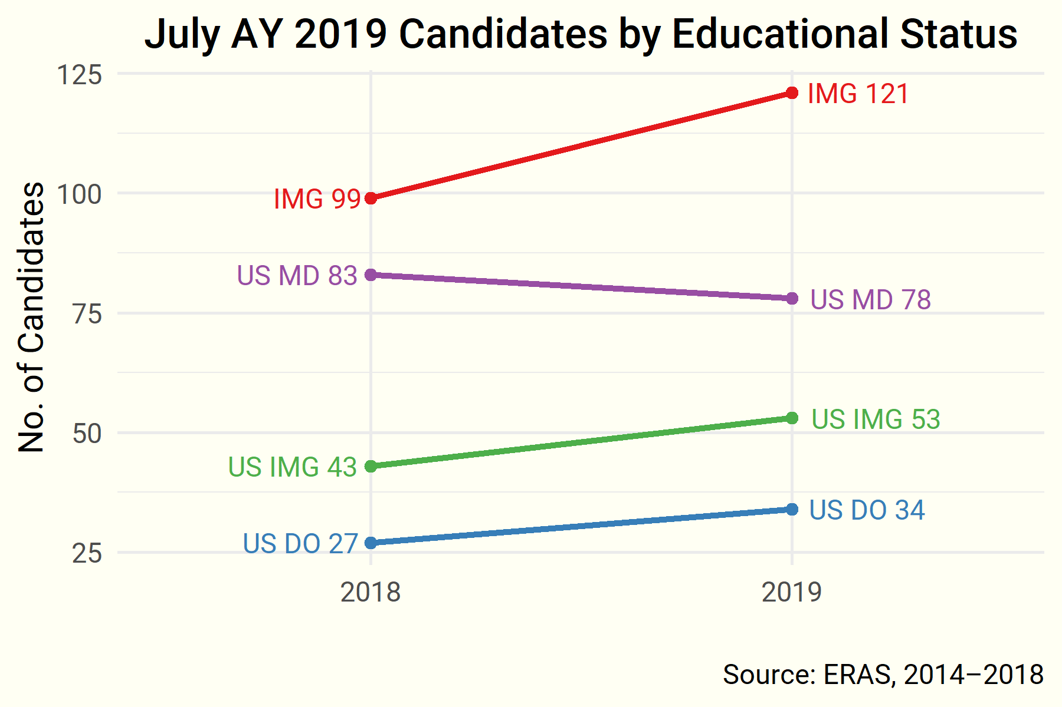
IMG candidates are back …

Slide 8
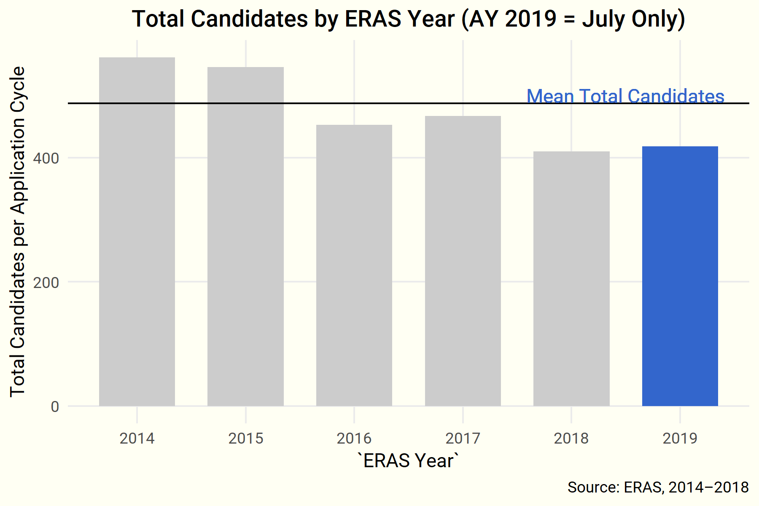
…but total candidates …

Slide 9
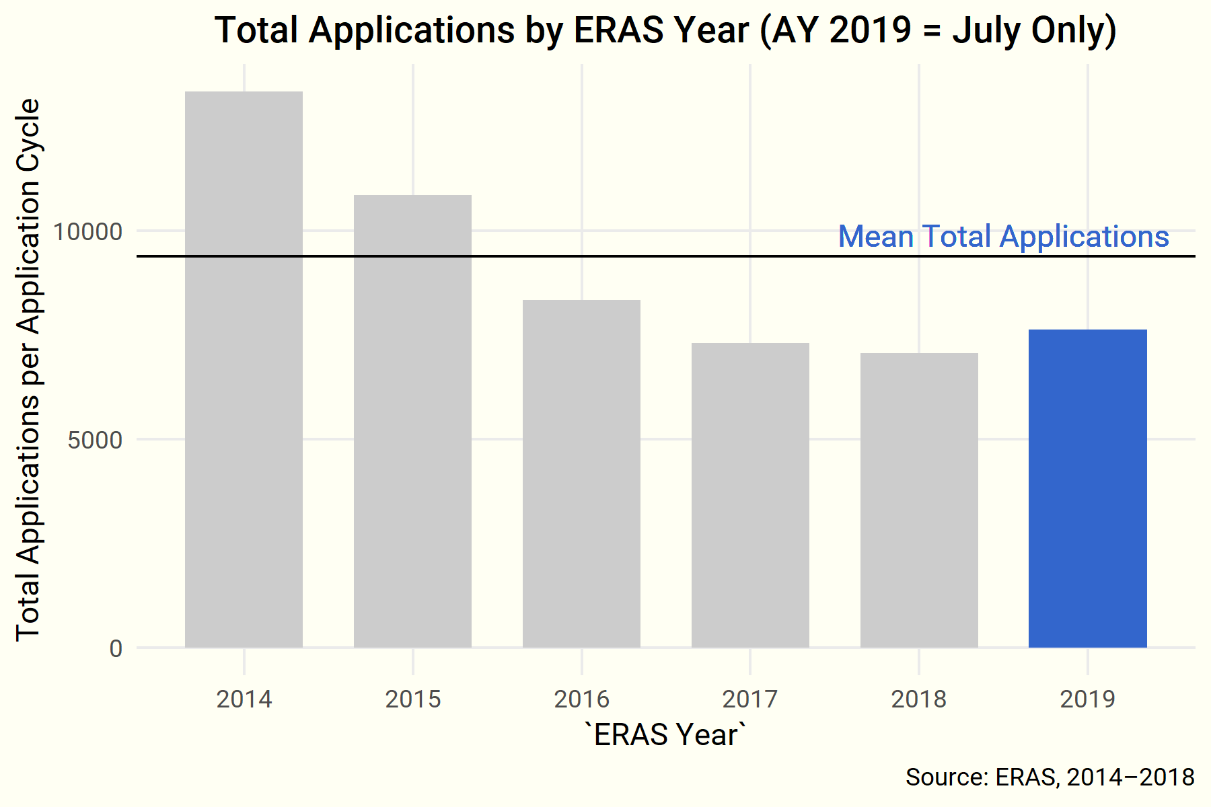
…and applications are still down compared to historic averages.

Slide 10
Up Next
Future Data Briefs will report ERAS application data as it becomes available.
Questions? Comments?
Contact ASN Data Science Officer Kurtis Pivert at 202-699-0238 or kpivert@asn-online.org.

