Slide 1
AY 2019 Nephrology Match—Preliminary Results
Kurtis Pivert, ASN Data Science Officer

Slide 2
I. Moving in Two Directions

Slide 3
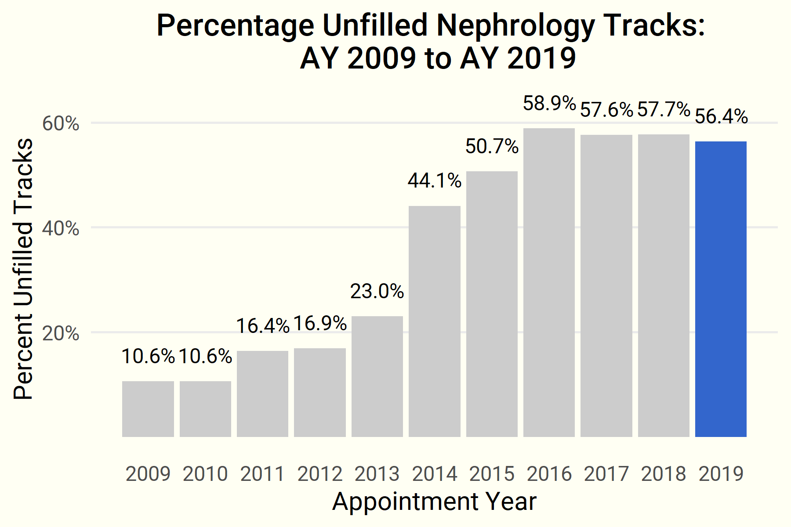
Unfilled training tracks…

Slide 4
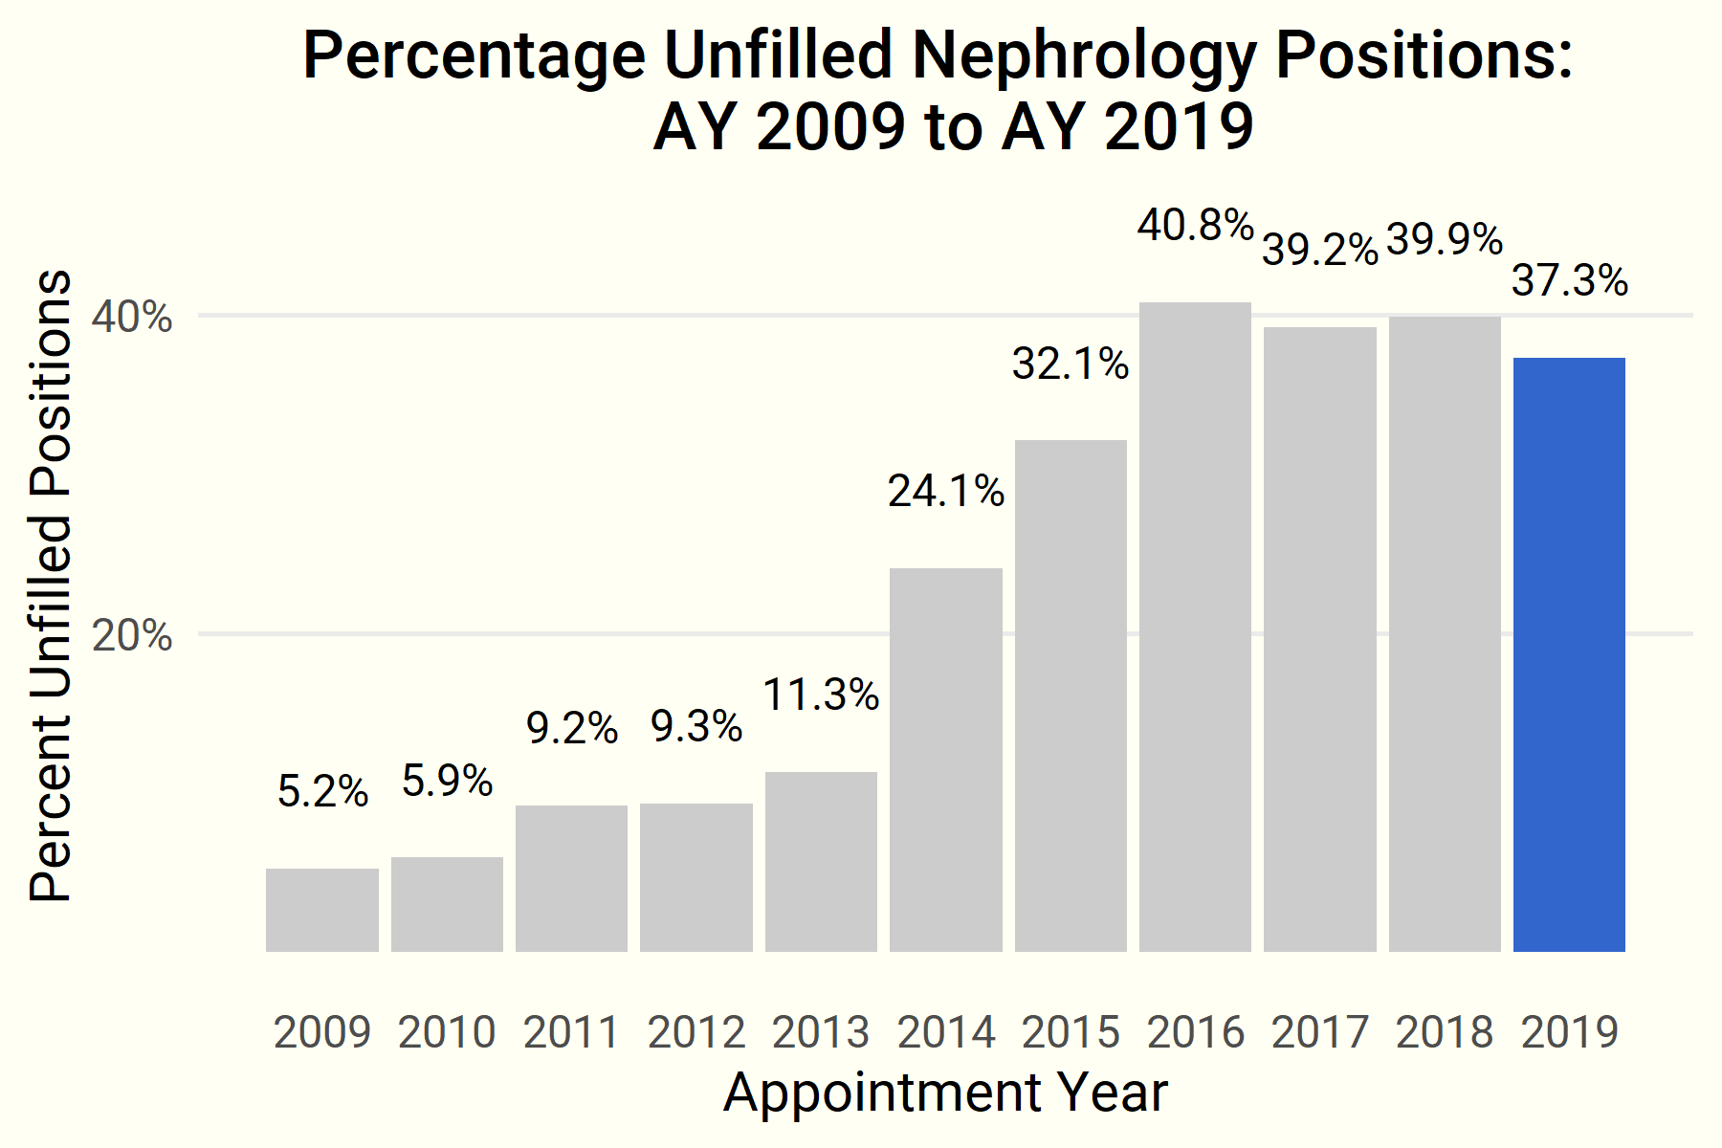
…and unfilled positions edged down in the AY 2019 Match.

Slide 5
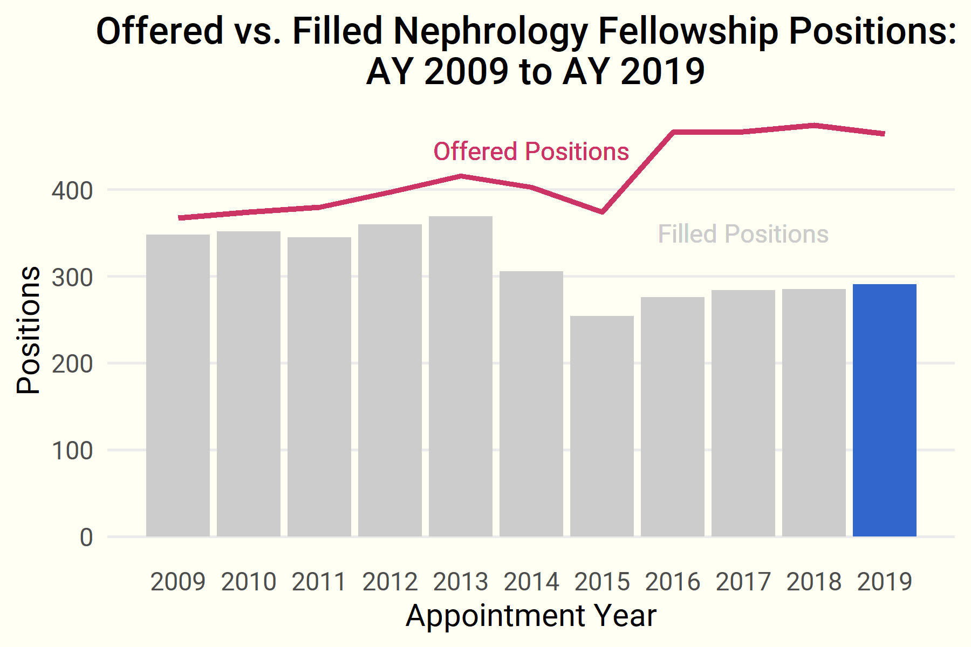
Yet the gap in offered and filled positions…

Slide 6
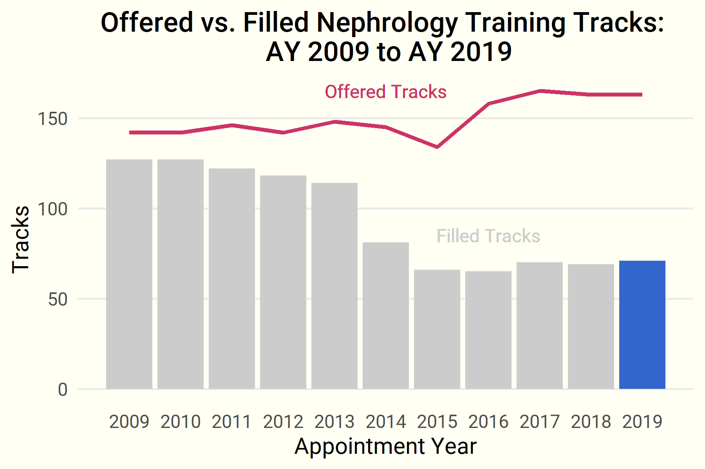
… and training tracks, while narrowing, remains wide.

Slide 7
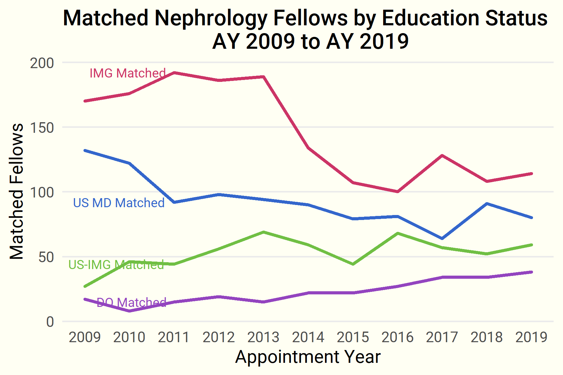
An increasing number of US-IMGs and DOs are entering nephrology…

Slide 8
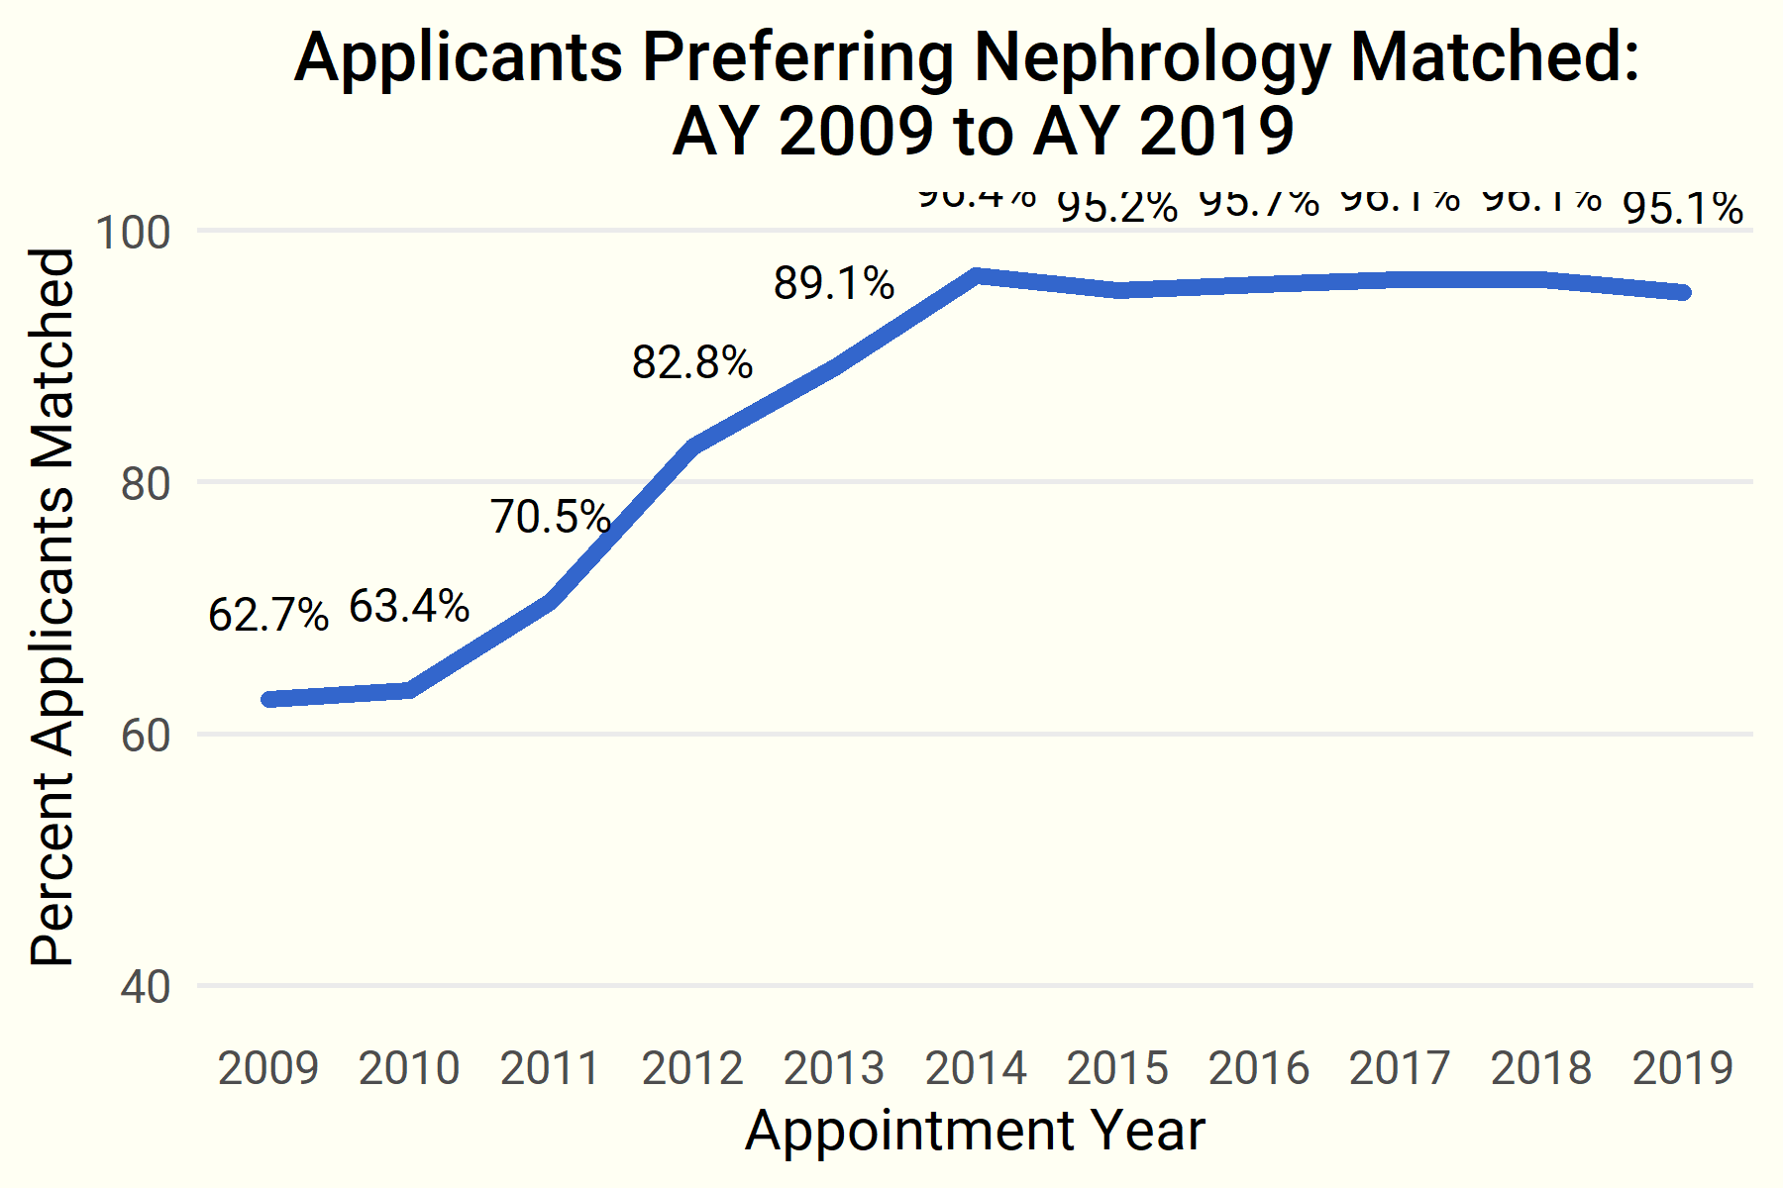
…and nearly all candidates preferring the specialty obtained fellowships.

Slide 9
II. ERAS Application Data: A Look at the Candidates

Slide 10
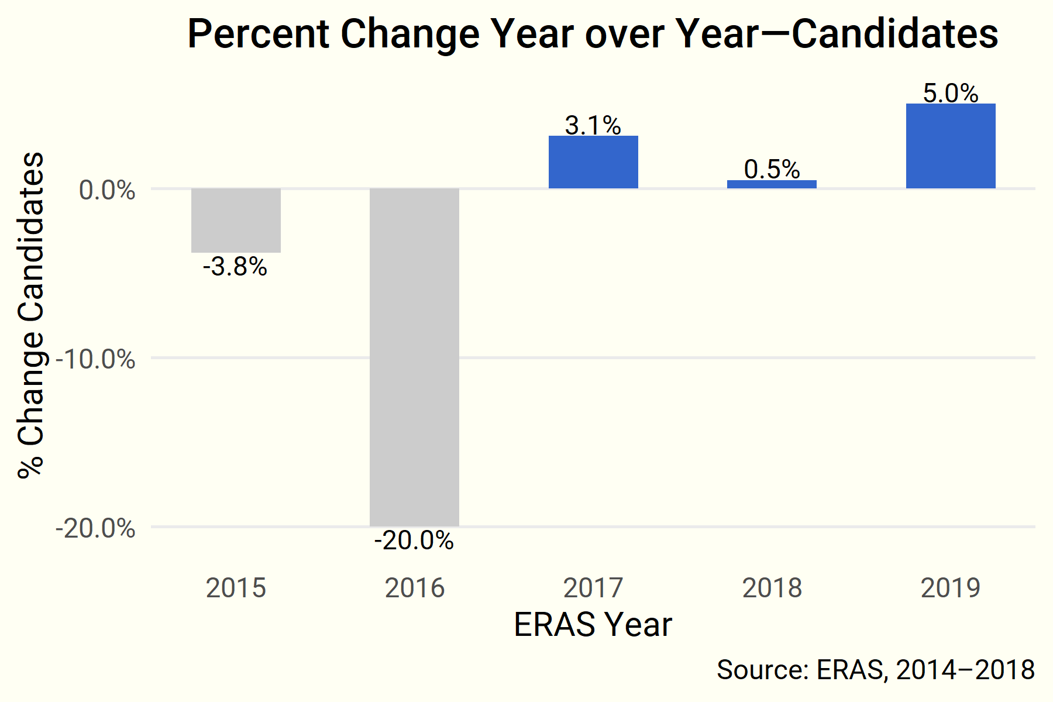
Year over Year—Candidates

Slide 11
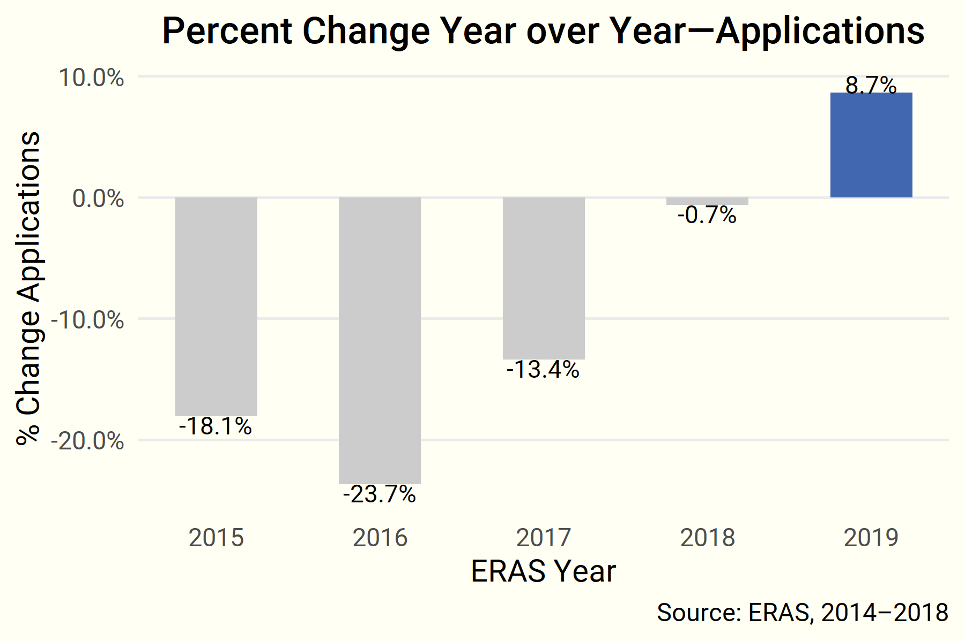
Year over Year—Applications

Slide 12
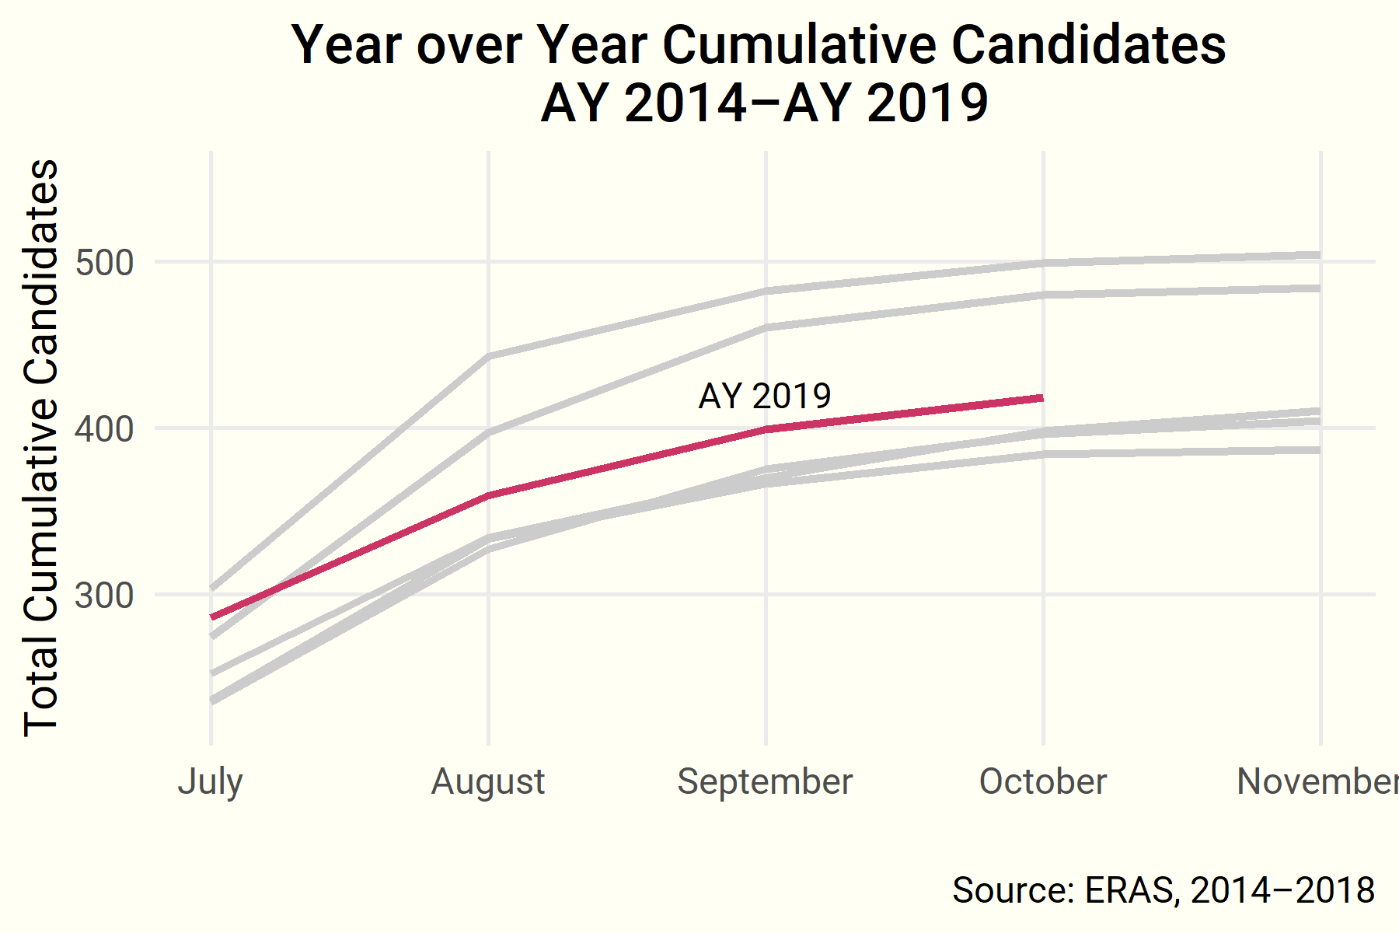
Year over Year—Cumulative Candidates

Slide 13
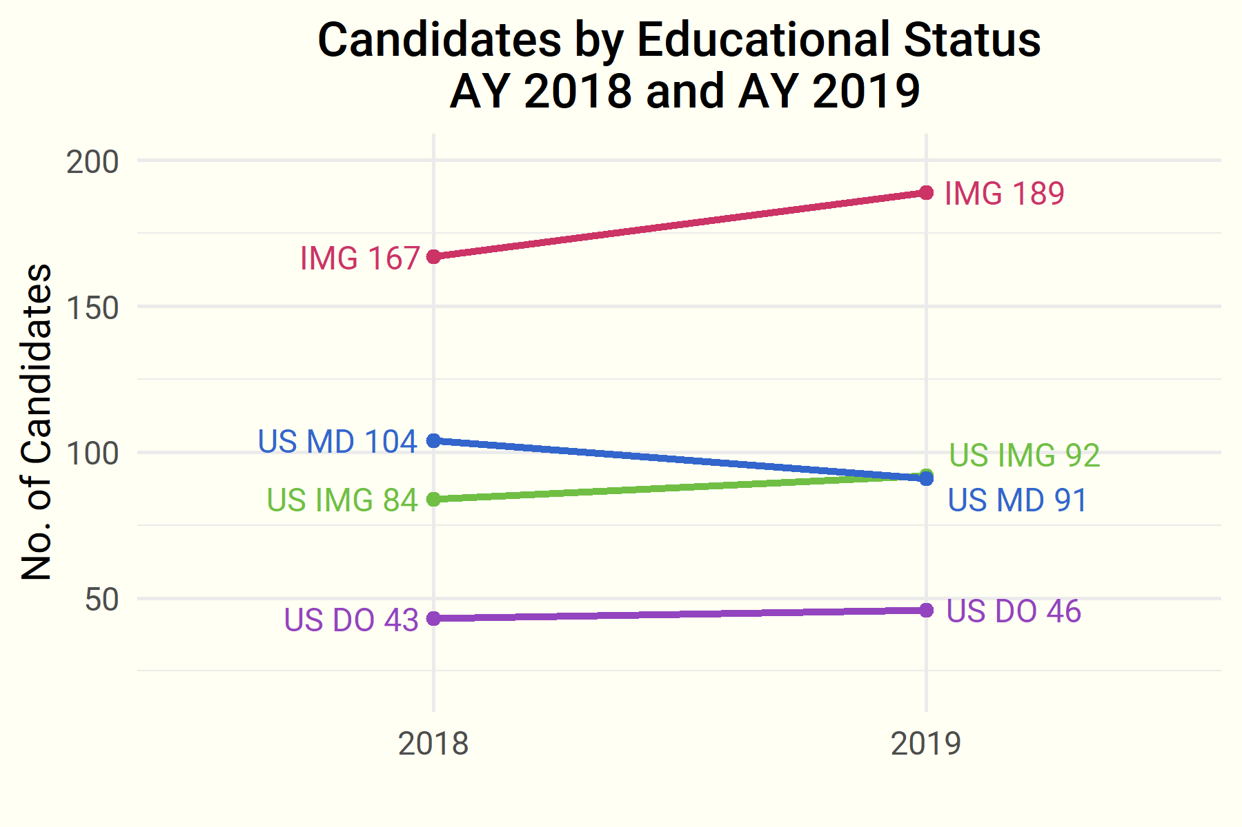
Fellow Educational Status

Slide 14
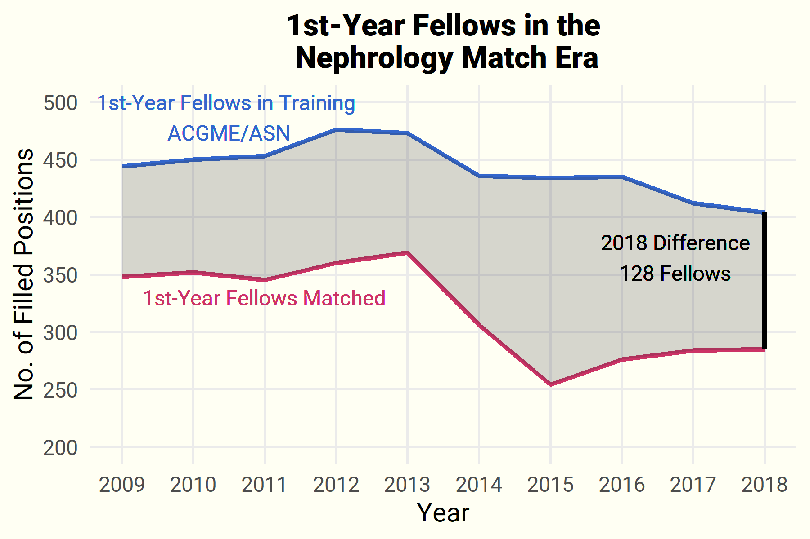
III. The Match in Context

Slide 15
Questions? Comments?
Contact ASN Data Science Officer Kurtis Pivert at 202-699-0238 or kpivert@asn-online.org.

