Slide 1
Early Career Nephrologists: Results of a 2017 Survey
George Washington University Health Workforce Institute

Slide 2
Early Career Nephrologists: Results of a 2017 Survey

Slide 3
Prepared for The American Society of Nephrology
By The George Washington University Health Workforce Institute
Leo Quigley, MPH George Washington University Health Workforce Institute and School of Nursing
Edward Salsberg, MPA, FAAN George Washington University Health Workforce Institute and School of Nursing
Ashté Collins, MD George Washington University School of Medicine
The views and findings in this report reflect the work of the GW Health Workforce Institute (GW-HWI) and do not necessarily reflect the views of ASN or GW University. The GW-HWI and ASN welcome comments and feedback on this report.

Slide 4
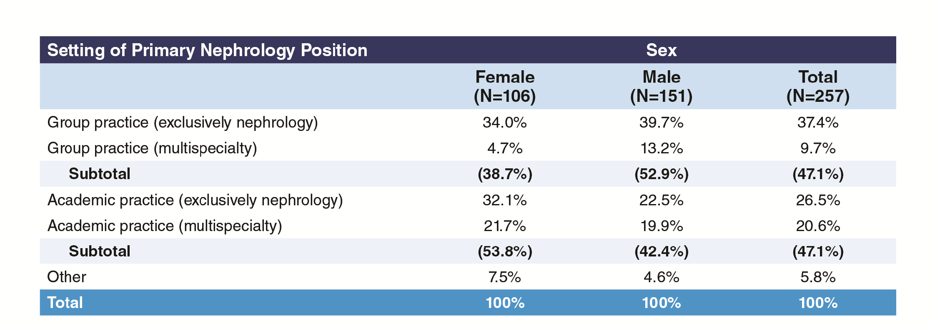
Exhibit A1: Setting of Primary Nephrology Job by Gender

Slide 5
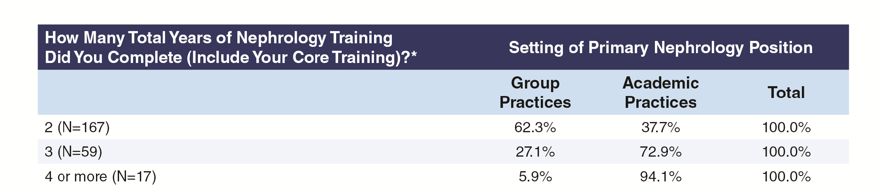
Exhibit A2: Setting of Primary Nephrology Job by Total Years Training Completed, Academic and Group Practice Only

Slide 6
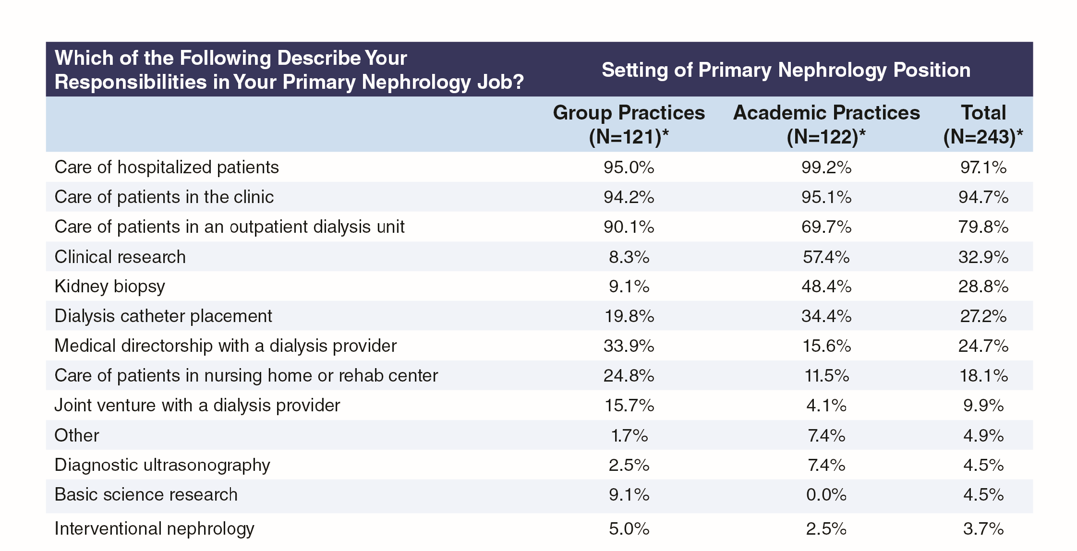
Exhibit A3: Responsibilities in Primary Nephrology Job by Group or Academic Practice Setting

Slide 7
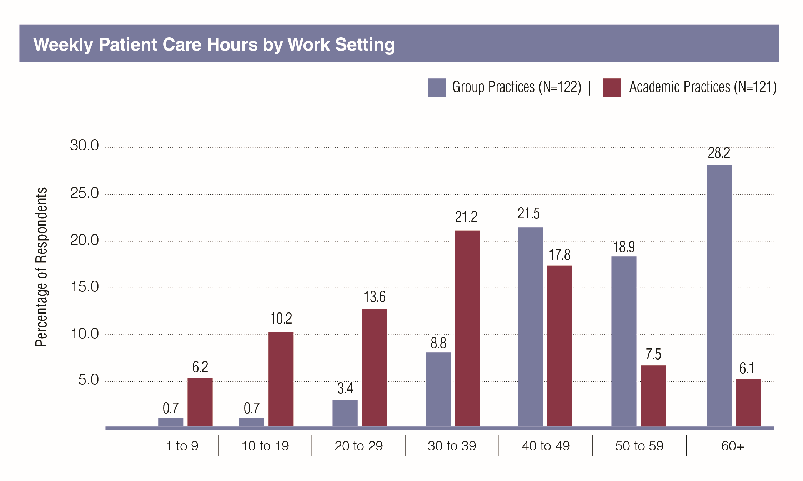
Exhibit A4: Time Spent in Patient Care by Group or Academic Practice Setting

Slide 8
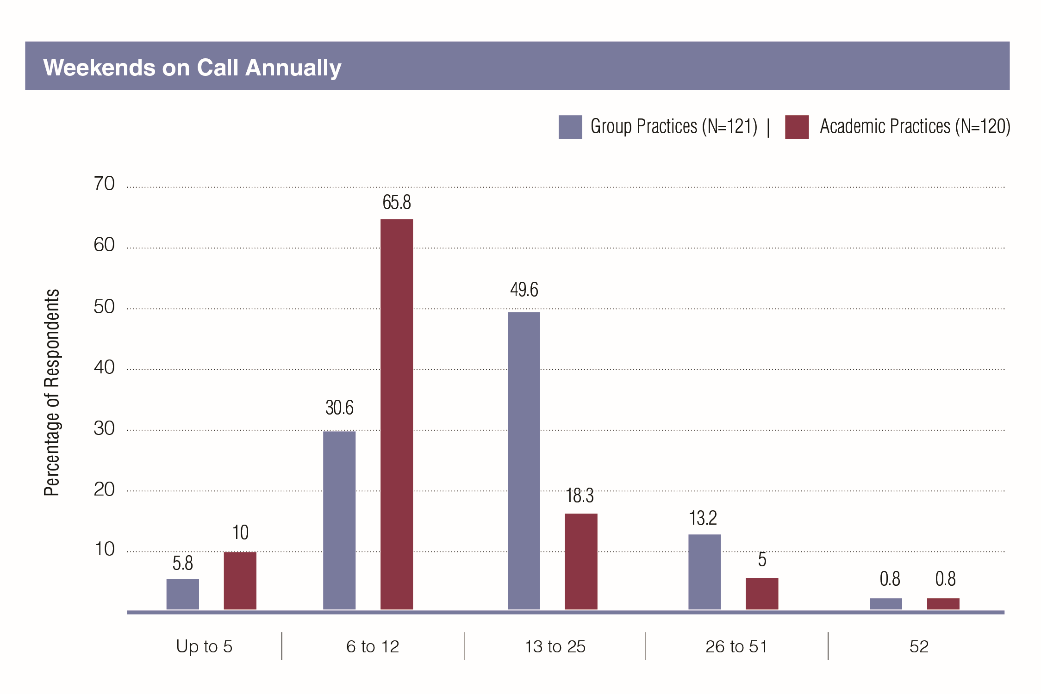
Exhibit A5: Number of Weekends on Call Annually by Group or Academic Practice Setting

Slide 9
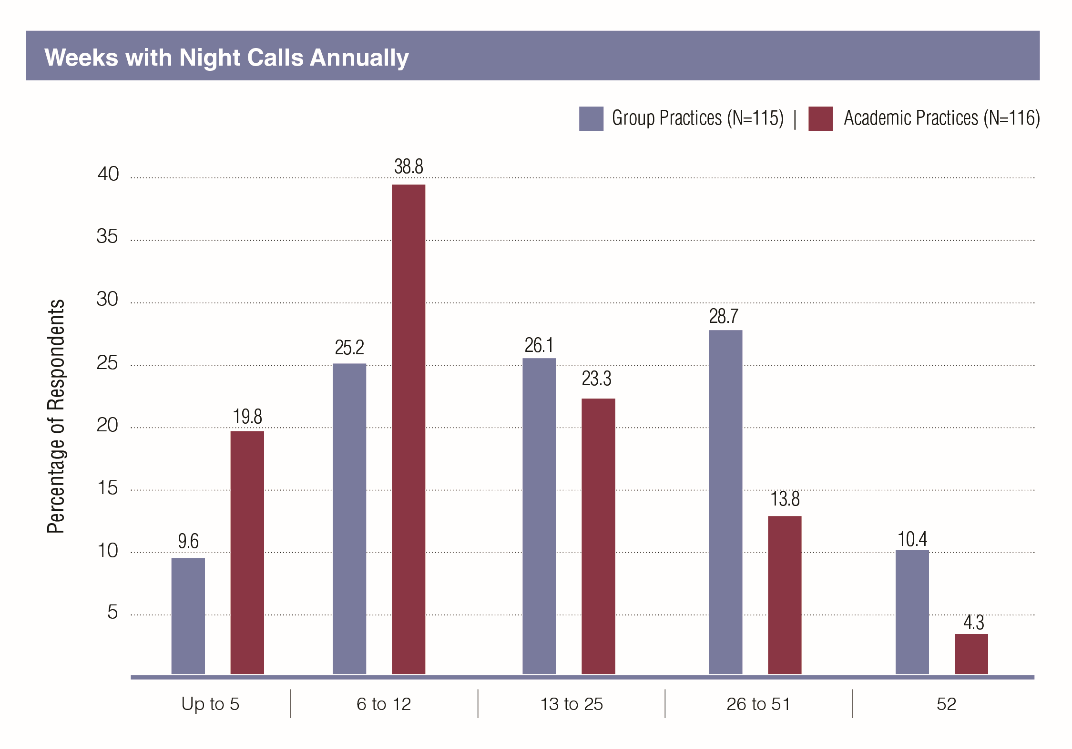
Exhibit A6: Number of Weeks with Night Calls Annually by Group or Academic Practice Setting

Slide 10
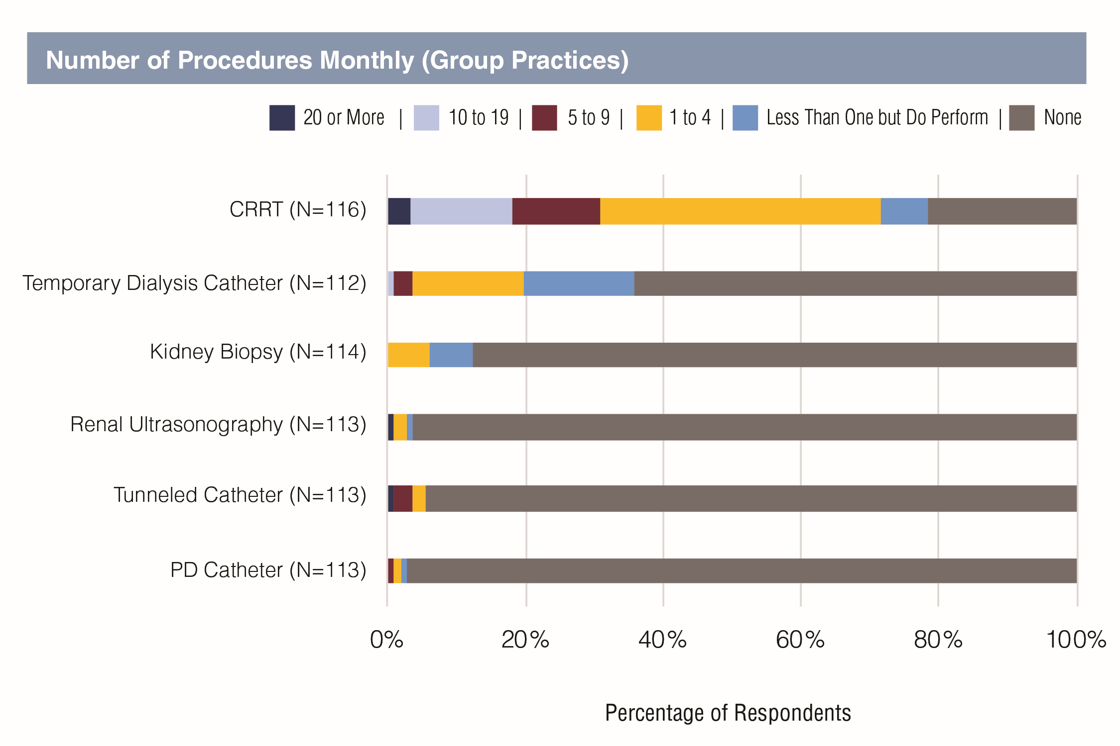
Exhibit A7: Frequency Common Procedures Were Performed by Group or Academic Practice Setting

Slide 11
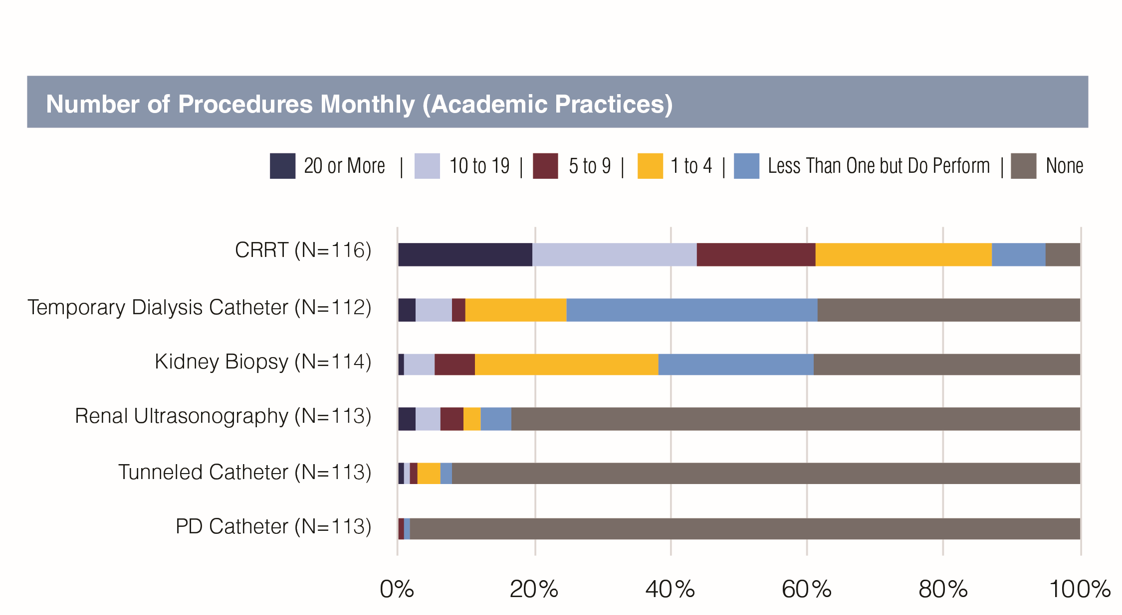

Slide 12
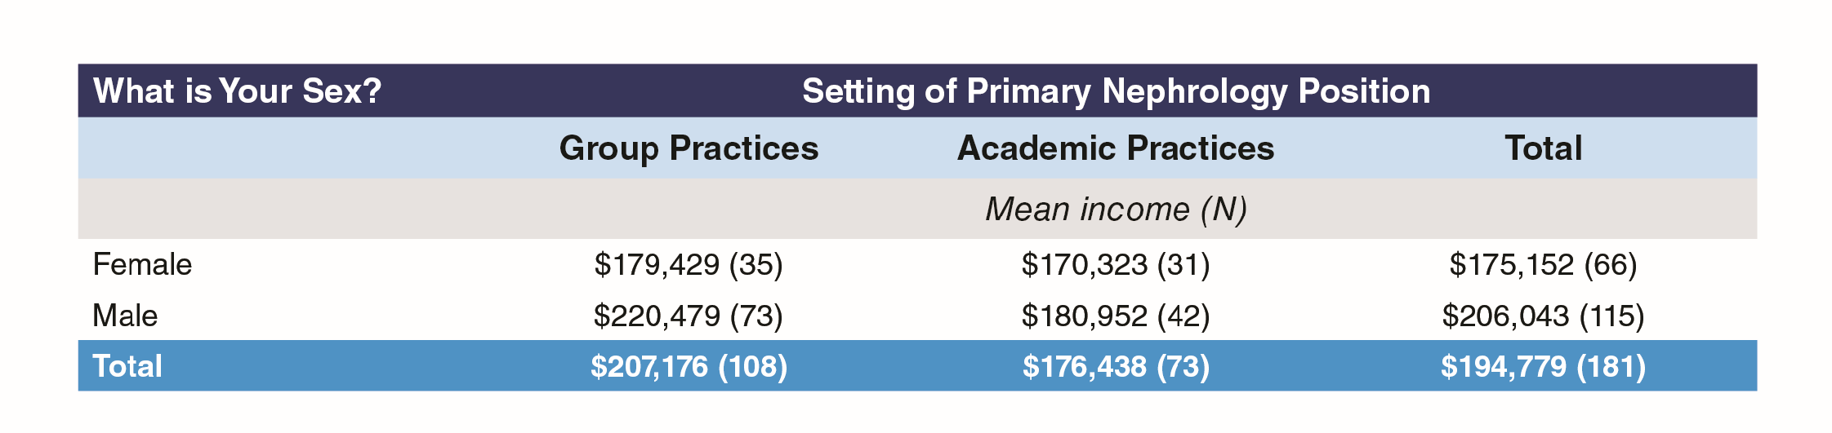

Slide 13
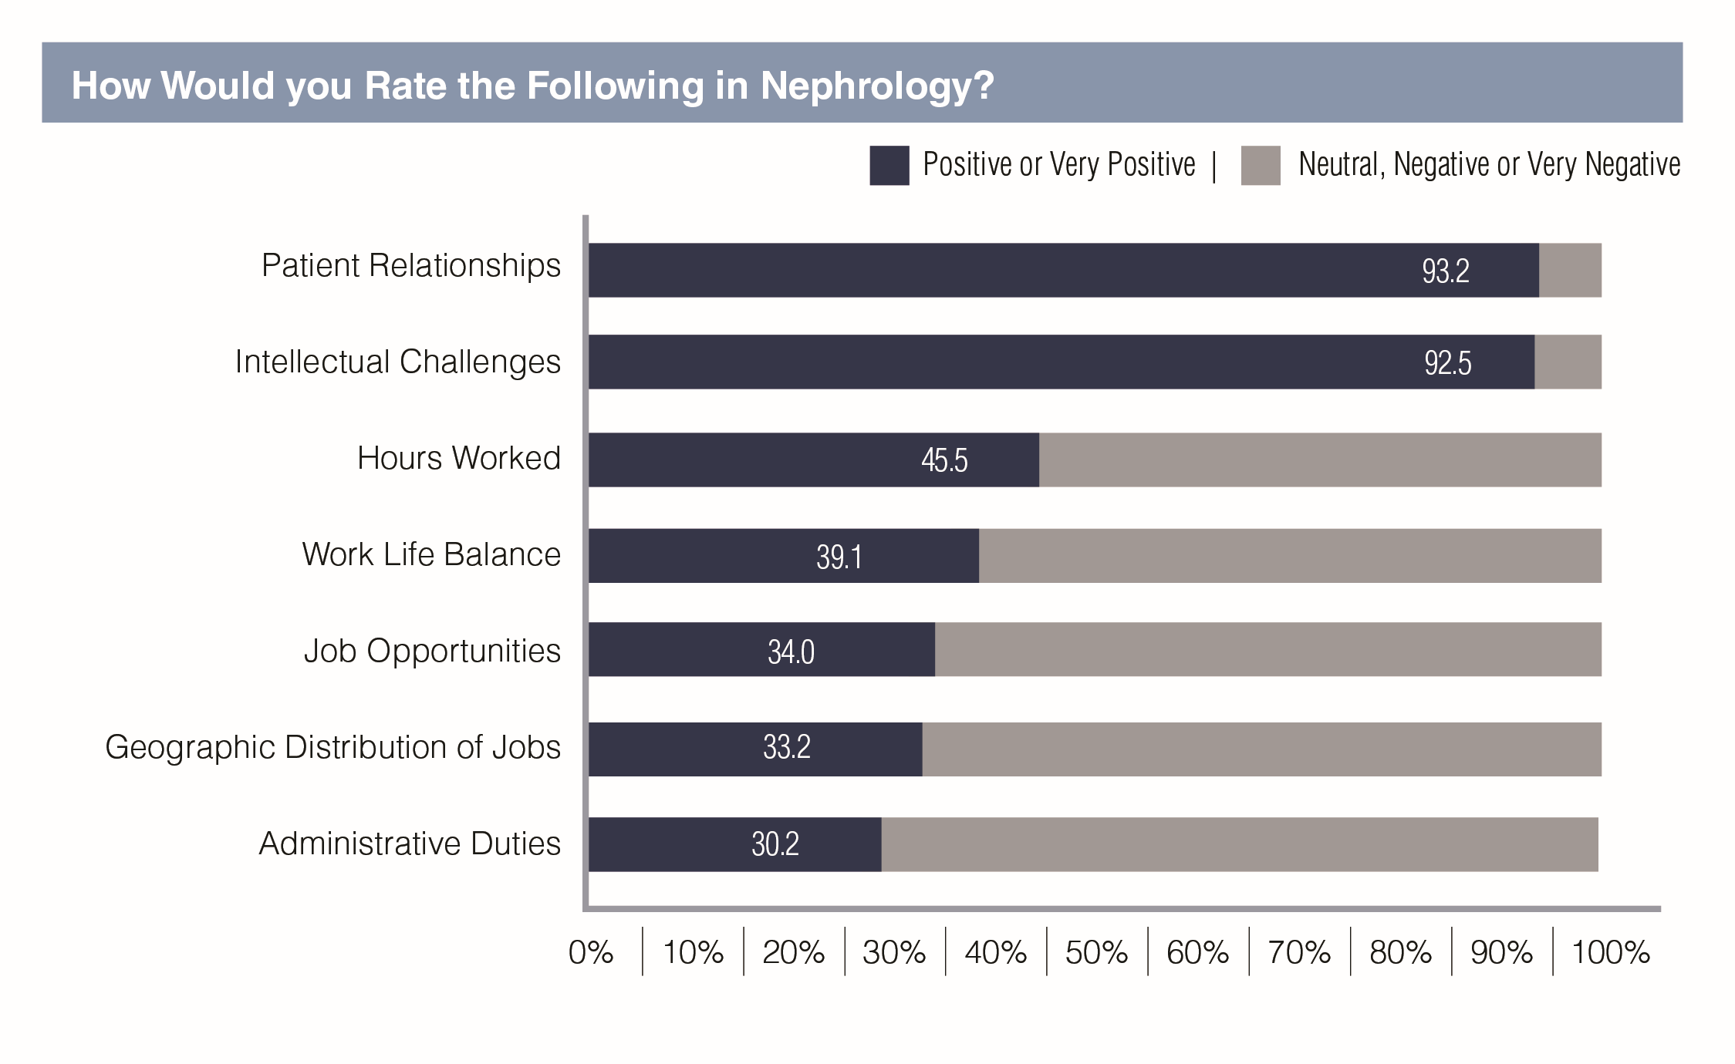
Exhibit A9: Ratings of Aspects of Nephrology

Slide 14
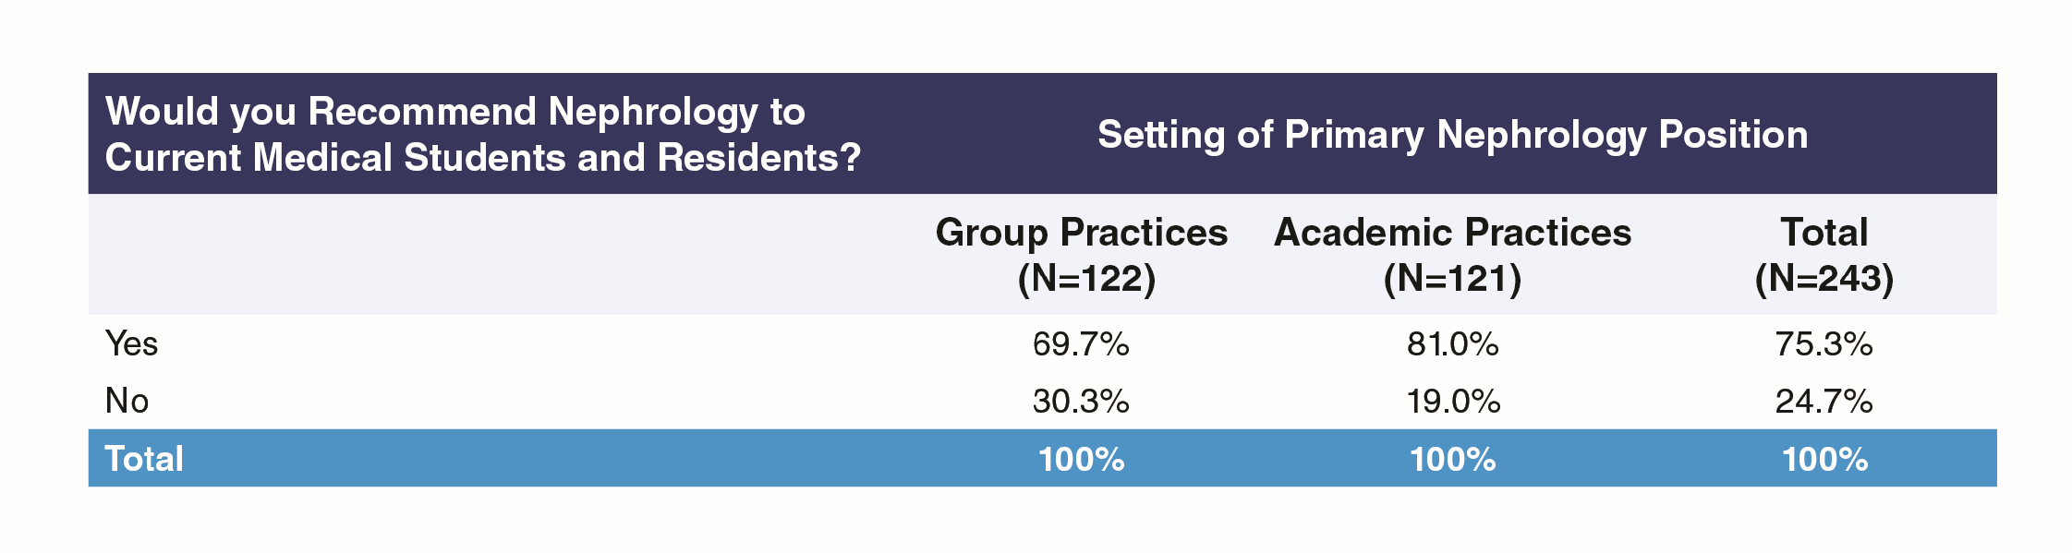
Exhibit A10: Would Recommend Nephrology to Medical Students and Residents, by Group or Academic Practice Setting

Slide 15
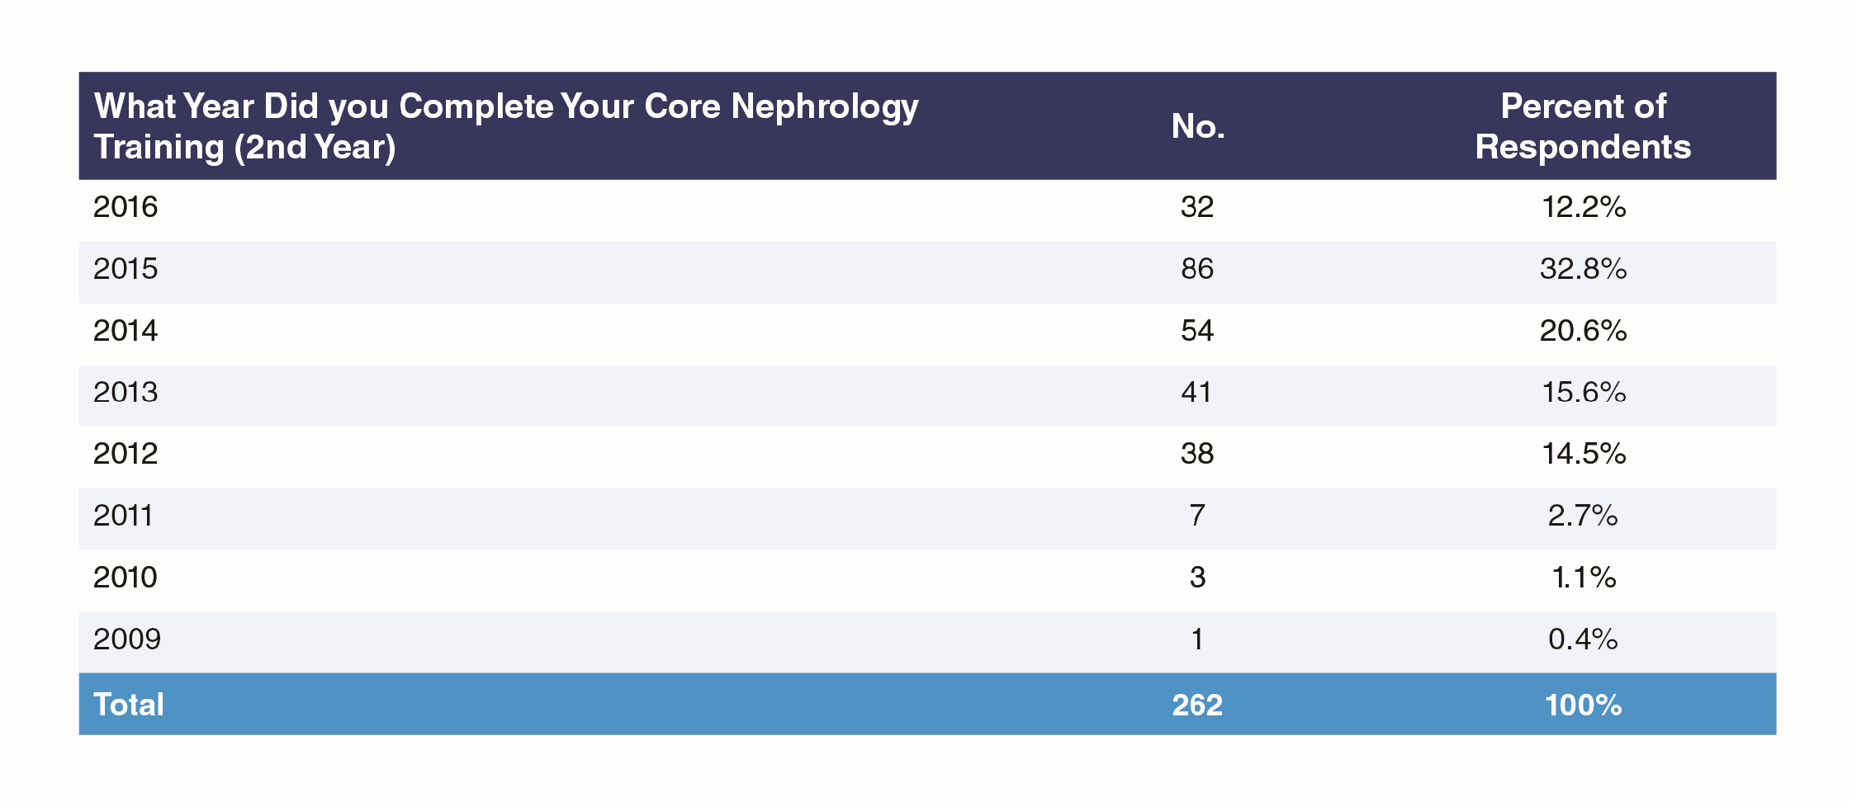
Exhibit 1: Year of Completing Core Nephrology Training

Slide 16
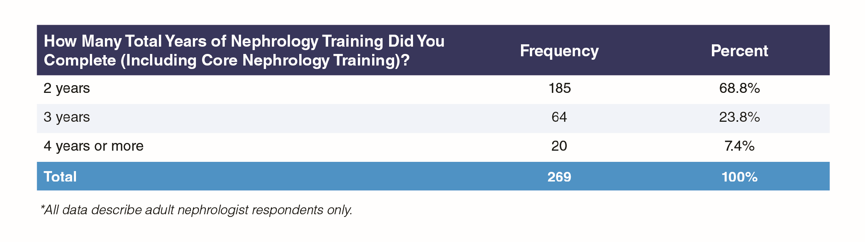
Exhibit 2: Responding by Total Years of Nephrology Training

Slide 17
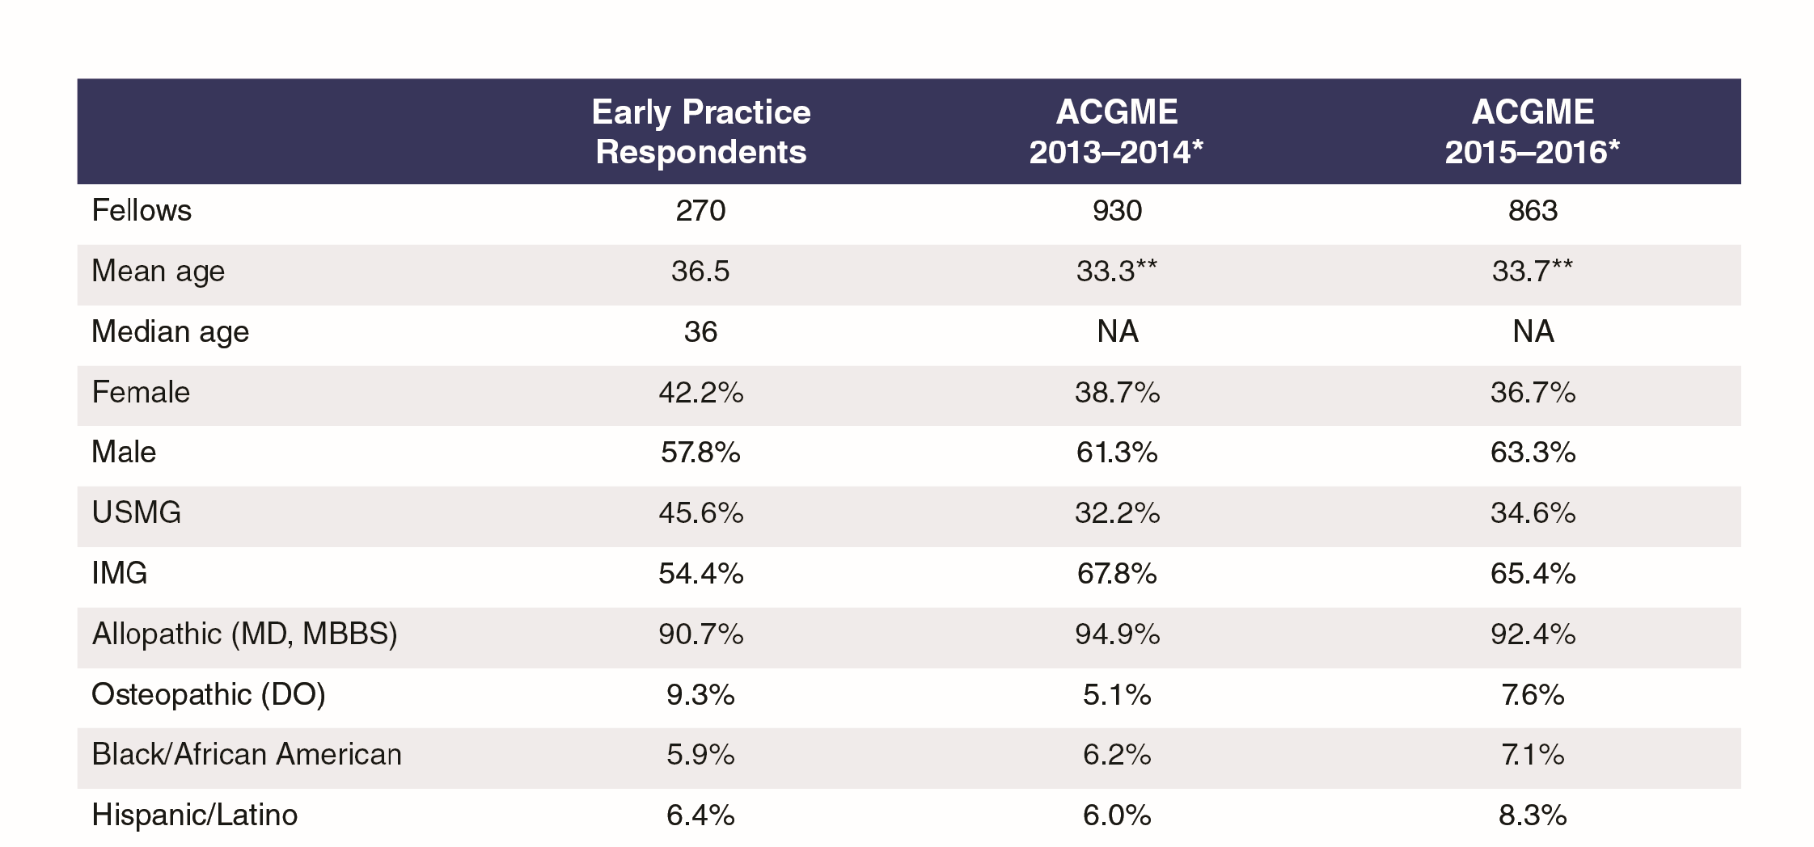
Exhibit 3: Profile of Respondents

Slide 18
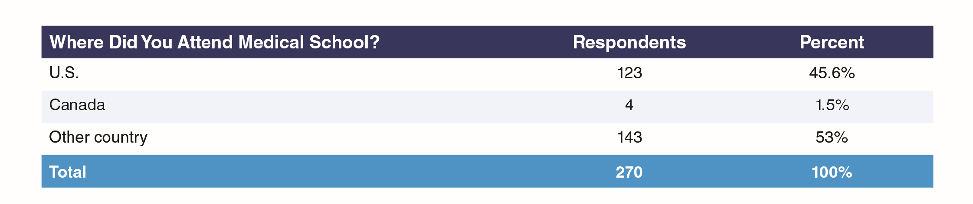
Exhibit 4: Medical School Location

Slide 19
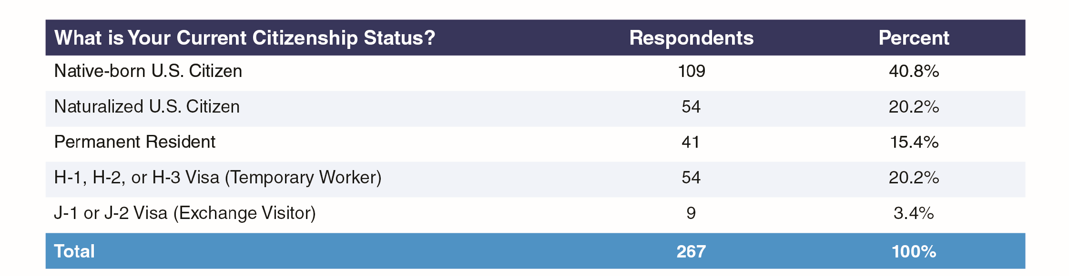
Exhibit 5: Citizenship Status

Slide 20
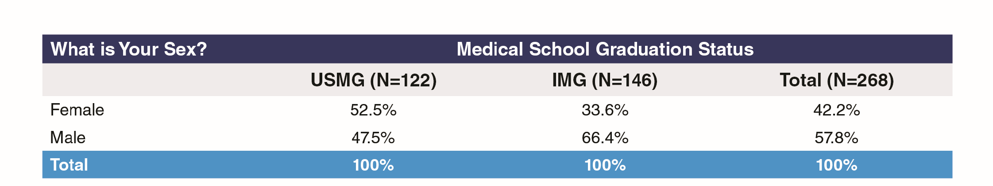
Exhibit 6: Sex of Respondents by IMG Status

Slide 21
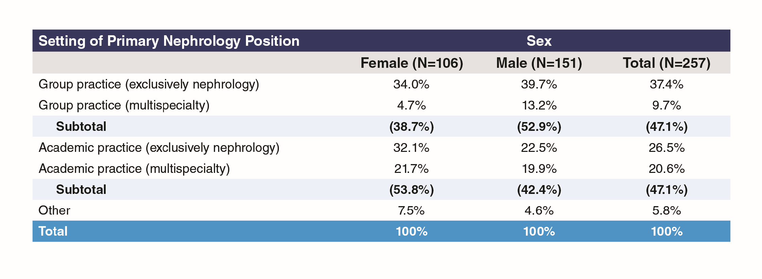
Exhibit 7: Setting of Primary Nephrology Job by Sex

Slide 22
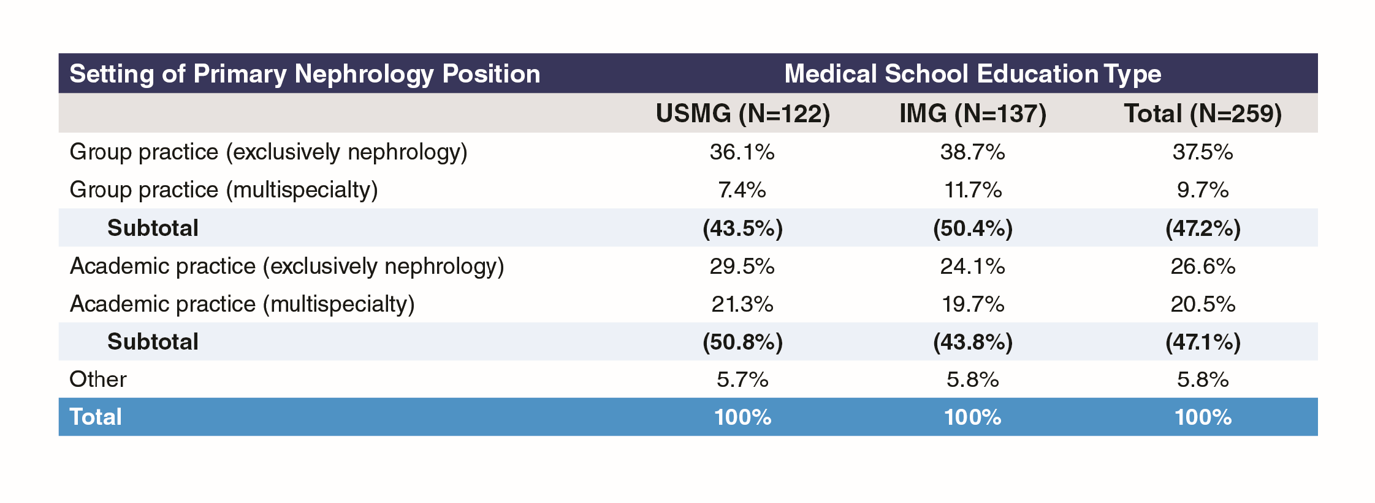
Exhibit 8: Setting of Primary Nephrology Job by Medical School Type

Slide 23
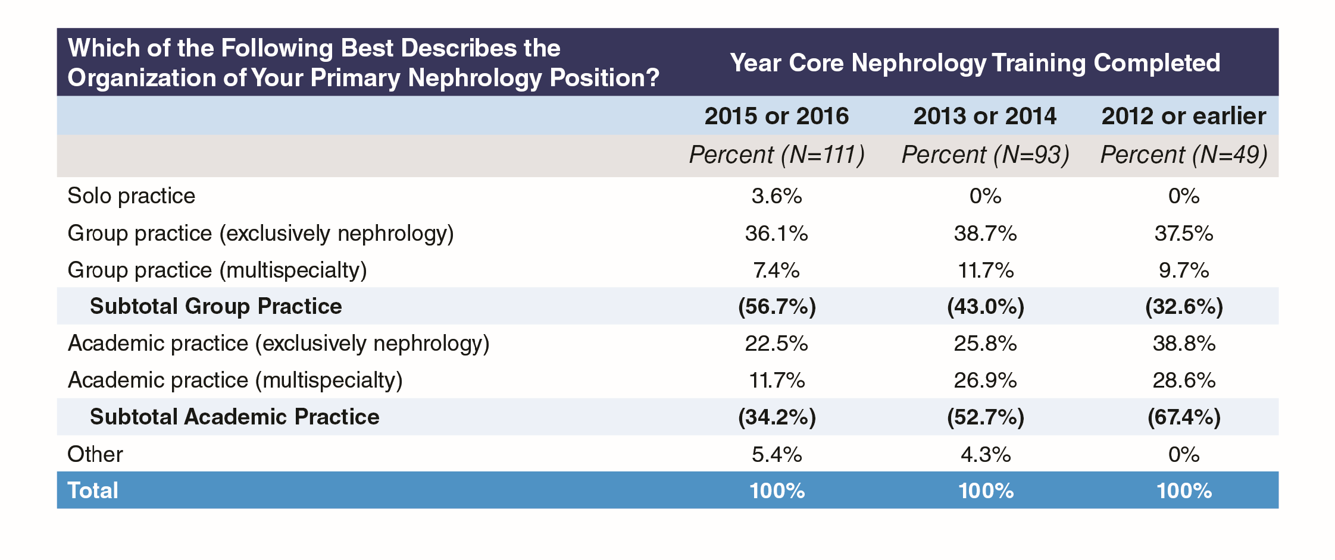
Exhibit 9: Setting of Primary Nephrology Job by Year Core Training Completed

Slide 24
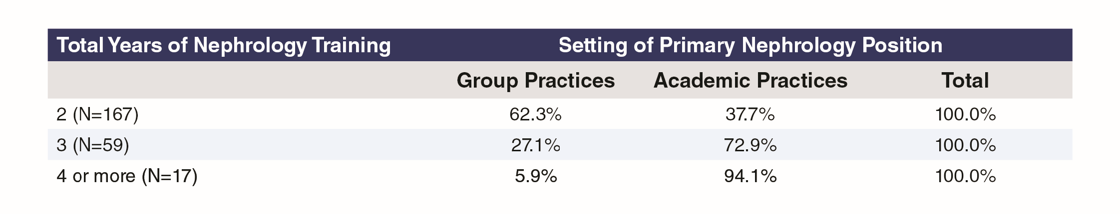
Exhibit 10: Setting of Primary Nephrology Job by Total Years Training Completed, Academic and Group Practices Only

Slide 25
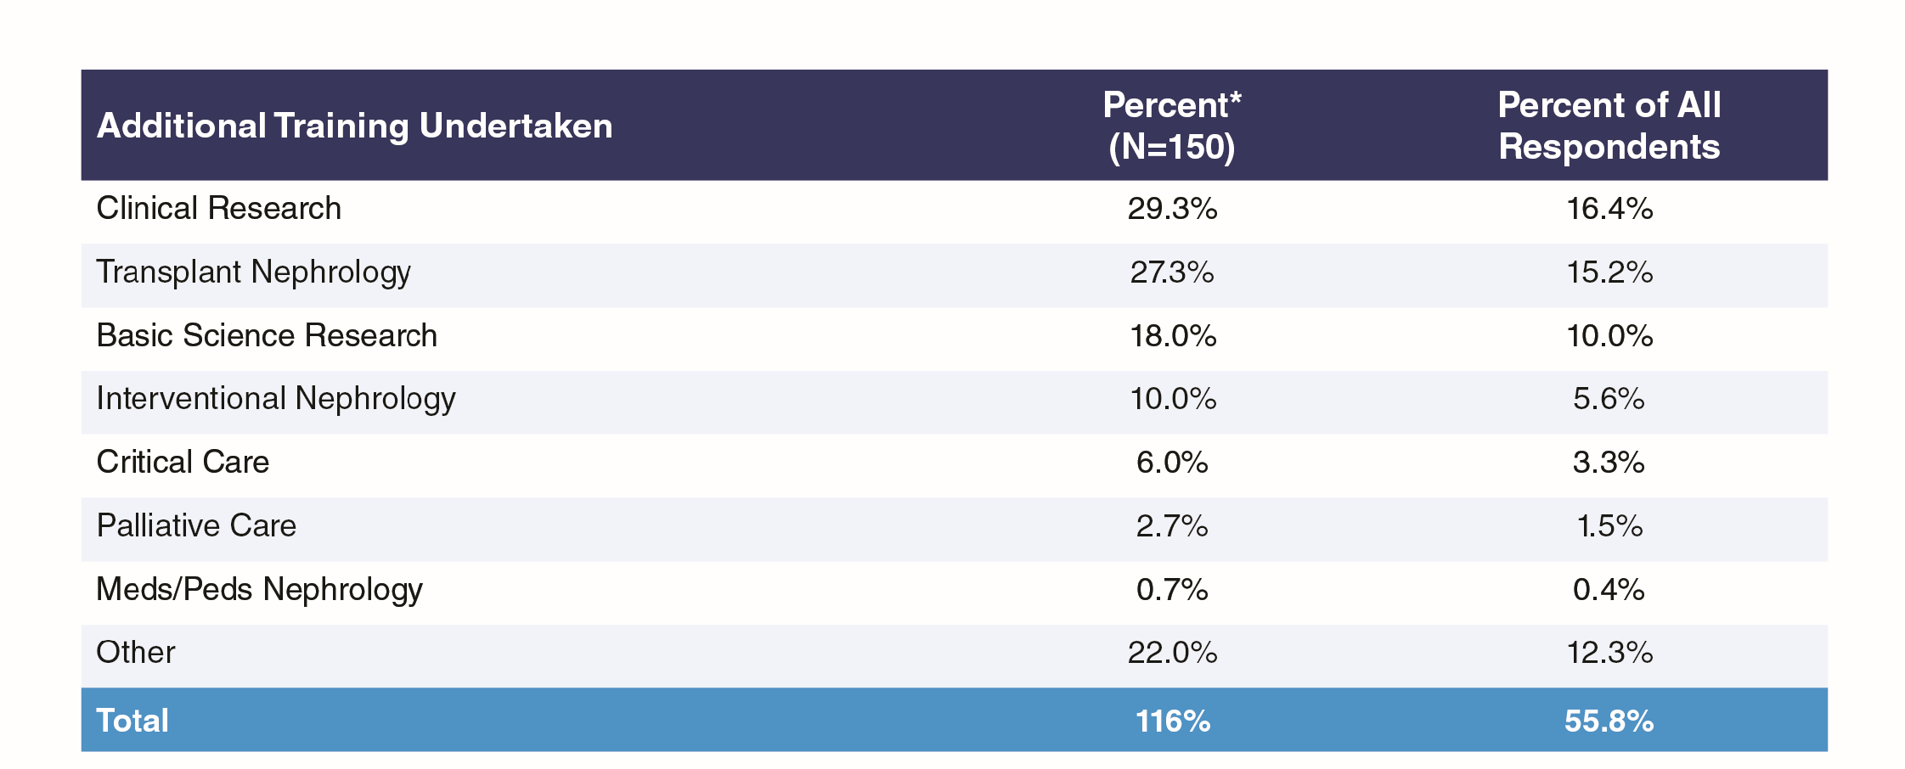
Exhibit 11: Additional Training After Completion of Core Nephrology Training

Slide 26
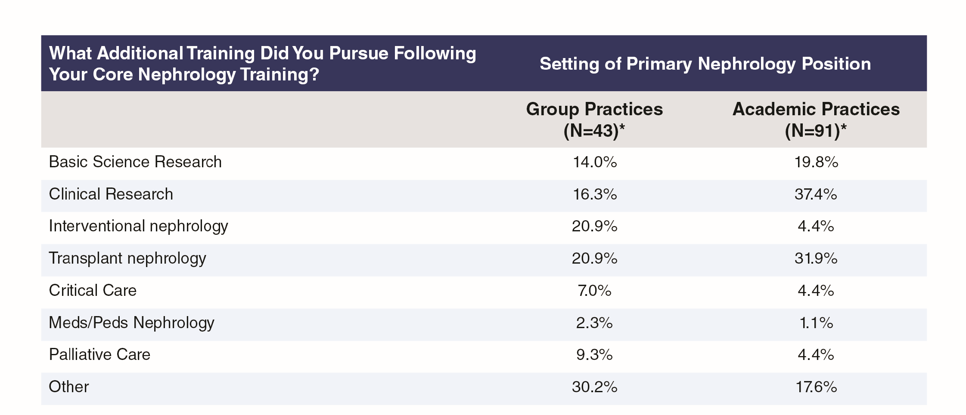
Exhibit 12: Additional Training After Completion of Core Nephrology Training, by Group or Academic Practice Setting

Slide 27
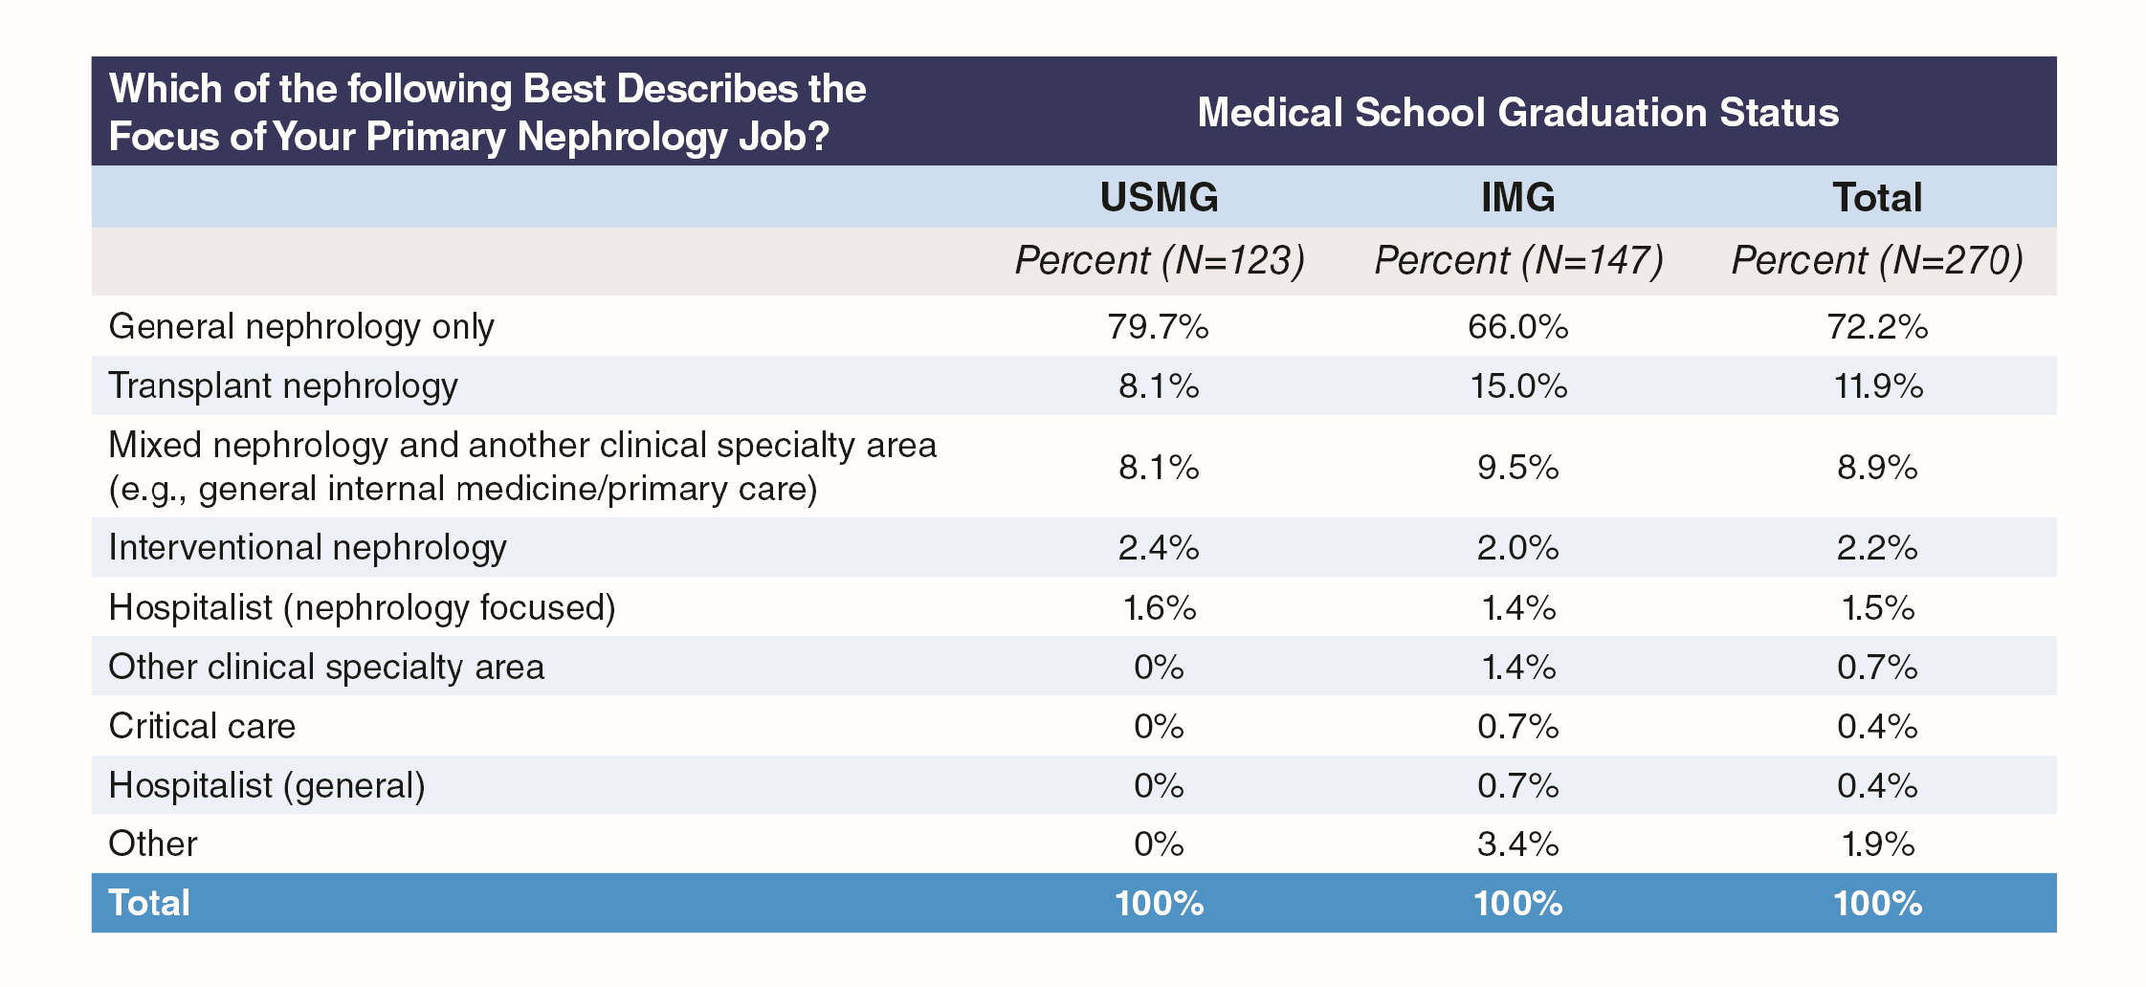
Exhibit 13: Focus of Primary Nephrology Job

Slide 28
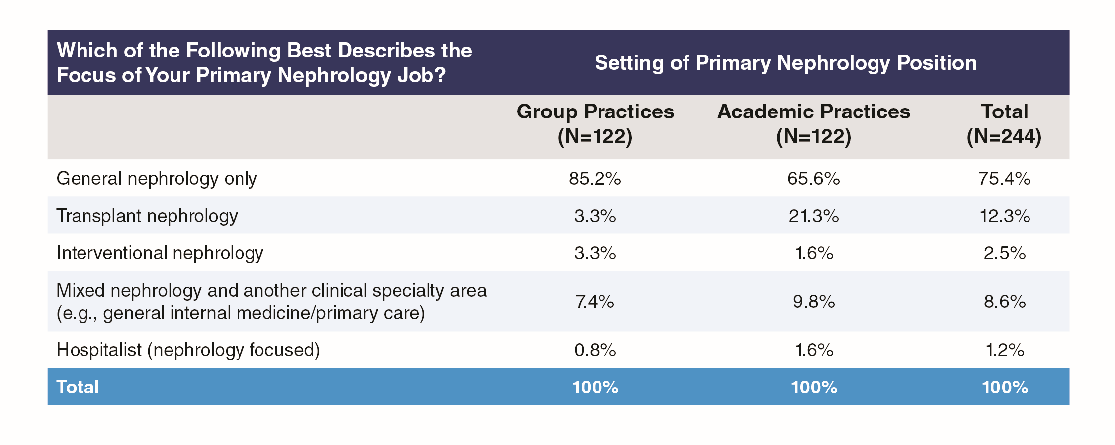
Exhibit 14: Focus of Primary Nephrology Job by Group or Academic Practice Setting

Slide 29
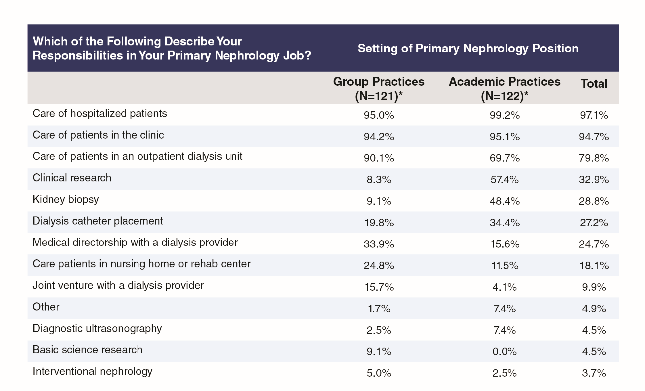
Exhibit 15: Responsibilities in Primary Nephrology Job by Group or Academic Practice Setting

Slide 30
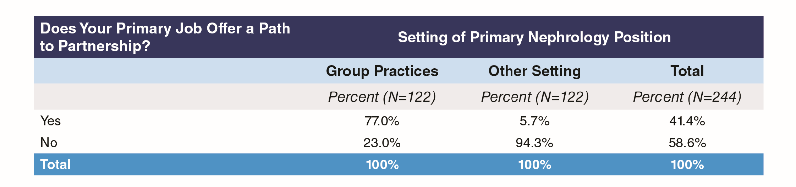
Exhibit 16: Partnership Opportunities

Slide 31
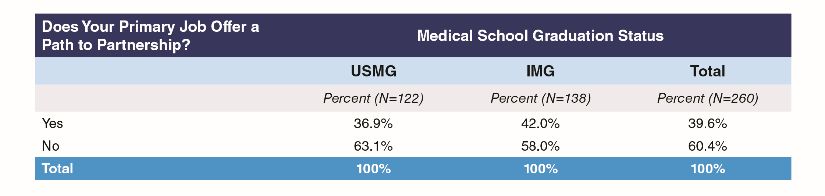
Exhibit 17: Primary Job Path to Partnership by Medical School Graduation Status

Slide 32
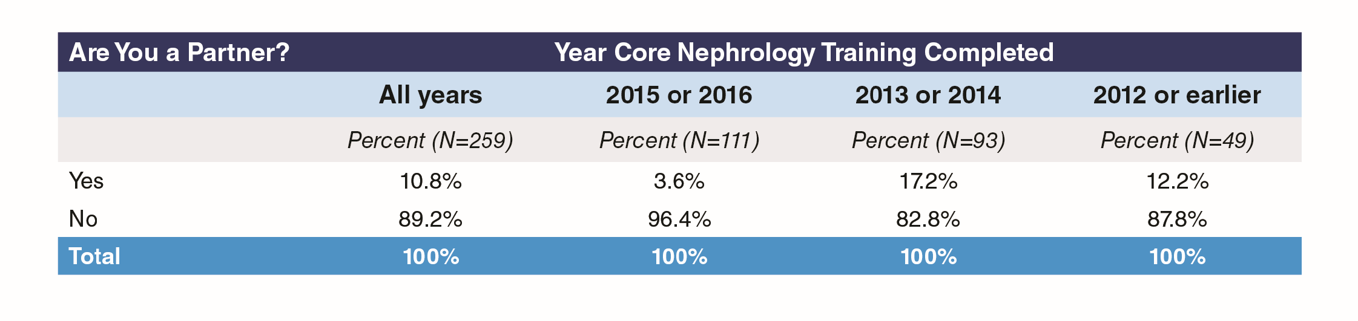
Exhibit 18: Whether or Not Partner

Slide 33
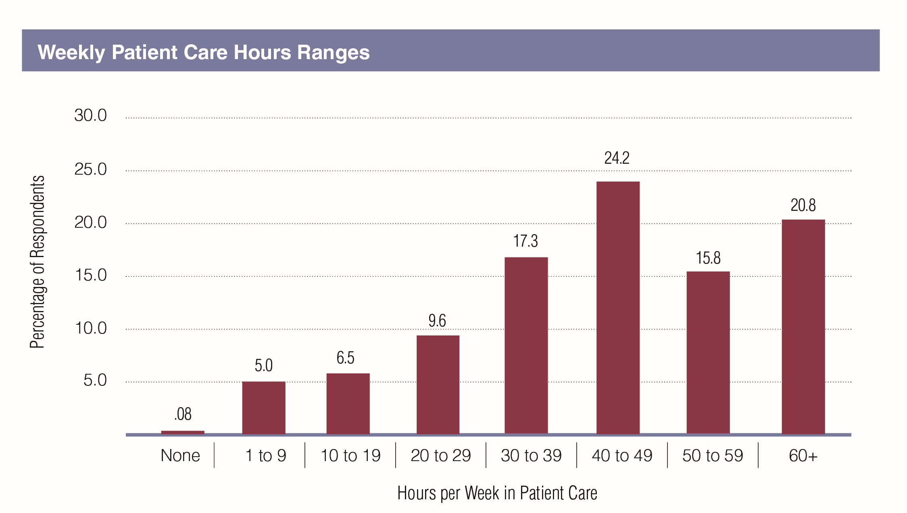
Exhibit 19: Time Spent in Patient Care

Slide 34
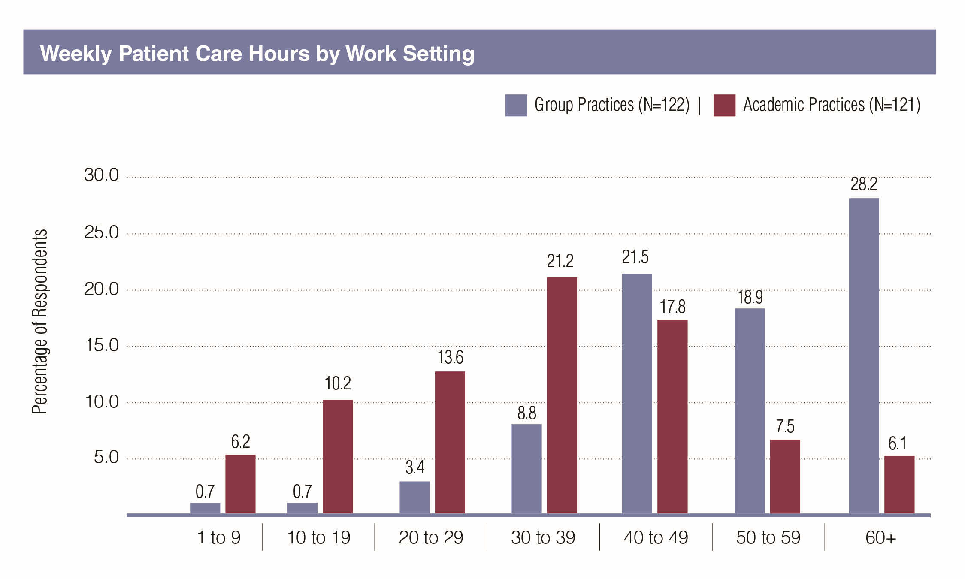
Exhibit 20: Time Spent in Patient Care by Group or Academic Practice Setting

Slide 35
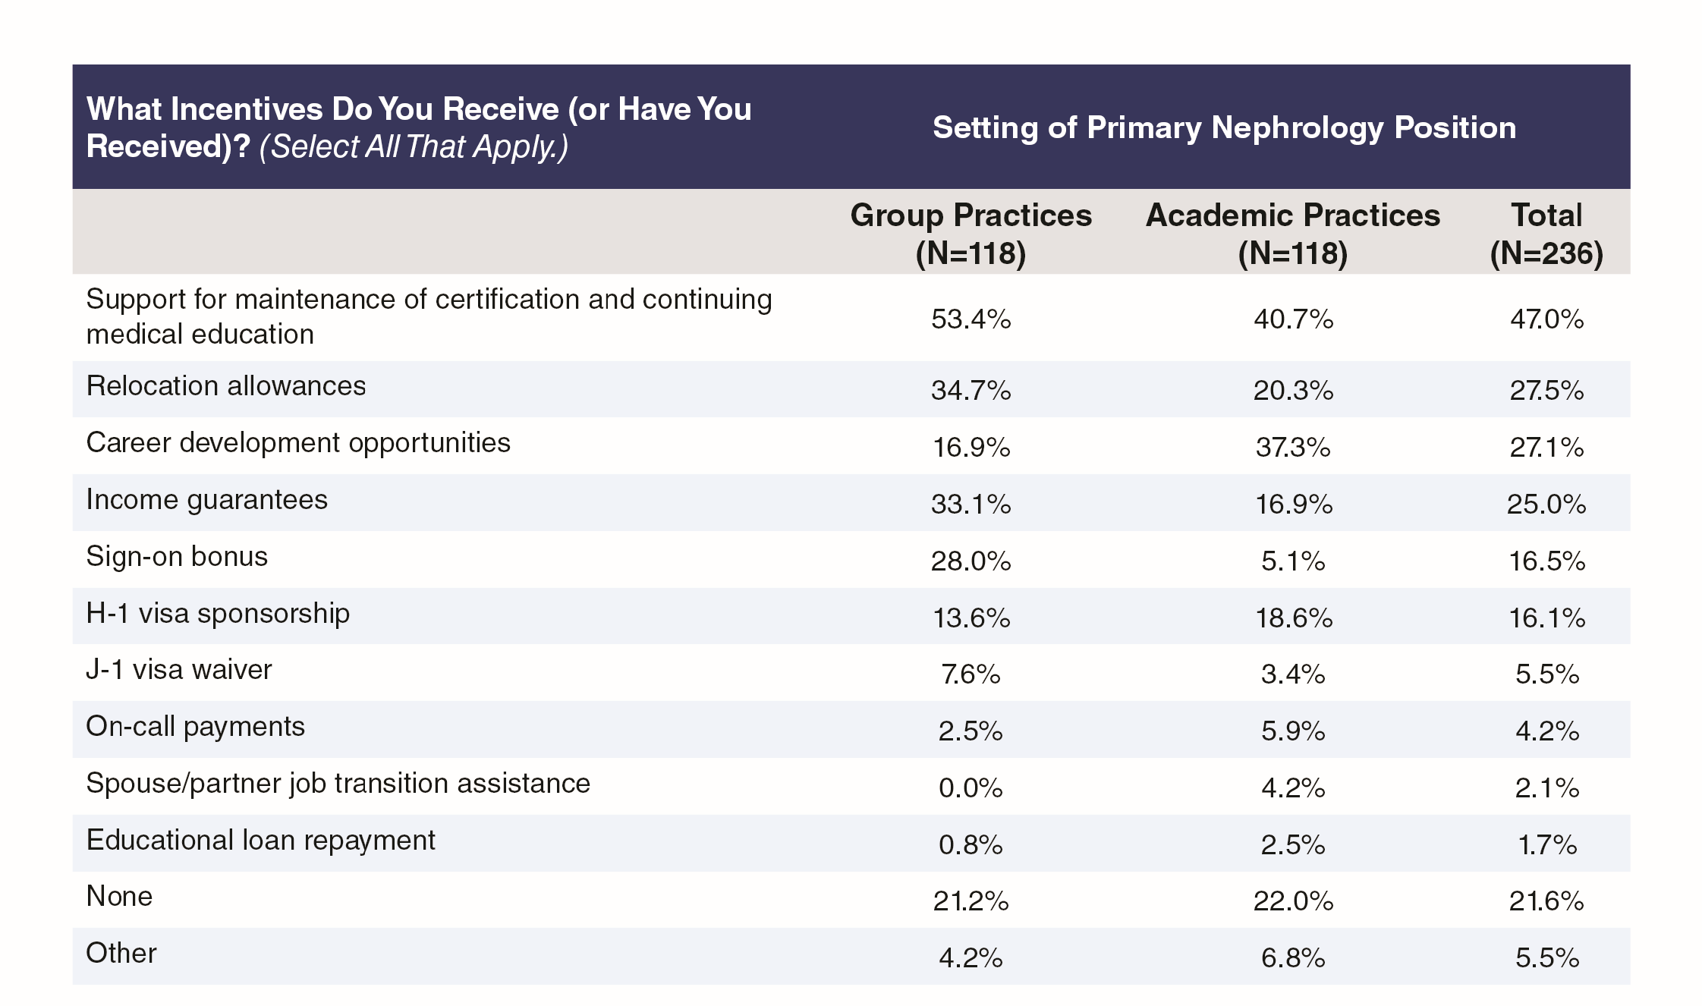
Exhibit 21: Incentives Received, by Group or Academic Practice Setting

Slide 36
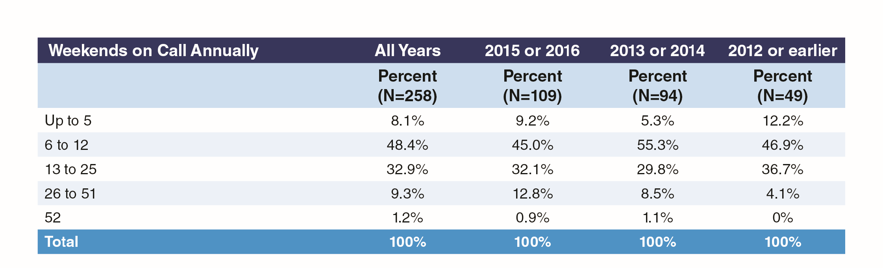
Exhibit 22: Number of Weekends on Call Annually

Slide 37
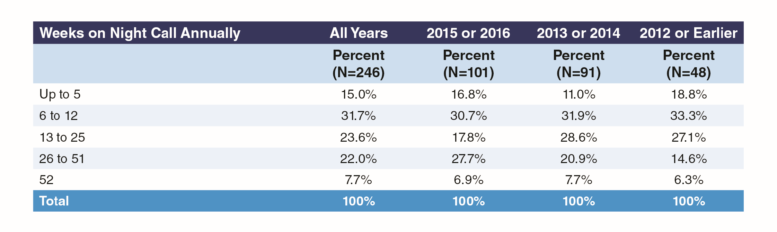
Exhibit 23: Number of Weeks with Night Calls Annually, by Year of Completing Training

Slide 38
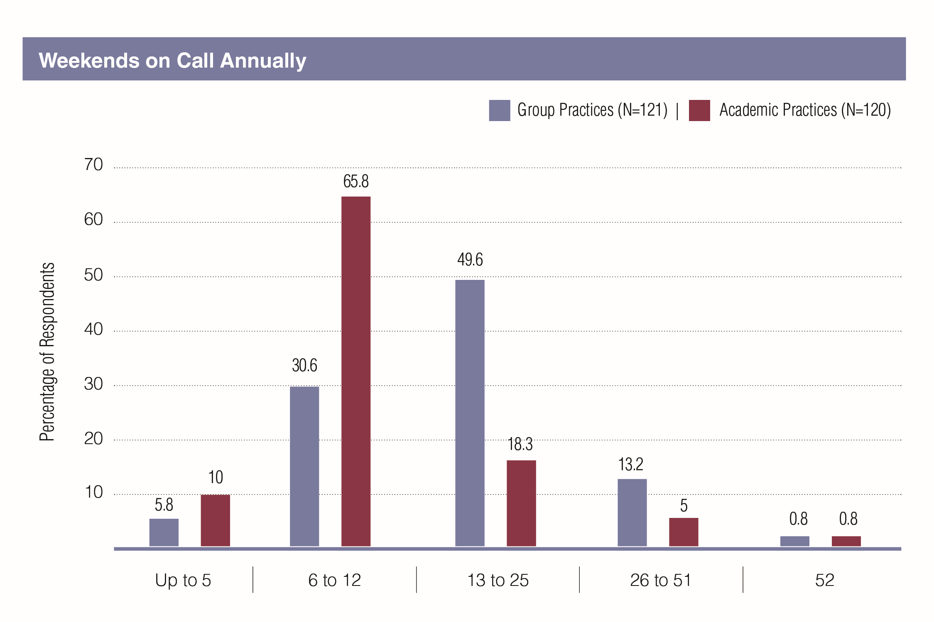
Exhibit 24: Number of Weekends on Call Annually by Group or Academic Practice Setting

Slide 39
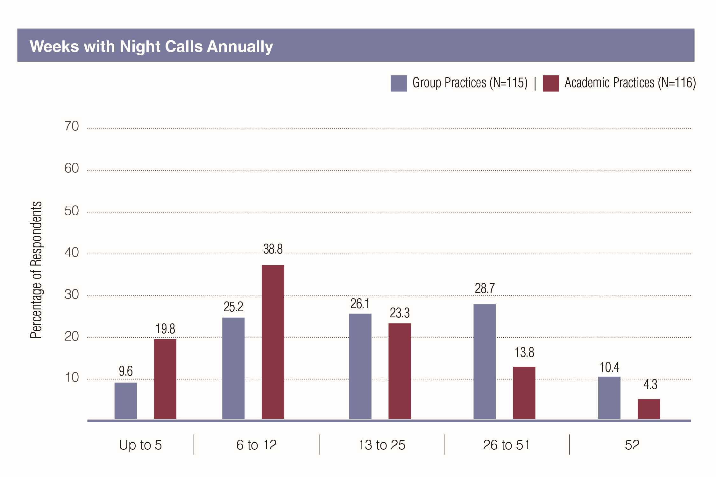
Exhibit 25: Number of Weeks with Night Calls Annually by Group or Academic Practice Setting

Slide 40
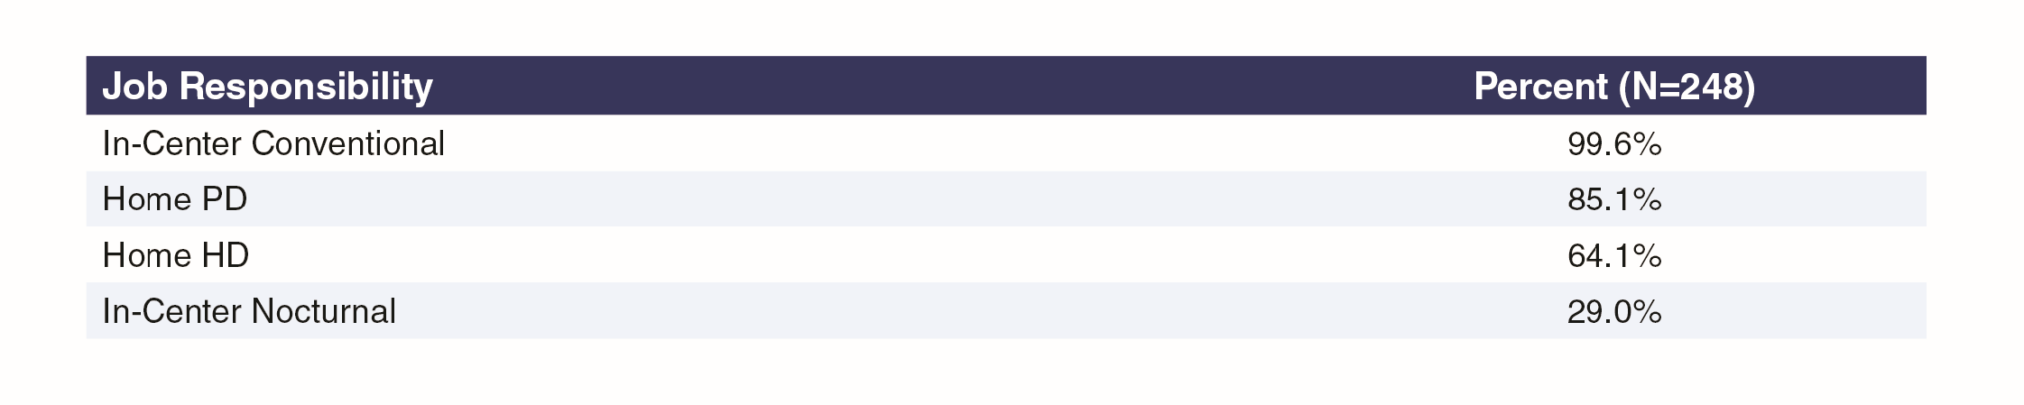
Exhibit 26: Dialysis Modalities Offered in Primary Nephrology Job

Slide 41
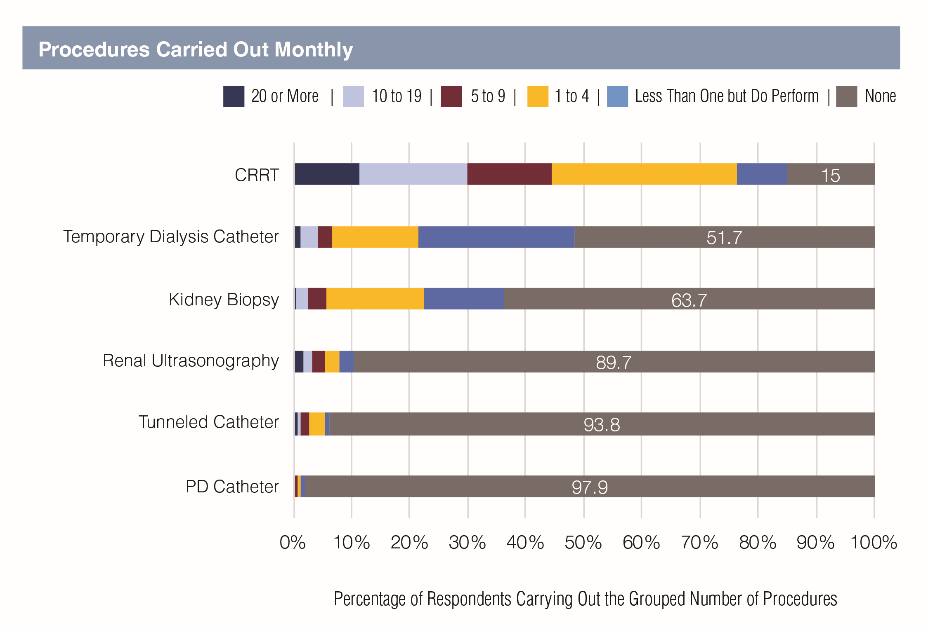
Exhibit 27: Frequency Common Procedures Were Performed

Slide 42
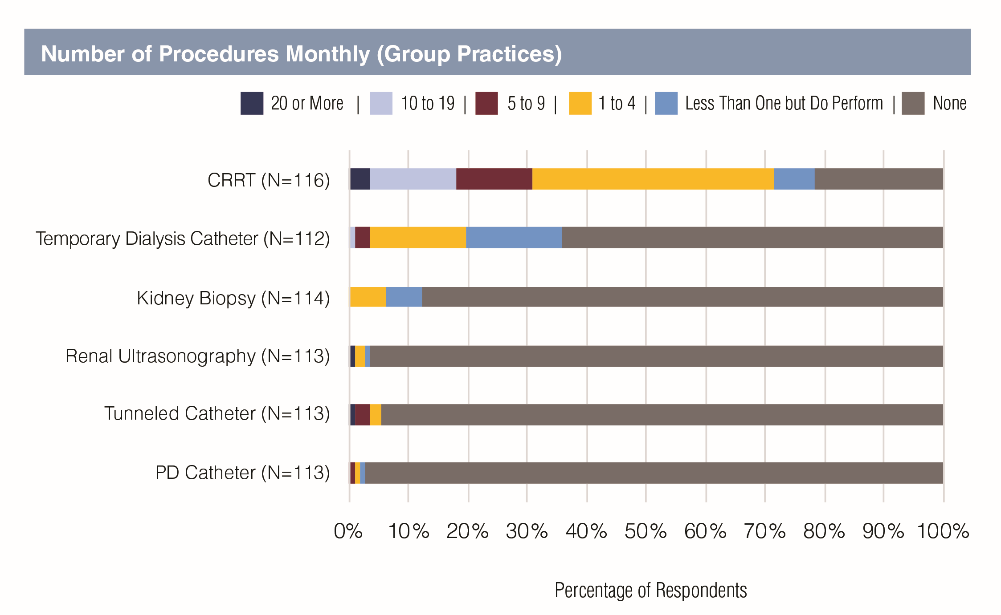
Exhibit 28: Frequency Common Procedures Were Performed, by Group or Academic Practice Setting

Slide 43
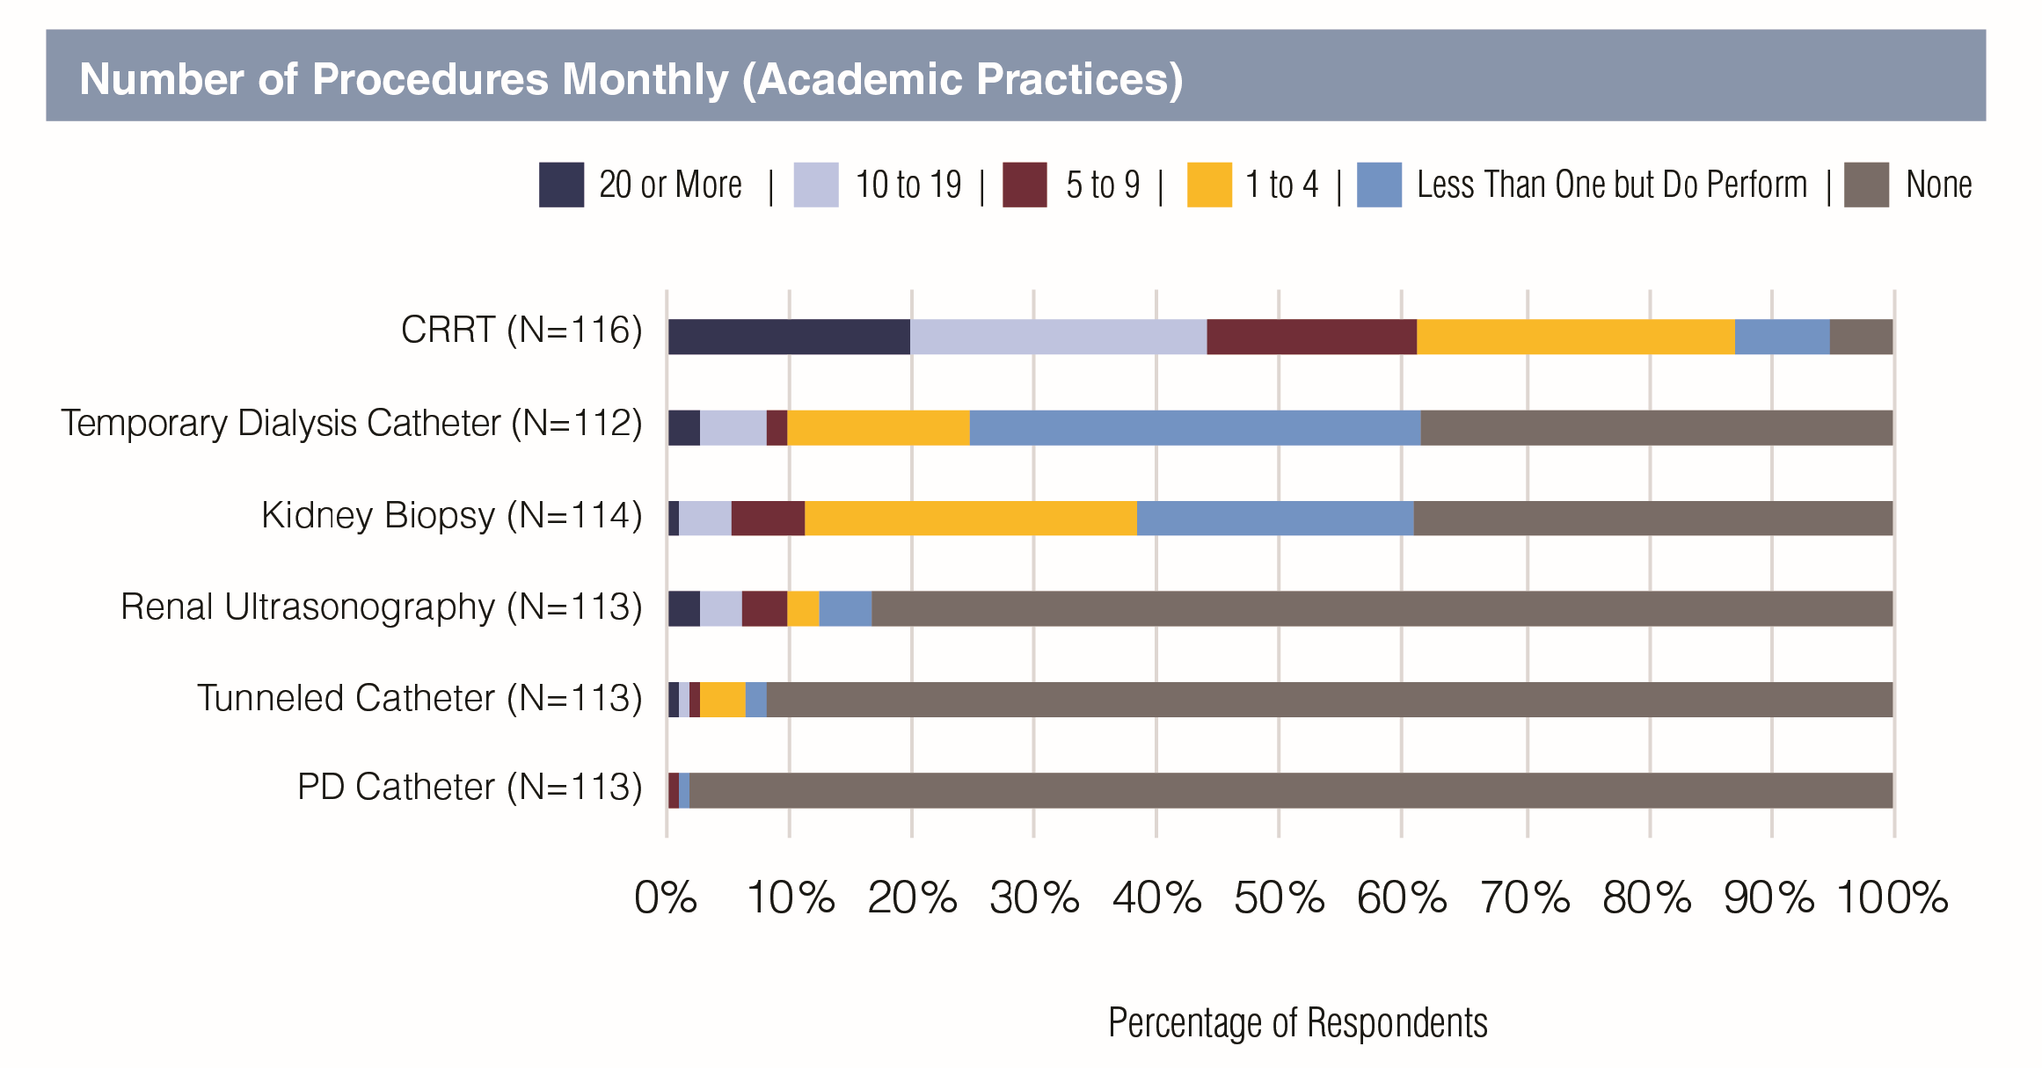

Slide 44
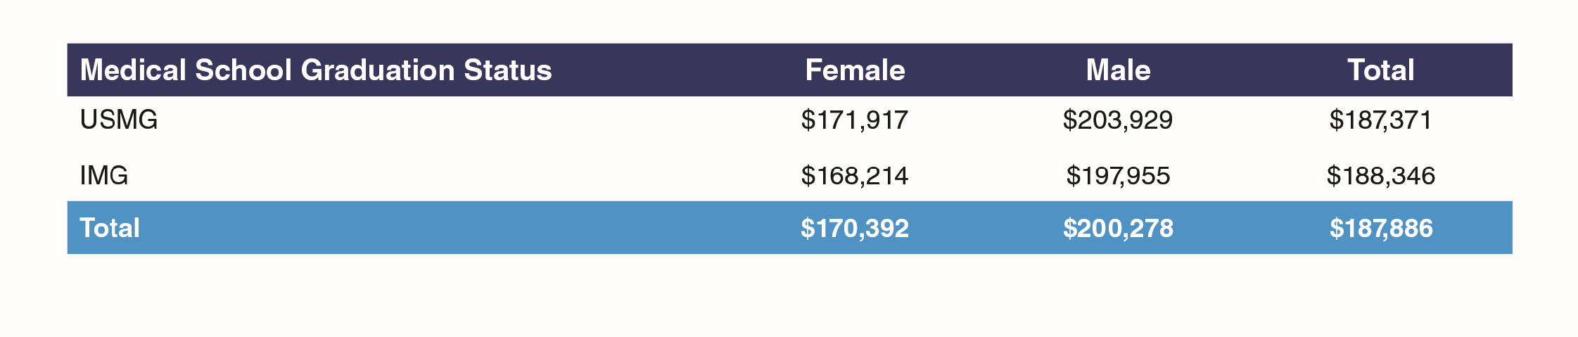
Exhibit 29: Base Salary (Mean) by Medical School Graduation Status and Sex

Slide 45
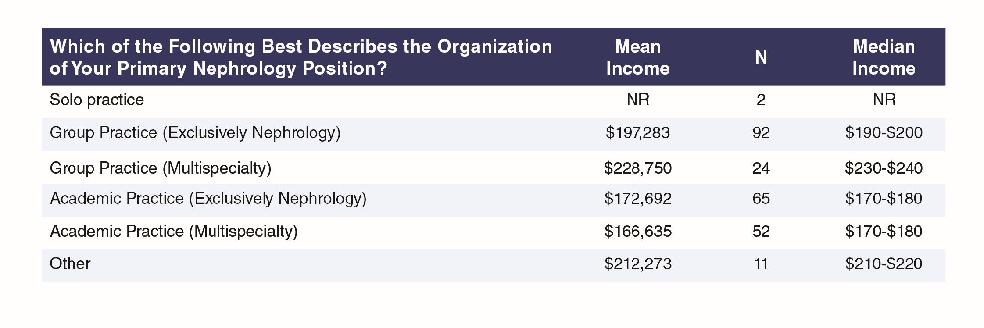
Exhibit 30: Mean Base Salary by Setting of Primary Nephrology Job

Slide 46
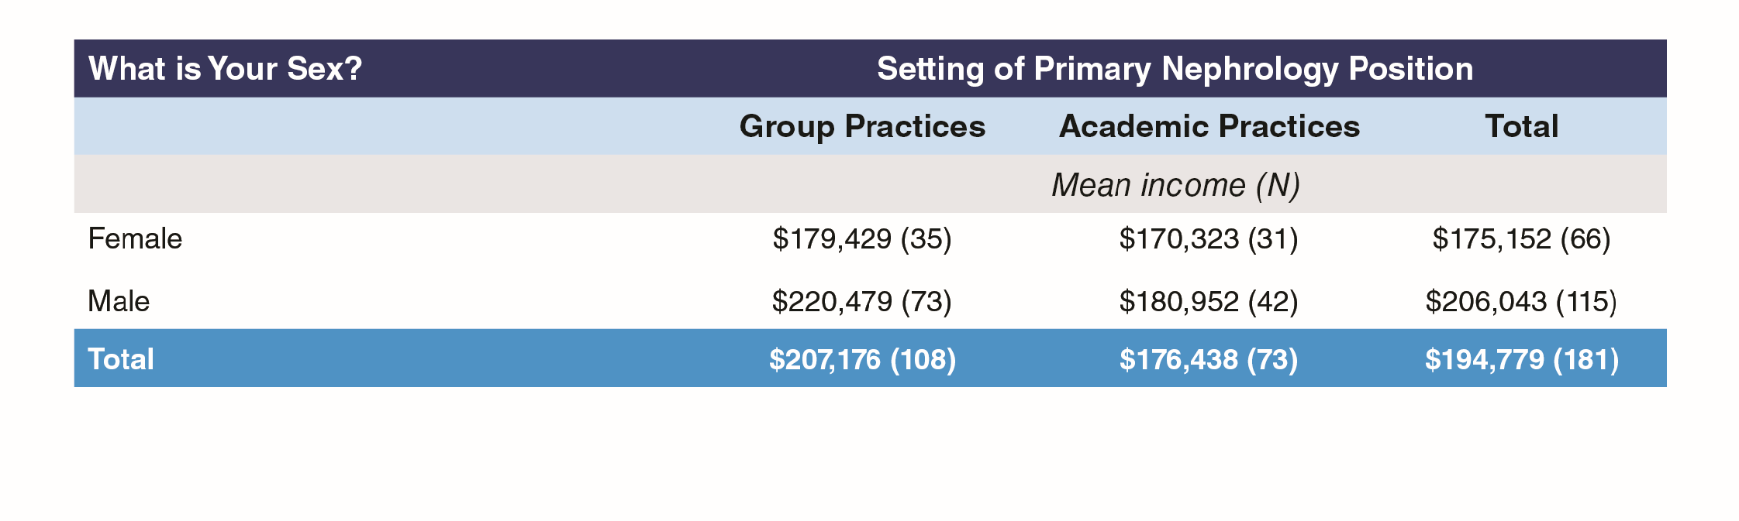
Exhibit 31: Mean Base Salary by Sex and Setting of Primary Nephrology Job

Slide 47
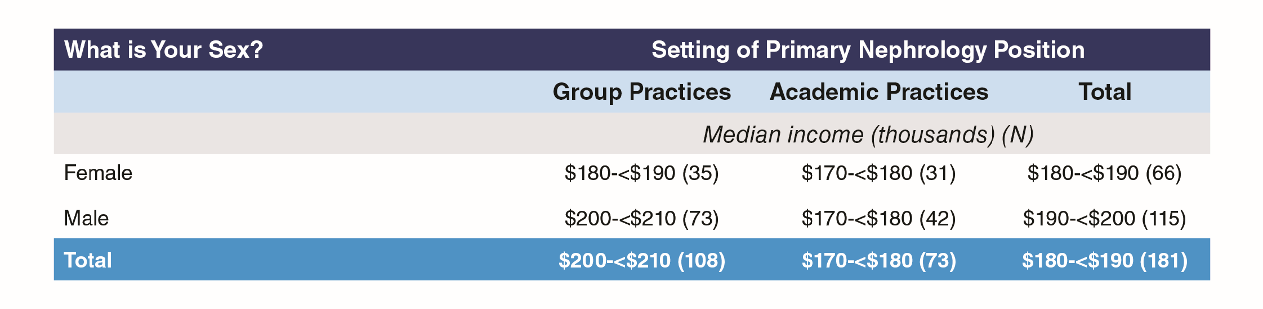
Exhibit 32: Median Base Salary by Sex and Setting of Primary Nephrology Job

Slide 48
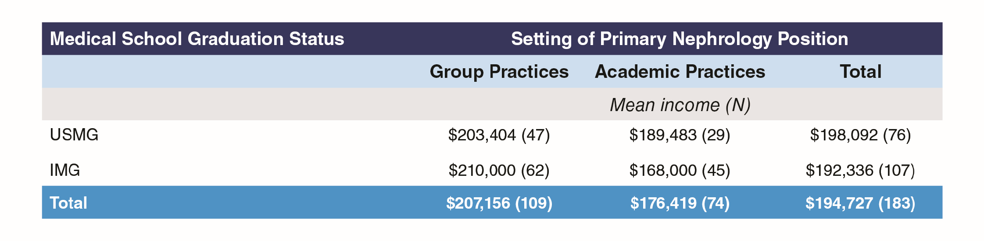
Exhibit 33: Mean Base Salary by Group or Academic Practice Setting and Medical School Graduation Status

Slide 49
Exhibit 34: Median Base Salary by Group or Academic Practice Setting and Medical School
Graduation Status

Slide 50
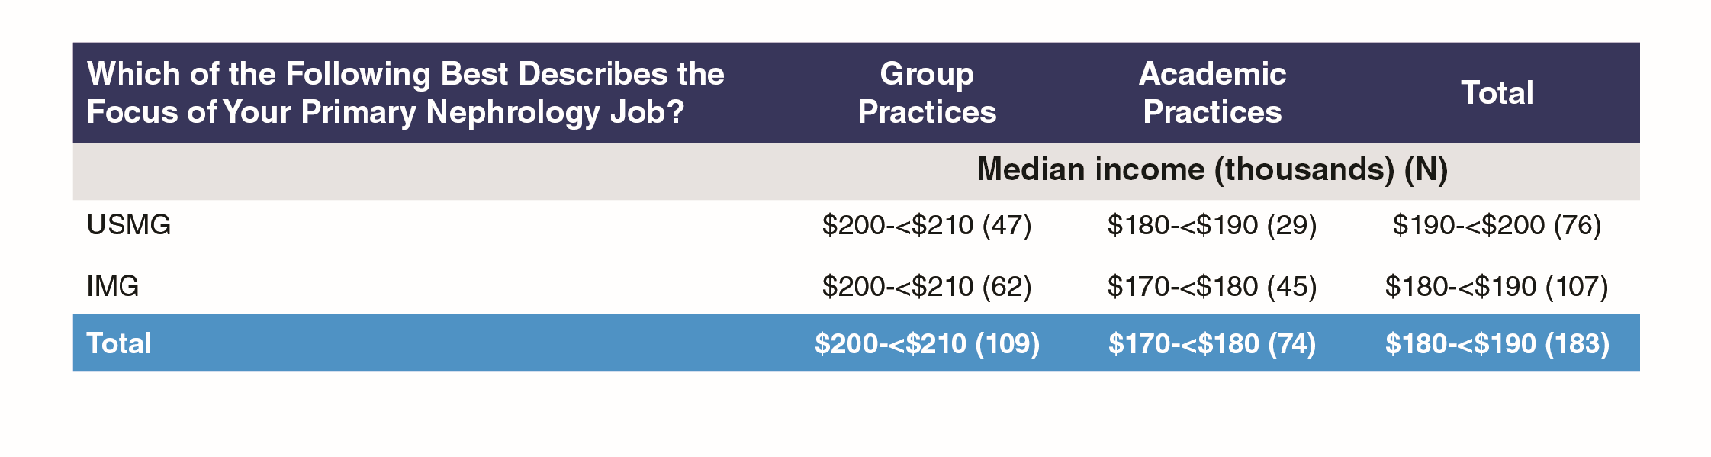

Slide 51
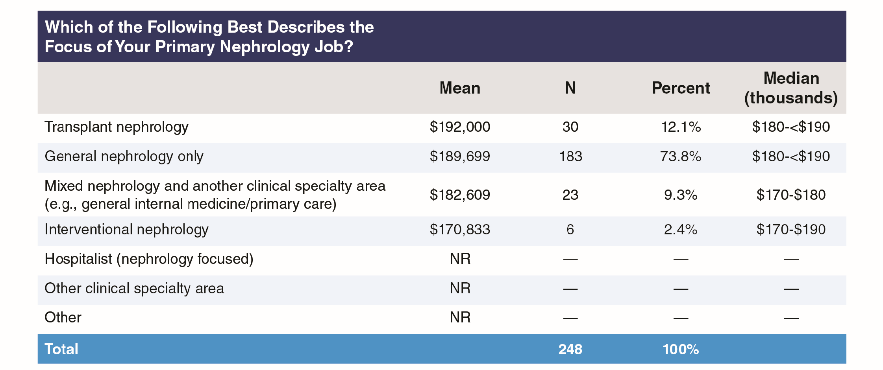
Exhibit 35: Mean and Median Base Salary by Practice Focus

Slide 52
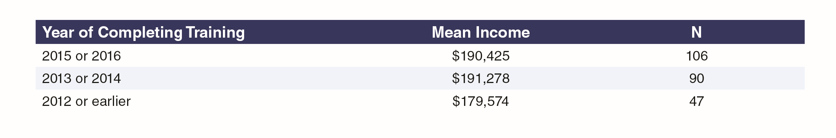
Exhibit 36: Mean Base Salary by Year of Completing Core Nephrology Training

Slide 53
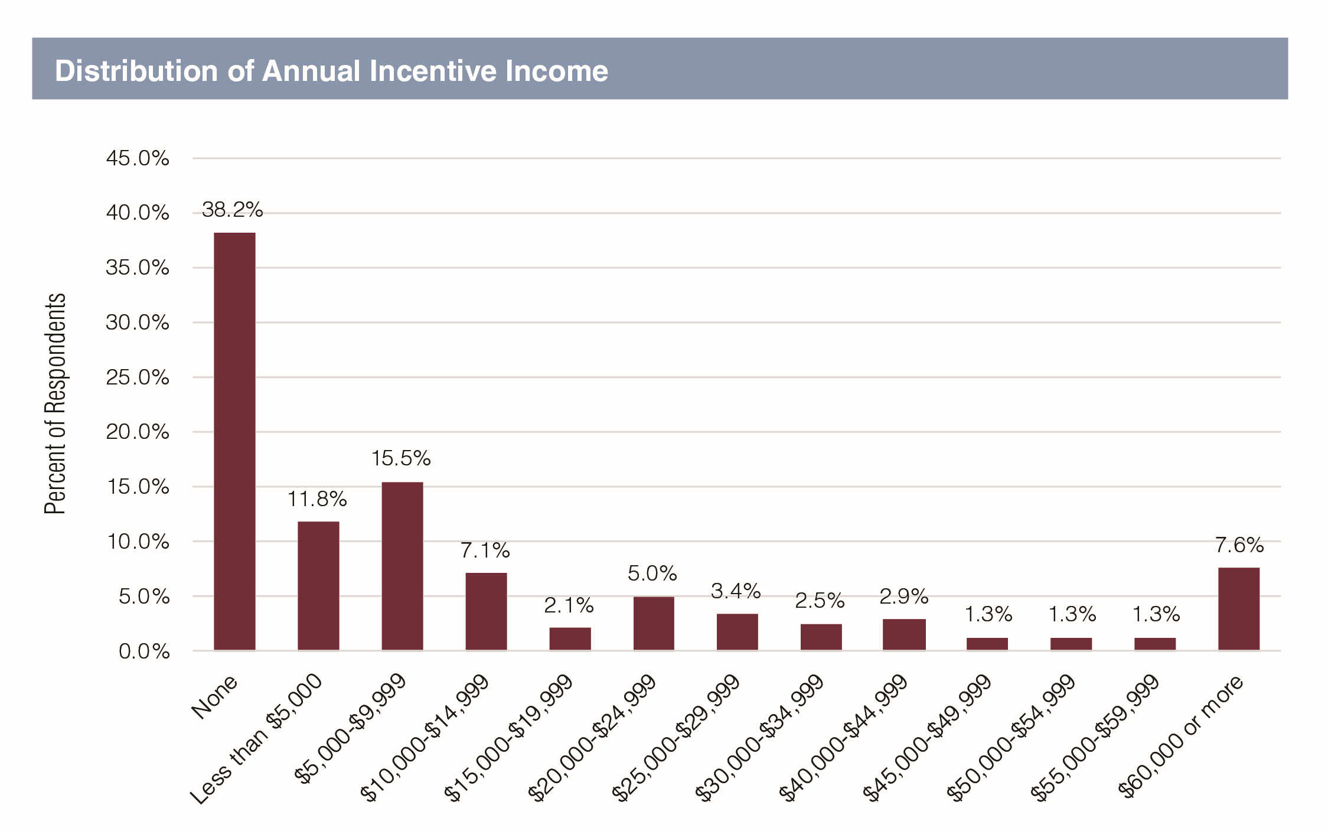
Exhibit 37: Distribution of Incentive Income

Slide 54
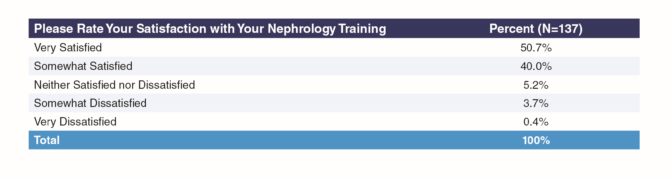
Exhibit 38: Satisfaction with Nephrology Training

Slide 55

Exhibit 39: Satisfaction with Overall Salary/Compensation for USMGs and IMGs

Slide 56

Exhibit 40: Satisfaction with Overall Salary/Compensation by Group or Academic Practice Setting

Slide 57

Exhibit 41: Satisfaction with Overall Salary/Compensation

Slide 58

Exhibit 42: Ratings of Aspects of Nephrology

Slide 59

Exhibit 43: Ratings of Aspects of Nephrology by Group or Academic Practice Setting

Slide 60


Slide 61

Exhibit 44: Satisfaction with Current Position

Slide 62

Exhibit 45: Would Recommend Nephrology to Medical Students and Residents, by Group or Academic Practice Setting

Slide 63

Exhibit 46: Would Recommend Nephrology to Medical Students and Residents, by Medical School Graduation Status

Slide 64

Exhibit 47: Willingness to Recommend Nephrology by Year of Completing Training

