Slide 1
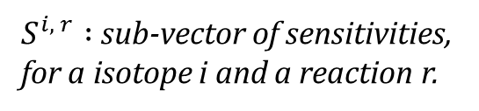
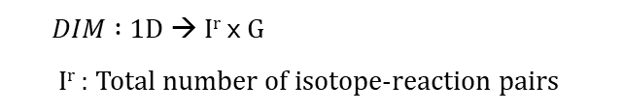
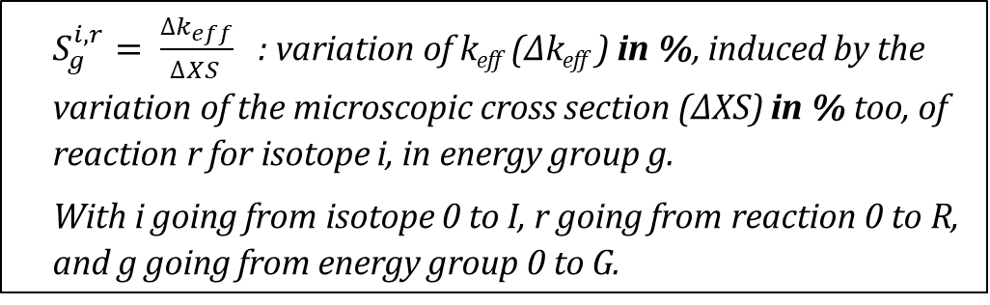

S : sensitivity vector
. | $${ S}_{g}^{i, r}$$ | $${ S}_{g+1}^{i, r}$$ | $${ S}_{g+2}^{i, r}$$ | . | . | $$S_{g}^{i, r+1}$$ | $$S_{g+1}^{i, r+1}$$ | $${ S}_{g+2}^{i, r+1}$$ | .
$DIM :$1D → I^{r} 𝗑 G
I^{r} : Total number of isotope-reaction pairs
$S^{i, r} :$ sub-vector of sensitivities,
for a isotope i and a reaction r.
$$S^{i, r+1}$$
$S_{g}^{i, r}= \frac{∆k_{eff}}{∆{XS}_{ }}$ : variation of k_{eff} (∆k_{eff} ) in %, induced by the variation of the microscopic cross section (∆XS) in % too, of reaction r for isotope i, in energy group g.
With i going from isotope 0 to I, r going from reaction 0 to R, and g going from energy group 0 to G.

Slide 2
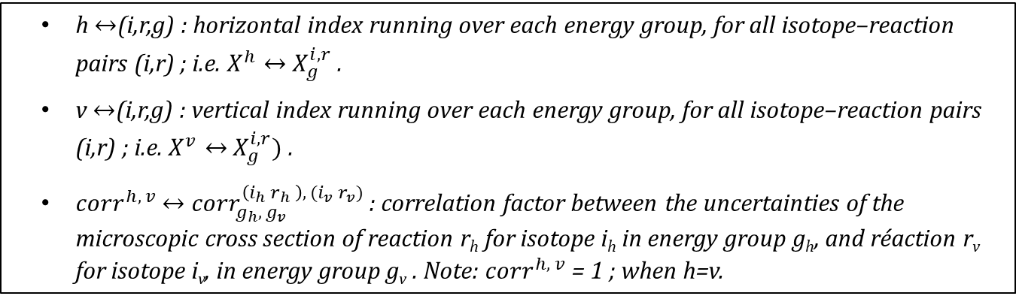
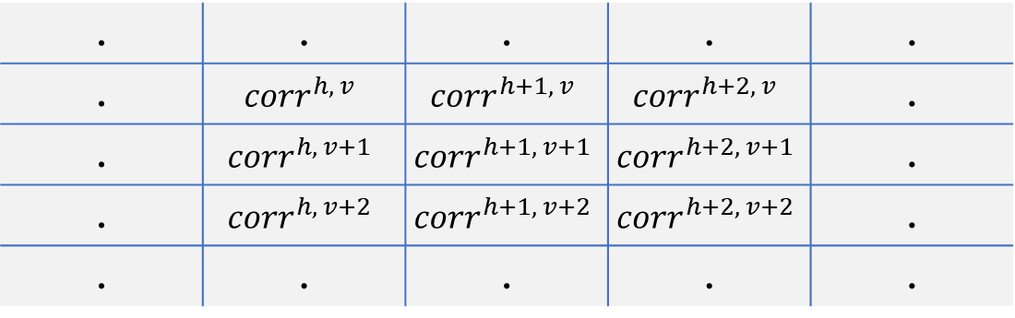

Corr : correlation matrix
. | . | . | . | .
. | $${corr}^{h, v}$$ | $${corr}^{h+1, v}$$ | $${corr}^{h+2, v}$$ | .
. | $${corr}^{h, v+1}$$ | $${corr}^{h+1, v+1}$$ | $${corr}^{h+2, v+1}$$ | .
. | $${corr}^{h, v+2}$$ | $${corr}^{h+1, v+2}$$ | $${corr}^{h+2, v+2}$$ | .
. | . | . | . | .
$DIM :2$D → I^{r} 𝗑 G | I^{r} 𝗑 G
h $↔$(i,r,g) : horizontal index running over each energy group, for all isotope–reaction pairs (i,r) ; i.e. $X^{h}↔$ $X_{g}^{i, r}$.
v $↔$(i,r,g) : vertical index running over each energy group, for all isotope–reaction pairs (i,r) ; i.e. $X^{v}↔$ $X_{g}^{i, r})$.
${corr}^{h, v}$ $↔$ ${corr}_{g_{h}, g_{v}}^{\left(i_{h} r_{h} \right), (i_{v} r_{v})}$ : correlation factor between the uncertainties of the microscopic cross section of reaction r_{h} for isotope i_{h} in energy group g_{h}, and réaction r_{v} for isotope i_{v}, in energy group g_{v} . Note: ${corr}^{h, v}$ = 1 ; when h=v.

Slide 3
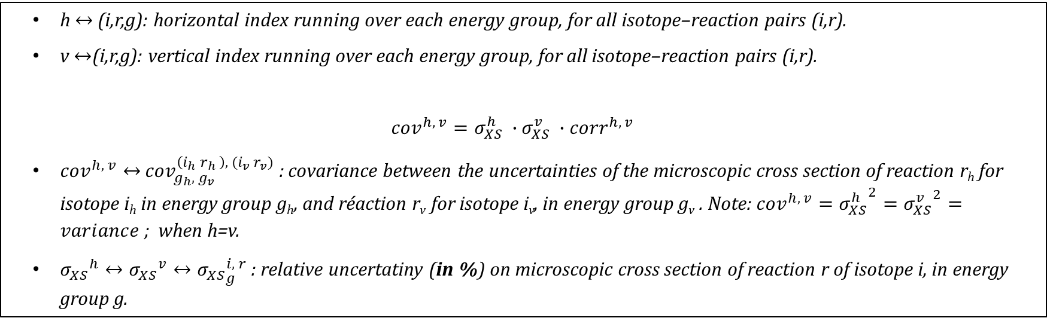
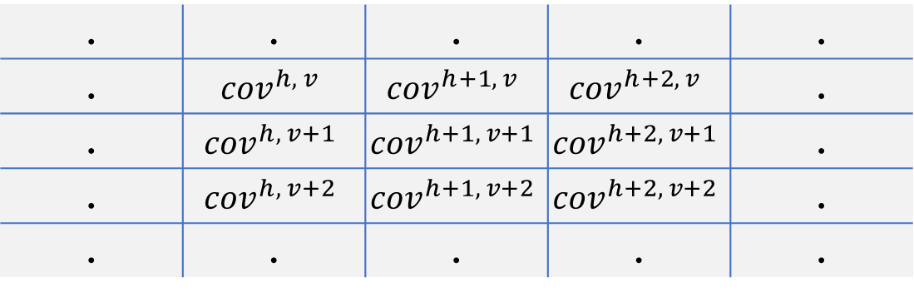

Cov : variances-covariances matrix
. | . | . | . | .
. | $${cov}^{h, v}$$ | $${cov}^{h+1, v}$$ | $${cov}^{h+2, v}$$ | .
. | $${cov}^{h, v+1}$$ | $${cov}^{h+1, v+1}$$ | $${cov}^{h+2, v+1}$$ | .
. | $${cov}^{h, v+2}$$ | $${cov}^{h+1, v+2}$$ | $${cov}^{h+2, v+2}$$ | .
. | . | . | . | .
$DIM :2$D → I^{r} 𝗑 G | I^{r} 𝗑 G
h $↔$ (i,r,g): horizontal index running over each energy group, for all isotope–reaction pairs (i,r).
v $↔$(i,r,g): vertical index running over each energy group, for all isotope–reaction pairs (i,r).
$${{{{cov}^{h, v}=σ}_{XS}^{h}}^{ }∙{σ_{XS}^{v}}^{ }∙corr}^{h, v}$$
${cov}^{h, v}↔$ ${cov}_{g_{h}, g_{v}}^{\left(i_{h} r_{h} \right), (i_{v} r_{v})}$ : covariance between the uncertainties of the microscopic cross section of reaction r_{h} for isotope i_{h} in energy group g_{h}, and réaction r_{v} for isotope i_{v}, in energy group g_{v} . Note: ${cov}^{h, v}={σ_{XS}^{h}}^{2}={σ_{XS}^{v}}^{2}=variance$; when h=v.
${σ_{XS}}^{h}↔{σ_{XS}}^{v}↔{σ_{XS}}_{g}^{i, r}$ : relative uncertatiny (in %) on microscopic cross section of reaction r of isotope i, in energy group g.

Slide 4
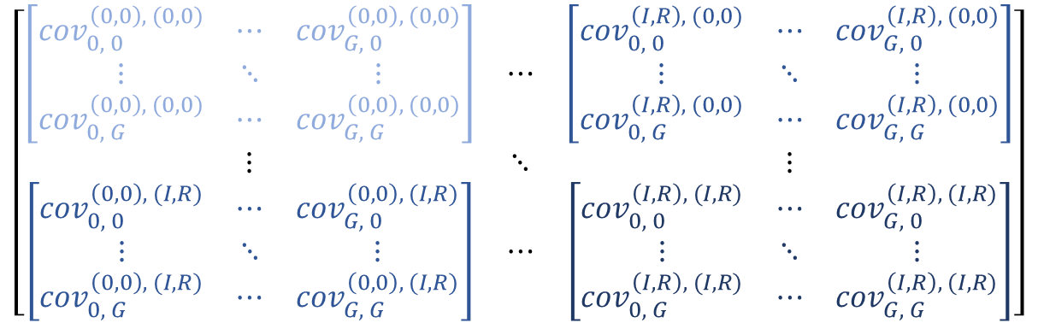
Cov : variances-covariances matrix
isotope-reaction list:
(i, r)
(0, 0) … (I, R)
$$\left[\begin{matrix}\left[\begin{matrix}{cov}_{0, 0}^{\left(0,0\right), (0,0)} & ⋯ & {cov}_{G, 0}^{\left(0,0\right), (0,0)} \\ ⋮ & ⋱ & ⋮ \\ {cov}_{0, G}^{\left(0,0\right), (0,0)} & ⋯ & {cov}_{G, G}^{\left(0,0\right), (0,0)}\end{matrix}\right] & ⋯ & \left[\begin{matrix}{cov}_{0, 0}^{\left(I,R\right), (0,0)} & ⋯ & {cov}_{G, 0}^{\left(I,R\right), (0,0)} \\ ⋮ & ⋱ & ⋮ \\ {cov}_{0, G}^{\left(I,R\right), (0,0)} & ⋯ & {cov}_{G, G}^{\left(I,R\right), (0,0)}\end{matrix}\right] \\ ⋮ & ⋱ & ⋮ \\ \left[\begin{matrix}{cov}_{0, 0}^{\left(0,0\right), (I,R)} & ⋯ & {cov}_{G, 0}^{\left(0,0\right), (I,R)} \\ ⋮ & ⋱ & ⋮ \\ {cov}_{0, G}^{\left(0,0\right), (I,R)} & ⋯ & {cov}_{G, G}^{\left(0,0\right), (I,R)}\end{matrix}\right] & ⋯ & \left[\begin{matrix}{cov}_{0, 0}^{\left(I,R\right), (I,R)} & ⋯ & {cov}_{G, 0}^{\left(I,R\right), (I,R)} \\ ⋮ & ⋱ & ⋮ \\ {cov}_{0, G}^{\left(I,R\right), (I,R)} & ⋯ & {cov}_{G, G}^{\left(I,R\right), (I,R)}\end{matrix}\right]\end{matrix}\right]$$
(0, 0)
…
(I, R)
liste isotope-réaction :
Cov^{(0,0), (I,R)} : variances-covariances sub-matrix between the reaction 0 of isotope 0 and the reaction R of isotope I.

Slide 5

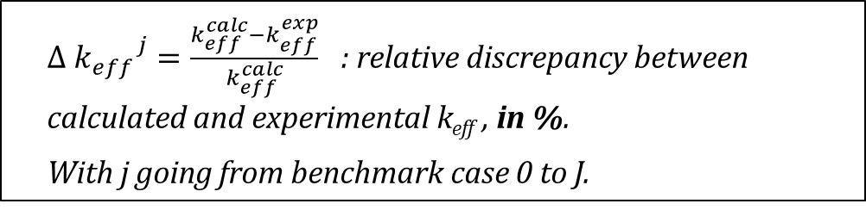

Δk_{C-E bench} : experimental C-E vector
. | $$Δ {k_{eff}}^{j}$$ | $$Δ {k_{eff}}^{j+1}$$ | $$Δ {k_{eff}}^{j+2}$$ | .
$DIM :$1D → J
$Δ {k_{eff}}^{j}=\frac{k_{eff}^{calc}−k_{eff}^{exp}}{k_{eff}^{calc}}$ : relative discrepancy between calculated and experimental k_{eff} , in %.
With j going from benchmark case 0 to J.

Slide 6

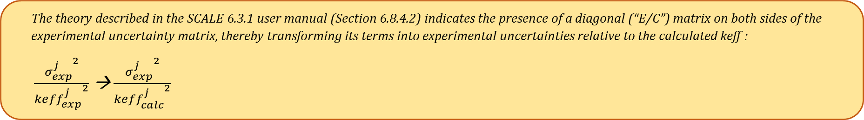
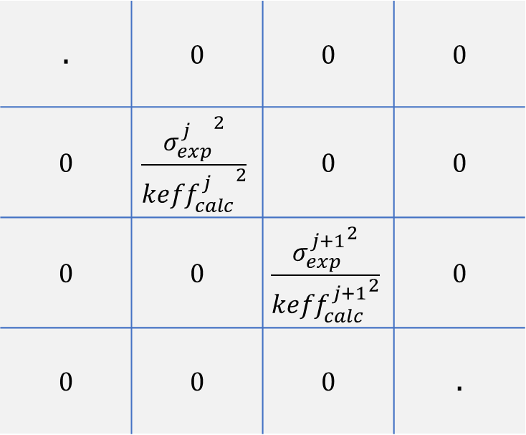

C_{bench} : experimental k_{eff} uncertainty matrix
. | 0 | 0 | 0
0 | $$\frac{{σ_{exp}^{j}}^{2}}{{{keff}_{calc}^{j}}^{2}}$$ | 0 | 0
0 | 0 | $$\frac{{σ_{exp}^{j+1}}^{2}}{{{keff}_{calc}^{j+1}}^{2}}$$ | 0
0 | 0 | 0 | .
Diagonal matrix
j : index going over all benchmark cases from 0 to J.
$DIM :2$D → J | J
The theory described in the SCALE 6.3.1 user manual (Section 6.8.4.2) indicates the presence of a diagonal (“E/C”) matrix on both sides of the experimental uncertainty matrix, thereby transforming its terms into experimental uncertainties relative to the calculated keff :
$\frac{{σ_{exp}^{j}}^{2}}{{{keff}_{exp}^{j}}^{2}}$ → $\frac{{σ_{exp}^{j}}^{2}}{{{keff}_{calc}^{j}}^{2}}$

Slide 7
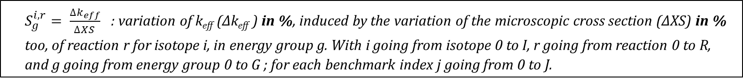

S_{bench} : experimental sensitivities matrix
. | $${ S}_{g}^{i, r}$$ | $${ S}_{g+1}^{i, r}$$ | $${ S}_{g+2}^{i, r}$$ | . | . | $$S_{g}^{i, r+1}$$ | $$S_{g+1}^{i, r+1}$$ | $${ S}_{g+2}^{i, r+1}$$ | .
. | $${ S}_{g}^{i, r}$$ | $${ S}_{g+1}^{i, r}$$ | $${ S}_{g+2}^{i, r}$$ | . | . | $$S_{g}^{i, r+1}$$ | $$S_{g+1}^{i, r+1}$$ | $${ S}_{g+2}^{i, r+1}$$ | .
. | $${ S}_{g}^{i, r}$$ | $${ S}_{g+1}^{i, r}$$ | $${ S}_{g+2}^{i, r}$$ | . | . | $$S_{g}^{i, r+1}$$ | $$S_{g+1}^{i, r+1}$$ | $${ S}_{g+2}^{i, r+1}$$ | .
J 3 2 1 0
. | $${ S}_{g}^{i, r}$$ | $${ S}_{g+1}^{i, r}$$ | $${ S}_{g+2}^{i, r}$$ | . | . | $$S_{g}^{i, r+1}$$ | $$S_{g+1}^{i, r+1}$$ | $${ S}_{g+2}^{i, r+1}$$ | .
Benchmark cases list/sensitivity vectors:
. | $${ S}_{g}^{i, r}$$ | $${ S}_{g+1}^{i, r}$$ | $${ S}_{g+2}^{i, r}$$ | . | . | $$S_{g}^{i, r+1}$$ | $$S_{g+1}^{i, r+1}$$ | $${ S}_{g+2}^{i, r+1}$$ | .
$DIM :2$D → J | I^{r} 𝗑 G
$S_{g}^{i, r}= \frac{∆k_{eff}}{∆{XS}_{ }}$ : variation of k_{eff} (∆k_{eff} ) in %, induced by the variation of the microscopic cross section (∆XS) in % too, of reaction r for isotope i, in energy group g. With i going from isotope 0 to I, r going from reaction 0 to R, and g going from energy group 0 to G ; for each benchmark index j going from 0 to J.

