Slide 1
Problem Statement
Challenges with single-sensor systems (e.g., cameras, radar) in adverse conditions.
Integration of LiDAR, radar, and cameras for robust detection.
Enhanced real-time situational awareness.
Application of machine learning and deep learning algorithms.
Improved detection of vehicle cut-ins.
Advancement of intelligent transportation systems (ITS) capabilities.
Reduction of delays in cut-in event detection.
Proactive safety measures facilitated by real-time monitoring.
Overall enhancement of road safety and accident prevention.

Slide 2
Unique Idea Brief (Solution)
Fusing data from various sensors
Machine learning and deep learning techniques
Real-time prediction and identification
Robustness against environmental challenges
Advanced object detection models (YOLO, DETR)Depth estimation techniques
Distance prediction using machine learning models (XGBoost, Random Forest, LSTM)
Use of stereo and monocular cameras
Integration of radar and LiDAR
Forward collision warning systems
Vision-based adaptive cruise control
Curriculum learning techniques for training efficiency

Slide 3
Features Offered
Integration of LiDAR, radar, and cameras for comprehensive detection.
Advanced algorithms including machine learning for accurate cut-in prediction.
Real-time monitoring and proactive response capabilities.
Enhanced accuracy in detecting cut-in events.
Mitigation of risks associated with poor weather and visibility conditions.
Contribution to the advancement of intelligent transportation systems (ITS).
Adaptive sensor fusion to optimize performance in varying environmental conditions.
Continuous improvement through data-driven insights and system feedback loops.

Slide 4
Process flow
Data acquisition from multiple sensors
Data preprocessing and cleaning
Object detection using advanced algorithms
Depth estimation with machine learning models
Distance prediction through predictive analytics
Fusion of sensor data for enhanced accuracy
Real-time processing and decision-making
Activation of vehicle safety mechanisms

Slide 5
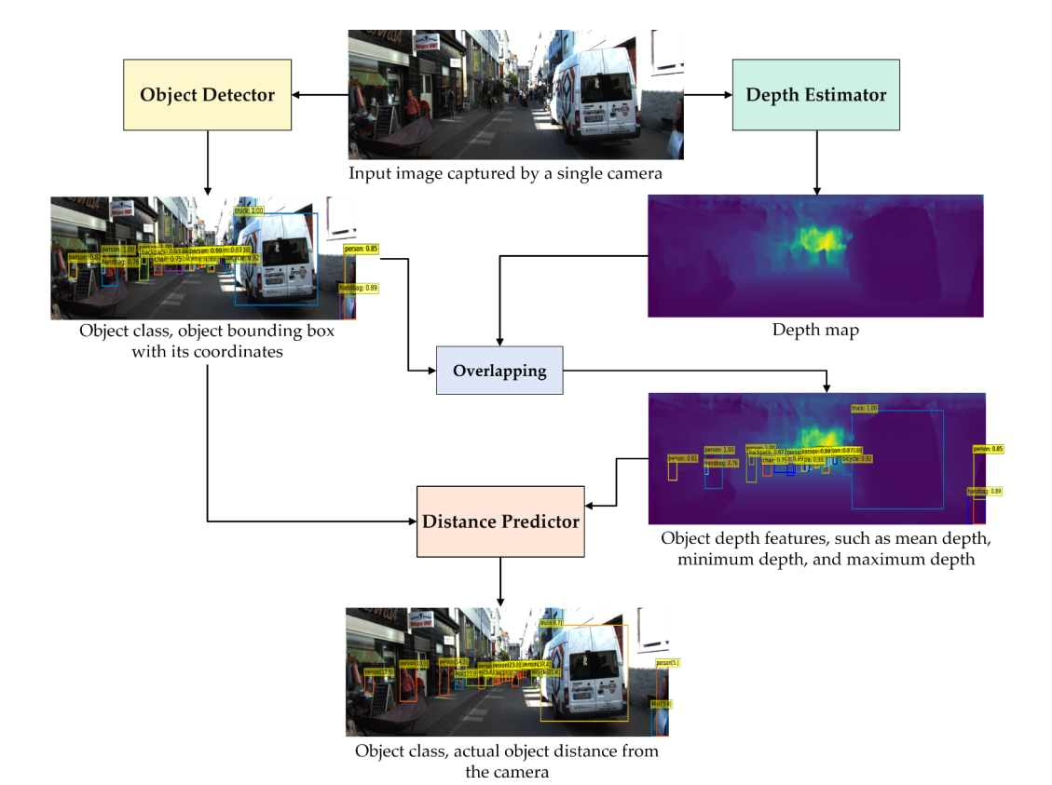
Architecture Diagram
Object detection using advanced algorithms (DETR)
Depth estimation with global-local path network
Distance prediction using machine learning models (XGBoost, Random Forest, LSTM)

Slide 6
Technologies used
LiDAR-
Radar
Cameras (Stereo and Monocular)
Convolutional Neural Networks (CNNs)
Detection Transformers (DETR)
Machine Learning Algorithms (XGBoost, Random Forest, LSTM)
Neural Networks for Depth Estimation
Real-time Processing Frameworks

Slide 7
Team members and contribution:
1. Meyyappan M – RA2211003010318 (mm0177@srmist.edu.in)
- Preprocessing and cleaning the collected data
- Annotating data for training machine learning models
- Developing and training depth estimation models (global-local path network)
2. Mukundan S – RA2211056010033 (ms7265@srmist.edu.in)
- Setting up the data acquisition module
- Ensuring data synchronization across different sensors
- Training object detection models (e.g., DETR)

Slide 8
3. Aniket Verma – RA2211003010345 (av1597@srmist.edu.in)
- Implementing distance prediction models using XGBoost, Random Forest, and LSTM
- Integrating the models into the vehicle's onboard computer system
- Developing the real-time processing framework
- Ensuring the system's performance under various driving conditions
4. Arpith S Prabhu – RA2211056010051 (ap1272@srmist.edu.in)
- Integrating all modules (data acquisition, processing, and decision-making)
- Analyzing results using metrics such as precision, recall, and F1-score
- Documenting the project and preparing the final report

Slide 9
Conclusion
The project successfully developed a robust vehicle cut-in detection system.
Integration of LiDAR, RADAR, and camera sensors provided comprehensive environmental data.
Advanced machine learning algorithms, including DETR, significantly improved object detection accuracy.
Depth estimation using the global-local path network enhanced spatial understanding.
Machine learning models like XGBoost, Random Forest, and LSTM accurately predicted distances and vehicle interactions.
Extensive testing demonstrated the system's reliability and effectiveness in various driving conditions.
The system has the potential to significantly enhance road safety and driver assistance capabilities.
Future work will focus on further improving accuracy, robustness, and exploring additional applications in autonomous driving technologies

