Slide 1
Building a music recommendation system (Using Spotify dataset)
MOUNIKA GAMPA(a20488077)
ANSH SHRIVASTAVA(a20481422)

Slide 2
Contents : -
Abstract
Introduction and Overview: Why is music important for relaxation, and what challenges do users face in finding music that fits their moods? How does recommendation system work?
Examples for this type of systems
Implementation:
Data selection : How is the Spotify dataset prepared for use with the recommendation system.
Features : What tools are used to transform the data into feature vectors?
Process
Summarization : similarity and recommendation
Conclusion: What are the key takeaways from this project, and what future directions could be pursued for improving the recommendation system?
Next steps
References

Slide 3

Abstract
A music recommendation system has been created using automatic music content analysis and machine learning techniques to categorize and recommend music based on users' moods. The system uses the Spotify dataset, processed using tfidf vectorizer, and cosine similarity algorithm to find similarities and recommend similar songs based on users' previous interests. This system aims to help users find their favorite songs and relax in their busy lives.
Our team of two decided to create this music recommendation system using the Spotify dataset available on Kaggle. The dataset contains all the necessary song data in a processed form that is compatible with our model. We use the tfidf vectorizer to convert the data into feature vectors, which serve as input to the main model.

Slide 4
Introduction and overview:
In today’s world all online platforms are using recommendation system to attract user’s and Spotify is the fastest growing music social media company. Recommendation systems make suggestions for content based on a person’s personal viewing history or the combined viewing histories of themselves and family.
Relaxation is key importance for busy day individuals .Every person has their unique way of relaxing, music is one of them. So based on that we decided to build a music recommendation system to help users to listen their likable songs based on their mixed feelings.
The cosine similarity model is used to find similarities between the user's preferences and recommend similar songs based on their previous interests. The cosine similarity algorithm is available in the scikit-learn library in Python. As relaxation is a crucial factor in individuals' busy lives, we believe our system will help users find their favorite songs based on their mixed emotions.
Why a recommendation system is used for song prediction?
During the process of developing a music recommendation system, a cluster-based method may be employed to predict which songs a user may enjoy. However, this method has limitations when it comes to incorporating other relevant information, such as a categorization predictor.
To address this limitation, the clustering results can be integrated into the recommendation system using both content-based filtering and collaborative filtering techniques. By combining these approaches, a hybrid recommendation system can be created that is better suited for accurately predicting which songs a user may like.

Slide 5
Project Requirements:
Mac OS or Windows.
Google colabs.
Python.

Slide 6
Example for this type of systems:
Netflix: Recommends movies and TV shows based on a user's viewing history and preferences.
Amazon: Recommends products based on a user's purchase history and browsing behavior.
Spotify: Recommends music based on a user's listening history and mood.
YouTube: Recommends videos based on a user's viewing history and preferences.

Slide 7
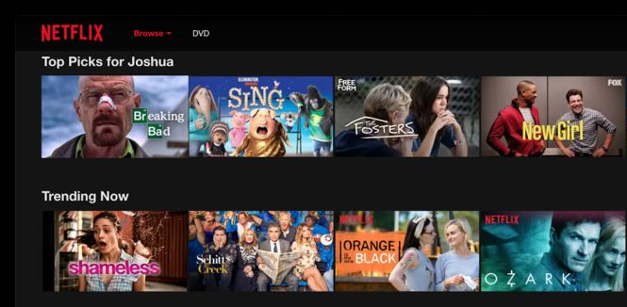
Netflix suggestion based on trending and user history

Slide 8
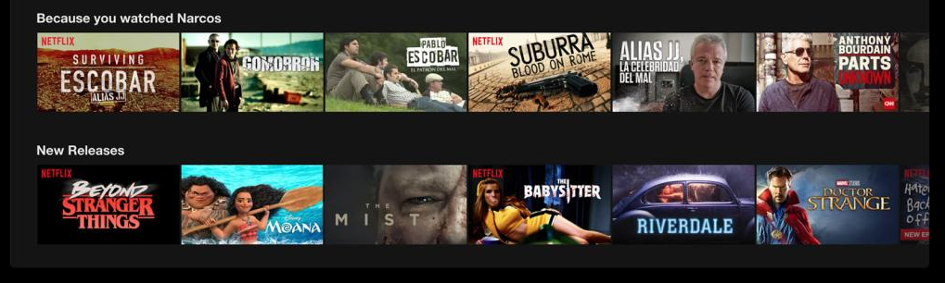
Netflix suggestion based on new releases and previously watched

Slide 9
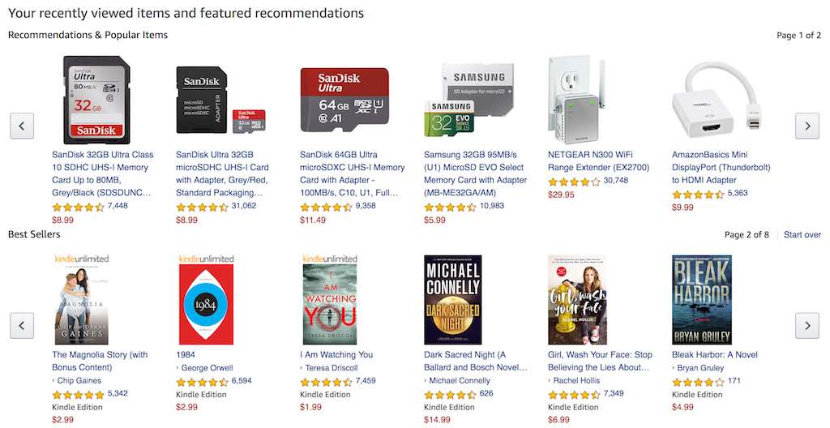
Amazon recommending items based on purchase history

Slide 10
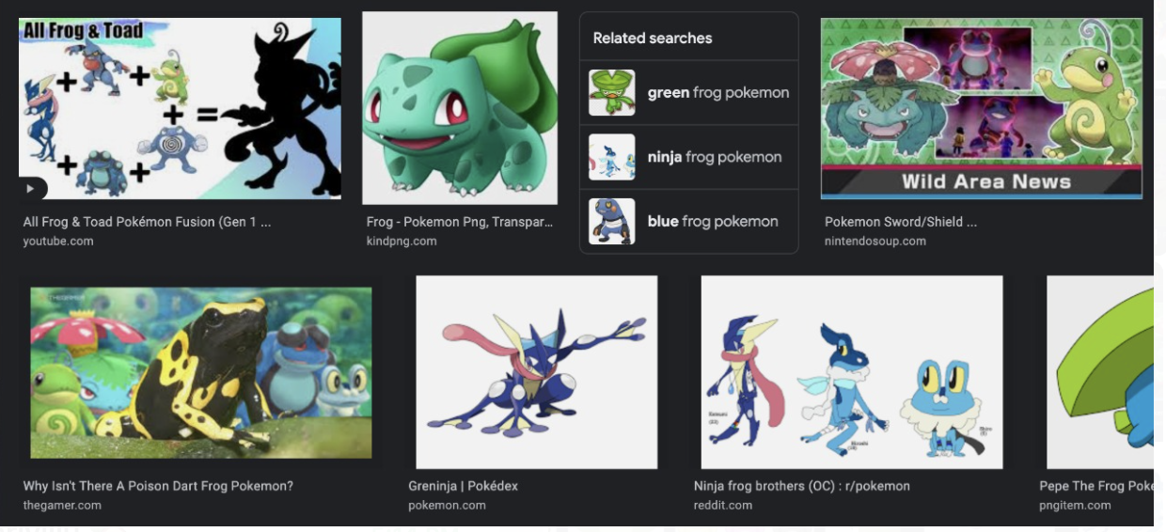
Bing giving the images of frog type pokemon from the popular game (pokemon go)

Slide 11
Implementation:
We will process the data using feature engineering so that it can be given into the algorithm used for the content-based filtering as well as the similarity metric.
Data Selection:-
It is essential to remove duplicate tracks from different playlists.
In order to prevent mistakenly deleting tracks with the same name by various artists, the process involves gathering the names of the artists and the track titles.
The above is conducted simply via pandas data frame manipulation.
Features:
Each category is transformed into a column, allowing each category to be represented as either True or False.
In order to avoid favoring some genres over others, we need to consider the significance of each genre.

Slide 12
TF-IDF is a commonly used technique for analyzing text data that involves counting the frequency of words across a group of texts. The goal of TF-IDF is to identify which words are particularly significant within the documents being analyzed.
TF-IDF = Term Frequency x Inverse Document Frequency.
When analyzing text data, Term Frequency (TF) refers to the number of times a term appears in each document divided by the total word count in the document, while Inverse Document Frequency (IDF) is the log value of the document frequency, which is the total number of documents where one term is present.
This method is preferable to one-hot encoding because it avoids giving equal weight to all genres, regardless of how common or significant they are. In the absence of weighting, less common genres would be overrepresented.

Slide 13
Process summarization
Summarization:
During the summarization stage of our music recommendation system, we compile a playlist of songs into a vector that can be compared to every other song in the dataset to identify similarities. To accomplish this, it's important to first remove the songs in the playlist to avoid bias.
Next, we use the dataset created in the previous step to identify the attributes of the songs in the playlist. Finally, we combine the feature values of each song on the playlist to create a summarization vector that captures the key attributes of the songs in the playlist
Similarity and recommendation:
After summarizing the playlist and extracting non-playlist tracks, we use a mathematical measurement called cosine similarity to determine how closely each song in the database matches the playlist.
Cosine similarity measures the similarity between two vectors, in this case, the playlist summarized vector and the non-playlist tracks in the database. If we were to visualize the music vectors as a two-dimensional graph, it would resemble the image below.

Slide 14
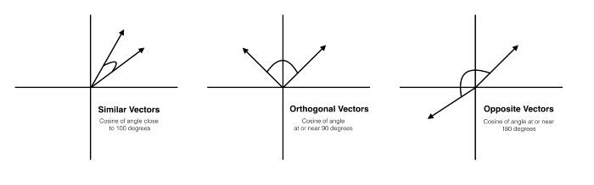
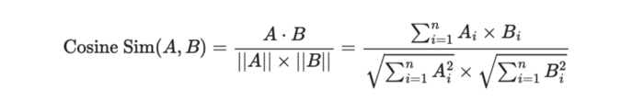

Slide 15
Progress Work removing duplicates algorithm
Def drop_duplicates(df):
'''
Drop duplicate songs
'''
df ['artists_song'] =df.apply(lambdarow: row['artist_name']+row['track_name'],axis =1) returndf.drop_duplicates('artists_song')
songDF =drop_duplicates(playlistDF)

Slide 16
Taking certain columns from the data.
defselect_cols(df):
'''
Select useful columns
'''
returndf[['artist_name','id','track_name','danceability', 'energy', 'key', 'loudness', 'mode','speechiness', 'acousticness', 'instrumentalness', 'liveness', 'valence','tempo', "artist_pop", "genres", "track_pop"]]
songDF =select_cols(songDF)
songDF.head()

Slide 17
The genres column is made into the list.
defgenre_preprocess(df): ‘’’ preprocess the genre data ‘’’
df['genres_list'] =df['genres'].apply(lambdax: x.split(" "))
returndf
songDF =genre_preprocess(songDF)
songDF['genres_list'].head()

Slide 18
Conclusion
In conclusion, our music recommendation system uses a combination of techniques to create a personalized playlist for each user. We start by collecting data on each user's musical preferences and moods, which are used to create a summary vector that represents their unique tastes.
Using cosine similarity, we compare the user's summary vector to the dataset of available songs to identify the best matches. We also incorporate additional information, such as categorization predictors, to further enhance the accuracy of our recommendations.
Our system is designed to be flexible and adaptable, allowing for continuous improvement and refinement based on user feedback. We believe that our music recommendation system will provide an enjoyable and personalized listening experience for music lovers everywhere.

Slide 19
Next step:
The next step in our music recommendation system is to prepare the data for loading into our algorithm. We will use a Tf-IDF vectorizer and cosine similarity to predict the recommended songs from the dataset.
We are confident that our filtered data will be well-suited for training our model and that it will ultimately provide accurate results for our users.

Slide 20
References:
"Music Recommendation Systems: A Comparative Study" by SpringerLink: https://link.springer.com/article/10.1007/s10796-020-10040-4
"Using Spotify Data to Predict Popular Music" by Towards Data Science: https://towardsdatascience.com/using-spotify-data-to-predict-popular-music-f7df952f16f5
"Building a Music Recommendation System with Machine Learning" by Towards Data Science: https://towardsdatascience.com/building-a-music-recommendation-system-with-machine-learning-8118d1cfc9f9
"A Survey on Music Recommendation Systems" by International Journal of Computer Applications: https://www.ijcaonline.org/archives/volume179/number23/29928-2021654998

Slide 21
Thank you
.

