Slide 1
Adidas Sales Performance Analysis (2020-2021)

Slide 2
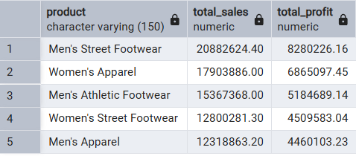
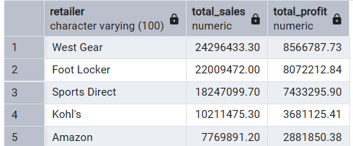
Identify our top 5 products and top 5 retailers based on both sales and profit.
1. Top 5 best product based on sales and profit
SQL query :
select Product, sum(revenue) as Total_Sales, sum(profit) as Total_Profit
from sales_data
group by Product
order by Total_Sales desc
limit 5;
Recommendations :
my recommendation to company is to produce and sale more product like this which help to increase the sales and profit of the company due to large number of demand In market
2. Top 5 best Retailer based on sales and profit.
SQL query :
select retailer, sum(revenue) as Total_Sales,sum(profit) as Total_Profit
from sales_data
group by retailer
order by Total_Sales desc
limit 5;
Recommendations :
my recommendation to the company is to supply more product to these top retailers to increase sales and profit. These retailers have good market strategies and are clearly driving a large amount of demand for our products.

Slide 3


2. Which region and state had the highest sales? Which were the most profitable?
1. Which region have highest sales ?
SQL query :
select region, sum(revenue) as total_sales, sum(profit) as total_profit
from sales_data
group by region
order by total_sales desc
limit 1 ;
Recommendations:
I recommend we focus more on the West region to increase sales and profit. The West has shown the highest demand, and by allocating more resources there, we can significantly boost our overall revenue.
2. Which region have highest sales ?
SQL query :
select state, sum(revenue) as total_sales, sum(profit) as total_profit
from sales_data
group by state
order by total_sales desc
limit 1 ;
Recommendations:
I suggest running more campaigns and advertisements in New York. The data shows this state has the highest demand, and we can capitalize on this to generate even better revenue.

Slide 4
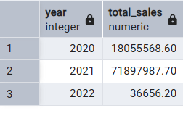
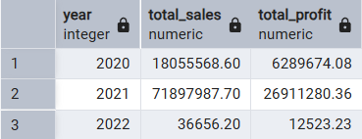
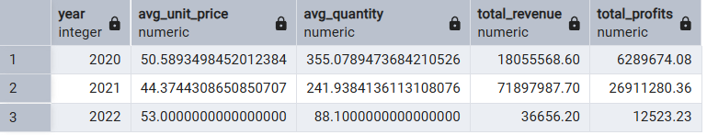
3. Do sales go up or down at certain times of the year (like a specific month or quarter)?
How do sales change over different year?
SQL query :
select year, sum(revenue) as total_sales
from sales_data
group by year
order by year, min(invoice_date) desc;
Reason of decreasing :
we can see in the table that total sales are decreasing year by year. This is because the average quantity of product sold is getting lower, from 355 in 2020 down to just 88 in 2022. The average unit price is also getting lower, which is another reason for the decrease in sales.
Recommendations :
I recommend that the company increases the production of products and considers lowering the price to boost sales. We should also focus on our best regions like the 'West' and states like 'New York' to help increase sales and profit.

Slide 5
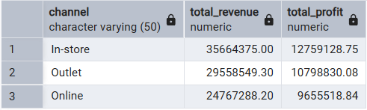
Compare the performance of our different sales methods (like "In-store" versus "Online"). Which method is most profitable?
Which sales method generated the highest revenue?
SQL query :
Select channel, SUM(profit) AS total_profit
From sales_data
Group by channel
Order by total_profit desc ;
Recommendation :
The data shows that our in-store channel is the most profitable, followed by outlet and online. To maximize our returns, I recommend we focus on the in-store channel by increasing the quantity and variety of products available.

Slide 6
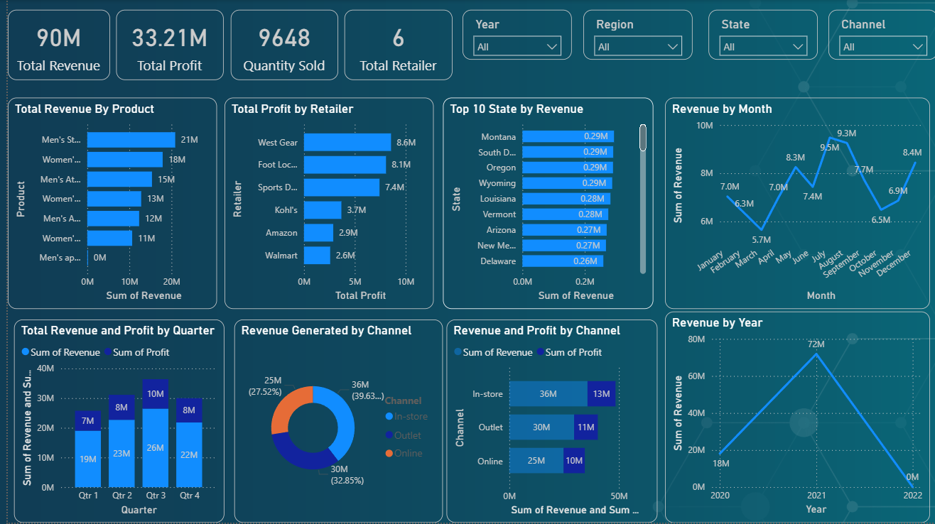
Addidas visualisation and Dashboard

