Slide 1
Before we start
Fork and clone the git repository – follow the link from the online schedule
We will refer to the directory where you have just cloned the repo as ODD_dir throughout the lecture (i.e. so you have /ODD_dir/potions/, /ODD_dir/potions/tools/, etc.)

Slide 2
Organizing, documenting and distributing scientific code
ASPP 2019, Camerino

Slide 3
Motivation
You want to write code that is usable for you and future you (and other people)
Organising your code in a standardized way makes it easier for others to contribute to your project
Notes:
will try to convince you that even if you don’t want to distribute your project, it is helpful to have your project in this format.

Slide 4
We’ve all done it!
Search for a package that does what you need
Install following (sometimes questionable) instructions online
Try to import into python
On a good day… it works! ☺
On a bad day.. everything breaks. ☹
Notes:
Show of hands: Who has installed something with pip? Who has never had a problem with installing packages with pip? Who knows what pip install x really means Who has used an import statement, e.g. import numpy as np? Who knows what that statement actually does?

Slide 5
Understanding Modules and Packages
Converting a Project into a Package
Distributing a Package

Slide 6
Modules and packages
A module is a file consisting of Python code e.g. functions and/or classes and/or variables
Typically a package is a directory with an __init__.py file and one or more python files or even other packages
potions
__init__.py
make_potion.py
potion.py
tools
__init__.py
ingredients.py
cooking.py
Notes:
Make clear that this is the package structure they will be using

Slide 7
Installing other packages
PIP is a command-line utility that allows you to install or uninstall Python packages from PyPI or a VCS (Version Control System) e.g. github
PyPI (Python Package Index): the central repository for third-party Python packages
Option 1: if package is included in PyPI
pip install numpy
Option 2: install from a VCS like git
pip install git+https://github. com/user/package.git
downloads all the files in that package
saves those files into a directory that is searchable by Python (not current directory)
Notes:
Does option 2 allow for installing a particular version?? How does option 2 relate to the master branch of that project?
Pip takes the code you want to use and puts it somewhere safe

Slide 8
Importing
Python code in one module gains access to the code in another module by the process of importing it
The import statement combines two operations:
searches for the named module/package
potions
__init__.py
make_potion.py
potion.py
tools
__init__.py
ingredients.py
cooking.py
equipment.py

Slide 9
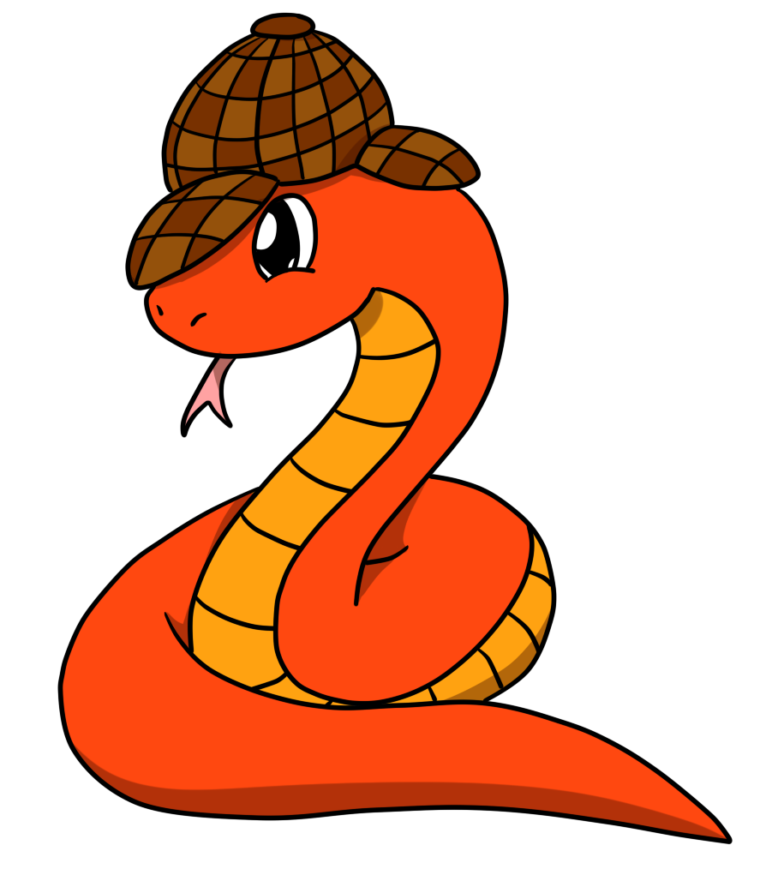
Import from where?
1) Python core packages
(time, math, …)
nope
2) Python path
(list of directories to look for packages; all installed packages)
nope
3) Current directory (folder and file names)
nope
potions
__init__.py
make_potion.py
potion.py
tools
__init__.py
cooking.py
Terminal
potions $ python
>>> import potions
ModuleNotFoundError: No module named 'potions'

Slide 10
Import from where?
1) Python core packages
(time, math, …)
nope
2) Python path
(list of directories to look for packages; all installed packages)
nope
3) Current directory (folder and file names)
Yes!
potions
__init__.py
make_potion.py
potion.py
tools
__init__.py
cooking.py
Terminal
ODD_dir $ python
>>> import potions
>>>
Notes:
CHECKS IN SUBDIRECTORIES AS WELL??

Slide 11
Import from where?
potions
__init__.py
make_potion.py
potion.py
tools
__init__.py
cooking.py
Terminal
anywhere $ python
>>> import potions

Slide 12
Installing your own package
PIP is a command-line utility that allows you to install or uninstall Python packages from PyPI or a VCS (Version Control System) e.g. github
PyPI (Python Package Index): the central repository for third-party Python packages
Option 1: if package is included in PyPI
pip install numpy
Option 2: install from a VCS like git
pip install git+https://github.com/ user/package.git
Option 3: install an existing package with -e (--editable) option pip install -e /path/x/
(package needs to be installable!)

Slide 13
Import from where?
1) Python core packages
(time, math, …)
nope
pip install -e /path/ODD_dir
2) Python path
(list of directories to look for packages; all installed packages)
Yes!
3) Current directory (folder and file names)
nope
potions
__init__.py
make_potion.py
potion.py
tools
__init__.py
cooking.py
Terminal
anywhere $ python
>>> import potions
>>>

Slide 14
Importing
Python code in one module gains access to the code in another module by the process of importing it
The import statement combines two operations:
searches for the named module/package
makes the module/package code accessible via the module/package name
potions
__init__.py
make_potion.py
potion.py
tools
__init__.py
ingredients.py
cooking.py
equipment.py

Slide 15
Import package
from potions import potion
1) Importing a package runs the code in the __init__.py file in that folder
if __init__.py is empty: finishes importing, but does not import anything
if __init__.py includes: from potions import potion then the code in potion.py is run
__init__.py
potions
__init__.py
make_potion.py
potion.py
tools
__init__.py
cooking.py
Terminal
anywhere $ python
>>> import potions
>>>
>>> potions.potion.func()
<potions.potion.func object>
anywhere $ python
>>> import potions
>>>
anywhere $ python
>>> import potions
>>>
>>> potions.potion.func()
AttributeError: module 'potions' has no attribute 'potion'
Notes:
When a module is imported, Python runs all of the code in the module file
When a package is imported, Python runs all of the code in the package’s __init__.py file, if such a file exists
All of the objects defined in the module or the package’s __init__.py file are made available to the importer

Slide 16
Import module
2) Importing a module directly will run the __init__ files of the packages in which the modules are contained:
- /potions/__init__.py
- /potions/tools/__init__.py
- /potions/tools/cooking.py
Note that the same happens when running
from potions.tools import cooking
__init__.py
potions
__init__.py
make_potion.py
potion.py
__init__.py
tools
__init__.py
cooking.py
cooking.py
Terminal
anywhere $ python
>>> import potions.tools.cooking
>>>
anywhere $ python
>>> import potions.tools.cooking
>>>
anywhere $ python
>>> import potions.tools.cooking
>>>
anywhere $ python
>>> import potions.tools.cooking
>>>
anywhere $ python
>>> import potions.tools.cooking
>>>
>>> potions.tools.cooking.func()
<potions.tools.cooking.func obj>
Notes:
When a module is imported, Python runs all of the code in the module file
When a package is imported, Python runs all of the code in the package’s __init__.py file, if such a file exists
All of the objects defined in the module or the package’s __init__.py file are made available to the importer
potions.tools.cooking is a path

Slide 17
Importing
In /ODD_dir run pip install -e /path/ODD_dir
Follow the instructions in Issue #2 – Exercise 1: Importing
(There is no need to submit a pull request for this exercise)

Slide 18
Understanding Modules and Packages
Converting a Project into a Package
Distributing a Package

Slide 19
Package elements
required: makes package installable by pip
ODD_dir
setup.py
required:
flags folder as Python package
potions
__init__.py
make_potion.py
required:
name of package
potions_class.py
modules
tools
__init__.py
ingredients.py
methods.py
tests
test_make_potion.py
LICENSE
README

Slide 20
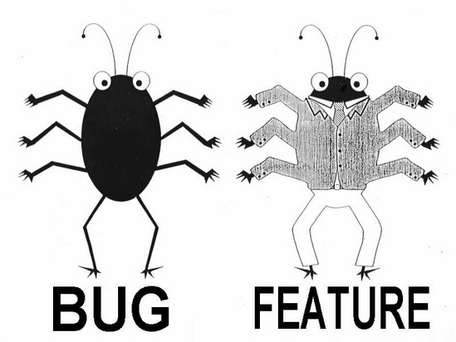
Workflow (realistic?)
1
Create
2
Build & Test
3
Publish
Write feature
Set up folder structure
Create files: __init__.py
setup.py
README
LICENSE
Make installable now
In setup.py update:
version
requirements
Update README
__init__.py
Write test
Document
Test

Slide 21
Write your function
We are missing only one potion making function before publishing the potions package
Exercise:
Create a branch with a unique name
Follow the instructions in Issue #3 – Exercise 2: Writing and testing to write and test a function to make a “Python expert” potion

Slide 22
Documentation
Documenting your code provides a way of making you code usable for future you and others
Comments (#): describe what a line (or multiple lines of code do); notes to self
Function/method docstring (''' '''): purpose of function + params / return
Module docstring (''' '''): what’s in this file
""" Module doctring """
def add_points(house_points, points=0):
""" Function docstring """
# comment
points += 1000
return house_points + points

Slide 23
NumPy style
""" This module demonstrates docstrings. """
def add_points(house_points, points=0):
""" Adds up Gryffindor points for house cup.
If this function were more complicated,
further explanations could go here.
Parameters
----------
house_points : int
Current house cup score.
points : int, optional
New points to be added/ subtracted.
Returns
-------
int
"""
# Dumbledore adds 1000 points regardless.
points += 1000
return house_points + points
triple double quotes below declaration
The first line should be a short description
If more explanation is required, that text should be separated from the first line by a blank line
Specify Parameters and Returns as name : type description (put a line of --- below sections)
Each line should begin with a capital letter and end with a full stop

Slide 24
Document your function
Document the function you just wrote according to the instructions in Issue #4 – Exercise 3: Documentation. You will also find a link outlining NumPy style docstrings there.
To access the documentation you just wrote, use the function help() in a Python interpreter.

Slide 25
Keeping track of your docstrings
Most commonly used hosting websites: facilitate building, versioning, and hosting
github.io
readthedocs.org
Automate documentation
Sphinx: a package to collect docstrings and create a nicely formatted documentation website

Slide 26
Understanding Modules and Packages
Converting a Project into a Package
Distributing a Package

Slide 27
Other files
setup.py is needed to make package installable (pip executes setup.py during installation).
potions
setup.py
LICENSE.txt
A LICENSE makes the package (legally) usable. Pick one from choosealicense.com
README.rst
A README contains more information e.g. instructions on how to use your package.
potions
__init__.py
make_potion.py
potions_class.py
tools
__init__.py
ingredients.py
methods.py
tests
test_make_potion.py
27

Slide 28
Setup.py: level 0
The setup function receives package information and package meta data
required entries: name, version, packages(/modules)
install_requires not optional if code relies on other packages to work (go through modules and update regularly, don’t just copy ‘$ pip freeze’)
from setuptools import setup
setup(
name = 'potions',
version = '0.1.0',
packages = ['potions', 'potions.tools'],
author = 'ASPP 2019',
author_email = 's.snape@hogwarts.ac.uk',
description = 'an example of a simple python package',
license = 'MIT',
url = 'https://github.com/ASPP/2019-camerino-ODD.git',
install_requires = ['numpy',
'matplotlib'],
)

Slide 29
Setup.py: level 1
Additions:
long_description from README file
let setuptools find packages automatically
added flexible version of requirements (this can also go into separate requirements.txt)
from setuptools import setup, find_packages
with open('README.txt', 'r') as fh:
long_description = fh.read()
setup(
name = 'potions',
version = '0.1.0',
packages = find_packages(),
author = 'ASPP 2019',
author_email = 's.snape@hogwarts.ac.uk',
description = 'an example python package',
long_description = long_description,
license = 'MIT',
url = 'https://github.com/ASPP/2019-camerino-ODD.git',
install_requires = ['numpy >= 1.13.0’,
'matplotlib ~= 2.1.0'],
)

Slide 30
Avoiding dependency incompatibilities
Example 1 (Unnamed*, 2017):
You are an auditory neuroscientist using Python 3.
You start a new modelling project and want to use BrianHears (an auditory modelling library), which uses Python 2 and requires older versions of NumPy/SciPy/etc.
You downgrade your packages and cause all other projects to fail.
Example 2 (Unnamed**, 2018):
Until now, you just happily installed new packages with pip whenever you needed them without thinking about it.
Suddenly nothing works and you have to delete and reinstall everything.
* Pam ** Cat

Slide 31
Virtual Environments
What is a virtual environment?
A semi-isolated python environment -> you cannot access packages (libraries and their dependencies) installed in other environments.
packages are installed inside a project-specific virtual environment folder (not into general python path)
If you break something, you can start over easily

Slide 32
Using Virtual Environments
venv
create: $ python3 -m venv /path/to/venv
activate: $ source /path/to/venv/bin/activate
deactivate: $ deactivate
Check what packages are installed in your system Python ($ pip freeze)
Make a new environment in ODD_dir folder Tip: If you are in the /ODD_dir, then /path/to/venv can be: . (a full stop)
Activate the environment and install a specific package e.g. numpy==1.0.1
Can you see (env_name)? Check $ pip freeze and $ which python
Environments can also be installed with conda, but then you need to install your packages through conda, not pip
conda
create: $ conda create --name hogwarts python=3.7
activate: $ conda activate hogwarts
deactivate: $ conda deactivate

Slide 33
Distributing
To distribute a package our project has to:
be organized into a package structure (__init__.py, modules)
have all the necessary installation files (setup.py)
be well documented, ideally with examples and tutorials
be uploaded to either a VCS or PyPI with installation instructions

Slide 34
Last things last
Uninstall the potions package pip uninstall potions
Delete or deactivate the environment venv rm ….?

Slide 35
Mischief Managed
Any questions?

