Slide 1
Potions Organizing, documenting and distributing scientific code
ASPP 2019, Camerino

Slide 2
Motivation
You want to write code that is usable for you and future you (and other people)
Ensures your project is installable and usable by co-workers and researchers
Using a standardized organization makes it possible for others to contribute to your project

Slide 3
We’ve all done it!
Search for a package that does what you need
Install following (sometimes questionable) instructions online
Try to import into python
On a good day… it works! ☺
On a bad day.. everything breaks. ☹

Slide 4
Understanding Modules and Packages
Converting a Project into a Package
Distributing a Package

Slide 5
Modules and packages
A module is a file consisting of Python code e.g. functions and/or classes and/or variables
Typically a package is a directory with an __init__.py file and one or more python files or even other packages
potions
__init__.py
make_potion.py
potion.py
tools
__init__.py
ingredients.py
cooking.py

Slide 6
Installing other packages
PIP is a command-line utility that allows you to install or uninstall Python packages from PyPI or a VCS (Version Control System) e.g. github
PyPI (Python Package Index): the central repository for third-party Python packages
Option 1: if package is included in PyPI
pip install numpy
Option 2: install from a VCS like git
pip install git+https://github.com/ user/package.git
saves code into a different directory (not current directory),
into a folder that is searchable by python (on python path)

Slide 7
Over to you
Clone the repo for this part of the course from here: $ git clone https://github.com/ASPP/2019-camerino-ODD.git
Be careful of autoformatting when copy and pasting (esp. into terminal!): some characters might change: – and - ; ‘ and ' ; “ and " ; …
Check location of where package was saved? current location?
We will refer to the directory where you have just cloned the repo as ODD_dir throughout the lecture (i.e. so you have /ODD_dir/potions/, /ODD_dir/potions/tools/, etc.)

Slide 8
Importing
$ git clone https://github.com/ASPP/2019-camerino-ODD.git
Python code in one module gains access to the code in another module by the process of importing it
The import statement combines two operations:
searches for the named module/package
potions
__init__.py
make_potion.py
potion.py
tools
__init__.py
ingredients.py
cooking.py
equipment.py

Slide 9
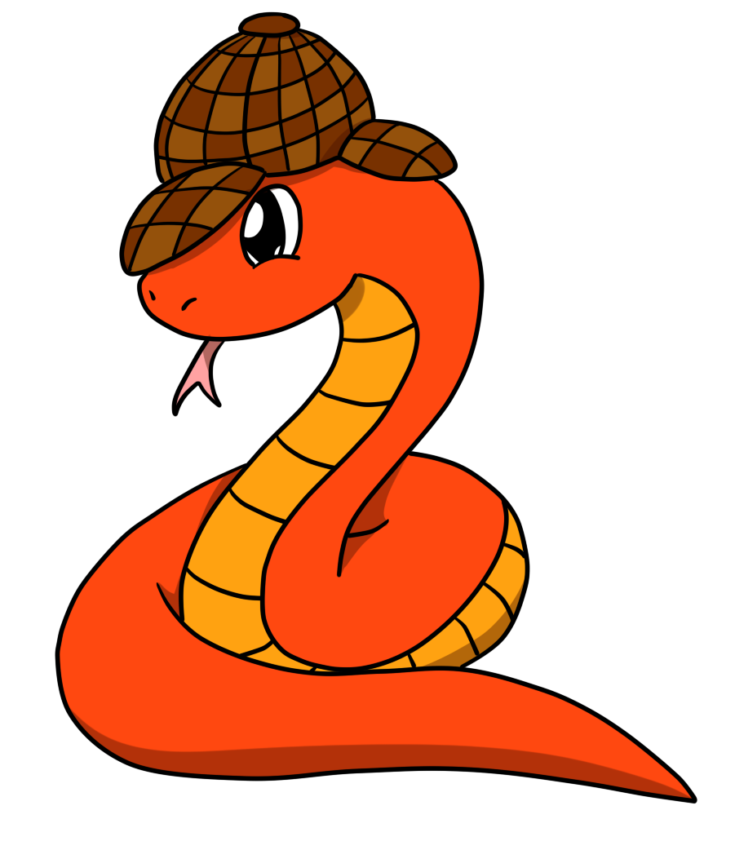
Import from where?
1) Python core packages
(time, math, …)
nope
2) Python path
(list of directories to look for packages; all installed packages)
nope
3) Current directory and subdirectories (folder and file names)
nope
potions
__init__.py
make_potion.py
potion.py
tools
__init__.py
cooking.py
Terminal
potions $ python
>>> import potions
ModuleNotFoundError: No module named 'potions'

Slide 10
Import from where?
1) Python core packages
(time, math, …)
nope
2) Python path
(list of directories to look for packages; all installed packages)
nope
3) Current directory and subdirectories (folder and file names)
Yes!
potions
__init__.py
make_potion.py
potion.py
tools
__init__.py
cooking.py
Terminal
ODD_dir $ python
>>> import potions
>>>

Slide 11
Import from where?
potions
__init__.py
make_potion.py
potion.py
tools
__init__.py
cooking.py
Terminal
anywhere $ python
>>> import potions

Slide 12
Installing your own package
PIP is a command-line utility that allows you to install or uninstall Python packages from PyPI or a VCS (Version Control System) e.g. github
PyPI (Python Package Index): repository for third-party Python packages
Option 1: if package is included in PyPI
pip install numpy
Option 2: install from a VCS like git
pip install git+https://github.com/ user/package.git
Option 3: install an existing package with -e (--editable) option
pip install -e . pip install -e /path/x/
(package needs to be installable!)

Slide 13
Import from where?
1) Python core packages
(time, math, …)
nope
pip install -e /path/ODD_dir
2) Python path
(list of directories to look for packages; all installed packages)
Yes!
3) Current directory and subdirectories (folder and file names)
nope
potions
__init__.py
make_potion.py
potion.py
tools
__init__.py
cooking.py
Terminal
anywhere $ python
>>> import potions
>>>

Slide 14
Importing
$ git clone https://github.com/ASPP/2019-camerino-ODD.git
Python code in one module gains access to the code in another module by the process of importing it
The import statement combines two operations:
searches for the named module/package
makes the module/package code accessible via the module/package name
potions
__init__.py
make_potion.py
potion.py
tools
__init__.py
ingredients.py
cooking.py
equipment.py

Slide 15
What does import do?
from potions import potion
1) Importing a package runs the code in the __init__.py file in that folder
if __init__.py is empty: finishes importing, but does not import potion.py
if __init__.py includes: from potions import potion then the code in potion.py is run
Running the code makes it available and binds it to name
__init__.py
potions
__init__.py
make_potion.py
potion.py
tools
__init__.py
cooking.py
Terminal
anywhere $ python
>>> import potions
anywhere $ python
>>> import potions
>>>
>>> potions.potion
AttributeError: module 'potions' has no attribute 'potion'
anywhere $ python
>>> import potions
>>>
>>> potions.potion
<module 'potions.potion’>
>>> potions.potion.func()
<potions.potion.func object>
Notes:
When a module is imported, Python runs all of the code in the module file
When a package is imported, Python runs all of the code in the package’s __init__.py file, if such a file exists
All of the objects defined in the module or the package’s __init__.py file are made available to the importer

Slide 16
What does import do?
2) Importing a module directly will run the __init__ files of the packages in which the modules are contained:
- /potions/__init__.py
- /potions/tools/__init__.py
- /potions/tools/cooking.py
Note that the same happens when running
from potions.tools import cooking
__init__.py
potions
__init__.py
make_potion.py
potion.py
__init__.py
tools
__init__.py
cooking.py
cooking.py
Terminal
anywhere $ python
>>> import potions.tools.cooking
>>>
anywhere $ python
>>> import potions.tools.cooking
>>>
anywhere $ python
>>> import potions.tools.cooking
>>>
anywhere $ python
>>> import potions.tools.cooking
>>>
anywhere $ python
>>> import potions.tools.cooking
>>>
>>> potions.tools.cooking
<module 'potions.tools.cooking'>
>>> potions.tools.cooking.func()
<potions.tools.cooking.func obj>
Notes:
When a module is imported, Python runs all of the code in the module file
When a package is imported, Python runs all of the code in the package’s __init__.py file, if such a file exists
All of the objects defined in the module or the package’s __init__.py file are made available to the importer

Slide 17
Importing
In /ODD_dir run pip install -e . (don’t forget the .) or pip install -e /path/ODD_dir
Follow the instructions in Issue #1 on https://github.com/ASPP/2019-camerino-ODD/issues
How far can you get in 10 minutes? (You are not expected to finish all parts!)

Slide 18
Understanding Modules and Packages
Converting a Project into a Package
Distributing a Package

Slide 19
Package elements
ODD_dir
setup.py
required:
makes package installable
LICENSE
README
required:
flags folder as Python package
potions
__init__.py
required:
name of package
make_potion.py
potions_class.py
modules
tools
__init__.py
ingredients.py
methods.py
tests
test_make_potion.py

Slide 20
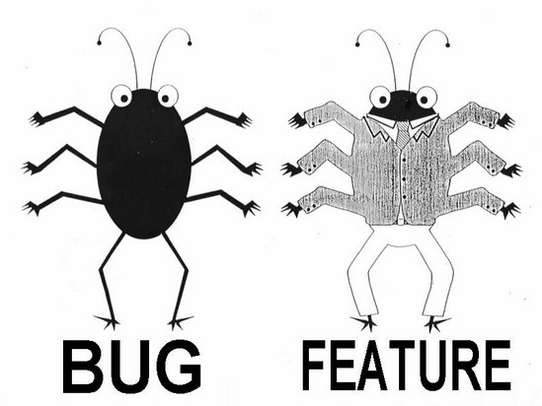
Workflow (realistic?)
1
Create
2
Build & Test
3
Publish
Write function
Set up folder structure
Create files: __init__.py
setup.py
README
LICENSE
Make installable now
In setup.py update:
version
requirements
Update README
__init__.py
Write test
Document
Test

Slide 21
Write your function
We are missing only one potion making function before publishing the potions package
Exercise: follow the instructions in Issue #2 to write and test a function to make a “Python expert” potion

Slide 22
Documentation
Documenting your code provides a way of making you code usable for future you and others
Comments (#): describe what a line (or multiple lines of code do); notes to self
Function/method docstring (''' '''): purpose of function + params / return
Module docstring (''' '''): what’s in this file
""" Module doctring """
def add_points(house_points, points=0):
""" Function docstring """
# comment
points += 1000
return house_points + points

Slide 23
NumPy style
""" This module demonstrates docstrings. """
def add_points(house_points, points=0):
""" Adds up Gryffindor points for house cup.
If this function were more complicated,
further explanations could go here.
Parameters
----------
house_points : int
Current house cup score.
points : int, optional
New points to be added/ subtracted.
Returns
-------
int
"""
# Dumbledore adds 1000 points regardless.
points += 1000
return house_points + points
triple double quotes below declaration
The first line should be a short description
If more explanation is required, that text should be separated from the first line by a blank line
Specify Parameters and Returns as name : type description (put a line of --- below sections)
Each line should begin with a capital letter and end with a full stop

Slide 24
Document your function
Document the function you just wrote. Issue #3 has the main points as well as a link explaining NumPy style docstrings.
Try accessing the documentation you write using the function help() in a python terminal

Slide 25
Keeping track of your docstrings
Most commonly used hosting websites: facilitate building, versioning, and hosting
github.io
readthedocs.org
Automate documentation
Sphinx: a package to collect docstrings and create a nicely formatted documentation website

Slide 26
Understanding Modules and Packages
Converting a Project into a Package
Distributing a Package

Slide 27
Other files
setup.py is needed to make package installable.
potions
setup.py
LICENSE.txt
A LICENSE makes the package (legally) usable. Pick one from choosealicense.com
README.rst
A README contains more information e.g. instructions on how to use your package.
potions
__init__.py
make_potion.py
potions_class.py
tools
__init__.py
ingredients.py
methods.py
tests
test_make_potion.py
27

Slide 28
Setup.py: level 0
The setup function receives package information and package meta data
required entries: name, version, packages(/modules)
install_requires not optional if code relies on other packages to work (go through modules and update regularly, don’t just copy ‘$ pip freeze’)
from setuptools import setup
setup(
name = 'potions',
version = '0.1.0',
packages = ['potions', 'potions.tools'],
author = 'ASPP 2019',
author_email = 's.snape@hogwarts.ac.uk',
description = 'an example of a simple python package',
license = 'MIT',
url = 'https://github.com/ASPP/2019-camerino-ODD.git',
install_requires = ['numpy',
'matplotlib'],
)

Slide 29
Setup.py: level 1
Additions:
long_description from README file
let setuptools find packages automatically
added flexible version of requirements (this can also go into separate requirements.txt)
from setuptools import setup, find_packages
with open('README.txt', 'r') as fh:
long_description = fh.read()
setup(
name = 'potions',
version = '0.1.0',
packages = find_packages(),
author = 'ASPP 2019',
author_email = 's.snape@hogwarts.ac.uk',
description = 'an example python package',
long_description = long_description,
license = 'MIT',
url = 'https://github.com/ASPP/2019-camerino-ODD.git',
install_requires = ['numpy >= 1.13.0’,
'matplotlib ~= 2.1.0'],
)

Slide 30
Avoiding dependency incompatibilities
Example 1 (Unnamed*, 2018):
You are an auditory neuroscientist using Python 3.
You start a new modelling project and want to use BrianHears (an auditory modelling library), which uses Python 2 and requires older versions of NumPy/SciPy/etc.
You downgrade your packages and cause all other projects to fail.
Example 2 (Unnamed**, 2019):
Until now, you just happily installed new packages with pip whenever you needed them without thinking about it.
Suddenly nothing works and you have to delete and reinstall everything.
* Pam ** Cat

Slide 31
Virtual Environments
What is a virtual environment?
A semi-isolated python environment -> you cannot access packages (libraries and their dependencies) installed in other environments.
packages are installed inside a project-specific virtual environment folder (not into general python path)

Slide 32
Using Virtual Environments
conda
venv
create: $ conda create --name hogwarts python=3.7
activate: $ conda activate hogwarts
deactivate: $ conda deactivate
create: $ python3 -m venv /path/to/venv # /path/to/venv can be .
activate: $ source /path/to/venv/bin/activate
deactivate: $ deactivate
Check what packages are installed in your system Python ($ pip freeze)
Make a new environment called hogwarts (conda) or in ODD_dir folder (venv)
Activate the environment and install a specific package e.g. numpy==1.0.1
Can you see (env_name)? Check $ pip freeze and $ which python

Slide 33
Advantages of using Virtual Environments
Advantages of working with virtual environments
keeping projects and their required packages separate
using different Python/package versions on same computer without conflict
If you break something, you can start over easily

Slide 34
Distributing
To distribute a package our project has to:
be organized into a package structure (__init__.py, modules)
have all the necessary installation files (setup.py)
be well documented, ideally with examples and tutorials
be uploaded to either a VCS or PyPI

Slide 35
Mischief Managed
Any questions?

Slide 36
SlidesCarnival icons are editable shapes.
This means that you can:
Resize them without losing quality.
Change fill color and opacity.
Change line color, width and style.
Isn’t that nice? :)
Examples:

