Slide 1

Testing, debugging, profiling Python tools for building software
Pietro Berkes, Enthought UK
Notes:
Kathryn talked about best practices for scientific programming -> recipes that have been shown to produce good software
I’m going to show you the Python tools for those techniques: unit testing, debugging, profile, …
PLEASE interrupt me whenever BRING UP YOUR USER CASES

Slide 2
Outline
The agile programming cycle
Writing scientific software
Testing
Debugging
Optimization and profiling
Notes:
Kathryn tried to *inspire* you to use best practices, I’ll try to scare you into them. Good cop / bad cop

Slide 3
Python tools for building software
There are many tools, based on command line or graphical interface.
I’ll present:
Python standard “batteries included” tools
Mostly, no graphical interface necessary
Magic commands for IPython

Slide 4
The agile development cycle
Write tests to check that feature works
Write simplest code that makes tests pass
Run tests and debug until all tests pass
Refactor and optimize only if necessary
Pick your next feature
Notes:
As opposed to waterfall model
Reminder
1) describe cycle
2) short development cycles
3) for all of these steps there are python tools to help you; there’s no tool yet for writing the code, unfortunately

Slide 5
Python tools
Write tests to check that feature works
Write simplest code that makes tests pass
Run tests and debug until all tests pass
Refactor and optimize only if necessary
Pick your next feature
unittest
pdb
timeit
cProfile
line_profiler
Notes:
As opposed to waterfall model
Reminder
1) describe cycle
2) short development cycles
3) for all of these steps there are python tools to help you; there’s no tool yet for writing the code, unfortunately

Slide 6
Testing scientific code

Slide 7
The agile development cycle
Write tests to check that feature works
Write simplest code that makes tests pass
Run tests and debug until all tests pass
Refactor and optimize only if necessary
Pick your next feature
unittest
pdb
timeit
cProfile
line_profiler
Notes:
As opposed to waterfall model
Reminder
1) describe cycle
2) short development cycles
3) for all of these steps there are python tools to help you; there’s no tool yet for writing the code, unfortunately

Slide 8
Why write tests?
Correctness is main requirement for scientific code
You must be able to show that your code works as intended
Tests are the best way to trust your code
Notes:
What makes scientific programming special?

Slide 9
Effect of software bugs in science
frequency
bug severity
oops, wrong labels!
need to send errata corrige
end of career
Notes:
Made up plot, not backed by any data; and no error bars!
This slide is supposed to scare you into listening to the rest
didn’t properly shuffle my data for the control, a couple of results are not statistically significant any more… errata

Slide 10
Software bugs in research are a serious business
Science, Dec 2006: 5 high-profile retractions (3x Science, PNAS, J. Mol. Biol.) because ”an in-house data reduction program introduced a change in sign for anomalous differences”
PLoS Comp Bio, July 2007: retraction because “As a result of a bug in the Perl script used to compare estimated trees with true trees, the clade confidence measures were sometimes associated with the incorrect clades.”
Notes:
When you get a crappy result, you triple check your code for bugs. If the results come out just the way you want them to, how much effort are you going to put into double-checking?
For two errors reported and retraced, many more undetected or not reported.

Slide 11

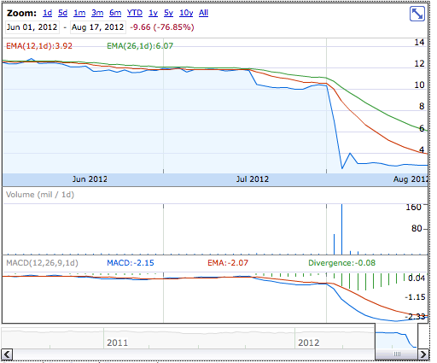
Not only in academia…
Source: Google Finance
NYT, 2 August 2012
Notes:
These slides were supposed to scare you into listening to the rest of the presentation: obviously, we need strategies to prevent this problems, and the agile programming techniques that Valentin talked about yesterday, and testing in particular, go a long way in this direction.

Slide 12
Not only in academia…
… but it worked on my machine!
Source: Google Finance
NYT, 2 August 2012
Notes:
These slides were supposed to scare you into listening to the rest of the presentation: obviously, we need strategies to prevent this problems, and the agile programming techniques that Valentin talked about yesterday, and testing in particular, go a long way in this direction.

Slide 13
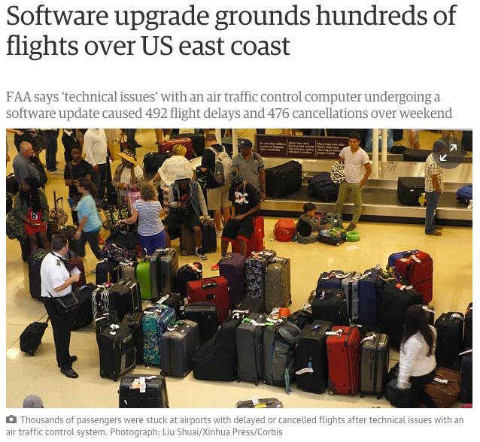
Most recent software failure
The Guardian, 17 August 2015

Slide 14
Most recent software failure
The IT guy wants you to know that “this never happened before”
The Guardian, 17 August 2015

Slide 15
Why write tests?
Correctness is main requirement for scientific code
You must be able to show that your code works as intended
Tests are the best way to trust your code
Leads to better and faster code: code can change, and consistency is assured by tests
Notes:
What makes scientific programming special?

Slide 16
TODO: mdp.utils.routine.permute

Slide 17
Save your future self some trouble
class DataManager(object):
# ...
def remove_data(self, data):
""" Remove the given data object. """
for idx, item in enumerate(self._data):
if data is item:
self._data[idx:idx+1] = []
break
else:
raise ValueError('Data item not in data manager’)
Notes:
what have I been smoking?

Slide 18
Tests to the rescue
class DataManager(object):
# ...
def remove_data(self, data):
""" Remove the given data object. ""”
self._data.remove(data)
Right?
Wrong!
======================================================================
ERROR: test_remove_ndarray_from_datamanager (....model.tests.test_data_manager_commands.TestDataManagerCommands)
----------------------------------------------------------------------
Traceback (most recent call last):
File "/.../model/tests/test_data_manager_commands.py", line 64, in test_remove_ndarray_from_datamanager
data_manager.remove_data(np_array)
...
ValueError: The truth value of an array with more than one element is ambiguous. Use a.any() or a.all()
Notes:
what have I been smoking?

Slide 19
Testing with Python
Tests are automated:
Write test suite in parallel with your code
External software runs the tests and provides reports and statistics
test_choice (__main__.TestSequenceFunctions) ... ok test_sample (__main__.TestSequenceFunctions) ... ok test_shuffle (__main__.TestSequenceFunctions) ... ok ------------------------------------------------------- Ran 3 tests in 0.110s OK
Notes:
everybody “tests” his software, little toy problems, or just run it and use it for a while and see than nothing breaks
Why automation is important: next slide

Slide 20
Hands-on!
Go to hands_on_exercises/pyanno_voting
Execute pyanno/tests/test_voting.py
Notes:
Open file, comment on content
Show next slide: all the ways to execute a test

Slide 21
How to run tests
Option 1: unittest.main() will execute all tests in all TestCase classes in a file if __name__ == '__main__': unittest.main()
Option 2: Execute all tests in one file python -m unittest [-v] test_module
Option 3: Discover all tests in all subdirectories python -m unittest discover

Slide 22
Test suites in Python: unittest
Writing tests with unittest is simple enough:
Each test case is a subclass of unittest.TestCase
Each test unit is a method of the class, whose name starts with ‘test’
Each unit tests one aspect of your code, and checks that it behaves correctly using “assertions”. An exception is raised if it does not work as expected.
Notes:
There’s a module in the Python standard library to define test suites

Slide 23
Anatomy of a TestCase
Create new file, test_something.py:
import unittest
class FirstTestCase(unittest.TestCase):
def test_truisms(self):
"""All methods beginning with ’test’ are executed"""
self.assertTrue(True)
self.assertFalse(False)
def test_equality(self):
"""Docstrings are printed during executions
of the tests in some test runners"""
self.assertEqual(1, 1)
if __name__ == '__main__':
unittest.main()
Notes:
Import unittest
Define a test unit as a subclass of TestCase
Define a series of methods beginning with ‘test_’ that test some aspect of the code
When unittest.main() is called, the method automatically finds the tests and executes them one by one giving back a report

Slide 24
TestCase.assertSomething
TestCase defines utility methods to check that some conditions are met, and raise an exception otherwise
Check that statement is true/false: assertTrue('Hi'.islower()) => fail assertFalse('Hi'.islower()) => pass
Check that two objects are equal: assertEqual(2+1, 3) => pass assertEqual([2]+[1], [2, 1]) => pass assertNotEqual([2]+[1], [2, 1]) => fail assertEqual can be used to compare all sorts of objects: numbers, lists, tuples, dicts, sets, frozensets, and unicode

Slide 25
Hands-on!
Add a dummy test to test_voting: test that one and two is three
Execute the tests again

Slide 26
Hands-on!
Add a dummy test to test_voting: Test that one and two is three
Execute the tests again
Now test that 1.1 + 2.2 is 3.3

Slide 27
Floating point equality
Floating point numbers are rarely equal (try 1.1 + 2.2). When developing numerical code, we have to allow for machine precision errors.
Check that two numbers are equal up to a given precision: assertAlmostEqual(x, y, places=7)
places is the number of decimal places to use: assertAlmostEqual(1.121, 1.12, 2) => pass assertAlmostEqual(1.121, 1.12, 3) => fail
Notes:
If you’re working with floating point numbers two number are rarely exactly the same

Slide 28
Testing error control
Check that an exception is raised: with self.assertRaises(SomeException): do_something() do_something_else()
For example: with self.assertRaises(ValueError): int('XYZ') passes, because int('XYZ') ValueError: invalid literal for int() with base 10: 'XYZ'
Notes:
Finally

Slide 29
Testing error control
Use the most specific exception class, or the test may pass because of collateral damage: with self.assertRaises(IOError): file(1, 'r') as expected, but with self.assertRaises(Exception): file(1, 'r')
=> fail
=> pass

Slide 30
Hands-on!
Have a look at the docstring of labels_count : It raises an error if there are no valid observations, but that’s not tested!
Add a test checking that the function raises an error if:
1) We pass a list of invalid annotations (all missing values) 2) We pass an empty list of annotations

Slide 31
TestCase.assertSomething
Many more “assert” methods: (complete list at http://docs.python.org/library/unittest.html) assertGreater(a, b) / assertLess(a, b) assertRegexpMatches(text, regexp) verifies that regexp search matches text assertIn(value, sequence) assert membership in a container assertIsNone(value) verifies that value is None assertIsInstance(obj, cls) verifies that an object is an instance of a class assertItemsEqual(actual, expected) verifies equality of members, ignores order assertDictContainsSubset(subset, full) tests whether the entries in dictionary full are a superset of those in subset
Notes:
only most useful, complete list at address

Slide 32
Hands-on!
Somebody sent us a new set of annotations… they indicate missing values with -999 :-(
Modify the existing code so that the function accept an optional missing value, which by default is -1

Slide 33
Testing with numpy arrays
class NumpyTestCase(unittest.TestCase):
def test_equality(self):
a = numpy.array([1, 2])
b = numpy.array([1, 2])
self.assertEqual(a, b)
E
======================================================================
ERROR: test_equality (__main__.NumpyTestCase)
----------------------------------------------------------------------
Traceback (most recent call last):
File "numpy_testing.py", line 8, in test_equality
self.assertEqual(a, b)
File "/Library/Frameworks/Python.framework/Versions/6.1/lib/python2.6/unittest.py", line 348, in failUnlessEqual
if not first == second:
ValueError: The truth value of an array with more than one element is ambiguous. Use a.any() or a.all()
----------------------------------------------------------------------
Ran 1 test in 0.000s
FAILED (errors=1)
Notes:
The intention was to test for equality element-by-element

Slide 34
Testing with numpy arrays
numpy.testing defines appropriate function: numpy.testing.assert_array_equal(x, y) numpy.testing.assert_array_almost_equal(x, y, decimal=6)
If you need to check more complex conditions:
numpy.all(x): returns True if all elements of x are true numpy.any(x): returns True is any of the elements of x is true numpy.allclose(x, y, rtol=1e-05, atol=1e-08): returns True if two arrays are element-wise equal within a tolerance; rtol is relative difference, atol is absolute difference
combine with logical_and, logical_or, logical_not: # test that all elements of x are between 0 and 1 assertTrue(all(logical_and(x > 0.0, x < 1.0))
Notes:
The right way to do this is using …
If you need to check more complex conditions
numpy.testing.assert_array_less(x, y)
allclose:
The tolerance values are positive, typically very small numbers. The
relative difference (`rtol` * abs(`b`)) and the absolute difference
`atol` are added together to compare against the absolute difference
between `a` and `b`.

Slide 35
Hands-on!
In voting , there is an empty function, labels_frequency. Write a test for it, then an implementation.
def labels_frequency(annotations, nclasses):
"""Compute the total frequency of labels in observed annotations.
Example:
>>> labels_frequency([[1, 1, 2], [-1, 1, 2]], 4)
array([ 0. , 0.6, 0.4, 0. ])
Arguments
---------
annotations : array-like object, shape = (n_items, n_annotators)
annotations[i,j] is the annotation made by annotator j on item i
nclasses : int
Number of label classes in `annotations`
Returns
-------
freq : ndarray, shape = (n_classes, )
freq[k] is the frequency of elements of class k in `annotations`, i.e.
their count over the number of total of observed (non-missing) elements
"""

Slide 36
How to test like a professional
What does a good test looks like?
What should I test?
Anything specific to scientific code?
At first, testing feels weird:
It’s obvious that this code works
The tests are longer than the code
The test code is a duplicate of the real code

Slide 37
Basic structure of test
A good test is divided in three parts:
Given: Put your system in the right state for testing
Create objects, initialize parameters, define constants…
Define the expected result of the test
When: Execute the feature that you are testing
Typically one or two lines of code
Then: Compare outcomes with the expected ones
Set of assertions regarding the new state of your system

Slide 38
Test simple but general cases
Start with simple, general case
Take a realistic scenario for your code, try to reduce it to a simple example
Tests for ‘lower’ method of strings
class LowerTestCase(unittest.TestCase):
def test_lower(self):
# Given
string = 'HeLlO wOrld'
expected = 'hello world'
# When
output = string.lower()
# Then
self.assertEqual(output, expected)
Notes:
First of all, you should start with testing your code with
explain typical test structure
show general case: two words, upper case chars randomly dispersed
special cases
SHOW THIS (cut & paste code)

Slide 39
Test special cases and boundary conditions
Code often breaks in corner cases: empty lists, None, NaN, 0.0, lists with repeated elements, non-existing file, …
This often involves making design decision: respond to corner case with special behavior, or raise meaningful exception?
def test_empty_string(self):
# Given
string = ''
expected = ''
# When
output = string.lower()
# Then
self.assertEqual(output, expected)
Other good corner cases for string.lower():
‘do-nothing case’: string = 'hi'
symbols: string = '123 (!'
Notes:
First of all, you should start with testing your code with
explain typical test structure
show general case: two words, upper case chars randomly dispersed
special cases
SHOW THIS (cut & paste code)

Slide 40
Common testing pattern
Often these cases are collected in a single test:
def test_lower(self):
# Given
# Each test case is a tuple of (input, expected_result)
test_cases = [('HeLlO wOrld', 'hello world'),
('hi', 'hi'),
('123 ([?', '123 ([?'),
('', '')]
for string, expected in test_cases:
# When
output = string.lower()
# Then
self.assertEqual(output, expected)
Notes:
First of all, you should start with testing your code with
explain typical test structure
show general case: two words, upper case chars randomly dispersed
special cases
SHOW THIS (cut & paste code)

Slide 41
Common testing pattern
Better still:
def test_lower(self):
# Given
# Each test case is a tuple of (input, expected_result)
test_cases = [('HeLlO wOrld', 'hello world'),
('hi', 'hi'),
('123 ([?', '123 ([?'),
('', '')]
for string, expected in test_cases:
with self.subTest(i= string):
# When
output = string.lower()
# Then
self.assertEqual(output, expected)
Notes:
First of all, you should start with testing your code with
explain typical test structure
show general case: two words, upper case chars randomly dispersed
special cases
SHOW THIS (cut & paste code)

Slide 42
Numerical fuzzing
Use deterministic test cases when possible
In most numerical algorithm, this will cover only over-simplified situations; in some, it is impossible
Fuzz testing: generate random input
Outside scientific programming it is mostly used to stress-test error handling, memory leaks, safety
For numerical algorithm, it is often used to make sure one covers general, realistic cases
The input may be random, but you still need to know what to expect
Make failures reproducible by saving or printing the random seed
Notes:
In textbooks about testing you will read that tests should always be deterministic
For example, if you want to test a function that computes the Fourier components of a signal: one can define simple deterministic cases (single sine wave), but it’s not general enough
GOOD EXAMPLE: better is random mixtures of sine waves, colored noise, signal with stationary statistics => compute the eigenvalues of the covariance matrix

Slide 43
Hands-on!
Write two tests for the function numpy.var : 1) First, a deterministic test 2) Then, a numerical fuzzing test

Slide 44
Numerical fuzzing – example
class VarianceTestCase(unittest.TestCase):
def test_var(self):
N, D = 100000, 5
# Goal variances: [0.1 , 0.45, 0.8 , 1.15, 1.5]
expected = numpy.linspace(0.1, 1.5, D)
# Test multiple times with random data
for _ in range(20):
# Generate random, D-dimensional data
x = numpy.random.randn(N, D) * numpy.sqrt(desired)
variance = numpy.var(x, axis=0)
numpy.testing.assert_array_almost_equal(variance, expected, 1)
Notes:
… generate 5 vectors with 100000 elements, such that each vector has a goal variance, which I set here to be 5 numbers between 0.1 and 1.5

Slide 45
Testing learning algorithms
Learning algorithms can get stuck in local maxima, the solution for general cases might not be known (e.g., unsupervised learning)
Turn your validation cases into tests
Stability tests:
Start from final solution; verify that the algorithm stays there
Start from solution and add a small amount of noise to the parameters; verify that the algorithm converges back to the solution
Generate data from the model with known parameters
E.g., linear regression: generate data as y = a*x + b + noise for random a, b, and x, then test that the algorithm is able to recover a and b
Notes:
…
There is no general rule for testing these algorithm, for each specific algorithm there are usually validation cases (e.g, a classifier might be validated using two classes of very different objects)

Slide 46
Other common cases
Test general routines with specific ones
Example: test polyomial_expansion(data, degree) with quadratic_expansion(data)
Test optimized routines with brute-force approaches
Example: test function computing analytical derivative with numerical derivative

Slide 47
Example: eigenvector decomposition
Consider the function values, vectors = eigen(matrix)
Test with simple but general cases:
use full matrices for which you know the exact solution (from a table or computed by hand)
Test general routine with specific ones:
use the analytical solution for 2x2 matrices
Numerical fuzzing:
generate random eigenvalues, random eigenvector; construct the matrix; then check that the function returns the correct values
Test with boundary cases:
test with diagonal matrix: is the algorithm stable?
test with a singular matrix: is the algorithm robust? Does it raise appropriate error when it fails?

Slide 48
Test-driven development (TDD)
An influential testing philosophy: write tests before writing code
Choose what is the next feature you’d like to implement
Write a test for that feature
Write the simplest code that will make the test pass
Forces you to think about the design of your code before writing it: how would you like to interact with it?
The result is code whose features can be tested individually, leading to maintainable, decoupled code
If the results are bad, then you’ll write tests to find a bug. If it works, will you?

Slide 49
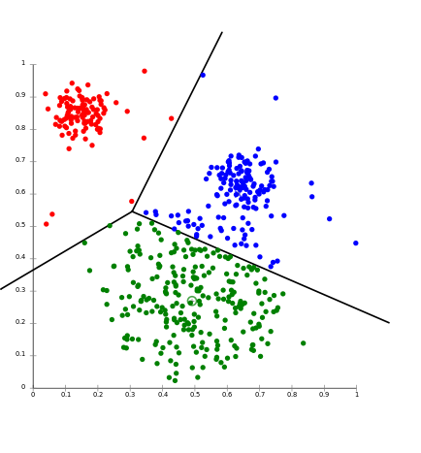
DEMO
k-means
+
+
+

Slide 50
Testing: Money back guarantee
I guarantee that aggressive testing will improve your code and your research, or you’ll get the Python school fee back!
Just remember, code quality is not just testing:
“Trying to improve the quality of software by doing more testing is like trying to lose weight by weighing yourself more often” (Steve McConnell, Code Complete)

Slide 51
Debugging

Slide 52
The agile development cycle
Write tests to check that feature works
Write simplest code that makes tests pass
Run tests and debug until all tests pass
Refactor and optimize only if necessary
Pick your next feature
unittest
pdb
timeit
cProfile
line_profiler
Notes:
As opposed to waterfall model
Reminder
1) describe cycle
2) short development cycles
3) for all of these steps there are python tools to help you; there’s no tool yet for writing the code, unfortunately

Slide 53
Debugging
The best way to debug is to avoid bugs
In TDD, you anticipate the bugs
Your test cases should already exclude a big portion of the possible causes
Core idea in debugging: you can stop the execution of your application at the bug, look at the state of the variables, and execute the code step by step
Avoid littering your code with print statements
Notes:
Bugs are inevitable

Slide 54
pdb, the Python debugger
Command-line based debugger
pdb opens an interactive shell, in which one can interact with the code
examine and change value of variables
execute code line by line
set up breakpoints
examine calls stack

Slide 55
Entering the debugger
Enter debugger at the start of a file: python –m pdb myscript.py
Enter at a specific point in the code (alternative to print):
If you have Ipython installed, use ipdb instead:
# some code here # the debugger starts here import pdb; pdb.set_trace() # rest of the code
import ipdb; ipdb.set_trace()

Slide 56
Entering the debugger from ipython
From ipython: %pdb – preventive %debug – post-mortem

Slide 57
DEMO

Slide 58
Optimization and profiling

Slide 59
The agile development cycle
Write tests to check that feature works
Write simplest code that makes tests pass
Run tests and debug until all tests pass
Refactor and optimize only if necessary
Pick your next feature
unittest
pdb
timeit
cProfile
line_profiler
Notes:
As opposed to waterfall model
Reminder
1) describe cycle
2) short development cycles
3) for all of these steps there are python tools to help you; there’s no tool yet for writing the code, unfortunately

Slide 60
Be careful with optimization
In many cases, scientist time, not computer time is the bottleneck
Researchers need to be able to explore many different ideas
Always weight the time you spend on a task vs benefits
Keep this diagram around: https://xkcd.com/1205/
Notes:
What makes scientific programming special?

Slide 61
Python code optimization
Python is slower than C, but not prohibitively so
In scientific applications, this difference often not noticeable: the costly parts of numpy, scipy, … are written in C or Fortran
Don’t rush into writing optimizations

Slide 62
How to optimize
Usually, a small percentage of your code takes up most of the time
Identify time-consuming parts of the code (use a profiler)
Only optimize those parts of the code
Keep running the tests to make sure that code is not broken
Stop optimizing as soon as possible

Slide 63
Optimization methods hierarchy
(This is mildly controversial)
In order of preference:
Vectorize code using numpy
Use a “magic optimization” tool, like numexpr, or numba
Spend some money on better hardware (faster machine, SSD), optimized libraries (e.g., Intel’s MKL)
Use Cython
Parallelize your code
Use GPU acceleration
The bottleneck might in memory or disk management, not the CPU (see Francesc Alteds’s videos online)

Slide 64
Measuring time: timeit
Precise timing of a function/expression
Test different versions of a small amount of code, often used in interactive Python shell
In ipython, you can use the %timeit magic command
from timeit import Timer
# more detailed control of timing
t = Timer("module.function(arg1, arg2)", "import module")
# make three measurements of timing, repeat 2 million times
t.repeat(3, 2000000)

Slide 65
Hands-on!
Write a dot product function in pure Python and time it in Ipython: dot_product(x, y) is x[1] * y[1] + x[2] * y[2] + … + x[N] * y[N]
Write a version using numpy (vectorized), time it again
Write a version using numpy.dot, time it again
Try with large vector (1000 elements) and small (5 element)

Slide 66
factorial

Slide 67
Measuring time: time
On *nix systems, the command time gives a quick way of measuring time:
“real” is wall clock time
“user” is CPU time executing the script
“sys” is CPU time spent in system calls
$ time python your_script.py
real 0m0.135s
user 0m0.125s
sys 0m0.009s

Slide 68
cProfile
standard Python module to profile an entire application (profile is an old, slow profiling module)
Running the profiler from command line:
Sorting options: TODO
python -m cProfile –s cumulative myscript.py
cumulative
Notes:
what it is
first, you need to have the profiler collect information while your program is running

Slide 69
cProfile
Or save results to disk for later inspection:
Explore with
python -m cProfile –o filename.cProfile myscript.py
python –m pstats filename.cProfile
stats [n | regexp]: print statistics
sort [cumulative, time, ...] : change sort order callers [n | regexp]: show callers of functions
callees [n | regexp]: show callers of functions
Notes:
what it is
first, you need to have the profiler collect information while your program is running

Slide 70
Hands-on!
Factorial example

Slide 71
537 python -m cProfile -o factorial.cProfile factorial.py
535 pyprof2calltree -i factorial.cProfile -k
538 pyprof2calltree -i factorial.cProfile -o callgrind.out.1
qcallgrind cachegrind.out.1
kcachegrind cachegrind.out.1
(In Python 2, have a look at RunSnakeRun)

Slide 72
Screenshots of runsnake / callgrind

Slide 73
line-profile
kernprof.py -l -o confidence-3.py.lprof confidence-3.py
python -m line_profiler confidence-3.py.lprof

Slide 74
No safety net!
Anybody offering code for optimization session?

Slide 75
Final thoughts
Scientific code has slightly different needs than “regular” code, including the need to ensure correctness
Agile programming methods, and testing in particular, go a long way toward this goal
Agile programming in Python is as easy as it gets, there are no excuses not to do it!
For maximum efficiency, check out how these tools can be integrated with your editor / IDE
Notes:
Homeworks: you spent 2 hours of your life listening to me, make this worthwhile :-D Give testing a chance…

Slide 76
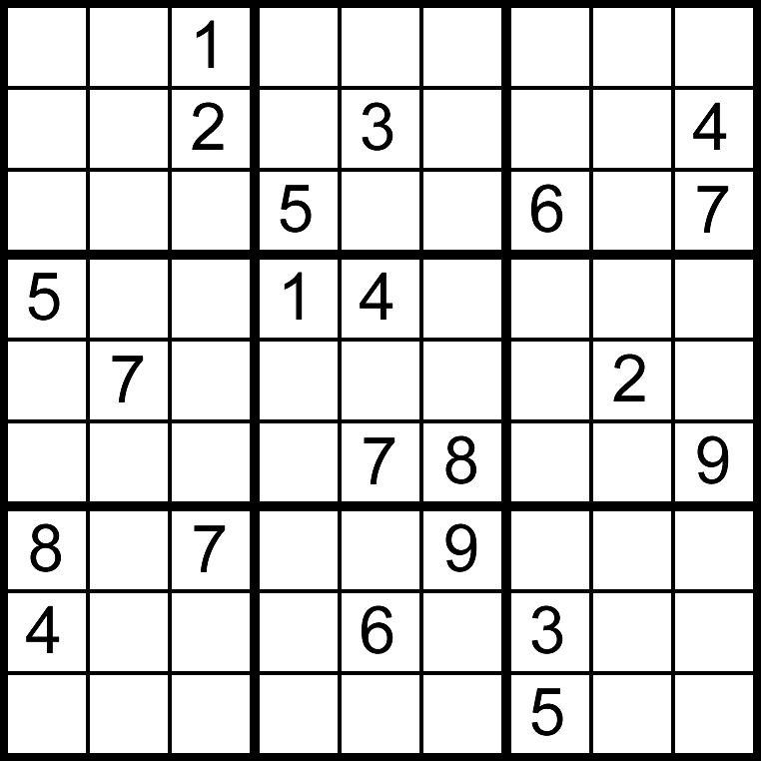
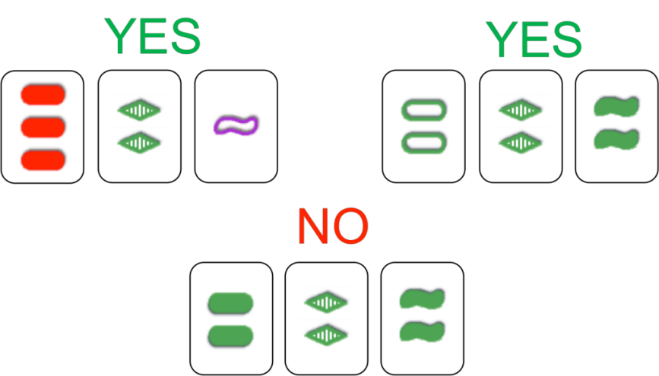
The End
Exercises!

Slide 78
Multiple TestCases
import unittest
class FirstTestCase(unittest.TestCase):
def test_truisms(self):
self.assertTrue(True)
self.assertFalse(False)
class SecondTestCase(unittest.TestCase):
def test_approximation(self):
self.assertAlmostEqual(1.1, 1.15, 1)
if __name__ == '__main__':
# execute all TestCases in the module
unittest.main()
Notes:
If there are multiple test cases in a module, unittest executes all of them
Possible organizations:
one TestCase per testable part of the code
one TestCase for the core functionality, one for error checking, ...

Slide 79
TestCase.assertSomething
One can also specify a maximum difference: assertAlmostEqual(x, y, delta=0.) E.g.: assertAlmostEqual(1.125, 1.12, delta=0.06) => pass assertAlmostEqual(1.125, 1.12, delta=0.04) => fail
Can be used to compare any object that supports subtraction and comparison: import datetime delta = datetime.timedelta(seconds=10) second_timestamp = datetime.datetime.now() self.assertAlmostEqual(first_timestamp, second_timestamp, delta=delta)
Notes:
Remove part about datetime?

Slide 80
TestCase.assertSomething
TestCase methods | Examples
assert_(expr[, msg) assertTrue(expr[, msg]) assertFalse(expr[, msg]) | assertTrue(isinstance([1,2], list) => pass assertTrue('Hi'.islower()) => fail
assertEqual(first, second[, msg]) assertNotEqual(first, second[, msg]) | assertEqual([2, 3], [2, 3]) => pass assertEqual(1.2, 1.3) => fail
assertAlmostEqual(first, second [, places[, msg]]) assertNotAlmostEqual(first, second [, places[, msg]]) | assertAlmostEqual(1.125, 1.12, 2) => pass assertAlmostEqual(1.125, 1.12, 3) => fail
assertRaises(exception, callable, ...) | assertRaises(exceptions.IOError, file, 'inexistent', 'r') => pass assertRaises(exceptions.SyntaxError, file, 'inexistent', 'r’) => fail
fail([msg]) | fail() => fail
Notes:
Most of the assert methods accept an optional msg argument; the explanation for the error will be msg if given, otherwise it will be None.

Slide 81
TestCase.assertSomething
Check that two numbers are equal up to a given precision: assertAlmostEqual(x, y, places=7)
placesis the number of decimal places to use: assertAlmostEqual(1.125, 1.12, 2) => pass assertAlmostEqual(1.125, 1.12, 3) => fail
Starting from Python 2.7, one can also specify a maximum difference: assertAlmostEqual(x, y, delta=0.) E.g.: assertAlmostEqual(1.125, 1.12, 0.06) => pass assertAlmostEqual(1.125, 1.12, 0.04) => fail
Notes:
Most of the assert methods accept an optional msg argument; the explanation for the error will be msg if given, otherwise it will be None.

Slide 82
Three more useful tools
pydoc: creating documentation from your docstrings pydoc [-w] module_name
pylint: check that your code respects standards

Slide 83
doctests
doctest is a module that recognizes Python code in documentation and tests it
docstrings, rst or plain text documents
make sure that the documentation is up-to-date
From command line: python –m doctest –v example.py
In a script: import doctest doctest.testfile("example.txt”) # test examples in a file doctest.testmod([module]) # test docstrings in module

Slide 84
DEMO

Slide 85
Possible additions
The optimization cycle: http://stackoverflow.com/questions/3657884/numpy-matrix-operations/3659619#3659619
testing: mock objects
example testing with HMM: HMM: random data -> 1/M emissions, 1/M transitions; weak, sequence of transitions with p=1, 1->2->3->1-> ...

Slide 86
More agile tools and concepts

Slide 87
Code coverage
It’s easy to leave part of the code untested Classics:
Feature activated by keyword argument
Exception raised for invalid input
Coverage tools mark the lines visited during execution
Use together with test framework to make sure all your code is tested

Slide 88
coverage.py
Python script to perform code coverage
Produces text and HTML reports
Allows branch coverage analysis
Not included in standard library, but quite standard

Slide 89
DEMO

Slide 90
Fixtures
Tests require an initial state or test context in which they are executed (the “Given” part), which needs to be initialized and possibly cleaned up.
If multiple tests require the same context, this fixed context is known as a fixture.
Examples of fixtures:
Creation of a data set at runtime
Loading data from a file or database
Creation of mock objects to simulate the interaction with complex objects
Notes:
It is often the case that all the tests need to setup some object before testing a functionality
example: classification algorithm; setUp -> load data and labels from file; tearDown -> close file

Slide 91
setUp and tearDown
import unittest
class FirstTestCase(unittest.TestCase):
def setUp(self):
""” setUp is called before every test """
pass
def tearDown(self):
""" tearDown is called at the end of every test, even if the test raises an exception. """
pass
# ... all tests here ...
Notes:
To avoid repeating the fixture code in every single test
In Python 2.7, there are methods called setUpClass

