Slide 1

Continuous Integration Because you’re worth it, continuously
Pietro Berkes, NAGRA Insight

Slide 2
Topics
What is it, why
automatize non-coding-related tasks
“it worked on my machine”
Concepts: events, CI server, virtual machine, jobs
Examples of most typical jobs
Options: Travis CI, Circle CI, Github Actions
Github Actions
architecture
demonstration and how to debug
exercise
security: workflow is not executed on first-time commits from branches
Security topics: secrets (just mention)

Slide 3
Continuous Integration
Merging the code of multiple contributor often, multiple times a day (originally this was a challenge, there was a person who was in charge of merging things on the main branch). Now merging is peanuts
Today it’s a set of tools and practices to make sure that a project with many contributors (>= 1) runs smoothly
Automatize the non-coding tasks:
making sure that the tests always pass
check for style consistency
build packages for distribution on multiple architectures
build documentation
Solves the “it works on my machine” problem

Slide 4
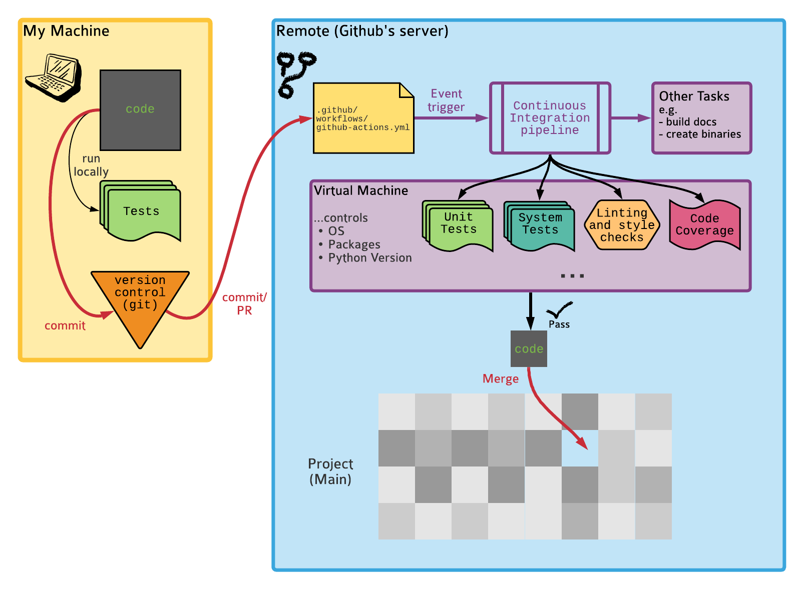
Concepts

Slide 5
The examples that you’ll find 95% of the time
Event: PR is created or a commit is pushed to master Tasks:
Run all tests
(Verify code coverage)
(Check code style)
Event: Repostory is tagged in a certain way
Create binary packages for Linux, Mac, Windows and upload them to a package repository
Build the documentaion

Slide 6


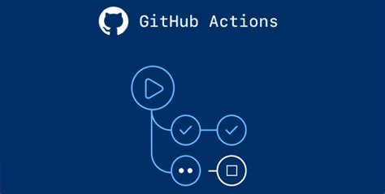
CI options
TravisCI
CircleCI
GitHub actions

Slide 7
GitHub Actions basic ideas
An event occurs, it has an associated commit SHA
GitHub searches for config files in .github/workflows at that SHA, and looks if there is a trigger that matches the event (the “on:” part of the config file
It then creates a virtual machine as specified in the config file and runs the commands listed there

Slide 8
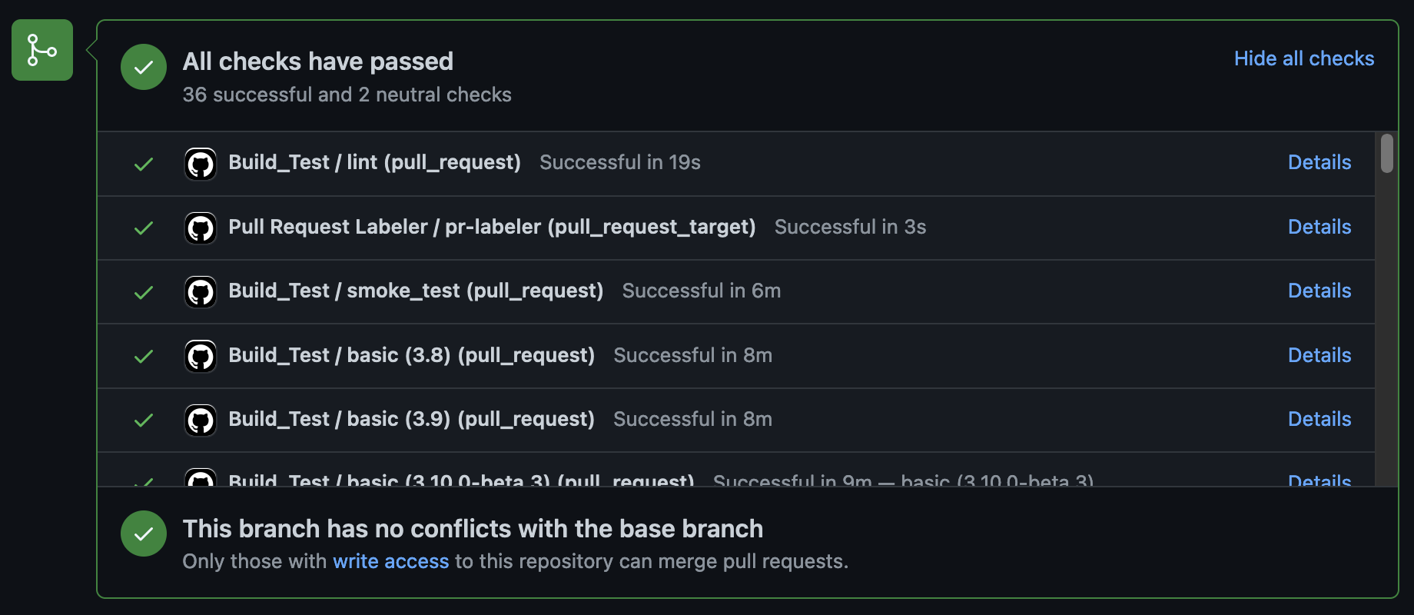
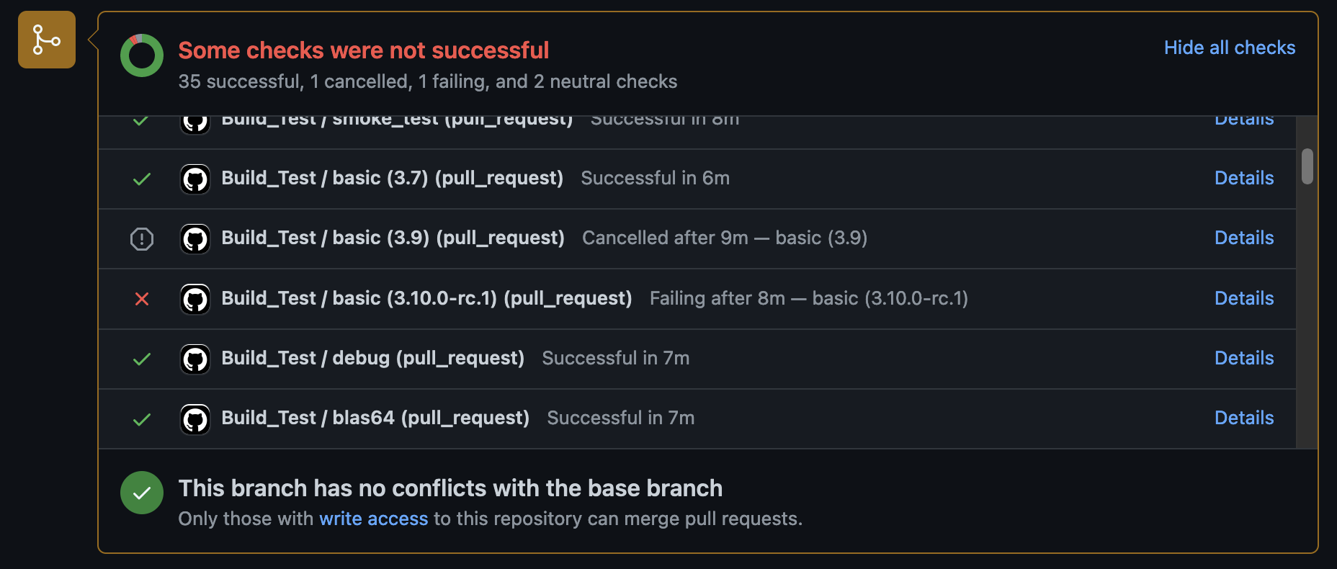
GitHub Actions basic ideas
The outcome is logged and if the job exits cleanly it is marked as ”passed” otherwise “failed”

Slide 9
GitHub config file
what it looks like (show example with all the options enabled like in pelita?)
Demo (?)

Slide 10
Hands On!
Add a CI pipeline to your logistic function project!

Slide 11
Notes on how to use github actions (is this best practice?)
set trigger to “push, pull_request” without branches so at every push you can see what is going on
debug by looking at ”Actions/workflows” tabs
once it works, add branches (typically main) if it makes more sense for you
PR -> Actions run
Executed:
1) when pushed to branch, on branch current state
2) when PR is made, on PR branch final state
3) when merged to master (push), on the master+PR final status

Slide 12
More advanced topics?
Security: be careful with passwords and other sensitive information (“secrets”) even on private repositories (needed e.g. to push a package to PyPi). Each CI system has a way to do it safely. In the repository you store a token that is linked to a GitHub account and the actual secret is store encrypted by GitHub. The secret is then decrypted at the moment of running the job and added as environment variable (double-check)

Slide 13
Thank you!

