Slide 1
Organizing, documenting and distributing code
= How to make your
code (more) usable
ASPP-LatAm 2023, CDMX
Notes:
Sounds super dry. But it’s actually quite useful and I’ve added some memes to keep you interested
Also, a goat will die, but don’t worry, it will be re-surrected
——
# ideas for changes
-----------------
- have two slides with different setups (mine + colleague/server/office laptop) aka python versions, package versions
- add flake, black, sort

Slide 2
Contents
usability features:
1) folder and file structure
2) error-free importing and installation
3) isolated, protected code
4) readability

Slide 3
Folder structure

Slide 4
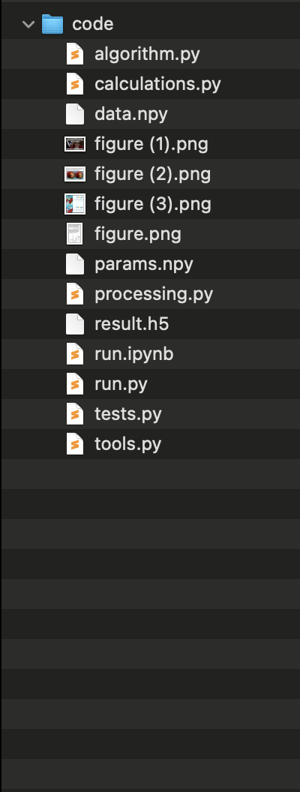
Notes:
This is the part where we solve the problem that we cannot find code we once wrote.
Make clear that this is the package structure they will be using

Slide 5
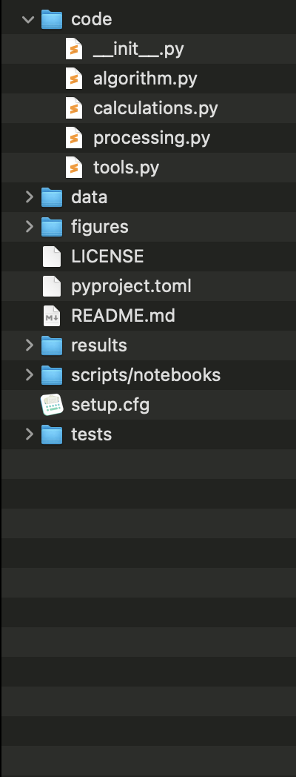
Notes:
This is the part where we solve the problem that we cannot find code we once wrote.
Make clear that this is the package structure they will be using

Slide 6
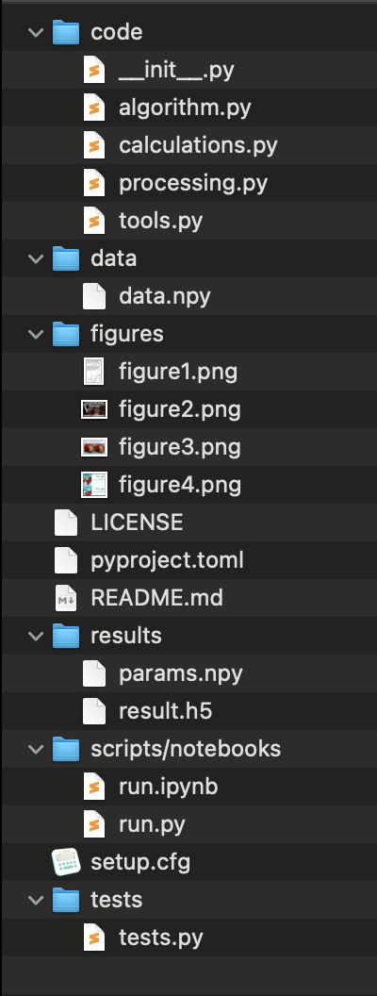
Notes:
This is the part where we solve the problem that we cannot find code we once wrote.
Make clear that this is the package structure they will be using

Slide 7
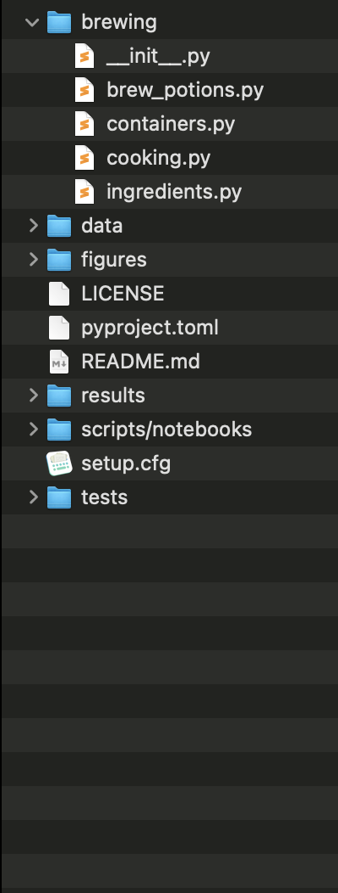
Notes:
This is the part where we solve the problem that we cannot find code we once wrote.
Make clear that this is the package structure they will be using

Slide 8
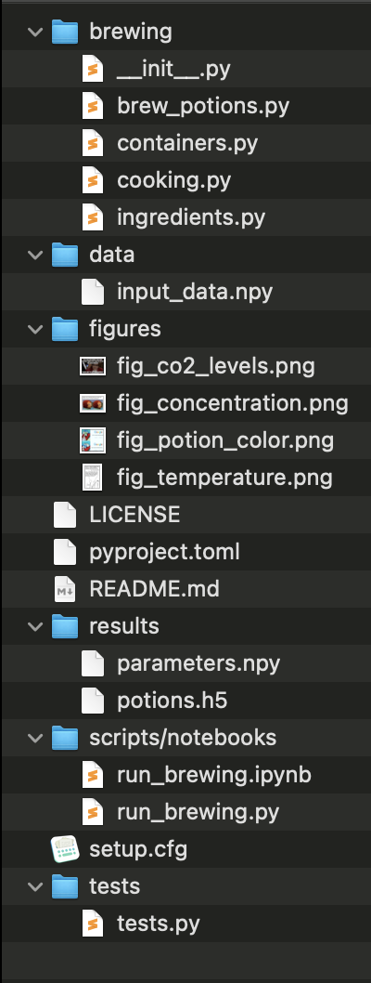
Notes:
This is the part where we solve the problem that we cannot find code we once wrote.
Make clear that this is the package structure they will be using

Slide 9
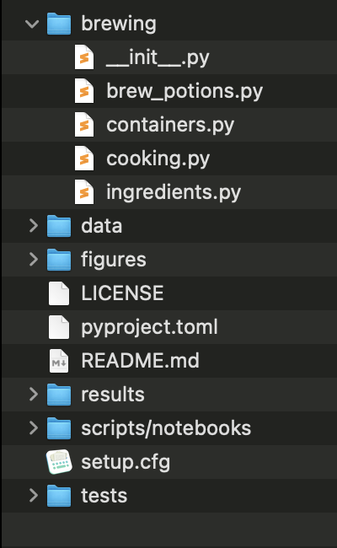
Python package structure

Slide 10
Python package structure
name of package
__init__.py
flags folder as package
modules
your .py files containing your code

Slide 11
Python package structure
name of package
__init__.py
flags folder as package
modules
your .py files containing your code
build instructions &
package metadata
will explain more later :)

Slide 12
Python package structure
name of package
__init__.py
flags folder as package
modules
your .py files containing your code
LICENSE
makes the package
(legally) usable.*
README
contains more information e.g. instructions on how to use your package.
build instructions &
package metadata
will explain more later :)
tests
you know why :)
* pick one from choosealicense.com

Slide 13
Advantages
know where to find items
(use meaningful file names)
it makes all of your code installable*
which makes all of your code importable
Terminal
> pip install brewing
>
> python
>>> import brewing
>>> brewing.brew_a_potion()
>>>
* (need a few other changes we will go over)

Slide 14
Importing

Slide 15
Brewing package
content of brewing package
  walk through code
  run brew_potions.py
  point out files for exercise

Slide 16
Importing
Follow the instructions in
Exercise 1 Importing.md
(There is no need to submit a pull request for this exercise)
Notes:
Why did Snape not complain when you imported brew_potions?
explain brewing package code (point out location and organisation)
start with the exercise of importing from different locations.
try to run, if does not work, note and move on
then explain importing from different locations
ask them how we could fix this? get suggestions?
there is no way to fix it for both cases
why is editing pythonpath a bad idea?
even if code is on pythonpath, code in the next folder is not, not usiversal.
is there another way , are there other examples where you can just du import x and have all the code available

Slide 17
Importing code
you can always import code from your current directory
- by calling import name, Python will look for
  a module called name.py inside the current directory
  a package called name inside in the current directory
  (= folder called name with an __init__.py file)
Importing a module will execute all the code in the module (including imports, print statements)

Slide 18
names & mains
any code running under if __name__ == "__main__":
will be ignored when importing
will be executed when the module is run as a script
if name == "__main__":
i_will_not_be_imported = True
print("Not printing when importing")
print("But printing when run as script")

Slide 19
Importing modules
you can always import code from other modules (.py files) in your current directory
Options for e.g. importing make_example_potion

Slide 20
Importing modules
you can always import code from other modules (.py files) in your current directory
Options for e.g. importing make_example_potion
import brew_potions
import brew_potions as br
from brew_potions import make_example_potion
from brew_potions import *

Slide 21
Importing modules
you can always import code from other modules (.py files) in your current directory
Options for e.g. importing make_example_potion
import brew_potions + brew_potions.make_example_potion
import brew_potions as br + br.make_example_potion
from brew_potions import make_example_potion + make_example_potion
from brew_potions import * + make_example_potion

Slide 22
Importing modules
you can always import code from other modules (.py files) in your current directory
Options for e.g. importing make_example_potion
import brew_potions + brew_potions.make_example_potion
+ brew_potions.make_python_expert_potion
import brew_potions as br + br.make_example_potion
+ br.make_python_expert_potion
from brew_potions import make_example_potion + make_example_potion
X make_python_expert_potion
from brew_potions import * + make_example_potion
+ make_python_expert_potion

Slide 23
Importing a package
you can always import a package locate in your current directory
Modules in the package are bound to the package name
import brewing
import brewing.brew_potions
from brewing.brew_potions import make_example_potion

Slide 24
Importing a package
you can always import a package locate in your current directory
Modules in the package are bound to the package name
import brewing
import brewing.brew_potions
from brewing.brew_potions import make_example_potion
* this is how it works when the __init__.py file is empty, which it usually is

Slide 25
Importing a package
you can always import a package locate in your current directory
Modules in the package are bound to the package name
import brewing X
import brewing.brew_potions + brewing.brew_potions.make_example_potion
from brewing.brew_potions import make_example_potion + make_example_potion
* this is how it works when the __init__.py file is empty, which it usually is

Slide 26
Importing
Thought(?) exercise:
Exercise 1 Importing.md
Is there a way to get
a) any 2
b) all 3
exercises to work simultaneously?

Slide 27
editable installation

Slide 28
Knowledge needed
what packages are available?
what does an editable pip installation do?
what are the requirements for this?
Notes:
This is the part where we solve importing errors

Slide 29
Available packages
  core packages e.g. time, math, os, …
  (come with Python, no installation needed)
  installed packages e.g. numpy, scipy, …
  (packages are downloaded to a system location
  e.g. /usr/lib64/python3.11/site-packages/
  which is on the Pythonpath => Python can find it)
  current directory
All packages which fall under these categories can be imported

Slide 30
Available packages
  core packages e.g. time, math, os, …
  (come with Python, no installation needed)
  installed packages e.g. numpy, scipy, …
  (packages are downloaded to a system location
  e.g. /usr/lib64/python3.11/site-packages/
  which is on the Pythonpath => Python can find it)
  current directory
All packages which fall under these categories can be imported

Slide 31
Installing other packages
Options to install a package using pip
Option 1: if package is included in PyPI
pip install numpy
Option 2: install from a VCS like git
pip install git+https://github.com/<user>/<package-name>.git
Notes:
Does option 2 allow for installing a particular version??
How does option 2 relate to the master branch of that project?
Pip takes the code you want to use and puts it somewhere safe

Slide 32
Installing other packages
You can install Python packages in your terminal using a package manager
pip
standard package manager for Python
can install packages from PyPI (Python Package Index) or from VCS e.g. github
conda
open source package manager/ environment manager
can install packages which were reviewed by Anaconda Inc

Slide 33
Knowledge needed
what packages are available?
what does an editable pip installation do?
what are the requirements for this?
>>>

Slide 34
Pip editable install
You can import the package you are currently working on as if it were a package you downloaded.
—> This lets you use your own code as any other package you installed
Advantages:
you can import the objects in the package from any directory
(no longer bound to the directory which contains the package)
at the same time you can keep your project in your current directory
you use your code as someone else would use it, which forces you to write it in a more usable way

Slide 35
Importing own project
Options to install a package using pip
Option 1: if package is included in PyPI
pip install numpy
Option 2: install from a VCS like git
pip install git+https://github.com/<user>/<package-name>.git
Option 3: install your package with -e (--editable) option
pip install -e <path-to-package>
(cd <path-to-package>; conda develop .)

Slide 36
Knowledge needed
what packages are available?
what does an editable pip installation do?
what are the requirements for this?
>>>

Slide 37
Python package structure
name of package
__init__.py
flags folder as package
modules
your .py files containing your code
LICENSE
makes the package
(legally) usable.*
README
contains more information e.g. instructions on how to use your package.
build instructions &
package metadata
the time has come to explain this…
tests
you know why :)
* pick one from choosealicense.com

Slide 38
Python package structure
name of package
orange file = required in order to make the package installable
__init__.py
flags folder as package
modules
your .py files containing your code
LICENSE
makes the package
(legally) usable.*
README
contains more information e.g. instructions on how to use your package.
build instructions &
package metadata
the time has come to explain this…
tests
you know why :)
* pick one from choosealicense.com

Slide 39
pyproject.toml
The pyproject.toml file holds static information about the package = meta data
Required entries: name, version, description, authors
dependencies not optional if code relies on other packages to work (go through modules and update regularly, don’t just copy ‘> pip freeze’)
-> can also go into separate requirements.txt file
[project]
name = "brewing"
version = "0.1.0"
description = "a python package for brewing potions"
authors = [{ name = "H. Granger", email = "h.granger@hogwarts.ac.uk" }]
license = { file = "LICENSE" }
requires-python = ">=3.7"
dependencies = ["numpy", "matplotlib >= 3.0.0", "pytest"]
[tool.setuptools]
packages = ["brewing"]
[project.urls]
“Homepage” = ["https://github.com/ASPP/2023-heraklion-ODD"]
[build-system]
requires = ["setuptools>=42"]
build-backend = "setuptools.build_meta"
>>>

Slide 40
pyproject.toml
dependencies should be kept minimal (only what you actually import in your module files)
When possible don’t depend on a specific version of a package. Conflicting version requirements between packages are annoying to handle as a user.
When possible don’t depend on a specific version of Python. It is usually not necessary.
[project]
name = "brewing"
version = "0.1.0"
description = "a python package for brewing potions"
authors = [{ name = "H. Granger", email = "h.granger@hogwarts.ac.uk" }]
license = { file = "LICENSE" }
requires-python = ">=3.7"
dependencies = ["numpy", "matplotlib >= 3.0.0", "pytest"]
[tool.setuptools]
packages = ["brewing"]
[project.urls]
“Homepage” = ["https://github.com/aspp-latam/2023-mexico-organizing-documenting-distributing"]
[build-system]
requires = ["setuptools>=42"]
build-backend = "setuptools.build_meta"
>>>

Slide 41
Pip editable installation
pip install -e <path-to-folder-above-brewing>
or in the directory above brewing
pip install -e .
Follow the instructions in
Exercise: Editable installation
(There is no need to submit a pull request for this exercise)

Slide 42
how to develop code if it’s in a package

Slide 43
Using the editable installation
You set your imports once and then never worry about them again
You have not lost any capability, you only gained usability
If you absolutely must use notebooks, then you can import your code from your modules into your notebook much easier

Slide 44
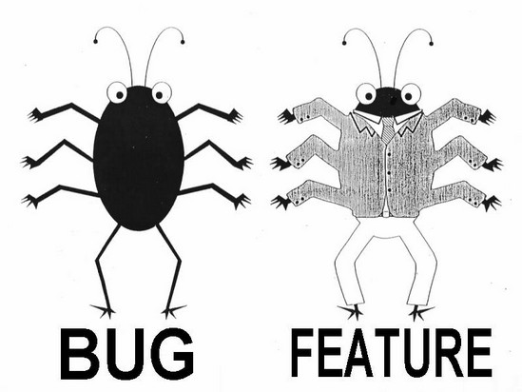
Workflow (ideal)
1
Create
2
Build & Test
3
Publish
Write feature
Set up structure
Create files: __init__.py pyproject.toml
README
LICENSE
Make installable at this point
In pyproject.toml update:
version
requirements
Update README
Write test
Document
Test

Slide 45
Workflow (realistic)
1
Create
2
Build & Test
copy that stuff to 2nd ipynb
3
Publish
Write stuff into ipynb
Set up structure
Create files: __init__.py
pyproject.toml
README
LICENSE
Make installable at this point
In pyproject.toml update:
version
requirements
Update README
change code ever so slightly
Write test
abandon test
Smugly write one comment
start new ipynb

Slide 46
Workflow (pragmatic)
Publish
Create
Publish
1
Create
Build & Test
1
2
2
3
3
Write stuff into ipynb
Set up structure
Create files: __init__.py pyproject.toml
README
LICENSE
Make installable at this point
Move code to package
In pyproject.toml update:
version
requirements
Update README
In pyproject.toml update:
version
requirements
Update README
Write test
Document
Test

Slide 47
Publishing code
Github/Gitlab
- perfectly fine for publishing publication code
- perfectly fine for hosting research group code
PyPI: Python Package Index
- if you want others to use your library you must have it on PyPI to make it easier for others to download and use
>>>

Slide 48
Write your function
Write the last remaining potion making function
we need before sharing the package
Exercise:
Create a branch with a unique name
Follow the instructions in Exercise 3 Workflow to write and test a function to make a “Python expert” potion
Create a Pull Request

Slide 49
defend your code

Slide 50
Why environments?
Project 1
= 1st year
PhD project
Notes:
This is the part where we solve installation errors

Slide 51
Why environments?
Project 1
= 1st year
PhD project
tensorflow
numpy
seaborn
stats
pandas
pytorch
dependencies
Notes:
This is the part where we solve installation errors

Slide 52
Why environments?
Project 1
= 1st year
PhD project
tensorflow
numpy
Project 2
= collaboration
with another lab
seaborn
stats
pandas
pytorch
dependencies
Notes:
This is the part where we solve installation errors

Slide 53
Why environments?
Project 1
= 1st year
PhD project
tensorflow
numpy
Project 2
= collaboration
with another lab
word2vec
seaborn
stats
pandas
pytorch
dependencies
Notes:
This is the part where we solve installation errors

Slide 54
Why environments?
x
Project 1
= 1st year
PhD project
pandas = 1.2.4
dependencies

Slide 55
Why environments?
x
Project 1
= 1st year
PhD project
Project 2
= 2nd year
PhD project
pandas = 1.2.4
dependencies

Slide 56
Why environments?
pandas = 1.3.0
x
Project 1
= 1st year
PhD project
Project 2
= 2nd year
PhD project
dependencies

Slide 57
Why environments?
pandas = 1.3.0
x
Project 1
= 1st year
PhD project
Project 2
= 2nd year
PhD project
dependencies

Slide 58
Why environments?
x
Project 1
= 1st year
PhD project
Project 2
= 2nd year
PhD project
pandas = 1.2.4
pandas = 1.3.0
dependencies

Slide 59
Why environments?
Project 1
= 1st year
PhD project
Project 2
= 2nd year
PhD project
pandas = 1.2.4
pandas = 1.3.0
dependencies

Slide 60
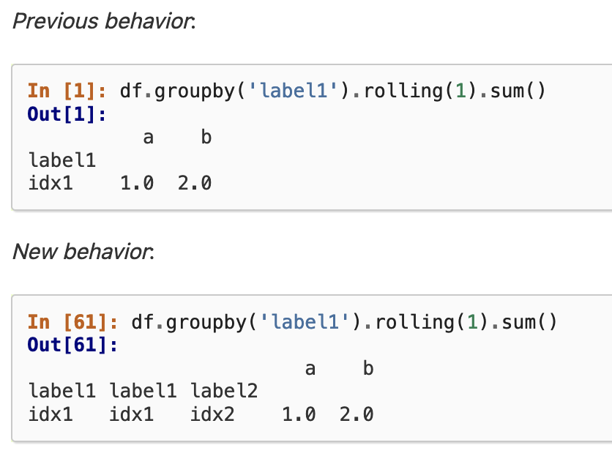
Breaking changes
Ever ignored a one of these?
This means that if you keep
updating your python packages,
you will run into issues at some point
  code errors
  unexpected results

Slide 61
Virtual Environments
What is a virtual environment?
A semi-isolated python environment -> you cannot access packages (libraries and their dependencies) installed in other environments.
packages are installed inside a project-specific virtual environment folder (not added to general python path)
If you break something, you can delete those folders and start over

Slide 62
Virtual Environments
Create and activate a virtual environment following
the directions in Exercise 5 Virtual Environments.md
See what changed with regard to the Python interpreter and the installed packages

Slide 63
Additional advantages
If you package your code, in your pyproject.toml you will have a record of at least one working combination of the versions of your dependency packages

Slide 64
Environment Managers
venv - current standard recommended by Python
Million others*:
conda, virtualenv-wrapper, pipenv, poetry, flit, hatch, PDM
* a description of the chaos:
https://chriswarrick.com/blog/2023/01/15/how-to-improve-python-packaging/

Slide 65
readability

Slide 66
Documentation
Documenting your code provides a way of making you code usable for future you and others
  Comments (#): describe what a line (or multiple lines of code do); notes to self
  Function/method docstring (''' '''): purpose of function + params / return
  Module docstring (''' '''): what’s in this file
""" Module docstring """
def add_points(house_points,
points=0):
""" Function docstring."""
# comment
points += 1000
return house_points + points
Notes:
This is the part where we solve the problem when we located code we wrote but cannot read it

Slide 67
NumPy style
""" This module demonstrates docstrings. """
def add_points(house, house_points, points=0):
""" Adds up points for house cup.
If the house is Gryffindor, Dumbledore adds
1000 points no matter what.
Parameters
----------
house_points : int
Current house cup score.
points : int, optional
New points to be added/ subtracted.
Returns
-------
int
"""
if house == “Gryffindor”:
points += 1000
return house_points + points
triple double quotes below declaration
The first line should be a short description
If more explanation is required, that text should be separated from the first line by a blank line
Specify Parameters and Returns as
name : type
description
(put a line of --- below sections)
Each line should begin with a capital letter and end with a full stop
access docs from the Python prompt:
help <module>.<object>

Slide 68
NumPy style
""" This module demonstrates docstrings. """
def some_function(df):
""" If it helps, you can add a DF example.
Parameters
----------
df : pd.DataFrame
Historical house cup scores.
house points
year
1999 Slytherin 100
2020 Hufflepuff 2800
"""
return df
personal suggestion:
if you work with pandas, it is easy to forget the shape of DataFrames.
Add the format into docstring (and keep up to date!)
OR
Write proper tests, you can always check the DataFrame format there

Slide 69
Typing (overkill?)
you can declare the type of the function argument
the package mypy checks whether the types make sense
Be aware that this might be a pain to maintain if you change your functions often and pass complicated objects…
tuple[int, dict[str, str]]
""" This module demonstrates docstrings. """
def add_points(house: str,
house_points: int,
points: int = 0)
-> int:
""" Adds up points for house cup.
If the house is Gryffindor, Dumbledore adds
1000 points no matter what.
Parameters
----------
house_points : Current house cup score.
points : optional; New points to be added
"""
if house == “Gryffindor”:
points += 1000
return house_points + points

Slide 70
Variable names
name your variables so that you can later go back and *read* what the code does
(same principle as with module names)
x = 10
p = 10
poi = 10
points = 10
points_add = 10
points_to_be_added = 10
x = 10
p = 10
poi = 10
points = 10
points_add = 10
points_to_be_added = 10

Slide 71
Variable names
name your variables so that you can later go back and *read* what the code does
(same principle as with module names)
x = 10
p = 10
poi = 10
points = 10
points_add = 10
points_to_be_added = 10
x = 10 —> terrible
p = 10 —> just as terrible
poi = 10 —> still terrible
points = 10 —> better, but potentially unspecific
points_add = 10 —> possibly better, possible worse that the one before
points_to_be_added = 10 # clear, but maybe a bit long

Slide 72
Variable names
added_points = [10, 5, 1]
# —> variable names use underscores
def add_points(house, house_points, points=0):
if house == “Gryffindor”:
points += 1000
return house_points + points
# —> function names also use underscores
class ScoreKeeper:
def __init__(self):
self.house_points = 0
self._secret_bonus = 5
def add_points(self, house, points):
if house == “Gryffindor”:
points += 1000
return house_points + points
# —> Class names use CamelCase
# —> private variables (intended for use only within the class) prepend “_”

Slide 73
Document your function
Document the function you just wrote according
to the instructions in Exercise 4 Documentation.
Use the same Pull Request

Slide 74
Summary

Slide 75
Contents
usability features:
1) folder and file structure
standard Python package structure
2) error-free importing and installation and publishing
  how to make a package installable
3) isolated, protected code
  virtual environments
4) readability
  documentation, typing, naming

