Slide 1

Need for Speed Optimization and profiling
Pietro Berkes, NAGRA Insight

Slide 2
The agile development cycle
Write tests to check that feature works
Write simplest code that makes tests pass
Run tests and debug until all tests pass
Refactor and optimize only if necessary
Pick your next feature
Notes:
As opposed to waterfall model
Reminder
1) describe cycle
2) short development cycles: granularity of chosen feature is important
3) for all of these steps there are python tools to help you; there’s no tool yet for writing the code, unfortunately

Slide 3
Testing makes you efficient, too!
An additional big bonus of testing is that your code is ready for improvements
Code can change, and correctness is assured by tests
Happily scale your code up!

Slide 4
The agile development cycle
Write tests to check that feature works
Write simplest code that makes tests pass
Run tests and debug until all tests pass
Refactor and optimize only if necessary
Pick your next feature
timeit
cProfile
line_profiler

Slide 5
Be careful with optimization
Python is slower than C, but not prohibitively so
In scientific applications, this difference is often not noticeable: the costly parts of numpy, scipy, … are written in C or Fortran
In many cases, researcher time, not computer time is the bottleneck
Researchers need to be able to explore many different ideas
Always weight the time you spend on a task vs benefits
Keep this diagram around: https://xkcd.com/1205/

Slide 6
Optimization methods hierarchy
(This is mildly controversial)
In order of preference:
Don’t do anything
Vectorize your code using numpy
Spend some money on better hardware (faster machine, SSD), optimized libraries (e.g., Intel’s MKL)
Use a “magic optimization” tool, like numexpr, or numba; or a “magic parallelization” tool, like joblib or dask
Use GPU acceleration
Use Cython
Parallelize your code

Slide 7
How to optimize
Usually, a small percentage of your code takes up most of the time
Identify time-consuming parts of the code Where’s the bottleneck? Computations? Disk I/O? Memory I/O? (see also Tiziano’s class) Use a profiler!
Only optimize those parts of the code
Keep running the tests to make sure that code is not broken
Stop optimizing as soon as possible

Slide 8
Measuring time: timeit
Jupyter/IPython magic command: %timeit
Precise timing of a function/expression
Test different versions of a small amount of code, often used in interactive Python shell In [6]: %timeit cube(123) 10000000 loops, best of 3: 185 ns per loop

Slide 9
Hands-on!
Write a dot product function in pure Python (i.e., with a for loop) and time it in IPython using %timeit: dot_product(x, y) is x[1] * y[1] + x[2] * y[2] + … + x[N] * y[N]
Write a version using numpy (vectorized), time it again
Write a version using numpy.dot, time it again
Try with large (1000 elements) and small vectors (5 elements)

Slide 10
factorial
Follow with me while we profile the file hands_on/factorial/factorial.py

Slide 11
Measuring time: time
On *nix systems, the command time gives a quick way of measuring time:
“real” is wall clock time
“user” is CPU time executing the script
“sys” is CPU time spent in system calls
$ time python your_script.py
real 0m0.135s
user 0m0.125s
sys 0m0.009s

Slide 12
cProfile
standard Python module to profile an entire application (profile is an old, slow profiling module)
Running the profiler from command line:
Sorting options:
python -m cProfile –s cumtime myscript.py
tottime : time spent in function only
cumtime : time spent in function and sub-calls
calls : number of calls
Notes:
what it is
first, you need to have the profiler collect information while your program is running

Slide 13
cProfile
Or save results to disk for later inspection:
Explore with
python -m cProfile –o filename.prof myscript.py
python –m pstats filename.prof
stats [n | regexp]: print statistics
sort [cumulative, time, ...] : change sort order callers [n | regexp]: show callers of functions
callees [n | regexp]: show callees of functions
Notes:
what it is
first, you need to have the profiler collect information while your program is running

Slide 14
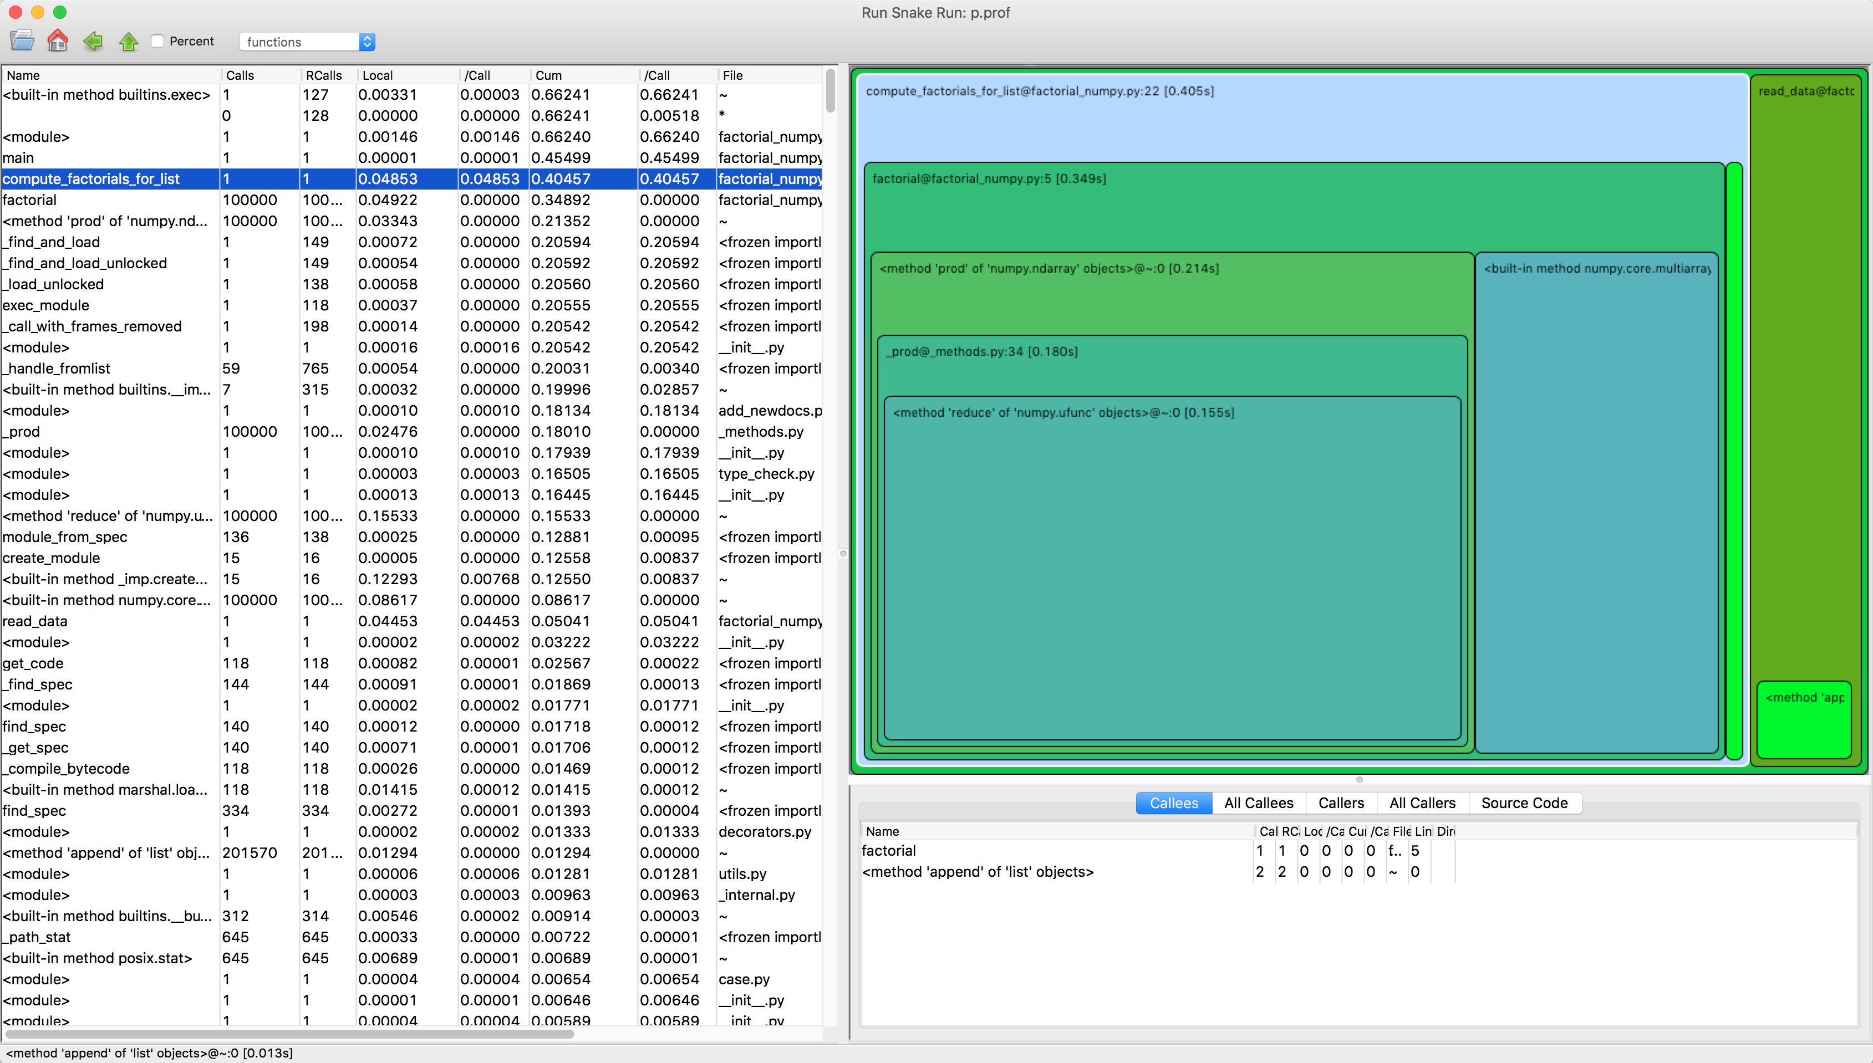
RunSnakeRun

Slide 15
Using RunSnakeRun
RunSnakeRun gives a graphical representation of profiling results:
Run profiler: python -m cProfile -o factorial.prof3 factorial.py
Convert Python3 profile format to Python2: prof3to2 factorial.prof3 factorial.prof2
Run RunSnakeRun: . runsnake factorial.prof2
Notes:
How to properly open qcachegrind on my Mac: open ~/Applications/qcachegrind.app

Slide 16
Hands-on
Make sure you can profile factorial and run RunSnakeRun on the result
Optimize the factorial function
Modify the code
Run tests to make sure it still works
Profile and measure progress

Slide 17
Fine-grained profiling: kernprof
You can profile a subset of all functions by decorating them with @profile kernprof –b -v factorial.py
Line-by-line profiling kernprof -b -l -v factorial.py

Slide 18
Hands-on:
Optimize an object counter for microscopic images hands_on/micro

Slide 19
Recap
Keep your options open by optimizing only as needed!
Optimizing without tests is irresponsible and punishable in some labs

Slide 20
The End
Thank you!

