Slide 1
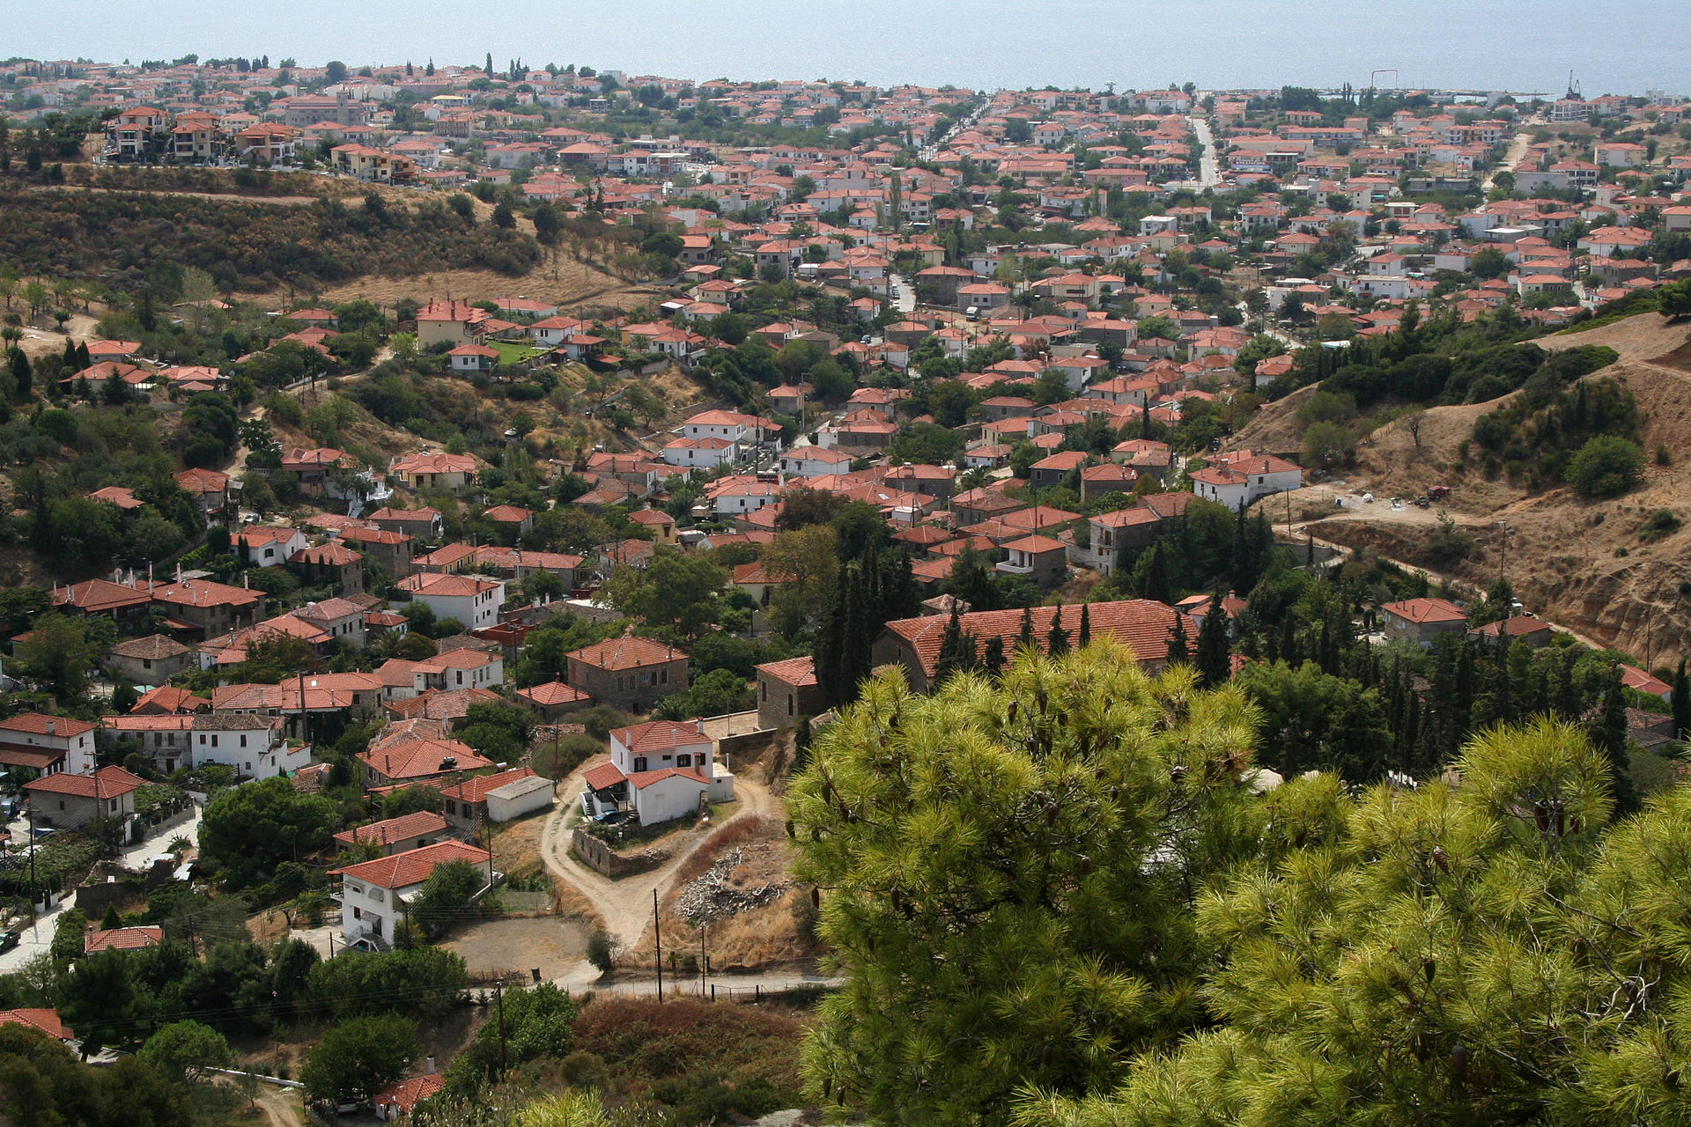
Memory-bound Problems
Zbigniew Jędrzejewski-Szmek
ASPP, Νικήτη 2017
By W.Horseman - Own work, CC BY-SA 3.0, https://commons.wikimedia.org/w/index.php?curid=12315622

Slide 2
About me
[ˈzbɨʂɛk]
https://github.com/keszybz
systemd
Fedora
NeuroRD

Slide 3
What your computer does while you wait

Slide 4
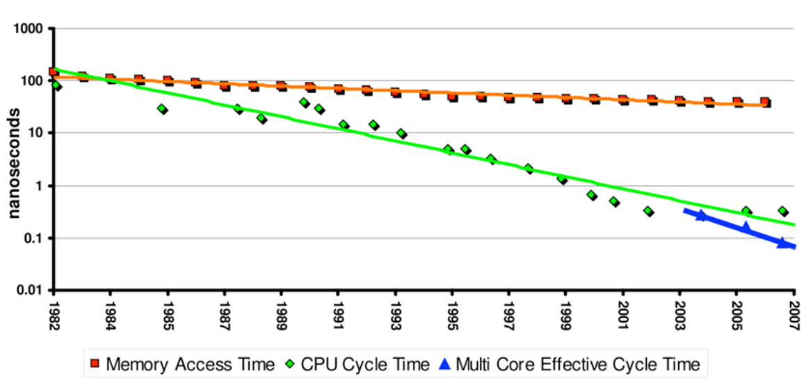
CPU and memory speeds

Slide 5
Exercise 0
Create a square array in NumPy
(4000 × 4000)
and measure the time to add it to itself:
A + A
and the time to add a transposed copy:
A + A’

Slide 6
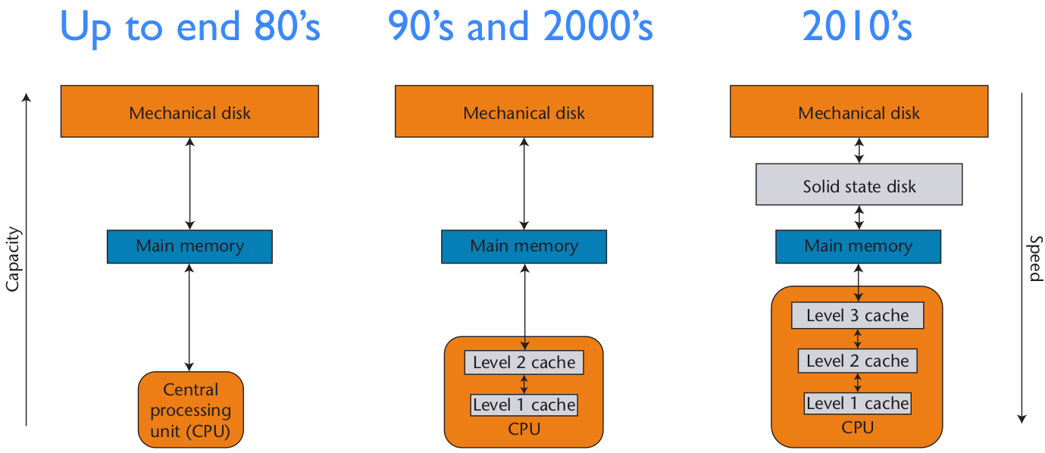
Computer architecture evolution

Slide 7
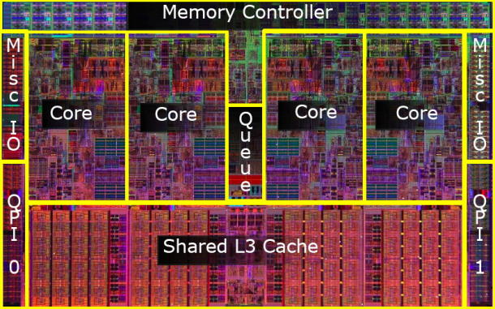
Memory cache
“a smaller, faster memory, closer to a processor core, which stores copies of the data from frequently used main memory locations”
“reduces the average cost (time or energy) to access data from the main memory”

Slide 8
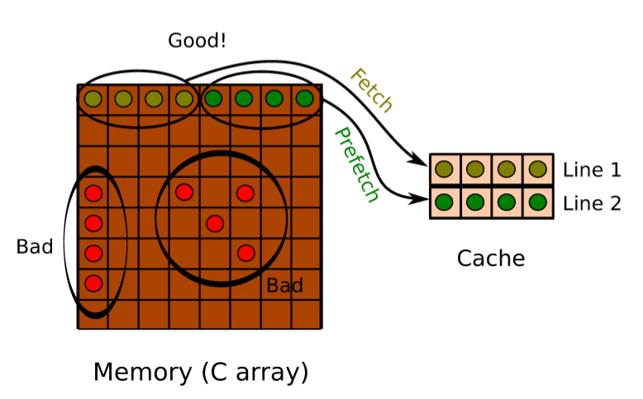
Cache is efficient only for some memory access patterns
temporal and spatial locality —
dataset is accessed sequentially

Slide 9
Checking your machine
lscpu
cat /proc/cpuinfo
x86info
lstopo
free -h

Slide 10
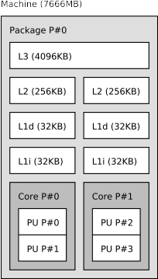
x86info & lstopo
$ x86info -a
Found 4 identical CPUs
CPU Model: Core i7-5600U [Broadwell]
Processor name string (BIOS programmed): Intel(R) Core(TM) i7-5600U CPU @ 2.60GHz
Cache info
L1 Data Cache: 32KB, 8-way associative, 64 byte line size
L1 Instruction Cache: 32KB, 8-way associative, 64 byte line size
L2 Unified Cache: 256KB, 8-way associative, 64 byte line size
L3 Unified Cache: 4096KB, 16-way associative, 64 byte line size
TLB info
Instruction TLB: 2M/4M pages, fully associative, 8 entries
Instruction TLB: 4K pages, 8-way associative, 64 entries
Data TLB: 1GB pages, 4-way set associative, 4 entries
Data TLB: 4KB pages, 4-way associative, 64 entries
Shared L2 TLB: 4KB/2MB pages, 6-way associative, 1536 entries
64 byte prefetching.
Address sizes : 39 bits physical, 48 bits virtual
2.60GHz processor (estimate).
Total processor threads: 4
This system has 1 dual-core processor with hyper-threading
(2 threads per core) running at an estimated 2.60GHz

Slide 11
Exercise I
Run exercises/cpu_vs_mem.py
Identify the “sweet spot” of the “working set size”

Slide 12
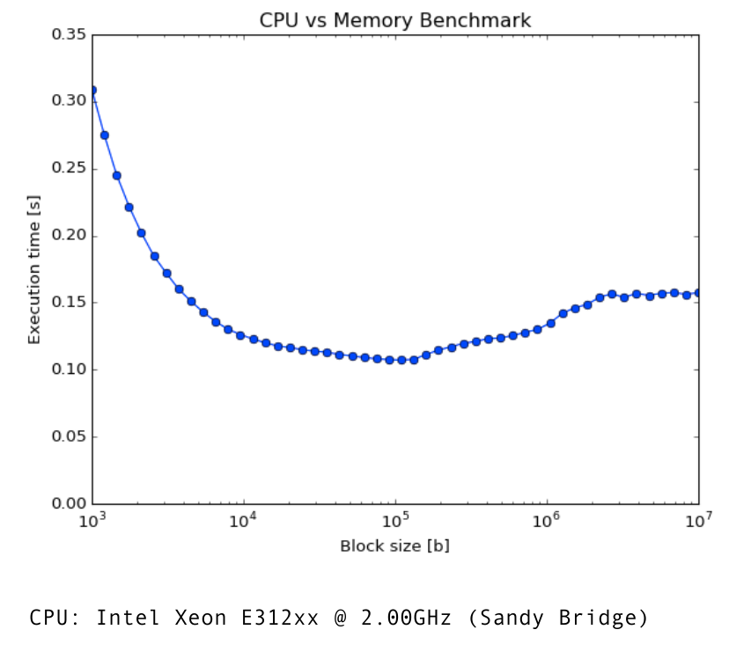
The Blocking Technique

Slide 13
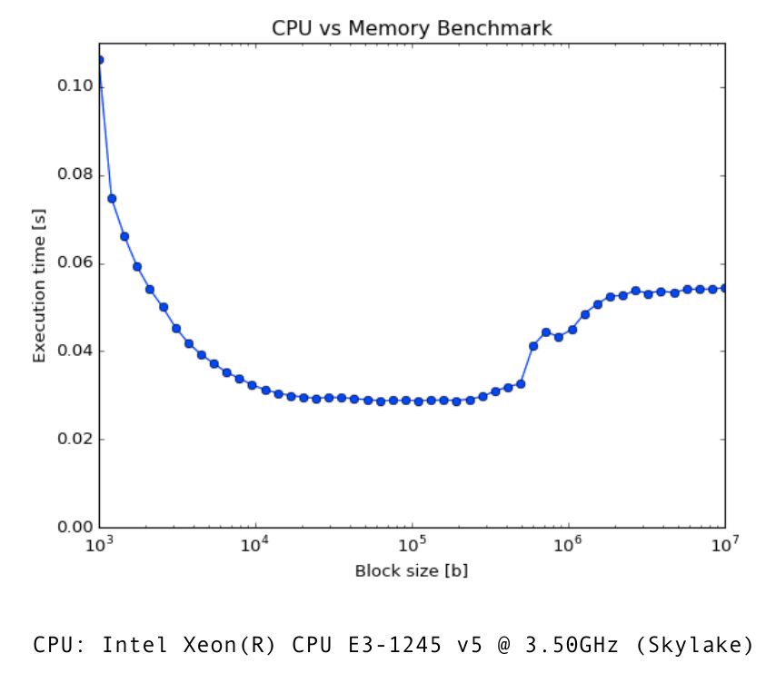
The Blocking Technique

Slide 14
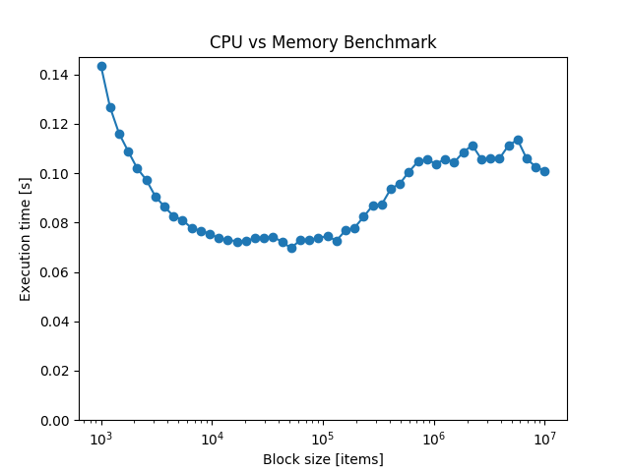
The Blocking Technique
CPU: Intel(R) Core(TM) i7-5600U CPU @ 2.60GHz (Broadwell)

Slide 15
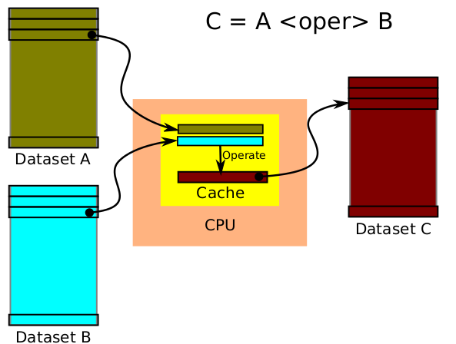
The Blocking Technique

Slide 16
Relative speeds of operations
 | computer scale | human scale
one operation = one CPU cycle | 0.3 ns | 1 s
L1 lookup | 1 ns | 3 s
L2 lookup | 5 ns | 15 s
L3 lookup | 20 ns | 1 min
main memory latency | 80 ns | 4 min
swapping:
solid state disk latency | 150 µs | 138 h 53 min 20 s = 5 d 18 h 53 min 20 s
rotating hard drive seek | 10 ms | 9259 h = 1 y 20 d 19 h

Slide 17
numexpr
Computation engine for numpy that makes sensible use of the memory hierarchy
optional multi-threading and SIMD (via Intel's MKL)
pytables, pandas, bcolz, and others can leverage numexpr automatically if installed

Slide 18
Exercise II: optimizing arithmetic expressions
Run exercises/poly.py
What ratios do you get for various operations?
Some computations are memory bound, others are CPU bound:
polynomials vs. transcendental functions

Slide 19
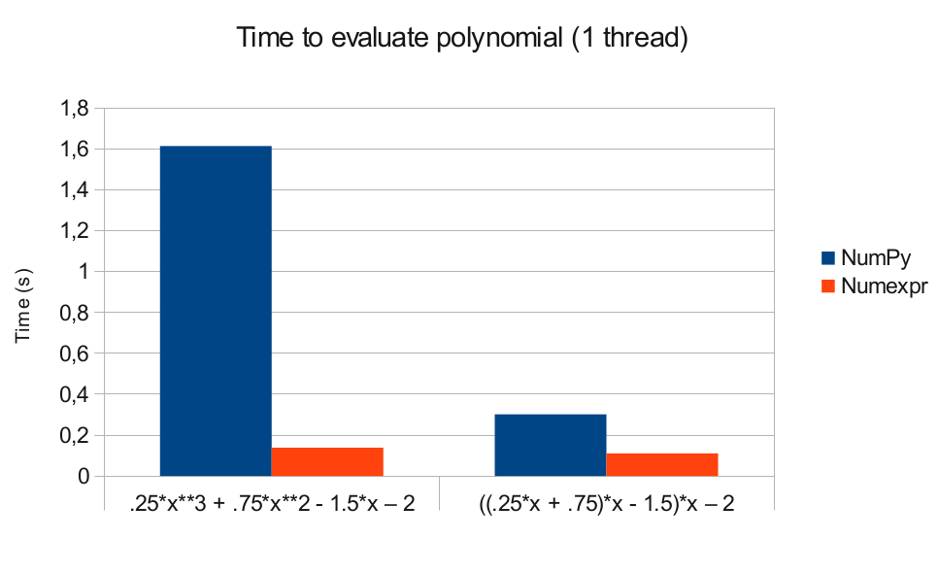
Computing with numexpr

Slide 20
Power expansion
numexpr expands expression:
0.25*x**3 + 0.75*x**2 + 1.5*x – 2
to
0.25*x*x*x + 0.75*x*x + 1.5*x – 2
and avoid the use of expensive pow()

Slide 21
How NumPy calculates the value of an expression
0.25*x**3 + 0.75*x**2 + 1.5*x – 2

Slide 22
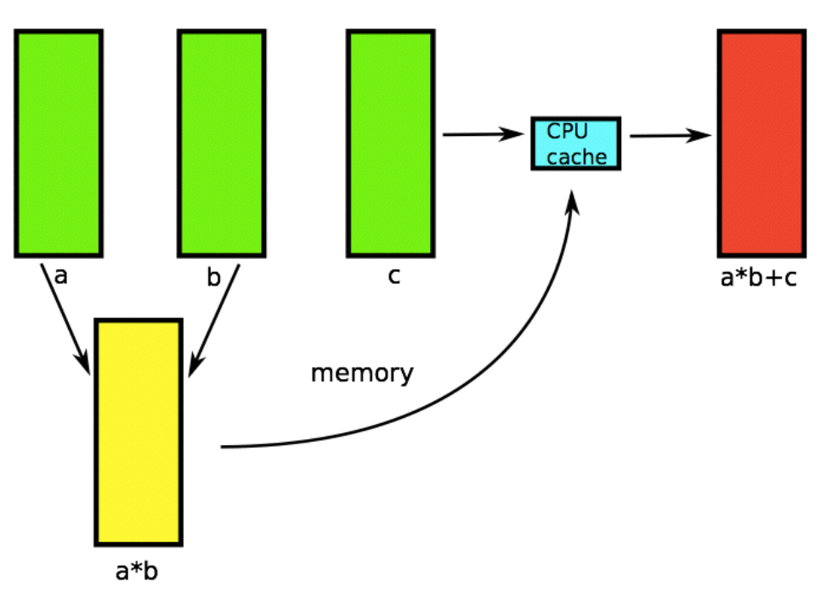
Computing with NumPy
Temporaries go to memory

Slide 23
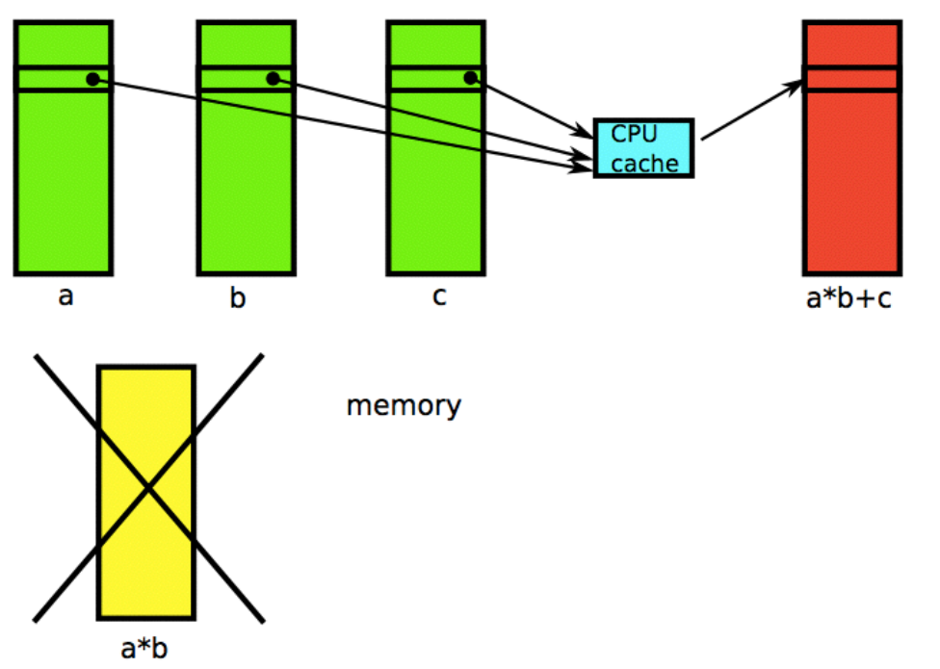
Computing with numexpr
Temporaries stay in cache

Slide 24
Exercise III: multithreaded NumPy and numexpr
Run exercises/poly-mp.py

Slide 25
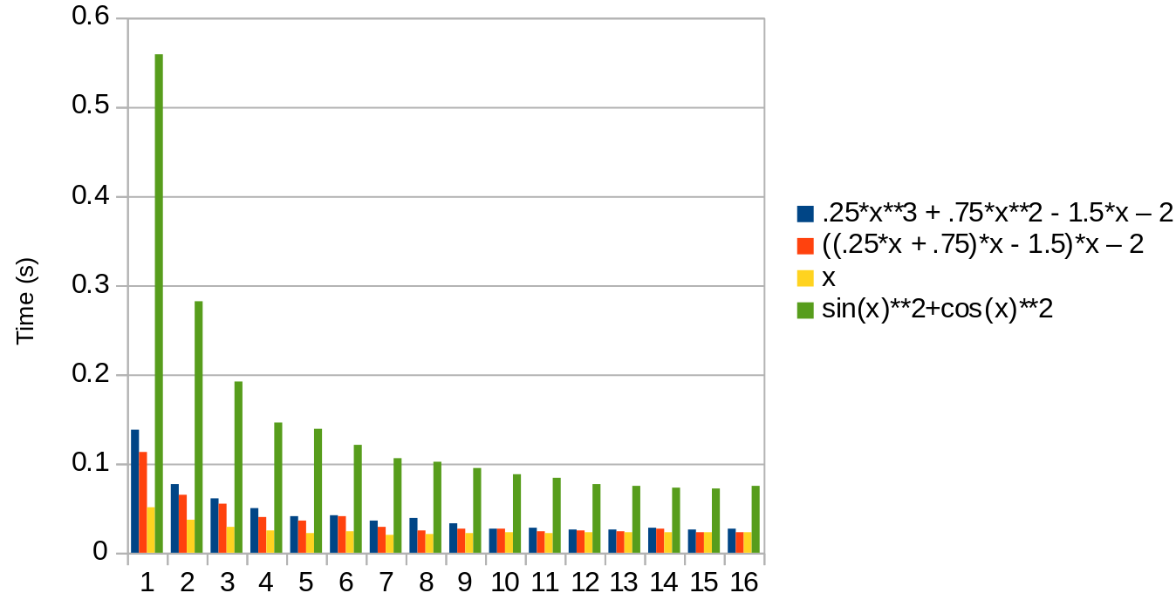
Multithreading can be faster
numexpr with 16 cores
number of threads / cores

Slide 26
Numexpr limitations
Numexpr only implements element-wise operations, i.e. a*b is evaluated as:
for i in range(N):
  c[i] = a[i] * b[i]
In particular, it cannot deal with things like:
for i in range(1, N):
  c[i] = a[i – 1] + a[i] * b[i]

Slide 27
Looking at the problem from the other side: how much work is the CPU doing
PMC — performance monitoring counters are special registers in the CPU used for monitoring utilization and load and the effectiveness of branch prediction and cache

Slide 28
Is the CPU really busy?
$ sudo sysctl -w kernel.perf_event_paranoid=-1
$ perf stat -- python3 exercises/poly.py
Computing: .25*x**3 + .75*x**2 - 1.5*x – 2
using numpy with 10000000 points
*** Time elapsed: 0.842 s
Performance counter stats for 'python3 exercises/poly.py':
1053.140414 task-clock (msec) # 1.000 CPUs utilized
15 context-switches # 0.014 K/sec
4 cpu-migrations # 0.004 K/sec
204,192 page-faults # 0.194 M/sec
3,309,715,381 cycles # 3.143 GHz
5,489,532,454 instructions # 1.66 insn per cycle
892,813,567 branches # 847.763 M/sec
3,571,513 branch-misses # 0.40% of all branches
1.053074429 seconds time elapsed

Slide 29
Is the CPU really busy?
$ perf stat -- exercises/noploop
Performance counter stats for 'exercises/noploop':
1608.635202 task-clock (msec) # 1.000 CPUs utilized
26 context-switches # 0.016 K/sec
0 cpu-migrations # 0.000 K/sec
44 page-faults # 0.027 K/sec
5,081,117,829 cycles # 3.159 GHz
20,068,179,150 instructions # 3.95 insn per cycle
11,407,085 branches # 7.091 M/sec
36,367 branch-misses # 0.32% of all branches
1.609390451 seconds time elapsed

Slide 30
Is the CPU really busy?
$ perf stat – ninja -C build systemd (compilation of
a fairly big C program)
Performance counter stats for 'system wide':
187524.663437 cpu-clock (msec) # 4.000 CPUs utilized
172,492 context-switches # 0.920 K/sec
10,552 cpu-migrations # 0.056 K/sec
3,631,227 page-faults # 0.019 M/sec
529,406,572,578 cycles # 2.823 GHz
424,491,171,471 instructions # 0.80 insn per cycle
91,324,946,188 branches # 487.002 M/sec
3,030,554,136 branch-misses # 3.32% of all branches
46.880863585 seconds time elapsed

Slide 31
Take-away messages
When optimizing calculations, have in mind the “starving CPUs problem”
This is particularly important for Python that does not have a compilation and optimization step
If memory is the bottleneck, paralellization will not help
As always: different tools for different problems. One solution does not fit all

Slide 32
The end: thanks and links
This lecture is based on Francesc Alted’s presentation from last year (all errors are mine)
http://www.blosc.org/docs/CISE-12-2-ScientificPro.pdf
http://www.blosc.org/
http://www.pytables.org/
https://github.com/pydata/numexpr
http://duartes.org/gustavo/blog/post/what-your-computer-does-while-you-wait/

